Slide 1



PRESENTATION TO THE PORTFOLIO COMMITTEE
Annual Report and
Audited Financial Statements
2017-18
10 October 2018

Slide 2
PURPOSE
Annual Report 2017-18
Performance against APP
Audit Outcomes
Management Structures and Vacancies
Current members of the Board
Winding down of NURCHA
Concluding remarks

Slide 3
MANDATE, VISION AND MISSION
NURCHA’S MANDATE
“NURCHA ensures the availability of bridging finance to small, medium and established contractors, and developers building low and moderate income housing and related community facilities and infrastructure.”
NURCHA’S VISION
“To be regarded as a partner of choice for those seeking innovative bridging finance solutions”
NURCHA’S MISSION
“NURCHA initiates programmes and takes considered risks to ensure a sustainable flow of finance for the construction of low-income and affordable housing, community facilities and infrastructure. We work in partnership with all role-players in these markets to maximize the development of sustainable human settlements”

Slide 4
TWO KEY DRIVERS OF STRATEGY
Relevance to development mandate
(OUTCOME 8, NDP, MTSF).
  Lending product innovations, - CFDP, Rental, higher density developments, emerging developer programme,
  Partnerships with provinces and municipalities in lending and service delivery programmes,
Restore and maintain organisational sustainability.
  Changed business model – discontinued intermediaries,
  Reduction of loan defaults,
  Diversification into fee based management services - fund management and programme management,
  Turnaround - from erosion of equity to surplus.

Slide 5
STRATEGY EXECUTION SCORE CARD
Change lending model | Terminate intermediaries and re-engineer model Resolve legal actions with intermediaries Attend to collection of legacy book Restore lending performance Improve reputation in the market
Improve credit rules | Certificate based lending Reduce infrastructure lending Lion’s share to affordable housing Diversification of affordable housing (client & geographic) Introduction of CFDP for new entrants, women and youth.
Close control of loan book | New controls and risk management measures Quick and sustained actions on defaulters
Write-offs and recoveries | Write-offs pre-2012 defaults and pursue recoveries on the book Engage stakeholders on changes and recovery actions Manage reputational issues arising from litigations
Buy-in on lending protocols with provinces | Engage stakeholders to improve access to finance for contractors Venture on provincial presence.
Introduction & formalization of PFM | Position NURCHA with new offerings and flagships Secure multi-year programmes Introduce of CFDP

Slide 6
CORE BUSINESS
  LENDING BUSINESS (project finance and working capital)
    Affordable Housing
      Home ownership – Full and Sectional Title
      Rental – conventional and student accommodation (short term finance)
    Bridging finance to contractors delivering subsidy housing,
    PROGRAMME MANAGEMENT
    Programme management support
    Fund management
    Contractor Finance and Development Programme (CFDP)

Slide 7
AUDITED ANNUAL RESULTS 2017/2018

Slide 8
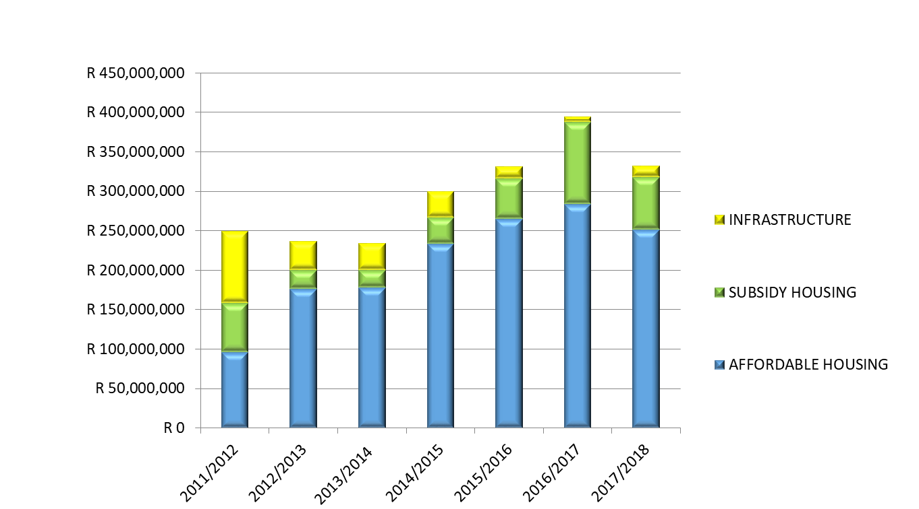
TOTAL LOAN BOOK TRENDS AND
EXPOSURE BY PROGRAMME

Slide 9
TOTAL IMPAIRMENTS VERSUS
TOTAL DEBTORS 2011/12 – 2017/18

Slide 10
LOAN BOOK TRENDS:
AFFORDABLE HOUSING PROJECT FINANCE

Slide 11
LOAN BOOK TRENDS:
SUBSIDY HOUSING CONTRACTOR FINANCE

Slide 12
Financial Performance Trends

Slide 13
FUNDING CAPACITY UTILISATION
AS AT 31 MARCH 2018
LENDING PROGRAMME | TOTAL ACTIVE PROJECTS |  | LOAN VALUE COMMITMENT |  | LOAN EXPOSURE
 | No. | (%) | (R'M) | (%) | (R'M) | (%)
AFFORDABLE HOUSING | 29 | 31.2% | 667.04 | 72.8% | 251.77 | 76%
SUBSIDY HOUSING | 57 | 61.3% | 222.94 | 24.3% | 65.83 | 20%
INFRASTRUCTURE | 7 | 7.5% | 26.33 | 2.9% | 14.99 | 5%
TOTAL | 93 | 100% | 916.31 | 100% | 332.59 | 100%

Slide 14
PROVINCIAL SPREAD
VALUE OF LOANS

Slide 15
GROSS INCOME SPREAD BY SOURCE - MARCH 2018

Slide 16
PROGRAMME AND FUND MANAGEMENT PORTFOLIO
Programme | Client | Status
Free State Programme Management Support | Free State HS | Closed
Eastern Cape Rural Development | Eastern Cape HS | Closed
Vulindlela PHP | KZN HS | Closed
Eastern Cape Bucket Eradication | Eastern Cape and NDHS | Closed
Kuyasa and Drakenstein Retrofit Programme | Western Cape HS | WIP
Gqeberha – NMBM PHP | Eastern Cape HS | WIP
Cape Town Ceilings Retrofit project (Phase 1 and 2) | City of Cape Town | WIP
Contractor Finance and Development Programme | NMBM | WIP

Slide 17
STATEMENT OF FINANCIAL PERFORMANCE FOR THE PERIOD ENDED 31 MARCH 2018
 | R'000 | Actual Q4 YTD | Budget Q4 YTD | Variance | Annual Budget | Prior Year
 |  | 2017/18 | 2017/18 |  | 2017/18 | 2016/17
Income from operations |  | 122,370 | 92,123 | 30,247 | 92,123 | 127,589
 | Interest on money market investments | 22,320 | 18,518 | 3,803 | 18,518 | 11,234
 | Interest on loans for construction projects | 42,719 | 59,289 | (16,570) | 59,289 | 53,459
 | Fees on loans for construction projects | 11,922 | 8,175 | 3,747 | 8,175 | 10,359
 | Programme management fees | 52,633 | 13,489 | 39,145 | 13,489 | 59,889
 | Less: Interest paid on loans raised | (7,224) | (7,347) | 123 | (7,347) | (7,351)
Other income |  | 6,301 | 6,550 | (249) | 6,550 | 7,449
Administration expenses |  | (91,041) | (69,271) | (21,770) | (69,271) | (99,363)
Other gains or losses
 | Decrease / (increase) in impairments of loans | (56,182) | (2,771) | (53,411) | (2,771) | (12,936)
 | Bad debts written off | (98) | - | (98) | - | (16)
 | Profit/ (loss) on disposal of fixed asset | 26 | - | 26 | - | 19
 | Fair value gain / (losses) | 2,297 | - | 2,297 | - | 155
 | Decrease / (increase) in impairments of investments | - | - | - | - | (1,838)
Taxation |  | (1,881) | - | (1,881) | - | (746)
(DEFICIT) / SURPLUS FOR PERIOD |  | (18,210) | 26,630 | (44,840) | 26,630 | 20,314

Slide 18
PERFORMANCE AGAINST APP 2018/19

Slide 19
FIRST QUARTER PERFORMANCE: HIGHLIGHTS
The year started with a fairly good loan book balance of R373m. That is 80% of the funding capacity.
The interest income has been sustained by the loan book balance from previous year and largely driven by affordable housing.
Fees and interest from the lending business has have been close to budget.
In the first quarter provisions for losses increased by R7m and ended the period by R6m deficit. The rate of increase in provisions to slow down significantly going forward;
  Interest on the impaired book will still be a driver of the upward movement,
  Trouble projects in the emerging developer book have largely been provided for,
  There are intensive engagements with key stakeholders to eliminate fraudulent diversion funds from financed projects,
  Improvements in controls where there has been weaknesses is underway,
  Staff morale also has to be turned around to achieve focus and achieve the above.
Monthly interest paid to PIC to service the loan is approx. R600 000

Slide 20
TOTAL DEBT OUTSTANDING PER
PROGRAMME (JUNE 2018 YTD)

Slide 21
HOUSES AND SITES SERVICES IN ACTIVE
PROJECTS – AFFORDABLE HOUSING

Slide 22
HOUSES AND SITES SERVICES IN ACTIVE PROJECTS – SUBSIDY HOUSING

Slide 23
HOUSES AND SITES SERVICES IN ACTIVE PROJECTS – SUBSIDY HOUSING Continued

Slide 24
TOTAL LOAN BOOK, OVERDUES, AND IMPAIRMENTS: YEAR TO DATE JUNE 2018
 | Total Debtors Book | Total Overdue Debts | Impairments
Affordable Housing | R 299,604,654 | R 71,159,402 | R 32,195,701
 | 79% | 24% | 40%
Subsidy Housing | R 68,360,440 | R 54,345,722 | R 40,639,625
 | 18% | 79% | 51%
Infrastructure | R 10,409,830 | R 8,357,923 | R 7,612,557
 | 3% | 80% | 9%
TOTAL NURCHA DEBTORS | R 378,374,924 | R 133,863,047 | R 80,447,883

Slide 27
OUTPUTS |  | MTSF TARGETS
 | ORIGINAL MTSF TARGET | REVISED 5 YEAR TARGET | VARIANCE: ORIGINAL AND REVISED TARGETS | MTSF TO DATE TARGET | ACHIEVED TO DATE | PROGRESS AGAINST MTSF TO DATE | % PROGRESS TO DATE
AFFORDABLE HOUSING FINANCE: GROW THE SUPPLY OF AFFORDABLE HOUSING STOCK
NUMBER OF CONTRACTS SIGNED | 114 | 74 | -40 | 56 | 55 | 98% | 74%
HOUSES AND SITES IN SIGNED CONTRACTS | 16,900 | 10,013 | -6,887 | 8,213 | 8,729 | 106% | 87%
VALUE OF LOANS | R1,710,000,000 | R1,560,126,192 | -R149,873,808 | R1,200,126,192 | R1,199,973,766 | 100% | 77%
VALUE OF PROJECTS FINANCED | R3,500,000,000 | R4,027,731,556 | R527,731,556 | R3,307,731,556 | R3,637,037,861 | 110% | 90%
HOUSES BUILT AND SITES SERVICED | 12,100 | 8,046 | -4,054 | 6,876 | 7,232 | 105% | 90%
SUBSIDY HOUSING FINANCE: IMPROVE DELIVERY OF SUBSIDY HOUSING
NUMBER OF CONTRACTS SIGNED | 173 | 171 | -2 | 124 | 100 | 81% | 58%
HOUSES AND SITES IN SIGNED CONTRACTS | 82,160 | 57,974 | -24,186 | 42,634 | 31,169 | 73% | 54%
VALUE OF LOANS | R692,000,000 | R627,404,461 | -R64,595,539 | R481,904,461 | 369,854,461 | 77% | 59%
VALUE OF PROJECTS | R7,574,000,000 | R5,421,337,175 | -R2,152,662,825 | R3,878,837,175 | 3,205,506,398 | 83% | 59%
HOUSES BUILT AND SITES SERVICED | 60,374 | 31,906 | -28,468 | 24,304 | 16,710 | 69% | 52%
INFRASTRUCTURE AND COMMUNITY FACILITIES: PROJECTS
NUMBER OF LOAN CONTRACTS SIGNED | 22 | 16 | -6 | 14 | 10 | 71% | 63%
VALUE OF LOANS | 78,380,000 | 54,354,841 | -24,025,159 | 46,354,841 | 30,245,763 | 65% | 56%
VALUE OF PROJECTS | R353,000,000 | R250,022,739 | -R102,977,261 | R150,022,739 | 165,633,711 | 110% | 66%
NUMBER OF PROJECTS COMPLETED | 18 | 5 | -13 | 3 | 4 | 133% | 80%

Slide 28
GROSS INCOME SPREAD BY INCOME
STREAM – JUNE 2018

Slide 29
STATEMENT OF FINANCIAL PERFORMANCE FOR THE PERIOD ENDED 30 JUNE 2018
 |  | R'000 | Actual Q1 YTD | Budget Q1 YTD | Variance | Annual Budget | Prior Year
 |  |  | 2018/19 | 2018/19 |  | 2018/19 | 2017/18
 | Income from operations |  | 18,603 | 18,023 | 580 | 73,720 | 122,370
 |  | Interest on money market investments | 3,922 | 3,638 | 284 | 13,604 | 22,320
 |  | Interest on loans for construction projects | 10,971 | 11,289 | (317) | 46,871 | 42,719
 |  | Fees on loans for construction projects | 2,973 | 2,019 | 954 | 12,627 | 11,922
 |  | Programme management fees | 2,481 | 2,827 | (346) | 7,615 | 52,633
 |  | Less: Interest paid on loans raised | (1,744) | (1,749) | 5 | (6,998) | (7,224)
 | Other income |  | 727 | 20 | 707 | 2,100 | 6,301
 | Administration expenses |  | (15,973) | (17,350) | 1,377 | (68,854) | (91,041)
 | Other gains or losses
 |  | Decrease / (increase) in impairments of loans | (7,157) | 1,016 | (8,174) | 613 | (56,182)
 |  | Bad debts written off | 0 | - | 0 | - | (98)
 |  | Profit/ (loss) on disposal of fixed asset | 0 | - | 0 | - | 26
 |  | Fair value gain / (losses) | 210 | - | 210 | - | 2,297
 |  | Decrease / (increase) in impairments of investments | - | - | - | - | -
 | Taxation |  | - | - | - | - | (1,881)
 | (DEFICIT) / SURPLUS FOR PERIOD |  | (3,590) | 1,710 | (5,299) | 7,579 | (18,210)

Slide 30
FINANCIAL YEAR AUDIT OUTCOMES
Unqualified Audit outcome with emphasis of matter on the following:
Transfer of functions between entities under common control.
Material increase in asset provision – Loan for construction projects - R57.9 million.
Irregular expenditure of R1.4 million
Fruitless and Wasteful expenditure of R48 425
Financial commitments amounting to R596 million reported

Slide 31
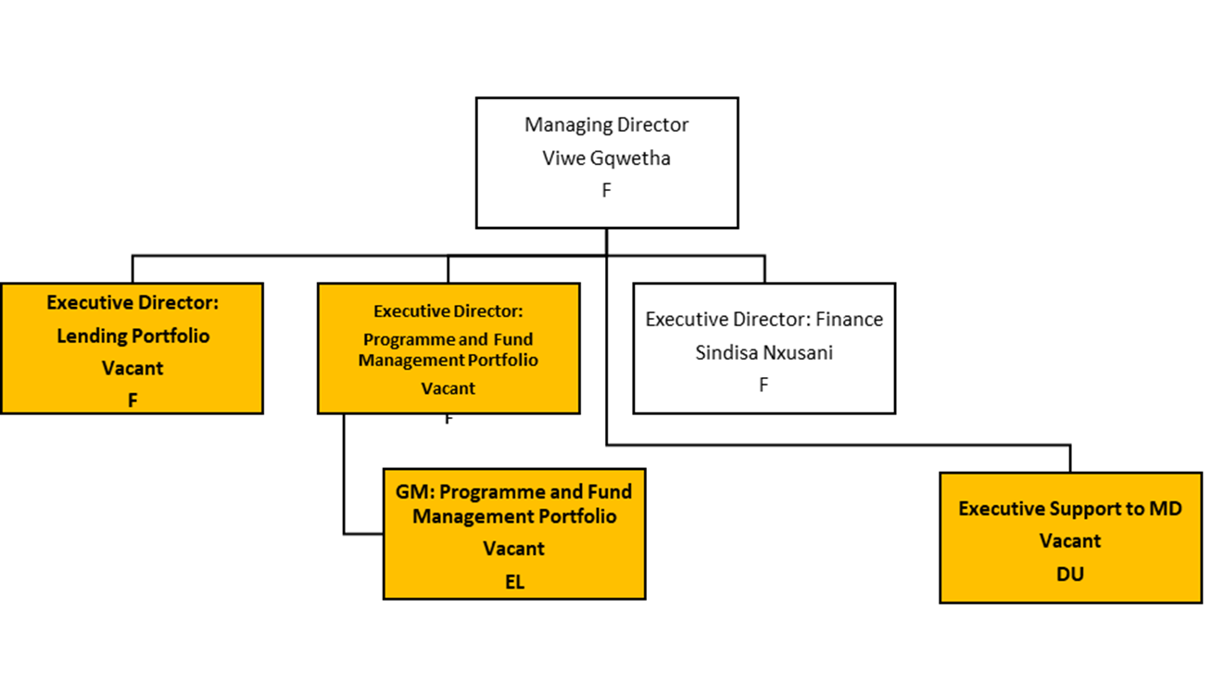
MANAGEMENT STRUCTURE:
EXECUTIVE

Slide 32
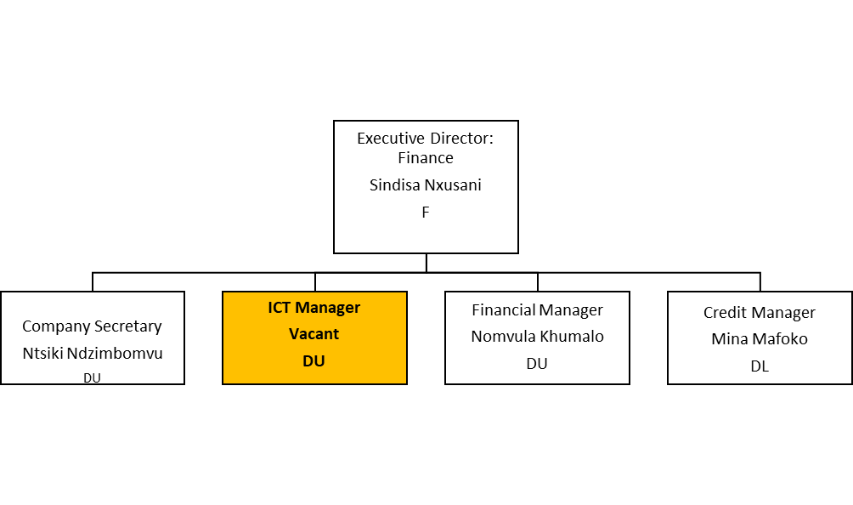
MANAGEMENT STRUCTURE:
FINANCE

Slide 33
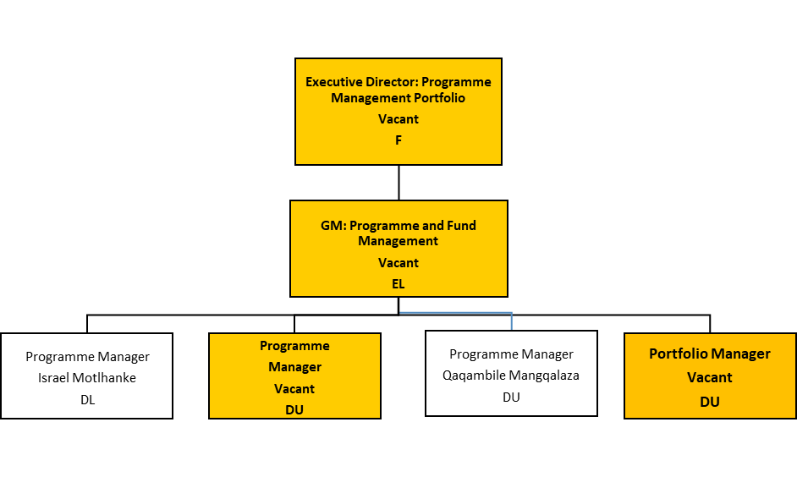
MANAGEMENT STRUCTURE:
PROGRAMME MANAGEMENT PORTFOLIO

Slide 34
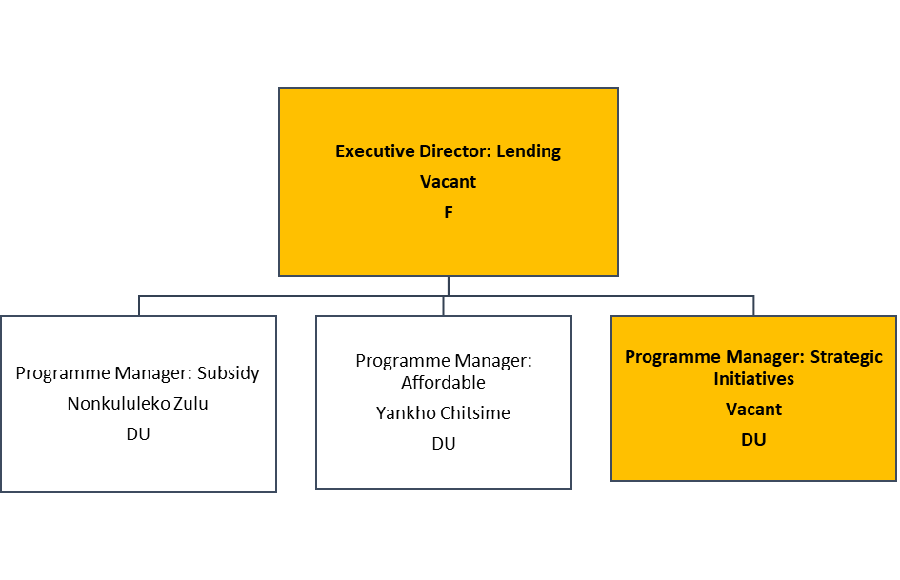
MANAGEMENT STRUCTURE:
LENDING PORTFOLIO

Slide 35
SENIOR MANAGEMENT VACANCIES
No. | Vacant Position
1 | Executive Support to MD
2 | ICT Manager
3 | Executive Director: Lending Portfolio
4 | Programme Manager: Strategic Initiatives
5 | Project Manager: Affordable Housing
6 | Project Manager: Subsidy Housing
7 | Executive Director: Programme and Fund Management Portfolio
8 | GM: Programme and Fund Management Portfolio
9 | Project Manager: Programme and Fund Management Portfolio
10 | Project Manager: Programme and Fund Management Portfolio
11 | Project Manager: Programme and Fund Management Portfolio
12 | Project Manager: Programme and Fund Management Portfolio
13 | Portfolio Manager

Slide 36
CURRENT MEMBERS OF
THE BOARD
Khehla Shubane (Chairperson), Thulani Nzimakwe, Linda Sing, Zyda Rylands, Maleho Nkomo, Cedric de Beer, Hein Prinsloo
Remaining Term of Office and dissolution processes:
It was resolved at the Board Meeting held in November 2017, that board appointments will be extended by a reasonable time after the consolidation to conclude the dissolution Audit.
To oversee and approve dissolution Audit and resign.
Current Executive Directors and Company Secretary will remain to dissolve the company.

Slide 37
CONCLUSION: SALIENT STRATEGIC BUSINESS MATTERS FOR NOTING
Lending capacity challenges,
  Constraints to borrowing,
  Short term finance and good deal flow,
  Tight management of existing capacity and constraint to meeting MTSF targets,
Strategic matters NURCHA grappled with,
  Sustainability; volumes, margins and risk management model,
  Working with department to eliminate fraudulent diversion of funds and secure buy-in of sector players,
  New products for market penetration and opening opportunities for PDIs and marginalised segments, - inclusion of women, youth and people living with disabilities.

Slide 38

THANK YOU

