Slide 1

PRESENTATION TO
THE PORTFOLIO COMMITTEE ON HUMAN SETTLEMENTS
10 OCTOBER 2018

Slide 2
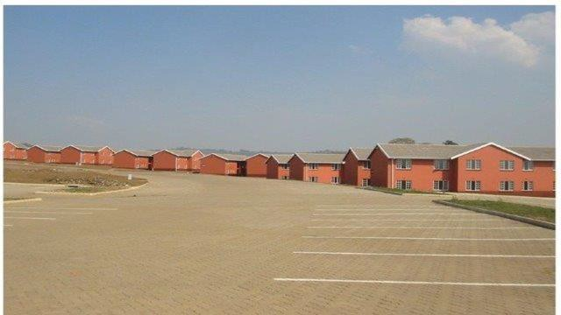

CONTENTS
NHFC Overview
Management Structure
Areas of Success
2017/18 External Audit
Business Plan (Targets)
Challenges
Acacia Park, Munsduzi - Pietermaritzburg, KZN

Slide 3
NHFC OVERVIEW
Established: 1996
Type of Organisation: Development Finance Institution (DFI)
Ownership:
Total Assets:
Total liabilities:
Funding Status:
Credit Rating:
Main business:
State Owned Company, 100% SA government R3,4 billion (31 March 2018 – group)
R323 million (31 Mar 2018 – group) Self sustaining
Long term A+, short term A1
Broadening and deepening access to affordable housing
finance for the low-to-middle income SA households
Geographic activities: National
Number of Employees: Group 61
Company 53

Slide 4


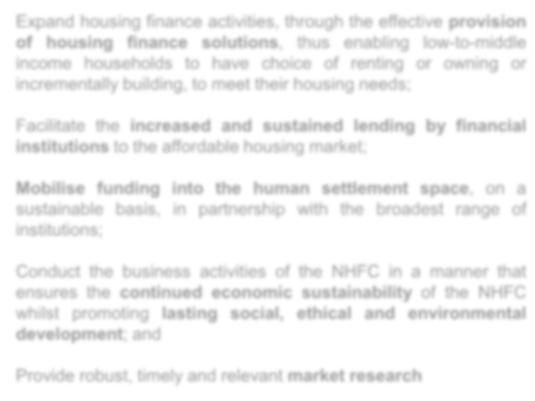
NHFC MANDATE
The National Housing Finance Corporation Soc Ltd (NHFC) is a state owned Development Finance Institution with a principal mandate to broaden and deepen access to affordable housing finance for the low- and middle- income households.
Ta r g e t M a r k e t :
S t r a t e g i c O b j e c t i v e s
Expand housing finance activities, through the effective provision of housing finance solutions, thus enabling low-to-middle income households to have choice of renting or owning or incrementally building, to meet their housing needs;
− The low- to middle-income housing market is any South African household with a regular monthly income between R1 500 and R15 000.
Facilitate the increased and sustained lending by financial institutions to the affordable housing market;
Mobilise funding into the human settlement space, on a sustainable basis, in partnership with the broadest range of institutions;
− The market segment is able to contribute towards its housing costs, but unable to access housing finance from Financial Institutions.
Conduct the business activities of the NHFC in a manner that ensures the continued economic sustainability of the NHFC whilst promoting lasting social, ethical and environmental development; and
Provide robust, timely and relevant market research

Slide 5
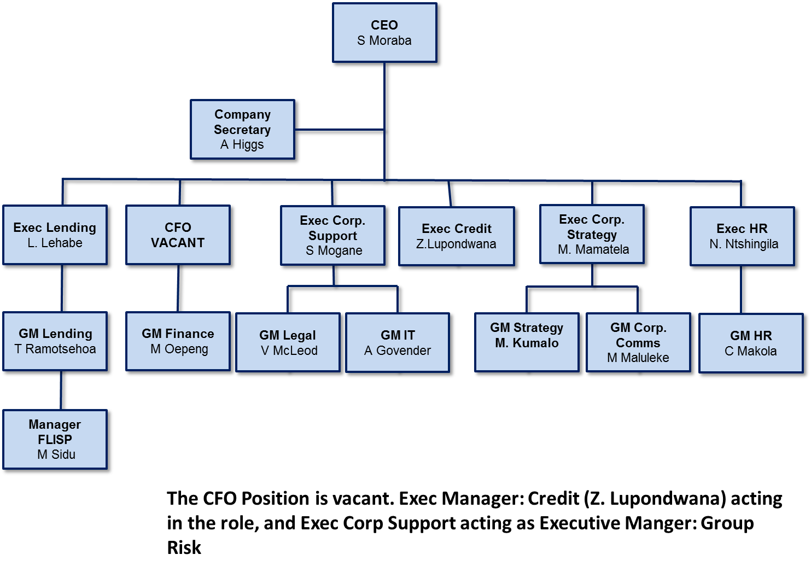
ORGANISATIONAL STRUCTURE

Slide 6
NHFC BOARD MEMBERS
From left to right:
1. Khehla Shubane
2. Phekane Ramarumo
3. Samson Moraba (Executive)
4. Johan Coetzee
5. Anthea Houston
6. Enoch Godongwana
7. Prof. Michael Katz (Chairman)*
8. Sizwe Tati (Acting Chairman)
9. Andrew Higgs (Company Secretary)
10. Thembi Chiliza
11. Adrian Harris
12. Sango Ntsaluba
*Stepped down, post Vacant

Slide 7
KEY STRATEGIC ISSUES
The Market Context
Current economic and market conditions negatively affects both the NHFC’s beneficiaries and clients.
Shareholder Funding Consolidated NHFC
Capitalisation over MTSF
Co–ordinated approach in the HS Sector
HS Entities to be positioned as engines of delivery - HSDB, SHRA, NHBRC and HDA .
Co-ordination of private sector funding mobilisation….HSDB
Graduation of matured Clients
Double edged sword :
  Revenue loss
  Mandate achievement
7

Slide 8
AREAS OF SUCCESS
Strategic Partnership & Leveraging
R21 billion to date ……(initial capitalisation R800m)
TUHF: scaling up rental delivery, biggest inner city regeneration, 64% property entrepreneurs, 33% ownership
HiP – innovation – income linked home loan product
IHS - increasing private sector financing
Fostering other funding sources
Attracted multilateral funding agencies to the total R500 million (AfD, EIB)
Potential relations – AfBD, KfW
Other local DFIs – PIC, DBSA
Advocacy Role
2003 removal of transfer and stamp duty – threshold now 2018 at R900k
Instrumental – establishment of regulator for micro finance intermediaries
NHFC Tax exempt
Increase available resource towards funding
8

Slide 9
2017/18 EXTERNAL AUDIT
November 2017: Nkonki appointed as external auditors (5 year term)
April 2018: Auditor General terminated the concurrent approval of appointment of Nkonki Inc
External audit process commenced fully 4 weeks later than scheduled
On 31 July 2018 AG informed National Treasury and NDOHS of delays in inability to submit Audited Financial Statements (AFS) for 2017/2018
On 31 August 2018 National Treasury and NDOHS were informed of inability to submit AFS for 2017/2018 of the NHFC (as required by Section 55 of the PFMA)
Independent Auditors report received on 18 September 2018
  Unqualified audit opinion
Printers will provide Integrated Report (printed) in time to meet 28 September 2018 Parliamentary deadline
9

Slide 10
2017/18 EXTERNAL AUDIT
Key Areas of Improvement:
Supply chain management
  Irregular expenditure identified (R2.95 m in 2017/18)
  Due to non compliance with regulation for 3 way quotation or competitive bid process
  Investigation revealed no financial loss or damages to NHFC
  Action plan in place to strengthen internal controls
Pre-determined outcomes indicators to be well supported by supporting evidence
Tightening or enforcing on the financial reporting deadlines:
  to minimise post 31 May AFS adjustments
10

Slide 11
2018 PERFORMANCE SNAPSHOT

Slide 12
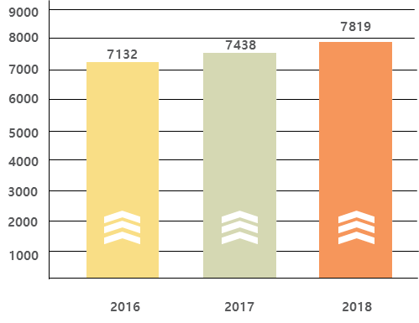
CUMULATIVE FUNDS DISBURSED DIRECTLY BY NHFC
R Million

Slide 13
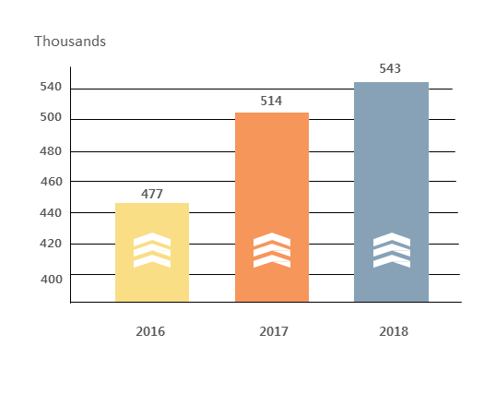
CUMULATIVE DEVELOPMENT IMPACT
Cumulative housing units/opportunities delivered through our funding, interventions and partnerships since 1996

Slide 14
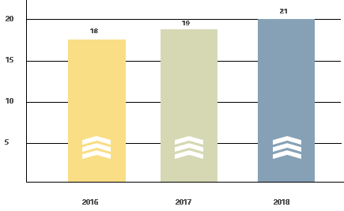
DEVELOPMENT IMPACT: FUNDS LEVERAGED
R billion (cumulative since 1996)

Slide 15
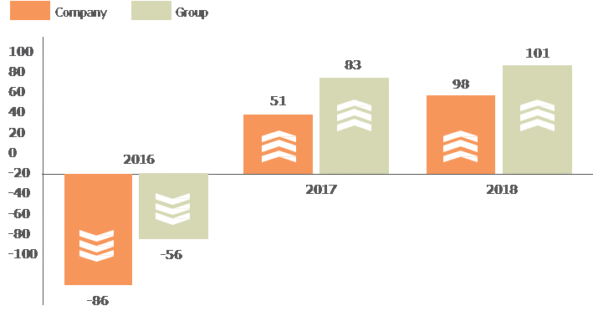
FINANCIAL PERFORMANCE
FINANCIAL PERFORMANCE
SURPLUS BEFORE TAXATION (R MILLION)

Slide 16
SUMMARY GROUP STATEMENT OF COMPREHENSIVE INCOME:
FY 2017/18
 | GROUP
 | Actual | Budget | Variance to budget | Actual
 |  |  |  | Mar-17
 | R'000
Lending income | 181 786 | 188 257 | -6 471 | 174 770
Sale of houses | 17 685 | 39 471 | -21 786 | 34 783
Operating income | 199 471 | 227 728 | -28 257 | 209 553
Cost of sales | -16 435 | -36 653 | 20 218 | -31 814
Impairments and bad debts | -61 725 | -90 118 | 28 393 | -58 611
Net operating income | 121 311 | 100 957 | 20 354 | 119 128
Operating expenses | -112 879 | -111 734 | -1 145 | -103 933
Net operating surplus | 8 432 | -10 777 | 19 209 | 15 195
Investment income | 70 325 | 23 710 | 46 615 | 62 519
Sundry income | 36 302 | 18 715 | 17 587 | 20 289
Share of profit of associates | 3 988 | 7 700 | -3 712 | 5 180
Interest paid | -18 532 | -17 656 | -876 | -19 770
Surplus before tax | 100 515 | 21 692 | 78 823 | 83 413
Taxation | - | -7 084 | 7 084 | -37 837
Surplus after tax | 100 515 | 14 608 | 85 907 | 45 576
Key drivers of performance: interest income, impairments & write-offs and operational expenses
Sundry income in FY 2018: Rental income: R13.5 m, Dividends: R8.3 m + Other operating income: R14.4 m
Surplus per Quarterly Report was R144 million versus R100 million above. Key difference is additional
impairments processed of R42 million

Slide 17
SUMMARY GROUP STATEMENT OF FINANCIAL POSITION:
FY 2017/18

Slide 18
KEY FINANCIAL INDICATORS: FY 2017/18

Slide 19
BUSINESS PLAN: MTSF TARGETS 2015 - 2019
 | MTSF 5 YR Targets 2015 – 2019 | MTSF Budget (2015, 2016, 2017 & 2018) | MTSF Actual (2015, 2016, 2017 & 2018) | % Achieved (2015, 2016, 2017 & 2018)
Approvals R'm | 2 380 | 1 635 | 1 192 | 73%
Disbursements R'm | 2 367 | 1 926 | 1 671 | 87%
Funds Leveraged R'm | 3 096 | 2 983 | 6 006 | 201%
Disbursements: Broader BEE R'm | 474 | 547 | 841 | 154%
Housing Opportunities | 47 897 | 43 876 | 102 937 | 235%
Housing Opportunities (excl incremental ) | 30 399 | 25 294 | 31 969 | 126%
Number of beneficiaries benefiting | 182 009 | 166 730 | 391 159 | 235%
Estimated number of jobs facilitated | 28 734 | 24 681 | 36 648 | 148%
BOARD
Approval targets remain under threat - quality and quantity of the deal flow in both private rental and social housing, credit criteria & viability assumptions.
Disbursements – delayed draws by IHS and HIP, committed funds will however be taken up fully within the MTSF enabling achievement of target.
Leveraged programmes continue to yield success.

Slide 20
CHALLENGES
DFI Consolidation/HSDB
Protracted consolidation process – now the delay in securing Section 66 National Treasury approval aggravates uncertainty among staff and stakeholders – Now Resolved;
Governance – risks associated diverse decisions in the context of the imminent consolidation – Now Resolved;
Social Housing
Rising culture of non-payment of rent and illegal occupation of social housing units. With ± 25% of total loan book in social housing matter being closely monitored. Specific clients that are non-performing in social housing and in arrears totalling R23 million (First Metro, Msunduzi, SOHCO and Freshco);
Robust Regulatory environment
conducive for blended lending
20

Slide 21
CHALLENGES
Compliance with PFMA (Submission of Integrated Annual Report (IAR) by 31 August 2018)
Delayed audit process (appr. 4 wks compared to prior year) due to termination of Nkonki Inc’s engagement as per AG’s directive led to non finalisation of the annual report (AR) – it is expected that the AR will be finalised mid - September. Indications given by the AG is that unqualified audit opinions will be given for CTCHC and NHFC, however, a matter of emphasis on irregular expenditure will be included in NHFC’s Audit Report.
Economy
Tepid economic growth now worsened by the confirmed technical recession (2 consecutive quarters of no growth) will continue affecting business confidence and private sector investment. 2018/19, will be challenging and DFI’s will struggle to achieve financial and key impact targets in an economy in recession.
21

Slide 22
OUTLOOK FOR 2018/19
Successful conclusion of Phase 1 of the consolidation process
JEP approval for the HSDB Business Case and Draft Legislation
After an improvement in business and consumer confidence in first quarter of 2018 (to 31 March 2018), there has been a slight downturn in confidence in Quarter 2 of 2018 and the situation has now worsened with the recently announced technical recession;
Land expropriation without compensation has to be handled properly as there are already indications of the negative impact of the debate on affordable housing. Some bond originators and the South African Affordable Residential Developers Association (SAARDA) indicate that demand for housing was down in Gauteng. They attribute this to expectations by the public for free land (stands) and or housing. Some developers are experiencing invasions. Affordable housing delivery in general may be negatively impacted going forward:
The social housing sector is expected to see an uptick in viable/bankable projects due to the gazetting of the increase in the subsidy quantum and in the new income bands;

Slide 23
KEY STRATEGIC ISSUES
DFI CONSOLIDATION/HSDB
1. Finalise Consolidation Transaction
PFMA Approvals
Establish Interim Board
Setup the Consolidated Organisational Structure
Commence with HSDB Draft Policy Business Case and Enabling Legislation
Secure Section 66 Approval
Consolidate Financials of Three DFIs
2. Establish HSDB
Finalise Business Case & Draft Legislation
Secure Approvals : Ministry & Joint Evaluation Panel
Promulgate Legislation (HSDB Act)
Operationalise Act
3. Full Operations
Secure Funding for HSDB
Finalise staffing
Implement new products and services
Deliver on mandate
Establishment Road-Map envisages three key stages ….stages 1&2 run in parallel…

Slide 24
DFI CONSOLIDATION MILESTONES
PHASE 1: CONSOLIDATION - NHFC,NURCHA & RHLF
Tax Exemption for NHFC - approved
effective April 2016
Companies Tribunal application –
approved April 2017
  3. PFMA Requirements
  Section 54 (2) - approved
  Section 66 (1) - approved
  Section 38 (1) (m) ; 51 (1) (g) – part JEP process
  Funders (Capital providers) approval – done
  AfD, EIB, PIC, DBSA/KfW
  5. Operational Integration
  Governance - Board Established
  PMO established
  Change management facilitation has commenced
  Staff Migration to NHFC offices finalised Oct’17
PHASE 2: ESTABLISHMENT OF HSDB
Policy for HSDB - done
Development of Business Case
Drafting of Enabling Legislation/Act
Approve and Capitalize HSDB
PHASE 3: OPTIMISATION
    Full integration of all systems and processes
    Implement new products / service lines
    Staff Migration

Slide 25
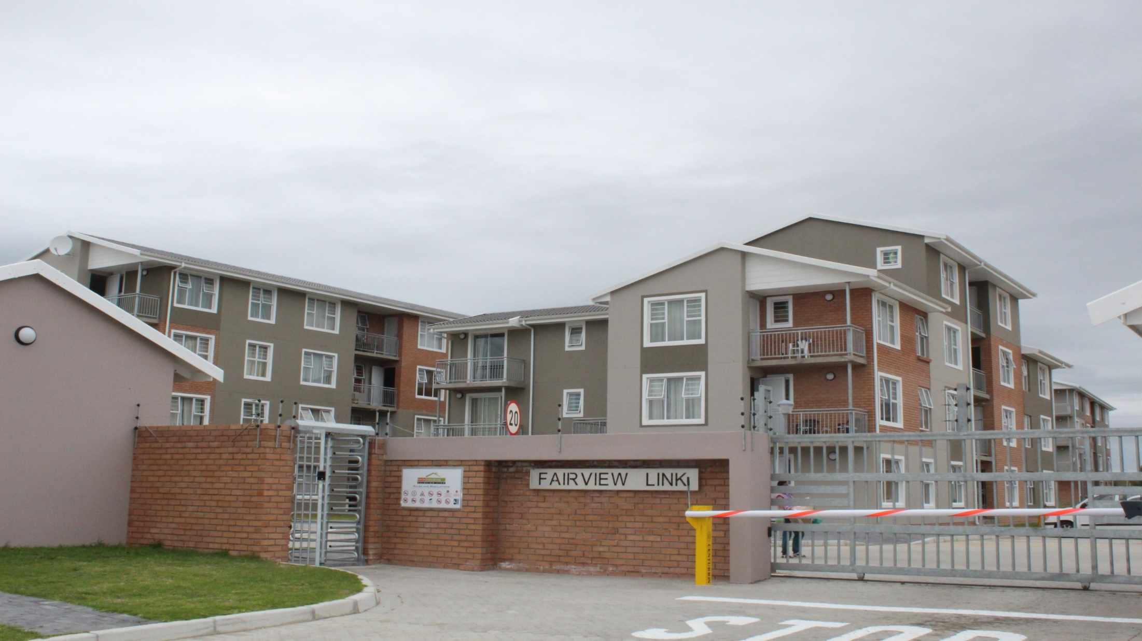
THANK YOU
Govt. Response:
  Increase focus NDP
  Fiscal Consolidation
  Rationalisation of DFIs

