Slide 1
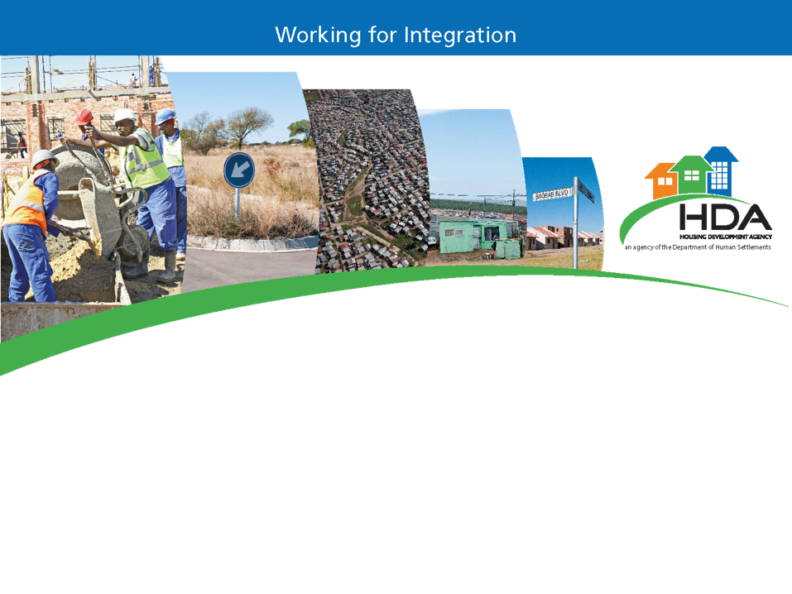
PORTFOLIO COMMITTEE 10 OCTOBER 2018
PRESENTED BY PASCAL MOLOI
Chief Executive Officer

Slide 2
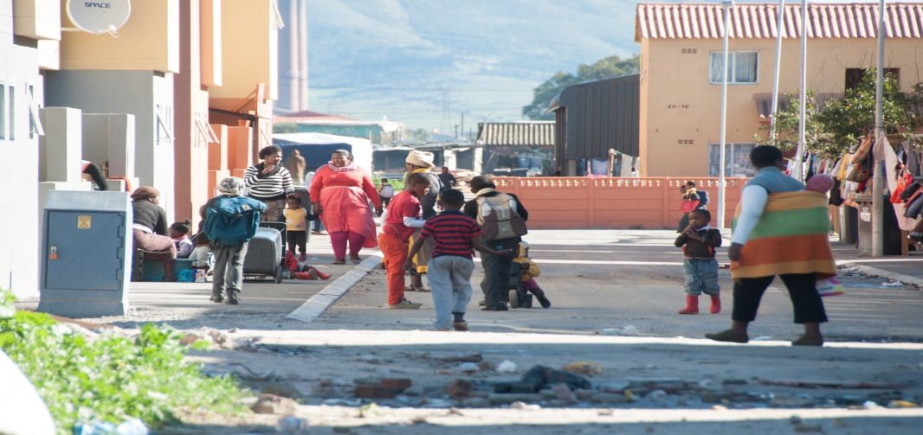
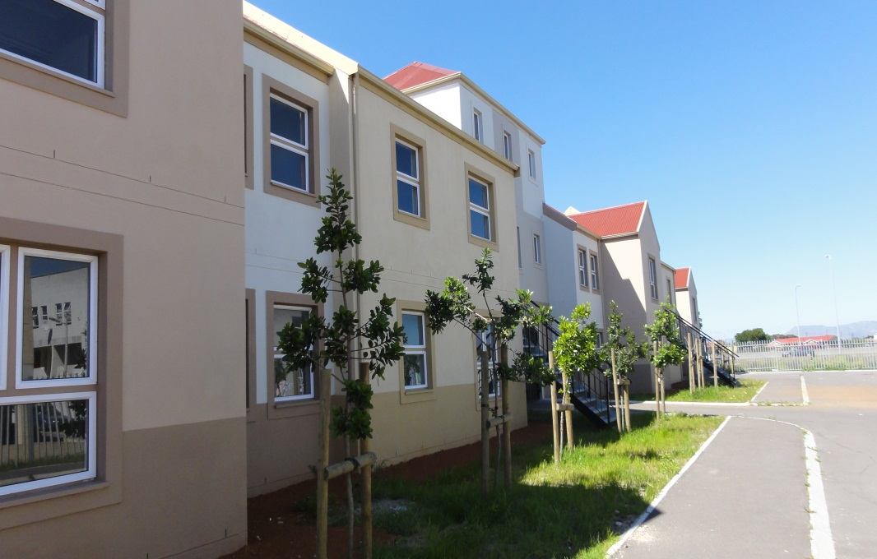
  1
  Introduction to the Housing Development Agency
  2
  Overview of the HDA’s Functions
  3
  The HDA MTSF Targets
  4
  Overview of National Priority Programmes
  5
  The HDA’s Performance Highlights: Macro Indicators
  6
  Programme Performance Information
  7
  Part 2: HDA Board and Terms of Office
  8
  Part 3: HDA Management Structures and Organogram
  Part 4: Audit outcome and key issues
  10
  11
  Financial Results

Slide 3

Introduction to the Housing Development Agency
The HDA was established to address the land acquisition and assembly process so as to accelerate housing delivery and the human settlements . The specific functions of the Agency are set out in Section 7 of the HDA Act (Act No. 23 of 2008)
VISION
MISSION
OBJECTIVES
Building partnerships to create integrated sustainable human settlements
Identify, acquire, hold, develop and release well located land and buildings
Provide project management support and housing development services
Vibrant communities living on well located land

Slide 4
HDA Act: Functions
Functions of the HDA (S.7)
Competency Areas
  Develop a development plan to be approved by the Minister in consultation with the relevant authorities in the provinces and municipalities;
  Develop strategic plans with regard to the identification and acquisition of state, privately and communal owned land which is suitable for residential and community development;
  Prepare necessary documentation for consideration and approval by the relevant authorities as may be required in terms of any other applicable law;
  Monitor progress of the development of land and landed property acquired for the purposes of creating sustainable human settlements;
  Enhance the capacity of organs of state including skills transfer to enable them to meet the demand for housing delivery;
  Ensure that there is collaboration and intergovernmental and integrated alignment for housing development services;
  Identify, acquire, hold, develop and release state, privately and communal owned land for residential and community development;
  Undertake such project management services as may be necessary, including assistance relating to approvals required for housing development;
  Contract with any organ of state for the purpose of acquiring available land for residential housing and community development for the creation of sustainable human settlement;
  Assist organs of state in dealing with housing developments that have not been completed within the anticipated project period;
  Assist organs of state with the upgrading of informal settlements; and
  Assist organs of state in respect of emergency housing solutions.
1.
Development Planning
2. Land Acquisition, Holding, Development and Monitoring
3.
Capacity Support to Organs of State
4.
Collaboration & IGR
5.
Project/Programme Management
6.
Unblocking
7. Informal Settlement Upgrading Support
8. Emergency Housing Solutions Support

Slide 5


HDA Act: Section 6
The Purpose of the Act is to provide for the:
Establishment of the Agency which will facilitate the acquisition of land and landed property;
Objects, roles, powers and duties of the agency; and
Fast tracking of land acquisition and housing development services for the purpose of creating sustainable human settlement
Section 6: Land which may be acquired
C
The Agency may, after consultation with the land owner, identify, acquire and hold land:
Registered or vested in the State or any organ of state and which it is prepared to dispose of;
privately owned; or
communal land for residential or community development purposes
E
Subject to section 25 of the Constitution of the Republic of South Africa, 1996, the Minister may expropriate land for the purposes of creating sustainable human settlements
Sections 6 to 23 of the Expropriation Act, 1975 (Act No. 63 of 1975), apply with the changes required by the context to the expropriation of land, and a reference in that Act to –
Minister must be construed as a reference to the Minister responsible for housing; and
section 2 must be construed as a reference to subsection (2).
i
Any consultation between organs of state in terms of this Act must be done in terms of Chapter 3 of the Intergovernmental Relations Framework Act, 2005 (Act No. 13 of 2005).

Slide 6
Proposed Priorities:
Recommendations
Land
Compensation framework to be finalised at Cabinet level.
Development of IGR Delivery Agreements to deal with land assembly and rezoning (selected properties)
Unlocking:
  SOC land – based on selective approach
  Target specific portions
  Covert what we have
Expropriation with a conscience
Top-slice USDG and HSDG for land
Policy, Regulation and Legislation
HSD Act (that supersede other services Acts)
  BNG forms the basis for White Paper
  Establishing a HSDB
Cabinet to adopt a process to fast track policy
Key Focus Areas and Activities for 2018 and Beyond…
Governance
Simplify and speed-up decision making
Use communication more effective
Guidance through Inter Governmental Relations
Develop a single planning and performance monitoring platform
Invest in Priority Projects (asset growth)
Programme / Project Investment: E.g. Duncan Village, Knysna
MSP / PHDA / SIPs / 9 Point Plan / Restructuring Zones to guide investment
Investment Framework
Funding and Resourcing (fiscal gap)
Dora
Raising capital (National , Foreign Direct Investment, BRICS)
Crowd-in Pty Investments (DFI Support, DBSA, PIC, GPF)
Minister to approve exemption i.t.o S54 of PFMA to enable agency to source funding, retain surplus and generating revenue

Slide 7

MTSF Targets supported by HDA
10 000 of well located hectares land rezoned and released for new development targeting poor and lower middle income households
16 618. 301 hectares
9 Provinces supported with HDA services through technical capacity programmes for human settlements development
IGR Programme Coordinating relationships with all nine Provinces
58 Government led catalytic projects approved
Develop, implement and maintain an approved Master Spatial Plan
The Master Spatial Plan has been developed with supporting PHDAs
12 projects at implementation stage
22 Mining Towns identified
National priority programmes provided with implementation support (Catalytic Projects, Mining towns & Informal Settlements)
National Priority Programems
356 Informal Settlements Assessed
Catalytic Projects
Mining Towns
Informal Settlements
6 In Implementation stage

Slide 8
Overview of the National Priority Programmes
The Minister of Human Settlements has given the HDA the mandate to manage the implementation of three National Priority Programmes i.e. Catalytic Programmes, Informal Settlements Upgrading Programme and the Revitalization of distressed mining towns. Collaborative solutions are a core principle of National Priority Programmes.
CATALYTIC PROJECTS
INFORMAL SETTLEMENTS UPGRADES
MINING TOWNS
Catalytic projects are spatially targeted interventions that aim to change the way we provide infrastructure by restructuring settlements patterns. These projects are mega in size. The benefits of catalytic projects are; Increased economic opportunities from jobs created when the projects start and post construction SMME job creation.
ISU programme is designed to provide technical and capacity support to provinces and municipalities for the implementation of informal settlement upgrading across the country through the use of the Upgrading of Informal Settlement Programme (UISP) together with other housing programmes.
The objectives of the human settlements component of the intervention require the transformation of the mining towns through the creation of sustainable integrated human settlements

Slide 9

MACRO INDICATORS
MACRO INDICATORS | Baseline | Annual Target 2017/18 | Annual Status | Comment
Frequency of providing monitoring and evaluation reports against the Framework for Spatial Investment for Human Settlements (FSIHS) based on the Master Spatial Plan. | Two Monitoring reports with research and impact studies done related to monitoring and evaluation of spatial transformation and targeting | Two monitoring reports on the implementation of spatial targeting and transformation against the framework. | Achieved | finalised Land Audit Report of 368 land parcels finalised Level 3 Report of 5 projects Published & workshopped Action Research Reports
Number of hectares of well-located land (targeting poor and middle-income households) acquired or released. | 6288.0651 hectares | 3000 hectares | Achieved | Total of 3 329.446 was achieved. The annual target was exceeded by 329 .446 hectares of land.
Hectares of land facilitated for rezoning | No Baseline – New target | 1000ha |  | Total of 1 564.129 was achieved. The annual target was exceeded by 564.129 hectares of land facilitated for rezoning

Slide 10
MACRO INDICATORS
MACRO INDICATORS | Baseline | Annual Target 2017/18 | Annual Status | Comment
Number of national priority programmes provided with programme management and technical project support. | 356 Informal Settlements provided with technical support | 5 Projects provided with implementation support |  | 6 Informal Settlement have been provided with implementation support i.e. Smashblock, Nkaneng, Noordgedacht, Jabulani, Promised Land, Amaoti
 | Technical support provided to projects in 22 mining towns | Technical support provided to projects in 22 mining towns |  | Technical support provided to projects in 22 mining towns as part of the governments revitalisation of mining towns.
 | 99 catalytic projects provided with support | 50 catalytic projects managed for implementation |  | A total of 58 Catalytic Projects have been managed for implementation.48 government led national priority human settlements catalytic projects have been approved/confirmed by MINMEC for programme delivery. An additional 10 with ; 3 private(Northam, Leratong & Helderwyk) and 7 Mega (Savanna city, Malibongwe, Clayville, Fleurhof, Esselen Park, Riverside view, Southhills)].

Slide 11

MACRO INDICATORS
MACRO INDICATORS | Baseline | Annual Target 2017/18 | Annual Status | Comment
Number of provinces provided with capacity and implementation support as per MTOPs and business plans. | 9 provinces provided with implementation support and regional coordination as per MTOPs and business plans | 9 provinces provided with implementation support and regional coordination as per MTOPs and business plans |  | 9 Provinces were provided with Human Settlements implementation support in line with MTOP’s or Business Plans
Number of housing units and serviced sites provided as part of Implementation support to programmes and projects | 6912 housing units | 6518 housing units |  | Annual Total 5690 housing units was achieved. There was a shortfall of 828 Housing Units to reach the annual target. Delivery of housing units was encumbered by the delay in appointing new contractors due to uncertainty regarding timeous receipt of funds from the EC Provincial Department of Human Settlements.
 | 9539 serviced sites | 5203 serviced sites |  | A Total of 7446 was achieved exceeding the annual target by a total of 2243. Due to the slow pace in the delivery of projects such as Joe Slovo in the Western Cape, additional projects were identified that required the HDA’s support. The addition of these projects resulted in improved performance for this indicator.

Slide 12
MACRO INDICATORS
MACRO INDICATORS | Baseline | Annual Target 2017/18 | Annual Status | Comment
Number of private sector developers meeting targets in the Transformation and Empowerment Framework (TEF) | No Baseline – New target | 19 Transformation and Empowerment plans signed |  | 21 transformation and empowerment plans signed with partners.
 | No Baseline – New Target | 5 Implementation frameworks signed |  | Implementation frameworks signed for catalytic projects

Slide 13
PROGRAMME 1: CEO’S OFFICE
Programme 1A: Office of the CEO Programme Purpose: To implement strategic leadership and good governance
Strategic Objective | Key Activities | Indicator Number | Performance Indicator | Baseline | 2017/18 Target | Actual | Variance | Reason for variance
To provide strategic leadership and support in the implementation of HDA mandate | Develop and Implement strategic and organisational frameworks and systems to ensure implementation of the new mandate and on-going programmes | 1A.1 | Business case and Strategic Plan developed and implemented | No Baseline | Business case and Strategic Plan implemented and set targets in the APP met | Not Achieved Business case implemented however not all targets were achieved | Not all targets in the APP for 2017 | The first part of the KPI, i.e. the business case and strategic plan has been successfully implemented however not all targets were achieved due to various reasons such as delays in the appointment of contractors and withdrawal of some projects from HDA’s portfolio

Slide 14
PROGRAMME 1: CEO’S OFFICE
Programme 1A: Office of the CEO Programme Purpose: To implement strategic leadership and good governance
Strategic Objective | Key Activities | Indicator Number | Performance Indicator | Baseline | 2017/18 Target | Actual | Variance | Reason for variance
To provide strategic leadership and support in the implementation of HDA mandate | Reposition and align the organization to the new mandate | 1A.2 | Strategic interventions to align the structures, systems, processes and capabilities to the new mandate implemented | No baseline | Identified structures, systems, processes and capabilities developed and implemented | Achieved Structures, system, processes and capabilities implemented | None | None

Slide 15
PROGRAMME 1: CFO’S OFFICE
Programme 1B: Office of the CFO Programme Purpose: To ensure that the HDA is financially sustainable
Strategic Objective | Key Activities | Indicator Number | Performance Measure/Indicator |  | 2017/18 Target | Annual Performance | Variance | Reason for variance
To ensure that the HDA is financially sustainable over the period of the MTEF | Formulate a budget for HDA that sets out operational and capital requirements | 1B.1 | Budget for the HDA formulated and approved in time | No Baseline | Budget for the HDA formulated and approved in time | Achieved Budget submitted with the HDA Annual Performance Plan 2018-2019 | None | None
 | Monitor budget implementation and report expenditure against budget to meet legislative and contractual requirements | 1B.2 | % within which expenditure of funds received is kept | No baseline | Ensure that expenditure is within a 5% variance (over or under) of budgeted funds received | Achieved All expenditure is kept within the 5% variance | None | None

Slide 16
PROGRAMME 1 : CFO’s OFFICE
Programme 1B: Office of the CFO Programme Purpose: To ensure that the HDA is financially sustainable
Strategic Objective | Key Activities | Indicator Number | Performance Measure/Indicator |  | 2017/18 Target | Annual Performance | Variance | Reason for variance
To ensure that the HDA is financially sustainable over the period of the MTEF | Develop & implement systems to ensure operational and capital requirements are implemented | 1B.3 | Systems to ensure operational and capital requirements are implemented developed | No Baseline | Reports showing 100% compliance produced | Achieved | None | None
 | Develop and implement a comprehensive financial modeling for long term sustainability of HDA | 1B.4 | Financial modelling developed and implemented | No Baseline | Development of financial modelling commenced | Not Achieved HDA financial model has not been developed | None | The was a delay in Process to procure a service provider, this target has been included in the 2018-2019 APP

Slide 17
Continued…
Programme 1B: Office of the CFO Programme Purpose: To ensure that the HDA is financially sustainable
Strategic Objective | Key Activities | Indicator Number | Performance Measure/Indicator | Baseline | 2017/18 Target | Annual Performance | Variance | Reasons for Variance
To ensure that the HDA is financially sustainable over the period of the MTEF | Develop and monitor implementation of systems to manage finance, budgets and performance management, SCM and risk management compliance | 1B.5 | Unqualified financial audit opinion on the financial statements obtained from external auditors | Unqualified financial audit opinion obtained for the 2016-2017 financial year | Unqualified financial audit report for 2017/18 from external auditors | Achieved All finance controls are within the legislative requirements | None | None

Slide 18
PROGRAMME 1: CORPORATE SUPPORT
Programme 1C: Corporate Support Strategic Goal: Enhance efficiency and effectiveness of the organization
Strategic Objective | Key Activities | Indicator Number | Performance Measure/Indicator | Baseline | 2017/18 Target | Annual Performance | Variance | Reasons for variance
To ensure that the organisational structure is reviewed, approved and implemented | Develop, finalize and approve organizational structure and recruit and place staff | 1C.1 | Organizational structure developed, approved and placement of staff commenced | Organizational structure developed, approved and placement of staff commenced | Organizational structure developed, approved and placement of staff commenced | Achieved Final organisational Structure completed and approved Placement of staff in line with Approved organisational Structure | None | None
To ensure that the organisation functions at optimal capacity at all times | Fill all prioritized and budgeted posts in the approved organizational structure | 1C.2 | All prioritized and budgeted posts in the approved organizational structure filled | 100% of prioritised positions filled in accordance with approved organisational structure | 100% of prioritised positions filled in accordance with approved organisational structure | Achieved 100% of prioritised positions filled in accordance with approved organisational structure | None | None

Slide 19
PROGRAMME 1: CORPORATE SUPPORT
Programme 1C: Corporate Support Strategic Goal: Enhance efficiency and effectiveness of the organization
Strategic Objective | Key Activities | Indicator Number | Performance Measure/Indicator | Baseline | 2017/18 Target | Annual Performance | Variance | Reasons for variance
To promote HDA an employer of choice and that support social and community development | Develop and implement employee support and social responsibility programmes | 1C.3 | Employee support and social responsibility programmes implemented | No baseline | Employee support and social responsibility programmes developed | Achieved Employee support and social responsibility programmes implemented | None | None

Slide 20
PROGRAMME 2: ORGANISATIONAL PERFORMANCE
Programme 2A: Strategic Organisational Performance Programme purpose: To develop and implement a long-term vision and strategy for the HDA to achieve its mandate
Strategic Objective | Key Activities | Indicator Number | Performance Measure/Indicator | Baseline | 2017/18 Target | Annual Performance | Variance | Reasons for variance
To ensure the development and implementation of a long-term vision and strategy for the HDA | A workshop held with the HDA Executive Committee every six months to review and refine the strategic plan An annual evaluation undertaken of the strategic plan and revisions made accordingly | 2A.1 | Approved three-year strategic plan for the HDA Six monthly reviews by the Executive Committee Annual evaluation | No Baseline | Three-year strategic plan finalized by end August 2017 Annual evaluation in November 2017 | Achieved Annual Performance Plan and Strategic Plan 2018-2023 completed and approved by HDA Board | None | None
To ensure the development andeffective implementation and monitoring of the Annual Performance Plan | Produce reports on implementation of Annual Performance Plan. | 2A.2 | Reports produced 100% according to set reporting requirements | No Baseline | Reports produced 100% according to set reporting requirements | Achieved 100% reports developed in line with requirements as defined in the HDA Organisational Performance Management Framework | None | None

Slide 21
PROGRAMME 2: ORGANISATIONAL PERFORMANCE
Programme 2A: Strategic Organisational Performance Programme purpose: To develop and implement a long-term vision and strategy for the HDA to achieve its mandate
Strategic Objective | Key Activities | Indicator Number | Performance Measure/Indicator | Baseline | 2017/18 Target | Annual Performance | Variance | Reasons for variance
 | Intervene to resolve blockages in implementation | 2A.3 | 90% of targets in the APP are met | No baseline | 90% of targets in the APP are met | Achieved 90.4% of targets in the APP were met | 9.5% | Not all organizational target for the year under review were achieved
To ensure implementation of good corporate governance | Report quarterly on the compliance matrix to the NDoHS | 2A.4 | % compliance with governance protocols and standards as provided in the compliance matrix | No Baseline | 100% Compliance with governance protocols and standards as provided in the compliance matrix | Achieved 100% compliance to the compliance matrix | None | None
To ensure effective monitoring and improvement of organizational performance | Develop & implement organizational performance management framework | 2A.5 | Organizational performance management framework developed and implemented | No Baseline | Organizational performance management framework developed and implemented | Achieved Organisational performance management framework development Timelines for planning and reporting as defined by the Framework adhered to | None | None

Slide 22
PROGRAMME 2: COMMUNICATIONS AND SIR
Programme 2B: Marketing, Communication and SIR Programme purpose: To undertake effective stakeholder management and communications
Strategic Objective | Key Activities | Indicator Number | Performance Measure/Indicator | Baseline | 2017/18 Target | Annual Performance | Variance | Reasons for variance
To build partnerships and undertake stakeholder management so as to support HDA programmes | Develop and implement Stakeholder and Intergovernmental Strategy aligned to the Developer Role | 2B.1 | Stakeholder and Intergovernmental Strategy aligned to the Developer Role developed and implemented | No baseline | Platforms and forums for stakeholder management established and used to advance HDA programmes | Achieved All targeted stakeholders were engaged through the established platforms, to advance HDA programmes | None | None
To undertake effective communication on the HDA‘s activities | Develop and implement a Communication Plan | 2B.2 | Communication Implementation Plan developed, activities undertaken and set targets achieved | No Baseline | Communication Implementation Plan developed, activities undertaken and set targets achieved | Achieved All activities in the Communication Implementation Plan implemented | None | None

Slide 23
PROGRAMME: SPATIAL INFORMATION ANALYSIS
Programme 2C: Spatial Information and Analysis Programme purpose: To identify and evaluate land parcels and projects for development by the HDA within an overall investment framework of effective spatial transformation and targeting of human settlements
Strategic Objective | Key Activities | Indicator Number | Performance Measure/Indicator | Baseline | 2017/18 Target | Annual Performance | Variance | Reasons for variance
To ensure acquisition of strategic land and landed properties for development by HDA | Identify and acquire strategic land and landed properties for development projects aligned to the Master Spatial Plan | 2C.1 | % of land parcels and landed properties acquired and projects with investment potential submitted | No baseline | 100% of land parcels and projects submitted | Achieved Reports outlining land and landed properties developed | None | None
To ensure effective M & E of land development for the achievement of spatial transformation in human settlements | Develop an M & E framework to monitor and report on alignment to Master Spatial Plan (MSP) | 2C.2 | Quarterly reports on alignment to MSP produced at set intervals | 2 monitoring reports with research and impact studies done related to M&E of spatial transformation and targeting | 2 monitoring reports with research and impact studies done related to M&E of spatial transformation and targeting | Achieved 2 Monitoring reports completed finalised Land Audit Report of 368 land parcels finalised Level 3 Report of 5 projects Published & workshopped Action Research Reports | None | None
To ensure integrated spatial planning | Develop a comprehensive Spatial Master Plan | 2C.3 | Spatial Master Plan developed and implemented | Develop Master Spatial Plan | MSP in place | Achieved Master Spatial Plan developed | None | None

Slide 24
PROGRAMME 3A: NATIONAL TECHNICAL ASSISTANCE
Programme 3A: National Technical Assistance (NTT) Programme purpose: To provide technical services so as to enable the implementation of human settlement developments by the HDA
Strategic Objective | Key Activities | Indicator Number | Performance Measure/Indicator | Baseline | 2017/18 Target | Annual Performance | Variance | Reason for variance
To ensure provision of technical support services to (Programme 3 B & Programme 4 A & B) so as to enable the implementation of human settlement developments or the implementation of priority programmes. | Provide technical support services to Programme 3 within agreed time frames and costs | 3A.1 | % of requests responded within agreed timeframes and costs | No Baseline | 100% of requests responded to in the agreed time frame and costs | Achieved 100% requests for NTT technical support intervention have been provided with support | None | None

Slide 25
PROGRAMME 3B: NPD&M
Programme 3B: National Programme Design and Management Programme purpose: To package and manage the implementation of national priority programs
Strategic Objective | Key Activities | Indicator Number | Performance Measure/Indicator | Baseline | 2017/18 Target | Annual Performance | Variance | Reasons for variance
To ensure the packaging, management and implementation of national priority programmes as agreed with the Minister including catalytic projects, mining towns and NUSP. | Develop, implement and monitor the Business Plan for priority projects | 3B.1 | Number of priority programmes and projects implemented | 3 | 3 programmes managed for implementation including catalytic projects, mining towns and NUSP implemented | Achieved 3 National Priority Programmes have been implemented. i.e. Catalytic Projects, Informal Settlement Upgrade Programme and the Mining Towns Programme | None | None
 | Provide Support for implementation of National Upgrading Of Informal Settlements Programme | 3B.2 | Number of informal settlements projects provided with implementation support | 356 Informal Settlement Projects provided with technical support | 5 projects provided with implementation support | Achieved 6 projects provided with implementation support | 1 | A request form the KZN was received to provide support to an additional project. The following projects were provided with implementation support: Smash-block Nkaneng Promised LandNoordgedacht Jabulani Amaoti

Slide 26
PROGRAMME 3B: NPD&M
Programme 3B: National Programme Design and Management Programme purpose: To package and manage the implementation of national priority programs
Strategic Objective | Key Activities | Indicator Number | Performance Measure/Indicator | Baseline | 2017/18 Target | Annual Performance | Variance | Reasons for variance
To ensure effective implementation of strategic/catalytic human settlement developments | Implement and identified catalytic projects | 3B.3 | Number of projects identified and implemented | 99 projects identified and provided with support | 50 catalytic projects managed for implementation (20 projects selected) | Achieved A total of 58 Catalytic Projects have been managed for implementation | 8 | To date 48 government led national priority human settlements catalytic projects have been approved/confirmed by MINMEC for programme delivery. An additional 10 with 3 private(Northam, Leratong & Helderwyk) and 7 Mega (Savanna city, Malibongwe, Clayville, Fleurhof, Esselen Park, Riverside view, Southhills)].This isdue to the prioritisation of the Programme by the Gauteng Provincial Department of Human Settlements

Slide 27
PROGRAMME 3B: NPD&M
Programme 3B: National Programme Design and Management Programme purpose: To package and manage the implementation of national priority programs
Strategic Objective | Key Activities | Indicator Number | Performance Measure/Indicator | Baseline | 2017/18 Target | Annual Performance | Variance | Reasons for variance
To ensure that identified human settlement development projects are unblocked and implemented | Identify projects requiring ‘unblocking’ and fast track their implementation | 3B.4 | Number of identified projects unblocked and implemented | No Baseline | 5 of identified projects unblocked and implemented | Achieved 5 Projects were unblocked | None | None
Mining towns: To ensure revitalisation of the distressed mining communities in the identified 22 mining towns and 12 Labour sending areas with mining companies . | Intervention in 22 mining towns | 3B.5 | Number of transformation plans | No Baseline | 5 Transformation Plans | Achieved 7 transformation plans were finalized | 2 | The following Transformation Plans were developed: Moses Kotane,Greater Tubatse, Mogale City, Randwest City, Merafong, Kgatelopele,Elias Motsoaledi The target was exceeded due to approval of transformation plans at municipal level moving quicker than anticipated

Slide 28
PROGRAMME 3B: NPD&M
Programme 3B: National Programme Design and Management Programme purpose: To package and manage the implementation of national priority programs
Strategic Objective | Key Activities | Indicator Number | Performance Measure/Indicator | Baseline | 2017/18 Target | Annual Performance | Variance | Reasons for variance
Mining towns: To ensure revitalisation of the distressed mining communities in the identified 22 mining towns and 12 Labour sending areas with mining companies | Intervention in 22 mining towns and 12 labour sending areas | 3B.6 | implementation strategy for mining towns and labour sending areas developed | No Baseline | 1 implementation strategy for mining towns and labour sending areas | Achieved 1 Implementation Strategy developed | None | None
 | 12 Labour sending Areas | 3B.7 | Number of transformation plans developed | No Baseline | 12 transformation plans | Not Achieved 0 achieved | 12 | Focus shifted from developing transformation plans for labour sending areas to developing strategies for labour sending areas.

Slide 29
PROGRAMME 4A: REGIONAL COORDINATION-REGION A
Programme 4A: Regional Coordination and Human Settlements Implementation Support Services Strategic Goal: Accelerate delivery of resilient, integrated and sustainable human settlements
Strategic Objective | Key Activities | Indicator Number | Performance Measure/Indicator | Baseline | 2017/18 Target | Annual Performance | Variance | Reasons for variance
To enhance capacity and provide projects implementation services to provinces and municipalities for human settlements development | Build capacity for implementation of human settlements projects | 4A.1 | Number of provinces provided with capacity support as per MTOPs and business plans | 3 Provinces | 3 provinces provided with capacity support as per MTOPs and business plans | Achieved 3 Provinces provided with capacity support | None | None
 | Deliver/support serviced lands for human settlements | 4A.2 | Number of human settlements serviced sites delivered/supported | 2896 serviced sites | 5203 serviced sites | Achieved A Total of 7446 was achieved | The Annual target was exceeded by a total of 2243. | Due to the slow pace in the delivery of projects such as Joe Slovo in the Western Cape, additional projects were identified that required the HDA’s support. These projects were added to the HDA’s portfolio. T addition of these projects resulted in improved performance for this indicator.

Slide 30
PROGRAMME 4A: REGIONAL COORDINATION-REGION A
Programme 4A: Regional Coordination and Human Settlements Implementation Support Services Strategic Goal: Accelerate delivery of resilient, integrated and sustainable human settlements
Strategic Objective | Key Activities | Indicator Number | Performance Measure/Indicator | Baseline | 2017/18 Target | Annual Performance | Variance | Reasons for variance
To enhance capacity and provide projects implementation services to provinces and municipalities for human settlements development | Deliver/support serviced lands for human settlements | 4A.3 | Number of human settlements units delivered/supported delivered | 6317 Housing Units | 6518 housing units | Not Achieved A total of 5691 Units was achieved | There was a shortfall of 827 Housing Units. | Delivery of housing units was encumbered by the delay in appointing new contractors due to uncertainty regarding timeous receipt of funds from the Provincial Department of Human Settlements. Delivery was also impeded in the Western Cape.
To facilitate the transformation of the Human Settlement sector and empowerment of previously disadvantaged | Develop and sign transformation and empowerment agreements to transform the Human Settlement Sector | 4A.4 | Number of T/E agreements signed | New Baseline | 19 T/E signed agreements | Achieved 21 Transformation and Empowerment agreements have been concluded | 2 | The target was exceeded due to increased interest by the sector and partners to ensure there is meaningful transformation and empowerment of the previously disadvantaged
 |  |  | Number of implementation frameworks signed with developers |  | 5 implementation frameworks signed | Achieved 5 Implementation frameworks have been concluded | None | None

Slide 31
PROGRAMME 4A: REGIONAL COORDINATION-REGION A
Programme 4A: Regional Coordination and Human Settlements Implementation Support Services Strategic Goal: Accelerate delivery of resilient, integrated and sustainable human settlements
Strategic Objective | Key Activities | Indicator Number | Performance Measure/Indicator | Baseline | 2017/18 Target | Annual Performance | Variance | Reasons for variance
To enhance capacity and provide projects implementation services to provinces and municipalities for human settlements development | Deliver/support serviced lands for human settlements | 4A.5 | Number of human settlements units delivered in Western Cape Province | 1250 Serviced Sites | 1335 serviced sites | Achieved A total of 3386 sites were delivered, | The target was exceeded by 2051 sites serviced. | Due to impeded progress with certain projects – notably Joe Slovo Phase 3 and Boystown – additional projects were added to the existing portfolio in Q3 to compensate for the challenges experienced
 |  |  |  | 1325 Housing Units | 1595 housing units | Achieved A total of 1994 units were achieved | The target was exceeded by 399 Housing Units | Due to impeded progress with certain projects – notably Joe Slovo Phase 3 and Boystown – additional projects were added to the existing portfolio in Q3 to compensate for the challenges experienced.

Slide 32
PROGRAMME 4
REGION A
Programme 4A: Regional Coordination and Human Settlements Implementation Support Services Strategic Goal: Accelerate delivery of resilient, integrated and sustainable human settlements
Strategic Objective | Key Activities | Indicator Number | Performance Measure/Indicator | Baseline | 2017/18 Target | Annual Performance | Variance | Reasons for variance
To enhance capacity and provide projects implementation services to provinces and municipalities for human settlements development |  | 4A.6 | Number of human settlements units delivered in Eastern Cape Province | 2616 Housing Units | 2367 housing units (0 serviced sites) | Achieved 856 Housing Units Achieved | There was an underachievement of 1511 Housing Units | The delay in appointing new contractors due to uncertainty regarding timeous receipt of funds from the Provincial Department of Human Settlements had a knock-on effect on attainment of units resulting in only 856 units to be constructed out of the 2367 planned with 793 units in-progress at end of the financial year
 |  | 4A.7 | Number of human settlements units delivered in Northern Cape Province | No Baseline | 600 serviced sites (0 housing units) | Achieved A total of 618 was delivered . | Target was exceeded by 18 Serviced Sites | The Snake Park project progressed better than expected yielding an extra 18 serviced sites.

Slide 33
PROGRAMME 4A: REGIONAL COORDINATION-REGION B
Programme 4A: Regional Coordination and Human Settlements Implementation Support Services Strategic Goal: Accelerate delivery of resilient, integrated and sustainable human settlements
Strategic Objective | Key Activities | Indicator Number | Performance Measure/Indicator | Baseline | 2017/18 Target | Annual Performance | Variance | Reasons for variance
To enhance capacity and provide projects implementation services to provinces and municipalities for human settlements development | Build capacity for implementation of human settlements projects | 4A.5 | Number of provinces provided with capacity support as per MTOPs and business plans | 3 Provinces Provided with Capacity Support as per MTOP’s and Business Plans | 3 provinces provided with capacity support as per MTOPs and business plans | Achieved 3Provinces provided with capacity support | None | None
 | Deliver/support serviced lands for human settlements | 4A.6 | Number of human settlements units delivered in Limpopo Province | No Baseline | 500 serviced sites | Not Achieved 0 | 500 serviced sited | Project withdrawn from HDA portfolio
 |  | 4A.7 |  | 379 Housing Units | 295 housing units | Achieved A total of 483 Housing Units was delivered | The target was exceeded by housing units 188 | The management of contractors on site assisted to make sure that delivery is expedited leading to more housing units delivered than it was initially anticipated

Slide 34
PROGRAMME 4A: REGIONAL COORDINATION-REGION B
Programme 4A: Regional Coordination and Human Settlements Implementation Support Services Strategic Goal: Accelerate delivery of resilient, integrated and sustainable human settlements
Strategic Objective | Key Activities | Indicator Number | Performance Measure/Indicator | Baseline | 2017/18 Target | Annual Performance | Variance | Reasons for variance
To facilitate the transformation of the Human Settlement sector and empowerment of previously disadvantaged | Number of human settlements units delivered in Gauteng Province | 4A.8 | Number of human settlements serviced sites delivered/supported | 1646 Serviced sites | 2768 serviced sites | Achieved A total 3442 sites were serviced | The target was exceeded by 674 serviced sites | There has been an acceleration of project delivery in Gauteng leading to targets being exceeded
 |  | 4A.9 | Number of human settlements units delivered/supported | 1997 top structures | 2261 top structures completed | Achieved 2358 Housing Units (top structures) completed | The target was exceeded by 97 top structures completed | There has been an acceleration of project delivery in Gauteng leading to targets being exceeded

Slide 35
PROGRAMME 4A: REGIONAL COORDINATION-REGION C
Programme 4A: Regional Coordination and Human Settlements Implementation Support Services Strategic Goal: Accelerate delivery of resilient, integrated and sustainable human settlements
Strategic Objective | Key Activities | Indicator Number | Performance Measure/Indicator | Baseline | 2017/18 Target | Annual Performance | Variance | Reasons for variance
To enhance capacity and render projects implementation services to provinces and municipalities for human settlements development | Projects Implementation and capacity enhancement programmes for human settlements development | 4A.10 | Number of Provinces provided with capacity support as per MTOPs and business plans | 3 Provinces provided with capacity support as per MTOPs and business plans | 3 Provinces provided with capacity support as per MTOPs and business plans | Achieved 3 Provinces provided with capacity support as per MTOPs and business plans | None | None

Slide 36
PROGRAMME 4B: LAND MANAGEMENT
Programme 4B: Regional Coordination and Human Settlements Implementation Support Services Strategic Goal: Promote integrated spatial planning and sustainable land development
Strategic Objective | Key Activities | Indicator Number | Performance Measure/Indicator | Baseline | 2017/18 Target | Annual Performance | Variance | Reasons for variance
To ensure the acceleration of the release of well-located land for housing and human settlements | Identify and acquire land for human settlement developments | 4B.1 | Number of hectares of well-located land (targeting poor and middle-income households) acquired or released | 6 288.065 ha acquired | 3000ha | Achieved 3 329.446 of land acquired | 329.446 ha of land | The target was exceeded due to 1117.9537 ha was released by the department of Rural Development and land reform to Thembisilie Hani local municipality for human settlements development
 |  | 4B.2 | Number of hectares of land facilitated for rezoning | New Baseline | 1000ha | Achieved 1 564.129 Ha of land facilitated for rezoning | 564.129 ha of land facilitated for rezoning | Land measuring 526.2704 hectares within Cities of Johannesburg & Ekurhuleni Metropolitan Municipalities rezoned for sustainable human settlements development. This led to the target being exceeded by 564.129 ha

Slide 37

PART 2 : BOARD MEMBERS AND TERMS OF OFFICE

Slide 38
HDA BOARD
NAME BOARD MEMBERS | Appointment and Resignation | Term ends
Mr Mavuso Msimang (Chairman of Board) | 4th Nov 2015 | 3rd November 2018
Mr Maanda Mutheiwana | 4th Nov 2015 | 3rd November 2018
Ms Thuthuka Songelwa | 4th Nov 2015 | 3rd November 2018
Mr Pravin Singh | 4th Nov 2015 | 3rd November 2018
Mr Thozamile Botha | 26th May 2017 | 25th May 2020
Mr Mzukisi Mpahlwa | 26th May 2017 | 25th May 2020
Mr Lamla Jiyose | 22nd February 2018 | 21st February 2021

Slide 39
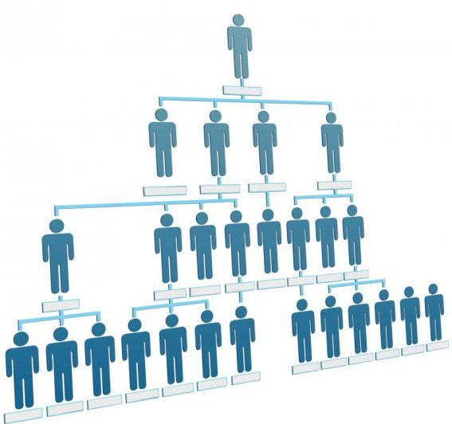
PART 3 : MANAGEMENT STRUCTURES AND VACANCIES

Slide 40
EXCO (13 EXCO MEMBERS)
CEO - Mr Pascal Moloi
Acting CFO - Mr Bryan Chaplog
Strategic Initiatives - Mr Willem Steenkamp
Head: Strategic Support - Mr Mcezi Mnisi
Company Secretary - Ms Elizabeth Africa
Head: Business Intelligence - Mr Johan Minnie
Head: Land - Mr Lucien Rakgoale
Head: Programme Management Office – Mr Mandla George
Head: Planning Programme Design – Ms Daphney Ngoasheng
Head: Corporate Support – Ms Rashida Issel
Regional Manager: Region A – Mr Bosco Khoza
Regional Manager: Region FS & NW – Mr Mooketsi Mphahlele
Regional Manager: Region C – Ms Nomsa Mlotshwa

Slide 41
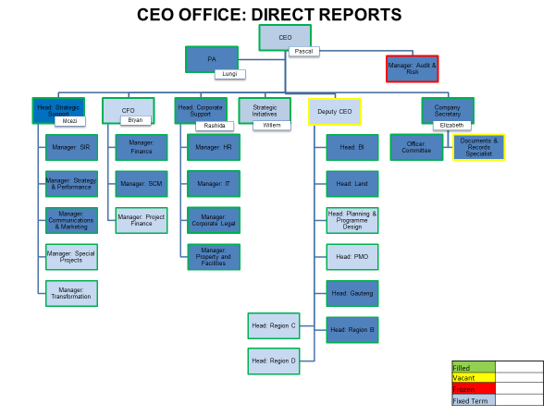
HDA ORGANOGRAM

Slide 42
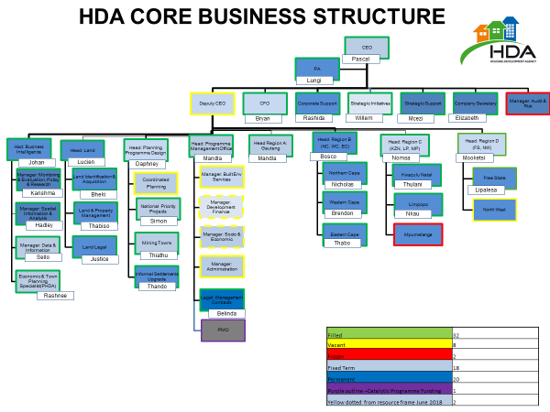
HDA CORE BUSINESS STRUCTURE

Slide 43

PART 4 :AUDIT OUTCOME

Slide 44

PART 4 :AUDIT OUTCOME
Audit Opinion
Unqualified
The financial statements present fairly, in all material respects, the financial position of the Housing Development Agency as at 31 March 2017, and its financial performance and cash flows for the year then ended in accordance with South African Standards of Generally Recognised Accounting Practice (SA Standards of GRAP) and the requirements of the Public Finance Management Act of South Africa (Act No.1 of 1999)(PFMA)..

Slide 45
PART 5 : FINANCIAL STATEMENT

Slide 46
PART 4 : FINANCIAL STATEMENTS

Slide 47
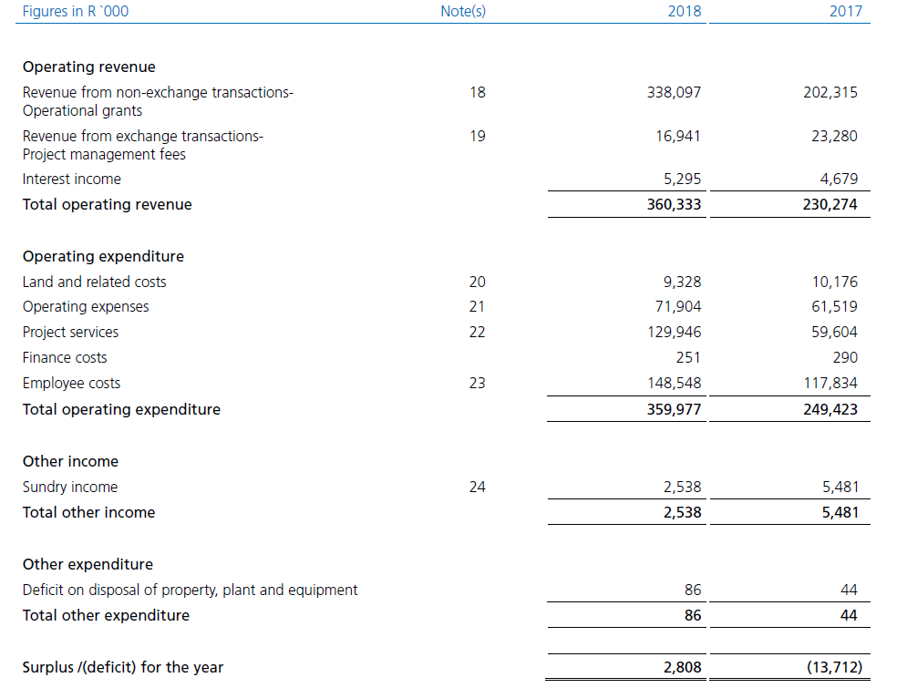
PART 4 : FINANCIAL STATEMENTS

Slide 48
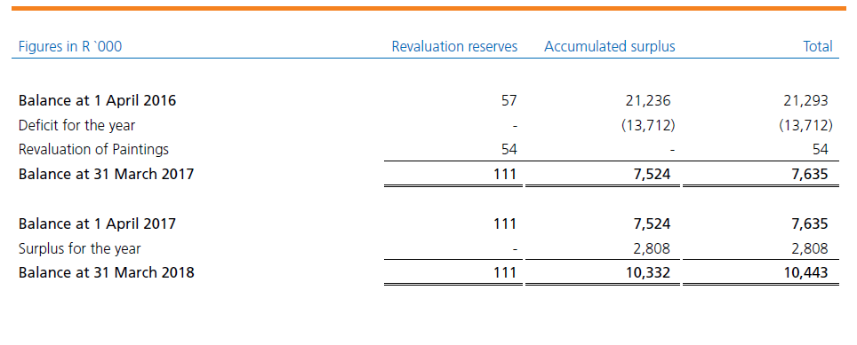
PART 4 : FINANCIAL STATEMENTS

Slide 49
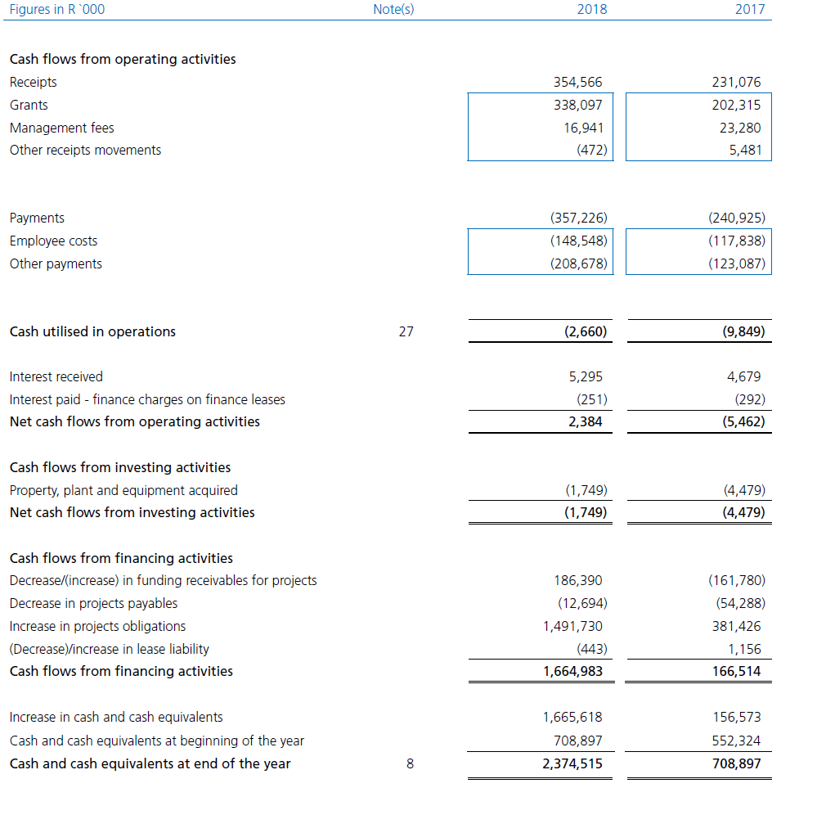
FINANCIAL STATEMENTS

Slide 50
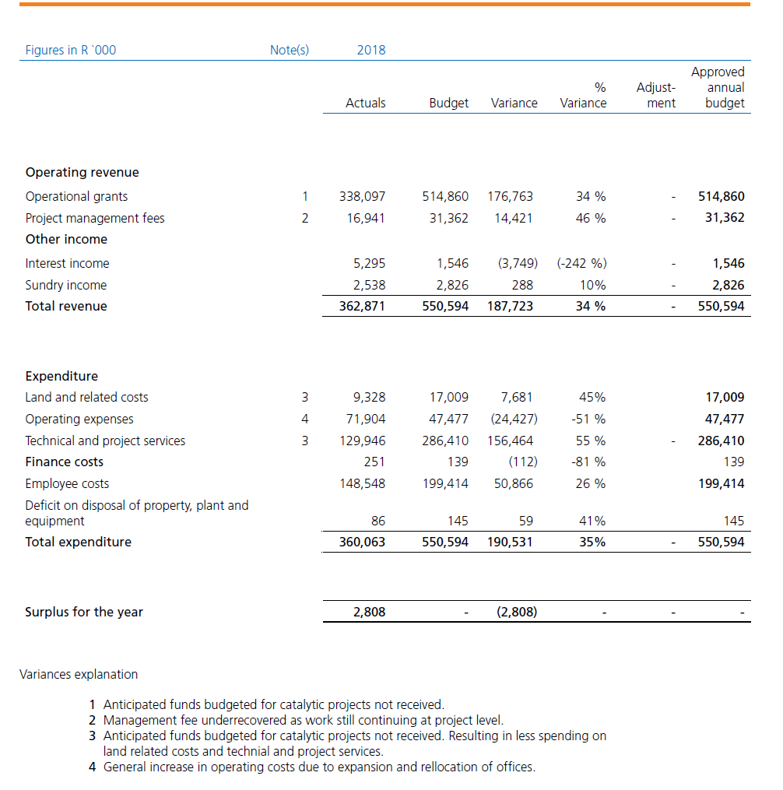

Slide 51



