Slide 1
Submission for the 2019/20 Division of Revenue
Select Committee on Appropriations
10 October 2018
For an Equitable Sharing of National Revenue

Slide 2
Background to the Submission
Submission made in terms of:
Section 214(1) of the Constitution (1996)
Section 9 of the Intergovernmental Fiscal Relations Act (1998)
Section 4(4c) of the Money Bills Amendment Procedure and Related Matters Act (Act 9 of 2009)
Theme of 2019/20 Submission: Re-engineering the IGFR system in a fiscally constrained environment for National Development
Focus of submission: review of effectiveness and performance of current intergovernmental fiscal relations (IGFR) system and makes recommendations to re-engineer fiscal instruments, incentives and other measures to address challenges to achieving National Development Plan (NDP) objectives
Focus of previous two submissions was: (i) rural development (2016) and (ii) urban development (2017)

Slide 3
Outline of 2019/20 Submission Chapters
Chapter 1
Re-engineering the Intergovernmental Fiscal Relations System
Recentralisation – Implications for Service Delivery
Chapter 3
Chapter 4
Chapter 6
Chapter 5
Provincial Fiscal Adjustment Mechanisms in Times of Protracted Fiscal Constraints – Case of the Health Sector
Incentive Effects of Intergovernmental Grants – Evidence from Municipalities
Assessing Efficiency of Key Provincial Infrastructure Programmes – Case of Education, Health and Public Transport
Assessing the Effectiveness of Intergovernmental Fiscal Relations Instruments in Addressing Water Challenges
Chapter 2

Slide 4
Chapter 1. Re-engineering the Intergovernmental Fiscal Relations System
Chapter 1 looks at past performance of the economy and its future prospects and how fiscal constraints place new limitations on equitable sharing and policy formation
Using a quantitative model, this chapter assesses changes in the aggregate consumption expenditure level and the distributions across the population that are required to achieve NDP, or Sustainable Development Goals (SDGs) of halving poverty and eliminating hunger, come 2030
Since 2008/09 global economic and financial crisis, economic recovery has been slow – the accompanying narrowing fiscal space, has culminated in a severe fiscal constraint

Slide 6
Chapter 1. Re-engineering the Intergovernmental Fiscal Relations System [cont.]
Key message of the chapter is that continuing with ‘business as usual’ regarding policies and interventions will fail to meet the poverty and inequality reduction targets set for 2030, i.e. 27.5% and 0% respectively
More than ever before, focus should be on speeding up economic growth and fighting poverty and unequal access to opportunities without further compromising public finances that are severely constrained
Current gross domestic product (GDP) growth of 2.0% must be accelerated to 4.5% between 2015 and 2030 to achieve the SDGs on poverty and hunger
To meet the economic growth target, an increase of domestic and private investment of 5.7% on average annually is required
The rest of the submission focuses on the structural nature of the fiscal crisis and implications for intergovernmental fiscal instruments across provinces and municipalities

Slide 7
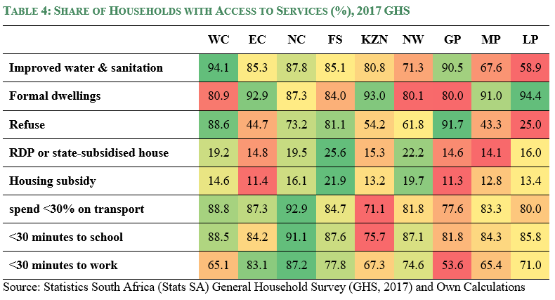
Socio-Economic and fiscal Profiles of provinces

Slide 8
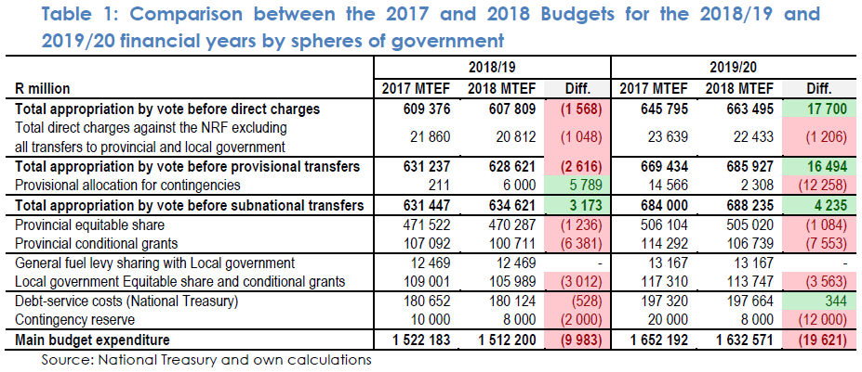
Socio-Economic and fiscal Profiles of provinces (cont.)

Slide 9
Chapter 2. Recentralisation: Implications for Service Delivery and Intergovernmental Fiscal Relations
Highlights potential of increased vertical control of administrative and funding instruments in the wake of fiscal constraints
Recentralisation raises various concerns: it is contrary to spirit/principles underpinning multilevel system of government in South Africa and the relocation of functions come with definite financial implications for both the sphere gaining and the one losing the function
Key question: Is recentralization the solution for South Africa during times of financial constraint?
Case-studies of key examples of recentralisation were used to generate broad lessons applicable to the public sector
Regarding fiscal recentralisation, the use and performance of earmarked conditional grants, particularly those in the human settlements sector, were assessed
In the case of administrative recentralisation, technical and vocational education and training (TVET) colleges were analysed

Slide 10
Chapter 2. Recentralisation: Implications for Service Delivery and Intergovernmental Fiscal Relations
Key Findings:
Been a change in the way Government has broadly responded to fiscal stress, when considering the period post 2007/08 global financial crisis relative to current outlook for the 2018 MTEF
Post the 2007/08 financial crisis, conditional grant funding increased rapidly whilst discretionary, equitable share funding grew more moderately
Over current subdued economic period, opposite of this trend has occurred – notable however is the increase in the number and funding level of earmarked conditional grants, which amounts to ring-fencing, and more stringent conditions being applied to pockets of funding within existing conditional grants
Real growth in block grants and conditional grants, 2003/04-2019/20

Slide 11
Chapter 2. Recentralisation: Implications for Service Delivery and Intergovernmental Fiscal Relations
Key Findings [cont.]
National government does not perform better at service delivery compared to subnational, thereby questioning rationale behind recentralisation
When recentralising a function, a blanket approach is not ideal– analyses show for example, that some colleges that were efficient prior to recentralisation, saw a decline in levels of efficiency post the reform

Slide 12
Chapter 2. Recommendations
In the current constrained economic environment with limited resources, government should not automatically resort to increasing the role of national government, since historical performance data does not generally show support for this leading to improved performance
To improve service delivery and attainment of specific priority outcomes, control measures other than the implementation of earmarked conditional grant funding must be developed and strengthened
When recentralising a function is deemed necessary, a differentiated approach must be adopted – ideally government should focus on where the weaknesses within performance lie instead of applying a blanket approach which may negatively affect good performers

Slide 13
Chapter 3. Provincial Fiscal Adjustment Mechanisms in Times of Protracted Fiscal Constraints: Case of Health Sector
Health care delivery is under severe fiscal pressure and lacks necessary levers to respond to its fiscal situation
Sector simultaneously facing declining revenue and burgeoning demands
Estimates suggest that current health budget is underfunded by R13 billion in 2018
Requires provinces to adjust their budgets accordingly, but provinces lack the necessary levers
Key question: How responsive is the fiscal framework in facilitating smooth adaptation in a constrained fiscal environment?
Undertook qualitative analyses of national government-imposed provincial fiscal adjustments, trend evaluation of provincial fiscal performance and an empirical estimation of provincial fiscal adjustment instruments and channels

Slide 15
Chapter 3. Provincial Fiscal Adjustment Mechanisms in Times of Protracted Fiscal Constraints: Case of Health Sector [cont.]
Key Findings [cont.]
Provinces tend to use imprudent fiscal devices such as expenditure accruals to conceal negative budget balances and to plug fiscal gaps
Major provincial fiscal adjustments tend to cascade from the centre through the cuts or additions made to the transfers
Notwithstanding claims of provincial fiscal strain, alternative views attribute the source of pressure to episodes of fiscal mismanagement
Incidents of cutting health delivery outputs to manage pressure are scant because of fiscal risks associated with such practices

Slide 16
Chapter 3. Recommendations
National and provincial treasuries in collaboration with the national and provincial departments of health should develop a framework or criteria for determining serious financial strain, with clear measurable financial and non-financial factors that can be monitored, reported and used to trigger automatic fiscal adjustment overseen by provincial legislature
The National Treasury and the Department of Health through the respective Ministers should allocate part of the 2019/18 MTEF health infrastructure budget towards gradually offsetting expenditure accruals which arise from unavoidable demand pressures for which allocated budgets were depleted. Conditional upon meeting targeted reductions in accruals.
The Minister of Finance through National Treasury should ensure that the framework for health infrastructure conditional grants (Health Facility Revitalisation Grant and National Health Insurance (non-personnel component)) accommodates flexibility during periods of protracted fiscal constraint so that provinces can re-allocate their available capital allocations towards maintenance

Slide 18
Chapter 4. Incentive Effects of Intergovernmental Grants: Evidence from Municipalities
Seek empirical evidence on revenue and expenditure incentive effects of the two types of transfers: unconditional transfers allocated according to a formula and conditional transfers allocated on an ad-hoc basis
Test National Treasury’s aim of enhancing fiscal autonomy of municipalities via emphasis on reduced conditional grants and the increased channeling of resources via the Local Government Equitable Share
Key questions:
How responsive are intergovernmental grants received by municipalities to revenues generated by municipalities?
Does South Africa’s grant allocation framework lead to grant-driven crowding out (in) behavior among recipient municipalities?
Utilized theoretical model developed by Gramlich (1991) and extended in empirical works of Lewis & Smoke (2017) as well as Liu & Zhao (2017)

Slide 19
Chapter 4. Incentive Effects of Intergovernmental Grants: Evidence from Municipalities
Key Findings:
For metropolitan (category A) municipalities: Conditional grant transfers positively correlate with own revenue collection and also generate increased funding of capital outlays. On the other hand, increased equitable share funding (ESF) is associated with lower capital and operating expenditures
For secondary cities (category B1) municipalities: ESF is positively correlated with own revenue while unconditional grant transfers negatively impact operating expenditure
For large towns (category B2) municipalities: ESF has positive effects on own revenue and expenditure per capita but conditional grant allocations induce lower per capita outlays on capital and operational goods
For small towns (category B3) municipalities: ESF is beneficial for own revenue and capital and recurrent components of municipal spending, while conditional grants aid higher per capita spending on capital and operational goods and services
For rural (category B4) municipalities: ESF is beneficial for own revenue and different components of municipal spending, while conditional grants tend to lower capital expenditure

Slide 20
Chapter 4. Recommendations
The Minister of Finance through National Treasury gives municipalities, particularly those in small and rural municipalities (categories B3 and B4), greater flexibility in the use of grants to encourage innovative approaches to resolving local problems
A fiscal capacity component be introduced into the equitable share formula to make it more efficient and incentivizing. The component should incorporate two aspects:
Recognising the revenue-raising effort of municipalities
Recognising the redistributive element of addressing horizontal imbalances

Slide 21
Chapter 5. Assessing Efficiency of Key Provincial Infrastructure Programmes: Case of Education, Health and Public Transport
Infrastructure projects are critical for service delivery and economic growth, however, delivery of infrastructure projects is suboptimal and typically characterised by cost overruns, low productivity and poor quality
In current fiscally constrained environment, infrastructure grants bear the brunt of government’s need to cut and reprioritise spending over the 2018 MTEF period – this is contrary to acknowledgement that infrastructure spending programmes address important historical backlogs and constitutional imperatives
Key question: Within the prevailing fiscal context, how can provincial governments achieve the same level of infrastructure delivery with less money?
Budget analyses used to examine efficiency of provincial infrastructure spending in health, education and transport, (2)survey administered to assess the type and extent of inefficiencies including fiscal misappropriation and (3)interviews conducted with key stakeholders to map the value-chain and identify potential incentives for rent-seeking behaviour, using the education sector as a case study

Slide 22
Chapter 5. Assessing Efficiency of Key Provincial Infrastructure Programmes: Case of Education, Health and Public Transport
Key Findings:
Cuts to baseline funding for provincial infrastructure slow down infrastructure delivery in the short-term. In the medium term provinces can absorb spending cuts through efficiency gains, if infrastructure procurement and built environment personnel at sector departments/public works are increased
Aligning planning, budgeting and implementation functions of provincial infrastructure delivery leads to better outcomes – currently these functions are separated between sector departments and implementing agents, thus distorting incentives and weakening the accountability chain
Survey results showed that 91% of respondents (contractors) felt government procurement processes are not open and transparent whilst 57% agreed corruption is most prominent during the procurement and tender phases of the infrastructure cycle
When asked what percentage of the contract value is paid in informal payments or inducements to get government contract, only 14% said no payments were made whilst 76% said payments between 3-12% of the contract value were made to secure a government contract. For this, contractors pay a higher percentage of the contract value for smaller contracts relative to larger contracts, with a few notable exceptions

Slide 23
Chapter 5. Assessing Efficiency of Key Provincial Infrastructure Programmes: Case of Education, Health and Public Transport
Key Findings [cont.]
The analysis of the infrastructure value-chain reveal that a lack of oversight at key delivery points are increasing incentives to engage in fiscal misappropriation
Key challenges that arise due to lack of oversight
Consultants are incentivized to over-design projects because their payment is often based on a percentage of the project cost
There is no third party review of tenders awarded by implementing agents even though they are solely responsible for appointing contractors with very little participation from sector departments – awarding projects to contractors without the proper grading and proven track record is a key driver of inefficiencies in provincial infrastructure provision
Permanent onsite supervision of contractors is largely absent, allowing for the concealment of defects and the use of poor quality material

Slide 24
Chapter 5. Recommendations
The national sector departments of Education, Health and Public Transport should develop clear performance evaluation frameworks for the provincial infrastructure grants under their control
The national sector departments of Education, Health and Public Transport should include greater scrutiny of requisition variation orders (such as automatic review and approval requests to provincial treasuries) when the value of these rises above acceptable levels of the project costs
The Minister of Finance, through National Treasury, set and publish the criteria to be measured in monitoring and evaluating infrastructure grants. The assessment criteria regarding infrastructure cuts should also be published

Slide 25
Chapter 6. Assessing the Effectiveness of Intergovernmental Fiscal Relations Instruments in Addressing Water Challenges
Achieving water security is the overarching goal of national water management
Key question: Do the fiscal instruments and other measures introduced through the IGFR framework help to achieve NDP’s goal of ensuring affordable and reliable access to sufficient safe water and hygienic sanitation for all?
Overview of the poor state of water services
Physically available (infrastructure) | 96% of households have minimum standard infrastructure
 | 81.2% piped water in house or stand
 | Only rural provinces (Limpopo, NW, EC & KZN) have public taps, tankers >20%
Reliably available (operation) | 85% infrastructure functional
 | 65% reliably functioning
Water safety indicators | Data no longer publicly available
Sanitation indicators | Often unsatisfactory, wastewater treatment failures

Slide 26
Chapter 6. Assessing the Effectiveness of Intergovernmental Fiscal Relations Instruments in Addressing Water Challenges
IGFR instruments underpinning provision of water services:
Equitable Share supports municipal water services provision - must ensure municipalities are able to provide basic services
Regional Bulk Infrastructure Grant (RBIG) to develop new, refurbish, upgrade and replace ageing water and sanitation infrastructure of regional significance
Municipal Infrastructure Grant (MIG) subsidises the capital costs of providing basic services to poor households – specifically aimed at providing capital finance for eradicating infrastructure backlogs
Water Services Infrastructure Grant (WSIG) assists Water Services Authorities to reduce water and sanitation backlogs

Slide 27
Chapter 6. Assessing the Effectiveness of Intergovernmental Fiscal Relations Instruments in Addressing Water Challenges
Key Findings:
Despite significant spending, access to safe and reliable water services is declining
Inadequate expenditure on operations and maintenance is leading to service failures
Current IGFR system incentivises this over-provision of infrastructure without providing for related operating/maintenance costs
Water-related allocations in the local government equitable share (LES) and conditional grants
Year on year growth | 2015/16-2016/17 | 2016/17-2017/18 | 2017/18-2018/19 | 2018/19-2019/20 | 2019/20-2020/21
Total water-related conditional grant allocations | -0.6% | 3.0% | 1.2% | 4.6% | 5.5%
Total water-related allocation from LES |  |  |  | 9.9% | 9.7%
Breakdown of water-related allocation in LES, 2018/19 | Allocation per household eligible for free basic services
Operations (in Rands per month) | 112.9
Maintenance (in Rands per month) | 12.55
Total (in Rands per month) | 125.45
Total allocation for water in the LES (R'million) | 14 761

Slide 28
Chapter 6. Assessing the Effectiveness of Intergovernmental Fiscal Relations Instruments in Addressing Water Challenges
Key Findings [cont.]:
Goal of providing basic minimum infrastructure almost achieved. Priority must shift to sustainable operations and maintenance
Provision of higher than basic water standards with limited revenue collection aggravates municipal, water board and the National department’s financial deficits
Poorly defined grant objectives allow substantial deviations from policy
RBIG’s wide mandate mars accountability, aggravates financial shortfalls
Many municipalities do not pursue cost recovery for services provided at a level higher than basic – result is a poor quality of service provided and inadequate funds to maintain infrastructure, leading to high level of infrastructure system failures

Slide 29
Chapter 6. Recommendations
A review of the basic norms and standards for water services and the associated Local Government Equitable Share must be undertaken by the Department of Water and Sanitation (DWS)
Municipalities indicate what standards they intend to provide and how their capital and operational costs are to be funded. This should be done through Water Services Development Plans
In times of fiscal constraint, operating and maintenance costs must be prioritised
Clearer statements of grant objectives to achieve defined basic service levels or sustainability of services, must be established by DWS
Stronger conditions must be attached to financial transfers to ensure compliance and proper spending for the purposes indicated. Grant funding should be withheld from municipalities that do not have the necessary measures to monitor and control water consumption, or which do not meet criteria or have valid abstraction licences
The IGFR system should shift towards incentivizing sustainable operations and maintenance and introduce a dimension of outcomes-based support for higher levels of service

Slide 30
Concluding Remarks
Central message that underlies the various recommendations made, is that in the context of the country’s intergovernmental fiscal system, three key issues must be faced:
First, there is an urgent need to properly understand the country’s economic challenges and to address them specifically and directly
Second, is the need to establish a balanced fiscal position that can be sustained over the long term
Third, the efficiency of all government activity must be sharpened, so that residents receive the best possible value for money from the taxes they pay

Slide 31
www.ffc.co.za

