Slide 1


COMMUNITY SCHEMES OMBUD SERVICE

Slide 2
Presentation Contents
2017/18 ANNUAL PRFORMANCE REPORT
MANAGEMENT STRUCTURES, INCUMBENTS AND SENIOR MANAGEMENT VACANCIES
BOARD MEMBERS
FINANCIAL PERFORMANCE
DRAFT AUDIT FINDINGS AND REMEDIAL AUDIT PLAN

Slide 3
Performance Information
Ndivhuo Rabuli
Acting CO

Slide 4
STRATEGIC OBJECTIVE 1:
REGULATE ALL COMMUNITY SCHEMES WITHIN SOUTH AFRICA (p.15)
Key Result Area | Key Performance Indicator | Annual Target 2017/18 | Actual: 2017/18 | Variance
Regulate all Community Schemes within South Africa | Number of schemes registered | [1] 30 000 schemes registered | 17 446 Target Not Achieved | -12 554
Comments:
There was a decline in the number of schemes submitting the registration documentation. CSOS will implement penalty provisions in the CSOS Act to enforce compliance with the registration process. Of the 76 677 ST schemes received from the Deeds Office, 27.7% (20 969) are registered with the CSOS

Slide 5
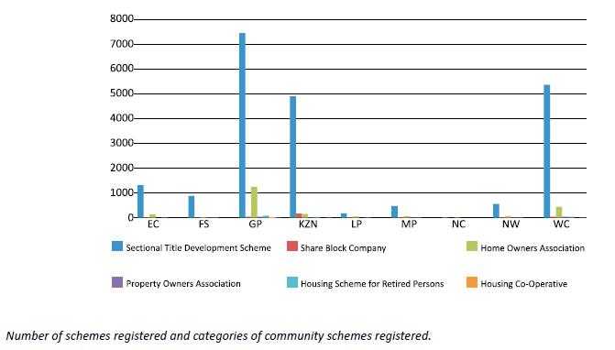
STRATEGIC OBJECTIVE 1 p. 15:

Slide 6
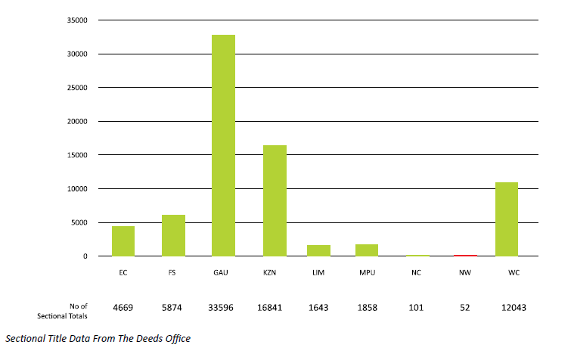
STRATEGIC OBJECTIVE 1 p. 16:

Slide 7
STRATEGIC OBJECTIVE 2
CONTROL AND PROVIDE QUALITY ASSURANCE OF COMMUNITY SCHEMES GOVERNANCE DOCUMENTATION (p.17)
Key Result Area | Key Performance Indicator | Annual Target 2017/18 | Actual: 2017/18 | Variance
Control and provide quality assurance of Community Schemes Governance Documentation | Number of Governance Documentation Quality Assured (New Schemes and Amendments of rules) | [2] 5000 governance documentation quality assured | 1561 Target Not Achieved | - 3439
COMMENTS:
There were challenges with capacity to handle request for quality assurance. CSOS has since appointed more officers within the governance business unit
Key Result Area | Key Performance Indicator | Annual Target 2018/19 | Actual: 2017/18 | Variance
Control and provide quality assurance of Community Schemes Governance Documentation | Number of Certificates issued for community schemes governance documentation that has been quality assured | [3] 5000 Certificates issued for community schemes governance documentation that has been quality assured | 961 Target Not Achieved | -4039
COMMENTS
There were challenges with capacity to handle request for quality assurance. CSOS has since appointed more officers the unit to conduct quality assurance

Slide 8
STRATEGIC OBJECTIVE 3
PROVIDE A DISPUTE RESOLUTION SERVICE FOR COMMUNITY SCHEMES (p.18)
STRATEGIC OBJECTIVE 3: Provide a Dispute Resolution service for Community Schemes
Strategic Objective | Key Performance Indicator | Annual Target 2017/18 | Actual: Quarter 1 | Variance
Provide a Dispute Resolution service for Community Schemes | Percentage of disputes resolved | [4] 60% of Disputes received resolved | 64% Target Achieved | 4%
COMMENTS:
The appointment of Part-Time Adjudicators ensured that more cases are resolved. During the financial year under review, a total of 4060 disputes were lodged with the CSOS compared to 1282 in the previous year.

Slide 9
STRATEGIC OBJECTIVE 4
PROVIDE STAKEHOLDER TRAINING, CONSUMER EDUCATION AND AWARENESS FOR PROPERTY OWNERS, OCCUPIERS AND OTHER STAKEHOLDERS IN COMMUNITY SCHEMES (p.25)
STRATEGIC OBJECTIVE 4: PROVIDE STAKEHOLDER TRAINING, CONSUMER EDUCATION AND AWARENESS FOR PROPERTY OWNERS, OCCUPIERS AND OTHER STAKEHOLDERS IN COMMUNITY SCHEMES
Key Result Area | Key Performance Indicator | Annual Target 2017/18 | Actual: Quarter 1 | Variance
Provide stakeholder training, consumer education and awareness for Community schemes | Number of national consumer / stakeholder activations | [5] Nine (9) national consumer / stakeholder activations | Nine (9) national consumer / stakeholder Activations Target Achieved | None.
COMMENTS:
Stakeholder activations were conducted nationally according to plan. Results in terms of stakeholder reach reported on the quarterly reports
Key Result Area | Key Performance Indicator | Annual Target 2017/18 | Actual: 2017/18 | Variance
Provide stakeholder training, consumer education and awareness for Community schemes | Number of stakeholder e-newsletter publications | [6] Three (3) stakeholder e-newsletter publications | Three (3) stakeholder e-newsletter publications Target Achieved | None
COMMENTS:
E-newsletters were distributed to all CSOS stakeholders in the current databased as planned

Slide 10
Performance Information – Strategic Objectives (p.25)
STRATEGIC OBJECTIVE 4: PROMOTE GOOD GOVERNANCE IN SECTIONAL TITLES AND OTHER COMMUNITY SCHEMES
Key Result Area | Key Performance Indicator | Annual Target 2017/18 | Actual: 2017/18 | Variance
Provide stakeholder training, consumer education and awareness for property owners, occupiers and other stakeholders in Community Schemes | Number of consumer awareness campaign and activations | [7] Four (4) consumer awareness campaigns with 2 activations | Four (4) consumer awareness campaigns with 2 activations Target Achieved | None
COMMENTS:
Consumer awareness campaigns were conducting nationally according to plan. Results in terms of stakeholder reach reported on the quarterly reports
Key Result Area | Key Performance Indicator | Annual Target 2017/18 | Actual: 2017/18 | Variance
Provide stakeholder training, consumer education and awareness for property owners, occupiers and other stakeholders in Community Schemes | Number of stakeholder engagement campaigns | [8] Twelve (12) national consumer / stakeholder activations | Nine (9) national consumer / stakeholder Activations Target Not Achieved | -3
COMMENTS:
The effort was on the Roadshows which were held in all Provinces, reported under Nine (9) national consumer / stakeholder activations.

Slide 11
Performance Information – Strategic Objectives (p.26)
SO 5: ENSURE THAT THE CSOS IS AN EFFECTIVE AND SUSTAINABLE ORGANISATION
STRATEGIC OBJECTIVES 5: ENSURE THAT THE CSOS IS AN EFFECTIVE AND SUSTAINABLE ORGANISATION
Strategic Objective | Key Performance Indicator | Annual Target 2017/18 | Actual: 2017/18 | Variation
Ensure that the CSOS is an effective and sustainable organization | Number of functional facilities available and accessible to members of the public, to deliver the CSOS services | [9] No visible CSOS point of presence established | None Target Not Achieved | -3
COMMENTS:
The revised budget was approved in the second quarter and the organization focused more on capacitating the current understaffed offices. Negotiations were conducted with other entities for points of presence but no agreements were signed.
Strategic Objective | Key Performance Indicator | Annual Target 2017/18 | Actual: 2017/18 | Variation
Ensure that the CSOS is an effective and sustainable organization | Implemented Revenue Management Model in Collection arrangement R90 000 000 Levies Collection | [10] Collect R90 000 000.00 in CSOS Levy Income | R 170 824 372 collected as CSOS Levy Income Target Achieved | R 80 824 372 collected over the projected R 90 000 000
COMMENTS:
Levy collection exceeded the projected amount as the industry has responded well to the paying of levies since the CSOS started collecting
Strategic Objective | Key Performance Indicator | Annual Target 2017/18 | Actual: 2017/18 | Variation
Ensure that the CSOS is an effective and sustainable organization | % of uptime of ICT systems | [11] Achieve 99% uptime of ICT systems | 99.67 % Target Achieved | 0.67%

Slide 12
PERFORMANCE OVERVIEW
CSOS STRATEGIC PROGRAMMES FOR 2017/18 |  |  |  |  |  |  |  | NOT ACHIEVED |  | ACHIEVED |  | TOTAL KPIs |  | NOT ACHIEVED % |  | ACHIEVED %
Regulate all Community Schemes within South Africa |  |  |  |  |  |  |  | 1 |  | 0 |  | 1 |  | 100% |  | 0%
Control and provide quality assurance of Community Schemes Governance Documentation |  |  |  |  |  |  |  | 2 |  | 0 |  | 2 |  | 100% |  | 0%
Provide a Dispute Resolution service for Community Schemes |  |  |  |  |  |  |  | 0 |  | 1 |  | 1 |  | 0% |  | 100%
Provide stakeholder training, consumer education and awareness for property owners, occupiers and other stakeholders in Community Schemes |  |  |  |  |  |  |  | 1 |  | 3 |  | 4 |  | 25% |  | 75%
Ensure that the CSOS is an effective and sustainable organisation |  |  |  |  |  |  |  | 1 |  | 2 |  | 3 |  | 33% |  | 67%
TOTAL |  |  |  |  |  |  |  | 5 |  | 6 |  | 11 |  | 45% |  | 55%

Slide 13
Human Capital
4 Vacant Executive Positions
9 Vacant Manager Positions
21 Filled Positions (Man and Execs)

Slide 14
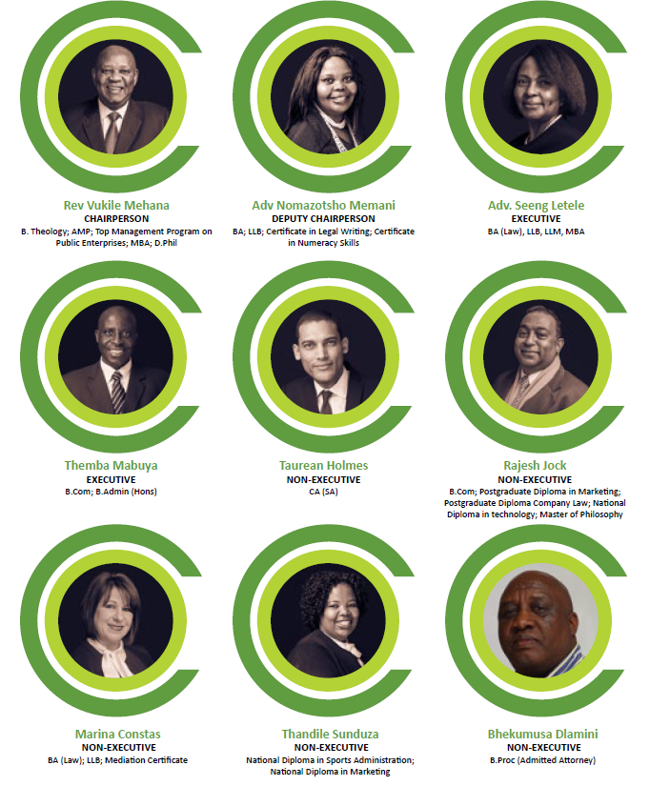
Board Members
Non-Executive Members (Term ending 31 December 2018)
Re. Dr V. Mehana (Serving 2nd Term)
Adv. N. Memani (Serving 2nd Term)
Mr. Taurean holmes
Mr. Rajesh Jock
Ms. Marina Constas
Ms. Thandile Sunduza
Mr. Bhekumusa Dlamini
Executive members
Adv. Seeng Letele
Themba Mabuya

Slide 15
Financial Performance and Audit Plan
Nathi Dube
Acting CFO

Slide 16
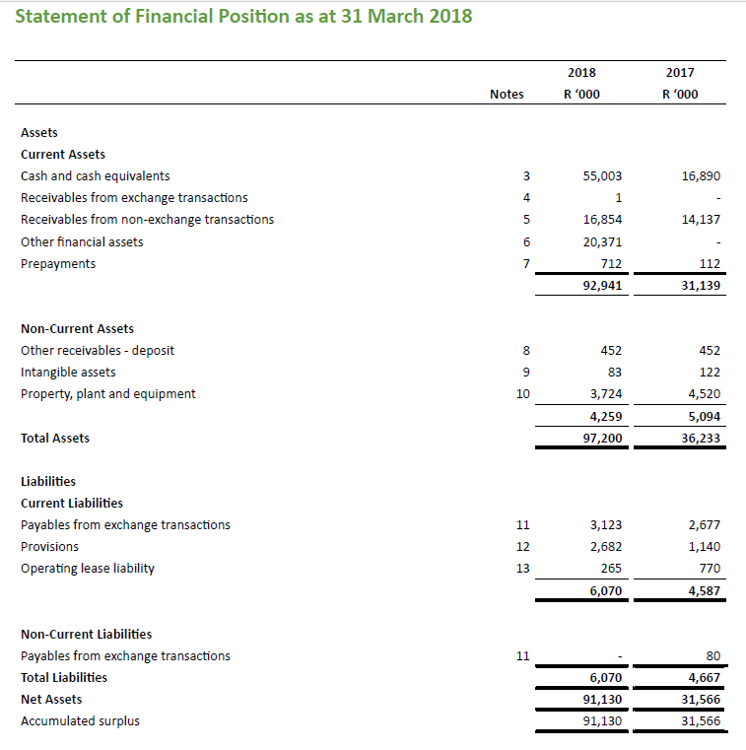
Annual Financial Statements

Slide 17
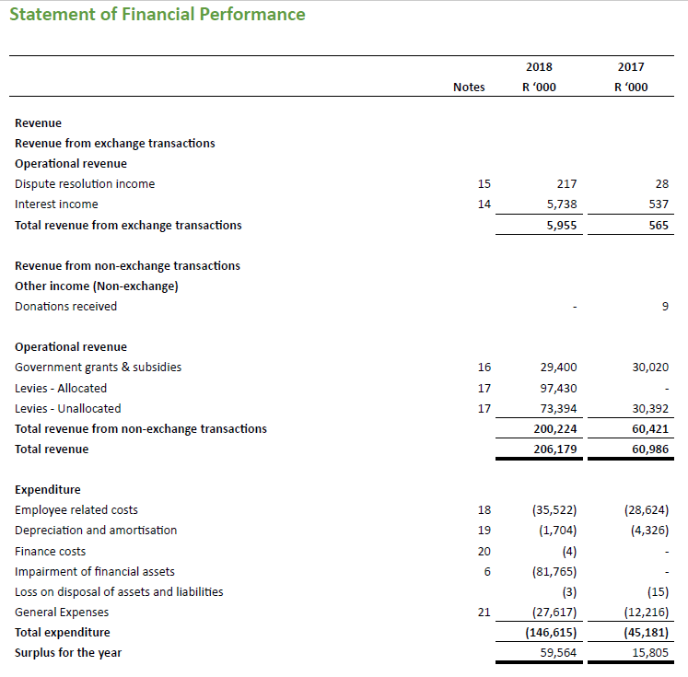
Annual Financial Statements (continued)

Slide 18
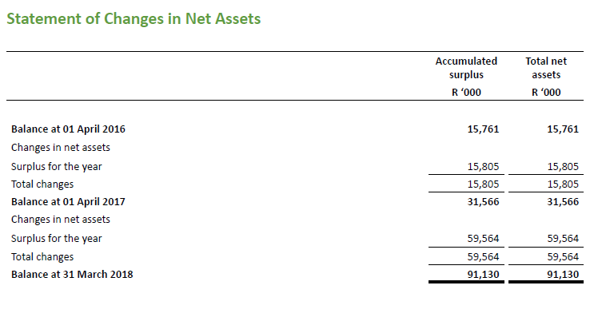
Annual Financial Statements (continued)

Slide 19
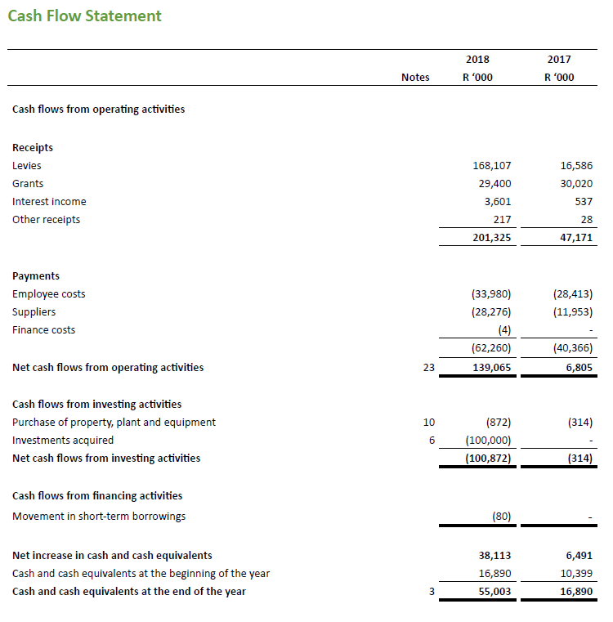
Annual Financial Statements (continued)

Slide 20
Remedial Audit Plan
FINDINGS | ACTION PLAN | IMPLEMENTATION DATE | PROGRESS | RESPONSIBLE PERSON
1. Submission of annual financial statements on 31 May 2018 not approved by the accounting authority (Finding corresponding to Audit Report paragraph 24) | Management will develop a detailed project plan indicating the detailed timelines building to the compilation of Annual Financial Statements to be submitted that will be discussed at EXCO as a standing agenda item. | Year end 2018/19 AFS preparation. | In progress – the proposed detailed project plan will be discussed at the next Exco meeting by 31 Oct 2018 | Acting CFO

Slide 21
Remedial Audit Plan Cont.
FINDINGS | ACTION PLAN | IMPLEMENTATION DATE | PROGRESS | RESPONSIBLE PERSON
2. Completeness of revenue from non-exchange transactions (levies) and receivables from non-exchange transactions (Audit Report paragraph 3, paragraph 23 and paragraph 25. ) | Database of all Sectional Titles Schemes registered with the Deeds Office. Notice will be issued to at least 60% of the identified sectional titles. CSOS will engage other government entities (including SARS, SALGA, etc.) to obtain the data on other forms of community schemes i.e. HOAs, etc. Finance will recruit personnel that will perform reconciliations manually while awaiting to procure a revenue management system. | 31 March 2019 31 Jan 2019 01 Dec 2018 | In progress - in the process of recruiting personnel to implement the reconciliation project | Acting CFO

Slide 22
Remedial Audit Plan Cont.
FINDINGS | ACTION PLAN | IMPLEMENTATION DATE | PROGRESS | RESPONSIBLE PERSON
3. Cash and cash equivalents – Bank account opened without prior approval from National Treasury (Finding corresponding to Audit Report paragraph 29) | There is compliance checklist developed and will be monitored on a monthly basis by the CFO and reported on a quarterly basis to the relevant governance structures i.e. Finance and Audit Committees Finance checklists have been developed and will be implemented Consequence Management will be implemented | Immediately 30 Sept 2018 | In progress – Currently there is an investigation running | CFO CFO Chief Ombud and board

Slide 23
Remedial Audit Plan Cont.
FINDINGS | ACTION PLAN | IMPLEMENTATION DATE | PROGRESS | RESPONSIBLE PERSON
4. Other financial assets – Investment of surplus funds (Finding corresponding to Audit Report paragraph 28) | Consequence Management will be implemented | Immediately | In progress – Currently there is an investigation running | Chief Ombud and Board
5. Statement of Comparison of Budget to Actual Amounts not agreeing to Approved Budget (Finding corresponding to Audit Report paragraph 26 and 27) | Intensify monthly reporting that will be presented to the monthly EXCO meetings Consequence management will be implemented. | 31 Oct 2018 Immediately | First improved report will be presented by the 31 Oct 2018 to the Exco Investigation is in progress | CFO Chief Ombud and Board

Slide 24
Remedial Audit Plan Cont.
FINDINGS | ACTION PLAN | IMPLEMENTATION DATE | PROGRESS | RESPONSIBLE PERSON
6. Cash and cash equivalents – Investment of surplus funds(Finding corresponding to Audit Report paragraph 28) | The investment policy shall be update with the amendments to include the treasury regulations. Future investments will follow the proper process as per the approved policy. | Immediately | In progress – Currently there is an investigation running | CFO
7. Preference points calculated incorrectly (quotations)(Finding corresponding to Audit Report paragraph 29) | SCM will make use of a manual point system calculation to verify the system generated calculations | Immediately | In progress – SCM is already manually calculating the preference points | CFO

Slide 25
Thank you

