Slide 1
Presentation to Parliamentary Portfolio Committee on Public Works cidb Annual Performance Report 2017/18 11 Oct 2018

Slide 2
Presentation Layout
Overview
Core Programme Performance Highlights:
Achievements
Non-achievements
Other Highlights
Recovery Plan
Audit Outcomes
Governance Matters
Financial Report

Slide 3
Overview

Slide 4
Legislative Mandate
Strategic leadership to stimulate sustainable growth, reform and improvement of the construction sector
Sustainable growth and participation of the emerging sector in the industry
Improved performance and best practice
Uniform application of policy and ethical standards, construction procurement reform, improved procurement and delivery management
Monitoring and regulating the performance of the industry, including the Registration of Projects and Contractors
Note: Simplified Mandate

Slide 5
Mission
We exist in order to regulate and develop the construction industry through strategic interventions and partnerships

Slide 6
Strategic Outcome Orientated Goals
A transformed construction industry that is inclusive, ethical and contributes to a prosperous South Africa and the World
Inclusive growing construction industry
Innovative and thriving construction environment
Working in alliance
Reputable Regulator
Sound corporate governance

Slide 7
Programmes ( Drivers)
Focus areas for 2017/18 aligned to the following core programmes :
Programme 1 - Administration
Sound corporate governance
Programme 2 - Regulation and Advocacy
Reputable Regulator
Programme 3 - Development and Capacitation
Innovative and thriving construction environment
Programme 4 - Industry Performance and Transformation
Inclusive growing construction industry
Organisational Design in Progress

Slide 8
Core Programmes Performance Highlights:

Slide 9
Overview; Audited Performance
Programme | Annual Targets | Achieved | Not Achieved | Indicators without targets
Administration | 24 | 8 | 16 | 0
Regulation and advocacy | 16 | 4 | 8 | 4
Development and capacitation | 12 | 2 | 4 | 6
Industry Performance and Transformation | 11 | 4 | 4 | 3
Total | 63 | 18 | 32 | 13

Slide 10
Performance Summary: Achievements

Slide 11
Administration (i)
 | Strategic Objectives | Annual Target | Achieved
1 | To ensure that the cidb is complying to all legislative requirements) | 70% of all audit findings resolved with the reporting cycle of relevant report | 88% of audit findings relating to AG were resolved
2 | To improve governance and accountability addressing and resolving all recurring audit findings. | 60 % of recurring audit findings that are resolved. | Averages of 60% recurring audit findings were resolved

Slide 12
1. Administration (ii)
KPI Nr | Performance Indicator | Target
1.2.3 | Current ratio | 2.3:1
 |  | Achieved Average of 3:03 current ratio was achieved.
1.2.4 | % irregular expenditure / budget | 0.85
 |  | Achieved Average of 0.13% of irregular expenditure to budget was incurred.
1.6.2 | % Downtime of multiple systems. | 20%
 |  | Achieved System uptime exceeded 80%.

Slide 13
1. Administration (iii)
KPI Nr | Performance Indicator | Target
1.3.2 | % of items approved in line with the 5-year strategy. | 25%
 |  | Achieved 42% of items approved in line with its 5-year strategy.(Board – 26%, ARGC – 31%, HRC – 25%, RRC – 77%, SESC – 50%)
1.5.1 | Competency assessment index | 60%
 |  | Achieved 60% of Competency assessment index achieved.
1.6.2 | % of recurring audit findings that are resolved. | 60%
 |  | Achieved Averages of 60% recurring audit findings were resolved.

Slide 14
2. Regulation and Advocacy (1)
KPI Nr | Performance Indicator | Quarter 1 Target
2.2.2 | % of Grade 2 to 9 contractors and PSP's registered within 21 working days. | 80%
 |  | Achieved 95% ( 5996 of 6269 ) contractors registered within 21 working days.
2.2.3 | % of Grade 2 to 9 contractors and PSP’s correctly graded through validation and verification sampling | 95%
 |  | Achieved 96% of grade 2 to 9 contractors accurately recommended by Assessors.
2.2.4 | % of Grade 2 to 9 contractors satisfied/very satisfied with registration services | 60%
 |  | Achieved 79% contractors rated the service as satisfied / very satisfied

Slide 15
2. Regulation and Advocacy (ii)
KPI Nr | Performance Indicator | Quarter 1 Target
2.3.1 | % customer registration satisfaction rating. | 96%
 |  | Achieved 99% (690 out of 698) of customer registration satisfaction rating was achieved.

Slide 16
3. Development and Capacitation
No. | Target | Progress Report
3.1.4 | Submission of cidb Standard for CPGs | cidb Standard for Contractor Participation Goals (CPGs) submitted to DPW in December 2017 for endorsement prior to submission to cidb Board
3.2.3 | Submission of cidb Standard for Auditing of H&S Management | cidb Standard for Auditing of H&S Management Plans submitted to DPW in December 2017 for endorsement before submitting to cidb Board

Slide 17
4. Industry and Transformation (i)
KPI Nr | Performance Indicator | Target
4.1.2 | % Industry Transformative index | Baseline determined
 |  | Baseline determined is 28%
4.1.3 | % public sector SME contracts awards index. | Baseline determined
 |  | Achieved Baseline determined is 50%
4.2.3 | # of export advisory services provided to contractors at grades 5 to 9. | Baseline determined
 |  | Achieved Baseline was determined and submitted to Exco

Slide 18
Performance Summary:
Key Non-Achievements

Slide 19
1. Administration (i)
No. | Target | Progress Report
1.2.1 | 65% of total revenue received through other revenue streams | 58% of total revenue received through other revenue streams Reasons for Deviation: Delays in best Practice Fee
1.2.5 | 75% SCM turnaround index | 70% turnaround times achieved Reasons for Deviation: Specification rework, clarifications, time taken to schedule BEC meetings, staff capacity constraints

Slide 20
1. Administration (ii)
No. | Target | Progress Report and reason for deviation
1.6.1 | 2nd Level of maturity regarding implementation of ICT governance strategy | 1ST Level of maturity Reason for deviation IT Policy and Framework not finalised

Slide 21
1. Administration (iii)
No. | Target | Progress Report and Reason for Deviation
1.3.1 | 80% of targets achieved in scorecard | 36% of targets achieved Reasons for Deviation: See Recovery Plan
1.4.2 | 100% of fraud cases reported investigated within specified timeframes | 15% of fraud cases reported and investigated Number of cases reported: 26 Number that should have been investigated: 22 Reasons for Deviation: Delays in appointing new service providers
1.5.2 | 50 % Employee satisfaction rating | Employee satisfaction survey was not conducted on time

Slide 22
Administration (iv)
No. | Target | Progress Report and Reason for Deviation
1.6.1 | 70% Board resolutions and decisions implemented within specified timeframes | 63% target was achieved Reasons for Deviation: Delay in the appointment of auditors
1.6.2 | Strong Internal audit risk rating on final report | An average of moderate rating was achieved in this period Reasons for Deviation: Findings of vacancies of key positions were not addressed
1.6.4 | 100% of completed Internal Audits | 60% of internal audit projects were completed in March 2018 Reasons for Deviation: Delay in the appointment of auditors

Slide 23
1. Administration (v)
No. | Target | Progress Report and Reason for Deviation
1.7.1 | 25% stakeholder perception index | Stakeholder perception survey was not finalised (has subsequently been concluded in current financial year)
1.7.2 | 40% Customer satisfaction rating | Customer satisfaction survey not done (has subsequently been concluded in current financial year)
1.7.3 | 60% IGR resolutions implemented | Not achieved Reason for deviation Process of stakeholder engagement not finalised on time (has subsequently been concluded in current financial year)

Slide 24
2. Regulation and Advocacy (i)
No. | Target | Progress Report and Reason for Deviation
2.2.1 | 80% Register of Project Information Verified and Corrected within Eight Weeks Index | 4% of Index was achieved Reason for Deviation Of 84 records, 80 were outside the cidb’s control. Data entered by client departments
2.3.2 | 94% Grade 1 contractors activated within 48 hours. | 92% ( 446711 out of 48737) was processed within 48hrs Reason for Deviation System Performance and Infrastructure Constraints

Slide 25
2. Regulation and Advocacy (ii)
No. | Target | Progress Report and Reason for Deviation
2.3.3 | 5% of Contractors Graduating from CDP's Provincial Index. | 0% of Index was achieved Reason for Deviation Assessment of contractors not finalised in 9 Provinces
2.3.4 | 5% Contractor and PSP Recognition Provincial Index. | 0% Index was achieved Reason for Deviation Awareness workshops held in all provinces, but slower uptake than expected (only 4 CMS recognised in SA).

Slide 26
2. Regulation and Advocacy (iii)
No. | Target | Progress Report and Reason for Deviation
2.3.5 | % Projects Compliance Provincial Index. (Baseline determined) | Baseline not determined Reason for Deviation Private sector: index could not be determined due to no agreement concluded with Department of Labour
2.3.6 | % Provincial Performance Index per Province. (Baseline determined) | Baseline not determined Reason for Deviation The baseline was determined after March 2018

Slide 27
2. Regulation and Advocacy (iv)
No. | Target | Progress Report and Reason for Deviation
2.3.7 | 75% Provincial Business Advisory Services to Contractors at Grades 2 to 6 Index. | 0% Index was achieved Reason for Deviation The process to establish Business Advisory Services has not been finalised
2.3.8 | 85% Project Assessment Scheme Compliance Provincial Index. | 0% Index was achieved Reason for Deviation Draft Regulations were published for public comment.

Slide 28
3. Development and Capacitation (i)
No. | Target | Progress Report and Reason for Deviation
3.1.2 | 75% projects with contractor and PSP performance ratings by clients. | Index achieved is 0% Reasons for Deviation: Regulatory processes not concluded.

Slide 29
3. Development and Capacitation (ii)
No. | Target | Progress Report and Reason for Deviation
3.2.4 | % accelerated contractor growth index ( Baseline determined) | Baseline was not determined Reasons for Deviation: Online query system in place but not yet linked to the web for registration and recording purposes.

Slide 30
4. Industry and Transformation (i)
No. | Target | Progress Report and Reason for Deviation
4.1.4 | 81% of contractor payment within 30 days Index. | Index achieved is 0% Reasons for Deviation: Inadequate monitoring processes
4.2.3. | % advisory services provided to contractors at level 2 - 6 rated as good.(Baseline determined) | Baseline not determined Reasons for Deviation: The Business plan and strategy will be submitted by end of September 2018.

Slide 31
4. Industry and Transformation (ii)
No. | Target | Progress Report and Reason for Deviation
4.3.1. | 35% index rating inadequate access to credit as a constraint | 40.6% index rating was achieved Reasons for Deviation: Contractors surveyed reflected a decrease in credit available in the market.
4.3.2 | % contractors grown through strategic partnerships (Baseline determined) | Baseline not determined Reasons for Deviation: The Business plan and strategy will be submitted by end of September 2018.

Slide 32
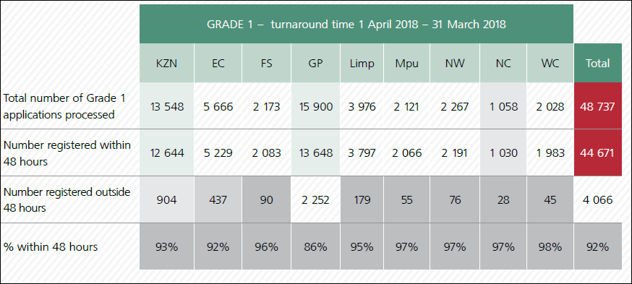
Registration Processing Time, Grade 1
*95% for Grades 2 to 9 (Compliant Applications)

Slide 33
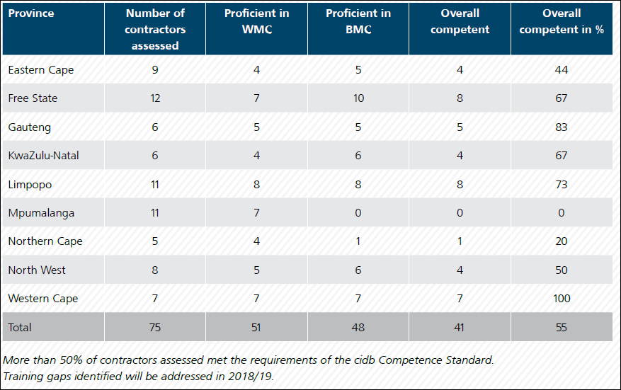
Contractor Development - Contractor Competence

Slide 34
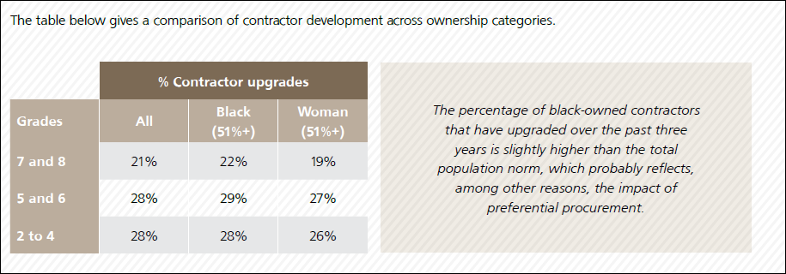
Contractor Upgrades

Slide 35
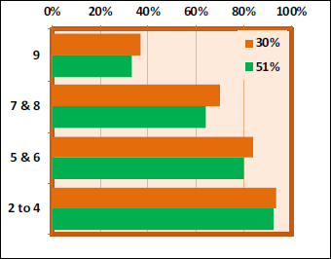
Black Ownership

Slide 36
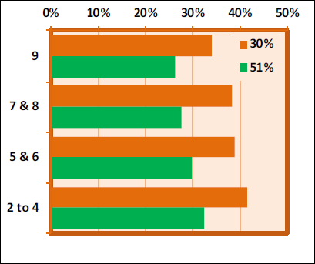
Women Ownership

Slide 37
Recovery Plan

Slide 38
Recovery Plan
 | Action | Accountable Persons | Due Date
1 | Review incomplete 2017/18 performance targets and re-plan for 2018/19 | COO | end-May 2018
2 | Undertake a risk assessment of all 2018/19 performance targets | COO | end-May 2018
3 | Drive a value system of accountability for targets in the cidb | CEO | on-going
4 | Performance management workshops and the cidb 2018/19 performance targets | CEO | mid-June 2018
5 | Monthly monitoring, reporting and management of corrective actions within areas of responsibilities | CEO | 1 May 2018 ongoing
6 | Monthly monitoring, reporting and management of corrective actions at Exco | COO | 1 May 2018 ongoing
7 | Performance assessments of Exco and Senior Managers must, where applicable, reflect any failure to achieve performance targets | CEO | March and September 2018
8 | Finalise the Organisational Redesign | Board | end- July 2018
Notes 1: SCG: Strategic & Corporate Governance

Slide 39
Audit Outcomes

Slide 40
Audit Outcomes matters
Unqualified audit opinion was obtained from AG with other matters raised on :
Key Findings | Corrective Action Plan
Irregular expenditure incurred within financial year (R 413 746) | Motivation for condonation been drafted for NT
Vacancies of key positions i.e. CEO, COO and CFO | The Board has completed interviews for CEO’s position. CFO interviews underway. O.D. finalization pending.
Inaccuracy of annual performance reporting | Most of the errors of the POE were corrected in engagement with A.G., before conclusion of audit.
One Supplier did not declare their employment in state | To assess detection systems available as there is a lack of detection controls to identify suppliers who have not correctly declared their work status in SBD forms.

Slide 41
Governance

Slide 42
Governance
There are 224 positions in the old Organisational structure , 171 positions are filled. Process to fill vacant positions has been suspended until the OD is finalised.
The proposed new structure has been tabled to cidb Human Resource Committee on 17 September 2018 and will be tabled to Board on 25 October 2018.
Misconduct and Disciplinary Actions
Final Written Warning: 1
CCMA Resolved Cases: 3
Labour Court Resolved Case: 1

Slide 43
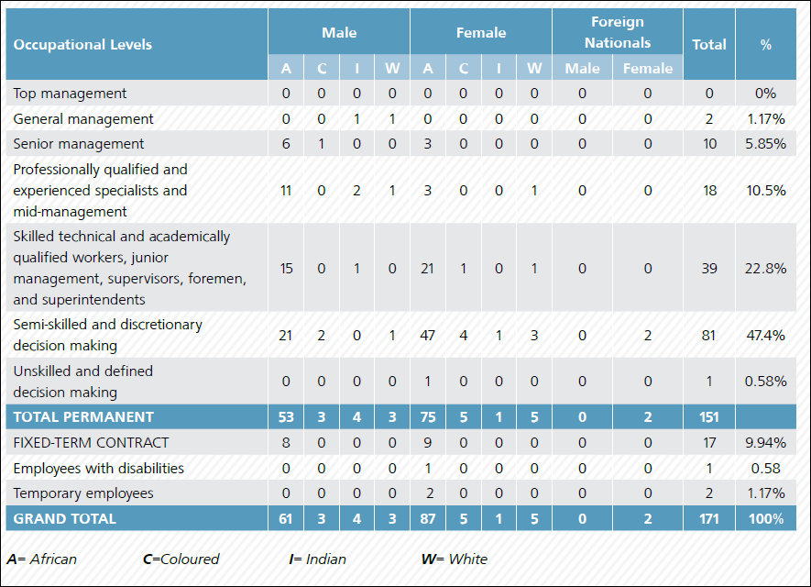
Employment Equity

Slide 44
Finance Report

Slide 45
Annual Report; Period Ending March 2018
 | Actual YTD | Budget YTD | Variance %
INCOME
Registers | 87 761 630 | 85 553 000 | 2 208 630
Transfer DPW | 74 984 000 | 74 984 000
Interest | 14 666 268 | 7 940 000 | 6 726 268
Sundry | 103 904
 | 177 515 806 | 168 477 000 | 9 038 802
EXPENDITURE
Administrative Expenses | 44 972 505 | 56 727 000 | 11 754 495
Capital Expenses | 215 628 | 4 500 000 | 4 284 373
Personnel Expenses | 78 257 000 | 89 500 000 | 11 242 500
Professional & Special Services | 18 874 903 | 17 750 000 | -1 123 903
 | 142 320 536 | 168 477 000 | 26 156 464
SURPLUS / (DEFICIT) | 35 195 266 |  | 35 195 266

Slide 46
Thank You

