Slide 1
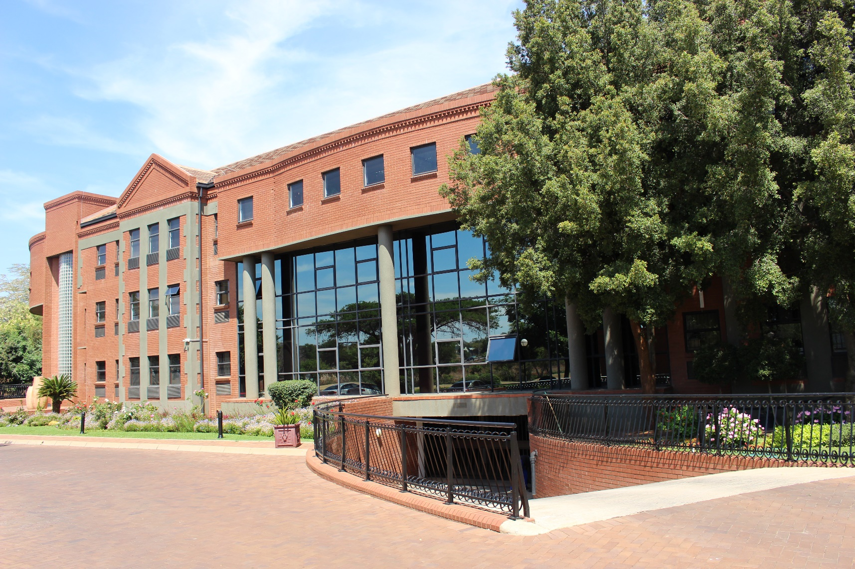
Annual Report of the Council on Higher Education (CHE) for the Year 2017/18
Presentation to the Parliamentary Portfolio Committee on Higher Education and Training
10 October 2018

Slide 2
Outline of the Presentation
Part 1: About the CHE
Vision & Values
Service Delivery Environment
AGSA Audit Process & Outcome
Reflections on the Past Year
Key Challenges

Slide 3
Part 2: Performance Highlights
The Performance Environment
Performance Summary Statistics
Performance Overview
Main outputs per programme
Part 3: Financial Performance
Analysis of Statement of Financial Position
Reasons for Variances on the Budget & Actual Expenditure
Ten Top Cost Drivers & their Percentage Contribution …….
Report of the AGSA

Slide 4
Part 1 About the CHE
Chairperson
Prof N.Themba Mosia

Slide 5
Vision of the CHE
To be a dynamic organisation contributing to a transformed, equitable & quality higher education & training system in South Africa

Slide 6
Organisational Values
In pursuit of its vision & mission the CHE is committed to & guided by the following values:
Social justice
Quality
Integrity
Accountability

Slide 7
Service Delivery Environment
The CHE serves the entire higher education system
The services rendered include advice to the Minister, external quality assurance, quality promotion, research, monitoring & publications in higher education, conferences & workshops, networks & other knowledge services
The demand for CHE services has grown exponentially due to the increase in the number of universities & private higher education institutions, & the incorporation of the higher education sector into the broader PSET system

Slide 8
AGSA Audit Process & Outcome
The audit was conducted by the auditors from the Office of the Auditor General of SA (AGSA)
It covered financial statements, reported performance information, & compliance with relevant legislation
Process:
Engagement letter outlining scope, roles & responsibilities was received from the AG
Information was requested
Requested information was provided
Provided information was tested by the auditors

Slide 9
e) Auditors also undertook on-site verification
f) Explanations were provided to the auditors for queries raised
g) Provisional report was compiled & discussed with management
h) Final management report was issued to Council
Outcome of the audit: clean audit, which is a step higher than the unqualified audit outcome of the previous year

Slide 12
Reflections on the Past Year
The year saw the higher education landscape regain some degree of normality following the turmoil of the 2016 academic year
A giant step was taken towards addressing the imperative of social justice by declaring that students from poor & working class families would be funded on a phased-in full cost by the State
NSFAS’ implementation challenges, especially on accommodation & meal disbursements, remained a major concern

Slide 13
Key Challenges
The year started with a shortfall of R12.5 million in the operational budget which meant that some activities & projects outlined in the APP had to be curtailed or cancelled
The funds to off-set the short-fall were made available only 3 months before the end of the financial year, which was too late to execute in full the planned activities & projects
The Articulation Policy published by the DHET in 2017 increased the mandate of the CHE substantially without a concomitant increase in funding

Slide 14
There were 3 long-drawn out court cases flowing from negative consequences for providers of poor quality programmes. They challenged the decisions – without success. In two instances, cost orders were awarded against a provider and a pressure group
The CHE continued to find it difficult to attract & retain appropriately skilled professionals in a very competitive market in the higher education sector
Staff retention is becoming an increasing problem

Slide 15
CHE Cares: CSR Project Funded by Staff Contributions

Slide 16
Part 2 Performance Highlights
Chief Executive Officer
Prof Narend Baijnath

Slide 17
The Performance Environment
The performance environments consists of 4 operational components referred to as programmes
Each programme focuses on activities & projects that seek to advance the realisation of a particular strategic goal
Each programme has a number of sub-programmes, each of which is responsible for delivery on a suite of strategic objectives
An outline of the programmes & sub-programmes follows

Slide 18
Programme 1: Institutional Quality Assurance
Advances Strategic Goal 1: The CHE is a credible, efficient quality assurer in higher education, with processes developed & implemented to inform, assure & promote quality
Comprises 3 sub-programmes:
Assessment of HEIs QA Systems (Institutional Audits)
Accreditation
Quality Enhancement

Slide 19
Programme 2: Qualifications Management & Programme Reviews
Advances Strategic Goal 2: The CHE is a well- established Quality Council promoting the goals of the NQF in the context of the PSET Sector
Comprises 3 sub-programmes:
Management of the HEQSF
Development of Qualification Standards
National Reviews

Slide 20
Programme 3: Research, Monitoring & Advice
Advances Strategic Goal 3: The CHE is a recognised centre for information, policy analysis & advice on higher education that informs & influences the public dialogues for the transformation of the higher education system
Comprises 3 sub-programmes:
Research
Monitoring
Advice

Slide 21
Programme 4: Administration & Support
Advances Strategic Goal 4: The CHE strives to be an effective, sustainable & dynamic organisation with systems, processes & capacity/resources that enable it to discharge its mission & legal mandate optimally
Comprises 5 sub-programmes:
Information Communication & Technology
Human Resource Management
Finance & Supply Chain Management
Office of the Chief Executive Officer
Quality Assurance & Promotion Coordination

Slide 22
2017/18 Performance Summary Statistics
Programme | No. APP Targets | No. Targets Achieved | % Target Achieved
Institutional Quality Assurance | 08 | 04 | 50.0%
Qualification Management & Programme Reviews | 14 | 04 | 28.6%
Research, Monitoring & Advice | 05 | 03 | 60.0%
Administration & Support | 13 | 10 | 76.9%
Total for the organisation | 40 | 21 | 52.5%

Slide 23
Performance Overview
The performance of the organisation was negatively affected by the R12.5 million short-fall in operational budget because a significant proportion of activities & projects planned for the year had to be cancelled or placed on hold
Funds to cover the shortfall were received 3 months to the end of the financial year, & thus it was not possible to execute fully the activities & projects that had been placed on hold at the beginning of the year to the point of final deliverables [A heavy peer dependence for its activities necessitates fitting in with availability of peers for a large part of QA and research related activities

Slide 24
Most of the activities & projects that had been placed on hold at the beginning of the year were in the Qualification Management & Programme Reviews
These activities & projects have an intensive stakeholder engagement component which could not be undertaken without funding
The result is that only 28.6% of the targets in the Qualification Management and Programme Reviews were met as reflected in the Table above

Slide 25
This brought down the overall organisation total percentage of targets achieved to 52.5% as reflected in Table above
Capacity constraints constitute another major challenge that also affected performance negatively, particularly in the Institutional Quality Assurance Programme, & also in the Research, Monitoring & Advice Programme
The twin factors of funding & capacity have to be addressed to ensure that the organisation performs optimally going forward

Slide 26
Main Outputs: Institutional QA Programme
Report of the special audit of the University of Zululand
Conclusion & closure of institutional audit for the Water Sisulu University
660 out of 725 (85%) educational programmes submitted by HEIs for accreditation were processed & adjudicated on by the HEQC
Synthesis Report for Phase 1 of the Quality Enhancement Project
24 Institutional Reports of Phase 2 of the Quality Enhancement Project

Slide 27
Main Outputs: Qualification Management & Programme Review
2 uploads of student achievement data for private HEIs onto the National Learner Records Database (NLRD)
Draft qualification standard for doctoral studies completed, approved by the HEQC & released for stakeholder consultation
4th iteration of the draft qualification standard for Library Sciences completed
National Report on the LLB Review completed, approved by the HEQC & released

Slide 28
Main Outputs: Research, Monitoring & Advice
Publication of Kagisano 11 on ‘Constituting Higher Education’
Publication of Vitalstats 2015, & VitalStats 2016
Online publication of 5 issues of monitoring briefs entitled BrieflySpeaking
Advice on the proposed Policy on the Minimum Admission Requirements for Entry into Higher Education Institutions’ Programmes Requiring a National Senior Certificate for Adults (NASCA)
Comments on various DHET draft policy documents

Slide 29
Main Outputs: Administration & Support
Clean Audit Report (Auditor-General SA)
Regional Workshop on Quality Assurance in Higher Education for Southern Africa, organised with financial assistance from the German Academic Exchange Services (DAAD)
International colloquium on a framework for interaction, coordination & collaboration in PSET, organised jointly with the DHET & the EU Dialogue Facility Programme
Hosting of delegations from QA Bodies in Mozambique, Botswana & Oman

Slide 30
2017 NQF Impact Study on patterns & trends of student movement between public universities & private HEIs, coordinated by SAQA
Consultative workshops for public HEIs, & another for private HEIs, on proposals for a new approach to QA
Publication of 3 issues of Quality Matters, the CHE’s electronic newsletter

Slide 31
Consultative Workshop in Progress: Public Universities

Slide 32
Consultative Workshop in Progress: Private HEIs

Slide 33
Part 3 Financial Performance
Chief Financial Officer
Mr Thulaganyo Mothusi

Slide 34
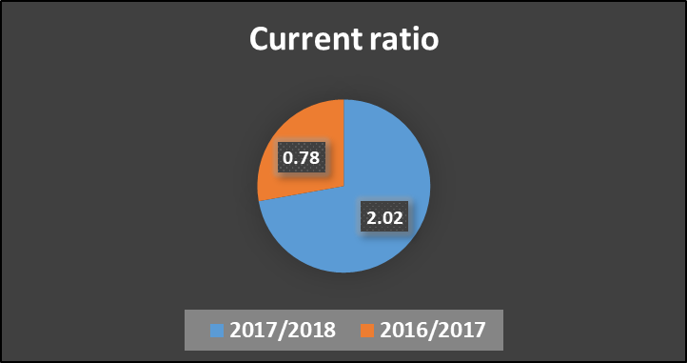
Analysis of the Statement Of Financial Position As At 31st March 2018
Liquidity
The fiscal year 2017/2018 current ratio is higher than the prior fiscal year 2016/2017. This implies that CHE is able to satisfy its short-term obligations as they become due.
The graph below depicts the current ratio.

Slide 35
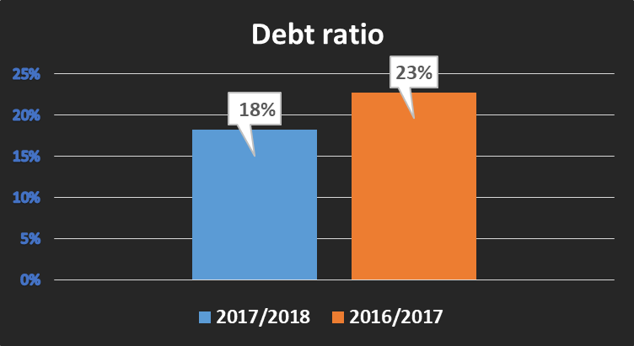
Analysis of the Statement of Financial Position as at 31st March 2018 Cont..
Leverage ratio
The fiscal year 2017/2018 debt ratio is lower than the prior fiscal year 2016/2017. This reflects an improvement in using its creditors to finance its total assets. The graph below depicts the debt ratio.

Slide 36
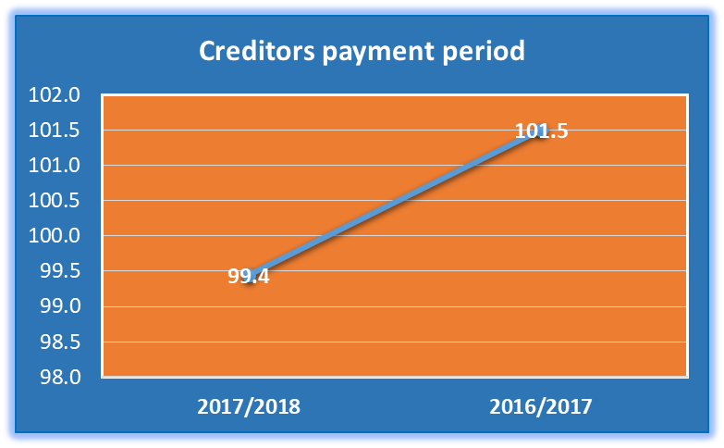
Analysis of the Statement of Financial Position as at 31st March 2018 cont..
Going Concern
The fiscal year 2017/2018 creditors payment period is lower than the prior fiscal year 2016/2017. This reflects an improvement in paying creditors within 30 days [monthly] as prescribed in PFMA. The graph below depicts the creditors payment days for the year.

Slide 37
Analysis of the Statement of Financial Performance for the Year Ended 31st March 2018
REVENUE
The revenue for the fiscal year 2017/2018 was higher by R20 234 293 compared to the prior fiscal year 2016/2017. This was as a result of a slightly higher budget allocation on the government grant and also a conditional grant for conducting the UniZulu special audit.
EXPENDITURE
The expenditure for the fiscal year 2017/2018 was higher by R69 004.00 compared to the prior fiscal year 2016/2017. This was due to more spending on employee related costs, & repairs and maintenance.
SURPLUS
A surplus of R11 202 485 was realised for the fiscal year 2017/2018 because total revenue was more than total expenditure, attributable to the covering of the budget shortfall late in the third quarter as indicated.

Slide 38
Reasons for Variances on the Budget and Actual Expenditure
Revenue
Revenue from exchange transactions was higher than budget due to more applications received from private institutions for accreditation.
Interest received from the bank is more than the budget as a result of additional surplus funds invested in the short-term call accounts during the year.
A conditional grant of R673 600.00 from DHET to conduct a special audit for UniZulu and not fully spent during the year. The R191 264.00 unspent was recorded as contingent liabilities.
Additional funding of R12.5 million received in December 2017 from National Skills Fund to address the 2017/2018 budget shortfall. The R10 million unspent was recorded as contingent liabilities.

Slide 39
Expenditure
Employee costs underspent due to vacancies, and there were some unforeseen delays to fill the posts during the year under review.
Depreciation and amortisation including loss on disposal of assets not budgeted for because they are non-cash items and therefore not considered for budgeting purposes.
Repairs and maintenance underspent as a result of less repairs and maintenance required for the building.
General expenses underspent due to the adjustment of the budget in December 2017 when the CHE received additional funding for the year. The CHE could not spend the funds in the remaining period.

Slide 40
Ten Top Cost Drivers and their Percentage Contributions to the General Expenses
Description of spending item | 2017/2018 Contribution Percentage | 2016/2017 Contribution Percentage
Peer academics | 16 | 24
Legal fees | 25 | 17
Travel costs local | 11 | 16
Outsourced services | 7 | 7
Consultancy services | 6 | 5
Auditors remuneration | 5 | 5
Remuneration of Council and Committee members | 5 | 4
IT expenses | 5 | 4
Printing and Stationery | 5 | 3
Recruitment costs | 4 | 2

Slide 41
Ten Top Cost Drivers and their Percentage Contributions of the General Expenses for the Year 2017/2018
Outsourced services is only for SAQA HEQCIS online system contract.
Consultancy services include payment of VIP Payroll & HR system consultancy and also payment to governance subcommittees such as Accreditation; Human Resource Recruitment Committee etc. Payment of VIP Payroll & HR system consultancy contributed 4% while payment to governance subcommittees members contributed 96% of the consultancy service spending.
IT expenses include licence fees, computer consumables, internet subscriptions, contract on support for HEQC online system and contract on support maintenance. The contributions towards IT spending are as follows: Licence fees 42%, Computer consumables 2%, Internet subscriptions 5%, Support for HEQC online system 27% and Support maintenance 24%.

Slide 42
Report of the Auditor General South Africa (AGSA)
Audit Opinion
Clean audit for the fiscal year 2017/2018 and unqualified for the fiscal year 2016/2017.
The audited financial statements for the fiscal year 2017/2018 were free from material misstatements.
Remedial Action
No remedial actions required because all the audit findings on the next slide were corrected and agreed with AGSA before the end of the audit in July 2018.

Slide 43
Report of the Auditor General of South Africa (AGSA) Continues
AUDIT FINDINGS | 2017/2018 | 2016/2017 | REMARKS
Other important matters
Incorrect classification of assets | Applicable | Not applicable | Non recurring
The inconsistencies between the accounting policies and the fixed assets register | Applicable | Not applicable | Non recurring
Misstated disclosure notes | Applicable | Not applicable | Non recurring
Differences identified between the figures presented on the face of the statement of cash flow and the auditors’ recalculation | Applicable | Not applicable | Non recurring
Inconsistency between the reported planned target (APR) and the planned target (APP) | Applicable | Applicable | Recurring

Slide 44
AGSA Clean Audit Certificate & Trophy

Slide 45
Congratulations
on achieving an unqualified opinion with no material findings
We encourage you to maintain sound control environment as well as good governance practices.
Congratulations again from AGSA

Slide 46
Recommendations
Portfolio Committee Members requested to note the Annual Report and its Annual Financial Statements for the year 2017/2018.

Slide 47
Thank you

