Slide 1
FP&M SETA
Presentation to Parliament SA –
AGSA Audit Outcome – 2017/18

Slide 2
Content
1. Vision & Mission
2. Organisational Values & Scope
3. Overall Organisational Performance
4. Learning Programmes Implementation
5.Audit Outcomes
6. Controls
7. Questions and Answers

Slide 3
Vision & Mission
Notes:
Vision –To be a credible and effective skills development partner to produce a highly-skilled world-class workforce
Mission –To facilitate an efficient and effective skills development process through a range of partnerships to contribute to sector competitiveness and economic growth.

Slide 4
Organisational Values
ORGANISATIONAL VALUES

Slide 5
Scope of the FP&M SETA
Clothing
Footwear
Forestry
Furniture
General Goods
Leather
Packaging
Print Media
Printing
Publishing
Pulp And Paper
Textiles
Wood Products

Slide 6
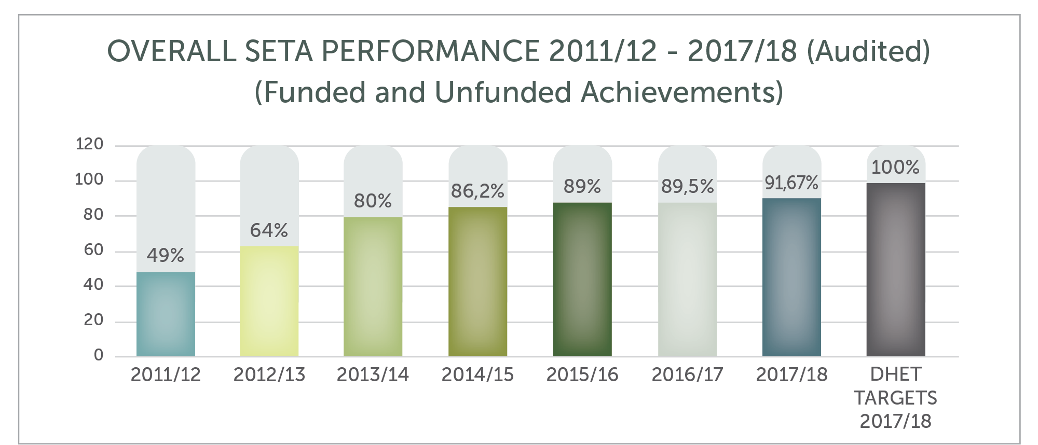
OVERALL FP&M SETA PERFORMANCE
Overall FP&M SETA Performance is on an increasingly upward trajectory since its establishment in 2011.
The SETA achieved 44 out of a total of 48 performance indicators and targets, representing an achievement of 91.67% against the FP&M SETA APP.
100% against DHET SLA Targets

Slide 7
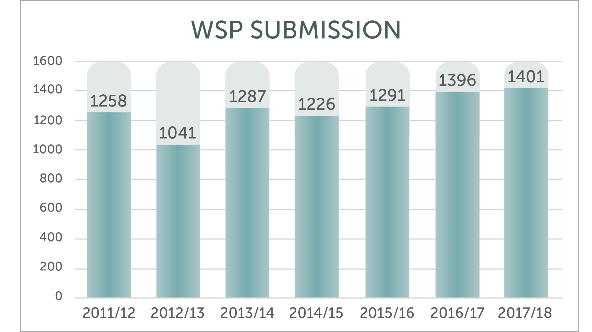
WSP Submissions

Slide 8
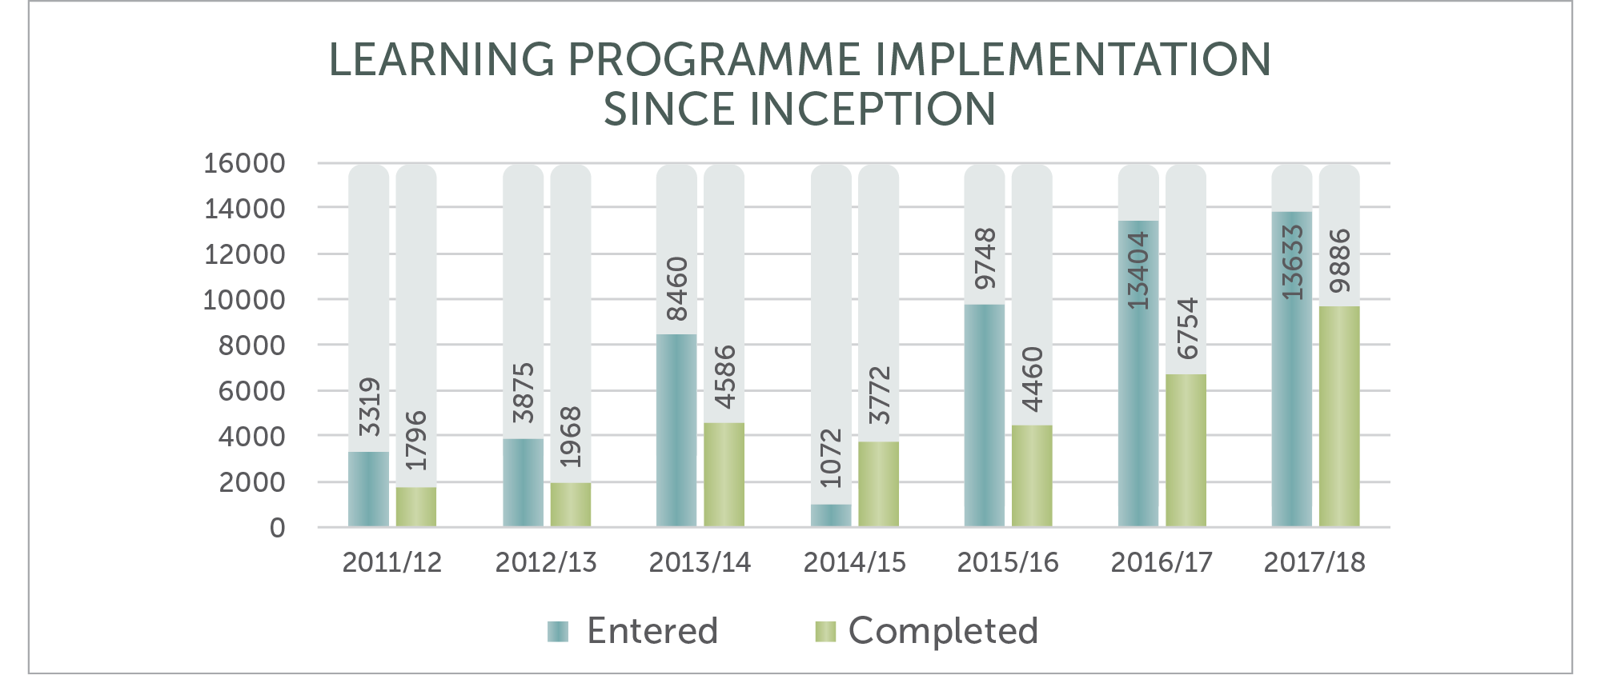
Learning Programmes Implementation

Slide 9
Learners in the FP&M System
Since Inception of the FP&M SETA in 2011
Total number of learners entered:
53,511 Learners 62,08 %
Total number of learners certificated:
33,222 Learners
TThroughput Rate:
hroughput Rate:
Throughput Rate: 62,08 %

Slide 10
Learner Profile
More Than 95% Black Learners
More Than 50% Female Learners
More Than 85% Of Unemployed Learners Are Younger Than 35
250 Disabled learners trained in 2017/18

Slide 11
Audit Outcomes
2013 - 2014
45 Findings - Unqualified
2014 - 2015
17 Findings - Unqualified
2015 - 2016
8 Findings Clean Unqualified Audit / Clean Administration
2016-2017
Clean Unqualified Audit / Clean Administration
2017-18
4 Findings
Unqualified Audit

Slide 12
AGSA AUDIT FINDING 2017 /2018
Findings of the Auditor General was based on the following:
The Broad Based Black Economic Empowerment ("BBB-EE") points for suppliers were incorrectly allocated and incorrect suppliers were awarded which results in irregular expenditure and which affects the effectiveness of the internal controls; and
AGSA made a finding that FP&M SETA awarded BBB-EE points were a supplier did not submit a BBB-EE certificate.

Slide 13
Comments to be noted concerning the FP&M SETA Procurement process
The FP&M SETA operates a fair, functional, transparent, equitable, competitive and cost-effective procurement process.
A systems glitch caused an anomaly, which impacted on the procurement process.
In line with Legislation, the FP&M SETA reads supplier BEE level information from National Treasury Central Supplier Database (CSD) and automatically allocate BEE points based on their BEE level as contained on CSD.

Slide 14
SCM CONTROLS – RELATING TO THE FINDING
The FP&M SETA has satisfied its obligation to create and maintain an appropriate procurement system as envisaged in the PFMA and related procurement legislation;
The system is managed, monitored and regularly updated.
The FP&M seta is currently performing manual calculations of BEE points. We are requesting suppliers to submit copies of their current BEE certificates or sworn affidavits when they respond to our RFP’s. We use these to calculate points and check whether the system is allocating points correctly. In instances where CSD information is outdated then we advise supplier to update their CSD records. This is in line with National Treasury Regulations.

