Slide 1
COUNCILLOR REMUNERATION, BENEFITS AND ALLOWANCES 3 OCTOBER 2018

Slide 2
Presentation Outline
Introduction, Legislative Framework and Prescribed Processes
Upper Limits Notice & Implementation
2.1 Grading
2.2 Total Remuneration Package
2.3 Motor Vehicle Allowance
2.4 Pension Fund & Medical Aid
2.5 Special Risk Insurance
2.6 Tools of Trade
2.7 Other Additional Benefits

Slide 3
Introduction
In terms of relevant legislation (Public Office bearers Act, Income Tax Act) the following are recognised as Public Office Bearers:-
President of Republic;
Cabinet Ministers;
Premiers and MECs;
Members of Parliament and Provincial Legislatures;
Councillors;
Traditional Leaders;
Judges and Magistrates.

Slide 4
Legislative Framework
Constitution of the RSA
Section 219(1) of the Constitution stipulates that an Act of Parliament must establish a framework for determining the upper limits of salaries, allowances and benefits of POBs.
Relevant National Legislation
In an attempt to deal with the remuneration of Public Office Bearers as envisaged in the constitution, parliament enacted:-
Independent Commission for the Remuneration of Public Office–Bearers Act of 1997, that establishes the Commission, which is to make recommendations concerning the salaries, allowances and benefits of public office-bearers; and
the Remuneration of Public Office Bearers Act No.20 of 1998, which provides the framework for remuneration of public office-bearers.

Slide 5
Legislative Framework
Municipal Finance Management Act of 2003 (MFMA)
Section 167 has a major impact on the remuneration of Councillors.
- It stipulates that political office-bearers may only be remunerated within the framework of the Remuneration of Public Office Bearers Act and Section 219 (4) of the Constitution.
- It declares that any payment, whether in cash or kind, made outside this framework would be regarded as an irregular expense.

Slide 6
PROCESS TO DETERMINE SALARIES, BENEFITS AND ALLOWANCES FOR PUBLIC OFFICE BEARERS
NAT & PROV
Independent Commission Promulgates Recommendation
President Determines through promulgation in Govt Gazette
Implementation
Vis-à-vis
Independent Commission Promulgates Recommendation
Minister issue draft followed by Final Notice in Govt Gazette
1.Council
2.MEC Concurrency
3. Implementation
LOCAL
Process for determination of salaries, benefits and allowances of Councillors curiously differs from other public office bearers.

Slide 7
KEY COMPONENTS OF THE UPPER LIMITS NOTICE 15 Dec 2017
Upper Limits published on 15 Dec 2017 deals with:-
Grading of municipalities for purpose of remuneration scales;
Upper Limits of total remuneration packages of full-time and part-time councillors;
Upper limits of remuneration or allowances in respect of appointed councillors (district councillors);
Upper limits of cellphone allowances;
Upper Limits of pension fund and medical aid benefits;
Sitting allowances for SALGA NEC/PEC members;
Tools of Trade: set of tools of trade for councillors;
Risk Benefits: risk insurance extended to councillors; and
Capacity Building initiatives.

Slide 8
IMPLEMENTATION:GRADING
Number of Total Population in Area?
Municipal Income for previous financial year?
GRADE of Municipality
(1 – 6)
APPLICATION
Population figures Community Survey 2016
=
points
Income 16/17 financial statements
=
points
Grade
NOTE: Grading for Councillor Remuneration NOT the same as
Grading for Municipal Employees’ Remuneration

Slide 9
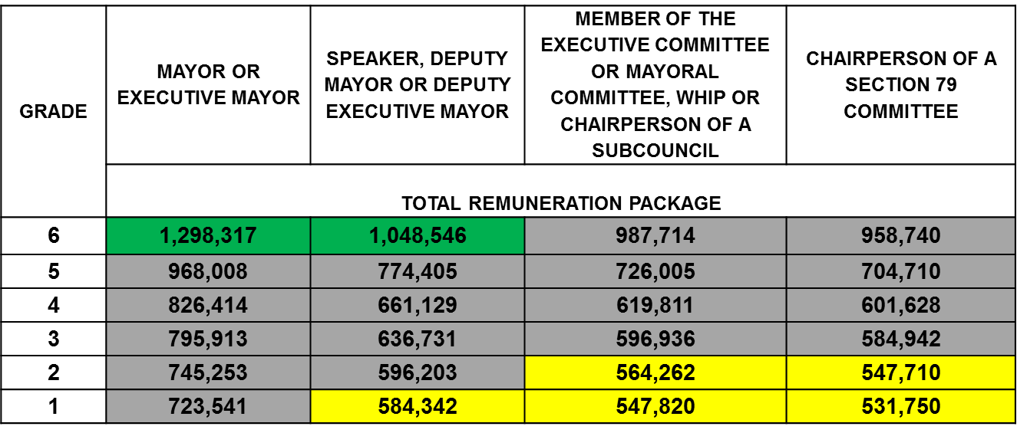
Government Gazette No. 41335 of 15 December 2017
TOTAL REMUNERATION PACKAGE
The upper limits of the annual total remuneration package of a full–time councillor for 2017/18 financial year are as follows:

Slide 10
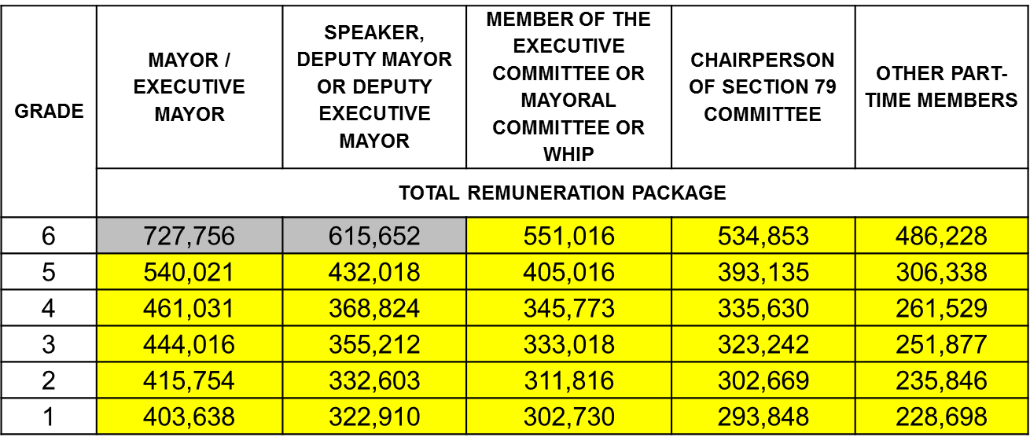
Government Gazette No. 41335 of 15 December 2017
TOTAL REMUNERATION PACKAGE
The upper limits of the annual total remuneration package of a part–time councillor for 2017/18 financial year are as follows:

Slide 11
TOTAL REMUNERATION PACKAGE
- Motor Vehicle Allowance;
- housing;
- pension fund;
medical aid;
- basic salary
TOTAL REMUNERATION PACKAGE
Additional to Total Remuneration Package:-
Risk Insurance
Travel reimbursement for all official business travel
Out of pocket expense and
Cell phone allowances

Slide 12
DM COUNCIL
COMPOSITION
Appointed Councillors
Proportional Representative Councillors
District Municipal Councillors
REMUNERATION
- LM, total rem package
DM, difference or sitting allowance + trav
District Municipality

Slide 13
Pension Fund for Councillors
Pension Fund contribution is included in the total package and calculated on the basic salary;
Councillors have a discretion to participate in a Pension Fund Scheme and if they do, may participate in any fund of choice;
A large number of councillors subscribe to the Municipal Councillors Pension Fund (MCPF);
Participation in MCPF open to all Municipalities with eligibility for membership restricted to Councillors - CONTRIBUTION : 28.75% of basic salary;
Contributions payable are deducted from the total remuneration package by the municipality concerned and paid to the Fund by that Municipality on the members’ behalf.

Slide 14
Medical Aid for Councillors
Medical Aid contribution is included in the total remuneration package;
Councillors have discretion to participate in a medical scheme and if they do, may subscribe to any medical Scheme of choice;
A majority of councillors do NOT have medical aid – largely as the medical aid contribution will holistically come from the total remuneration package;
Exception: May NOT include medical aid, when already subscribing to a medical aid scheme in full time employment outside of being a councillor.

Slide 15
SALGA Recommendations
It is recommended that, to create uniformity amongst all public office bearers:-
the compulsory participation in pension funds and medical aids should be extended to councillors;
Consideration be given to a single Pension Fund and a single Medical Aid scheme for all Public Office Bearers (national, provincial and local government);
funding of these benefits, at a similar rate as public office bearers at national and provincial level, should be extended to councillors and funded by the National Fiscus.

Slide 16
THANK YOU CONTACT DETAILS:- LANCE JOEL 012 3698000 0829083335 ljoel@salga.org.za

