Slide 1
KHAYELITSHA HOSPITAL PRESENTATION TO STANDING COMMITTEE ON COMMUNITY DEVELOPMENT

Slide 2
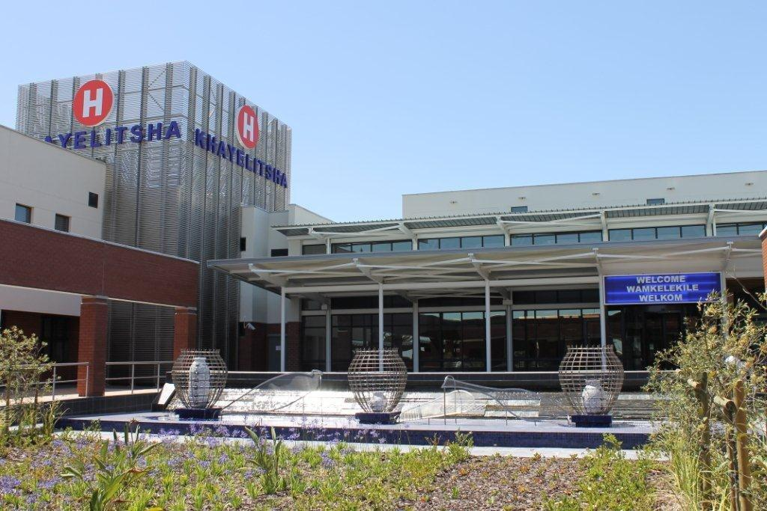
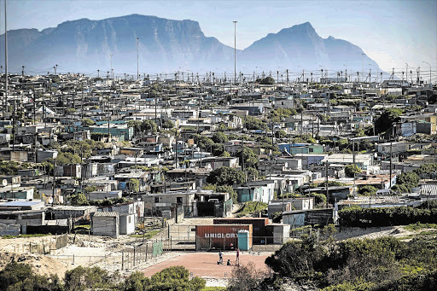
Outline of presentation
Population served by the Hospital
Burden of Disease
Clinical services and outcomes
Improvement plan

Slide 3
Population served by Khayelitsha Hospital

Slide 4
Official population figures
From Census 2011:
Population: 391 749
Households: 118 809
Average household size: 3.3
62% of labour force (15-64y) employed
74% households monthly income < R3200.
These numbers are hotly disputed in some circles….
Age pyramid

Slide 5
Burden of Disease
Khayelitsha and its population are currently characterised by:
A high proportion of households poor and dependant on public health services
A heavy “quadruple burden” of disease
communicable diseases (HIV and TB)
non-communicable diseases (Diabetes / HPT / Mental Illness, etc.)
diseases affecting pregnant women, newborns and children
injuries (vehicle accidents, violence).

Slide 6
General information: Hospital catchment area and population
Mfuleni CHC
Nolungile CDC
Town Two Clinic
Site B / Khayelitsha CHC
Matthew Goniwe
Clinic
Zakhele Clinic
Luvuyo Clinic
KuyasaClinic
Mayenzeke Clinic
Michael Maphungwana CHC
Khayelitsha Hospital

Slide 7
Services provided by Khayelitsha Hospital

Slide 8
Hospital: Package of services
Khayelitsha Hospital is a 340-bed hospital
Opened in 2012 as a primarily District level facility.
Due to pressures within the Community and limited capacity at the referral hospitals to absorb the patient load, the hospital has changed into a Large Metro District Hospital with a primarily Regional Package of Care.
Other hospitals in this situation include Mitchells Plain Hospital, Karl Bremer Hospital and Victoria Hospital.
It receives referrals from 7 City Health clinics and 4 MDHS health centres (1 shared) as well as NGO’s and private health care providers.
It refers patients primarily to Tygerberg Hospital (25km) and Lentegeur Psychiatric Hospital (8.5km)
Notes:
Mayenzeke, Matthew Goniwe, Zakhele, Kuyasa, Town 2, Nolungile,

Slide 9
Hospital: package of services offered
Emergency Centre
Forensics / “Thuthuzela” Unit
Internal Medicine
General Surgery and Orthopaedics
Paediatrics and Neonatology
Obstetrics and Gynaecology
Mental Health Service
Clinical Psychology
Radiology Services (X Ray, Ultrasound and CT Scan)
Laboratory Services – NHLS
Outpatients Department
Physiotherapy, Occupational Therapy
Dietetics
Speech Therapy, Audiology
Social Services

Slide 10
Khayelitsha Hospital: 340 BEDS
Psychiatry | 60 | Obstetrics | 58
Medicine | 90 | Paediatrics | 32
Orthopaedics | 14 | Nursery | 22
Surgery | 31
Intermediate Care | 30

Slide 11
Service trends, including pressure points

Slide 12
Bed Occupancy Rate (%)

Slide 13
Average Length of Stay : Incl/Excl Psychiatry

Slide 14
Emergency Centre and Outpatient Headcounts

Slide 15
Patient Day Equivalents and Inpatient Days

Slide 16
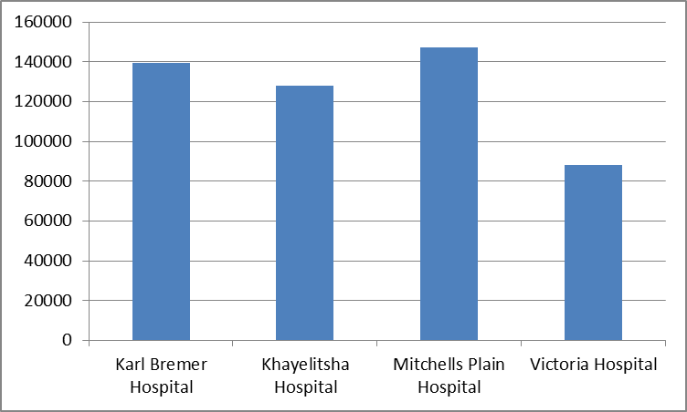
PDE vs other LMDH

Slide 17
Hospital vs LDMH vs Provincial Mortality rates

Slide 18
Hospital Service Pressures
The following service components are under pressure due to the large volume of clients accessing the facility daily:
Emergency Centre due to the high prevalence of violence and injuries.
Internal Medicine Services, due to the high prevalence of HIV and TB and Chronic Diseases Of Lifestyle.
Neonatal service due to high Obstetric numbers (> 350 deliveries per month) with high rate of prematurity.
Mental Health services, partially due to the high prevalence of substance abuse, as well as social pressures.
Theatre Pressures due to expanding Surgical / Orthopaedic and Obstetric services

Slide 19
Organisational aspects

Slide 20
Hospital Management
Ms. Grace Mashaba
Acting CEO
Mr Craig Olivier
Acting DD:Nursing
Dr Kitesh Moodley
Clinical Manager
Ms Marie Voigt
DD:Finance
Vacant
DD:Facilty Management

Slide 21
Hospital Board
Chairperson | Mr. Z Feni
Deputy Chairperson | Mr. N Ndibongo
Non-clinical Staff | Ms E van Tonder
Clinical staff | Dr. S Mukonkole
Academic Interest | Prof. D Helenberg
Municipality(Councillor) | Cllr. V Matanzima
Community rep | Ms P Mdini
Community rep | Mr A Nuko
Community rep | Mr N Tshengu
Community rep | M L Mahomba

Slide 22
Human Resource Matters
Total of 617 posts funded at the hospital (15 August 2018)
46 posts currently vacant
Shortages in specific areas (e.g Specialised nursing) reflect a National shortage

Slide 23
New appointments and EE
New Appointments :1 Jan -31 August 2018
Community Service Personnel |  |  |  |  |  | 40
Other Personnel |  |  |  |  |  | 25
Total: |  |  |  |  |  | 65
Race &Gender representivity at Khayelitsha District Hospital
Race&Gender |  |  |  |  | Total at Institution | (%)Percentage at Institution
African Female |  |  |  |  | 297 | 52%
African Male |  |  |  |  | 93 | 16%
Coloured Male |  |  |  |  | 42 | 7%
Coloured Female |  |  |  |  | 76 | 13%
White Male |  |  |  |  | 15 | 3%
White Female |  |  |  |  | 29 | 5%
Indian Female |  |  |  |  | 10 | 2%
Indian Male |  |  |  |  | 9 | 2%
Total employees at institution |  |  |  |  | 571

Slide 24
Finance
Budget 2017/18 R 330M
Expenditure 2017/2018 R 350M
Budget 2018 /2019 R373M

Slide 25
Challenges

Slide 26
CHALLENGES
Burden of disease within Khayelitsha has resulted in increased pressure on the public health facilities
High incidence of TB / HIV
Poorly controlled Chronic Diseases of Lifestyle
High Obstetric numbers with complicated deliveries
Interpersonal violence
Substance abuse – alcohol
Fragmentation of the PHC services with Provincial and CoCT sites increases the challenges of gaining control of some of the above conditions

Slide 27
CHALLENGES
Khayelitsha Community has grown significantly over the past 6 years
New informal settlements seen at the Spine roads / Endlovini and Baden Powell sites
In addition Mfuleni has been included in the drainage area of Khayelitsha hospital
All of the above has resulted in increased service pressures with patient admissions beyond ward capacity

Slide 28
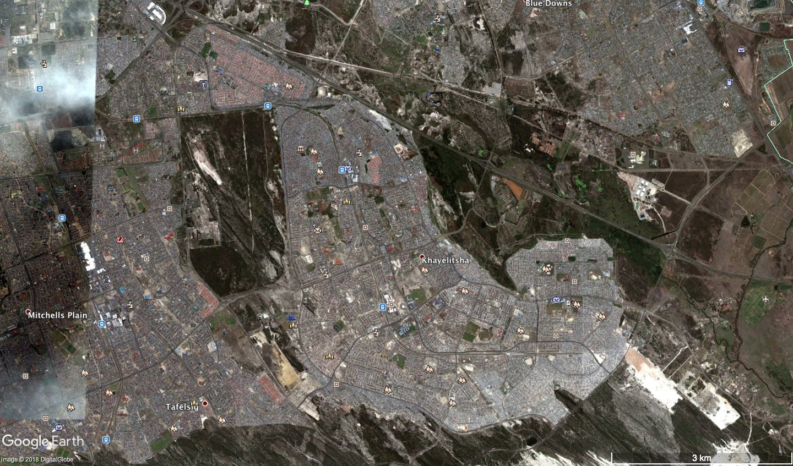
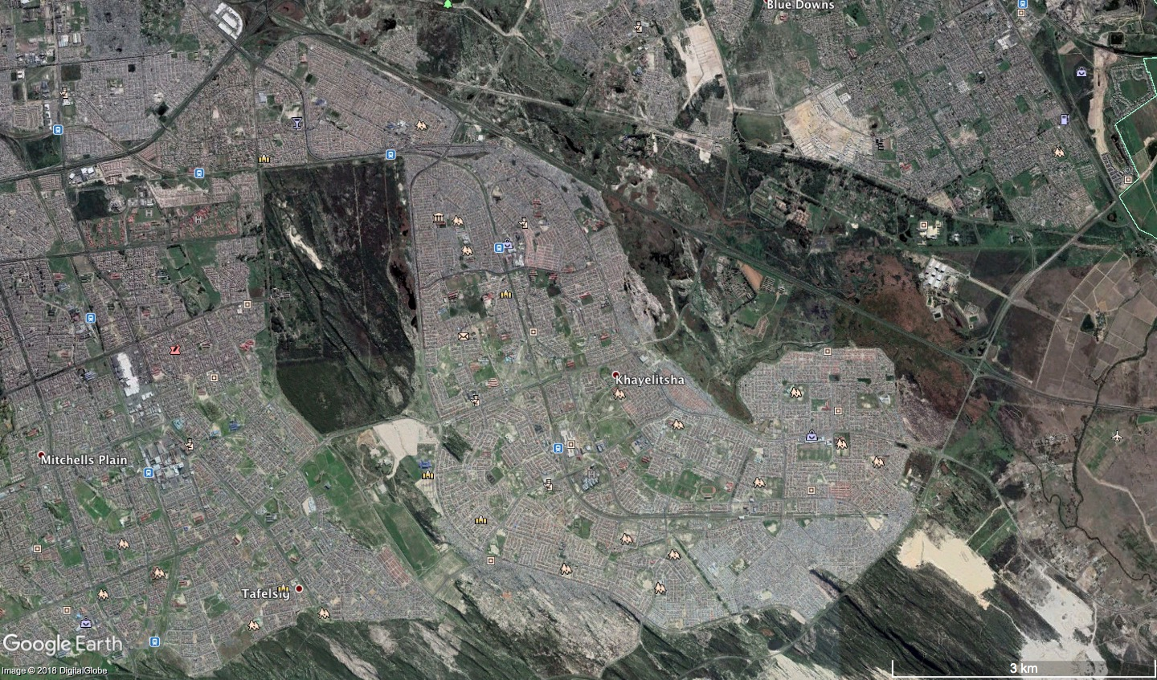
Khaya 2013
Spine Road
Baden Powell
Endlovini

Slide 29
CHALLENGES
High expectations and Increased scrutiny and pressure from political and societal organisations has resulted in high profile media coverage, especially on social media
This has lead to lowered morale of staff within the facility, with high turnover rates in some areas

Slide 30
Additional interesting facts

Slide 31
Paediatric Services
Notes:
Similar pattern during surge – most admissions for pneumonia and diarrhoea
Drop in RXH S11 admissions in 2012/13 by 25% – resources not followed – nursing, clerical

Slide 32
Obstetrics Service outcomes

Slide 33
Orthopaedic Services

Slide 34
EC Resuscitation area January to June 2018 : Total 3177

Slide 35
Crime Statistics – Khayelithsa

Slide 36
Achievements

Slide 37
ACHIEVEMENTS – SERVICE DELIVERY
Seen a total of 466000 patients seen since January 2012
Total of 1000+ compliments vs 100 complaints
Hospital pharmacy received a gold medal award in 2012 for the best functioning pharmacy in the province.
National Core Standards
78% in National DOH audit in 2012
77% in Provincial DOH internal audit in 2013
95% in Provincial DOH internal audit in 2017
100% score in MBFI accreditation

Slide 38
ACHIEVEMENTS - ACADEMIC
NURSING
SANC Accreditation for Nurse Training
Since 2012, 22 nurses have progressed from Enrolled nursing to Professional or Professional to Specialty
Nursing Leadership training : 2 OPM’s studying PGD in health management, nursing directorate initiatives.
MEDICAL
Specialist Training site for Emergency Medicine / Medicine / Obs / Paediatrics / Surgery / Orthopaedics
Completed training 2 Paediatrics / 1 Obs
Currently training 3 registrars in EM / 3 Paeds / 2 Obs / 1 Ortho / 3 Med
45 Diploma graduates – Primary Emergency Care (DiPEC) / Child Health (DCH) / Anaesthetics (DA) / HIV Management

Slide 39
Improvement Plan
Services
On Site Blood Bank (In Planning)
Mental Health Unit (In Design)
Intermediate Care Beds (October 2018)
Initiation of Eye services, with iImproved screening and treatment of
Diabetic Retinopathy
Glaucoma
Retinopathy of Prematurity
Breast Clinic
Screening and earlier diagnosis of Breast Cancer
EC congestion
Implemented a Q-marshal : assist to guide and improve communication at triage
Strengthen night nursing office: complaint management after hours
Linkages to PHC / CBS
Intermediate care

Slide 40
Conclusion:
Khayelitsha district Hospital was commissioned 5 years ago.
It was built to meet the health needs of a large community, comprising mainly poor people, mostly reliant on public health services.
The Staff, Hospital management and the board are working within the prescripts of the package of care and financial envelope to meet the community’s health needs and DOH priorities.

Slide 42
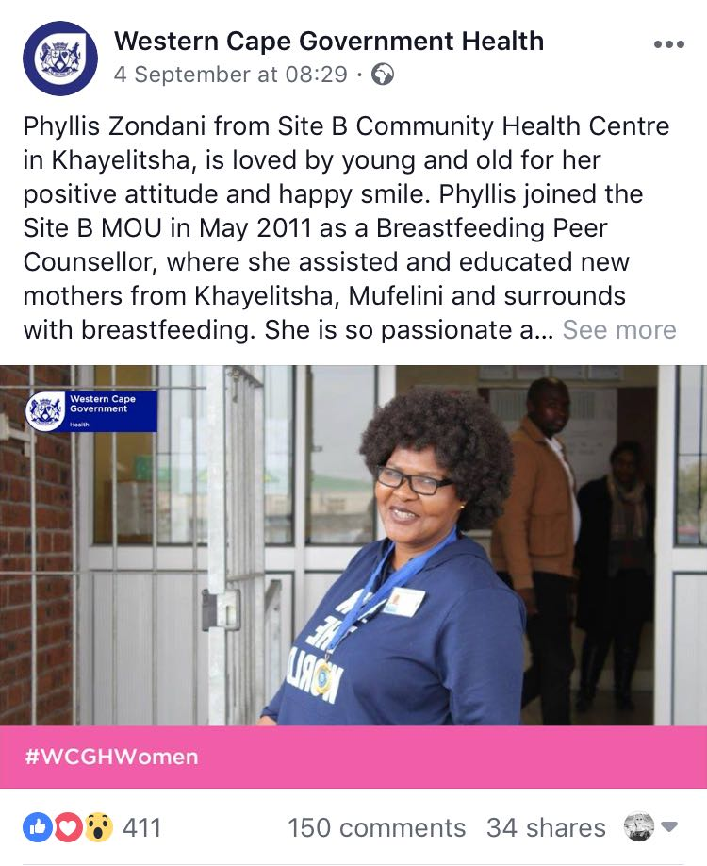
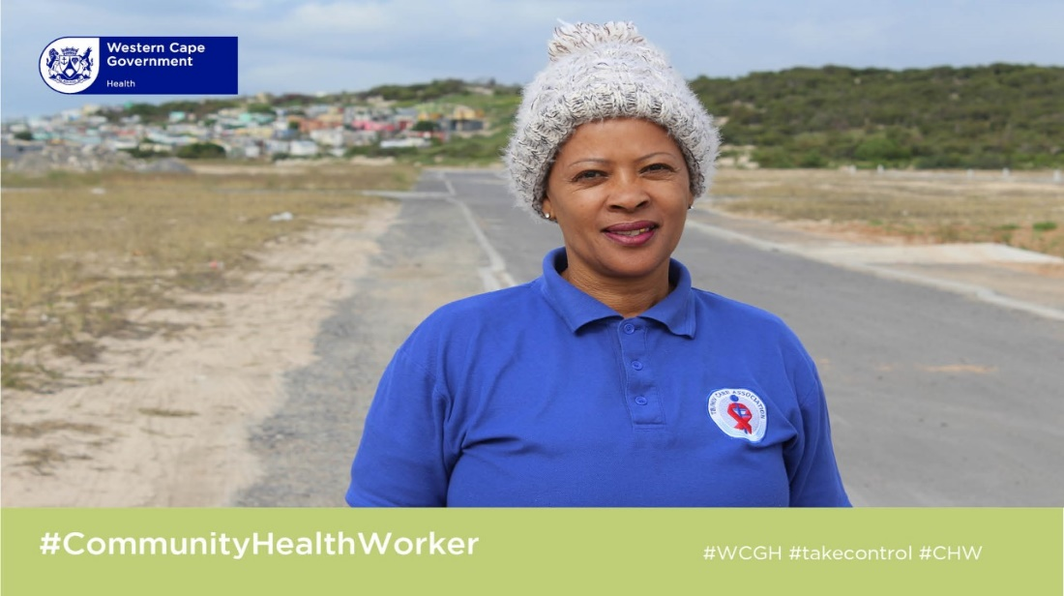
Using social media to drive health information
Features on staff and community workers and chronic clubs

Slide 43
Thank you
Thank you for availing an opportunity to Khayelitsha district hospital to do a presentation to honourable committee members.

