Slide 1
Presentation to Portfolio Committee
1
SEPTEMBER 2018
CENTRE FOR PUBLIC SERVICE INNOVATION
QUARTERLY PERFORMANCE REPORTS

Slide 2
OVERVIEW
2
Introduction
Executive Summary
Progress on 4th Quarter Targets
4th Quarter Financial Report for the 2017/18 Financial Year
Progress on 1st Quarter Targets
1st Quarter Financial Report for the 2018/19 Financial Year

Slide 3
Introduction
3
This is a report on the organisation’s progress with regards to the achievement of the 4th Quarter (1 January 2018 - 31 March 2018) on the organisation’s 2017/2018 Annual Performance Plan (APP) and the 1st Quarter of 2018/19 APP.
Both reports have been audited by the Internal Audit Unit and presented to the Audit and Risk Committee

Slide 4
4
4TH QUARTER
2017/18

Slide 5
Executive Summary
5
No of Targets | 4th Quarter Targets Achieved | 4th Quarter Targets Not Achieved
15 | 13 | 2
During the 4th Quarter period the organisation had 15 Targets, 13 (87%) of the targets were achieved and 2 targets (13%) were not achieved by 31 March 2018.

Slide 6
Progress on 4th Quarter Targets
6
Target no | Responsible unit | Target for 2017/18 as per Annual Performance Plan (APP) | 4th Quarter Target | Actual Achievement for the 4th Quarter | Deviation from planned target to Actual Achievement for the 4th Quarter | Comment/ Mechanisms to address differences in targets | Performance Rating
 | SM | Review the organisation’s Strategic Plan and develop the Annual Performance Plan and submit to the Executive Authority (for tabling in Parliament), DPSA, DPME, AGSA and the National Treasury within the required timeframes to comply with legislation, frameworks and prescripts | Final Annual Performance Plan submitted to Executive Authority for tabling in Parliament by 31 March 2018 | Final Annual Performance Plan submitted to Executive Authority for tabling in Parliament by 31 March 2018 | None | None | Achieved
2. | SM | Quarterly performance reports submitted to the Executive Authority, DPSA, DPME and the National Treasury within 30 days from the end of each quarter | 3rd quarter performance report for 2017/18 developed and submitted to Executive Authority, DPSA, DPME and the National Treasury by 30 January 2018 | 3rd quarter performance report for 2017/18 produced and submitted to Executive Authority, DPSA, DPME and the National Treasury by 30 January 2018 | None | None | Achieved

Slide 7
Progress on 4th Quarter Targets
7
Target no | Responsible unit | Target for 2017/18 as per Annual Performance Plan (APP) | 4th Quarter Target | Actual Achievement for the 4th Quarter | Deviation from planned target to Actual Achievement for the 4th Quarter | Comment/ Mechanisms to address differences in targets | Performance Rating
3. | CRM | At least two (2) CRM policies and/or strategies developed and/or reviewed and implemented, annually | Two (2) CRM policies, procedures, plans or strategies implemented | The following policies were implemented: Gifts, Donations and Sponsorships Policy Information Technology Security Policy | None | None | Achieved
4. | ITM | Quarterly ICT Corporate Governance reports Developed and submitted to EXCO for approval | Submit the 3rd Quarter report on ICT Corporate Governance to the executive management by 31 January 2018 | 3rd Quarter report on ICT Corporate Governance submitted to the executive management by 31 January 2018 | None | None | Achieved

Slide 8
Progress on 4th Quarter Targets
8
Target no | Responsible unit | Target for 2017/18 as per Annual Performance Plan (APP) | 4th Quarter Target | Actual Achievement for the 4th Quarter | Deviation from planned target to Actual Achievement for the 4th Quarter | Comment/ Mechanisms to address differences in targets | Performance Rating
5. | OCFO | Three (3) budget review documents prepared and submitted to the DPSA and the National Treasury | Submit the final ENE to DPSA and the National Treasury | The final ENE submitted to DPSA and the National Treasury | None | None | Achieved
6. | OCFO | Annual and quarterly Financial Statements, free from material misstatements, prepared and submitted to AGSA, DPSA and the National Treasury | Submit 3rd Quarter Financial Statements to AGSA, DPSA and the National Treasury by 31 January 2018 | 3rd Quarter Financial Statements Submitted to AGSA, DPSA and the National Treasury by 31 January 2018 | None | None | Achieved
7. | OCFO | 100 Percent of all undisputed invoices paid within 30 days | 100 percent of all invoices paid within 30 days on receipt of a valid invoice and reported to National Treasury within 15 days from the end of each month | 100 percent of all invoices paid within 30 days on receipt of a valid invoice and reported to National Treasury within 15 from the end of each month | None | None | Achieved

Slide 9
Progress on 4th Quarter Targets
9
Target no | Responsible unit | Target for 2017/18 as per Annual Performance Plan (APP) | 4th Quarter Target | Actual Achievement for the 4th Quarter | Deviation from planned target to Actual Achievement for the 4th Quarter | Comment/ Mechanisms to address differences in targets | Performance Rating
8. | OCFO | Annual Organisational Procurement Plan submitted to the Chief Procurement Officer and implementation monitored and reported quarterly | Monitor and report on the 2017/18 Organisational Procurement Plan by 31 January 2018 | Organisational Procurement Plan monitored and report submitted to the Chief Procurement Officer by 31 January 2018 | None | None | Achieved
9. | OCFO |  | Submit the Organisational Procurement Plan for 2018/19 to the DPSA and National Treasury by 31 March 2018 | Organisational Procurement Plan for 2018/19 submitted to the DPSA and National Treasury by 31 March 2018 | None | None | Achieved

Slide 10
Progress on 4th Quarter Targets
10
Target no | Responsible unit | Target for 2017/18 as per Annual Performance Plan (APP) | 4th Quarter Target | Actual Achievement for the 4th Quarter | Deviation from planned target to Actual Achievement for the 4th Quarter | Comment/ Mechanisms to address differences in targets | Performance Rating
10. | SSI | At least one (1) new pilot project initiated to address service delivery challenges over a short-term period | Continuation of the initiation of one (1) pilot of the innovative service delivery solution started in the 3rd quarter | Initiation of 1 pilot continued. Patient Flow from Accident and Emergency and Theatre continued at Bertha Gxowa Hospital. An improved discharge system was also implemented (see Patient flow discharge process chart. In addition, following implementation of a scheduling system including improved communication of scheduled operations to patients and medical personnel, Bertha Gxowa Hospital saw an improvement in theatre use from 29% to 51%. | None | None | Achieved

Slide 11
Progress on 4th Quarter Targets
11
Target no | Responsible unit | Target for 2017/18 as per Annual Performance Plan (APP) | 4th Quarter Target | Actual Achievement for the 4th Quarter | Deviation from planned target to Actual Achievement for the 4th Quarter | Comment/ Mechanisms to address differences in targets | Performance Rating
11. | SSI | At least 330 officials and other partners accessed the MMIC | 85 officials and other partners accessed the MMIC | 85 officials and other partners accessed the MMIC | None | None | Achieved
12. | EE | Vol 8 Issue 1 and 2 of "Ideas that Work": The South African Public Sector Innovation Journal published | Vol. 8 Issue 2 of "Ideas that Work": The South African Public Sector Innovation Journal published | Vol. 8 Issue 2 of "Ideas that Work": The South African Public Sector Innovation Journal published | None | None | Achieved
13. | EE | Upload 1300 content items on innovation, public administration and finance onto the UNPAN Portal | 325 SADC public administration, finance and innovation documents, news and events uploaded on the UNPAN Portal | 445 SADC public administration, finance and innovation documents, news and events uploaded on the UNPAN Portal | 120 more documents were uploaded on the UNPAN Portal to cover the shortfall from Q2 and Q3 | None | Achieved

Slide 12
Progress on 4th Quarter Targets
12
Target no | Responsible unit | Target for 2017/18 as per Annual Performance Plan (APP) | 4th Quarter Target | Actual Achievement for the 4th Quarter | Deviation from planned target to Actual Achievement for the 4th Quarter | Comment/ Mechanisms to address differences in targets | Performance Rating
14. | SSI | At least one (1) new pilot project initiated to address service delivery challenges over a multi- year period | Initiation of one (1) pilot | Pilot project was not initiated | CPSI’s partner on the Pharmacy Automation Project, Right to Care, suspended the project as they were implementing and preparing to launch another project in Alexander to demonstrate to funders the solution in order to mobilise more funding for Chris Hani Baragwanath Hospital Project | Pharmacy Automation Project: Alexander PDU launched with partners Right to Care and Gauteng Department of Health: Further work and financial mobilisation to be further undertaken in the 2018/19 as this is a Multi-year project | Not Achieved

Slide 13
Progress on 4th Quarter Targets
13
Target no | Responsible unit | Target for 2017/18 as per Annual Performance Plan (APP) | 4th Quarter Target | Actual Achievement for the 4th Quarter | Deviation from planned target to Actual Achievement for the 4th Quarter | Comment/ Mechanisms to address differences in targets | Performance Rating
15. | SSI | Identify, facilitate and support two (2) CPSI award winning and/or other innovation projects for replication | Project initiation Facilitated | No project Initiated | Project initiation not facilitated | Mpumalanga Tele- Radiology (link between Mpumalanga and Gauteng Department of health) was identified as a project to be replicated, a project Charter and Plan developed but could not be initiated due to leadership changes at the Gauteng Department of Health. The project was handed over to a new person in February 2018 which affected the implementation plan. Gauteng further intended to merge the project with a larger initiative, contributing to the delay into the new financial year. Revenue Enhancement Project was identified and supported but the project could not yet be initiated due to late approvals in the implementing departments in Limpopo. | Not achieved

Slide 14
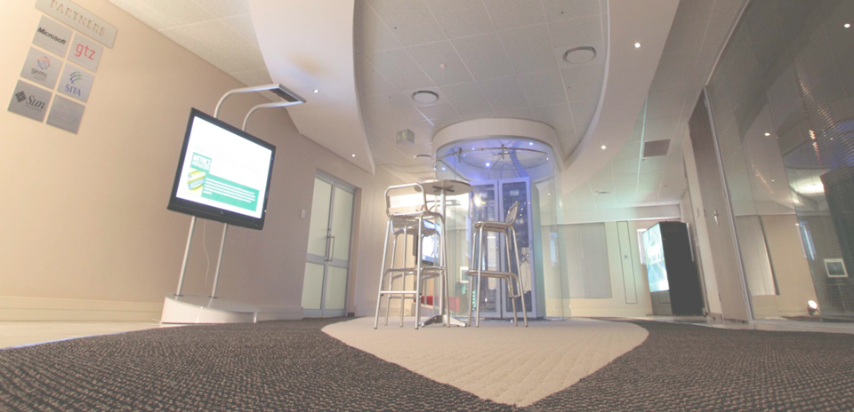
4th QUARTER FINANCIAL REPORT FOR THE 2017/18 FINANCIAL YEAR
14

Slide 15
Appropriation statement (expenditure for period 1 April 2017 to 31 March 2018)
15
Programme 1: Administration
The amount received in Programme 1: Administration was R18.6 million for the period 1 April 2017 to 31 March 2018. The spending for the same period was R18.3 million.
The variance between projection and spending of R300 000 can be explained as follows:
Compensation of employees: Two posts were only filled in July 2017 and not in April 2017 as original anticipated, resulting in a saving of R294 000.
Programme 2: Public Sector Innovation
The amount received in Programme 2: Public Sector Innovation amounted to R15.3 million for the period 1 April 2017 to 31 March 2018. The spending for the same period was R14 million.
The variance between projection and spending of R1.3 million can be explained as follows:
The projected payment of R600 000 to Innovation Hub for projects was stopped.
ICT procurement was also stopped
Projected expenses for S&T were less than anticipated, due to cost containments.

Slide 16
Appropriation statement (expenditure for period 1 April 2017 to 31 March 2018)
16
Programme |  |  | 2017/18
 |  |  | Final Appropriation R'000 | Actual Expenditure R'000 | Variance R'000 | Expenditure as % of final appropriation %
1. | Administration |  | 18 675 | 18 327 | 348 | 98.1%
2. | Public Sector Innovation |  | 15 380 | 14 084 | 1 296 | 91.6%
 | TOTAL |  | 34 055 | 32 411 | 1 644 | 95.2%
Departmental receipts |  |  | 24
Aid assistance |  |  | 3 407
Actual Revenue per Statement of Financial Performance |  |  | 37 486
Add: |  | Aid assistance |  | 3 398
Actual Expenditure per Statement of Financial Performance |  |  |  | 35 809

Slide 17
Appropriation statement (expenditure for period 1 April 2017 to 31 March 2018) continued
17
Per Economic Classification | 2017/18
 | Final Appropriation R'000 | Actual Expenditure R'000 | Variance R'000 | Expenditure as % of final appropriation %
Current payments | 33 464 | 33 421 | 1 516 | 95.5%
Compensation of employees | 18 360 | 18 046 | 796 | 98.3%
Goods and services | 15 061 | 13 859 | 1 202 | 92.0%
Transfers and subsidies | 1 | - | 1 | 0.0%
Payments of Financial Assets | 9 | 9 | - | 100.0%
Payments for capital assets | 624 | 497 | 127 | 79.6%
Machinery and equipment | 590 | 406 | 185 | 82.5%
TOTAL | 34 055 | 32 411 | 1 644 | 95.2%

Slide 18
Appropriation statement (expenditure for period 1 April 2017 to 31 March 2018) continued
18
Description | 2017/18
 | Final Appropriation R'000 | Actual Expenditure R'000 | Variance R'000 | Expenditure as % of final appropriation %
Strategic Management | 3 717 | 3 677 | 40 | 98.9%
Corporate Resource Management | 9 116 | 8 936 | 180 | 98.0%
Office of the Chief Financial Officer | 5 842 | 5 714 | 128 | 97.8%
PROGRAMME 1: ADMINISTRATION | 18 675 | 18 327 | 348 | 94.4%
Research and Development | 3 624 | 3 421 | 203 | 94.4%
Solution Support and Incubation | 3 405 | 3 315 | 90 | 97.4%
Enabling Environment | 8 351 | 7 348 | 1 003 | 88.0%
PROGRAMME 2: PUBLIC SECTOR INNOVATION | 15 380 | 14 084 | 1 296 | 91.6%
Total | 34 055 | 32 411 | 1 644 | 95.2%

Slide 19
30 day payments
19
All Payments were made within 5.63 days of receipt of an invoice.
432 payments were processed from 1 April 2017 to 31 March 2018

Slide 20
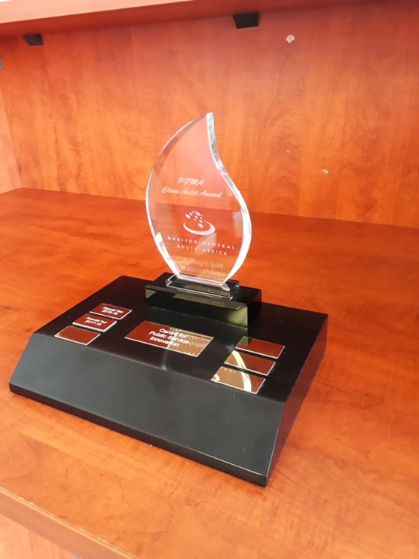
2017/18 AUDIT OUTCOME
20

Slide 21
21
1ST QUARTER
2018/19

Slide 22
Executive Summary
22
No of Targets | 1st Quarter Targets Achieved | 1st Quarter Targets Not Achieved
4 | 4 | 0
During the 1st Quarter period the organisation had 4 Targets and all 4 (100%) of the targets were achieved by 30 June 2018.

Slide 23
Progress on 1st Quarter Targets
23
Target no | Responsible unit | Target for 2018/19 as per Annual Performance Plan (APP) | 1st Quarter Target | Actual Achievement for the 1st Quarter | Deviation from planned target to Actual Achievement for the 1st Quarter | Comment/ Mechanisms to address differences in targets | Performance Rating
 | SM OCFO | 4 Quarterly financial reports submitted to MPSA, DPSA and National Treasury and non-financial reports submitted to MPSA, DPSA, DPME, and National Treasury as per required timeframes | Fourth quarter financial report submitted to MPSA, DPSA and National Treasury and non-financial report submitted to MPSA, DPSA, DPME and National Treasury by 30 April 2018 | Fourth quarter financial report submitted to MPSA, DPSA and National Treasury and non-financial report submitted to MPSA, DPSA, DPME and National Treasury | None | None | Achieved
2. | SSI | Two (2) CPSI award winning and/or other innovation projects facilitated for replications | Two (2) projects for 2019/20 identified and assessed for replication | Two (2) projects for 2019/20 identified and assessed for replication | None | None | Achieved

Slide 24
Progress on 1st Quarter Targets
24
Target no | Responsible unit | Target for 2018/19 as per Annual Performance Plan (APP) | 1st Quarter Target | Actual Achievement for the 1st Quarter | Deviation from planned target to Actual Achievement for the 1st Quarter | Comment/ Mechanisms to address differences in targets | Performance Rating
3. | SSI | 330 Public sector officials and other partners capacitated | 75 Public sector officials and other partners capacitated | 185 Public sector officials and other partners capacitated | 110 more Public sector officials and other partners capacitated | The CPSI exhibition of the mobile MMIC at public sector events attracted a lot of interest from the delegates, hence the increased number | Achieved
4. | EE | Six (6) knowledge platforms hosted to unearth, demonstrate, share, encourage and award innovation in the public sector | Public Sector Innovation Awards Programme launched | The 2018 Public Sector Innovation Awards Programme was officially launched in East London on 11th May 2018 | None | None | Achieved

Slide 25
1st QUARTER FINANCIAL REPORT FOR THE 2018/19 FINANCIAL YEAR
25

Slide 26
Appropriation statement (expenditure for period 1 April 2018 to 30 June 2018)
26
Expenditure for the first quarter of the 2018/19 financial year amounted to R6.9 million, or 19.42 percent of the appropriation of R36.03 million for the year. The expenditure for can be explained as follows:
Compensation of Employees: An amount of R4.2 million was spent in the 1st quarter of the financial year (21.65 percent of the budget);
An amount of R2.7 million was spent on Goods and Services for the same period;
The expenditure per component for June 2018 is as follows:
Description | 2018/19 ENE Original Allocations | Actual Expenditure 30 June 2018 | Budget Unspent | % Budget Spent
 | R'000 | R'000 | R'000 | %
SM | 4,060 | 343 | 3,717 | 8.45
CRM | 9,166 | 1,684 | 7,482 | 18.37
OCFO | 6,165 | 1,442 | 4,723 | 23.38
Admin | 19,391 | 3,469 | 15,922 | 17.89
RD | 3,899 | 870 | 3,029 | 22.32
SSI | 3,915 | 947 | 2,968 | 24.19
EE | 8,825 | 1,711 | 7,114 | 19.39
Innovation | 16,639 | 3,528 | 13,111 | 21.20
Total | 36,030 | 6,997 | 29,033 | 19.42

Slide 27
Appropriation statement (expenditure for period 1 April 2018 to 30 June 2018)
27
The expenditure per economic classification for June 2018 is as follows:
Description | 2018/19 ENE Original Allocations | Actual Expenditure 30 June 2018 | Budget Unspent | % Budget Spent
 | R'000 | R'000 | R'000 | %
Compensation of Employees | 19,425 | 4,206 | 15,219 | 21.65
Goods and Services | 16,351 | 2,653 | 13,698 | 16.22
Transfers and Subsidies | 1 | 64 | (63) | 6,403.49
Machinery and Equipment | 253 | 74 | 179 | 29.31
Total | 36,030 | 6,997 | 29,033 | 19.42

Slide 28
30 day payments
28
All Payments were made within 4.42 days of receipt of an invoice.
100 payments were processed from 1 April 2018 to 30 June 2018.

Slide 29
29
THANK YOU

