Slide 1
South African Metered Taxi Operators

Slide 2
$$ACT OR PROPOSED BILL$$
$$COMMENTS$$
Amendment of section 1 of Act 5 of 2009
1. Section 1 of the National Land Transport Act, 2009 (herein after referred to as the principal Act), is hereby amended— (a) by the insertion after the deﬁnition of ‘‘adapted light delivery vehicle’’ of the following: ‘‘ ‘association’ means a group of operators— (a) which has been formed not for gain; (b) whose object is to promote the interests of its members, and (c) whose funds are to be applied in promoting those interests;’’
We are in support of this amendment as per section 1 (a) in Toto, by virtue of this section qualifying the South Africa Metered Taxi Operators
“SAMTO” as an association, with the intensions as stipulated therein.

Slide 3
$$ACT OR PROPOSED BILL$$
$$COMMENTS$$
Amendment of section 1 of Act 5 of 2009
‘integrated public transport network’
(c) by the substitution for the deﬁnition of ‘‘integrated public transport network’’ of the following: ‘‘ ‘integrated public transport network’ means a system in a particular area that integrates public transport services between modes, including non-motorised transport, with through-ticketing and other appropriate mechanisms, that may be implemented in a phased manner, to provide users of the system with the optimal solutions to be able to travel from their origins to destinations in a seamless manner with integrated pedestrian access for all passengers, and may, in appropriate municipalities, include— (a) integrated rapid public transport networks, being high-quality networks of car competitive public transport services that are fully integrated regardless of mode, have dedicated right of way if road based, with or without bus rapid transit systems; and (b) bus rapid transit systems, which are high volume bus corridors served by an integrated feeder system;’
We are in support of this amendment as per section 1(c) in Toto, SAMTO has designed an integrated ticketing system called E-Ticketing that aims at reducing cash handling in all the Integrated Transport Mode. This helps;
(a) Reduce theft
(b) Create a seamless transport payment system and Integration for all modes
(c) Create the Integrated Public Transport Network

Slide 4
$$ACT OR PROPOSED BILL$$
$$COMMENTS$$
Amendment of section 1 of Act 5 of 2009
by the substitution for paragraph (c) of the deﬁnition of ‘‘metered taxi service’’ of the following paragraph:
‘‘(c) is equipped with a sealed meter, in good working order, for the purpose of determining the fare payable, that is calibrated for such fare or complies with any other requirements applicable to such meters as prescribed by the Minister under section 66(4)(cA), or is equipped with an electronic hailing application or similar technology that complies with requirements so prescribed, or both such meter and application or technology;’’
We argue the addition of the paragraph “as prescribed by the Minister under section 66(4)(cA), or is equipped with an electronic hailing application or similar technology that complies with requirements so prescribed, or both such meter and application or technology;’’ on the definition of Metered Taxi Services on Section 1 (c). Already the definition states that a metered taxi is equipped with a sealed meter either a manual meter or digital meter or similar technology, in good working order, for the purpose of determining the fare payable

Slide 5
$$Word or Phrase$$
$$Definition$$
What is the meaning of e-hailing?
E-Hail App. A Software program approved by the TLC residing on a smartphone which performs one or more of the following functions:
Allows a passenger to identify the location(s) of available Taxicabs in a given area and allows a Driver to identify the location of a passenger who is currently ready to travel;
Allows a passenger to hail a Taxicab via the electronic device
Allows a Driver to receive a hail request from such a passenger if the application provides for connecting a passenger to a Driver; or
E-Payment.
Source: https://definedterm.com/e_hail_app

Slide 6
$$Word or Phrase$$
$$Definition$$
What is the meaning of ride hailing?
ride-hailing service - Computer Definition. Transportation from an unlicensed taxi service such as Uber or Lyft. Also called a "ride-sharing" service, which is a misnomer when applied to single-fare rides but accurate when referring to the carpool service that the companies offer.
Source: www.yourdictionary.com/ride-hailing-service

Slide 7
$$ACT OR PROPOSED BILL$$
$$COMMENTS$$
Amendment of section 5 of Act 5 of 2009
2. Section 5 of the principal Act is hereby amended by the deletion in subsection (4) of the word ‘‘and’’ at the end of paragraph (i), by the addition of the word ‘‘and’’ at the end of paragraph (j) and by the addition of the following paragraph: ‘‘(k) promote measures to ensure the safety of pedestrians and all forms of passengers using public transport by means of regulations or the publication of guidelines or standards or through other appropriate measures.’’.
We are in agreement of this Amendment as we have seen recent criminal activities being done illegal operators against the passengers of Metered Taxi Services and other modes of Transport, we have cases of passengers being raped or robbed by illegal operators using platforms that are not properly checked if they are secure for public.
We propose that a strict background check be implemented to the Operators before acquiring an operating license. This should be mandatory to all operators to ensure public passenger safety

Slide 8
$$ACT OR PROPOSED BILL$$
$$COMMENTS$$
Amendment of section 8 of Act 5 of 2009
Section 8 of the principal Act is hereby amended;
(fB) codes of conduct for operators or drivers of public transport services, which may differ in respect of different types of services or different categories of operators or drivers;’’
SAMTO concur with the amendment, because of the 4th generation and evolution of technology it is imperative to have code of conducts that protect operators or drivers as we have seen the exploitation of drivers by some individual companies who exploited drivers in the form of employment.
Therefore SMTI is in agreement of the Proposed addition on Section 8 subsection (fB), that Operators or drivers must have code of conduct.

Slide 9
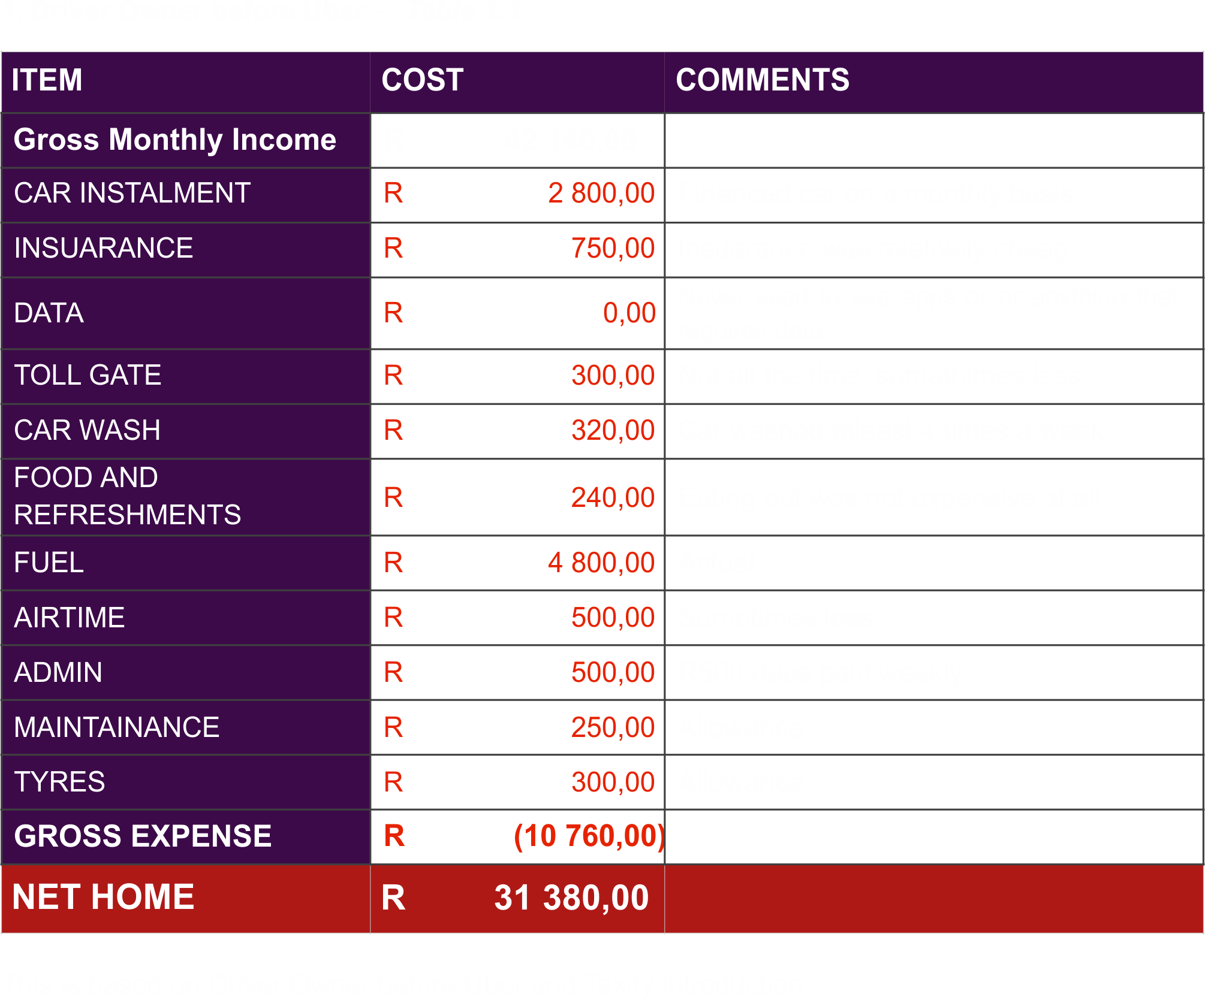
TABLES BELOW COMPARE DATA

Slide 10
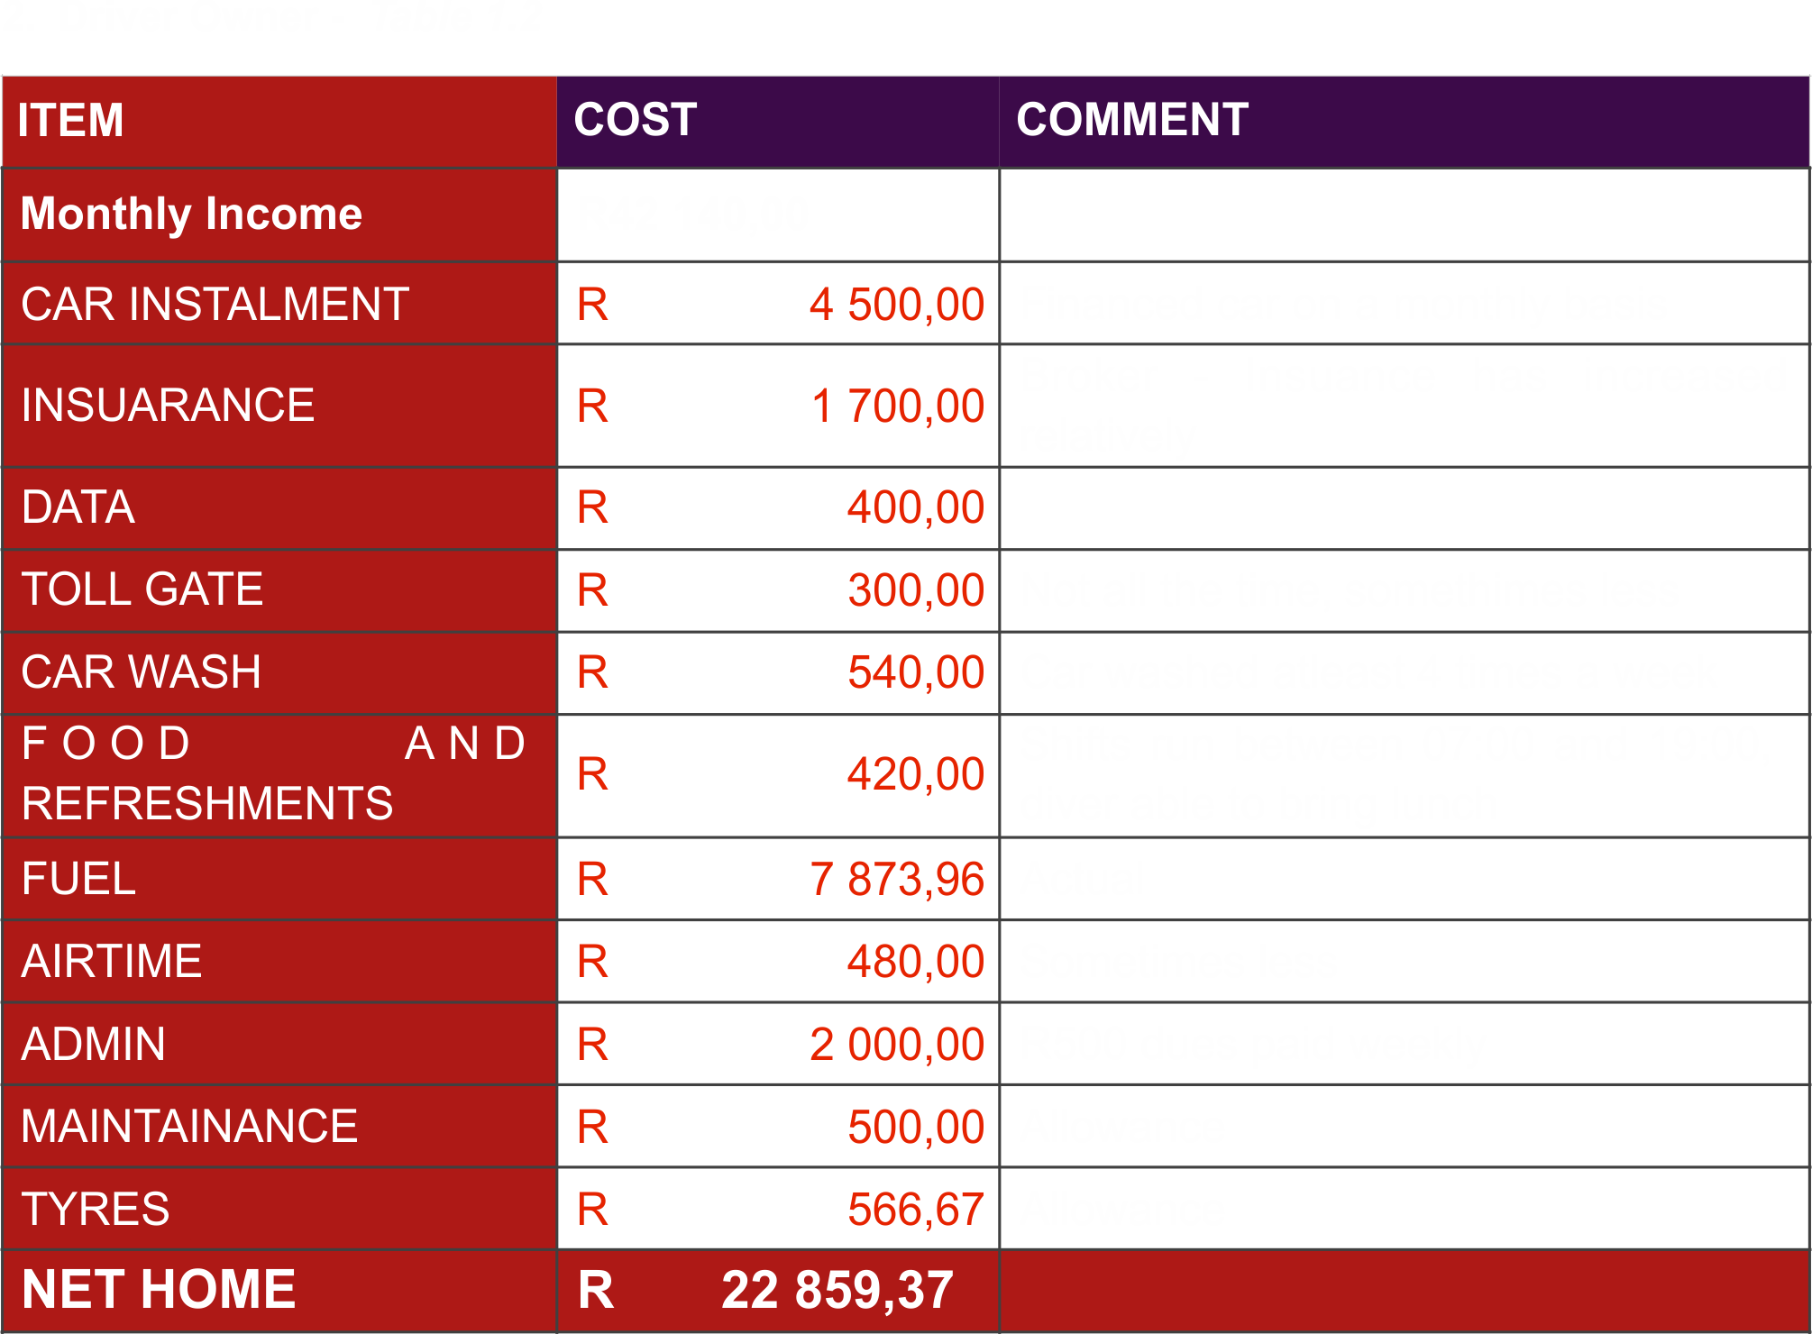
TABLES BELOW COMPARE DATA

Slide 11
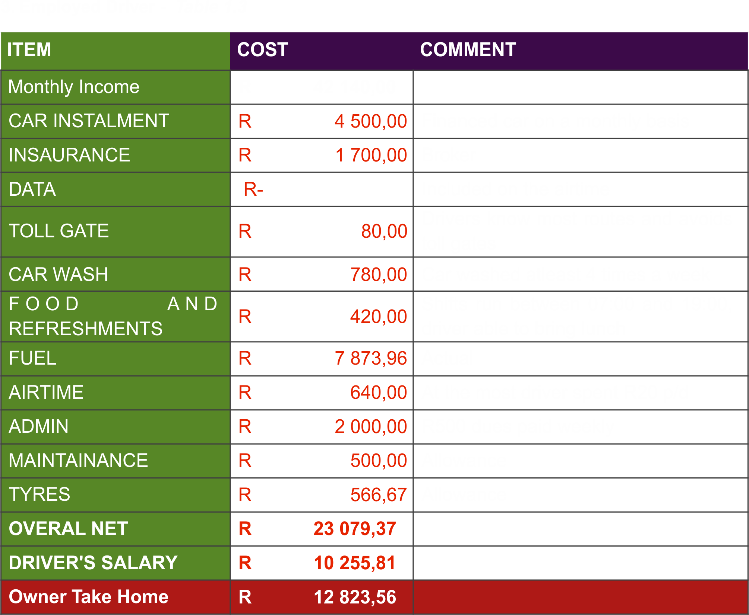
TABLES BELOW COMPARE DATA

Slide 12
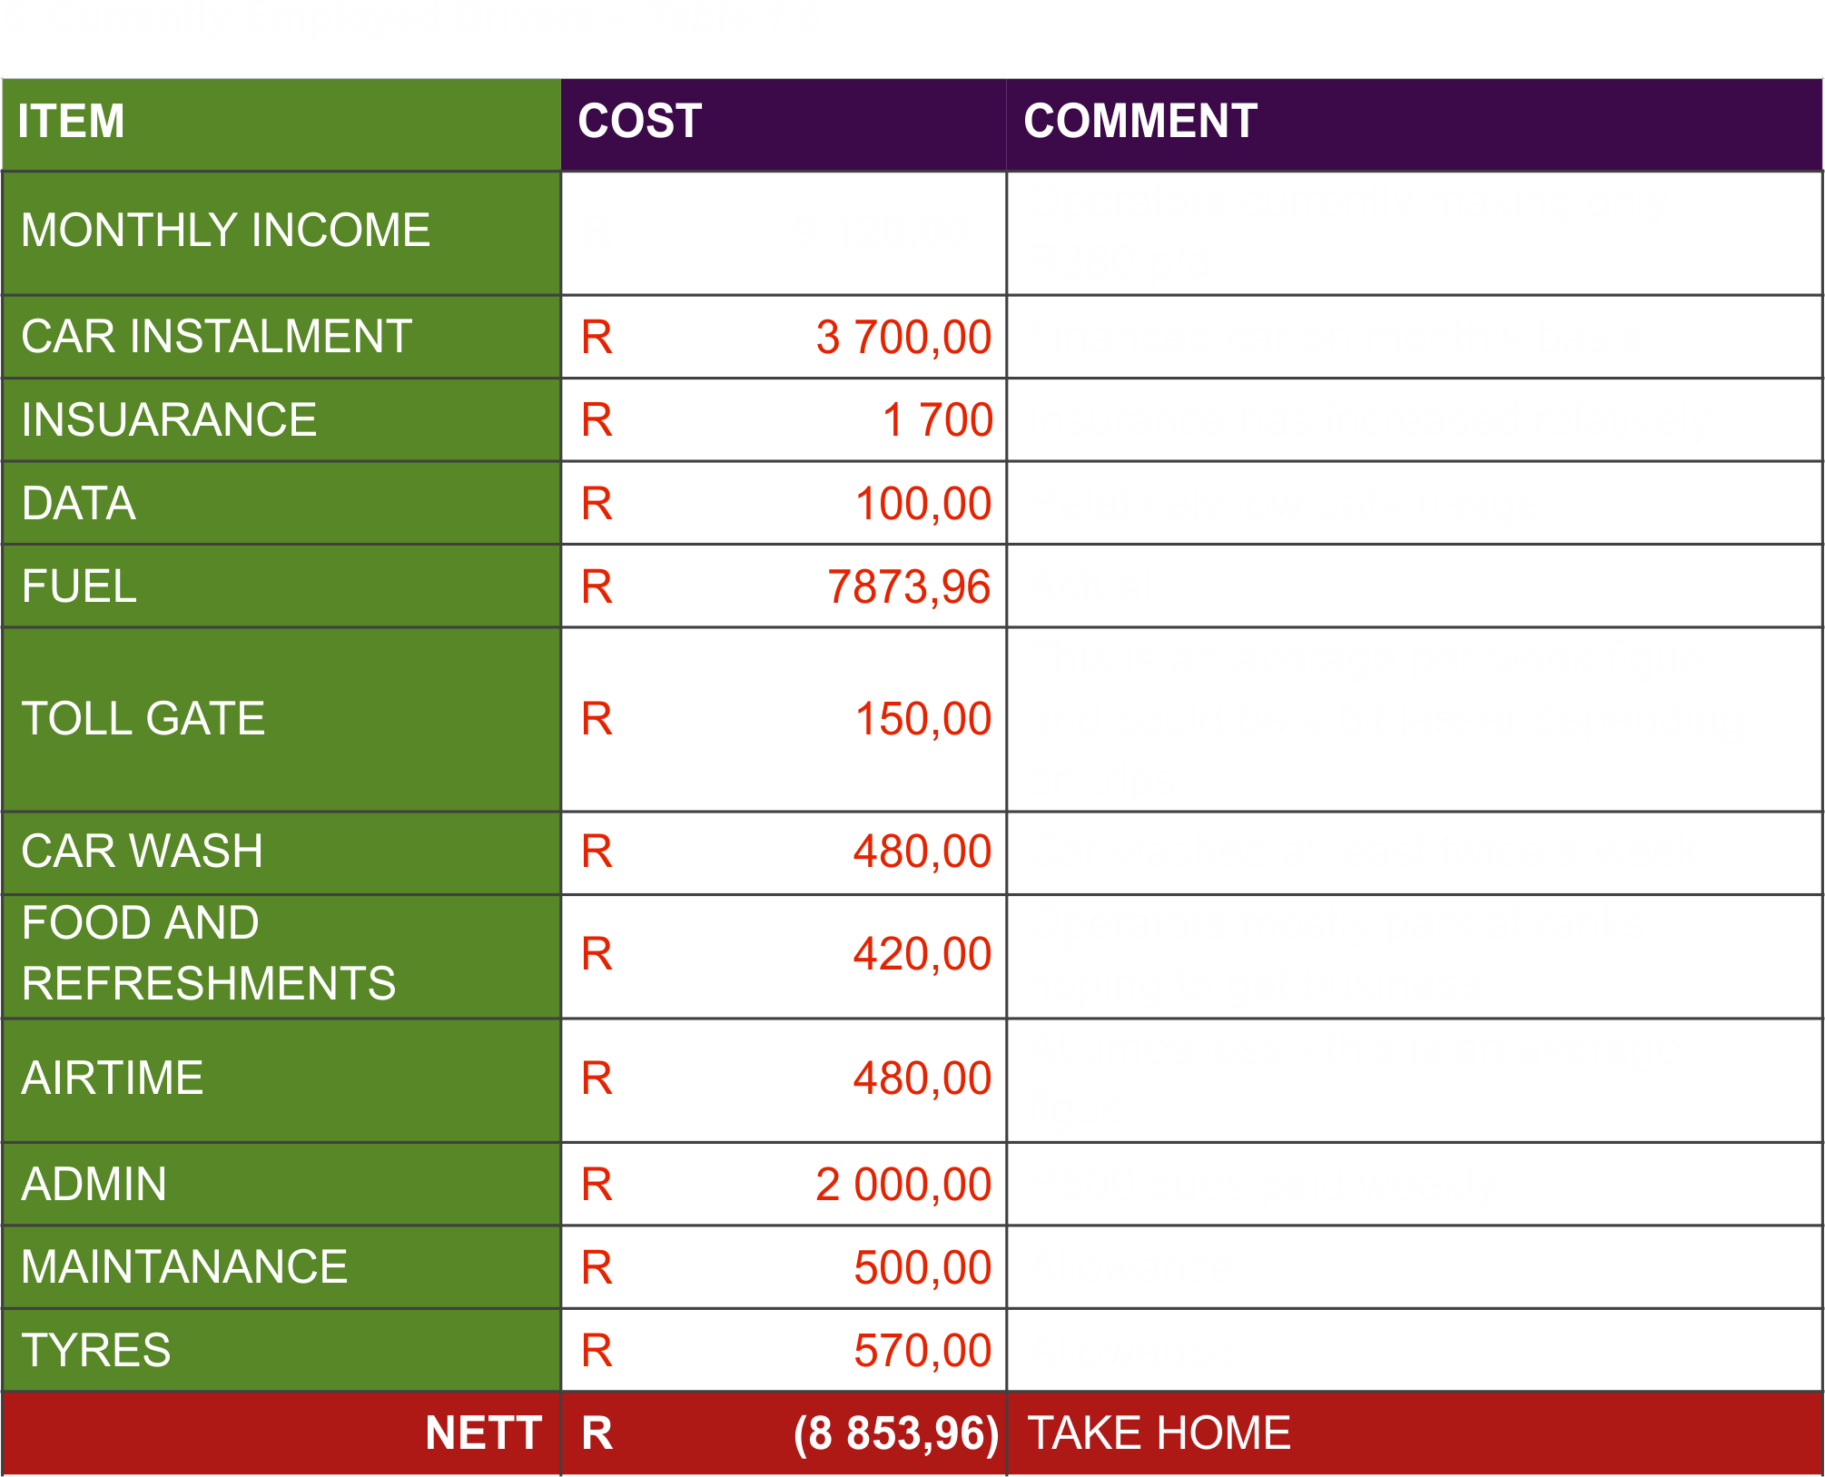
TABLES BELOW COMPARE DATA

Slide 13
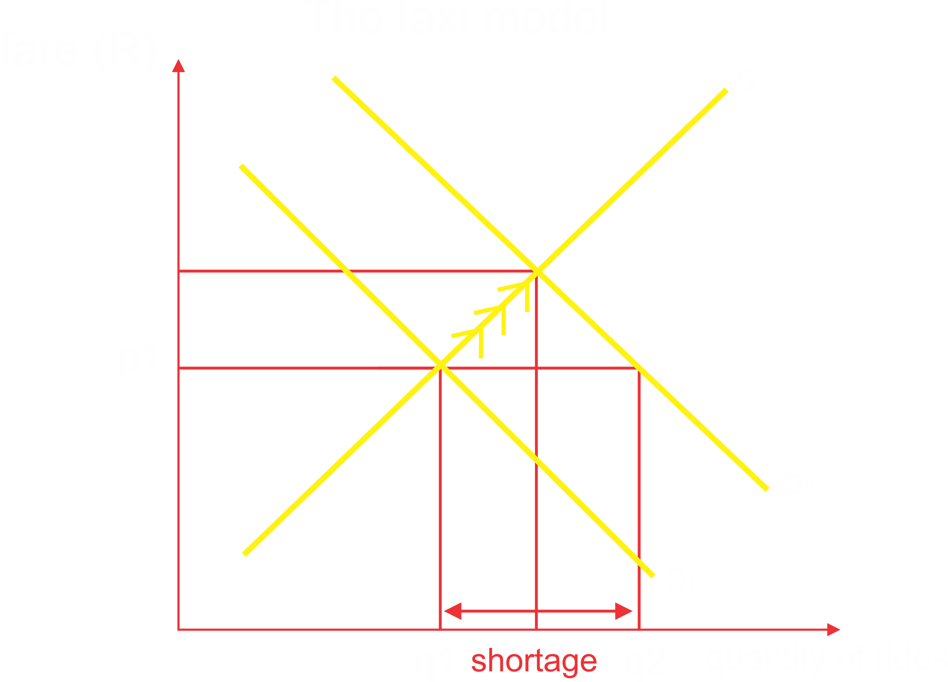
Demand & Supply Curves of Taxi Rides

Slide 14
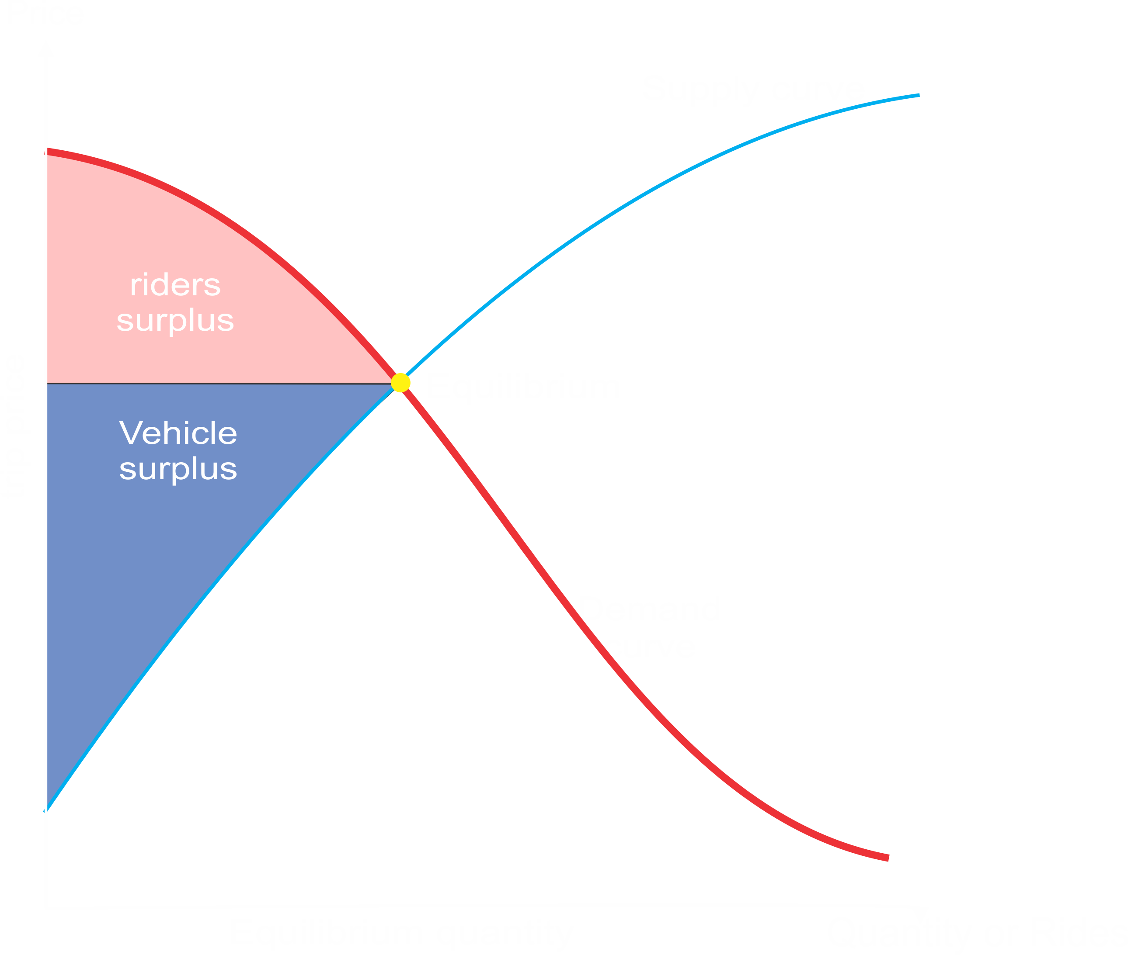
Demand & Supply Curves of Taxi Rides

Slide 15
$$ACT OR PROPOSED BILL$$
$$COMMENTS$$
Amendment of section 8 of Act 5 of 2009
Section 8 of the principal Act is hereby amended;
(c) by the substitution in subsection (1) for paragraph (h) of the following paragraph: ‘‘(h) colour coding and branding of vehicles used for public transport where national uniformity is required;’’
SAMTO concur with the amendment, it is difficult to identify a vehicle whether it is a metered taxi or it’s a private vehicle, therefore we go with the motion that a branding of some sort be implemented whether in form of sticker or any form of marking that is visible in a at least a distance of 50 meters.

Slide 16
$$ACT OR PROPOSED BILL$$
$$COMMENTS$$
Amendment of section 10 of Act 5 of 2009
5. Section 10 of the principal Act is hereby amended by the insertion in subsection (1) after paragraph (e) of the following paragraph: ‘‘(eA) colour coding and branding of vehicles used for public transport in the province, subject to any regulations made by the Minister in terms of section 8(1)(h);’’.
SAMTO concur with the amendment, it is difficult to identify a vehicle whether it is a metered taxi or it’s a private vehicle, therefore we go with the motion that a branding of some sort be implemented whether in form of sticker or any form of marking that is visible in a at least a distance of 50 meters.

Slide 17
$$ACT OR PROPOSED BILL$$
$$COMMENTS$$
Amendment of section 66 of Act 5 of 2009
Section 66 of the principal Act is hereby amended :
(a) by the deletion of subsection (2)
(2) In the absence of requirements published in terms of the Trade Metrology Act, 1973 (Act No. 77 of 1973), the Minister must set standards for sealed meters for metered taxis in accordance with standards set by the South African Bureau of Standards in terms of the Standards Act, 1993 (Act No. 29 of 1993).
SAMTO prefers to defer and not delete this Subsection as this gives Standards Bureau of South Africa to control a Standard Measure Applied on both digital or manual meters so that they are not digitally or manually tempered.

Slide 18
$$ACT OR PROPOSED BILL$$
$$COMMENTS$$
Amendment of section 66 of Act 5 of 2009
Section 66 of the principal Act is hereby amended :
by the deletion in subsection (4) of the word ‘‘and’’at the end of paragraph (c) and the insertion of the following paragraph in that subsection after paragraph
‘‘(cA) standards or requirements for meters or electronic hailing applications or similar technology, where such applications or technology either operate in tandem with a meter or without a meter, to be installed in or applied by metered taxis, as prescribed including the following: (i) the manner in which the meter must be calibrated and sealed after calibration; (ii) prescribing measures to ensure accurate readings of meters and such applications or technology; (iii) prescribing information regarding the driver that must be communicated to the passenger; and (iv) prescribing information that the meter, electronicc hailing applications or similar technology must provide to passengers.’’; and
SAMTO proposes that the paragraph be put as follows:
‘‘(cA) standards or requirements for analogue meter or digital meter or similar technology meter, where such digital meter or similar technological meter either operate in tandem with a meter or without a meter, to be installed in or applied by metered taxis, as prescribed including the following: (i) the manner in which the meter must be calibrated and sealed after calibration; (ii) prescribing measures to ensure accurate readings of analogue meters and digital meters or similar technological meter; (iii) prescribing information regarding the driver that must be communicated to the passenger; and (iv) prescribing information that the analogue meter, digital meter or similar technological meter must provide to passengers.’’; and
The proposal to change the paragraph is based on proper definitions of such terms as electronic hailing as they are incorrectly defined.

Slide 19
$$ACT OR PROPOSED BILL$$
$$COMMENTS$$
Amendment of section 66 of Act 5 of 2009
Section 66 of the principal Act is hereby amended :
by the addition of the following subsections:
‘‘(5) Meters, electronic hailing applications or similar technology must— (a) have the facility to estimate distances and fares, taking into account distance and time, and communicating such estimate to passengers in advance, and (b) communicate the fare to the passenger at the conclusion of the journey; (6)A meter must be installed where an electronic hailing application or similar technology will not be able to function optimally in areas where the metered taxi concerned is licensed to operate.’’.
SAMTO proposes that the paragraph be put as follows:
‘‘(5) analogue meter or digital meter or similar technology meter, must— (a) have the facility to estimate distances and fares, taking into account distance and time, and communicating such estimate to passengers in advance, and (b) communicate the fare to the passenger at the conclusion of the journey, by (c)either analogue or digital means
SAMTO further proposed the deletion of the following Bill Proposal Amendment: (6)A meter must be installed where an electronic hailing application or similar technology will not be able to function optimally in areas where the metered taxi concerned is licensed to operate.’’.
The above amendment is saying that Metered taxi cannot evolve with technology and is confusing the real definition of Metered Taxi in Section 1 (c)

Slide 20
$$ACT OR PROPOSED BILL$$
$$COMMENTS$$
Amendment of section 67 of Act 5 of 2009
Section 67 of the principal Act is hereby amended
(b) by the deletion of subsection (3);
(3) Where application is made for an operating licence for vehicle hires with drivers as charter services, the entity granting the operating licence ,must evaluate whether the services should rather be provided as metered taxi services, and, if it grants the application for a charter service, should attach appropriate conditions.
SAMTO proposes that the paragraph below not be deleted:
(3) Where application is made for an operating licence for vehicle hires with drivers as charter services, the entity granting the operating licence ,must evaluate whether the services should rather be provided as metered taxi services, and, if it grants the application for a charter service, should attach appropriate conditions.
Subsection (3) clearly defines the difference between metered taxi services and charter services, by removing Subsection (3) it compromises the Definitions in Section 1 that have been set to separate Metered Taxi Service & Charter Services as this will allow Charter Services to Roam and create conflict with Metered Taxi Services
In Section 1 the National Land & Transport Act clearly defines the two modes of transport offer different services.

Slide 21
$$ACT OR PROPOSED BILL$$
$$COMMENTS$$
Amendment of section 67 of Act 5 of 2009
Section 67 of the principal Act is hereby amended
by the addition of the following subsection:
‘‘(4) When converting a permit authorising services described as ‘‘organized parties’’ to an operating licence under section 47, the relevant regulatory entity must describe the services in the operating licence as charter services if they fall within the deﬁnition of such services in section 1.’’.
SAMTO proposes that the amendment to add proposed paragraph below be deleted:
‘‘(4) When converting a permit authorising services described as ‘‘organized parties’’to an operating licence under section 47, the relevant regulatory entity must describe the services in the operating licence as charter services if they fall within the deﬁnition of such services in section 1.’’.
SAMTO has failed to locate “organised parties” in the definitions or current National Land & Transport Act of 2009. By changing the operations of current Charter Permit Holders will cause conflict of interests with Metered Taxi Services.
However if possible there be an explanation as to why one would change their permit.

