Slide 1


Briefing by the Department of Tourism and South African Tourism on the Progress & Interventions to stimulate
Domestic Tourism to:
Select Committee on Trade and International Relations
5 September 2018

Slide 2
PRESENTATION OUTLINE
Purpose
Strategic Framework
Background
Revision 2016/17
Domestic Tourism Focus Area: Department of Tourism
Working Together: Tourism Month: Project Steering Committee
Domestic Market Strategy
7. Strategic Framework
8. Holiday Characteristics of South Africans
9. Barriers to Domestic Holiday Travel
10. Goals for the Market
11. The Campaign
12. Acronyms

Slide 3
PURPOSE
To give a status update on the progress report and interventions to stimulate Domestic Tourism.

Slide 4
Challenge:
Lack lustre Domestic Tourism
Performance
Source: SA Tourism
South Africa has seen a decline in the total number of domestic trips; total number of domestic travellers; and domestic travel spend in real terms.

Slide 5
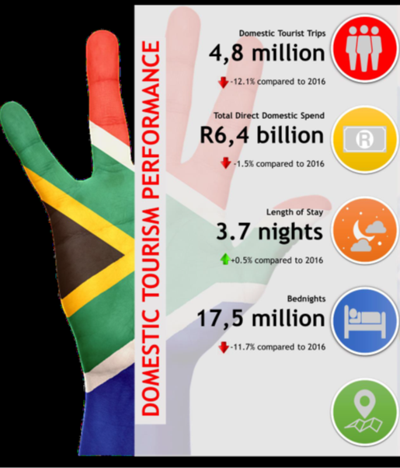
The biggest challenge facing the South African tourism sector is how to grow domestic tourism on the back of tough economic conditions in the country.
The sharp drop in overall domestic tourist trips shows that ordinary South Africans are feeling the pinch.
Source: SA Tourism

Slide 6
STRATEGIC FRAMEWORK: DEPARTMENT
National Tourism Sector Strategy: 2016-2026 (NTSS)
Domestic Tourism Growth Strategy Review (2016/17):
    Its objective is to create “A robust domestic tourism economy by 2030”.
    This is to be achieved from by “Making affordable and compelling tourism experiences accessible for the domestic tourism market”.
Domestic Tourism Unit established
Notes:
The reviewed strategy was approved by Minister Hanekom on 30 March 2017
Copies will be made available as it will be shared with the presentation

Slide 7
OVERARCHING GOAL AND FIVE STRATEGIC NTSS PILLARS
Inclusive and Quality Growth of the South African Tourism Economy
Facilitating Ease of Access
The Visitor Experience
Destination Management
Effective Marketing
Broad Based Benefits

Slide 8
Tourism Sector Support Services: Links on Strategic Objectives, Objective Statements and Programme Performance Indicators
ANNUAL PERFORMANCE PLAN - DEPARTMENT
Strategic Objective 5: To accelerate the transformation of the tourism sector.
Objective Statement | Programme Performance Indicator (PPI)
To implement programmes aimed at the empowerment of marginalised enterprises and individuals to promote inclusive growth of the sector. | PPI 2: Number of initiatives supported to stimulate domestic tourism

Slide 9
BACKGROUND:
The Department developed the Domestic Tourism Growth Strategy (DTGS) 2012 - 2020, aligned to the National Tourism Sector Strategy (NTSS).
This DTGS was compiled with due consideration to the global and domestic contexts as well as in keeping with the priorities of the NTSS.
Through the strategy, we expect to build a culture that will result in the following:
  increased awareness of tourism and its value for the country; and
  an increase in the levels of community participation in the tourism sector.

Slide 10
BACKGROUND (Cont...)
The DTGS sets practical measures to generate greater value from travel and tourism in South Africa.
The implementation plan of the strategy seeks to direct a consolidated and integrated approach to addressing the challenges of geographic spread and seasonality, which offer opportunities for enhanced levels of domestic tourism.
  It does so by unlocking the previously neglected growth points like school-based tourism, targeting various community initiatives like stokvels, religious tourism, sports tourism etc.
  The Domestic Tourism Growth Strategy goes further to outline practical mechanisms to address the lack of a tourism culture amongst South Africans, particularly the previously disadvantaged communities.
  The Revised Domestic Tourism Growth Strategy and resultant implementation plan was developed with revised timelines to 2026 and its implementation commenced in 2017/18. This will be achieved through education and awareness across the country as well as promoting affordable and accessible travel and tourism opportunities

Slide 11
BACKGROUND (Cont…)
Under the DTGS, the Department and South African Tourism (SAT), seek to do the following:
  Implement programmes and projects aimed at benefiting local communities;
  Prioritise campaigns that target both the lower and higher end of the domestic market;
  Create a holiday culture among previously disadvantaged groups;
  Extend visits to friends and relatives into tourism leisure and market domestic leisure to all major local markets (conversion).

Slide 12
RATIONALE: 2016/17 REVISION:
In 2015, due to an over-reliance on in-bound tourism, lacklustre performance within the domestic tourism market and the need to transform the sector, a decision was taken to review the DTGS. The Minister instructed that the review must be a joint exercise between the Department and SAT.
  This was done in consultation with the tourism value chain stakeholders so that their views and inputs were taken into consideration.
  A think tank session took place over two days in Pretoria 2018, with representatives from government, parastatals and private sector.
  The main aim of the engagement was to identify, what may have contributed to the possible decline in the number of domestic tourism trips undertaken in the years subsequent to the growth experienced up to 2014.

Slide 13
2016/17 REVISION: DTGS FINDINGS & RECOMMENDATIONS
FINDINGS
1. | Actions from the current strategy had been partially implemented due to a lack of a dedicated focus.
2. | Limited focus on domestic tourism has led to the under resourcing of the function across public and private sector. National, provincial and local tourism authorities all battle for space at the international level. Domestic Tourism marketing is not prioritised strategically and financially
3. | Over 70% of associations believe SAT can improve their performance in marketing tourism to the domestic market.
4. | Prioritisation of tourism by government only from an international arrival perspective.
5. | Narrow view of stakeholders excludes critical stakeholders; i.e. labour.
6. | Understanding Visiting Family & Friends (VFR) differently is needed – not as a negative but the fuel to power up domestic by way of conversion

Slide 14
2016/17 REVISION: DTGS FINDINGS & RECOMMENDATIONS (Cont…)
FINDINGS
7. | Different Research methodologies between SAT and Stats SA.
8. | No incentives to stimulate investment in product development to attract domestic tourist
9. | Group travel (e.g. Stokvels, Youth Groups ) not adequately catered for.
10. | Current resorts need upgrading to respond to the tastes of the new traveler.
11. | Drivers of domestic travel such as sport, cultural and heritage societies are often not part of the planning and implementation.
12. | Affordability due to economic circumstances will impact on the building of a culture of travel. It’s necessary to expose those with limited means to travel. Thus a need for a focus on social tourism.

Slide 15
DOMESTIC TOURISM FOCUS AREAS – DEPARTMENT OF TOURISM
To develop a framework for supporting tour operators to facilitate domestic tourism with an emphasis on previously disadvantaged groups.
  Develop a Tour Operators Framework that seeks to address the gaps identified in the Domestic Tourism Growth Strategy, which amongst other things includes access, affordability, seasonality and uneven geographic spread.
  One of the benefits of developing this framework will be an increase on domestic travel.
  It will further outline the support required by the tour operators in order to actively participate and promote social tourism in South Africa.
  It is being developed in consultation with the tour operators and interested provincial stakeholders.
  These engagements area examining the challenges faced by the existing tour operators when it comes to affordable and budget destinations packaging,
  The findings will help the department to develop an in-depth Social Tourism Scheme which is aimed at encouraging a culture of travel amongst South Africans.

Slide 16
DOMESTIC TOURISM FOCUS AREAS: DEPARTMENT OF TOURISM (Cont….)
2. Develop a Social Tourism Scheme (STS)
  The aim is, the development of a social tourism scheme that will enable travel and tourism participation by people of modest income and previously marginalized members of society.
  The STS explores challenges faced by the disadvantaged and low to middle income earners, it also provides recommendation on how South Africa can implement the scheme to promote and encourage travel amongst South Africans.

Slide 17
WORKING TOGETHER: TOURISM MONTH : PROJECT STEERING COMMITTEE (PSC):
The objectives of the Tourism Month Programme is to develop and plan a year-long approach for Tourism Month which will lead to it being known by South Africans.
We strive to develop an awareness and educational program out of Tourism Month Programme to in order to educate South Africans about domestic tourism and its importance in their lives.
The Tourism Month Programme seeks to provide an improved platform where there is optimal alignment and coordination of the spheres of government and tourism industry players so that they can share a common approach when implementing Tourism Month.
In order to maximize this, the value of tourism will be realised by unlocking its value through strategic partnerships and intergovernmental involvement.
Notes:
SAT to add more

Slide 18
WORKING TOGETHER: TOURISM MONTH : PROJECT STEERING COMMITTEE (PSC): (Cont...)
The Tourism Month Programme is coordinated under the PSC which consists of SAT and other tourism sector stakeholders (i.e. national departments; relevant national parastatals; provincial tourism departments, provincial marketing authorities and private sector representative bodies) to support national and provincial activities as part of the National Tourism Month.
The PSC seeks to facilitate the development of national and provincial domestic tourism initiatives and programmes to ensure the successful development of the domestic tourism market.

Slide 19
Domestic Tourism Marketing Review

Slide 20
STRATEGIC FRAMEWORK: SOUTH AFRICAN TOURISM (SAT)
SAT Domestic Marketing Strategy (2012).
SAT “5 in 5”, 2017 in response to review of the DTGS
Domestic Tourism Marketing Campaigns activated:
  Welcome Campaign
  Sho’t left
  Its your country, enjoy
  We do tourism
Notes:
The reviewed strategy was approved by Minister Hanekom on 30 March 2017
Copies will be made available as it will be shared with the presentation

Slide 21

SA Tourism’s 5-in-5 Strategy: Focus on Driving Domestic Holiday Travel
SA Tourism’s 5-in-5 strategy is focused on driving the growth of domestic tourism by increasing holiday trips by ~1 million during 2017-21
SA Tourism formulated its Enhanced Strategy for Growth leveraging various policy mandates. As part of its strategy, SA Tourism set itself a medium-term, five-year goal of adding five million international arrivals and domestic holiday trips to the existing tourism baseload by 2021
Change the culture of travel in the country, to drive the tourism economy. To enhance the holiday culture,
SA Tourism will focus on the following:
Make travel familiar, aspirational, relevant and attainable. For this, SA Tourism will undertake the following efforts:
  Convert the non-leisure travellers into income-generating travellers by making travel a need beyond any other desire
  Forge partnerships with Proudly South African companies
  Acknowledge the role of everyone in the tourism value chain
  Make holidays accessible and easy
AS PART OF THE DEFINED GOAL, DOMESTIC TOURISM HAS BEEN SET TO INCREASE ITS HOLIDAY TOURISM BASELOAD BY ONE MILLION TRIPS BETWEEN 2017 AND 2021
  Create more opportunities within tourism
  Ensure tourism is accessible, easy and part of everyday life for all South Africans
Source: South African Tourism Enhanced Strategy for Growth

Slide 22
To inform the Domestic Market Strategy, a deeper analysis of the South African population was conducted to identify the insights that would help SA Tourism promote domestic holiday travel
South Africa has ~22 million adults who have a source of income and can be considered as the population that has the potential to travel
Total South African population, 2014
56.5 Million
(100% of total)
37 Million¹
(65.5% of total)
Typically, people aged 18 years and above are capable of making their own travel decisions; hence, the focus is kept on all the adults aged 18 years and older
Adult population over the age of 18 years
21.5 Million²
(38.0% of total)
The results of the Domestic Survey 2014 indicated the prevalence of domestic travel among all income groups (i.e., anyone earning more than ZAR 1), though the nature of travel varied, including the purpose of travel such as VFR
Adults with a
source of income
This group represents 21.5 million South Africans, all over the age of 18 and earning a personal monthly income
Note: ¹We have estimated the population in above 18 category by equally distributing the population in the category 15–19 years across all the ages in the category, and deducting population for 15, 16 and 17 years from the total population estimates; ²Based on the data from the 2017 Domestic Study, we observed that 58% of the adult population or 38% of the total population has a source of income
Source: ‘Mid-year population estimates’, July 2017

Slide 23
Domestic Marketing Strategy to Meet the Set Targets
The domestic travel market has been reclassified into three primary segments, based on the degree of holiday-taking culture across the population. Each segment is being targeted with a tailored strategy
56.5 Mn
Key Barriers to Travel
4.1 MM
(7% of total population)
BUILD the culture of travel
37 Mn
Adults earning more than R 5,000 per month (threshold income for holiday travel). This group has the appropriate socio-economic background, but might not be travelling.
Have a limited budget for travel that they set aside for their VFR trips
21.5 Mn
CONVERT to start travelling for holiday
1.4 MM
Adults already travelling for any purposes. This group is travelling for several purposes, but might not necessarily be travelling for holiday.
Consider South Africa as an expensive destination during the peak season; Concerned about their home and personal security
(2% of total population)
DEFEND and ensure up-sell
369,242
(~0.7% of total population)
Adults already travelling for holiday purposes. This group is mature in terms of holiday travel.
Assert that they can travel overseas at the cost of travelling domestically
Notes: ¹Current travellers are those who have taken at least one overnight trip in the last 12 months; ²The number of holiday travellers have been calculated by multiplying the percentage of holiday travellers to the number of current travellers
Source: Domestic Surveys for 2014-17

Slide 24

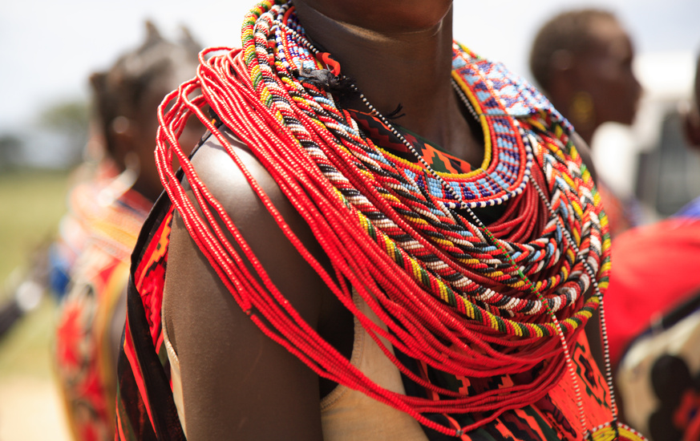
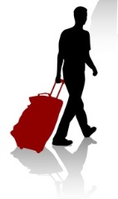
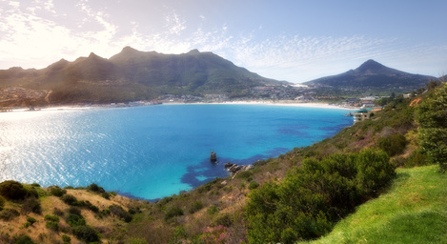


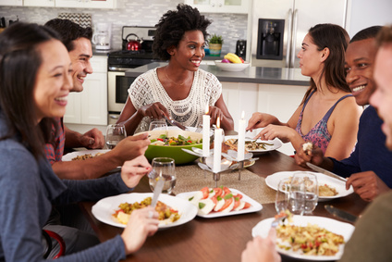
In terms of needs, South Africans primarily go on holidays to relax; their destination choices are influenced by friends’ recommendations and travel websites
Key Holiday-taking Characteristics of South Africans
South Africans believe that holidays give them an opportunity to take a break from the routine and relax. For ‘defend’ travellers, holidays also help to reconnect with the families
They believe that travelling domestically for holiday allows them to experience new and different things in the country. They also assert that travelling domestically is important to stay in touch with their friends and relatives
They prefer outdoor, nature-based destinations with the beach being a firm favourite, but the mountains and bush are also appealing
While some South Africans consider VFR a holiday, most of them believe that VFR trips restrict their freedom and enjoyment, and burden them with work
They get inspired to go on holidays based on recommendations by their friends. Though most prefer to plan their holidays, a select few go on the spur of the moment trips, often referred to as road trips
Most travellers favour the affordable option after researching on travel review websites. They prefer to manage bookings themselves using online travel booking websites
Source: Focus Group Discussions in South Africa, 2016

Slide 25
Domestic Market Performance: Purpose of Trips
‘Visit to Friends and Family’ is still the most prominent purpose for domestic trips of South Africans; however, it reduced share considerably in 2017
Domestic Trips by Purpose
2013
2014
2015
2016
2017
VFR
Holiday
Religion
Business
Medical
Others
Note: The information for 2017 is based on preliminary results
Source: Domestic Survey 2013-2017

Slide 26
Impact of Macro-economic Environment on Domestic Holiday-taking
Macroeconomic factors such as increasing taxes and unemployment rate, shrinking disposable income coupled with concerns over safety and security have negatively impacted the overall domestic tourism in recent years
Impact of Macro-economic Factors on Domestic Tourism
GDP Per Capita (USD)
Inflation Rate (%)
Unemployment Rate (%)
CAGR:
+2.7%
  Though the GDP per capita is expected to rise in 2017, the economy is still recovering from the significant drop it witnessed in 2016
  Despite decreasing inflation, lower government revenue has affected its ability to compensate wage earners in line with inflation. It has also resulted in higher income taxes for employed individuals, resulting in shrinking disposable income
  Rising unemployment rate due to skill shortages, declining global competitiveness, and frequent strikes at workplaces limit the economic growth in the country
Other Factors
Economic Outlook: According to a 2017 survey conducted by the Bureau for Economic Research at Stellenbosch University, South Africans have the most pessimistic economic outlook since the survey began in 1982
Water Crisis: The water crisis in major cities of South Africa such as Cape Town and Durban has become worse restricting travel to these cities
Increasing Crime: Increasing number of crimes in the country is also a concern for the citizens when planning travel
Source: IMF; World Bank; Federal Reserve; Fin24; businesstech

Slide 27

SA Tourism’s Marketing Efforts towards Domestic Holiday Tourism
SA Tourism actively launches targeted campaigns towards the domestic market; despite the economic environment, the holiday market witnessed an upward trajectory in 2017
Domestic Holiday Tourism Performance vs. Marketing Budget¹
Holidays Trip (In MM)
Other Marketing Budget (including Trade) (In MM)
Consumer Marketing Budget (In MM)
141.3
128.0
ZAR Million
52.7
35.6
Whatever you looking for. It’s here!
2013
2014
2015
2016
2017
Vaya Mzansi!
Nothing’s More Fun than a Sho’t Left...
Marketing Campaigns
A Million New Experiences are a Sho’t Left Away
It’s Your Country Enjoy It
Note: ¹The budgets include consumer marketing budget, trade budget and other budgets (towards provinces, etc.); The information for 2017 is based on preliminary results
Source: Domestic Tourism Analysis; Domestic Survey 2013-2017

Slide 28
Impact of Marketing Efforts: Perceptions towards Domestic Holiday-taking
Perceptions of the South African population towards domestic holiday-taking experiences have improved, which can potentially positively impact domestic holiday-taking in the future
Domestic Holiday-Taking Experiences within South Africa
  100%
  Overall (Feb ’17)
  n=1,000
  95%
  Overall (Aug ‘16)
  n=1,000
  90%
  85%
  0%
Awareness
of Holiday-taking experiences within SA
Consideration
of Holiday-taking experiences within SA
Selection
of Holiday-taking experiences within SA
Intent to travel
in the future
Intent to travel in
the next 12 months
Reasons to Travel within South Africa
  Aug ‘16 (n=821)
  Feb ’17 (n=829)
  Visit friends/ relatives
  Relax at beach/bush/berg
  Explore beautiful scenery
  Experience different cultures
  My friends/family recommended
  Enjoy the warm climate
  Visit historic sites
  Engage in a variety of activities
  Want to fulfil a dream
  For the food/wine
Source: Domestic Lifestyle and Brand Tracking Study Survey, Wave 0, 2016; Domestic Lifestyle and Brand Tracking Study Survey, Wave 1, 2017

Slide 29

Key Barriers to Domestic Holiday Travel: By Segments
While holiday-taking is increasing its competitiveness amongst other discretionary expenses, there is a growing concern over personal safety among South Africans, across target segments
Reasons to not Travel within South Africa
BUILD SEGMENT
Have a limited budget for travel that they set aside for their VFR trips
  Aug ‘16 (n=61)
  Feb ’17 (n=52)
CONVERT SEGMENT
  Aug ‘16 (n=17)
  Feb ’17 (n=13)
Consider South Africa as an expensive destination during the peak season; Concerned about their home and personal security
0%
0%
0%
0%
0%
0%
0%
0%
0%
DEFEND SEGMENT
  Aug ‘16 (n=15)
  Feb ’17 (n=29)
Assert that they can travel overseas at the cost of travelling domestically
0%
0%
0%
0%
0%
0%
  Will not have sufficient time
  Have other higher priority expenses
  Hard to find affordable accommodations and activities
  Concerns for my personal safety
  Not comfortable with the type of people I might meet
  Afraid of political climate/civil unrest
  Bad climate/weather
  Cannot plan due to health issues
  No relaxing destinations
  Do not know anyone outside the city/town
Source: Domestic Lifestyle and Brand Tracking Study Survey, Wave 0, 2016; Domestic Lifestyle and Brand Tracking Study Survey, Wave 1, 2017

Slide 30

Barriers to promoting domestic holiday travel
Infrastructure
  Well maintained infrastructure needs to be available for South Africans to enjoy an affordable holiday trip within South Africa.
  A study conducted in 2013/14 approximately 700 government owned resorts were identified as under-utilised or disused. The development of these sites by the National Department of Tourism, Provincial and Local Tourism Departments will ensure that there is a greater and more affordable offering for South Africans to travel their country.
  Most domestic tourists travel by road (cars, taxis and busses) to their destinations hence the importance of well-maintained roads. In destinations where the roads have been developed and well maintained, e.g. Limpopo, domestic tourism to those areas has improved.
  The water crisis in Cape Town led to holiday travelers considering other destinations to travel to. Holiday travel is a reward to South Africans and they prefer to go to destinations that provide them with that sense of reward. The water crisis and tourists being asked to take shorter showers leads to travel not being rewarding. Efforts for South Africans to be water wise should be in place throughout the year to limit such a crisis that has a huge impact on tourism in the country.

Slide 31

Barriers to promoting domestic holiday travel (Cont….)
New Product for New Market
  South Africa has a growing black middle class that is looking to explore the country in their own way. The Sho’t Left marketing initiatives also showcase black South Africans enjoying their country and its variety of experiences in their own way. South African Tourism therefore partners with the tourism industry and provides them with information pertaining to this target audience. The information includes who they are, what they are looking for in travel and at what cost, which assists in packaging for them appropriately.
  Racism is also a factor for this new market – partnerships are necessary to ensure that South Africans feel more welcomed when travelling in their own country.

Slide 32
Goals for the market 2018/19
Market Summary:
Domestic trip volume has declined over the 2014–2017 period and 2017 saw a considerable YoY decline. This is largely a function of adverse macro-economic conditions, with the sharpest decline occurring in the VFR category
By contrast, domestic holiday trips increased in 2017 after witnessing a continuous decline during 2013–2016.
Overall domestic trip spend and holiday trip spend declined YoY in 2017.
Average spend per trip grew strongly, driven by a sharp decline in total bed nights.
In 2017, Gauteng was the largest source market (37% of total); however, the number has been steadily declining. Limpopo was the most visited province (27% of total).
Visiting friends/relatives and relaxing at the beach/bush/berg were the top three factors influencing tourists’ intention to travel during 2016–2017.
More than half of the travellers select their destination based on recommendations from friends and family; online travel aggregators play a major role in making travel bookings.
The biggest challenge that we have is a conversion platform that is easy and reliable.

Slide 33
Goals for the market 2018/19
Consumer Insight:
South Africans are inspired by ‘Word of Mouth’ to travel for holidays; they most often leverage travel websites for information and booking. Furthermore, Relaxation is the most common holiday need across the three consumer segments.
  (Consideration - relaxation has to have a fun tonality to it)
Targets:
Holiday Trips = 3 106 000 (a 6,9% increase from 2017/18)
Total Direct Domestic Holiday Spend = R8,17 Billion
Big Things to be done:
Inspire our segments to take more holiday trips by showcasing a variety of affordable desired experiences in a clear and accessible manner.
Partner with and educate the distribution channels (traditional and non-traditional) to package and promote relevant value for money deals with supporting content on holiday activities, to encourage our prioritised segments book and travel.

Slide 34
The Campaign

Slide 35
KEY
CONSUMER INSIGHT

Slide 36
“I really love my country, and I would love to see all of the amazing sights and meet all the people, but it seems like an impossible dream.”

Slide 37
inspiration

Slide 38

We, the People of South Africa, declare for all our country and the world to know: that South Africa belongs to all who live in it.
So why are we not exploring it?

Slide 39
CHALLENGE

Slide 40
Access is the common factor:
Access to disposable income
Access to time
Access to information about what is available for the local tourist
Fear of the unknown

Slide 41
Through this campaign, we want to engage South Africans. We want to inspire them with the breadth of experiences that can be enjoyed within South Africa. Then, we want to turn that inspiration into action.
We want to call on all South Africans to experience an All Access Pass to Real South Africa, and enjoy all that our country has to offer.

Slide 42
How?

Slide 43
Summary of Activities
Activity | Date
Morning Live Campaign Launch | 30 November 2017
Photoshoot | 1 Dec 2017 – 31 Mar 2018
Radio Campaign | From Dec 2017
Always On Social Media | Ongoing
Public Relations | Ongoing
Travel Expo | Feb 2018
Out of Home | From March 2018
TV Campaign | From March 2018
Stokvel Activations | From Sept 2018
Holiday Expo | Aug 2018
Annual Sho’t Left Travel Week | 24 – 30 Sept 2018
Public Sector Activations | From Oct 2018

Slide 44

Radio Campaign Promoting Holiday Travel
(sound to be played on the day)
Generic Brand Message
Business Travel
International Travel
Beach Experience
Safari Experience
Winelands Experience

Slide 45






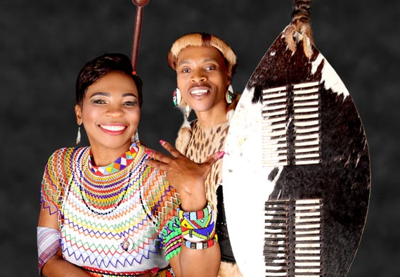


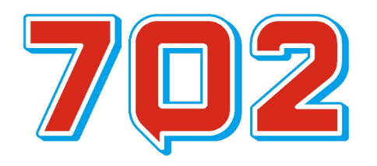



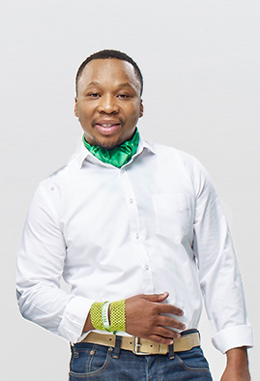








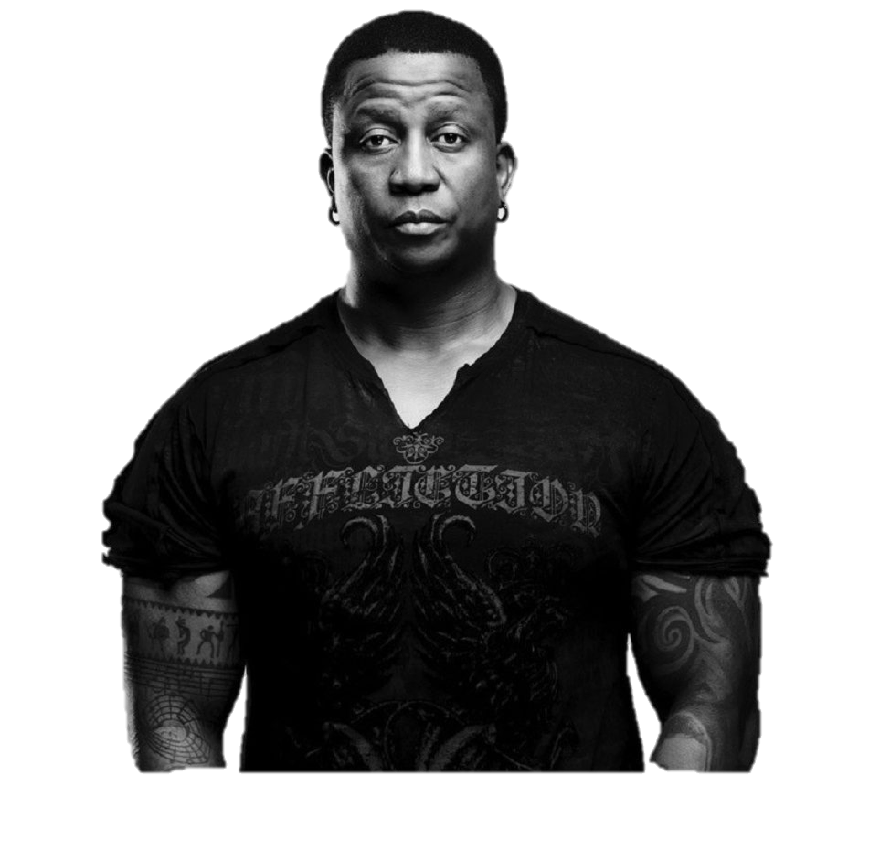




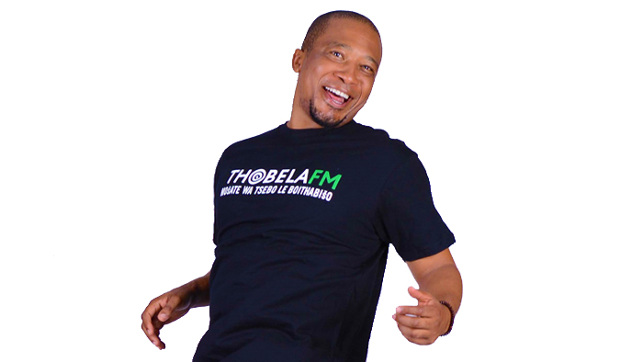



National and Regional Radio Campaign Promoting Holiday Travel and Packages
Radio Station | Activities | Target Show | Added Value | Province: Hosting
 | Power Spots DJ Endorsement Travel Clubs DJ Exchange |  | Interviews with SAT EXCO Competition and promos 2 x Outside Broadcasts Interview with competition winner | Western Cape Northern Cape
 | Power Spots DJ Endorsement Travel Clubs DJ Exchange |  | Interviews with SAT EXCO Interview with competition winner | North West Limpopo
 | Power Spots DJ Endorsement Travel Clubs DJ Exchange |  | Interviews with SAT EXCO 2 x Outside Broadcasts Competition and promos Interview with competition winner | KwaZulu Natal Gauteng
 | Power Spots DJ Endorsement Travel Clubs |  | Interviews with SAT EXCO Competition and promos Interview with competition winner | Free State Eastern Cape
 | Power Spots DJ Endorsement Travel Clubs |  | Interviews with Tourism Minister Interview with competition winner | Eastern Cape Mpumalanga
 | Power Spots DJ Endorsement Travel Clubs DJ Exchange |  | Interviews with SAT Interview with competition winner | Limpopo Western Cape
 | Power Spots DJ Endorsement Travel Clubs DJ Exchange |  | Interviews SMME Tour Operator Interview with competition winner | Gauteng North West
 | Power Spots DJ Endorsement Travel Clubs DJ Exchange |  | Interviews SAT EXCO MetroFM Awards Hosting Somizi TV Show Interview with competition winner | Northern Cape Free State
 | Power Spots DJ Endorsement Travel Clubs DJ Exchange |  | Interviews Provincial Tourism Authority EXCO Interview with competition winner | Mpumalanga KwaZulu Natal
Reach: 979k
498 000
410 000
130 000
DJ: T-BOSE - THE BEST T IN THE CITY (9AM – 12PM)
Reach: 7.6m
1,15m
197 000
263 000
NDIZA NATHI (12PM - 3PM)
DJ’s: MROZA & SBU BUTHELEZI
Reach: 1.4m
738 000
149 000
257 000
THE GOLDEN CIRCLE (9AM – 12PM)
DJ: MFUNDO DAZZLING
Reach: 1.0m
160 000
541 000
241 000
AZANIA MOSAKA SHOW (1PM – 3PM)
DJ: AZANIA MOSAKA
Reach: 5.4m
788 000
14 000
297 000
MASIGODUKE (3PM – 6PM)
DJ: AMAZA NTSHANGA & ZIZO TSHWETE
Reach: 700k
93 000
37 000
164 000
DZIAOROWA (3PM – 6PM)
DJ’s: DIVHAMBELE MBALAVHALI
Reach: 300k
160 000
64 000
60 000
URBAN LUNCH EXPEREIENCE (12PM – 3PM)
DJ: DEE NKOMO & ITU BANDA
Reach: 4m
1,9m
845 000
1,2m
FRESH BREAKFAST (5AM – 8AM)
DJ: DJ FRESH
Reach: 2.9m
415 000
11 000
159 000
MOSWA LE BOKAMOSO (3PM – 6PM)
DJ: SKHUMBUZO MBATHA

Slide 46
About Holiday Expo
Holiday Expo is a platform where travel exhibitors sell packages directly to consumers. - SA Tourism is hosting 17 Hidden Gems who have created packages that they will be selling at the EXPO. - The Hidden Gems underwent a 3 day training on running a business and packaging for the local market. - They also spent 3 months with a mentor who assisted them in creating marketing material for their businesses.
Province: Gauteng
Curiocity Backpackers (Maboneng) | Accommodation
The Hub Presents (Alex) | Experience
Tshuku's Transport Services (Cradle/Westrand) | Tour Operator
Province: Western Cape
Cultivar Travel | Tour Operator
San Parks | National Parks
Province: Kwa Zulu Natal
Africa Ignite (WoW Zulu) | Tour Operator
Happy Hippo accommodation | Accommodation
Province: Eastern Cape
Park Place Boutique Hotels CC | Accommodation
Drifters Raceway Theme Park | Experience
Province: Limpopo
Lapologa Bed & Breakfast | Accommodation
Province: Mpumalanga
Ntwanano Kruger Safaris | Tour Operator
Visit Vakasha Guest Lodge | Accommodation
Province: Free State
Vuka Tours | Tour Operator
Lions Rest Country Estate | Accommodation
Clarens Extreme adventure | Experience
Province: NorthWest
Thaba Legae Guest Lodge | Accommodation
Province: Northern Cape
Native Minds Heritage | Adventure Operator

Slide 47
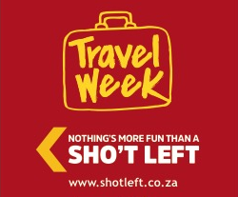
SHO’T LEFT TRAVEL WEEK
24 – 30 Sept 2018
Unlock holiday travel to all South Africans.
On a specified week, South African Tourism, in partnership with Tourism Grading Council of South Africa (TGCSA) and Provincial Tourism Authorities, would initiate an open week that unlocks the country to all South Africans who hold a valid ID, passport or driver’s license. This would include among others, free access to national parks and museums, discounts at graded establishments, discounts with transport partners etc.
24 – 30 September 2018 is the booking period and travel can happen later in the year (depending on the partners’ terms and conditions).
This is in line with our objective of providing easy access for South Africans to travel.

Slide 48












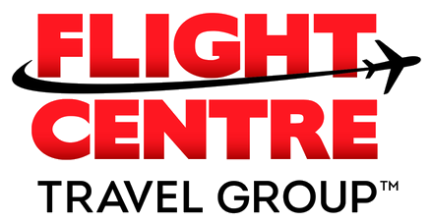




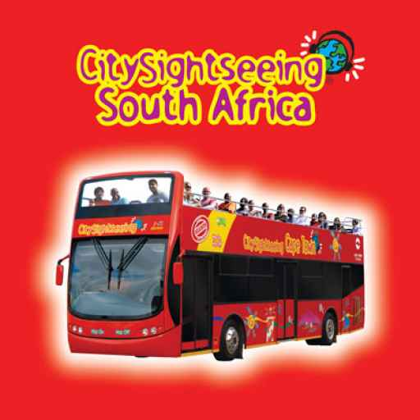

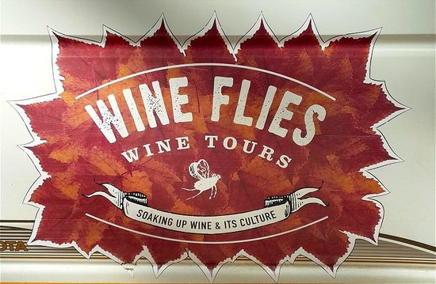


445 partners are registered (discounts ranging from 30% – 50%)
Highlights: (Hidden Gems also part of Travel Week.)

Slide 49
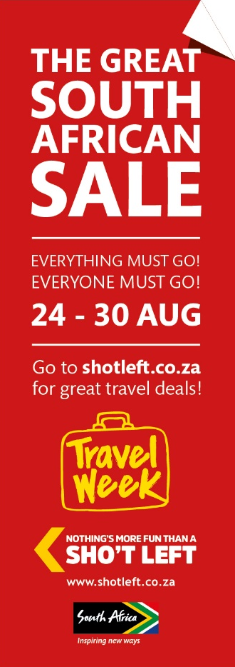
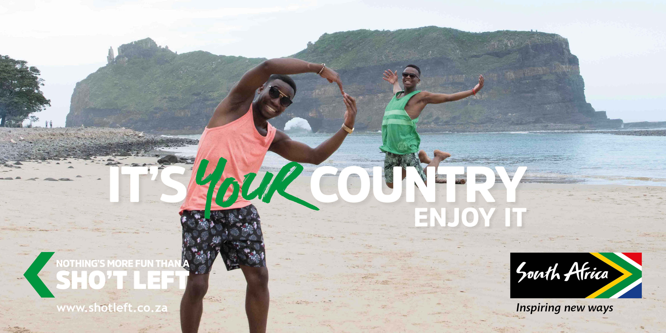
Out of Home including Airport TV and Gautrain TV: 17 sites
24 – 30 Sep 2018

Slide 50

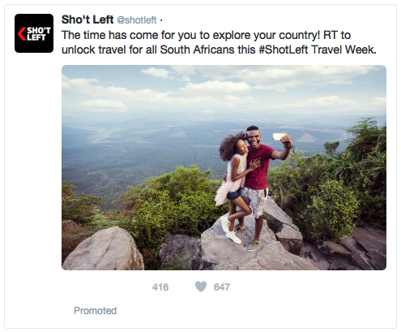
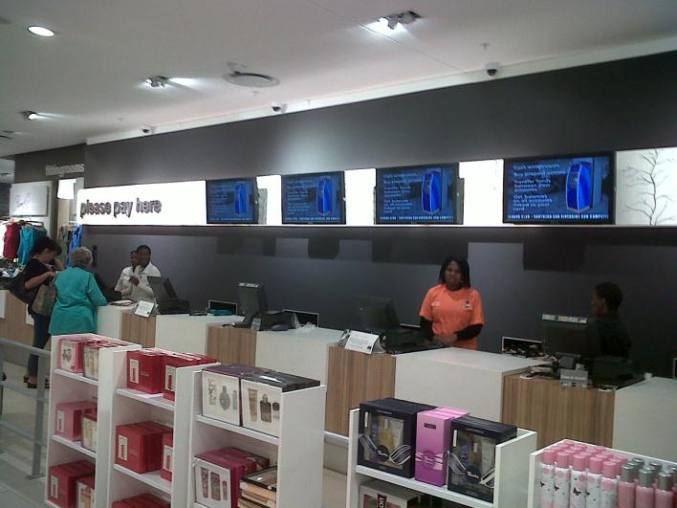
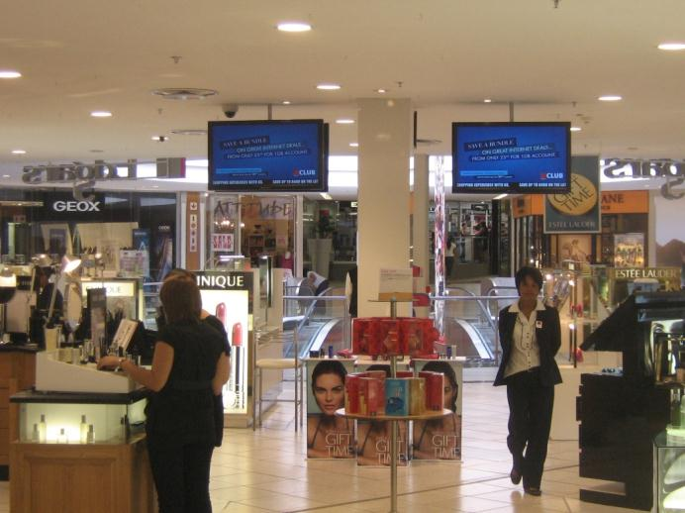
Digital and Social Media Promotion starting 1 – 30 September 2018
Edgars (86 stores)
Red Square (40 Stores)
Edgars Active (100 stores)
Clicks - (top 50 grossing stores in SA)
2 x 15 sec ads every 10 minutes for a month.

Slide 51
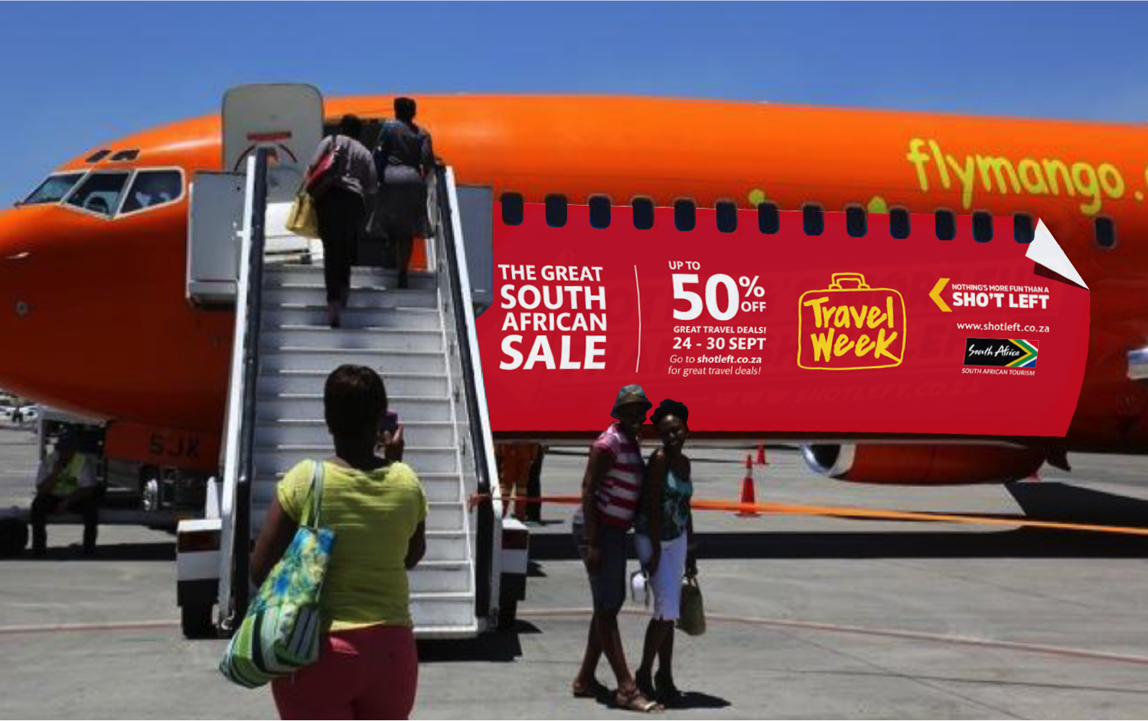
Branding of Mango Airline

Slide 52















Mass media promotion: 1 - 30 September

Slide 53
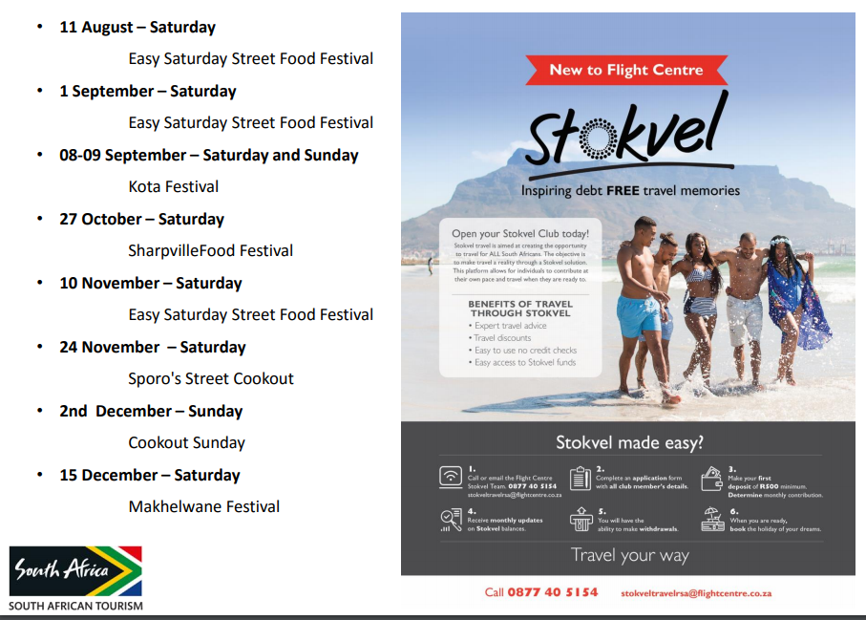
Stokvel Activations in partnership with Flight Centre

Slide 54
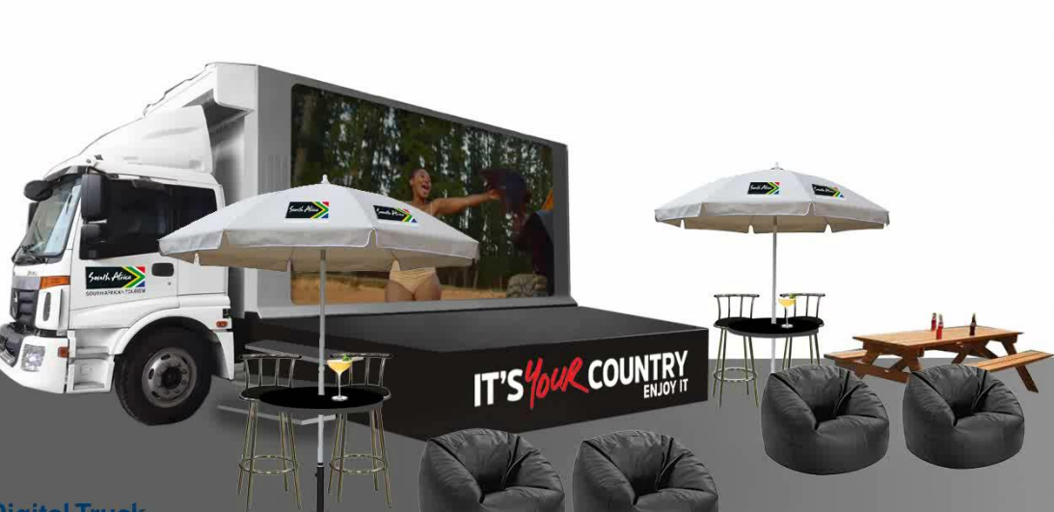
Digital Truck will be used as mobile billboard as well as interactive activation at the Stokvel Events

Slide 55
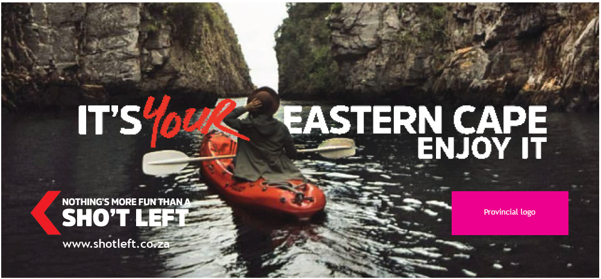
Provincial Creative

Slide 56
Acronyms
DT: Department of Tourism
DTGS: Domestic Tourism Growth Strategy
PSC: Project Steering Committee
SAT: South African Tourism
STS: Social Tourism Scheme
TM: Tourism Month

Slide 57

THANK YOU

