Slide 1
BRIEFING TO THE PORTFOLIO COMMITTEE ON PUBLIC WORKS FOCUSING ON PREVENTION AND REDUCING FRAUD RISK
04 SEPTEMBER 2018

Slide 2
Table of Content
No. | ITEM | Slide
1. | Introduction | 3-4
2. | Guiding Principles & Legislation | 5
3. | Fraud Prevention Strategy | 6-7
4. | Fraud Risk Management / Fraud Index | 8-9
5. | Key Components of the DPW Fraud Risk Plan | 10
6. | Fraud Prevention Framework | 11
7. | High Fraud Risks | 12
8. | Improvements on Internal Controls: Supply Chain Management Facilities Management Prestige Projects Construction & Maintenance Projects Financial Management Real Estate Management EPWP | 13-30
9. | Internal Investigations Statistical Overview on Allegations Reported Categories of Allegations Reported Statistical Overview on Disciplinary Action Statistical Overview on Criminal referrals to SAPS | 31-35
10 | Advocacy & Awareness Campaigns | 36
11 | The Special Investigating Unit | 37-42
No. | ITEM | Slide
12. | Project A – Security upgrades at President’s private residence at Nkandla Ministerial Task Team Investigation/Report Public Protector’s Investigation/Report SIU Investigation/Report | 43 44 45 46
13. | Unscheduled Maintenance Introduction and Background Expenditure per Region Expenditure per Service Provider Expenditure Maintenance per Building Extract of Possible Duplicate Payments Frequency of Payments Internal Control Weaknesses identified and Possible Fraud Risks Internal Investigations Proclamation R 20 OF 2018 Systemic Recommendations made to Management to Date | 47-59
12. | Maintenance and Repairs Projects | 60-64
13. | Conclusions | 65-67

Slide 3
Introduction
“A HOLISTICAL APPROACH TOWARDS COMBATING FRAUD, CORRUPTION AND UNETHICAL BEHAVIOUR WITHIN THE DPW AND PMTE”
The Department is aware that services cannot be delivered in an effective and efficient manner in an environment of high fraud risk.
As with any other organisation and with a combined annual property budget of approximately R20bn, the Department is not immune to fraud and corruption risks. Industry Reports along with our own experience would indicate that the construction and property sectors are highly susceptible to fraud and corruption risks.
This is largely due to the vast money involved in the sector and the nature of the job to be done, which is highly technical and with a few skilled capacity around to effectively manage and oversee infrastructure projects. The infrastructure sector therefore remains vulnerable to bid-rigging, credential misrepresentations, collusive tendering, bribery and general fraudulent misdemeanours.

Slide 4
Introduction cont.
“….up to R30bn is being lost annually to corruption in all spheres of government, emphasising the need for a tightening of systems
Review of R500bn on goods and services and construction work in the 2013-14 fiscal year revealed the following:
staff did not understand the importance of what they did;
inadequate skills;
high staff turnover;
no separation of responsibilities between technocrats and political office-bearers;
no consequences for those who failed to perform appropriately;
cumbersome regulations and policies;
difficulty of balancing transformation with getting work of the right quality at the best prices, on time.

Slide 5
Guiding Principles (Legislative And
Regulatory Environment)
Public Finance Management Act (S 38 (b) (h, II): Procurement)
Prevention and Combating of Corrupt Activities Act
Protected Disclosure Act
Constitution
Additional legislation, policies & regulations
DPW Fraud Prevention Strategy
DPW Whistle-Blowing Policy
Public Service Anti-Corruption Strategy
Code of Conduct for the Public Service

Slide 6
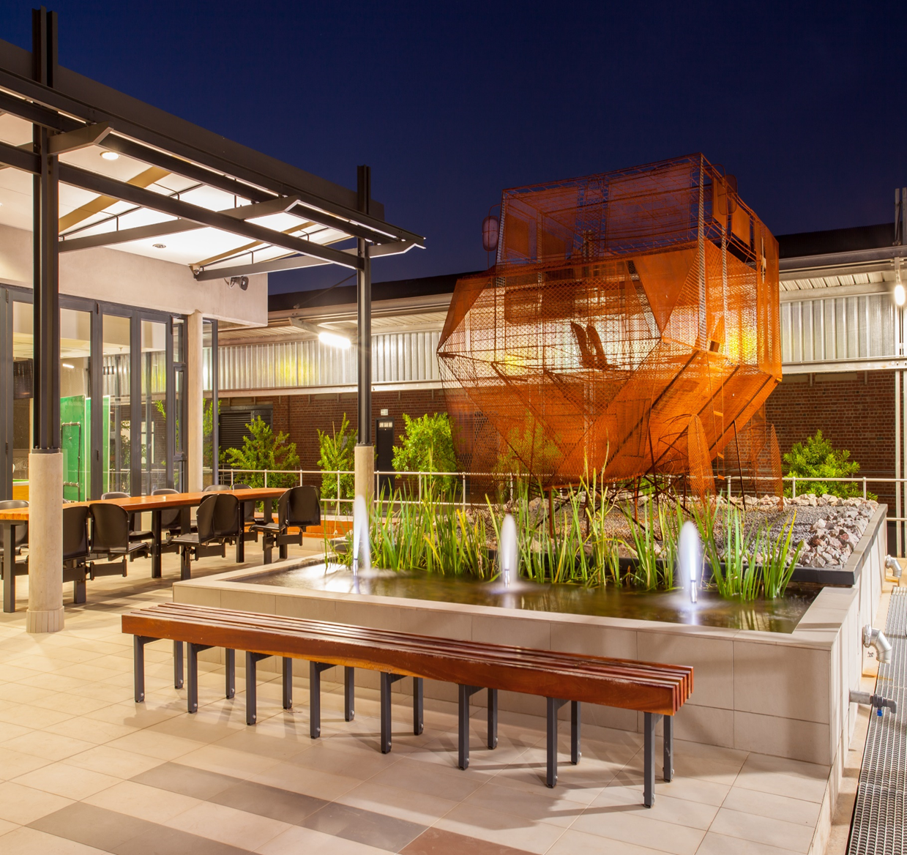
FRAUD PREVENTION / PRO-ACTIVE MEASURES

Slide 7
Fraud Prevention Strategy
Anti-Fraud and Corruption has become a significant measure of good governance in Government. In order to achieve good governance and effective service delivery, an Anti-Fraud and Corruption Strategy and measures must be put in place to prevent fraud and corruption.
DPW has an approved Fraud Prevention Strategy which is being rolled out across the Department.
The strategy identifies basic fraud and corruption prevention measures, which are already in place within the DPW.
The strategy evolves as DPW makes changes and improvements in its drive to promote good governance, accountability and effectively fight fraud and corruption.
The Plan/Strategy is reviewed periodically to enable the strategy to be effective in responding to nature of the prevailing challenges.
The Fraud Prevention Strategy however, does not guarantee that the DPW will not be impacted by incidents of fraud and corruption but, is intended to serve as an additional measure to assist in the limitation of the impact of fraud and corruption risks, with a particular focus on creating awareness and promoting ethical business conduct.
Anti Fraud and Corruption Strategy is comprised of Four (4) elements:
Proactive | Reactive
Prevention e.g. Fraud Risk Management | Investigations e.g. Internal Capacity, SIU
Detection e.g. Whistle-Blowing and Reporting Mechanisms | Resolutions e.g. Improved Controls, Disciplinary, Criminal and Civil

Slide 8
Fraud Risk Management
The Department of Public Works (DPW) during the 2015/16 embarked on a journey to develop a Fraud Prevention Plan, which is in line with the Public Finance Management Act, No 1 of 1999 (PFMA) and related National Treasury Regulations promulgated in terms of the PFMA.
In this respect the DPW will focus on proactive measures designed to identify fraud and corruption risks and manage or mitigate these risks proactively. Placing emphasis on preventative action through a fraud and corruption risk management framework significantly reduces the time, effort, costs and potential reputational damage of reacting to incidents of fraud and corruption.
Over a number of years the Department has been associated with fraud and corruption and serious maladministration, central to this was procurement related e.g. Inflated pricing in prestige projects; and to a larger extent mismanagement of leases. This was also made worse by the negative media publicity e.g. SAPS leases.
Adverse reports from Chapter 9 institutions e.g. Public Protector and AG Reports further underscored the undesirable state the Department was in, with regards to acts associated with fraud, corruption and maladministration. Instability in Senior Management positions also played a significant role in the manifestation of such acts and further undermined efforts to effectively address the fraud/corruption risks posed to the Department.
Emanating from investigations conducted both by the Internal Investigation Unit and the Special Investigating Units there appears to be a strong indication that the investigations conducted seems to point to the same areas of concerns being raised repeatedly without such being addressed which points to poor fraud risk management practices.

Slide 9
Fraud Risk Management
In order to further demonstrate its commitment to the effective and efficient management of fraud and corruption risks within the Department, the Department’s has committed through its Strategic Plan to reduce the FRAUD RISK EXPOSURE BY 85% by the 2019/20 financial year.
This fraud index was developed to measure fraud and corruption risks and risk owners were then expected to mitigate fraud risk within their area of responsibility and to report quarterly on their action plans to mitigate fraud risks, by implication the reduction in risk levels in respect of fraud and corruption risks.
All Branches are expected to incorporate fraud risks management in their business plans and action plans to mitigate identified fraud risks and report on progress with implementation thereof.
The measuring of the reduction in risk levels also in itself a very contentious subject as it is not based on any scientific processes but rather a matter of perception from the end-user point of view. for instance if the action plan was to develop a policy to ensure minimum documents required to process a payment after the development of the policy one will thus assume that the risk has been mitigated thus the exposure level has decreased, which might not necessarily a true reflection of the status quo

Slide 10
Key Components of the DPW
Fraud Risk Plan
Roll-Out of the DPW Fraud Risk Management Plan
No. | Milestone | Activities
1. | Framework Development | Fraud Prevention Plan, Anti-Corruption Strategy etc.
2. | Fraud Risk Assessment | Conduct fraud risk assessment workshops etc.
3 | Code of Conduct | Code of Conduct - Best practices
4 | Employee Due Diligence | Vetting process for hiring
5 | Suppliers Due Diligence | Supplier vetting processes
6 | Process Specific Fraud Controls | Fraud Risk Register, identify and develop anti-fraud controls/measures
7 | Monitor Prevention Controls | Test Control effectiveness
8 | System of Reporting Incidents | Maintain internal and external reporting mechanisms
9 | Data Analysis | Develop an automated Fraud Detection Methodology and Implementation
10 | Response Programs | Investigation methodology, Accountability processes

Slide 11
Fraud Prevention Framework
Fraud Risk Management
Risk assessment at strategic and operational level of the Department will include the assessment of fraud and identification of mitigating action plans and controls.
Integrated Strategy for Fraud Prevention and Control
All business units within the Department will have to align their financial and business internal control systems to the fraud prevention plan putting in place key controls that specifically address the risk of fraud.
Develop an Ownership Structure from the Top to the Bottom of the Department
Branches will be responsible for implementation of the fraud prevention plan within their area of responsibility.
Sound Operational Control Procedures
Management must put in place basic internal controls to prevent and detect fraud and corruption
Periodic Reports on the effectiveness of risk control effectiveness
As part of the risk monitoring, management will be required to report periodically on the risk control effectiveness

Slide 12
High Fraud Risks
Currently the DPW Fraud Risk Register contains 10 high fraud risks identified through the fraud Risk Process
Risk No | Risk Title
1 | Abuse of unscheduled maintenance
2 | Collusion between DPW officials and contractors
3 | Inflation of prices and scope of work
4 | Conflict of interest
5 | Irregular award of tender contracts
6 | Constructions Projects Mismanagement
7 | Duplicate payments
8 | Cover Quoting
9 | Fronting / Credential Misrepresentation
10 | Illegal transfer of State Properties
Appears on both
DPW and PMTE
risk registers
Appears on DPW’s
risk register only
Appears on PMTE’s
risk register only

Slide 13
IMPROVEMENTS ON INTERNAL CONTROLS:
SUPPLY CHAIN MANAGEMENT

Slide 14
Improvements on Internal Controls Supply Chain Management
NO. | WEAKNESSES | CONTROLS ENHANCEMENTS
1. | Abuse of Emergency Deviation | SCM to issue a Departmental directive wherein it will be stipulated that any work that is considered an “emergency” must first be tested against the National treasury definition of an emergency prior to be approved. If it found that work done the emergency definition was in fact not an emergency, the official who approved the emergency will be held accountable for the deviation.
 |  | The scope of work approved under the emergency delegations must not be expanded by client Departments or the service provider without following proper authorisation processes.
 |  | All RBCA must demand that any emergency work done which requires ex post facto ratification to facilitate payment, must be accompanied by a comprehensive motivation substantiating emergency.
 |  | Where an emergency occurs during normal working hours, all effort must be made to issue the contractor with a Government order which clearly stipulates the quantum of work to be done.

Slide 15
Improvements on Internal Controls Supply Chain Management
NO. | WEAKNESSES IDENTIFIED | CONTROLS ENHANCEMENTS
2. | Preferential Treatment of Service Providers | DPW Regions to implement term contracts for Facilities Management to ensure that a pool of prequalified services providers are shortlisted and work rotated equitably amongst them.
3. | Inordinate Deviations | The Department has implemented a business process for the management of all deviations that are either approved by the Department or submitted to NT. No official is empowered to approve a deviation that is not an emergency or sole supplier as this approval/support is delegated to the BAC
 |  | The DPW has adopted a zero tolerance to deviations and in this regard has issued circular No 15. The circular makes it compulsory to obtain a minimum of 3 quotes at all times and prohibits officials from taking procurement submissions directly to the AO for consideration. Submissions can only be referred to the delegated Committees
5. | Non-Compliance with SCM processes | The DPW has implemented a Procurement Compliance Checklist which serves as procurement gates for each procurement phase to ensure that awards made are not irregular nor deviate from supply chain prescripts.

Slide 16
IMPROVEMENTS ON INTERNAL CONTROLS:
FACILITIES MANAGEMENT

Slide 17
Improvements on Internal Controls Facilities Management
NO. | ACTIVITY | CONTROLS ENHANCEMENTS
1. | The FM Branch to consider a full re-implementation of scheduled maintenance term contracts | Draft directive of terms contracts is being developed – 30 August 2018 target date
2. | Schedule to term contracts should be managed by the relevant Works Managers | Reviewed in line with Archibus roll-out an issue a directive – 30 August 2018 target date
3. | Reporting of defects in respect of scheduled maintenance by Facility Managers be allocated a separate call reference number as opposed to those used for day-to-day maintenance. | Reviewed in line with Archibus rollout - CD FM & applicable branches – 21 September 2018
4. | Works Managers should keep an updated asset register, i.e. similar to that of the Facility Managers in order to monitor defects reported on specific items which could prevent duplicate/unnecessary defects reported on the same items | Reviewed in line with Archibus rollout - CD FM & applicable branches – 21 September 2018

Slide 18
Improvements on Internal Controls Facilities Management
NO. | ACTIVITY | CONTROLS ENHANCEMENTS
5. | Works Managers should keep an updated asset register, i.e. similar to that of the Facility Managers in order to monitor defects reported on specific items which could prevent duplicate/unnecessary defects reported on the same items | Programme on the capacity of artisans is being discussed Professional Services and HRD and a roll out plan being developed - CD FM, CD Professional Services & HRD – 30 August 2018
6. | DPW must consider the possibility of constructing its own warehouse to stock all major parts and consumables required for routine and general maintenance projects such as air conditioners, chillers, boilers, painting, swimming pools | To be incorporated into the FM strategy that is being developed - CD FM & applicable branches – 30 September 2018
7. | Training should be provided to DPW Workshop officials to enhance their skills so as to place the DPW in a position where all maintenance related to air conditioning, boilers, chiller plants, etc. can be managed in-house | Programme on the capacity of artisans is being discussed Professional Services and HRD and a roll out plan being developed -CD FM, CD Professional Services & HRD – 30 August 2018

Slide 19
Improvements on Internal Controls Facilities Management
NO. | ACTIVITY | CONTROLS ENHANCEMENTS
8. | DPW should consider either establishing a flat rate for these "checking" services to be charged by the contractors, alternatively utilize the DPW Workshop officials who has the necessary skills to render these services. | To be incorporated into the FM strategy that is being developed - CD FM & applicable branches – 30 September 2018
9. | In terms of an existing DPW Service Level Agreement, it is recommended that several sections thereof should not only be applicable in a Service Level Agreement situation but also in respect of contractors appointed for day-to-day maintenance | Review SLA and strengthen contract management - CD FM & applicable branches – 30 September 2018
10. | Works Managers should inspect prospective contractors' premises, plant and equipment prior to appointment | Reviewed in line with Archibus rollout - CD FM & applicable branches – 30 August 2018
11. | Regional Managers should reserve the right to execute repairs or replacement with DPW Workshop staff | Reviewed in line with Archibus rollout - CD FM & applicable branches – 30 August 2018

Slide 20
Improvements on Internal Controls Facilities Management
NO. | ACTIVITY | CONTROLS ENHANCEMENTS
12. | Contractors should submit, along with his claim, valid warranties in respect of parts, components or materials supplied; all redundant parts, components or material must be labelled with the complaint number and delivered to the DPW Workshop as it remains the property of DPW | Reviewed in line with Archibus rollout - CD FM & applicable branches – 30 August 2018
13. | Emergencies should be addressed within 2 hours and normal repairs within 8 hours upon receipt of complaint | Reviewed in line with Archibus rollout and Day-to-Day guidelines – CD FM & applicable branches – 30 August 2018
14. | Where a Client Department's core function relates to the wellbeing and safe keeping of humans and animals; such as the Zoo, 1 Military Hospital, SAPS K-9 unit, Aviation Medicine and prisons, the critical buildings' defects; especially emergency defects, must be addressed immediately and their budgets should be ring-fenced in order to ensure the availability of funding at all times and prevent other non-essential buildings from utilizing their funds. | Reviewed in line with Archibus rollout - CD FM & applicable branches – 30 August 2018

Slide 21
Improvements on Internal Controls Facilities Management
NO. | ACTIVITY | CONTROLS ENHANCEMENTS
15. | DPW should consider establishing a priority unit within the Works Managers space, where designated Works Managers are allocated to these critical buildings only (Zoo, 1 Military Hospital, SAPS K-9), in order to ensure rapid response to defects reported as and when they arise | Reviewed in line with Archibus rollout - CD FM & applicable branches – 30 August 2018
16. | Facility Managers should keep an updated asset register in respect of all equipment and items of their relevant buildings | Reviewed in line with Archibus rollout - CD FM & applicable branches – 30 August 2018
17. | When reporting a defect to the DPW Call Centre, the Facility Managers should provide a complete description of the defect, differentiate between whether the defect is an emergency or not, differentiate between whether it is a mere service that is required or repairs, include a detailed description of the location of the defect and include the relevant asset register number allocated to the specific item | Reviewed in line with Archibus rollout - CD FM & applicable branches – 30 August 2018

Slide 22
Improvements on Internal Controls Facilities Management
NO. | ACTIVITY | CONTROLS ENHANCEMENTS
18. | Facility Managers should keep an updated maintenance register in respect of all defects reported including information such as; date the defect was reported, description of the defect, call reference number, name of Works Managers allocated, date the contractor reports on site, name of contractor and the supervisor, date when the work is completed, client representative who verifies that the work was completed, date when Works Manager inspect that the work was completed, date when Facility Manager signs off on the job card and copy of the approved job card filed as per the maintenance register. | Reviewed in line with Archibus rollout - CD FM & applicable branches – 30 August 2018
19. | The DPW Call Centre business operations must be revised to enable call centre operators to combine calls relating to similar or exact services required on one breakdown notification report as a means of ensuring that required services and thus all subsequent processes to be followed are not duplicated and/or split into separate transactions. | Reviewed in line with Archibus rollout - CD FM & applicable branches – 30 September 2018
20. | The planning of the maintenance is completed in conjunction with the Client Department and signed off by the Facilities Manager | Reviewed in line with Archibus rollout - CD FM & applicable branches – 30 September 2018

Slide 23
IMPROVEMENTS ON INTERNAL CONTROLS:
PRESTIGE PROJECTS

Slide 24
Improvements on Internal Controls Prestige Projects
NO. | ACTIVITY | CONTROL ENHANCEMENTS
1. | There was no proper record keeping by Construction Project Managers and/or Supply Chain Managers | A proper system of record keeping has been introduced in order to safeguard all information relating to a specific project
2. | The Project Managers instructed Principal Agents to appoint various other consultants, and to claim their cost as a disbursement; | Project Managers have received proper training regarding the provisions of the JBCC contract, especially relating to the appointment of contractors.
3. | Proper training should be provided to the Project Managers in order for them to gain an understanding of proper procurement processes, which will further reduce instances of irregular expenditure | The Project Managers are regularly taken on training

Slide 25
Improvements on Internal Controls Prestige Projects
NO. | ACTIVITY | CONTROL ENHANCEMENTS
4. | Project costs escalated subsequent to the appointment of the professional consultants and that proper needs assessments were not conducted; and Projects were identified and were then motivated to be conducted on an urgent basis, but an urgency did not in fact exist, and the true reason for the execution of the project was to ensure that the annual budget was spent, which led to the incurrence of irregular expenditure | Comprehensive needs assessments are conducted prior to the appointment of a professional team in order to minimise escalation in the required budget; The professionals within the DPW are fully utilised throughout the duration of a project in order to guide and provide input to the various Project Managers. This has resulted in reduction of irregular expenditure
5. | The DPW Quantity Surveyors did not properly keep record of interactions with contractors and other role players during the scrutiny of the final accounts | A proper system of record keeping has been introduced in order to safeguard all information relating to contractors and other role players
6. | Consultants were merely re-appointed on new projects without following a proper procurement process | Project Managers have received training regarding the provisions of Section 217 of the Constitution that requires the department to test the market before appointing consultants. The process to be fair, transparent and competitive.

Slide 26
IMPROVEMENTS ON INTERNAL CONTROLS:
FINANCIAL MANAGEMENT (PMTE)

Slide 27
Improvements on Internal Controls Financial Management (PMTE)
NO. | ACTIVITY | CONTROLS ENHANCEMENTS
1. | Validation of payments by the system | Payments are processed on the sub-system and interface to a financial system for further processing and approval. The controls that have been built into the system is such that duplicate payments are easily detected and cannot be overridden.
2. | Bank Reconciliation | Bank Reconciliations are performed daily to reconcile the bank account against payments that have been processed on financial systems. Exceptions are cleared on a daily basis and reported to National Treasury on monthly basis.
3. | Safety Net | Safety Net is we-based payment system developed by the NT, in conjunction with the SARB and various commercial banks. The payment system verifies the details of the PAYEE against the details held by the receiving banks, who have FICA their clients.
4. | Segregation of duties | The system and processes within Finance are such that no one official may capture and authorise a payment. The approver is always an official at the rank above the capturer.
5. | Approval procedures in place | Officials are provided with training on procedures that are in place when it comes to approving payments and comply with the delegated authority. The risk of invalid payments are greatly reduced.

Slide 28
IMPROVEMENTS ON INTERNAL CONTROLS:
REAL ESTATE MANAGEMENT SERVICES

Slide 29
Improvements on Internal Controls Real Estate Management Services
NO. | ACTIVITY | CONTROLS ENHANCEMENTS
1. | The department to review its standard leasing agreement to reflect the following clauses, namely: The expiration or termination of this agreement shall not affect those provisions of this agreement which expressly provide that they will operate after any such expiration or termination or which of necessity must continue to have effect after such expiration or termination, notwithstanding the fact that the clauses themselves do not expressly provide this. The standard Lease Agreement does not address the possibly of insolvency/liquidation of the lessor at all. The standard Lease Agreement does not deal with the concept of operational cost at all. various clauses of the standard Lease Agreement are deleted by the landlords, and this is merely accepted by employees of the DPW. | The department has embarked on many workshops to solicit the inputs of key stakeholders in finalization of the DPW standard lease agreement. The process is on-going
2. | The landlords submitted false tax certificates to the department and the department relied on such tax certificates and awarded leases to such landlords. SIU has recommended that the department place such landlords on National Treasury’s Database of Restricted Suppliers | The department has already commenced with this process and it is on-going
3. | Department is paying for more parking bays than what is made available | the department already commenced to offset such loss against future rentals due to landlords

Slide 30
Improvements on Internal Controls Real Estate Management Services
NO.
4. | Department is paying for more space than what is actually available in the leased building. In other words, the space as recorded in the lease agreement differs from what is actually available | the department has already commenced the process to recover such losses back from landlords through offsetting such loss against future rentals due to those landlords. The department going forward will be insisting on a SAPOA certificate from landlords certifying the space and parking that is being made available.
5. | Lease premises are in an unsatisfactory condition and do not comply with the relevant prescripts of the Occupational Health and Safety Act, No. 85 of 1993 | the lease agreement between the department and landlord provides that maintenance and repair of the premises is the responsibility of the landlord and where the landlord fails to carry out this responsibility then department to write a letter to the landlord to repair the premises in 30 days. Should the landlord fail to effect the said repairs then the department can repair the premises and offset the monies from rental due to landlords.
6. | Leases are continually renewed without first testing the market. | department testing the market before awarding the leases to landlords

Slide 31
INTERNAL INVESTIGATION / ANTI-CORRUPTION UNIT

Slide 32
Investigations: Statistical Overview
on the Allegations Reported
 | 2012/13 | 2013/14 | 2014/15 | 2015/16 | 2016/17 | 2017/18 | 2018/19 | TOTALS
REGISTERED | 58 | 50 | 39 | 50 | 28 | 24 | 4 | 253
FINALISED | 58 | 50 | 39 | 40 | 25 | 12 | 0 | 224
INTERNAL REPORTING | 0 | 0 | 0 | 0 | 1 | 4 | 0 | 5
FIELDWORK | 0 | 0 | 0 | 0 | 0 | 8 | 4 | 12
REFERRED SIU/BU | 0 | 0 | 0 | 10 | 2 | 0 | 0 | 12
NOT STARTED | 0 | 0 | 0 | 0 | 0 | 0 | 0 | 0

Slide 33
Investigations: Statistical Overview
on the Allegations Reported
CATEGORY | 2012/13 | 2013/14 | 2014/15 | 2015/16 | 2016/17 | 2017/18 | 2018/19 | TOTALS
Fraud / Corruption | 21 | 18 | 10 | 29 | 6 | 7 | 2 | 93
Tender Irregularities | 14 | 10 | 17 | 14 | 12 | 7 | 1 | 75
Financial Misconduct | 5 | 8 | 6 | 6 | 7 | 6 | 0 | 38
Lease Irregularities | 6 | 4 | 2 | 0 | 1 | 1 | 0 | 14
Human Resources | 7 | 2 | 2 | 1 | 3 | 3 | 1 | 18
Project Mismanagement | 2 | 5 | 2 | 0 | 0 | 0 | 0 | 9
Security Breaches | 3 | 1 | 0 | 0 | 0 | 0 | 0 | 4
EPWP Beneficiaries | 0 | 2 | 0 | 0 | 0 | 0 | 0 | 2
TOTALS | 58 | 50 | 39 | 50 | 28 | 24 | 4 | 253

Slide 34
Resolutions: Statistical Overview
on Disciplinary Actions
 | 2012/13 | 2013/14 | 2014/15 | 2015/16 | 2016/17 | 2017/18 | 2018/19 | TOTALS
No of Recommended Dc | 39 | 26 | 40 | 65 | 77 | 14 | 0 | 261
Finalised | 39 | 24 | 39 | 62 | 37 | 13 | 0 | 214
Dismissals | 0 | 0 | 5 | 2 | 1 | 1 | 0 | 9
Final Written Warning | 3 | 0 | 7 | 6 | 5 | 3 | 0 | 24
Written Warning | 7 | 0 | 2 | 13 | 14 | 9 | 0 | 45
Suspension without pay | 2 | 3 | 6 | 1 | 0 | 0 | 0 | 12
Verbal warning | 4 | 1 | 3 | 1 | 1 | 0 | 0 | 9
Retire/Resigned/ Passed on/ before sanction | 4 | 5 | 3 | 6 | 7 | 0 | 0 | 25
Not charged / Not found guilty/Not pursued | 17 | 0 | 13 | 29 | 10 | 0 | 0 | 69
Charges Withdrawn | 2 | 1 | 0 | 4 | 0 | 0 | 0 | 7
Pending | 0 | 0 | 1 | 3 | 42 | 1 | 0 | 47

Slide 35
Resolutions: Statistical Overview on
the Criminal Referrals to SAPS
2012/13 | 2013/14 | 2014/15 | 2015/16 | 2016/17 | 2017/18 | 2018/19 | TOTALS
9 | 3 | 9 | 10 | 4 | 3 | 0 | 38

Slide 36
Advocacy and Awareness
Programmes
The Department conducts regular Fraud/Corruption Awareness Workshops across the entire Department targeting all staff members regardless of levels.
The main purpose of these workshops is to create awareness and education to officials in respect of the Department’s fight against fraud and corruption. These workshops covers amongst others:-
Fraud and Corruption Risks prevalent within the DPW operations
Status and nature of cases investigated by the Anti-Corruption Unit
Statistics relating to disciplinary process emanating from investigations conducted
Impact of fraud and corruption
Responsibilities of officials and Management in the fight against fraud and corruption
Reporting mechanisms
To date a total of hundred and nighty-five (195) fraud awareness presentations have
been conducted within the Department since the 2012/13 financial year targeting all
DPW officials regardless of levels.
2012/13 – 32
2013/14 – 25
2014/15 – 29
2015/16 – 28
2016/17 – 35
2017/18 – 32
2018/19 – 16

Slide 37
THE SPECIAL INVESTIGATING UNIT - SIU

Slide 38
The Special Investigating Unit
- SIU
The SIU has conducted and is continuing to conduct investigations in the Department in terms of four Presidential Proclamations. The focus areas of the Proclamations include the Capital Projects delivered by the department; property leased in from the private sector, and renovations to Prestige facilities.
Their investigations are guided by the terms of reference of the Proclamations. When an investigation has been finalized, SIU provides the President with a Report of their findings
Emanating from the investigations, the SIU recommends to the Department to institute disciplinary action against departmental officials where there is prima facie evidence justifying such action.
Where there is prima facie evidence of criminal transgressions by officials and/or other persons, for example contractors or service providers, SIU registers a criminal case with the South African Police Service (SAPS) for further criminal investigation. The objective of this action is to obtain a successful prosecution. In terms of the SIU’s legislation, the SIU also institutes civil action for recovery of monies due to the State (for example, in cases of over-payments, fraudulent claims, etc.) or for other legal remedy (for example, the cancellation of illegal contracts between the Department and landlords, in instances of leased property, etc.)

Slide 39
Presidential Proclamations
No. | Proclamation No. | Date published | Period covered by Proclamation | Subject
1. | R38 of 2010 | 30/7/2010 | 1/10/2003 – 30/7/2010 | SCM irregularities; Leases (Proc. has been extended by Proc R27 of 2015 – see 5 below)
2. | R59 of 2013 | 20/12/2013 | 1/1/2008 – 20/12/2013 | Prestige project: Security Upgrades at President’s private residence at Nkandla
3. | R59 of 2014 | 27/8/2014 | 1/1/2003 – 27/8/2014 | Lease Portfolio
4. | R54 of 2014, amended by Proc R44 of 2015 | 1/8/2014 10/12/2015 | 28/11/2007 – 1/8/2014 14/3/2004 – 10/12/2015 | Prestige Houses: W Cape
5. | R27 of 2015 | 20/7/2015 | 31/7/2010 – 20/7/2015 | Extension of Proc R38 of 2010 (See 1 above)

Slide 40
XXXXXXXXXXXXXXX
 | Proc. R38 of 2010 – SCM/Leases | Proc. R27 of 2015 – extension of R38 of 2010 | Proc. R59 of 2013 – Nkandla | Proc. R59 of 2014 - Leases | Proc. R54 of 2014 -Prestige | TOTAL
Investigations
Finalised | 97 | 30 | 1 | 1,020 | 11 | 1,159
Pending | - | - | - | - | 4 | 4
Outstanding | - | 19 | - | 1142 | - | 1161
TOTAL | 97 | 49 | 1 | 2,162 | 15 | 2,324
Disciplinary Action
Finalised (Resigned/retired/died before sanction) | 2 | - | 2 | 1 | 1 | 6
Finalised (Verbal warning) | 3 | - | - | - | - | 3
Finalised (Written warning) | 7 | - | 2 | 4 | 2 | 15
Finalised (Final written warning) | 3 | 2 | - | 3 | - | 8
Finalised (Final written warning and suspension without pay) | - | - | 6 | 5 | - | 11
Pending | 2 | 1 | 3 | 6 | - | 12
Insufficient evidence to prove misconduct | 1 | 7 | - | 3 | - | 11
Finalised (Dismissed) | 6 | - | - | - | - | 6

Slide 41
XXXXXXXXXXXXXXX
 | Proc. R38 of 2010 – SCM/Leases | Proc. R27 of 2015 – extension of R38 of 2010 | Proc. R59 of 2013 - Nkandla | Proc. R59 of 2014 - Leases | Proc. R54 of 2014 -Prestige | TOTAL
Disciplinary Action
Found not guilty | - | - | - | 2 | - | 2
Settled – hearings called off | - | - |  | - | -
TOTAL | 24 | 10 | 13 | 24 | 3 | 74
Civil Action
Finalised (AOD’s signed) | 4 R1,134, 732 | - | - | 8 R867,834 | - | 12 R2,002,566
Finalised (matters settled) | 1 | - | - | - | - | 1
Tenants evicted | 11 | - |  | - |  | 11
Matters referred to AFU | 2 R336, 000 000 | - |  | 14 R130, 580, 495 |  | 16 R466, 580,495
Matters pending (Summons issued/in Court) | 7 R 138,767, 803 | - | 1 R 155, 324, 516 | 7 | 1 R5,031, 838 | 18 R 299,124,157
Matters pending (referred to State Attorney) | 1 R50,800,000 | - | - | 15 | - | 16 R 50,800,000

Slide 42
XXXXXXXXXXXXXXX
 | Proc. R38 of 2010 – SCM/Leases | Proc. R27 of 2015 – extension of R38 of 2010 | Proc. R59 of 2013 - Nkandla | Proc. R59 of 2014 - Leases | Proc. R54 of 2014 -Prestige | TOTAL
Civil Action
Matters pending (referred to DPW for recovery) | 1 R 82,000 000 | - | - | 101 R296,913,517 | - | 102 R378,913,517
Matters finalised (recoveries made) | - | - | - | 21 (R30,222,666) | -
TOTAL | 27 R608,702,535 |  | 1 R155,324,516 | 166 R428,361,846 | 1 R5,031, 838 | 195 R1, 200,000,000
Criminal Action & Related Referrals
Matters Finalised (withdrawn by NPA/declined to prosecute) | 14 | - | 3 | - | - | 17
Matters referred to NPA for decision | 5 | 7 | 1 | 29 | - | 42
Matters referred to SARS | 3 | - | 14 | - | - | 17
Matters registered/investigated by SAPS | 5 | - | - | - | - | 5
Matters before Court | 2 | - | - | - | - | 2
TOTAL | 29 | 7 | 18 | 29 | - | 83

Slide 43
Security Upgrades At Nkandla
Three formal investigations were conducted regarding the security upgrades at the President’s private residence at Nkandla, namely by the:
Ministerial Task Team (MTT)
Public Protector (PP)
Special Investigating Unit (SIU)

Slide 44
Ministerial Task Team Investigation
/ Report
The Minister of Public Works ordered an investigation into the conduct and management of security upgrades at the President’s private residence at Nkandla (Nkandla), in October 2012.
The Minister of Public Works, in conjunction with the Ministers of Police and State Security, appointed a Task Team to do the investigation.
The MTT submitted their Report in January 2013.
No. | Recommendation | Status
1 | That the Report be referred to law enforcement agencies, including SIU, AGSA and SAPS to investigate possible acts of criminality | Done
2 | That DPW develop a policy for the management and control of particular Prestige Projects | Done
3 | That DPW do a cost apportionment of total expenditure, to allocate costs to and invoice relevant stakeholders | In abeyance, pending civil claim against architect
4 | To investigate whether there was justifiable reasons to delegate authority to RBAC | Done
5 | To further investigate a surety that DPW had made to IDC on behalf of Bonelena Constructions and Projects | Done
6 | That immediate disciplinary measures be instituted against officials who might be implicated in any wrongdoing, including flouting of policies and procurement procedures | Done
7 | That the SSA conduct comprehensive vetting of all Supply Chain Management Personnel within DPW | Process Underway
8 | That any breach of law, which has resulted in a criminal act or omission, be reported to the relevant authorities for investigation and prosecution | Done

Slide 45
Public Protector’s Investigation /
Report
The Public Protector (PP) conducted her investigation in terms of sec. 182 of the Constitution, and in terms of the Executive Members’ Ethics Act, 82 of 1998.
The investigation was carried out in response to 7 complaints lodged between 13 December 2011 and November 2012.
The investigation covered the period 19 May 2009 – end January 2014.
No. | Recommendation | Status
1 | Decide whether disciplinary action should be taken against officials involved in the Nkandla Project, for failing to comply with prescripts | Done
2 | Determine the extent of the over expenditure on the Nkandla Project, and obtain legal advice on the recovery thereof | Finalised
3 | Do a cost apportionment of total expenditure, to allocate costs to SAPS and DOD | In abeyance, pending civil claim against architect
4 | Enter into a lease agreement with the KZN Ingonyama Trust Board in respect of the property occupied by the State adjacent to the President’s private residence | Done
5 | Take urgent steps to relocate the Park Homes to another organ of state that requires temporary accommodation | Done
6 | Review the delegation of authority to Regional Offices of DPW | Done
7 | Take urgent steps to relocate the Park Homes to another organ of state that requires temporary accommodation | Done
8 | Ensure that all DPW staff involved in SCM is properly trained on deviations | Ongoing Process
9 | Ensure that all DPW staff involved with projects are properly trained | Ongoing Process
10 | Comply with the provisions of GIAMA in respect of the assets acquired as a result of the Nkandla project | Ongoing Process
11 | Develop a Policy for the implementation of security measures at the private residences of the President, Deputy President and former Presidents and Deputy Presidents | Inputs provided

Slide 46
Siu Investigation / Report
Based on a recommendation by the MTT the President issued Proclamation R59 of 2013 on 20 December 2013, directing the SIU to investigate certain aspects of the security upgrades at Nkandla
The SIU submitted their Final Report on 20 August 2013
SIU investigations are outcomes driven – in terms of sect. 4(1) of the SIU act, the SIU must:
No. | Recommendation | Status
1 | Refer relevant evidence to the Head of the institution it is investigating, or to the relevant prosecuting authority | SIU referred evidence of misconduct to DG – 13 officials has been subjected to disciplinary action. One employee passed away, one retired and one was no longer with the department at the time of disciplinary proceedings. The remaining ten matters were concluded via a combination of convictions and settlements with the department.
2 | Institute civil proceedings to recover damages or losses | SIU instituted civil action against the architect.– matter before Pietermaritzburg High Court.
3 | Criminal action | 4 criminal action has been recommended- 3 relating to violation of PFMA, 1 relating to a contractor submitting a fraudulent tax certificate, 4 matters has been finalised as the NPA refused to prosecute. 14 matters of possible tax fraud referred to SARS.

Slide 47
UNSCHEDULED MAINTENANCE / DAY TO DAY MAINTENANCE

Slide 48
Unscheduled Maintenance:
Introduction & Background
The GRC conducted a detection review on day to day maintenance to identify anomalies in respect of suspected irregular payments effected and possible duplicate payments effected
A high level of frequency was noted for payments effected in respect of day to day maintenance of air conditioners, geysers, plumbing, boiler services, access control and pots
It is evident that the magnitude of the consolidated expenditure for day to day maintenance is not economic and does not constitute an effective and efficient use of resources. The ACU employed a data driven approach to conduct the Detection Review assisted by the Forensic Data Analytics team in the SIU
The team ran trends analysis on the data of the DPW, by identifying red flags, in order to highlight relevant trends and patterns in day to day maintenance expenditure
Red flags are not evidence of wrong-doing, they are an indication that something may need to be investigated or corrected from a management perspective
Red Flags are indicators that are detected once a criteria is set to identify anomalies in a business process

Slide 49
Unscheduled Maintenance:
Introduction & Background
The ACU obtained the LOGIS (NT), PMIS (DPW) and WCS (DPW) data
65 queries have been written for the detection review in phase one
Contractors/Suppliers Rendering Service/Maintenance In PMIS Buildings
Suppliers With The Highest Number of Payments
Expenditure Incurred Per Building
Repeated Services Performed by Suppliers on Same Property
Frequency Of Payments for Services Performed on Premises By Contractor/Supplier
Suppliers using the same address/bank account number
Possible duplicate payments – same building/same amount
Whether contractors received payment for services after lease expire dates

Slide 50
Unscheduled Maintenance:
Expenditure Per Region
10 YEAR PERIOD |  |  | 3 YEAR PERIOD
REGION | TOTAL AMOUNT |  | REGION | TOTAL AMOUNT
PRETORIA | 2 572 511 011,01 |  | PRETORIA | 1 132 531 784,04
CAPE TOWN | 1 278 954 048,42 |  | CAPE TOWN | 629 117 681,68
DURBAN | 1 117 714 779,65 |  | DURBAN | 483 754 989,30
JOHANNESBURG | 643 027 871,21 |  | JOHANNESBURG | 349 377 903,02
POLOKWANE | 411 730 809,44 |  | MMABATHO | 161 808 548,06
PORT ELIZABETH | 294 932 432,20 |  | POLOKWANE | 161 535 601,19
MMABATHO | 284 130 392,69 |  | PORT ELIZABETH | 136 619 511,16
NELSPRUIT | 265 583 164,56 |  | NELSPRUIT | 96 232 959,06
BLOEMFONTEIN | 206 116 371,01 |  | BLOEMFONTEIN | 93 342 862,43
KIMBERLEY | 91 148 270,58 |  | KIMBERLEY | 31 468 200,58
UMTATA | 87 046 652,19 |  | UMTATA | 25 386 268,59
Grand Total | 7 252 895 802,96 |  | Grand Total | 3 301 176 309,11

Slide 51
Unscheduled Maintenance:
Expenditure Per Service Provider
10 YEAR PERIOD |  |  |  | 3 YEAR PERIOD
SUPPLIER NAME | REGION NAME | Total |  | SUPPLIER NAME | REGION NAME | Total
1ST GEAR TRADING 177 CC T/A ST | CAPE TOWN | 240 706 122,67 |  | 1ST GEAR TRADING 177 CC T/A ST | CAPE TOWN | 135 144 334,68
HAT H T SPECIALIST CC | POLOKWANE | 40 468 100,63 |  | THAMANDLA CONSTRUCTION AND MAI | PRETORIA | 93 847 746,14
HAT H T SPECIALIST CC | PRETORIA | 138 029 682,47 |  | SHANAAZ AND MEZAAN PLUMBING AN | CAPE TOWN | 81 951 569,34
SUPERFECTA TRADING 209 CC | JOHANNESBURG | 66 948 295,12 |  | LEFATSHE LA RONA TRADING AND P | PRETORIA | 73 694 165,63
SUPERFECTA TRADING 209 CC | PRETORIA | 102 891 229,89 |  | KROUCAMP PLUMBERS CC. | CAPE TOWN | 56 419 093,20
AUTUMN STAR INDOOR AIR QUALITY | PRETORIA | 131 868 312,67 |  | AMATOLA WATER | PORT ELIZABETH | 56 348 326,67
THAMANDLA CONSTRUCTION AND MAI | PRETORIA | 101 536 967,61 |  | INYAMEKO TRADING 1442 CC | CAPE TOWN | 52 877 674,94
MOTSENG FACILITIES MANAGEMENT | PRETORIA | 99 517 798,97 |  | ROY'S OIL AND GAS CC | CAPE TOWN | 51 713 229,43
SHANAAZ AND MEZAAN PLUMBING AN | CAPE TOWN | 89 070 127,47 |  | BNT MASINGA TRADING AND PROJEC | JOHANNESBURG | 47 842 852,20
JURO PIPING CC | CAPE TOWN | 76 192 626,79 |  | MALOTA TRANSPORT AND PROJECTS | PRETORIA | 46 231 157,68
AMATOLA WATER | PORT ELIZABETH | 74 376 647,41 |  | LEFHUMO LWA BAREMA TRADING ENT | JOHANNESBURG | 46 021 586,21
Grand Total |  | 1 161 605 911,70 |  | Grand Total |  | 742 091 736,12

Slide 52
Unscheduled Maintenance:
Expenditure Per Building
10 YEAR PERIOD |  |  |  |  | 3 YEAR PERIOD
PROPCODE | BUILDING | REGION NAME | Total |  | PROPCODE | BUILDING | REGION NAME | Total
005279 | COMPLEX:THABA TSHWANE DEFENCE | PRETORIA | 292 415 675,07 |  | 005279 | COMPLEX:THABA TSHWANE DEFENCE | PRETORIA | 152 351 806,83
008544 | PAUL KRUGER BUILDING | PRETORIA | 241 558 747,31 |  | 008544 | PAUL KRUGER BUILDING | PRETORIA | 69 226 862,69
312010 | ERF 28 | PRETORIA | 153 501 331,48 |  | 137485 | COMPLEX: CENTRAL PRISON | PRETORIA | 61 207 079,17
008838 | COMPLEX: AIR FORCE BASE | POLOKWANE | 90 217,943,62 |  | 095799 | COMPLEX: PRISON WESTVILLE | DURBAN | 47 561 931,15
137485 | COMPLEX: CENTRAL PRISON | PRETORIA | 89 592 705,62 |  | 004333 | NEW CO-OPERATION BUILDING | PRETORIA | 41 013 321,10
004333 | NEW CO-OPERATION BUILDING | PRETORIA | 76 361 294,67 |  | 012284 | COMPLEX: WONDERBOOM MIL BASE | PRETORIA | 40 004 876,04
095799 | COMPLEX: PRISON WESTVILLE | DURBAN | 74 166 226,15 |  | 061628 | COMPLEX: NAVAL BASE SALDANHA | CAPE TOWN | 35 575 360,06
012284 | COMPLEX: WONDERBOOM MIL BASE | PRETORIA | 71 548 218,03 |  | 004649 | CGO CENTRAL GOVERNMENT OFFICES | PRETORIA | 35 141 464,33
154900 | COMPLEX: TEK BASE | PRETORIA | 63 180 927,09 |  | 303413 | OLD SA RESERVE BANK | PRETORIA | 34 931 026,84
002825 | COMPLEX: ZONDERWATER PRISON | PRETORIA | 62 528 359,63 |  | 256001 | COMPLEX: SAPS LOGISTICS | PRETORIA | 34 596 033,56
Grand Total |  |  | 1 215 071 428,67 |  | Grand Total |  |  | 551 609 761,77

Slide 53
Unscheduled Maintenance:
Extract Of Possible Duplicate Payments
REGION NAME | BUILDING | SUPPLIER NAME | FROM DATE | LAST DATE | TOTAL AMOUNT PAID
CAPE TOWN |  | HLUMANI WASTEMAN PTY LTD | 20JUN2006 | 20JUN2006 | 22 644,46
CAPE TOWN |  | L D K INDUSTRIAL CC | 27JUN2006 | 27JUN2006 | 1 026,00
CAPE TOWN |  | GREYSTONE TRADING 389 CC | 28JUL2006 | 28JUL2006 | 24 954,60
PRETORIA | OKLAHOMA HOTEL STAND 1877 | HAT H T SPECIALIST CC | 13SEP2007 | 13SEP2007 | 8 447,40
PRETORIA | THIBAULT NAVARRE COMPLEX | SUPREMEAIR (PTY) LTD | 20APR2006 | 20APR2006 | 59 409,20
PRETORIA | THIBAULT NAVARRE COMPLEX | SUPREMEAIR (PTY) LTD | 25APR2006 | 25APR2006 | 59 409,20
PRETORIA | THIBAULT NAVARRE COMPLEX | BATTERY CARE CC | 02MAY2006 | 02MAY2006 | 113 930,00
PRETORIA | THIBAULT NAVARRE COMPLEX | METSI CHEM (PTY) LTD | 22MAY2006 | 22MAY2006 | 513,00
PRETORIA | THIBAULT NAVARRE COMPLEX | METSI CHEM (PTY) LTD | 09JUN2006 | 09JUN2006 | 410,40
PRETORIA | THIBAULT NAVARRE COMPLEX | D & F DIESEL FUEL SERVICES CC | 15JUN2006 | 10SEP2007 | 1 740,00
PRETORIA | THIBAULT NAVARRE COMPLEX | D & F DIESEL FUEL SERVICES CC | 13JUL2006 | 28JUL2006 | 1 160,00
PRETORIA | THIBAULT NAVARRE COMPLEX | BATTERY CARE CC | 25JUL2006 | 07MAY2007 | 318 613,99
PRETORIA | THIBAULT NAVARRE COMPLEX | SUPREMEAIR (PTY) LTD | 31JUL2006 | 15AUG2006 | 131 925,03
PRETORIA | THIBAULT NAVARRE COMPLEX | D & F DIESEL FUEL SERVICES CC | 06OCT2006 | 07MAR2008 | 79 306,54
PRETORIA | THIBAULT NAVARRE COMPLEX | BATTERY CARE CC | 23NOV2006 | 23NOV2006 | 132 886,68

Slide 54
Unscheduled Maintenance:
Frequency Of Payments
10 YEAR PERIOD |  |  |  |  | 3 YEAR PERIOD
SUPPLIER NAME | REGION NAME | NUMBER OF PAYMENTS | TOTAL AMOUNT |  | SUPPLIER NAME | REGION NAME | NUMBER OF PAYMENTS | TOTAL AMOUNT
1ST GEAR TRADING 177 CC T/A ST | CAPE TOWN | 16973 | 240 706 122,67 |  | 1ST GEAR TRADING 177 CC T/A ST | CAPE TOWN | 8302 | 135 144 334,68
HAT H T SPECIALIST CC | POLOKWANE | 4596 | 40 468 100,63 |  | SHANAAZ AND MEZAAN PLUMBING AN | CAPE TOWN | 5368 | 81 951 569,34
HAT H T SPECIALIST CC | PRETORIA | 10787 | 138 029 682,47 |  | KROUCAMP PLUMBERS CC. | CAPE TOWN | 3447 | 56 419 093,20
PEST RELIEVERS (40) | CAPE TOWN | 14116 | 7 169 823,02 |  | ANIL M JESSA CC | CAPE TOWN | 3127 | 34 882 068,22
SUPERFECTA TRADING 209 CC | JOHANNESBURG | 3682 | 66 948 295,12 |  | ROY'S OIL AND GAS CC | CAPE TOWN | 2850 | 51 713 229,43
SUPERFECTA TRADING 209 CC | PRETORIA | 2456 | 102 891 229,89 |  | JASAIR PTY LTD | JOHANNESBURG | 2697 | 25 888 624,71
SHANAAZ AND MEZAAN PLUMBING AN | CAPE TOWN | 5763 | 89 070 127,47 |  | NO FEAR SYSTEMS CC | CAPE TOWN | 2213 | 32 620 481,89
ELECTRIM CONTROL SYSTEMS CC | PRETORIA | 5635 | 27 004 112,72 |  | HENVEN VERKOELING BK | POLOKWANE | 2101 | 20 745 362,14
MMAMONIBOLLA TRADING CC | NELSPRUIT | 1 | 17 469,37 |  | INYAMEKO TRADING 1442 CC | CAPE TOWN | 1978 | 52 877 674,94
MMAMONIBOLLA TRADING CC | POLOKWANE | 5388 | 31 059 288,48
WESTPRO FLUID HANDLING SYSTEMS | CAPE TOWN | 5367 | 66 807 492,99
JASAIR PTY LTD | JOHANNESBURG | 5359 | 44 305 657,83
D & F DIESEL FUEL SERVICES CC | PRETORIA | 5186 | 27 219 863,18
L D K INDUSTRIAL CC | CAPE TOWN | 4963 | 19 588 184,04
Grand Total |  | 90272 | 901 285 449,88 |  | Grand Total |  | 32083 | 492 242 438,55

Slide 55
Unscheduled Maintenance: Internal
Control Weaknesses Identified & Possible Fraud Risks
Internal Control Weaknesses Identified
Lack of verification of serviceable items : geysers, boilers, air conditioners and pots
Non existence of maintenance plan reflecting scheduled maintenance per building and its components
There is no register reflecting building components, their life spans and conditions
2. Possible Fraud Risks
Fictitious calls from client departments resulting in the department effecting payments for services not rendered
Collusion between client department, control works manager and service providers resulting in payment for services not rendered
Abuse of emergency services : every service irregularly categorized as emergency in order to override normal SCM processes
Deliberate splitting of services to circumvent SCM processes

Slide 56
Unscheduled Maintenance:
Internal Investigations
PRETORIA REGIONAL OFFICE
At one state owned property at 6 Grace Av, Meyerspark, the swimming pool and water feature to be maintained are not in working order and had not been in a working order for more than a year. DPW has been and is currently continuing to pay for said maintenance at R7000 per month for the swimming pool and R7000 per month for the water feature.
Three (3) companies employed by the DPW to maintain the swimming pools and water features over the last two (2) years employed the brother of the Chief Horticulturist to conduct the actual work.
Disciplinary processes under way against implicated officials
Legal services to recover R84, 704.47 from Sakhile Business Enterprises and R 53, 405.16 from Gau-Flora for payments made for services not rendered

Slide 57
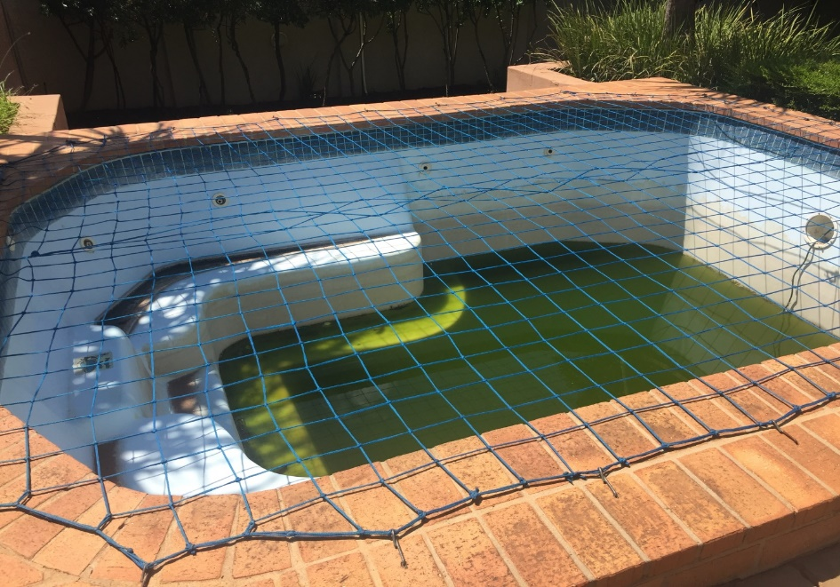
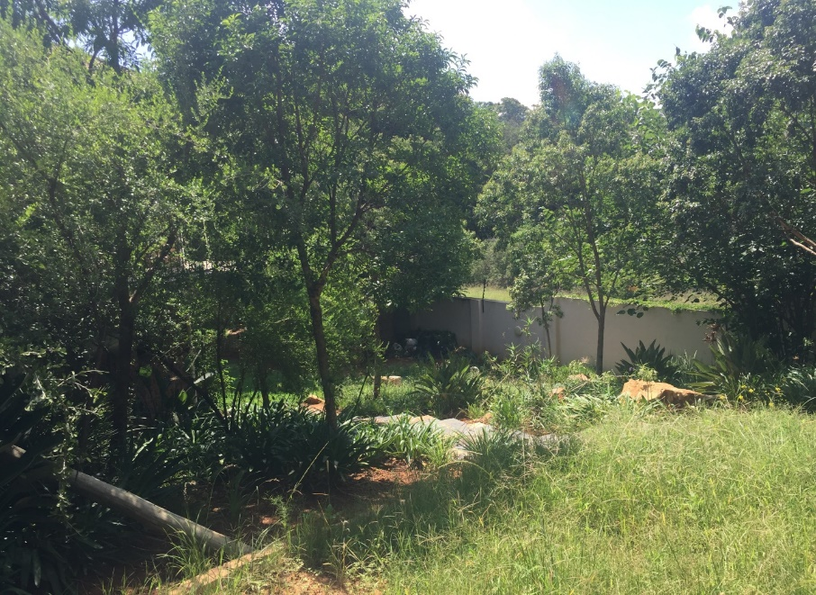
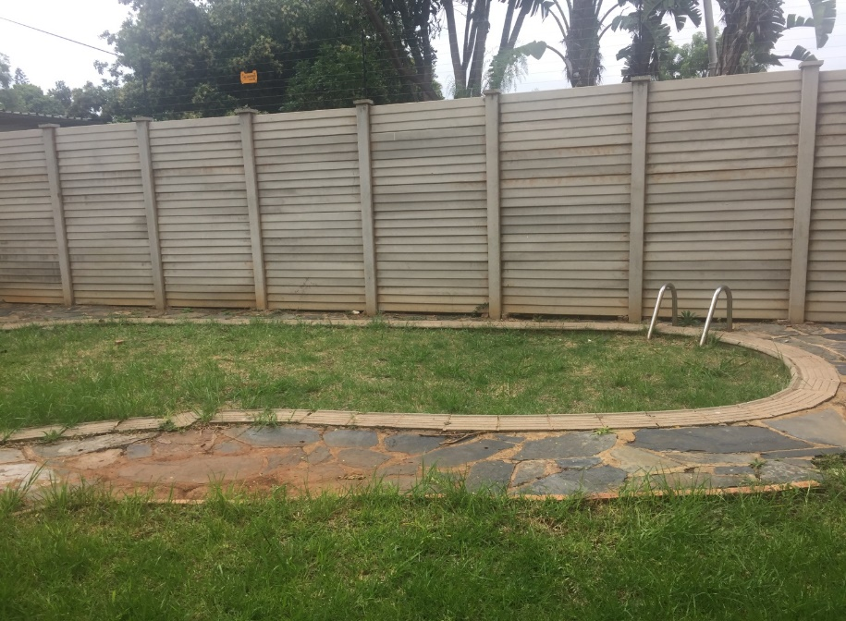
Unscheduled Maintenance:
Internal Investigations

Slide 58
Unscheduled Maintenance:
Motivation For SIU Proclamation
The GRC through the Office of the Director-General requested Ministry to motivate for the Presidential Proclamation (through the SIU) due to the serious allegations pertaining to unscheduled maintenance.
The Minister of Public Works approved the request on 31/01/2018 and correspondence was forwarded to the Head of the SIU motivating for a Presidential Proclamation on day to day maintenance.
The SIU acceded to the DPW Request, meetings were held between the DPW and the SIU to commence with the legislative processes to motivate for the Proclamation. The SIU made a motivation to the President to extend Proclamation 38 of 2010.
The President has signed the Proclamation Number R 20 of 2018 extension of Proclamation 38 of 2010 as amended by Proclamation 27 of 2015. The Proclamation was gazetted in government gazette on the 13 July 2018.
The Proclamation will be focusing on five DPW Regional Offices, namely:
- Pretoria Regional Office;
- Bloemfontein Regional Office;
- Cape Town Regional Office,
- Durban Regional Office; and
- Johannesburg Regional Office.
These Regional Offices were observed to be consistently prone to irregularities related to unscheduled / day-to-day maintenance.

Slide 59
Unscheduled Maintenance: Systemic
Recommendations Made To Management To Date
Facilities Management should ensure that physical verification of all building components for each building is conducted to ascertain their existence
Facilities Management should conduct building conditions assessment to determine state of the building and its components
Facilities Management should develop maintenance plan reflecting scheduled maintenance per building and its components
Facilities Management should develop a register reflecting building components, their life spans, and condition equipment that has already passed its life span should be replaced
Facilities management with assistance from the Information Technology Unit should develop an early warning system to identify suspicious payments e.g. for same service, items, areas and period
Facilities management should engage Client Departments to develop framework in consultation with National Treasury to allow department to purchase capital equipment through Capital Expenditure budget on the client Department’s behalf
Facilities Management should consider the above proposed action plans when implementing Facilities Management contract for 300 earmarked building and in developing Facility Management Strategy

Slide 60
MAINTENANCE AND REPAIRS PROJECTS

Slide 61
Maintenance And Repairs Projects
The Anti-Corruption Unit conducted and is currently conducting investigation into allegations of serious maladministration in respect of projects awarded by the DPW.
The DPW engaged services of various suppliers to render various maintenance and repairs projects. These service providers failed to fulfil the terms of contracts as they failed to complete their work with due diligence, regularity and expedition and to bring the work to practical completion resulting in cancellations of their contracts.
Of particular concern to the Department was that huge amounts of money were paid to these contractors at the time of cancellations of their contracts in some instances to values exceeding the contract amount. It is suspected that the Department did not get value for money in this regard and/or there is no justification for the payments made. Of further concern to the Department was that when other service providers were appointed to complete the outstanding work the contract amounts were in all instances greater than the initial contract amount which fortifies the notion that payments made to the initial contractors cannot be justified and/or the Department did not receive value for money for payments made.

Slide 62
Maintenance And Repairs Projects
JHB RO Projects
The ACU conducted investigations relating to several projects awarded by the JHB RO – Maintenance and repairs Projects
No | Name of Contractor | Nature of services | Date of award | Contract amount | Payments at the time of cancellation of contract
1 | Mathabatha Building Suppliers CC | Eden Park Police Station: Repairs and renovation contract | 12 July 2011 | R4, 306, 181.28 | R7, 067, 797.00
2 | Zwa-Shu Trading JV Phumi Trading | Replacement of boilers and maintenance of boilers for period of 24 months | 20 January 2012 | R18, 824, 992.66 | R13, 464, 954.68
3 | Ineelo Trading Enterprise CC | Condition based maintenance for sewer plant | 13 March 2015 | R4, 114, 043.40 | R1, 632,143.70
4 | Nzwalo Investments | Repair and maintenance of mechanical and electrical installations | 10 December 2008 | R13, 811, 639.22 | R6, 855, 024.67
5 | Lumacon Air Conditioning | Benoni Modderbee Prison: Repair and Maintenance of mechanical and electrical installations | 17 December 2008 | R13, 811, 639.22 | R7, 758, 566.04
6 | Nthatheng Trading II | Tsakane Magistrate Office: Additional accommodation: construction of new building | 08 July 2005 | R10, 988, 743.26 | R12, 593, 026.70
7 | Mperere Legafe JV | SANDF Heidelberg Gymnasium: Head Quarters | 10 October 2008 | R4, 880, 000.00 | R4, 374, 491.57
8 | Sincindi Projects CC | Oberholzer Magistrate Office: Security measures upgrade including minor works sewerage pipes | 27 November
9 | Realeka Investments | Kagiso Magistrate Court: Construction of new building | 21 May 2007 | R27, 181, 957.60 | R22, 788, 956.14

Slide 63
Maintenance And Repairs Projects
JHB RO Projects
The investigation conducted by the ACU revealed that these projects were characterised by:-
The Project Risk Assessment conducted prior to the awards were disregarded by the Evaluation Committees, This led to the appointment of unsuitable contractors.
Poor Project Management, the assigned Project Managers and Principal Agents do not exercise due diligence during the execution of the Projects.
Payments made are not justifiable or in accordance with the Project Milestones.
Projects not completed within the Projects timeframes.
Contractors not delivering on their contract obligations leading to contract cancellations at a loss to the Department.
Project Managers/Principal Agents not issuing final accounts to recover cancellation losses.
Secondary contractors in most instances appointed in excess of the original contract amounts.

Slide 64
Maintenance And Repairs Projects
JHB RO Projects
On completion of the investigation the ACU recommended…
Disciplinary actions against 42 officials at the JHB Regional Office for various misconducts relating to project mismanagement and failure to comply with SCM directives.
8 contractors for Blacklisting from conducting business with the DPW / State due to failure to fulfil their contract obligations to the DPW / State.
The Legal Services Unit was also advised to consider instituting recovery processes to recover an amount estimated at R 27m for losses incurred to non-performance and subsequent cancelation of contracts.
3 Referrals to be made to Professional Bodies to consider sanctioning their members (Principal Agents) for failure to exercise due diligence in executing their tasks.

Slide 65
CONCLUSION

Slide 66
CONCLUSION
Introduced the fraud risk management as the preeminent component of the anti-corruption strategy
More emphasis on Fraud Prevention through implementation of a robust and responsive fraud risk management process.
Implemented pro-active measures to combating fraud, such as the use of data analytics as value adding initiatives e.g. unscheduled maintenance interventions
Improved consequence management within the Department which serves as a deterrence to fraud and corruption.
Fraud Risk Management incorporated into the Business Plans and Performance Agreements of Senior Managers
The GRC further plays an active role in Management structures established within the DPW to promote accountability e.g. AMC, RMC

Slide 67
CONCLUSION
The Department’s second phase of the turnaround emphasizes efficiency enhancement within the Department ranging from systematic, process and performance improvements.
There is a realization however that these improvements, as well as eliminating fraud and corruption in the Department is ultimately dependent upon and requires a change in departmental values that direct us toward a new organizational culture.
In this regard, the Department has developed a number of Governance Frameworks for continuous performance improvement while meeting governance obligations and legislative requirements. These include a Compliance Framework (CF), to proactively and systematically manage compliance throughout the department, as well as an Integrity Management Framework (IMF).
The IMF in particular has been developed in response to the Department’s position on zero tolerance towards fraud and corruption and a commitment to public service delivery. This naturally calls for a renewed Organisational culture of department.
The Department having emphasised on the investigative tools at its disposal, the department, while continuing with this strategy, will therefore place an increasing emphasis on integrity management and the preventative aspects of the anti-corruption strategy including requiring every senior manager to assume accountability for managing fraud risks in their respective areas of responsibility

Slide 68
Thank You
National Department of Public Works (NDPW)
Head Office: Public Works CGO Building Cnr Bosman and Madiba Pretoria Central Private Bag X65 Pretoria 0001
Website: http://www.publicworks.gov.za

