Slide 1

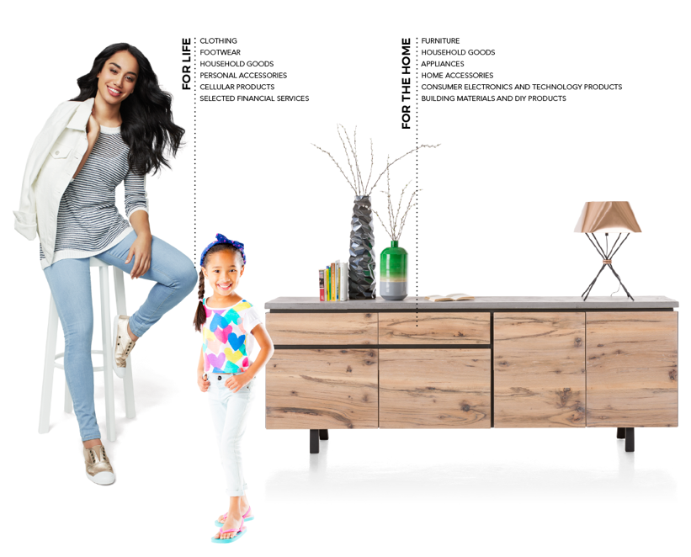
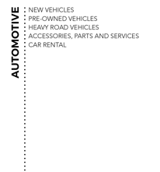

Steinhoff
Briefing to Parliament
29 August 2018

Slide 2
Content
The Steinhoff delegation here today
Reminder of our commitment
Where we were in January 2018
Progress since January 2018
Reminder of Steinhoff the company
Group overview (summarised)
Half-year results
Restructuring framework
Litigation and claims update
PwC investigation
Conclusion

Slide 3
The Steinhoff delegation here today
Heather Sonn (chairperson of the supervisory board)
Louis du Preez (management board; commercial director)

Slide 4
Reminder of our commitment
We remain deeply aware of the current impact of events at Steinhoff on the company’s stakeholders (including investments and pension funds) and the reputation of the company, its business and the nation
We are doing our utmost to uncover the truth, to rectify any wrongdoings and to communicate
as fully as we can on an ongoing basis
We have cooperated fully with our regulators and will continue to do so
We are working constantly to restructure the group’s international debt
The company now employs 120 000 people, 50 000 of whom are in South Africa. We are very conscious of the importance of the retention of those jobs
We are working hard to further stabilise the group, to finalise the audited financial statements and to ensure that the investigations are far enough advanced to enable us to proceed with legal and other necessary steps that we intend to take, based on the findings
Given the gravity of the situation, you will appreciate that the board (including the individuals present here) remains legally and otherwise quite constrained in what it is able to communicate publicly. We say this on the advice of the company’s lawyers
As a delegation we represent the company and are not here in our personal capacities

Slide 5
Where we were in January 2018
The resignation of the CEO on 5 December 2017 and the postponement of financial statements triggered a significant share price decline and a liquidity crisis (both at group level and for individual operating companies)
In the announcement of 5 December 2017, the company confirmed that PwC was appointed
to conduct an independent forensic investigation
Heather Sonn was appointed as acting chair on 15 December 2017
The supervisory board experienced several resignations and retirements
Much of the management team were newly appointed and were working around the clock
to understand and contain the nature and scale of the crisis
PwC had been given an unrestricted scope with unlimited access to the group

Slide 6
Progress since January 2018
Overall
The group has been in ongoing dialogue and constructive engagement with creditors, regulators, exchanges and other stakeholders and interested parties
Audits – a significant number of the group companies' audits have already been cleared and completed
The PwC investigation remains on track
The group aims to provide audited financials for the financial year 2017 before the end
of December 2018, and for the current year by January 2019
The threats of imminent collapse have effectively been averted; interim arrangements have
been made with creditors (e.g. the Lock-up Agreement); and there have been structured
disposals of certain assets
Substantial debts have been repaid (e.g. the African debt)
Steinhoff has met with various regulators and dealt with their requests
A Section 34 report (the Prevention and Combatting of Corrupt Activities Act) has been submitted, and various interactions with law enforcement officials are ongoing
The group intends to reclaim bonuses paid in the past to certain senior executives under the relevant Dutch code (to the extent applicable and appropriate)
Virtually all of the group’s 120 000 jobs have been secured

Slide 7
Progress since January 2018 (continued)
Governance
The supervisory board was strengthened with the appointment of five new directors with a broad range of diverse skills (AGM – April 2018)
Recent nomination of Paul Copley for appointment as independent supervisory director
The board’s sub-committees were reviewed and reconstituted
The management board was confirmed at the AGM with the appointment of four new members
The leadership team was strengthened with the appointment of an internationally experienced chief restructuring officer
The boards, management and staff have been working around the clock to keep the businesses running
Financial reporting
Detailed unaudited half-year results, including restated comparatives, were released in late June
The group is working with Deloitte to finalise the audited 2017 consolidated financial statements before the end of December 2018
The group is also committed to releasing the audited 2018 consolidated financial statements
before the end of January 2019

Slide 8
Progress since January 2018 (continued)
Lenders
Steinhoff has successfully repaid €2 billion of South African holding company debt
Save for Pepkor (previously STAR) debt and working capital, the group has very limited African debt
There has been constant interaction with the international debt holders and we have received good support from the various lender groups
A lock-up agreement with creditors, including a standstill, was finalised in mid July 2018, and this
is providing time for the group to implement a debt restructure supported by a very high percentage of debt holders/lenders
The debt restructure will afford the group financial stability until the end of 2021
Regulators
Steinhoff has had regular engagement and is cooperating fully with its various regulators in all relevant jurisdictions, and will continue to do so
The group’s ordinary shares continue to trade on the FSE and the JSE

Slide 9
Reminder of Steinhoff the company
History
Steinhoff was founded in Germany in 1964 by Bruno Steinhoff. He introduced the Steinhoff business to South Africa in 1997 and Steinhoff International listed on the Johannesburg Stock Exchange in 1998
In the years that followed, Steinhoff became a global group in approximately 12 000 retail outlets in 30 countries
Steinhoff listed on the Frankfurt Stock Exchange in 2015
International company
Steinhoff International Holdings N.V., the ultimate parent company of the group, is a Dutch company, registered in the Netherlands. It is governed by a supervisory board and managed by a management board, in each case appointed by shareholders under Dutch law
Steinhoff’s primary listing is in Frankfurt, Germany
Steinhoff’s secondary listing is on the Johannesburg Stock Exchange
Steinhoff Investment Holdings
Steinhoff Investment Holdings is a South African company
It has issued perpetual preference shares that are listed (currently suspended) on the JSE

Slide 10






Group overview (summarised)
Steinhoff International
Holdings N.V.
(The Netherlands)
100%
100%
100%
Steinhoff Investment Holdings Ltd
(South Africa)
Steinhoff Finance
Holding GmbH
(Austria)
Stripes US Holding Inc.
(USA)
100%
100%
100%
Steinhoff International Holdings Proprietary Limited
(South Africa)
Steinhoff Africa
Holdings Pty Ltd
(South Africa)
Steinhoff Möbel Holding Alpha GmbH
(Austria)
100%
100%
100%
100%
Steinhoff Services Ltd
(South Africa)
Ainsley Holdings Pty Ltd
(South Africa)
Hemisphere International Properties B.V.
(The Netherlands)
Steinhoff Europe AG
(Austria)
Property investment holding company
Europe Businesses
Australasia Businesses
^{c.71%}
^{c.26%}

Slide 11











Group overview* (summarised)
UK Household goods
Conforama Europe
Pepkor Europe
397 stores
4 500 employees
€339m revenue H1FY18
298 stores
13 000 employees
€1 831m revenue H1FY18
2 210 stores
31 000 employees
€1 523m revenue H1FY18
USA
Australasia
3 304 stores
9 500 employees
€1 255m revenue H1FY18
628 stores
5 700 employees
€644m revenue H1FY18
Africa
Automotive
392 dealership and rental outlets
6 000 employees
€766m revenue H1FY18
5 108 stores
46 000 employees
€2 147m revenue H1FY18
*Information shown for largest parts of the Steinhoff Group and therefore is not a breakdown of the full group.
Revenue shown for the 6 months ended 31 March 2018. Store numbers and employees (shown as approximate) as at 31 March 2018.

Slide 12
Half-year results
Steinhoff released unaudited 2018 half-year results (March 2018) on 29 June 2018
A significant amount of financial and other detailed information was released (90 pages)
Summarised unaudited results (H1FY17 restated):
 | H1FY18 €m | H1FY17 €m | Change %
Revenue | 9 345 | 9 896 | (6)
Sustainable EBITDA | 340 | 405 | (16)
Loss for the period | (599) | (362) | 65
NAV per share | 58 | 121 | (52)
Net debt | 9 360 | 9 219 | 2
Total equity restatement |  | (10 943)

Slide 13
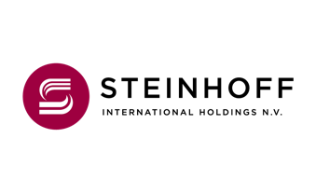
Restructuring framework
OUTLINE | Restructuring the group’s debt is an essential part of the response to the events of December 2017 The restructuring framework developed by the group is designed to address near term maturities and provide stability to: – enable recovery of value and debt reduction through potential asset disposals – enable proper evaluation of all contingent litigation claims and defence and/or settlement – ensure fair treatment of all creditors (i.e. finance creditors and any crystallised litigation claims) relative to existing rights and claims As part of the restructuring framework: – all debt to be restated at par within current borrowing entities with a common maturity date for all loans three years from restructuring date – no cash payment of interest on any debt (excluding Hemisphere, the sub group that owns European property) – appropriate asset security at current borrowing entity level where feasible and permissible – all debt instruments retain existing guarantee claims – retention of disposal proceeds basket to fund ongoing liquidity requirements to be agreed with lenders – proposals on group governance to be implemented – future information and reporting arrangements to be agreed with lenders

Slide 14
Restructuring framework (continued)
PROGRESS | A lock-up agreement was concluded with Steinhoff Europe and Steinhoff Finance Holdings lenders on 20 July 2018 – The agreement provides for a three month period in which the group can implement the restructuring A lockup agreement was similarly concluded with the Hemisphere lenders on 26 July 2018 – In terms of that agreement the parties committed to implement before 31 August 2018 Once implemented the terms of both restructures will remain in place until the end of 2021

Slide 15
Litigation and claims update
Shareholder claims | VEB: Several claims for declaratory relief in relation to damage alleged to have been suffered by shareholders due to investing in Steinhoff securities German group action: Steinhoff International Holdings NV (“SIHNV”) has received legal proceedings (instituted by one shareholder) requesting the authorisation of model case proceedings (German class action) A retail shareholder instituted proceedings requesting the authorisation of a South African class action
Vendor claims | Titan related companies: Summons received for claim at Steinhoff International Holdings Proprietary Limited (“SIHPL”) as well as a reversal of the transfer of the European assets effected in 2016 and a damages claim at SIHNV GT Ferreira / Tokara BEE Trust: Claim at SIHPL Other PSG vendors Tekkie Town: Summons received for SIHNV
Other claims | POCO: Joint venture dispute with possible settlement. However, co-shareholders have declared a dispute regarding the distribution of any settlement proceeds AIH: Loan claim proceedings ongoing, next hearing scheduled for September 2018. Court date has been set for 5 December 2018 to determine further case directions in the conversion proceedings Other: 1) Tax authorities, 2) BaFin penalty, 3) JSE penalty

Slide 16
PwC investigation
PURPOSE AND APPROACH | Key aims: 1) to determine what happened, 2) financial investigation, 3) responsibility Appointed by and reporting to the supervisory board Unrestricted scope and unhindered process
PROGRESS TO DATE | Good progress has been made, and the investigation is ongoing There has been good cooperation between PwC, Steinhoff and the regulators Constant interaction with the group to ensure appropriate remedial steps can be taken at the right time
completion | PwC expects the investigation to be substantially completed by the end of 2018 The group will communicate any material developments at the appropriate time, while being cognisant of the sensitivities around the investigation and possible legal proceedings

Slide 17
Conclusion
We appreciate the current impact of events at Steinhoff on the company’s stakeholders (including pension funds); staff; the reputation of the company; and on South African business.
The PwC investigation is making good progress and those responsible will be held accountable.
We have reported half-year results, including:
– Income statement for the six months ended 31 March 2018 and 2017 (restated)
– Balance sheet as at 31 March 2018, 31 March 2017 (restated), and 30 September 2017
– Cash flow statement for the six months ended 31 March 2018 and 31 March 2017 (restated)
– Trading update for the six months ended 31 March 2018 and restated 2017 comparatives
We are committed to releasing the audited 2017 results before the end of December 2018, and the audited 2018 results before the end of January 2019.
We have communicated with and are cooperating fully with regulators.
It remains important that Steinhoff remains listed.

Slide 18
Conclusion (continued)
We are currently focusing on implementing a debt restructure that will result in financial stability for a period of three years (end 2021), during which time we need to focus on supporting and delivering value in the operating businesses.
We remain fully aware of the importance of regular communication with the public as we
make progress in balancing the interests of all stakeholders (more than 75 SENS announcements
in 2018).

