Slide 1
COMMUNITY DEVELOPMENT WORKER PROGRAMME
BRIEFING TO THE STANDING COMMITTEE ON PUBLIC ACCOUNTS
22 August 2018
Presenter: Mr Heinrich Magerman

Slide 2
CONTENT PAGE
CDWP Background
Roles and Responsibilities of CDWs
CDWP Annual Performance Plan Indicators
CDWP Allocation and Regional Breakdown
CDW Skills Audit Summary
CDWP Capacity Building
CDW Placement and Institutional Arrangements
Budget Allocation 2016/17 and 2017/18
CDWP Transfer Funding 2017/18 and 2018/19
Partnership Programmes
Economic Opportunities Supported

Slide 3
CDWP BACKGROUND
Community Development Worker Programme (CDWP) was introduced in 2003 by National Government to help bridge the gap between government and the community.
In Western Cape the CDWP evolved out of LGSETA Sponsored Learnership in 2005 and 2006.
200 CDWs were employed on permanent basis by DLG in 2006.
CDWP staff are employed by DLG and are governed by the Code of Conduct for Public Servants.
Performance Agreements are signed based on the Performance Management Information System (PERMIS)
Offices for CDWs are predominantly provided by municipalities.
CDWs work across three spheres of government
60% of CDW work is allocated to Provincial and National spheres
40% of CDW work is allocated to Municipalities

Slide 4
ROLES AND RESPONSIBILITES OF CDWS
Section 108 of the Public Service Regulations, 2016
The objectives of the CDWP are to:
Assist with improving service delivery and accessibility of services to the public;
Assist with inter-governmental coordination both between government line departments and the three spheres of government;
Facilitate community development and stronger interaction and partnerships between government and communities; and
Support participatory democracy.

Slide 5
ROLES AND RESPONSIBILITES OF CDWS
The CDWP may achieve the objectives contemplated in subregulation (1) by:
Regularly communicating governmental and other information to communities in an accessible way;
(b) Providing feedback to government regarding community experiences of service
and governance;
(c) Providing early warning to government of any obvious reduction in service
standards or performance that could lead to the collapse or significant
impairment of the overall service function;

Slide 6
ROLES AND RESPONSIBILITES OF CDWS
(d) Reporting any corruption or irregularity that is encountered within any sphere of
government, government department, community organisation or private
company;
(e) Facilitate government assistance to community projects where required and
appropriate;
(f) Facilitate community interaction with public works programmes;
(g) Assisting communities to engage with and provide input into integrated
development plans and other programmes of government;
(h) Assisting in the coordination of inter-departmental programmes and programmes
that involve more than one sphere of government;

Slide 7
ROLES AND RESPONSIBILITES OF CDWS
Maintaining communication with community based organisations and initiatives of civil society;
(j) Promoting the principles of Batho Pele and community participation;
(k) Improving community linkages to relevant public entities, non-governmental
organisations and private donors;
Monitoring and reporting significant trends within communities related to health,
social development and livelihood security as well as the impact of associated
development projects;
(m) Performing such other functions consistent with the objectives of the CDWP as
may be determined by the CDWP Framework.

Slide 8
CDWP ANNUAL PERFORMANCE PLAN INDICATORS
Support programmes to improve access to government services
Community Outreaches (All Spheres of Government)
Mobilisation for Thusong Outreach Programme
Indigent Grant Subsidy (Municipality)
Child Support Grant/Maintenance
Social Relief of Distress
Support programmes to improve access to small scale economic opportunities
Food Security
Small Enterprise Development
Tourism Development
Heritage Development
Environmental Management projects

Slide 9
CDWP ALLOCATION AND REGIONAL BREAKDOWN
District | Municipalities | Regional Structure
Cape Winelands | Cape Winelands District – 2 CDWs Witzenberg – 7 CDWs Drakenstein - 6 CDWs Stellenbosch - 3 CDWs Breede Valley - 7 CDWs Stellenbosch - 3 CDWs Langeberg - 1 CDW | 1 Regional Coordinator 2 CDW Supervisors
Central Karoo | Laingsburg – 5 CDWs Prince Albert - 4 CDWs Beaufort-West – 9 CDWs | 1 Regional Coordinator 1 CDW Supervisors
Eden | Kannaland - 6 CDWs Hessequa – 1 CDW Mossel Bay - 3 CDWs George - 3 CDWs Oudtshoorn - 3 CDWs Bitou - 1 CDW Knysna - 3 CDWs | 2 Regional Coordinator 2 CDW Supervisors
Metro | City of Cape Town – 50 CDWs | 2 Regional Coordinator 4 CDW Supervisors
Overberg | Overberg District - 1 CDWs Theewaterskloof - 7 CDWs Overstrand - 3 CDWs Cape Agulhas - 2 CDWs Swellendam – 2 CDWs | 1 Regional Coordinator 1 CDW Supervisors
West Coast | West Coast District - 2 CDWs Matzikama - 4 CDWs Cederberg - 8 CDWs Saldanha - 4 CDWs Swartland - 2 CDWs | 1 Regional Coordinator 2 CDW Supervisors

Slide 10
CDWP SKILLS AUDIT SUMMARY
CDWs | 149 | CDW Learnership: 139 Diploma: 8 Degree: 6
CDW Supervisors | 13 | Certificate: 1 Diploma: 1 Degree: 1
Regional Coordinators | 8 | Certificate: 2 Diploma: 1 Degree: 3
Provincial Office | 12 | Diploma: 4 Degree: 7
Total | 182 | CDW Learnership: 139 Certificate: 3 Diploma: 14 Degree: 17

Slide 11
CDWP CAPACITY BUILDING
DLG/University of the Western Cape (LGSETA)
NQF Level 5
5 Modules:
Introduction to Local Government Accounting & Financial management
Public Sector Contract & Supply Chain Management
Computer Mapping & GIS for Local Government
Communication & Information Management
Theories & Approaches to Community Development
Cost of R3 069 150.00
Municipal Middle Management Development Programme (MMMDP)
Approved 2017 MMMDP course for the 20 CDW Programme officials facilitated by the University of Stellenbosch
Cost of R 252 000.00 for 20 CDW officials
On going capacity building through Workplace Skills Plan and the Provincial Training Institute

Slide 12
CDW PLACEMENT AND INSTITUTIONAL ARRANGEMENT
DLG has entered into Memorandum of Agreements, with 25 Municipalities across the Province.
Memorandum of Agreements regulates the relationship between DLG and Municipalities.
CDWs are accommodated in municipal facilities inclusive of Thusong Services Centres.
CDWs are providing support to municipal initiatives and programmes.
Regular local engagements between DLG and designated officials of various Municipalities are held to discuss how the various programmes can support each other to improve service delivery to communities.

Slide 13
CDWP BUDGET 2016/17 AND 2017/18

Slide 14
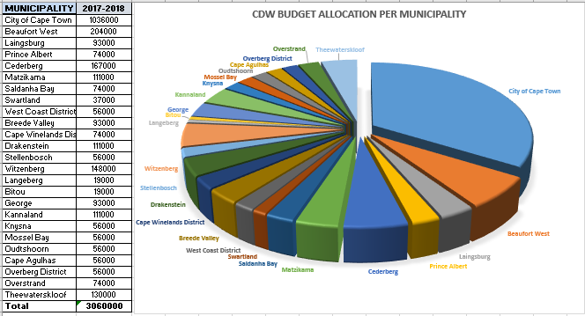
CDWP TRANSFER FUNDING 2017/18

Slide 15
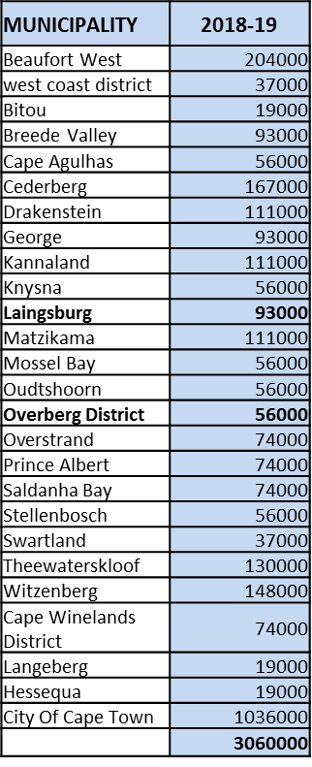
CDWP TRANSFER FUNDING 2018/19

Slide 16
PARTNERSHIP PROGRAMMES
Department of Economic Development and Tourism: Implementation of Occupational Skills Readiness Project in West Coast. CDWs recruited a total number of 1008 unemployed youth of the West Coast region for the West Coast Education and Skills Plan.
College of Cape Town: CDWs offered the College of Cape Town with wide network system as an additional recruitment support system. Provided the College with a list of more than 100 potential candidates which was contacted to participate in further assessment and training programme.
Office of the Consumer Protector: To strengthen cooperative governance by rollout of events, workshops and information sessions hosted by the Consumer Protector.
Western Cape Liquor Authority (WCLA): To strengthen cooperative governance by rollout of events, programs and projects hosted by WCLA, to educate communities on latest developments.
Department of Agriculture: Registration of beneficiaries by CDWs. CDWs identified areas and households where beneficiaries can start food gardens
Office of the Public Protector South Africa: CDWP co-operate on all activities that take place at community level such as workshops and the joint hosting of activities.

Slide 17
PARTNERSHIP PROGRAMMES
Department of Environmental Affairs and Development Planning: To encourage and capacitate individuals, households and communities at large to take control of their immediate environment. Exploring ways to promote sustainable living which will lead to the transfer of skills and job creation.
Department of Home Affairs: To engage with communities to ensure that they receive feedback on latest developments in respect of the Department of Home Affairs. CDWP assists with reissuing of documentation after fires in informal settlements, etc.
Department of Health: To engage with community members to ensure that communities are sensitised about programmes and interventions by the Department of Health
Epilepsy South Africa – Western Cape: To strengthen cooperative relations to mobilize, loud hail and engage communities to attend and take part in events, programs and projects in collaboration with partner.

Slide 19
ECONOMIC OPPORTUNITIES SUPPORTED
Local Economic Development
Supported Ukuchuma Africa Multi Cooperative Limited with registration at Companies & Intellectual Property Commission (CIPC) in Lentegeur, Mitchells Plain. The project opened and created employment opportunities on skills development facilitation, construction, property development as well as community projects.
Supported Masanganeni Farming Cooperative by networking with Companies and Intellectual Property Commission for the group to be registered and referred the group to the Department of Agriculture to access grant for drought relief scheme in Paarl (Cape Winelands).
Supported and facilitated an information session on Business opportunities in Arts & Craft to a group of unemployed women and youth to educate them in marketing and business branding in Bredasdorp (Overberg). A committee was established to drive skills training.

Slide 20
ECONOMIC OPPORTUNITIES SUPPORTED
Food Security
Supported Teske Gedenk Primary School Food Garden by networking with the Department of Agriculture and Casidra to source for seedlings and monitoring the progress of the project in Beaufort West (Central Karoo). The project provides fresh vegetables for the school feeding scheme of approximately 200 kids of the surrounding farms. Department of Agriculture funded the project with R25 000 for garden equipment.
A cooperative was established in Zoar to start a Food Garden Project with the aim to alleviate poverty by selling the vegetables to the community. Assistance was provided in drafting a constitution, registering the business as a cooperative, financial literacy training and business development training.
Supported De Doorns Backyard Food Garden by networking and referring the beneficiaries to the Department of Agriculture for seedlings and equipment in De Doorns (Cape Winelands). The project was established with the objective to produce fresh vegetables for subsistence and selling the surplus vegetables for income to alleviate poverty.

Slide 21
ECONOMIC OPPORTUNITIES SUPPORTED
Youth Development
Information session was conducted in Beaufort West (Central Karoo) for unemployed youth on recycling goods such as wood to make dog channels and to generate income by selling these goods. Assistance was provided by liaising with Karoo National Park for funding to buy tools such as pallets, hammers, nails and saws.
Supported Job seekers programme focusing on unemployed youth who are in the City of Cape Town to secure temporary and contract based job opportunities through the EPWP and community works programme in Sub Council 18 (Phumlani, Pelican Park, Parkwood, Lotus River, Ottery, Grassy Park and Steenberg) Metro 2.

Slide 22
ECONOMIC OPPORTUNITIES SUPPORTED
Early Childhood Development
Supported Emily’s Playschool Early Childhood Development Centre project with completing application forms for registration as Non Profit Organisation and to obtain funding from the Department of Social Development in Sir Lowry’s Pass (Metro 1). Eighty one (81) children are now registered at the school.
Lizalise Learning Centre project was registered as a Non-Profit Organisation in Khayelitsha and the main focus was for looking after children that were abused and orphans in Khayelitsha.
Supported Ithemba Learning Centre with registering the project as Non-Profit Organisation, drafting the constitution and forwarded it to the Department of Social Development in Khayelitsha (Metro 1)

Slide 24
Heinrich Magerman
Community Development Worker Program
021 483 2865
Heinrich.Magerman@westerncape.gov.za

