Slide 1
Small Enterprises Ombud Service Bill
Presentation to the Portfolio Committee on
Small Business Development
Toby Chance MP
22nd August 2018

Slide 2
Agenda
Why is this bill necessary?
What are the international precedents?
What factors were considered in writing this bill?
The bill’s sections
What are the main provisions of the bill?
What is the anticipated cost of the Ombud Service?
What measures are necessary to treat causes of disputes?
What have submissions/comments said?
What are the benefits to the economy and society?
Conclusion

Slide 3
Why is this bill necessary?
Small businesses do not operate on a level playing with big business and government
Big businesses use their financial muscle to bully and elbow aside small businesses
Government inefficiency negates the objectives of preferential procurement
Poor understanding of procurement/invoicing/contracting best practices particularly among emerging enterprises leads to unnecessary, costly and protracted disputes
Available dispute resolution mechanisms are failing small businesses:
Internal company/government processes
The courts
Arbitration services
SA’s economy is dominated by big business and government to the detriment of growth and employment creation by small and medium enterprises
The time for paying lip service to small business is over
We need something with teeth to give power to small business to level the playing field

Slide 4
At any one time, business is sitting on R350 billion of payables
Much of this will be overdue
Imagine how the cash flow of small businesses would improve if this were paid out!
As at December 2017, national Government and its agencies owed R7,7 billion of which R2,2 billion was 120 days or older
July 2018, reported that provincial government owed suppliers R20 billion in unpaid invoices

Slide 5
This Committee has received numerous pleas from small businesses to intervene in disputes they have with big business and government
Currently there is no legislative framework to enable SMMEs to effectively handle these disputes
The Committee has done its best to resolve them but applying pressure alone is not sufficient
The Small Enterprises Ombud Service Bill explanatory memo was gazetted on May 10th, the Bill was tabled in Parliament on 30th May

Slide 6
Questionnaire for Members of Parliament: Remuneration Review 2018/2019
1. Legislative responsibilities - law making
Processing legislation at committee level and engaging with relevant stakeholders
Convening/Attending public hearings
Participating in debates in Parliament
Research related to the assigned portfolio
Initiating Private Members’ Bills

Slide 7
What are the international precedents?
UK Small Business Commissioner set up in December 2017
“To ensure fair payment practices for Britain's 5.7 million small businesses, and support them in resolving their payment disputes with larger businesses and bring about culture change”.
The Federation of Small Business reported that in 2014 late payment cost the UK economy in the region of £2.5 billion and caused 50,000 businesses to go under.

Slide 8
The late payment culture that exists between businesses in the UK means that:
a third of payments to small businesses are late
the average value of each payment is £6,142
20% of small businesses have run in to cash flow problems due to late payments
The SB Commissioner can make non-binding recommendations on late payment and other issues affecting businesses with less than 50 employees

Slide 9
UK Groceries Code Adjudicator
Established in terms of the Groceries Code Adjudicator Act 2013
At a supplier’s request the GCA must arbitrate in disputes and may also do so following a request from a regulated retailer
Arbitration awards are binding and may include compensation
The GCA can launch investigations. If a breach of the Code is found, the GCA can make recommendations, require regulated retailers to publish details of any breach and in the most serious cases impose a fine
The GCA power to fine a retailer up to 1% of its UK turnover came into force on 6 April 2015

Slide 10
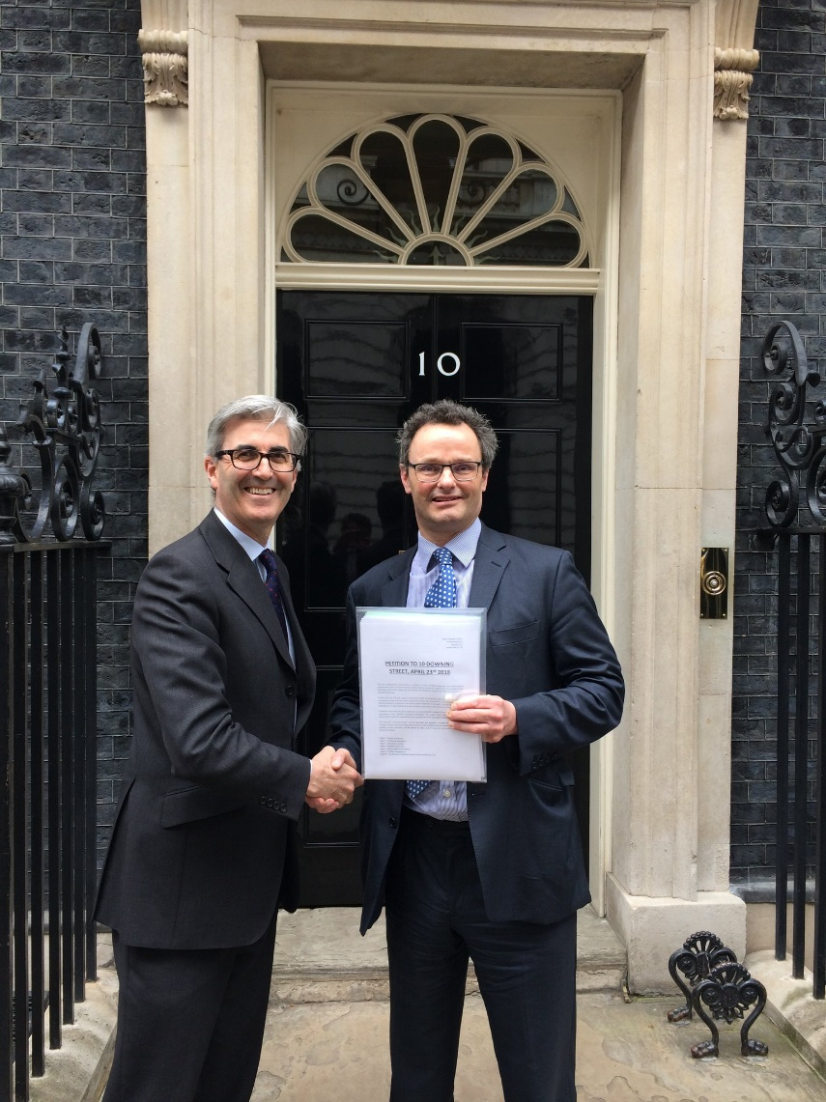
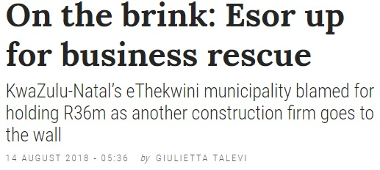
The Aldous Bill
Construction (Retention Deposit Schemes) Bill
Peter Aldous’ Private Member’s Bill received its first reading in the House of Commons in January 2018. 12 Parliamentary sponsors across all parties
Its purpose is to regulate the abuse of retentions in the construction industry – a form of late payment

Slide 11
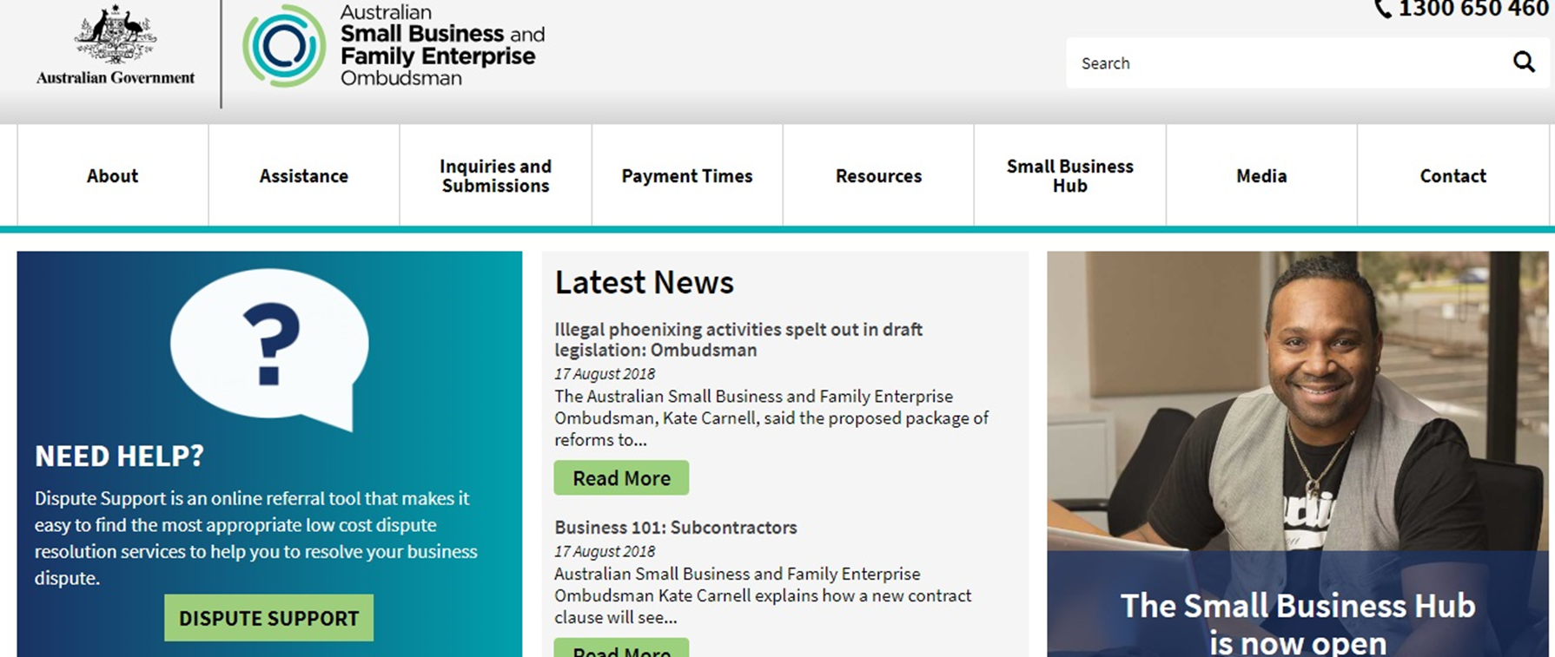
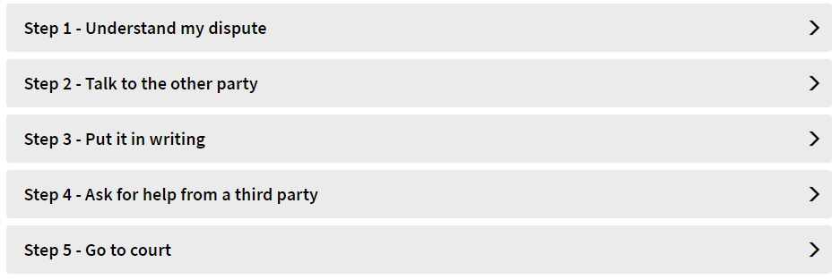
Established in terms of the Australian Small Business and Family Enterprise Ombudsman Act 2015
Two key functions: to assist and to advocate for small businesses and family enterprises.
http://www.asbfeo.gov.au/what-we-do

Slide 12
India - Micro and Small Enterprises Facilitation Councils
Councils established in
36 regions throughout
India

Slide 13
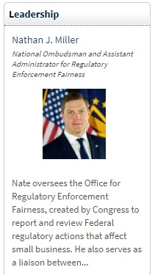
United States office of the National Ombudsman
The National Ombudsman's mission is to assist small businesses when they experience excessive or unfair federal regulatory enforcement actions, such as repetitive audits or investigations, excessive fines, penalties, threats, retaliation or other unfair enforcement action by a federal agency.
Congress established the Office of the National Ombudsman in 1996 as part of the Small Business Regulatory Enforcement Fairness Act (SBREFA). The Act ensures that businesses, small government entities, and small non profit organizations that experience unfair regulatory enforcement actions by federal agencies have a means to comment about such actions.
The SBA Administrator is required to appoint 10 Small Business Regulatory Fairness Boards. The Ombudsman coordinates activities of the boards which are comprised of five volunteer small business owners.

Slide 14
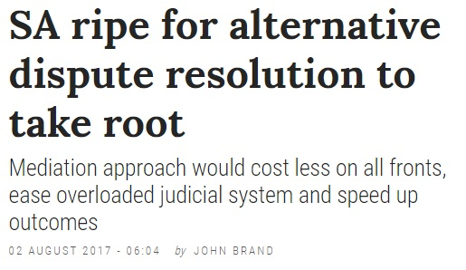
Arbitration Foundation of
South Africa still inaccessible
for small businesses due to
high cost of legal fees

Slide 15
What factors were considered in writing the bill?
Scope: The size and nature of businesses that can approach the Ombudsman (as well as government agencies)
Functions: Assistance, advocacy, dispute resolution processes, investigative hearings or inquiries
Powers: legally binding decisions; voluntary association
Administration: Which entity would administer the office?
Type: Executive, legislative or organisational

Slide 16
Ombudsman Standards
The term ‘Ombudsman’ should only be used if six key criteria are met. Those criteria are:
Independence of the Ombudsman from those whom the Ombudsman has the power to investigate
Accessibility
Fairness
Public accountability
Effectiveness
Impartiality

Slide 17
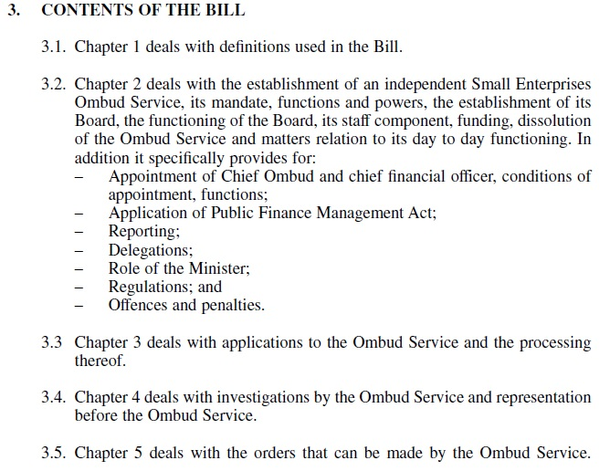
The bill’s sections

Slide 19
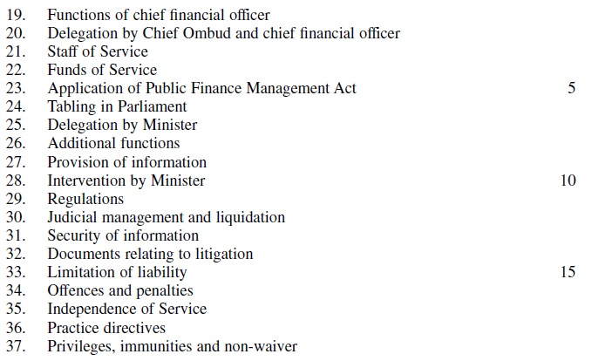

Slide 20
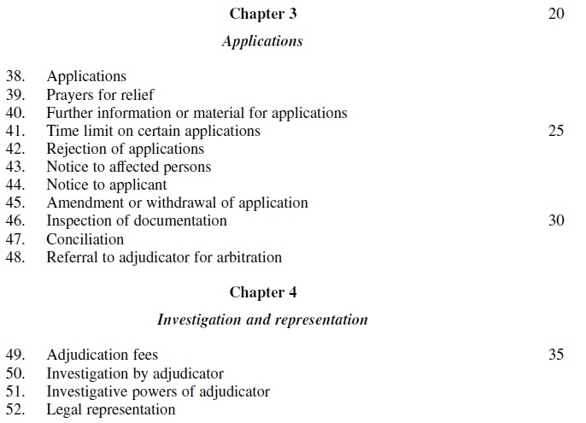

Slide 21
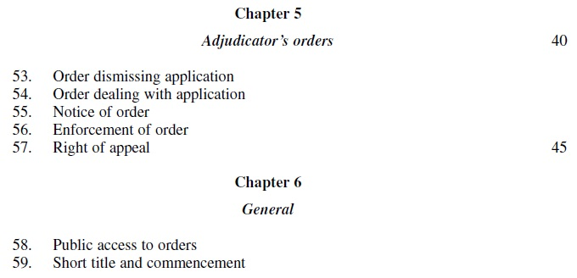

Slide 22
What are the main provisions of the bill?
3. (1) The Small Enterprises Ombud Service is hereby established as a juristic person.
(2) The Service operates as a national public entity listed in terms of the Public
Finance Management Act with its executive authority vested in the Minister.
(3) The Service must establish a national head office and regional offices.
(4) The provisions of the Public Finance Management Act apply to the Service.
4. (1) The Service must—
(a) develop and provide a dispute resolution service in terms of this Act;
(b) provide training for conciliators, adjudicators and other employees of the
Service; and
(c) take custody of, preserve and provide public access electronically or by other
means to small enterprises documentation and information such as may be
determined by the Minister by notice in the Gazette.

Slide 23
Appointment of Chief Ombud and chief financial officer
14. (1) The Board must, with the approval of the Minister, appoint a Chief Ombud and
a chief financial officer to assist the Service in meeting its objectives.
(2) The Board must invite applications for the posts of Chief Ombud and chief
financial officer by publishing advertisements in the media.
(3) The appointment must be made after following a transparent and competitive
process.
(4) A person appointed as Chief Ombud or chief financial officer must—
(a) have suitable qualifications and experience relevant to the functions of the
Service;
(b) have suitable expertise in and understanding of small enterprises; and
(c) not be disqualified as contemplated in section 9.

Slide 24
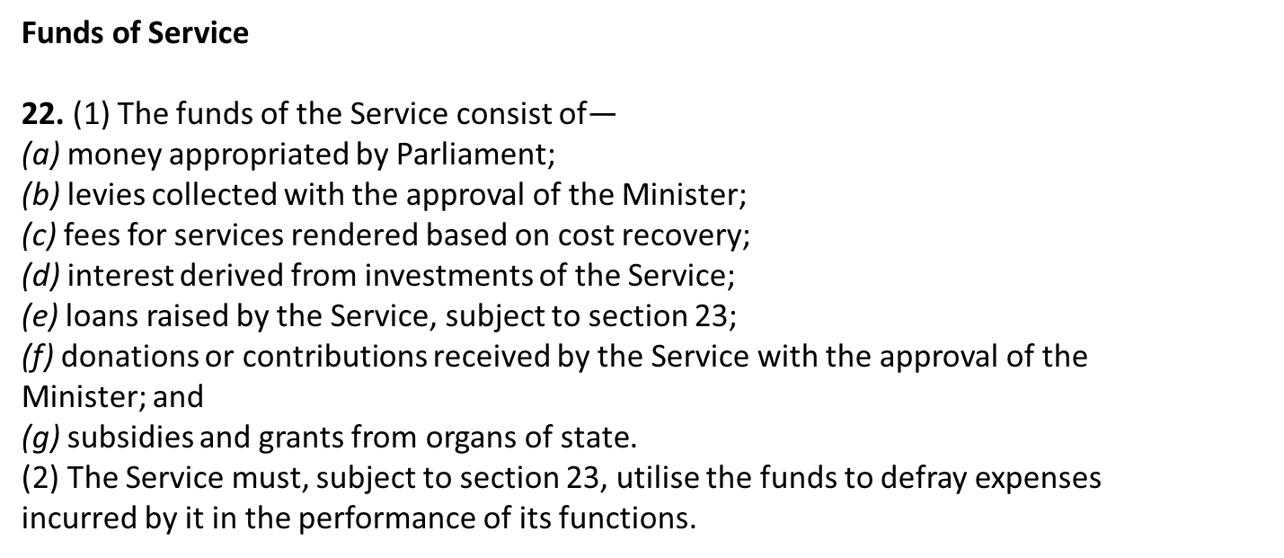
Applications
38. (1) Any person may make an application if such person is a party to a dispute
between a small enterprise on the one hand and either another enterprise or the State on
the other hand.
(2) An application must be—
(a) made in the prescribed manner and as may be required by practice directives;
and
(b) lodged with the—
(i) Ombud of the relevant regional office directly; or
(ii) Small Business Development Agency, as established by the National
Small Business Act, 1996 (Act No. 102 of 1996).

Slide 25
(3) In the event that an application is lodged in terms of subsection (2)(b)(ii), the
Small Business Development Agency must immediately refer such application to the
Ombud of the relevant regional office.
(4) The application must include statements setting out—
(a) the nature of the dispute;
(b) the supporting evidence that may be relevant to the dispute;
(c) the relief sought by the applicant, which relief must be within the scope of one
or more of the prayers for the relief contemplated in section 39;
(d) the name and address of each person the applicant considers to be affected
materially by the application; and
(e) the grounds on which the relief is sought.
(5) If the applicant is a large enterprise, the application must be accompanied by the
prescribed adjudication fees.
(6) If the applicant is of the view that the application qualifies for a discount or a
waiver of adjudication fees as prescribed, the application must substantiate the grounds
on which the applicant relies in the prescribed manner.

Slide 26
Prayers for relief
39. An application made in terms of section 38 must include a prayer for one or more
of the following orders:
(a) Payment or repayment of monies owed in terms of a service agreement
between the parties;
(b) specific performance in respect of the execution of the terms of a service
agreement between the parties;
(c) cancellation of a service agreement between the parties; or
(d) a declaratory order clarifying a
Conciliation
47. On acceptance of an application and after receipt of any submissions from
affected persons or responses from the applicant, if the Ombud of the relevant regional
office considers that there is a reasonable prospect of a negotiated settlement of the
disputes set out in the application, that Ombud must refer the matter to conciliation.

Slide 27
Referral to adjudicator for arbitration
48. (1) If the conciliation contemplated in section 47 fails, the relevant Ombud must
refer the application together with any submissions and responses thereto for arbitration,
the date of which may not be later than 10 days or such a period as may be prescribed,
from the date on which the conciliation process was deemed to have failed.
(2) The Ombud of the relevant regional office must give the applicant and all affected
parties notice of the referral in the prescribed format.
Investigation by adjudicator
50. The adjudicator must investigate an application to decide whether it would be
appropriate to make an order, and in this process the adjudicator must—
(a) observe the principles of due process of law;
(b) act quickly, and with as little formality and technicality as is consistent with a
proper consideration of the application; and
(c) consider the relevance of all evidence, but is not obliged to apply the
exclusionary rules of evidence as they are applied in civil courts.

Slide 28
Legal representation
52. The parties to an application referred to in terms of this Chapter are not entitled to
legal representation during the adjudication process unless—
(a) the adjudicator and all other parties consent; or
(b) the adjudicator, after considering—
(i) the nature of the questions of law raised by the dispute;
(ii) the relative complexity and importance of the dispute; and
(iii) the comparative ability of the parties to represent themselves in the
adjudication, concludes that it would be unreasonable to expect the party to deal with the
adjudication without legal representation.

Slide 29
Order dealing with application
54. (1) If the application is not dismissed, the adjudicator must make an order—
(a) granting or refusing each part of the relief sought by the applicant;
(b) in the case of an application which does not qualify for a waiver of
adjudication fees, apportioning liability for costs;
(c) including a statement of the adjudicator’s reasons for the order; and
(d) drawing attention in the prescribed form to the right of appeal.
(2) An order may require a person to act, or refrain from acting, in a specified way.
(3) The order may contain such ancillary and ensuing provisions as the adjudicator
considers necessary or appropriate.
(4) The order must set the time—
(a) when the order takes effect; or
(b) within which the order must be complied with.

Slide 30
Enforcement of order
56. (1) If an adjudicator’s order is for the payment of an amount of money or any other
relief which is within the jurisdiction of a magistrate’s court, the order must be enforced
as if it were a judgment of the magistrate’s court and a clerk of the magistrate’s court
must, on lodgement of a copy of the order, register it as an order of the magistrate’s
court.
(2) If an adjudicator’s order is for the payment of an amount of money or any other
relief which is beyond the jurisdiction of the magistrate’s court, the order may be
enforced as if it were a judgment of the High Court, and a registrar of the High Court
must, on lodgement of a copy of the order, register it as an order of the High Court.
Right of appeal
57. (1) An affected person may appeal an adjudicator’s order to the High Court, but
only on a question of law.
(2)An appeal against an order must be lodged within 30 days after the date of delivery
of the order of the adjudicator.

Slide 31
What is the anticipated cost of the service?
Comparisons with other ombud services
Community Schemes Ombud Service
Established by the Community Schemes Ombuds Service Act 2011
Dispute resolution service for community / sectional title schemes
2016/17 financial year
Total income R61 million (R30m government grant, R30m levies)
Total expenditure R45 million (R28m salaries, R12m general expenses)
285 complaints conciliated, 141 referred for arbitration

Slide 32
The Office of the Ombud for Financial Services Providers
Established in the Financial Advisory and Intermediary Service Act 37 of 2002 (FAIS Act)
2016-17 financial year
Total income R39 million
Total expenditure R45 million
Number of new complaints received – 10 864, of which 5 630 were justiciable.
How the complaints were resolved:
(a) Dismissed – 5 183
(b) Settled – 1005
(c) Determined – 68
(d) Referred to other fora – 4 769

Slide 33
Motor Industry Ombudsman of SA
Established in 2001 by the SA motor industry
Regulated in terms of King IV
The MIOSA has had a very positive influence on relieving the Courts of having to deal with cases of highly complicated automotive technical matters.
Provided free of charge to consumers
Funded from levies raised by the motor industry 2017/18 financial year
Total income R32 million
Total expenditure R32 million
Cases heard 7,695
Cases resolved 15,117

Slide 34
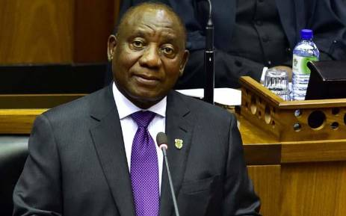
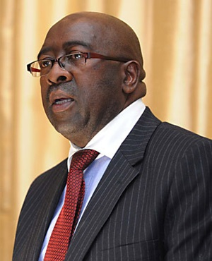
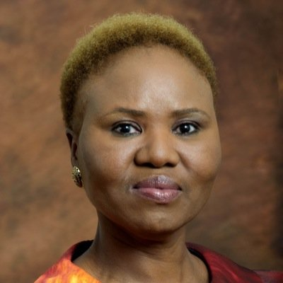
What other measures are necessary to treat the causes as well as the symptoms?
Prompt payment legislation and regulations must be enforced
30 day payment provision in PFMA and MFMA
Amendments required to facilitate pre-payments – priming the pump
Naming and shaming offenders
Holding offenders accountable – misconduct charges
Government agencies should publish payments performance quarterly
Late payment legislation (as per UK Late Payment of Commercial Debts (Interest) Act 1998 – interest of 8% plus BoE base rate payable on late payments)

Slide 35
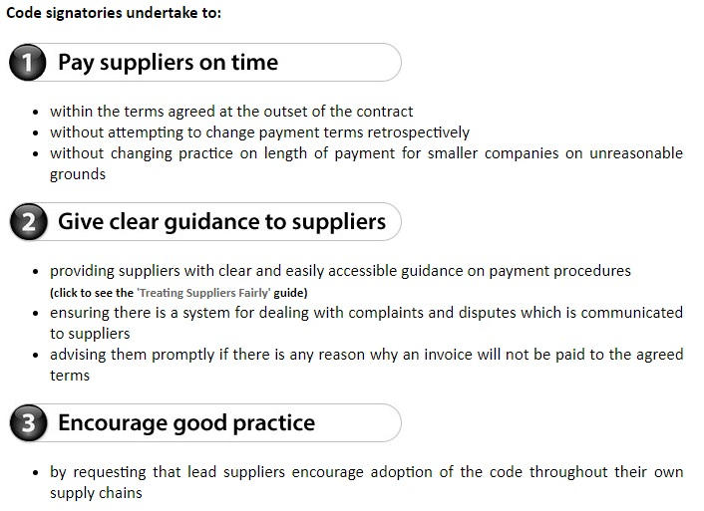

Slide 36
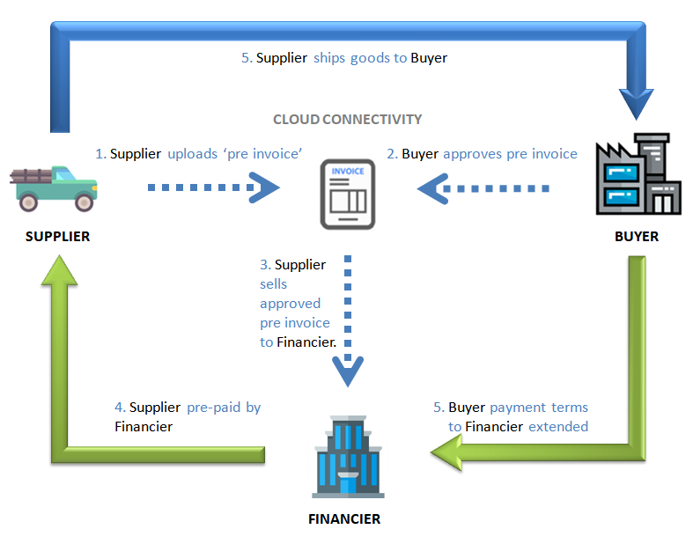
Supply chain finance solutions
Small businesses piggyback on the superior creditworthiness of their customers
Enable suppliers to be paid early for a small fee – typically far less than they can borrow for

Slide 37
What have the submissions/comments said?
Overwhelming support expressed in the majority of submissions and comments received – Cape Chamber of Commerce, NSBC, NEASA…
Some concerns over treating symptoms not causes
Need for a holistic approach – carrot and stick
King Code of corporate governance should include payment practices
Market based solutions can contribute
The Gentle Reminders Club
Reputation management
Some cynicism the Ombud service will actually do its job
Crucial to appoint professional, committed board/executives/staff

Slide 38
What are the benefits to the economy and society?
Levelling the playing field for small business, big business and government
A powerful, legislated backstop to resolve disputes – dissuades abusers
The ombud is a voluntary service and does not impose mandatory regulations on claimants – no increase in red tape
R350 billion in payables on business balance sheets, government commitment to paying within 30 days – releasing this money into the economy will boost small business and enable them to invest and grow, creating jobs
Finally, a mechanism to put flesh on the bone in SA’s commitment to supporting small business

Slide 39
Conclusion
The need for a mechanism to quickly and cheaply resolve disputes involving SMMEs and their customers is evident
The Department and Portfolio Committee have both acknowledged this
The Small Enterprises Ombud Service is that mechanism
This is the last piece of legislation the Committee is likely to be able to process in the 5th Parliament
Let the Committee make its mark and achieve cross-party support for the bill
This is a win-win opportunity for the overwhelming majority of stakeholders

Slide 40
Thank You

