Slide 1
Determination of hunting quotas in the
Greater Kruger system
Colloquium, 22 August 2018

Slide 2
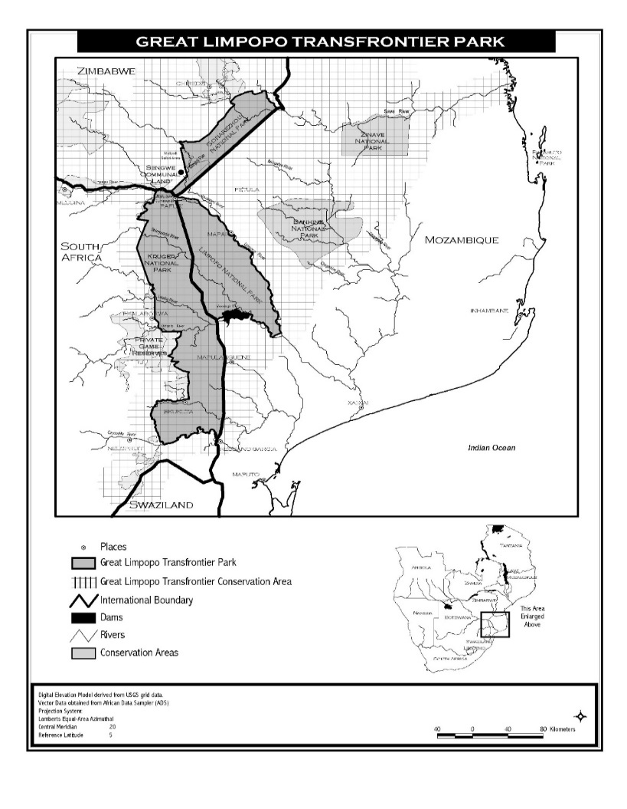
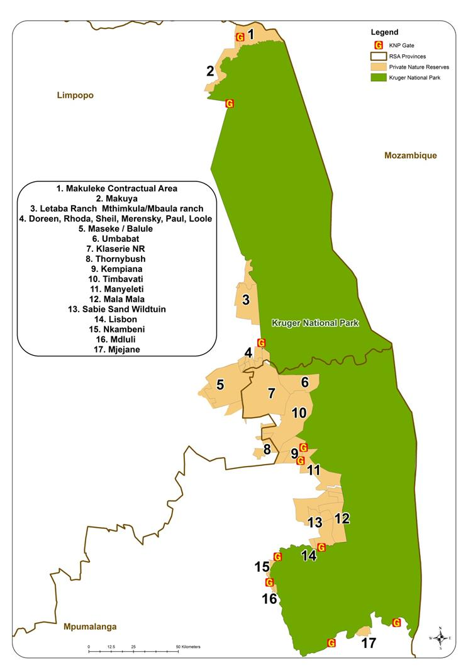
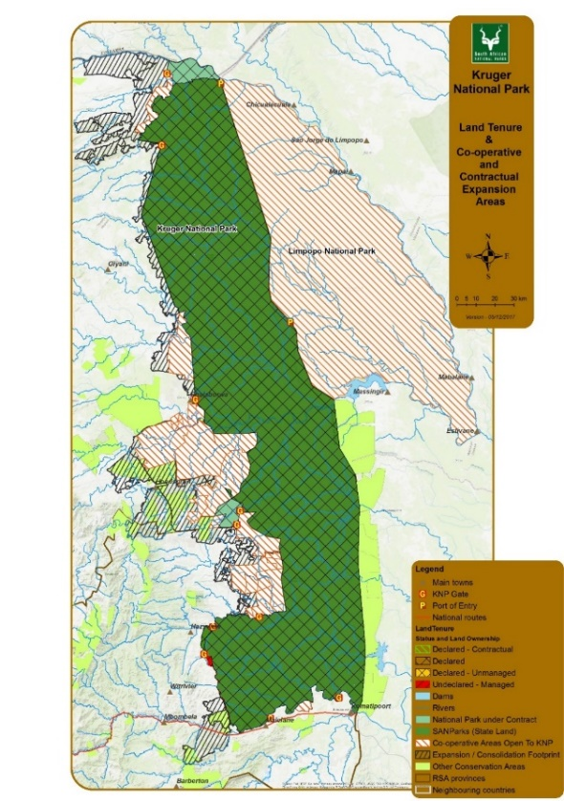
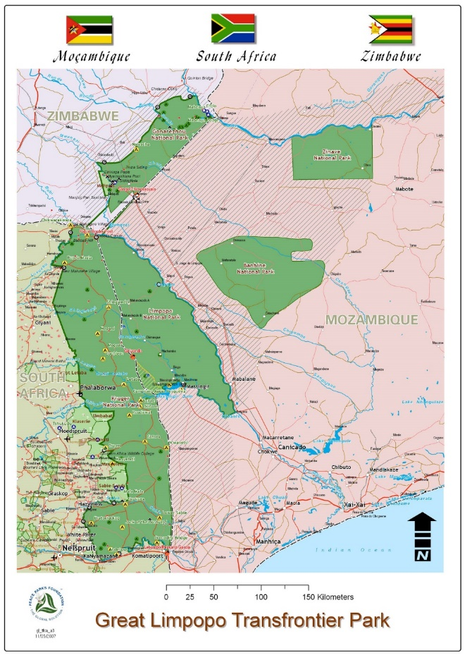
Greater Kruger parties
GLTP Treaty (2002) provides for:
Phase 1 -regularisation
Phase 2 -expansion
Phase 3 – integrated sector
20
19
18
6 million ha
2.25 million ha
Broader Desired state: GLTFCA Cooperative Agreement

Slide 3
Fundamental considerations within the Greater Kruger system
Harmonising protected area management practices in the Greater Kruger to contribute to responsible socio-economic and ecological outcomes within the broader integrated land use system.
Process embedded within sound and good cooperative institutional environment – currently being constituted.
Regularising and incentivising of conservation areas to contribute to joint GLTFCA outcomes.
Environment
Socio-economic
Safety and security
Strategic and Policy
Conventions, Treaties, Legal framework
Immediate
cooperative level,
e.g. APNR
Reserve level
GLTFCA level
Alignment of reserve management plan and practice within broader GLTP system and international framework
Integrative
programme
Good governance
Institutional
arrangements

Slide 4
Clarification of mandates
The MTPA and LEDET are the regulatory authorities for protected areas open and adjacent to KNP.
The MTPA and LEDET are the issuing authorities for resource use in areas open to KNP (western boundary).
These open areas are not managed by the KNP, and are state, private and community managed areas.
The MTPA and LEDET are overseeing the current regularisation process of the areas on the western boundary of KNP, in strong cooperation with SANParks, who is now facilitating the GLTFCA/Greater Kruger Agreement to support consistent practices in the open landscape.
SANParks does not hunt in National Parks, and no hunting takes place in the KNP.
The SANParks Policy framework supports sustainable, ethical and responsible resource use in areas adjacent to the KNP, as long as the Management Plans, Cooperative arrangement and protocols are in place, and are reviewed on a regular basis.

Slide 5
Greater Kruger Hunting Protocol Objectives
In line with IUCN best practice principles, and now be standardised to be consistent for the entire GLTFCA through the Joint Management Board, and the GLTFCA/Greater Kruger Cooperative Agreement Process:
Objectives
Promote ecological integrity through sustainable hunting practices within a Resource Use Strategy
Harmonise hunting practices with other conservation-related practices within the broader integrated system.
Support reserve specific social investment initiatives within communities
Develop transparent co-operative hunting arrangements and “best practice”
Promote good governance by reporting, monitoring and evaluating hunting practices
Develop a shared communication strategy and protocols on ethical and sustainable hunting practices

Slide 6
Steps being followed to inform quotas
Step 1 – Governance - verify that entity management plans and constitutions allow for resource use.
Step 2 – Census, other ecological, specialist studies, observation reports submitted and discussed.
This is an open system, therefore reports of the areas open to the KNP is submitted, such as the APNR entities, and LEDET managed areas open to KNP (Limpopo Province).
However, information for the broader KNP as well as direct adjacent KNP area is also considered. This is submitted around October each year.
Such pre-off-take meetings are attended by the APNR, relevant reserve representatives (or which ever area open to the KNP), MTPA, LEDET, SANParks and experts.
The information is then scrutinised, and recommendations are made in terms of ecological sustainability, governance and socio-economic aspects.
This includes reports on the financial sustainability/funding models of the reserve, and the contribution of the resource use to the management of the reserve in support of the objectives and broader conservation estate.

Slide 7
Steps being followed to inform quotas
Step 3: Post-off take reports of the previous year are submitted, together with the above.
This includes demographics (of the off-takes), an operational report by each reserve, measurements of species taken off, the age species, number of animals taken off, outfitter, reserve representative, permit number, compliance with the protocol.
Past season compliance reports, and intervention taken, to be submitted.
2. Step 4: The pre- and post off-take reports are discussed, and recommendations are made, based on ecological, governance, social-economic and other considerations, as guided by the legal framework, and IUCN responsible and best practice guidelines.
3. Step 5: Submission of the recommended off-take quotas to the EXCO structures of the adjacent conservation areas, for sign off. The inputs of SANParks, LEDET and MTPA are incorporated.

Slide 8
Supporting information to be submitted:
Ecological studies, including census reports
Specialists reports, including any veterinary reports, if required
Signed protocols
Past season non compliance reports
Service level agreements (e.g. in the case of LEDET co-managed areas)
Post off-take reports
Entities Management Plans/Elephant Managements plans (made available)
Any further due diligence reports, as required

Slide 9
Step 1. Management plans to provide for hunting, including cooperative aspects around it within an open landscape (consultation, ecological management, governance)
Step 2. Ecological surveys, censuses, specialist studies, observation inform off-takes (around August- October)
Step 3. Submit detailed post-off take records, in consideration with the above (around October)
Step 4. Off-take committees make recommendations, and submit to respective EXCO structures for approval, including e.g. the APNR JMC (November)
Step 5. EXCO obtains support from KNP, MTPA and LEDET, based on the following supporting documentation: pre-and post off-take information, Management plans, signed protocols and members being part of the Constitution, motivation of financial sustainability, Service level agreements (e.g. wrt LEDET)
Provincial Conservation authority
Issue, regulate, regularise conservation areas
KNP’s Mandate:
Comment, facilitate GLTFCA institutional processes from a conservation perspective
Step 6. MTPA or LEDET issues the permits, considering recommendations. Might request further supporting information. Official feedback to all parties, including KNP.

Slide 10
Final thoughts
Moving forward, the following procedural and other governance improvements will be pursued in the open systems:
The GLTFCA/ Greater Kruger Cooperative agreement will be signed between parties in the open system, to ensure consistent, transparent and well governed practices related to all aspects of protected area management, in support of the GLTP Treaty. This is not limited to resource use, but also includes responsible tourism practices, safety and security management and social investment.
Management plans of most protected areas in the Greater Kruger open system are currently being reviewed, and protected areas are being regularised, to adequately address cooperative aspects in the open system. The financial sustainability and contribution to the protected area management effectiveness need to be reflected.
Joint censuses and ecological surveys to be conducted and aligned in the open system as far as reasonably possible. This will require joint action by all parties in the open system, including with the APNR, LEDET-managed areas, MTPA-managed areas, SANParks-KNP and entities on the Mozambique & Zimbabwe borders.
Approved off-take quotas will be made publically available, however, the rights of the reserve, land owner and hunter outfitters will be respected, and implementation done as per Management Plans
Official feedback will be given to parties in terms of final approved quotas, and if amendments are approved following due diligence processes.

