Slide 1

SOUTH AFRICAN WEATHER SERVICE
  A WeatherSMART Nation
DEPUTY CHAIRPERSON OF THE BOARD
DR. PHILLIP DEXTER

Slide 2

  Table of Contents
Legislative and Other Mandates
Interphase: Board & Senior Management
Salary Parity
Salary Adjustment: GM Human Capital
Board Performance
Board Attendance 2015/16, 2016/17, 2017/18
Most contentious issues the Board had to deal with
Financial Management Report since inception
Psychometric Assessment: GM Human Capital

Slide 3
  LEGISLATIVE MANDATE
The South African Weather Service is a Schedule 3A entity, in terms of the Public Finance Management Act, No. 1 of 1999 and relevant Treasury Regulations. The entity derives its mandate from the South African Weather Services Act, No. 8 of 2001, as amended by the South African Weather Service Amendment Act, No. 48 of 2013.

Slide 4
  LEGISLATIVE MANDATE
The Board must ensure the financial viability and development of the commercial services;
The Board must ensure an efficient, cost effective and high quality weather service;
The Board must sets policy, standards and objectives within the framework issued by the Minister and ensure that the executive management implements these policies, standards and objectives;
The Board must facilitates succession and give guidance in the appointment of senior managers;
The Board must ensure that the Weather Service has adequate systems of internal control, both operational and financial;

Slide 5
  LEGISLATIVE MANDATE
The Board must monitor the performance of the Weather Service and make adjustments to the conditions of service of the personnel with due regard to the applicable labour legislation;
The Board must recommend any budget proposals or adjustments and submit them to the Minister;
The Board must set policy for recruitment, training and transformation of the Weather Service;
The Board must approve a business plan for the Weather Service annually for the next three years and submit it to the Minister for final approval;
The Board must ensure that the majority of the South African population benefits from the public good services of the Weather Service; and
The Board must perform any other function assigned to it by the Minister.

Slide 6
  INTERPHASE: BOARD & SENIOR MANGEMENT
The Board continues to play its oversight role over the implementation of strategies by the CEO, the Executive Team and staff of SAWS.
There are clearly defined reporting lines between the Board and the Executive Team which are supported by the Board, its duly established Committees and the delegation of duties.
The oversight activities of the Board and its Committees are regulated by clearly defined Charters and Work Plans for each reporting quarter of the financial year.

Slide 7
  SALARY PARITY
SALARY PARITY

Slide 8
  SALARY PARITY
SAWS implemented DEA’s Remuneration Framework and new pay scales in November 2017.
The Remuneration Framework’s intention was to address challenges around grading, pay levels and parity.
The Salaries of 253 employees on salary levels 1 to 12 below the midpoint of the scale were adjusted. R1.8m was spend on salary parity adjustments for 2017/18

Slide 9
  SALARY PARITY

Slide 10
  SALARY PARITY

Slide 11
  SAWS Salary Structure and Adjustments
SALARY ADJUSTMENT OF GM HUMAN CAPITAL

Slide 12
  Salary Structure of GM Human Capital
The Official was appointed on a five-year fixed term contract as the General Manager: Human Capital Management effective 06th December 2016 (05th December 2016 – 30th November 2021).
The position is currently Executive: Corporate Services and Regulatory Services after approval and implementation of realignment of SAWS’ executive and senior management structure.
Executives are on Level 15 and the CEO is on Level 16 of the Salary Structure.

Slide 13
  Salary Structure of GM Human Capital
The Official was appointed at a salary of
R1, 300.000.00 per annum.
The Official’s salary was reviewed and approved shortly after joining SAWS, leading to her package being increased to R1, 500.000.00 per annum.
When the annual salary negotiations for employees were finalized which is effective April each year, she received 7% salary adjustment which was effected to all employees in line with the Board Resolution for salary adjustments for 2017/18 financial year.

Slide 14
  BOARD PERFORMANCE
The Minister of Environmental Affairs is responsible for the assessment of the performance of the Board and a report relating thereto can only be provided by the Shareholder as the Executive Authority of SAWS.

Slide 15
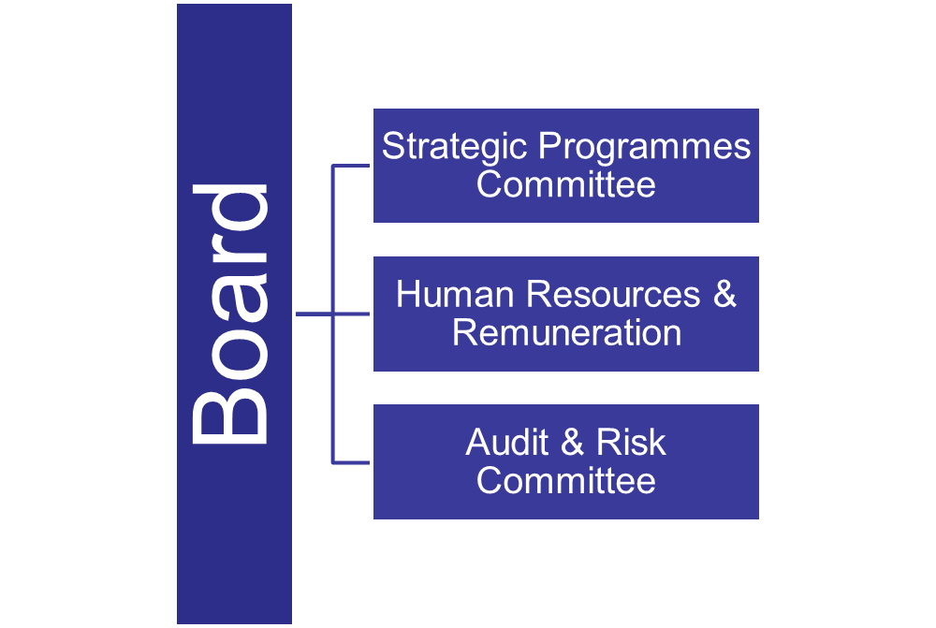
  BOARD 2015-16/2016-17/2017-18

Slide 16
  2015/2016 BOARD ATTENDANCE
No. | Members | Scheduled | Held | Attended
1. | Ms Ntsoaki Mngomezulu | 5 | 6 | 5
2. | Dr Lulama Gwagwa | 5 | 6 | 4
3. | Prof. Elizabeth Mokotong | 5 | 6 | 6
4. | Ms Judy Beaumont | 5 | 6 | 3
5. | Ms Nandipha Madiba | 5 | 6 | 2
6. | Ms Sally Mudly-Padayachie | 5 | 6 | 2
7. | Mr David Lefutso | 5 | 6 | 2
8. | Mr Derick Block | 5 | 6 | 1
9. | Dr Jasper Rees | 5 | 6 | 2
10. | Dr Linda Makuleni: CEO | 5 | 6 | 5
11. | Dr Jonty Tshipa | 5 | 6 | 5
12. | Dr Keabetswe Modimoeng | 5 | 6 | 2

Slide 17
  2016/2O17 BOARD ATTENDANCE
No. | Members | Scheduled | Held | Attended
1. | Ms Ntsoaki Mngomezulu | 4 | 9 | 9
2. | Dr Lulama Gwagwa | 4 | 9 | 6
3. | Prof. Elizabeth Mokotong | 4 | 9 | 7
4. | Ms Judy Beaumont | 4 | 9 | 8
5. | Ms Nandipha Madiba | 4 | 9 | 9
6. | Ms Sally Mudly-Padayachie | 4 | 9 | 8
7. | Mr David Lefutso | 4 | 9 | 8
8. | Mr Derick Block | 4 | 9 | 7
9. | Dr Jasper Rees | 4 | 9 | 6
10. | Dr Linda Makuleni: CEO | 4 | 9 | 5
11. | Ms Mmapula Kgari Acting CEO | 4 | 9 | 3
11. | Dr Jonty Tshipa | 4 | 9 | 9
12. | Dr Keabetswe Modimoeng | 4 | 9 | 7
13. | Mr Rowan Nicholls | 4 | 9 | 8

Slide 18
  2017/2O18 BOARD ATTENDANCE
No. | Members | Scheduled | Held | Attended
1. | Ms Ntsoaki Mngomezulu | 4 | 7 | 7
3. | Prof. Elizabeth Mokotong | 4 | 7 | 7
4. | Ms Judy Beaumont | 4 | 7 | 7
5. | Ms Nandipha Madiba | 4 | 7 | 7
6. | Ms Sally Mudly-Padayachie | 4 | 7 | 7
7. | Mr David Lefutso | 4 | 7 | 7
8. | Mr Derick Block | 4 | 7 | 5
9. | Dr Jasper Rees | 4 | 7 | 4
10. | Mr Jerry Lengoasa: CEO | 4 | 7 | 6
11. | Dr Jonty Tshipa | 4 | 7 | 5
12. | Dr Keabetswe Modimoeng | 4 | 7 | 6
13. | Mr Rowan Nicholls | 4 | 7 | 7

Slide 19
  MOST CONTENTIOUS ISSUES
Presidential Hotline: THE O.M.A INVESTIGATION;
2015/16 performance bonuses and 2016/17 salary adjustments for level 13 and above (senior and executive managers);
Dr. Linda Makuleni’s Early Release from Contract of Employment.

Slide 20
  MOST CONTENTIOUS ISSUES
SAWS / WIS Equity Partnership Allegations;
Employee Boycotting of Annual Awards: 2015;
Public Protector’s investigation into corruption and maladministration by the Chief Executive Officer;
New Head Office Lease (Lease Agreement for the Office Building on 1 Eco Park, Block B Eco Glades, Centurion)

Slide 21
FINANCIAL REPORT
Actual 2014/15 versus Actual 2015/16
Revenue:
Government Grant for 2014/15 includes: Capital Expenditure Grant of R35 million which was used to purchase the High Performance Super Computer. No CAPEX Grant received in 2015/16.
Commercial Revenue:
Increase due to Aviation income which increased by R16,18 million year-on-year mainly due to higher traffic volumes.
Other Commercial Revenue increased by R6,5 million due to increased sales of Lightning Detection Network sales and sales of Weather Stations.
Total Expenditure increased by 7% year-on-year due mainly to the following:
Salary costs increased by 8% year-on-year largely due to filling of vacancies and
annual salary adjustment
Increase of 14% in Depreciation and Amortization due to purchase of HPC and
Air-Quality Instruments
Increase in Fair Value adjustment is due to appreciation in value of Waterkloof Land

Slide 22
FINANCIAL REPORT
Actual 2015/16 versus Actual 2016/17
Revenue:
No Capital Expenditure Grant received for the year ending 31 March 2017.
Commercial Revenue:
Increase due to Aviation income which increased by R4,94 million largely due to a higher tariff rate which increased from R51.43 to R53.21 year-on-year.
Other Commercial Revenue increased by R10,35 million due to additional revenue from sale of Air-Quality information to various municipalities.
Fair Value Adjustment:
Increase due to appreciation in value of Waterkloof Land
Total Expenditure increased by 9% year-on-year due mainly to the following:
Salary costs increased by 8% year-on-year largely due to filling of vacancies and
annual salary adjustment
Increase of 15% in Depreciation and Amortization due to purchase of HPC and
which was partially depreciated in the previous financial year
Operating expenses increase mainly attributed to purchase of spare parts & computer licenses which are impacted by exchange rates.

Slide 23
FINANCIAL REPORT
Actual 2016/17 versus Actual 2017/18
Revenue:
Government Grant for 2017/18 includes Capital Expenditure Grant R35 million
Commercial Revenue:
Decreased due to Aviation income which decreased by R3,62 million mainly due to lower traffic volumes and a decrease in the tariff rate
Other Commercial Revenue decreased by R3,71 million due to a slow-down in sales of Weather Stations
Other income increase attributed to increase in interest income
Total Expenditure increased by 12% year-on-year due mainly to the following:
Salary costs increased by 10% year-on-year largely due to filling of vacancies,
annual salary adjustment and salary parity implementation.
Operating expenses increase mainly attributed to purchase of spare parts & computer licenses which are impacted by exchange rates, and other fixed costs based on CPI and contractual escalation values.
Fair Value Adjustment:
Gain mainly attributed to decrease in the value of the Post-Retirement Liability

Slide 24
ACTUAL, BUDGET, MTEF AND PROJECTED
CAPITAL EXPENDITURE
No Capital Expenditure Grant was received in 2015/16
R36 million spent on upgrade of HPC
A study for Infrastructure Development is currently underway and will determine how much is required in the short to long term for all SAWS technical infrastructure.
The MTEF figures are based on current needs assessment, while the approved MTEF by National Treasury for 2019/20 amounts to R38 million ;
For 2020/21, this is based on projected capital needs as the MTEF will only be approved during the 2018/19 financial year

Slide 25
AUDIT FINDINGS OVER THE LAST 3 FINANCIAL YEARS
Financial Year | Number of Findings | Resolved | In Progress | % Resolution | Audit opinion
2015/16 | 13 | 11 | 2 | 85% | Unqualified
2016/17 | 36 | 28 | 8 | 78% | Unqualified
2017/18 | 83 |  |  |  | Unqualified
The unresolved findings (2015/16 and 2016/17) are mainly related to:
ICT findings on Security Levels and Access Control
Audit of Performance Information
Timely filling of key management positions
General Ledger Reconciliations
These are being addressed through the Organisational Structure Design as they are related more to capacity issues

Slide 26
PSYCHOMETRIC ASSESSMENT GM: HUMAN CAPITAL

Slide 27
The Board of SAWS refers the Committee to the letter dated 11 July 2018 addressed to the Speaker of the National Assembly by the honourable Minister of Environmental Affairs, Dr BEE Molewa, in which she states, amongst other issues, as follows:

Slide 28
“Furthermore, in the event that the person concerned grants approval to share or release the results of his or her competency assessment, I am advised that the presentation must be made in camera by the specialist that conducted the competency assessment. If the above legal requirements are fully complied with by the Committee, only then can I legally authorise the release or sharing of Ms Mphafudi’s competency assessment with the Committee”.

Slide 29
Thank you

