Slide 1
Presentation to the Portfolio Committee on Small Business Development
15 August 2018

Slide 2
Outline
1
Telkom Group operating model
2
FutureMakers
3
We ThinkCode/Spliceworks
4
Telkom Foundation
5
Telkom and Screamer Telecoms: a case study
Telkom presentation to the Portfolio Committee on Small Business Development

Slide 3





The Telkom Group is the leading provider of integrated services in the ICT converged market in South Africa, managing a specialised portfolio of companies with R41bn revenues and employing ~19 000 people.
Telkom
Consumer
Wholesale Infrastructure
Converged ICT solutions
Connectivity solutions
Directory
& online services
Property management
Wholesaler provider of communication facilities
& infrastructure to ISPs
DSL, Fibre, ME etc.
End-to-end digital solutions provider of ICT solutions to enterprise customers
Connectivity, voice, IT, cloud etc.
Retail communications service provider to consumers
Broadband, voice, internet & mobile.
Local advertising and marketing organisation providing digital solutions
Directory, online search, e-commerce.
Property business managing masts and towers, property development and property management services.

Slide 4
Our business and operating model: shops and stores
  Our business model is based on retail stores operated as an integral part of our operations
  As a result, a vast majority of our shops and stores are run by us, and
  Our emphasis is on supplier development, skills development and Cooperate Social Investment (CSI)
Telkom presentation to the Portfolio Committee on Small Business Development

Slide 5



Creating Shared Value
FutureMakers was launched May 2015 as the Enterprise and Supplier development program of Telkom
Futuremakers enables the development and growth of qualifying black-owned businesses in the ICT sector by providing financial and non-financial support
The direct result of our investment is a more inclusive supply and value chain, a stimulated entrepreneurial economy and increased youth employment
Telkom presentation to the Portfolio Committee on Small Business Development

Slide 6
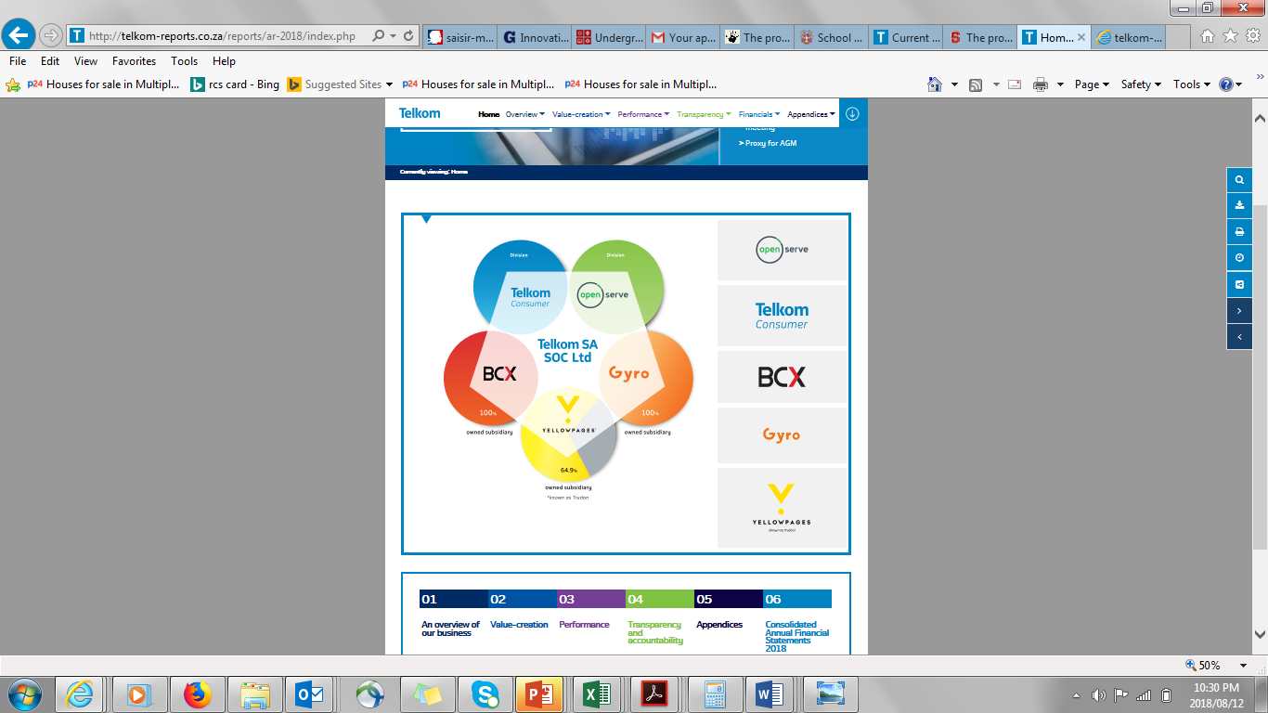
Creating Shared Value…
Telkom Group has invested R381 million to date supporting qualifying black owned and Black woman owned ICT enterprises in our supply and value chain
(R250 million CAPEX and R131 million OPEX)
Preferential Procurement
Supplier and Channel Development
Digital Innovation
Telkom presentation to the Portfolio Committee on Small Business Development
Notes:
Telkom views transformation as a catalyst to address South Africa’s socio-economic challenges and the associated impacts on business. We aim for sustainable transformation and go beyond compliance to B-BBEE certification. We have initiated strategies
and programmes in each Business Unit, to improve the effectiveness of our transformation initiatives to foster an active SMME economy in the ICT sector. The ESD programs are executed through preferential procurement, Supplier and Channel Development and Digital Innovation. The investment (excl BCX) has been R381m to date, and an additional R100m by BCX when rating BEE independently

Slide 7
Annual Investment in Future Fund
In FY2018:
BCX acquired an independent BEE rating certificate and invested an additional R100 million towards digital innovation into the Future fund, making the total R381 million invested to date by Group
Telkom presentation to the Portfolio Committee on Small Business Development
Notes:
Through FutureMakers, launched in May 2015, we have invested over R381 million (R250 million capex and R131 million operational expenditure) in the programme, and support the ESD drive in the ICT sector. The programme specifically supports small black-owned enterprises with a focus on channel development, supply chain development and technology innovation.

Slide 8
FutureMakers Impact Highlights
Internet Cafe
FutureMakers Investment
SMMEs Supported
Business development support
24
24 internet cafés were setup across the country, and are fully operational
381
Investment made to the FutureMakers since inception in May 2015
More than
SMMEs supported with through various FutureMakers initiatives
R47
Provision of connectivity, gap analysis services, business strategy development, mentorship, business training and auditing services
Million
2500
Million
Cafe
Hubs
Jobs created
Revenue Generated
Provision of affordable connectivity, work space, technical, back-office and business workshops to support more than 800 tech businesses
1604
7.2
R200
Procurement Accessed
3
Jobs
1604 has been created by the FutureMakers beneficiaries as a results of the FutureMakers Programme support
Million
More than 17 dealers received financial and non-financial support, generating R7.2mill revenue for Telkom.
Million
Telkom has procured more than R200 million from FutureMakers black owned businesses and black women owned businesses beneficiaries.
Hubs
Telkom presentation to the Portfolio Committee on Small Business Development
Notes:
In FY2018, R47 million was incurred towards providing non-financial support such as connectivity, office
space, gap analysis services, business strategy
development, mentorship, business training and
auditing services. More than 2 500 small businesses
have benefited from the non-financial support with
1 604 direct jobs created.

Slide 9
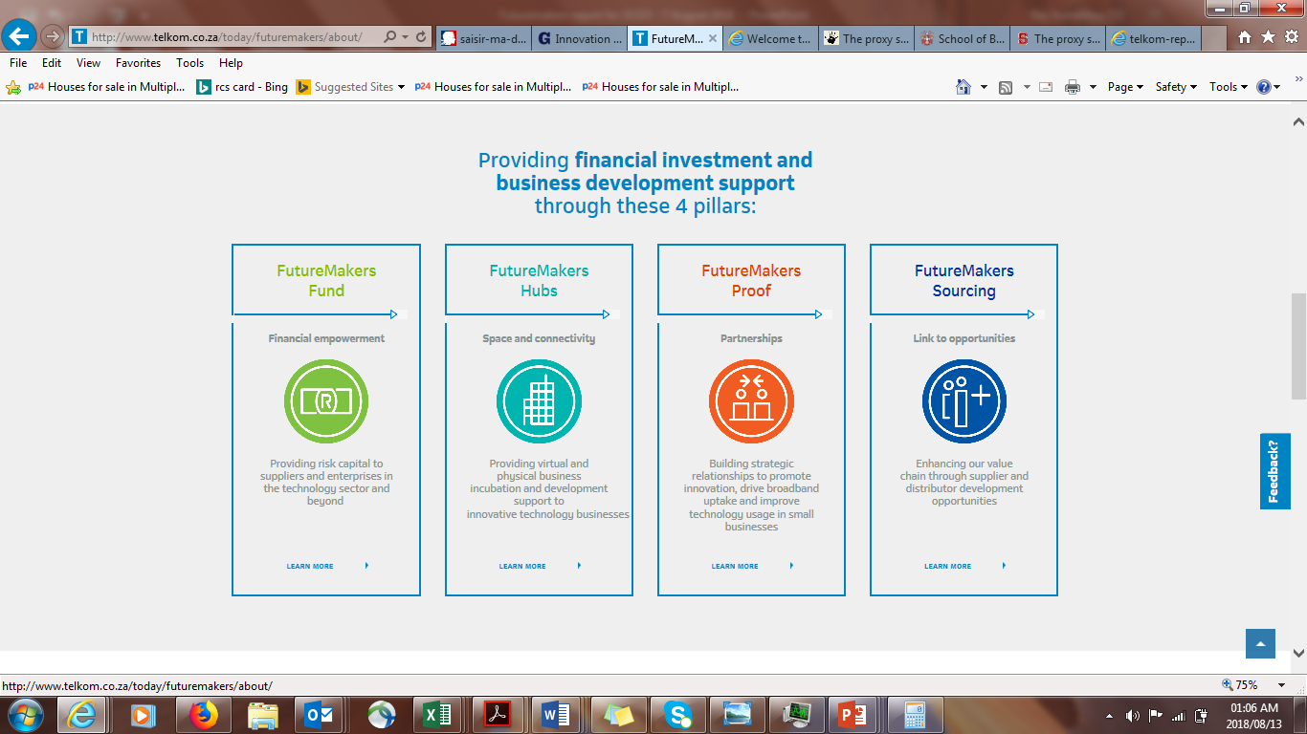
The 4 pillars of SMME support (financial and non-financial)
Futuremakers provides financial investment and business development support through these 4 pillars:
Telkom presentation to the Portfolio Committee on Small Business Development

Slide 10

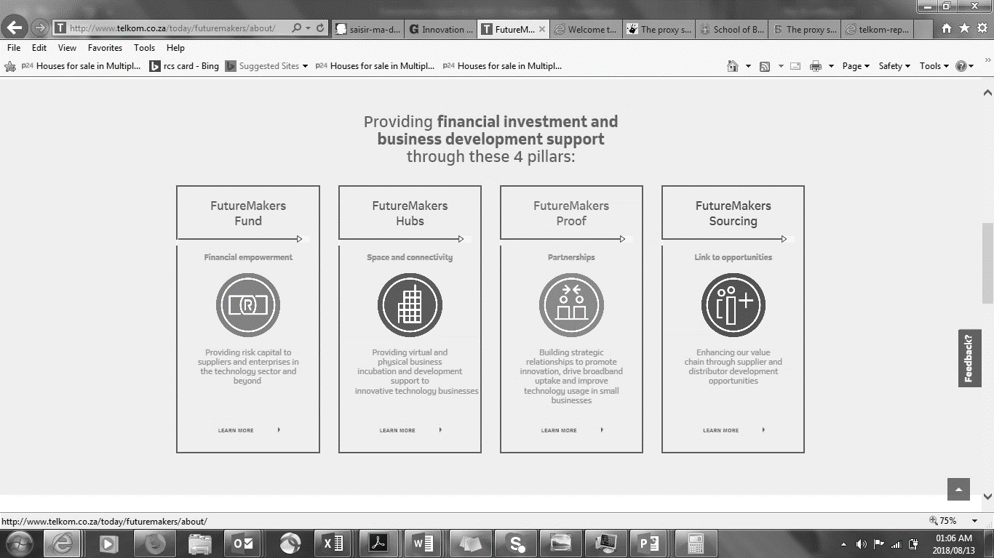
Identity Fund (IDF)
100% Black Woman Owned
Telkom presentation to the Portfolio Committee on Small Business Development
Notes:
Our fund is managed by a 100% Black Female Owned fund management enterprise, IDF Capital

Slide 11
FutureFund Investment and Impact Highlights
FutureFund
Main Fund
FutureFund
Early Stage Fund
FutureFund
Seed Fund
FutureFund Investment
R80
Commercial fund aimed at investing in matured black owned businesses with high returns
R42
Early Stage fund aimed at investing in emerging black owned businesses with low returns
R28
R250 million has been invested to the FutureFund
Seed fund aimed at investing in new start-up black owned businesses with low returns and that are high risk
R250
Million
Million
Million
Million
Rejection Rate
R89 mill Approved
Deal Pipeline
Social Impact
The fund has a low rejection, with the investment committee having a 77% approval rate of deals considered for funding
R89
48
Fund invested in 53 black businesses, which;
  67% were female owned businesses
  13% youth owned business
1 604 jobs created by invested black businesses
23%
The fund has approved deals to the value of R89 million
The deal pipeline under evaluation is R48 million, which is very health
Impact
Million
Million
Pending
verification
of stats from IDF
Telkom presentation to the Portfolio Committee on Small Business Development

Slide 12
FutureMakers Hubs
Telkom presentation to the Portfolio Committee on Small Business Development

Slide 13

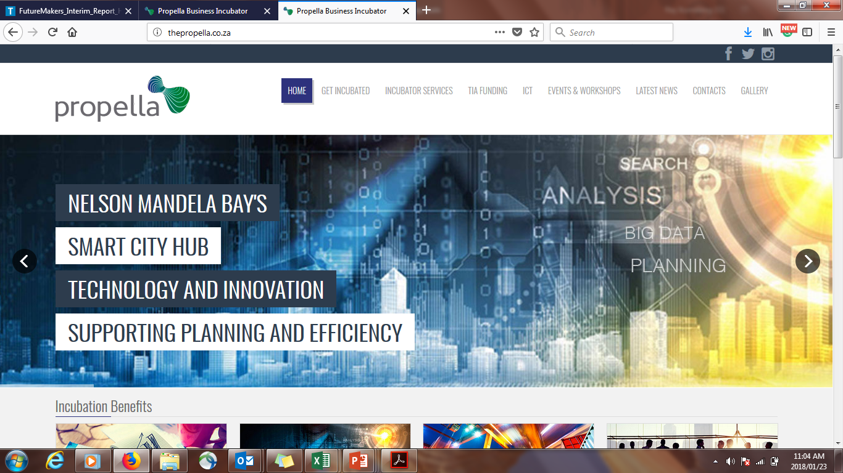

FutureMakers Hubs…
Supports digitally innovative black start-ups and existing businesses to generate ideas, develop and commercialise business solutions.
BCX will commercialise these solutions.
Entrepreneurs are supported from ideation, incubation, acceleration to commercialisation.
Three hubs are financially supported in PE, Jhb and Cape Town
1 300 technology entrepreneurs are supported by the hubs
Support instruments include:
  Virtual and physical business incubation
  Business development support
  Hot desks and technology events
  Connectivity and market linkages.
Johannesburg
Port Elizabeth
Cape Town
Telkom presentation to the Portfolio Committee on Small Business Development

Slide 14
FutureMakers Proof
Telkom presentation to the Portfolio Committee on Small Business Development

Slide 15
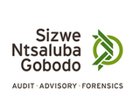

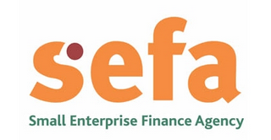

Strategic Partnerships for business development support
Futuremakers holds strategic relationships with key industry players to promote innovation, improve technology usage, business management strategies and back-office support
Innovation hubs
Professional services
Fund management partner
Industry partners
Other
Futuremakers supports other specialist SMME business development partners through our supply chain
Telkom presentation to the Portfolio Committee on Small Business Development

Slide 16

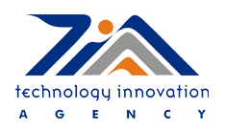
Acceleration, Scale and Commercialization of Tech Innovation
The I’M IN: pre-investment readiness programme
Launched in 2017 to support early-stage entrepreneurs with acceleration of business growth, advancement of business solutions and improved investment readiness.
R16.2 million investment towards accelerating early stage entrepreneurs
17 black-owned businesses supported
R5 million allocated to date
TECHNVEST: Tech Commercialization program
Launched in partnership with Microsoft, Technology Innovation Agency & IDF Capital
Assists stage 4 &5 businesses with commercialization, scale and market access opportunities
Supports 19 Black owned businesses
Telkom presentation to the Portfolio Committee on Small Business Development

Slide 17
FutureMakers Sourcing
Telkom presentation to the Portfolio Committee on Small Business Development

Slide 18
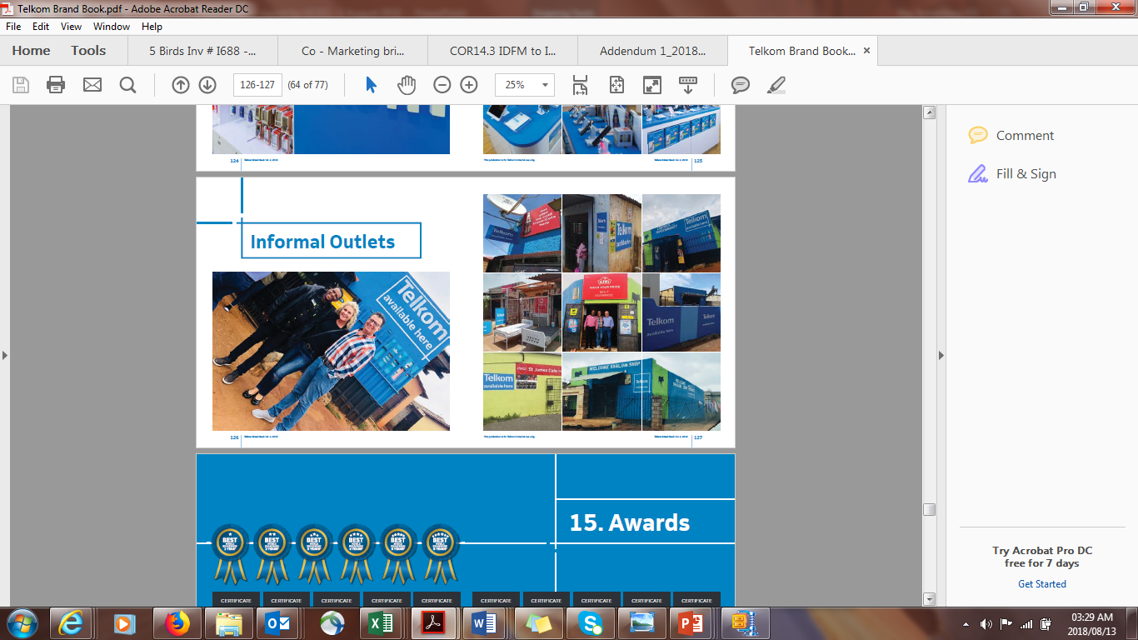
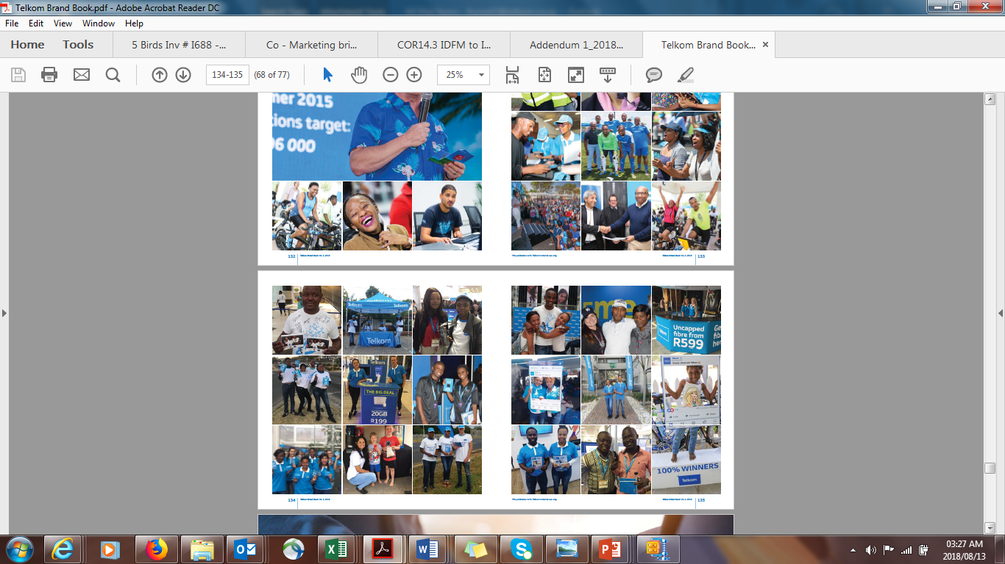
Channel development
This program exists to penetrate and diversify the market including township and peri-urban areas where it is imperative to develop black-owned channel partners.
The programme is aimed at:
Development and support of high-performing sales force distributor enterprises to drive product and services sales for Consumer and Openserve.
Creation of job opportunities for the unemployed youth in townships and rural areas though the employment of sales agents.
Developing of a black-owned airtime vending platform to enables black dealers to access the airtime full commission benefits
Telkom presentation to the Portfolio Committee on Small Business Development

Slide 19
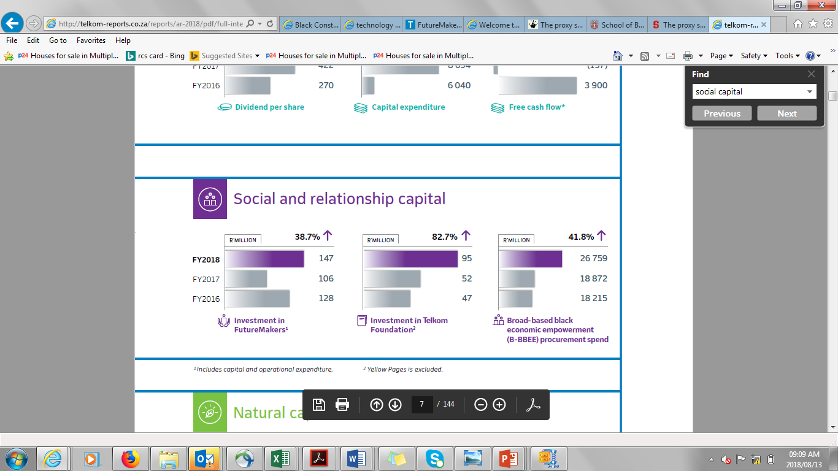
Social and Relationship Capital
Telkom presentation to the Portfolio Committee on Small Business Development

Slide 20
Skills Development
The world needs more problem solvers, thanks to WeThinkCode that could be a problem of the past
WeThinkCode is an institution which aims to eliminate the ICT skills shortage in South Africa while tackling youth unemployment within the space of software engineering and coding.
The programme was launched in South Africa in September 2015, and first opened its doors to 120 students in January 2016, about 3 500 South African students showed interest
Telkom has come in as a key sponsor of the project committing R20 million to the Programme for the next three years
This sponsorship will go towards paying for the tuition fees for the students and to ensure that the programme grows its footprint in South Africa
WeThinkCode is open to anyone between the age of 17 and 35 – no need for any previous education
Spliceworks is an online platform where Technology business can get access to clients who might need their technology or digital innovation, therefore facilitating growth and employment, and
It created over 1 000 jobs through FutureMakers
We think code
Spliceworks
Telkom presentation to the Portfolio Committee on Small Business Development

Slide 21
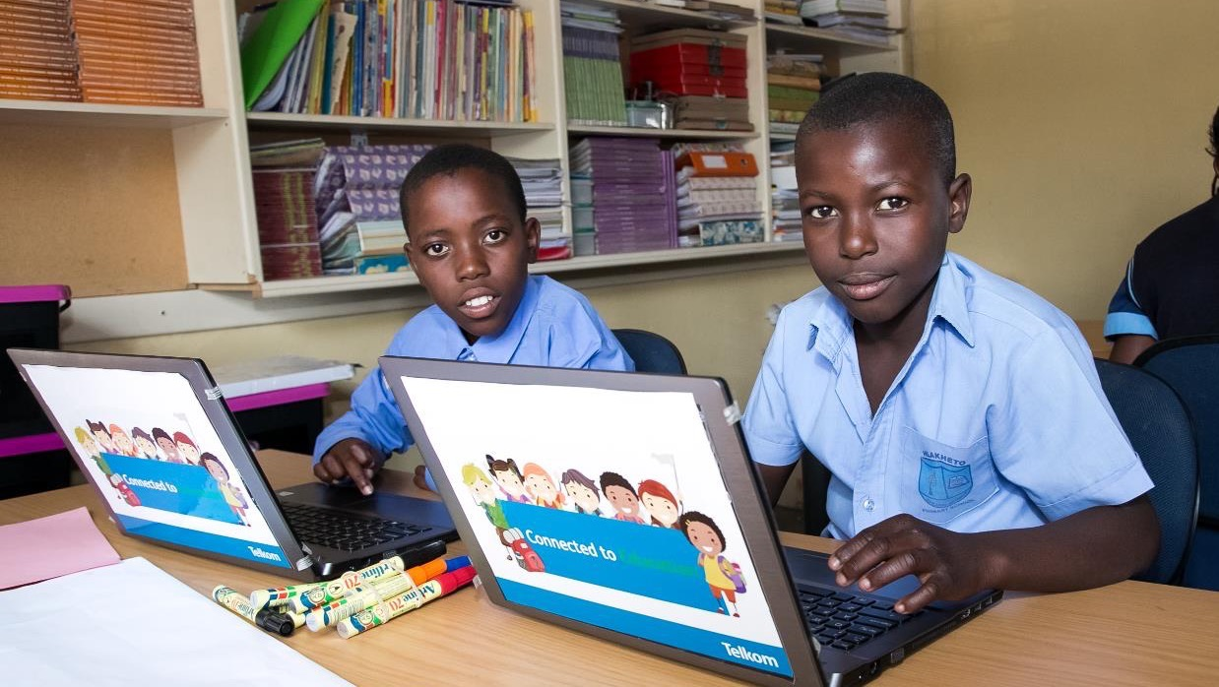



Corporate Social Investment (CSI)
2017
Main focus is on education Foundation over the past 3 years
New strategy
Goal:To identify, develop and support learners from Grade 8 through to employability in ICT through an ICT focused education programme and allied support processes.
R85 million
allocated to education.
Programme Overview
Integrated programme: supplementary teaching, ICT integration, teacher development, and psychosocial support.
ICT integration:
  Devices and smart boards for all targeted grade classrooms, teachers and learners
  Wifi connectivity
  ICT teacher training and in-school support
Supplementary teaching in maths and science: Saturdays and Holiday School programme.
Psychosocial support: online and face-to-face counselling services to address challenges.
Programme reach:
  5 schools in Gauteng, preparations underway for 2 schools in Eastern Cape.
  Currently 934 learners and 60 teachers, additional 1700 learners and 40 teachers in 2018.
9 770
learners benefited from
supplementary teaching.
4 140
teachers trained in ICT.

Slide 22
Case Study: Telkom and Screamer Telecoms
From old telecommunications systems to new generation networks (NGNs):
According our records Telkom contracted with Molapo April 2000
Molapo filed for liquidation in September 2016
Screamer was always a separate company, it CEO had on the side line delivers other services such as FTTX installation, supply,
mining, agricultural
It was never introduced into the Telkom domain until the liquidation was finalised
Infrastructure is deemed legacy when the protocols or transmission principles are now outdated, and there new ratified standards that have
superseded them
The role of Molapo/Screamer was to repair legacy equipment for which the OEM no longer supported
Molapo would source the components on the global/local market and then repair the boards on a component level
Telkom started to roll out NGN in 2006/7
As a business who had to please the Board and shareholders, Telkom started to look at other avenues to increase revenue
Screamer does not only want the repair business for legacy technologies, they also want the repair business for current technologies like
MSAN, Metro Ethernet, POTN etc
Telkom presentation to the Portfolio Committee on Small Business Development

Slide 23
Thank you

