Slide 1



Portfolio Committee on Environmental Affairs Stakeholder Workshop on Minamata Convention on Mercury
Rico Euripidou
15th August 2018

Slide 3
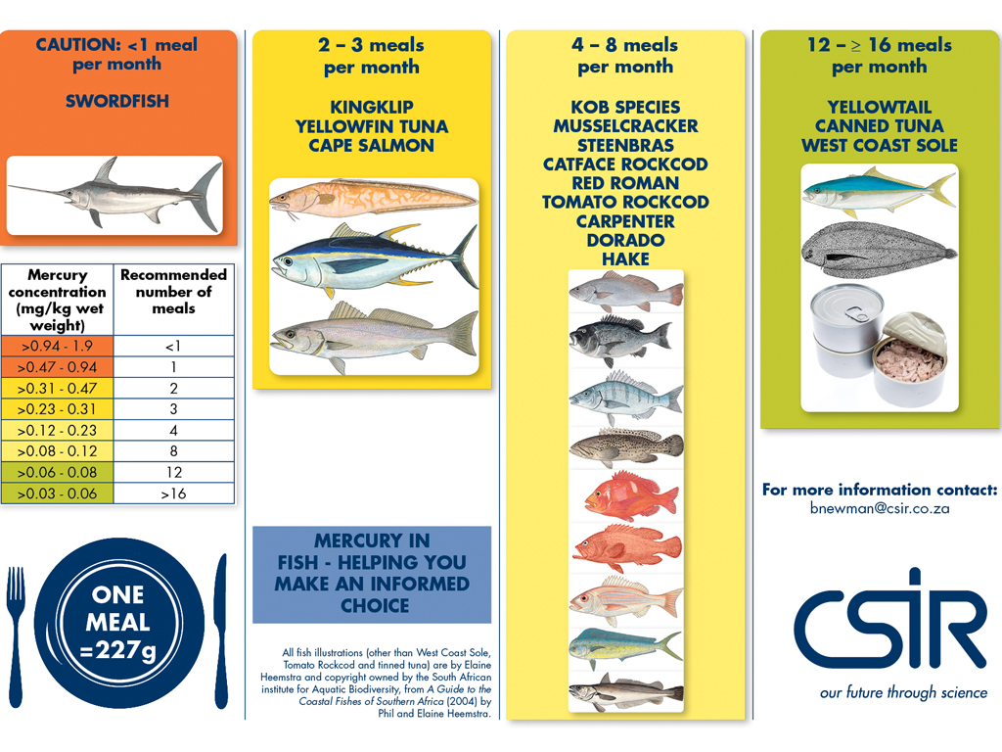

Slide 5
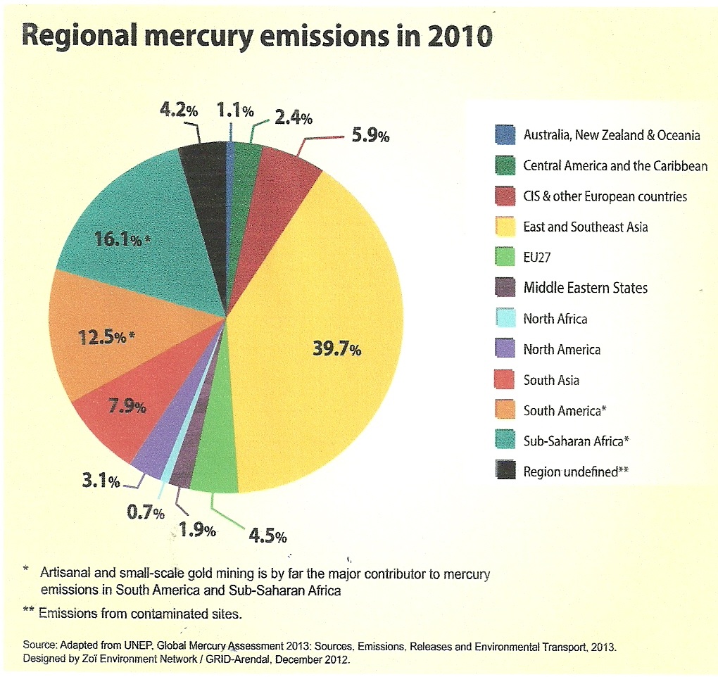

Slide 7
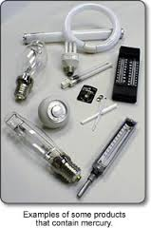
Mercury-added Products Banned by 2020
Batteries
Switches and relays
Cosmetics (w/mercury above 1 ppm), including soaps and cream
Pesticides, biocides, topical antiseptics
Non-electronic measuring devices, including barometers, hydrometers, manometers, thermometers, sphygmomanometers
Limit mercury content of lamps

Slide 8
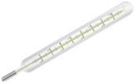
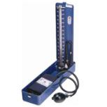
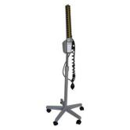
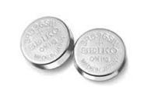
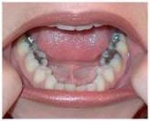

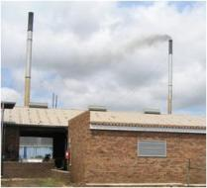
Mercury Sources in Health Care
Direct Uses
  Devices
    Thermometers, Sphygmomanometers
    Gastro-intestinal tubes
  Dental Amalgam
  Laboratory Chemicals
  Medication
  Lighting
  Switches and Relays
    Thermostats e.g. in stoves, washing machines, fridges
    Tilt switches in vehicles, level switches
  Batteries
Indirect Uses
  Fossil Fuels
    Boilers, incinerators, etc
  Electricity used (coal-fired power stations)

Slide 9
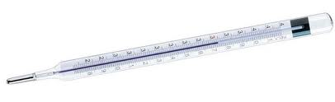

Hg in Health care
Significant releases of mercury to the environment result from the use of mercury added products, and from the incineration of medical waste. Health-care facilities may be responsible for as much as 5% of all mercury released in wastewater.

Slide 10

WHO recommendation
To understand better the problem of mercury in health-care sector, it is recommended that countries conduct assessments of current mercury usage and health-care waste management programs

Slide 11
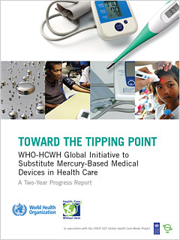
Mercury-free Products Are Increasingly Available
Many countries have already phased out mercury in many of the products banned by the Convention
There are many examples and guides on what steps countries can take to ban products containing mercury
For example, the World Health Organization created a guide for phasing mercury out of health care
As more countries ban products, the markets respond and economies of scale increase availability

Slide 12
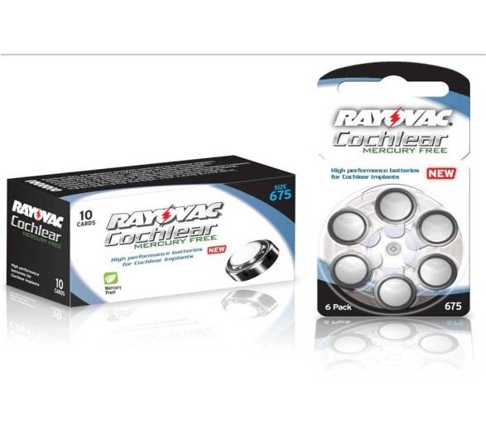
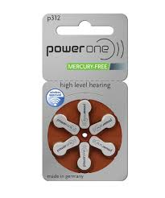
Mercury-free Batteries
2% mercury content limit for zinc air and silver oxide button batteries corresponds to amount currently used by manufacturers.
Manufacturers now make large quantities of mercury-free batteries which work as well.
The availability of these mercury-free products will increase substantially in response to government policies and market forces

Slide 13
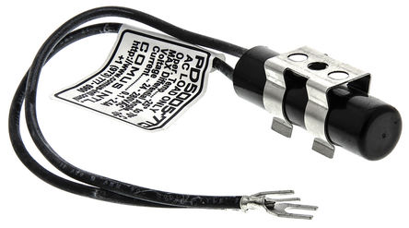
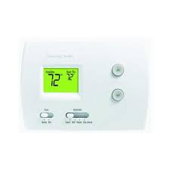
Mercury-free Switches & Relays
Electronic mercury-free alternatives are proven effective and widely available
Many manufacturers now produce mercury -free switches and relays because of restrictions in the EU’s RoHS Directive
Many countries have (or will soon impose) comparable bans
Hybrid tilt switch
Electronic Thermostat

Slide 14
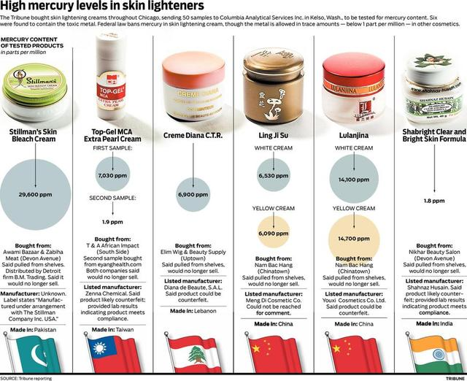

Slide 15
Mercury-free Cosmetics
Many countries already ban use of in cosmetics
Mercury-free alternatives widely available and used
Awareness and monitoring can reduce availability of hazardous cosmetics
Tighten down penalties for illegal import, sales
Provide health alerts and effective communication to notify affected populations
Products found to have mercury should be photographed and posted on the internet
Products found to contain mercury should be photographed and posted on the worldwide web
Several national governments, including Kenya and Indonesia, have mounted public education campaigns and banned long lists of specific products
Several national governments, including Kenya and Indonesia, have mounted public education campaigns and banned long lists of specific products

Slide 16
Banning Pesticides, Biocides and Topical Antiseptics Containing Mercury
Mercury-added pesticides, biocides and topical antiseptics are already banned in SA and many countries other as there are viable alternatives
Governments should also ensure that paints manufactured or imported into their countries should not have mercury added

Slide 17
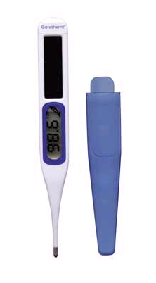
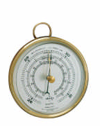
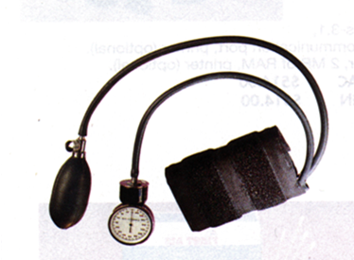
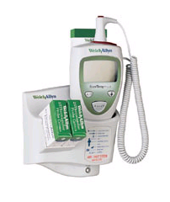
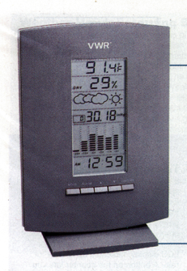
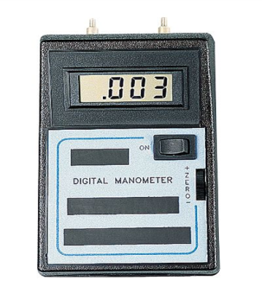
Mercury-free Measuring Devices are widely available!
Aneroid
Barometer
Digital
Thermometer
Aneroid Sphygmomanometer
SURE-TEMP Thermometer
Digital Barometer
Digital
Manometer

Slide 18
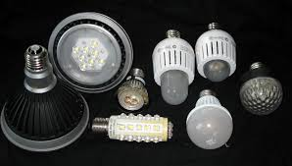
Limit Mercury Content of Lamps or Convert to Mercury-free Lamps
Mercury content limits for lamps are consistent with comparable EU RoHS standards
Global suppliers will soon be achieving those limits
The amount of mercury needed per lamp has decreased significantly due to technology and production improvements, including better dosing methods
Continued technology improvements and maximum mercury content limits can also eliminate outdated lamps and production techniques that aren’t energy effective
Over time, Light Emitting Diodes (LED) lamps are increasingly replacing mercury-added lamps, including compact fluorescent lamps (CFLs), in many applications
Lighting Emitting
Diodes (LEDs)

Slide 19
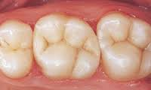
Phase Down/Out Dental Amalgam
Some countries have banned mercury use in dentistry
Mercury-free dental filling materials are often comparable or superior in performance
Dental schools should train first in the use of mercury-free alternatives
During treaty negotiations, African Region took lead in calling for amalgam phase out

Slide 20
So why do dentists support mercury-free dentistry? From my many dentist friends, here are the reasons I hear most freq...
To protect health: Dental amalgam releases mercury vapor. Mercury-free dentists know that children, the unborn, the hypersensitive, and others are especially vulnerable to the toxic effects of mercury.
To save teeth: Amalgam requires the removal of healthy tooth matter, weakens tooth structure, and cracks teeth as it expands and contracts – leading to higher dental bills later. Mercury-free dentists help you save your teeth and your money.
To create a safe workplace: Studies have shown that dental workers have elevated systemic mercury levels, which can be reduced by ending amalgam use in the workplace.
To engage in environmental stewardship: Dental amalgam is a major source of mercury pollution that dentists can prevent by using mercury-free alternatives.
To respect patient and parental choice: Once informed that amalgam contains mercury, 77% of people do not want mercury fillings – and mercury-free dentists respect this choice.

Slide 21

Global Initiative Launched by WHO and HCWH in 2008
Goal:
By 2017, to phase out the demand for mercury-containing fever thermometers and sphygmomanometers by at least 70% and to shift the production of all mercury-containing fever thermometers and sphygmomanometers to accurate, affordable, and safer non-mercury alternatives.
Component of the UNEP Products Partnership
www.mercuryfreehealthcare.org

Slide 22

Five Strategic Foci
International guidance on accuracy
Awareness raising and mobilization of the health care sector in all countries in order to shift demand.
Model policy development and catalytic activities to shift demand at global, regional, national, state and municipal levels.
Disposal– support proper management of mercury waste in health care settings.
Shift production to accurate affordable alternatives.

Slide 23


Slide 24
Use existing South African Minamata Initial Assessment (MIA) structures!

Slide 25
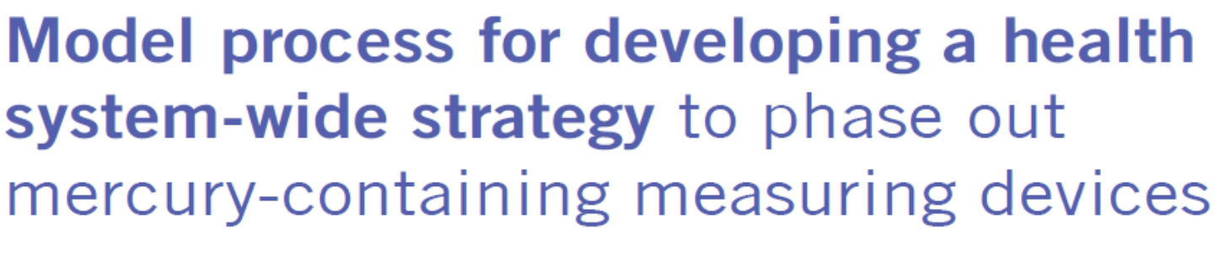

Slide 26
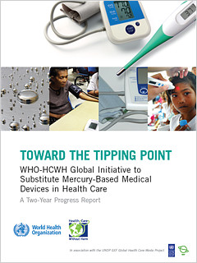
Creating momentum and a sense of the inevitable

Slide 27
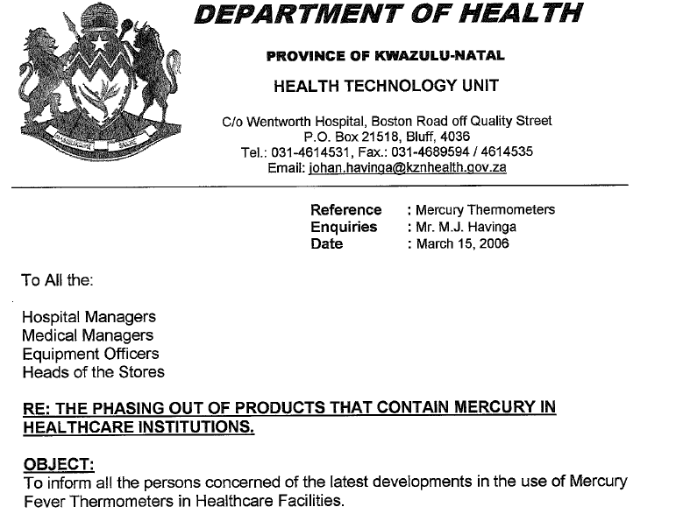

Slide 28

NETCARE TECHNICAL SERVICES
TECHNICAL POLICY AND PROCEDURE
MERCURY DISPOSAL
1. DOCUMENT DETAIL
Applicable Date: | 1 July 2011 | Document Version: | 1.1
Revision Date: | 30 June 2014 | Document Number: | TP201102
Document Location: | http://138.182.1.31/intranetcare/Technical Services/General Documents/Policy Mercury Disposal v1.1
2. OBJECTIVE To ensure safe disposal of all Mercury-containing Medical Equipment as well as fluorescent lighting.

Slide 29

Life Healthcare has informed all our hospitals to phase out mercury thermometers by the end of 2011. We have recommended digital thermometers and Tympano thermometry where appropriate.

Slide 30
Western Cape
Groote Schuur Hospital
Tygerberg Hospital
Private Hospitals in the Netcare, Mediclinic & LifeHealthcare Group

Slide 31
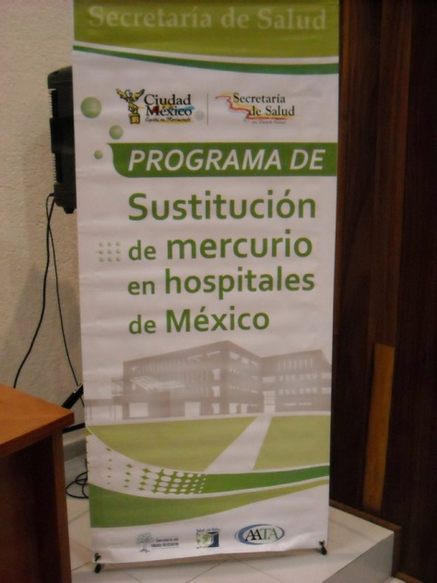

Global Progress: National, regional and megacity policy development
National policy
Regional and Mega-city Policy
Philippines (2008)
Argentina (2009)
Chile (2011)
Mongolia (2011)
In Process
India
South Africa
Costa Rica
Others
Mega-cities
Buenos Aires
São Paulo
Mexico City
Delhi
Provinces/States
KwaZulu Natal, Western Cape – South Africa
Santa Catarina and Sao Paulo-- Brazil

Slide 32
Resources
Minamata Convention on Mercury Ratification and Implementation Manual, Ban Toxics, NRDC and Zero Mercury Working Group (ZMWG)
http://www.zeromercury.org/phocadownload/Developments_at_UNEP_level/minamatamanual_eng_january%202015%20final.pdf
Mercury in Products, Button Cell Batteries Briefing Papers, ZMWG, http://www.zeromercury.org/index.php?option=com_phocadownload&view=file&id=81%3Azmwg-inc-2-briefing-paper-series&Itemid=15
http://www.unep.org/chemicalsandwaste/Portals/9/Mercury/Documents/INC4/Submissions%20from%20NGOs/ZMWG_Button%20Cell_INC4_final.pdf
Mercury-added Product Fact Sheets, Northeast Waste Mgt. Officials Assoc.,
http://www.newmoa.org/prevention/mercury/imerc/FactSheets/
Report on the major mercury-containing products and processes, their substitutes and experience in switching to mercury-free products and processes, UNEP OEWG2, http://www.unep.org/chemicalsandwaste/Portals/9/Mercury/Documents/OEWG2/2_7_add_1.pdf
MERCURY IN SKIN LIGHTENING PRODUCTS, World Health Organization,
http://www.who.int/ipcs/assessment/public_health/mercury_flyer.pdf?ua=1
Developing National Strategies to Phase Mercury Out of Thermometers and Sphygmomanometers Including in the Context of the Minamata Convention on Mercury, WHO,
http://www.who.int/ipcs/assessment/public_health/WHOGuidanceReportonMercury2015.pdf

Slide 33
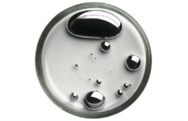

Thank you for your attention!
Rico Euripidou: rico@groundwork.org.za

