Slide 1


SITA | DHA
Improving End to End Service Availability and Performance
2018-08-14

Slide 2
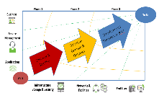
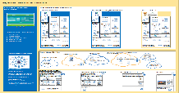
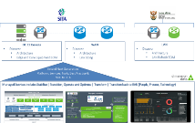
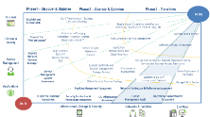
SITA are accelerating the modernization of Network Services to DHA
SITA engaged Dimension Data to assist with improving the Network Services and Management capability.
After a few weeks of working together, it was evident that a broader view of the SITA and DHA landscape was required in order to improve the end to end service delivery and availability as well as to define the existing landscape and understand the scope of remediation required for the uninterruptable Network
As-Is Landscape and Remediation Defined
To-Be Architecture Defined
Dimension Data team deployed to augment the SITA Network Service Management Team; and
Concluded a series of assessments that have provided a view of the interdependent components making up an end to end service: Network, Application Performance, Security, Data Centre, Environmental and Services
SITA and Dimension Data have defined a Managed Services approach to accelerate remediation of the DHA environment as well as the greater SITA Landscape
Holistic Roadmap Drafted
Accelerated Remediation via repeatable Managed Services

Slide 3






Assessment Highlights within the SITA and DHA landscape
DC CE Devices
  As-is and To-be Architecture
  Edge and Core Equipment BOM
WAN
  As-is and To-be Architecture
  Link Sizing
LAN
  As-is and To-be Architecture
  LAN Refresh BOM
Assessment Highlights
Power and Environment: 30%-50% of operational calls logged stem from power availability (Generator fuelling, UPS Configuration, Cabling);
LAN Refresh required: 450 devices assessed, 398 are totally obsolete;
WAN Refresh required: 395 sites assessed, equipment at 112 are totally obsolete;
Network performance is acceptable but application and server landscape is impacting performance as some applications are not optimally architected (example: application hosted in separate Data Centre to Database);
NOC: Limited End to End Outcome – Operational components require Hardware & Software upgrades as well as Toolset Architecture Optimisation and operational augmentation for accelerated remediation;
Data Centre: Customer Edge and LAN devices are reaching End of Life and upgrades must align to target architecture;
Security: People, Process and Technology risks exist and need to be addressed with significant vulnerabilities and malicious attacks identified;
Data Centre: Storage hardware require lifecycle management and optimisation ;
Data Centre: Consolidation to be addressed with Application Landscape Optimisation as well as Business Continuity and Disaster Recovery; and
Service Delivery: Operational Framework needs to be further matured in order to improve service delivery and first call resolution.

Slide 4
Findings

Slide 5
Site Environment Assessment - Key Assessment Findings
Scope
Conduct physical infrastructure assessment at 10 sites - Generators, Server rooms, Uninterruptable power supplies (UPS), Heating ventilation and air conditioning, Fire systems, Environmental monitoring, Racks, Power to the racks, Closed circuit television (CCTV), physical Security and Structured cabling.
Findings | Recommendation | Urgency | Rectification | Why is it required
None of the 10 sites met the required levels of maturity in Power Management (UPS and Generator), Fire Suppression, Cable Management, General Hygiene | Deployed Self Contained Racks which will result in "Server Room in a Box" with Fire Suppression, UPS, Power distribution and cooling | Immediate | 0-3 months | Standardisation of site environment elements and provision of missing elements.
None of the 10 sites assessed met the required levels of maturity in Access Control | Installation of standardised access control systems managed centrally from Head Office | Immediate | 0-3 months | There is no centralised view and management of access control across the Server Rooms. This is required to ensure only authorised personnel gain access to the facilities.
Generators are not configured to start up when mains outages occur. | Take action to ensure that the generators are put into the correct operation mode. | Immediate | 0-3 months | Generator does not activate when power goes down - Set to bypass mode - must be set to automatic start up operation.
Fuel is not available for the generators | Restructure and renew the fuelling agreements to ensure that fuel is always available | Immediate | 0-3 months | To ensure that there is sufficient fuel for the Generators to run
UPS not configured to take over when mains power fails. UPS inadequate | Upgrading the electrical infrastructure that includes the UPS units. | Immediate | 0-3 months | UPS power caters for the time lag before the generator is able to provide the required power requirements in the event of a mains failure.
Domestic multiplugs were being used in the server rooms | Replace all multiplugs in the racks with rack power distribution units (PDUs). | Immediate | 0-3 months | Power distribution units should be used instead of multiplugs to protect the equipment being powered
Cabling to be neatened and standardised | Implement cable standards and a maintenance process | Medium | 0-6 months | Simplify, maintenance and support
Server rooms were being used as storerooms | Clean up server rooms | Medium | 0-3 months | Hygiene, fire risk, unauthorised access

Slide 6
Cybersecurity Advisory Assessment - Key Assessment Findings (1 of 2)
Scope
The Cyber Security Advisory Assessment focussed on People, Process and Technology and Toolsets to determine the ‘as-is’ security posture; and recommended the future state. Where possible, specific security vulnerabilities were also identified
Findings | Recommendation | Urgency | Rectification | Why is it required
Information Security function relegated within the IT organisation without the required staffing, processes and systems | Dedicated resource to manage, review, update and execute the information security strategy. | Immediate | 0-6 months | Ensure Strategy is executed
Information Security function relegated within the IT organisation without the required staffing, processes and systems | Elevate the accountability and responsibility of the Information Security Function (ISS) to an Executive level | Immediate | 0-6 months | Ensure information security is managed across the entire orgnisation with C level accountability
Information Security function relegated within the IT organisation without the required staffing, processes and systems | Formalise an Information Security Management System (ISMS) | Immediate | 0-6 months | A centrally managed framework for keeping an organisation's information safe. A set of policies, procedures, technical and physical controls to protect the confidentiality, availability and integrity of information
Information Security function relegated within the IT organisation without the required staffing, processes and systems | Define an Asset & Data Classification policy | Immediate | 0-6 months | To organize data into categories to ensure they receive the respective protection
Specific vulnerabilities were identified requiring remediation | Identity and Access Management Project (Active Directory, Network Equipment) | Immediate | 0-6 months | Policies and technologies for ensuring that the people in an enterprise have the appropriate access to technology resources
Specific vulnerabilities were identified requiring remediation | Implement Patch Management and Vulnerability Management Project | Immediate | 0-6 months | Improve patch management compliance and reduce vulnerabilities
Notes:
Information Security Strategy defined, lacks implementation plan, resources, and funds to execute on it.
Cybersecurity unit exists lacks the necessary executive accountability and responsibility to effectively control and maintain across DHA.
no formal Business Impact Analysis has been conducted.
no Business Continuity Management function exists.
Agreements with third parties DHA’s information not adequately cover all relevant security requirements.
Although an information security policy exists, it lacks the necessary supporting standards and processes to assist with implementation, enforcement and monitoring of compliance.
Manual standard operating procedures exist introducing several risks to DHA (Loss of data, lack of data retention requirements, operational overheads etc)
inadequate and inconsistent adoption Asset Classification framework.
Minimal security culture / awareness / training controls
Limited security incident response and forensics capability exist.

Slide 7
Cybersecurity Advisory Assessment - Key Assessment Findings (2 of 2)
Scope
The Cyber Security Advisory Assessment focussed on People, Process and Technology and Toolsets to determine the ‘as-is’ security posture; and recommended the future state. Where possible, specific security vulnerabilities were also identified
Findings | Recommendation | Urgency | Rectification | Why is it required
Specific vulnerabilities were identified requiring remediation | Perform ABIS Vulnerability Assessment and Penetration Test | Immediate | 0-6 months | Ensure the security posture of ABIS is enhanced
Information Security function relegated within the IT organisation without the required staffing, processes and systems | Incident Management practices (tools, processes and people) must be defined | Medium | 6-18 months | Ensure security incidents are detected and remediated in a timely manner
Information Security function relegated within the IT organisation without the required staffing, processes and systems | Undertake a formalised security policy review and and update to allign with ISO 27001 | Medium | 6-12 months | Ensure Policy is aligned to best practice
Specific vulnerabilities were identified requiring remediation | Identify and update/replace all systems which are no longer supported by the relevant vendor. | Medium | 0-6 months | Ensure systems are a eligible for support and security patches
Specific vulnerabilities were identified requiring remediation | Deployment of Full disk encryption. | Medium | 12-24 months | Ensure sensitve data on endpoints is protected
Specific vulnerabilities were identified requiring remediation | Minimum Baseline Security Standards | Medium | 8 - 16 months | Ensure systems comply with a minimum set of security requirements
Hardware and software - end of life, does not conform to Uninterruptable Architecture requirements | Refresh Hardware - Firewall, Web Security, ISE | Medium | 6-12 months | Aligns to Uninterruptable Architecture
Hardware and software - end of life, does not conform to Uninterruptable Architecture requirements | Refresh software - Firewall, Web Security, ISE | Medium | 6-12 months | Aligns to Uninterruptable Architecture
There is currently no Security Incident and Event Monitoring with associated Managed Services | Implement a Security Operations Centre (SOC) with associated Managed Services | Medium | 6-12 months | Enables pro-active posture to security threats and incidents
Notes:
Information Security Strategy defined, lacks implementation plan, resources, and funds to execute on it.
Cybersecurity unit exists lacks the necessary executive accountability and responsibility to effectively control and maintain across DHA.
no formal Business Impact Analysis has been conducted.
no Business Continuity Management function exists.
Agreements with third parties DHA’s information not adequately cover all relevant security requirements.
Although an information security policy exists, it lacks the necessary supporting standards and processes to assist with implementation, enforcement and monitoring of compliance.
Manual standard operating procedures exist introducing several risks to DHA (Loss of data, lack of data retention requirements, operational overheads etc)
inadequate and inconsistent adoption Asset Classification framework.
Minimal security culture / awareness / training controls
Limited security incident response and forensics capability exist.

Slide 8
IT System Application Landscape Discovery - Key Assessment Findings
Scope
The IT Systems Application Landscape Discovery, the results of which will provide; ‘As-is’ Insight and visualisation of the enterprise Server estate, the Applications running as well as the touch-points/integration between applications
Findings | Recommendation | Urgency | Rectification | Why is it required
Applications are vulnerable to attack – signs of malware was found on 15 servers. | Remediate security breaches and all possible malware vulnerabilities via Managed Services | Immediate | 0-6 months | Improved application security in accelerated timeframe
Application transactions connecting across different Database’s within different Data Centres (Database in one Data Centre and the application in another) | Consolidate Data Centres | Medium | 6-12 months | Simplify for easy of Management and Support, minimise application latency
Management tasks, such as updates, are performed on the transactional network | Create a management network for environment management tasks via Network Managed Services | Medium | 6-12 months | Minimise impact on operations network traffic by leveraging Managed Services
Applications need to be optimised to be network friendly | Engage with application owners to optimise applications to be network friendly | Medium | 6-12 months | Allows applications to be more tolerant of network latency and congestion
No clear network segmentation between Production, Development and Test environments. | Implement a segmented network by splitting a network into subnetworks, each being a network segment, using Managed Services | Medium | 6-12 months | Accelerate improvement of security, minimise impact on Production traffic using Managed Services
Notes:
Information Security Strategy defined, lacks implementation plan, resources, and funds to execute on it.
Cybersecurity unit exists lacks the necessary executive accountability and responsibility to effectively control and maintain across DHA.
no formal Business Impact Analysis has been conducted.
no Business Continuity Management function exists.
Agreements with third parties DHA’s information not adequately cover all relevant security requirements.
Although an information security policy exists, it lacks the necessary supporting standards and processes to assist with implementation, enforcement and monitoring of compliance.
Manual standard operating procedures exist introducing several risks to DHA (Loss of data, lack of data retention requirements, operational overheads etc)
inadequate and inconsistent adoption Asset Classification framework.
Minimal security culture / awareness / training controls
Limited security incident response and forensics capability exist.

Slide 9
Network Assessment - Key Assessment and Findings
Scope
Network Assessment: Review and update Inventory, of network equipment and software licenses; and make recommendations to enhance and improve the Network architecture and Service Delivery
Findings | Recommendation | Urgency | Rectification | Why is it required
Device configurations not aligned to best practices | Implement a configuration review in-line with best practice deployments and security objectives leveraging Managed Services | Immediate | 0-3 months | Ensure devices are supportable, increase longevity of estate
Out of 450 LAN devices assessed, 398 are obsolete | Refresh LAN devices through Managed Services | Immediate | 0-6 months | Remediate Security Vulnerabilities
Out of 395 WAN devices assessed, 112 are obsolete | Refresh WAN devices through Managed Services | Immediate | 0-6 months | Ease of Management and Support
Security vulnerabilities identified | Remediate vulnerabilities on affected devices through Managed Services | Immediate | 0-6 months | Ease of Management and Support
Inconsistent software levels across devices | Upgrade IOS on all devices to maintain consistency through Managed Services | Immediate | 0-6 months | Provide immediate fit for purpose managed service environment - while stabilising the SITA NOC
Current architecture is not future-proof | Enable Software Defined Networking through Managed Services | Medium | 0-36 months | Ensure devices are supportable, increase longevity of estate
NOC Hardware - under spec, end of life, Software - requires migration / upgrades, People - require training, Processes - need to be updated | Leverage Managed Service Platform provider services while stabilising SITA’s NOC | Immediate | 0-36 months | Aligns to Uninterruptable Network Architecture

Slide 10
Accelerated Approach

Slide 11
Aligning the MOU and Solution Principles for a business outcome
MOU | Solution Principles
Improvement in the Network Stability (Uninterrupted Network) | MS via Dimension Data’s platforms & processes for desired service levels
Redundancy links (Network high availability) | To-be architecture to be implemented to improve network availability.
Ensure services are seamless within the Department | Dimension Data’s service desk will receive, own and manage all Network calls
End to end Monitoring of WAN and LAN (Proactive monitoring and reporting) | Leverage Dimension Data platforms to accelerate stabilisation and modernisation
Ensure Network performance Monitoring | Dimension Data platforms include capacity and performance management
Ensure the Establishment of the NOC at the Department | Real-time dashboards and platform to SITA , extended to DHA while remediating
Ensure there is a review of Architecture and Network Design | Network Design delivered, quarterly reviews included in Managed Services
Improvement in the Timeline of procuring services | Can be provided via WAN Carrier Managed Services (procurement)
Ensure improvement of Service Level Management | Dedicated Service Delivery Manager to be allocated
Management of existing TELCO operators for WAN access links | Incident Management (MS) can be expanded via WAN Carrier Managed Services
Review of Network mode of connectivity on regular basis | Quarterly reviews of architecture linked to Service Improvement Programme
The Network must be fault tolerant – always on | To-be Architecture will improve redundancy & Managed Service will be pro-active
Network infrastructure must be stable (reduced downtime on LAN and WAN) | Managed Service will be pro-active
Network must be scalable, flexible and intelligent and support business req. | To-be Architecture as well as transformation roadmap included
Support the Department’s digitisation strategy to paperless environment | To-be Architecture is flexible and scalable to support the changing app environment
Network security and governance must be taken into consideration | To-be Architecture will address Security and MS to include Governance
Support access to business application across different countries | To-be Architecture flexible to address cross border network requirements

Slide 12







Leveraging Managed Services to accelerate Remediation and Service Delivery, as well as use mature Transition back to business-as-usual
Build
Operate
Transfer
To Be
Business
Transform and Transition to BAU
Lead with DHA - Dimension Data Managed Services Platforms & Best Practise
Determine best mix of People, Process & Tools and Transition Services Back to SITA through flexible model
Repeatable approach for other SITA clients
Service
Management
Transition, Operate & Optimise
Discover & Stabilise
Applications
As Is
Infrastructure,
Storage & Security
Networks & Facilities
End User

Slide 13

Enabling SITA to support DHA’s modernisation programme
Phase1 – Discover & Stabilise
Phase 2 – Operate & Optimise
Phase 3 - Transform
To Be
Business
Build Transformation Business Case and Roadmap
Establish and Finalise MOU
Enable Digital Citizenship, Identification, eResidency, Modernised Point of Entry, etc
Citizens & Identity
Workshop on Emerging Technology Pilots (IOT, Drones, Blockchain, Hybrid IT)
Workspace as a Service
Next Generation Service Management
Align business SLAs and Service Provider B2B
Software Defined Environment
Appoint Network Services Manager
Service Delivery Framework maturity
Service Management
Application rationalisation and Cloud Readiness
Application placement Strategy
Define Workspace of the future
Service Management System Assessment
Business Continuity and Disaster Management Strategy Revised
Provide Next Generation Network Operations Centre Services and Dashboard
Define Security Services Strategy
Commence Build of Uninterrupted Network
Managed Print Service
Applications
Environmental Management
Facilities Management Assessment
Network Architecture & Performance Assessment
As Is
IT Systems Landscape Assessment
Cybersecurity Architecture & Penetration Assessment
DC Infrastructure Assessment
IT Asset Management Audit
Operational Support System Assessment
Infrastructure, Storage & Security
Networks & Facilities
End User

Slide 14

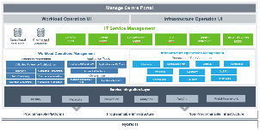
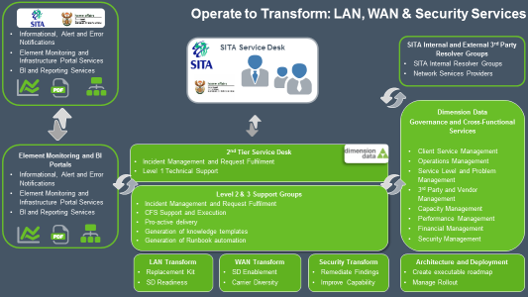
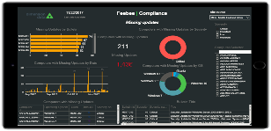
Way Forward: Accelerating SITA Network Services and Remediation for DHA
DC CE Devices
  As-is and To-be Architecture
  Edge and Core Equipment BOM
WAN
  As-is and To-be Architecture
  Link Sizing
LAN
  As-is and To-be Architecture
  LAN Refresh BOM
Extend Next Generation
Platform, Services, Tools, Best Practise & NOC to SITA
Managed Services include: Stabilise | Transition, Operate and Optimise | Transform | Transition back to BAU (People, Process, Technology)

Slide 15



Operate & Transform: LAN, WAN & Security Services
Informational, Alert and Error Notifications
Element Monitoring and Infrastructure Portal Services
BI and Reporting Services
SITA Service Desk
SITA Internal and External 3rd Party Resolver Groups
SITA Internal Resolver Groups
Network Services Providers
Dimension Data
Governance and Cross-Functional Services
Client Service Management
Operations Management
Service Level and Problem Management
3rd Party and Vendor Management
Capacity Management
Performance Management
Financial Management
Security Management
Element Monitoring and BI Portals
Informational, Alert and Error Notifications
Element Monitoring and Infrastructure Portal Services
BI and Reporting Services
2nd Tier Service Desk
Incident Management and Request Fulfilment
Level 1 Technical Support
Level 2 & 3 Support Groups
Incident Management and Request Fulfilment
CFS Support and Execution
Pro-active delivery
Generation of knowledge templates
Generation of Runbook automation
LAN Transform
Replacement Kit
SD Readiness
WAN Transform
SD Enablement
Carrier Diversity
Security Transform
Remediate Findings
Improve Capability
Architecture and Deployment
Create executable roadmap
Manage Rollout

Slide 16
Thank You
“If everyone is moving forward together, then success takes care of itself.”

Slide 17
Department of Home Affairs (DHA)
Uninterruptable Network Reference Architecture
Notes:
Hidden Slide

Slide 18
Agenda
Problem Statement and DHA Business Drivers
Key Assessment Findings and Recommendations
Reference Architecture Principles
DHA Assessment Highlights
  Site operation categories
  Network Site Categories
  Network Reference Architecture
  Hybrid-IT Network Platform
  High Availability WAN
  Uninterruptable Wireless Network
  Network Strategy Roadmap
Operate to Transform - Managed Services
Notes:
Hidden Slide

Slide 19
Problem Statement
Sole institution providing identity and status of citizens – no alternate institution available for citizens to access DHA services from anywhere else
Long service delivery timeframes – “War on Queues”
“Uninterruptable Network” – System downtime leading to citizen’s frustrated
Paper based, human error, manual processes – Lack of automation & technology adoption strategy
What is SITA doing?
Appointment of Dimension Data to improve governance and service efficiency
Assessment & gap analysis of current environment to determine roadmap for “Uninterruptable Network”
Implementation and modernization of current environment (stabalise operations)
Transition to Future network - clear roadmap with timeliness
Transform current environment according to DHA digitization strategy
Notes:
Hidden Slide

Slide 20
DHA Business Drivers
Support DHA’s Digitization strategy – Drive to paperless environment.
Client experience consistency
Operational efficiency
Network must be uninterruptable/always on
Drive to automation
Scalable, flexible and Intelligent
Network Security is Key
Expansion of Channels – Banks, Kiosks, Suitcases etc.
E-Government value chain – integrates DHA e-services to other departments
Managed Dashboards - Proactive, application visibility client experience
Foreign missions
Notes:
Hidden Slide

Slide 21
DHA Site operation categories
DHA Network Site Categories
Live Capture (High and Normal Volume)
Hospital connectivity
Ports of entry (High and Normal Volume)
Refugee Reception Center
Mobile Offices
Banks
Non-modernized – still to be modernized
Foreign missions – e.g. embassies outside South Africa
Visa facilitation Offices – Link to DHA Back Office Functions
External Service Providers – e.g. Emigration Partners
Small/Mobile campus site (< 11 users)
Medium campus site (11 – 24 users), and
Large campus site (> 25 users)
Notes:
Hidden Slide

Slide 22
Reference Architecture Principles
Principle 1: Security Everywhere: Securing the network is critical for the security of the business data that runs across the network.
Principle 2: Virtualize Everything: SDN controller situated at a central point can now control the behaviour and enforce policies to the network infrastructure
Principle 3: Designed for Automation: Automation is key to fast, standardized, delivery of changes across the infrastructure.
Principle 4: Service management: Define and provision network services and policies from a central point
Principle 5: Pervasive analytics: By proper analysis, problems in performance or behaviour can now be predicted in a proactive manner
Principle 6: Scalable and flexible: Network that is ready for future growth and expansion of DHA channels.
Principle 7: Integration of e-Government operations: Network connect to other Government Departments providing one view of Government Services
Principle 8: Single Accountable Managed Service Provider: Network must make use of multiple Network Service Providers and last mile carrier providers managed by a single MSP.
Notes:
Hidden Slide

Slide 23
DHA Hybrid-IT Network Platform
Notes:
Hidden Slide
The To- Be architecture has been designed to be future proof and ready to run Software Defined Environments – the next Generation Network Services

Slide 24
DHA High Availability WAN
Provided by SITA
Industry Reference – SDN Architecture
Notes:
The To-Be architecture has been designed to be highly available

Slide 25
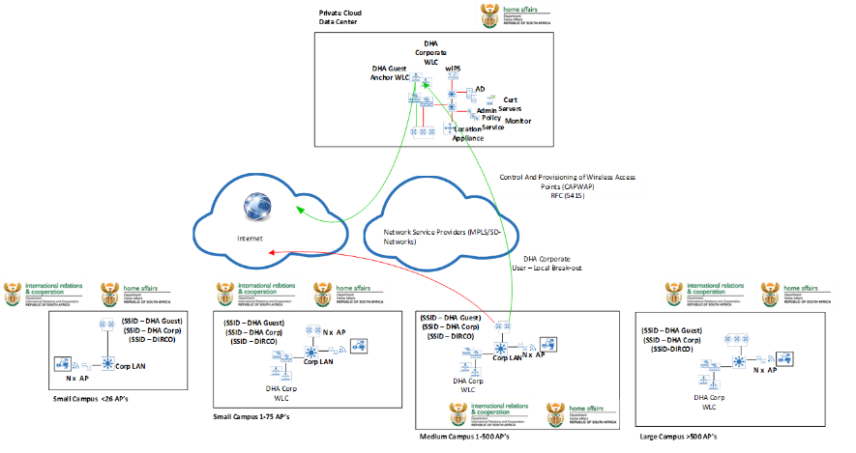
DHA Uninterruptable Wireless Network
Notes:
Highly available Network connectivity in remote areas are catered for

Slide 26
DHA Network Strategy Roadmap

