Slide 1
South African National Antarctic Program
Follow Up on Marion Island Challenges
Presentation to Portfolio Committee
14 August 2018

Slide 2
South African National Antarctic Program
SANAP
Southern Ocean, SANAE, Marion, Gough
DEA: D:SOAS
Logistics Support
DST/NRF: Science Support
DPW: Infrastructure planning, deployment, maintenance

Slide 3
Research Base Locations

Slide 4
MARION ISLAND BASE

Slide 5
Research on Marion Island
Weather Observations – SAWS
Monitoring of Seabirds – DEA, UCT
Marine Mammals – UP
Marine Top Predators - NMMU
Botany – Stellenbosch & UP
Space Weather – SANSA
Geomorphology – Rhodes
Fur Seals – PE Museum
Engineering – UKZN
Produced more than 1000 Published Scientific Papers (2010) and more than 200 Post Grad degrees.

Slide 6
Research on Marion Island 2
Collecting diet and blood samples from mammals and birds as well as soil and plant samples throughout the different seasons in the year.
Census of various bird species. Strong indications that in addition to the impacts of climate change, bird populations are under attack from mice. Work underway towards a mouse eradication plan.
Marine mammal program: long term research and monitoring program, understanding of top marine mammal predator ecology within the Southern Ocean region.
This integrates well with insights gained from monitoring the feeding habits of seabirds, produces data on feeding areas, &impacts (climate change, fishing etc)
Ship-based oceanographic research, resulting in a variety of physical, chemical and biological properties of the ocean surface waters being analysed.

Slide 7
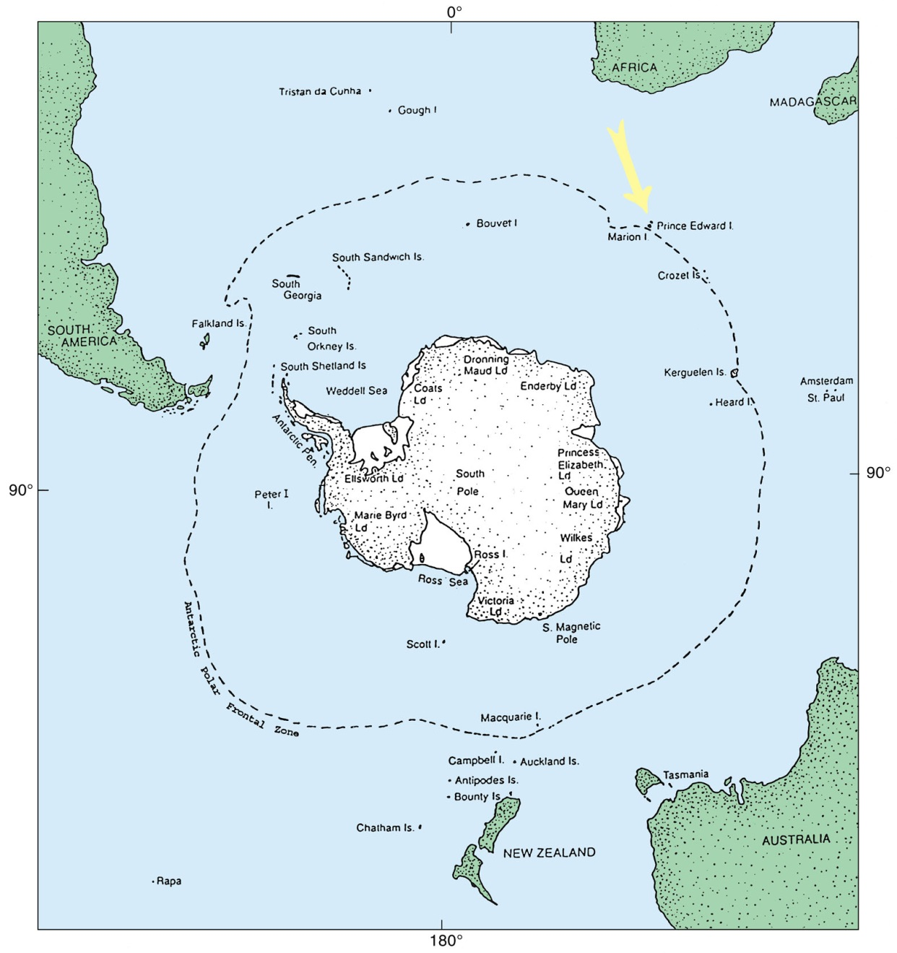
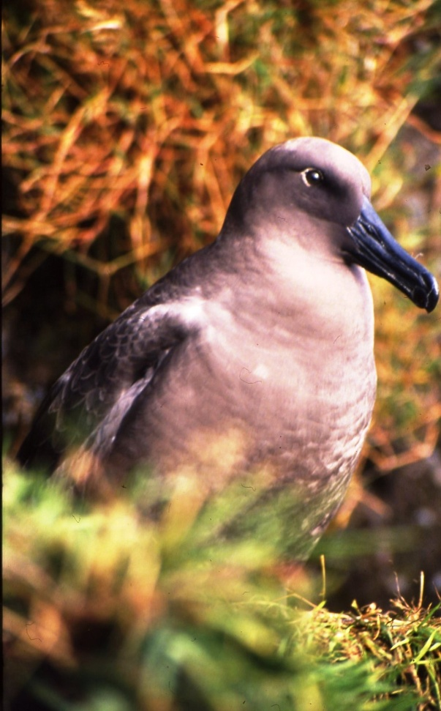
Value of DEA’s research on and monitoring of seabirds at South Africa’s Prince Edward Islands

Slide 9
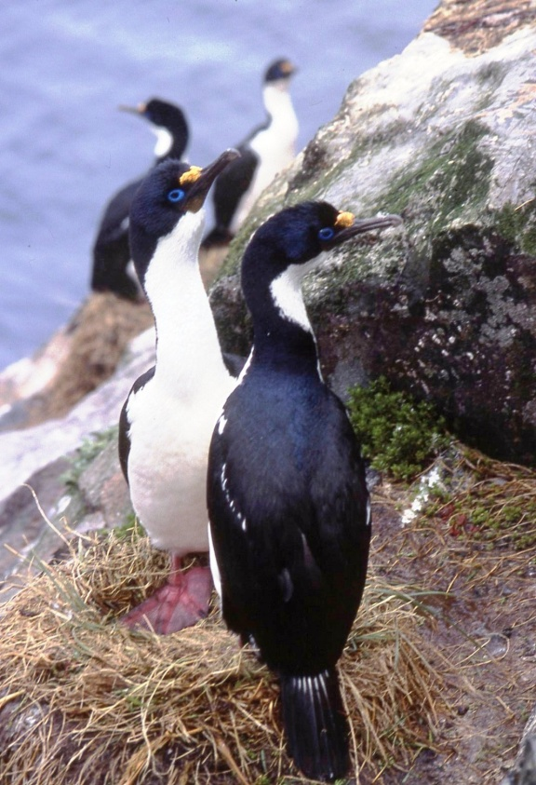
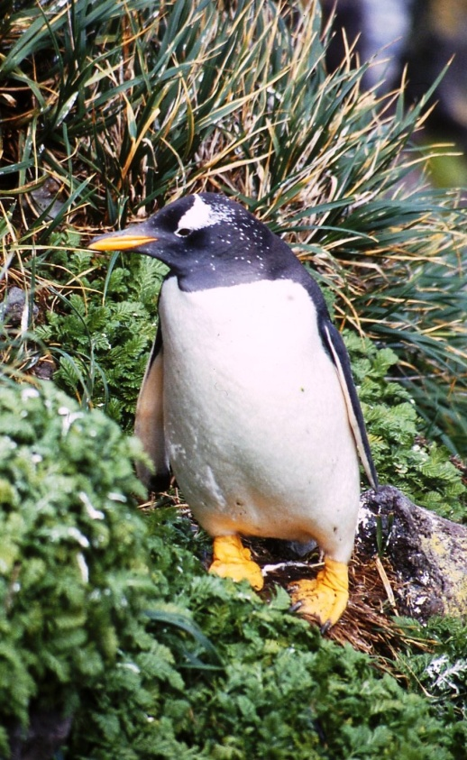
2. Monitor ecosystem change and health
E.g. Numbers of Crozet Shags (left) and Gentoo Penguins (right) breeding at Marion Island have shown congruent decreasing trends – both are benthic feeders eating similar prey. The congruent trends suggest possible ongoing change in the benthic marine environment that may be influenced by southward movement of the Sub-Antarctic Front.
Crawford RJM, Dyer BM, Upfold L, Makhado AB. 2014. Congruent, decreasing trends of Gentoo Penguins and Crozet Shags at sub-Antarctic Marion Island suggest food limitation through common environmental forcing. African Journal of Marine Science 36: 225–231.
Notes:
The Antarctic Circumpolar Current (ACC) lies between the Subantarctic Front (SAF) to the north and the Antarctic Polar Front (APF) to the south and exhibits substantial mesoscale variability in the vicinity of the Prince Edward Islands (Ansorge and Lutjeharms 2002). This is thought to influence local macro- and mesoscale oceanographic conditions: when the SAF lies far north of the islands there is water retention and algal bloom development between Marion Island and Prince Edward Island; in contrast when the SAF is close to the islands a strong flow-through system is established between the islands (Ansorge and Lutjeharms 2002, Allan et al. 2013). A decrease in δ¹³C signatures of N. marionis at Marion Island between 1984 and 2009 may reflect a decrease in phytoplankton growth rates and hence primary production in the vicinity of the Prince Edward Islands over this period, indicating a possible southward shift in the position of the SAF position (Pakhomov et al. 2004, Allan et al. 2013). When there is a strong flow system past the islands, phytoplankton blooms do not have time to develop and less sedimentation of phytoplankton occurs around the islands (Perissinotto et al. 2000). Adult and sub-adult N. marionis feed predominantly on benthic animals that utilise phytoplankton that falls to the sea floor (Perissinotto and McQuaid 1990).

Slide 10
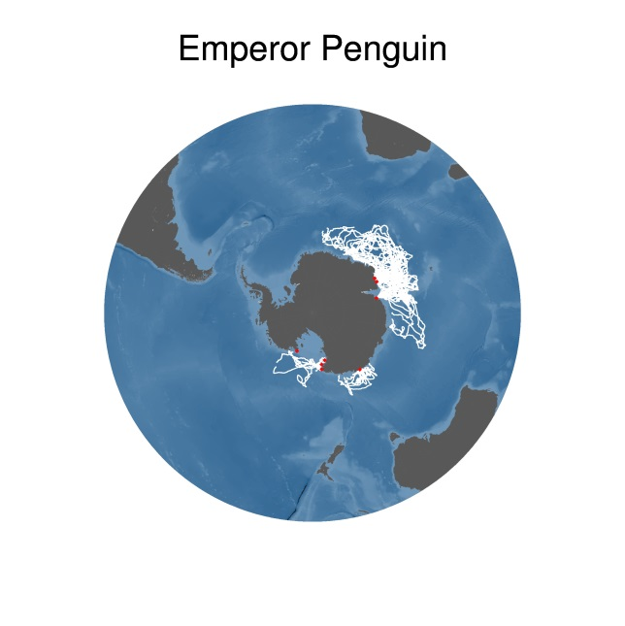
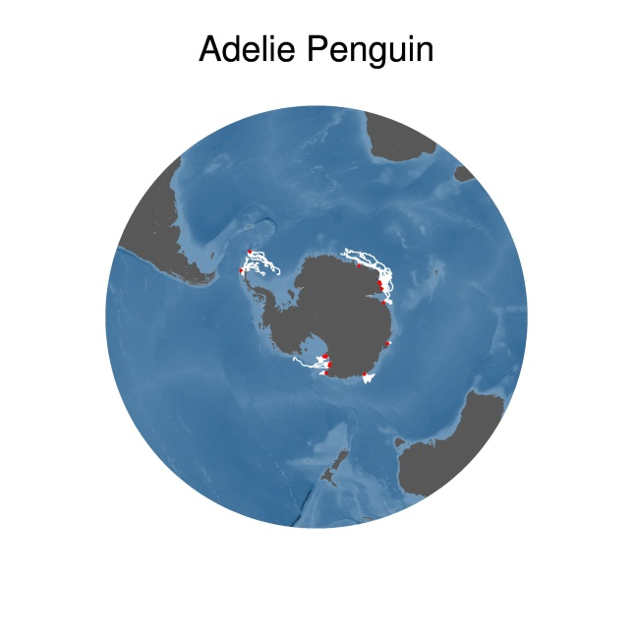
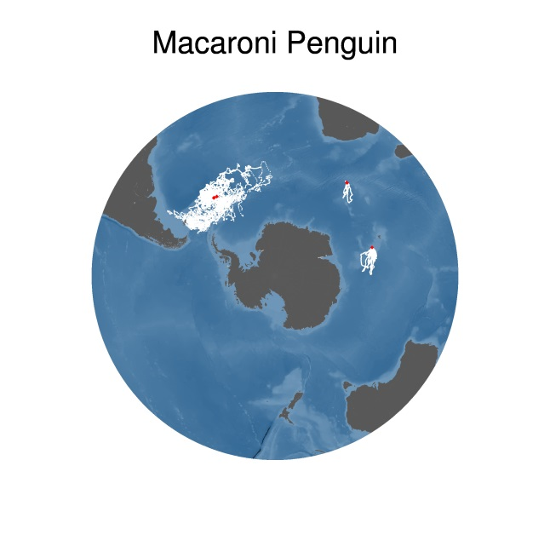
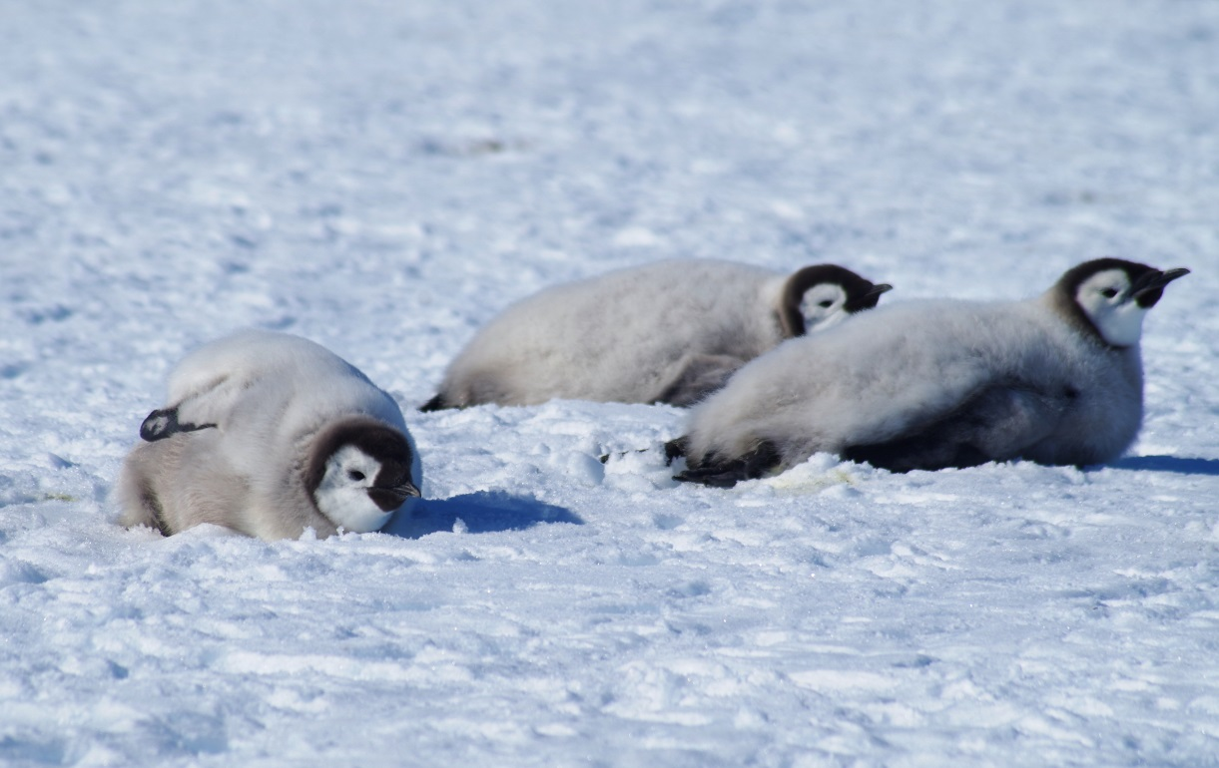
3. Contribute to Ecosystem-Based Management
e.g.. Marine Spatial Planning – South Africa contributed data to the Retrospective Analysis of Antarctic Tracking Data (RAATD) of the Scientific Committee for Antarctic Research (RAADT)

Slide 11
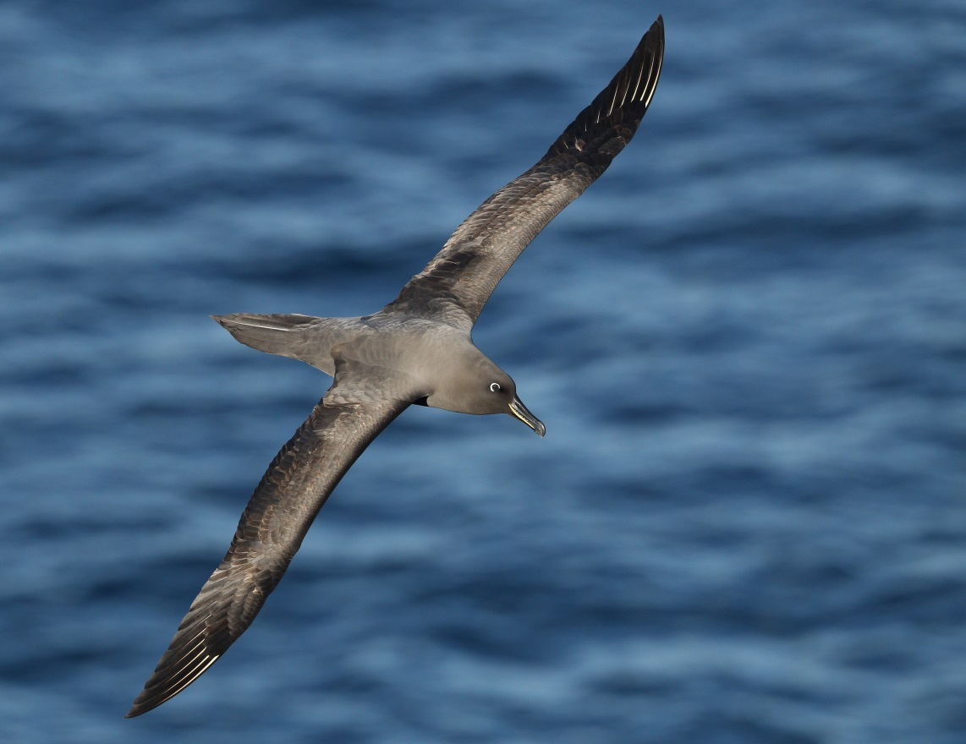
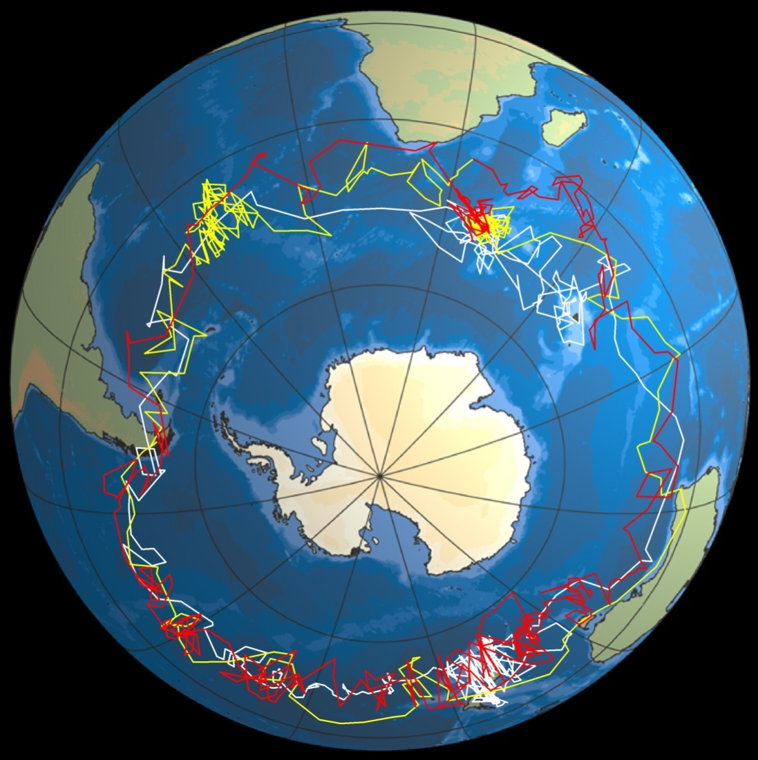
4. Understanding movements of highly-migratory, trans-boundary species and resultant threats
E.g. Sooty Albatrosses from Marion Island and interactions with fishing fleets inflicting mortality

Slide 12
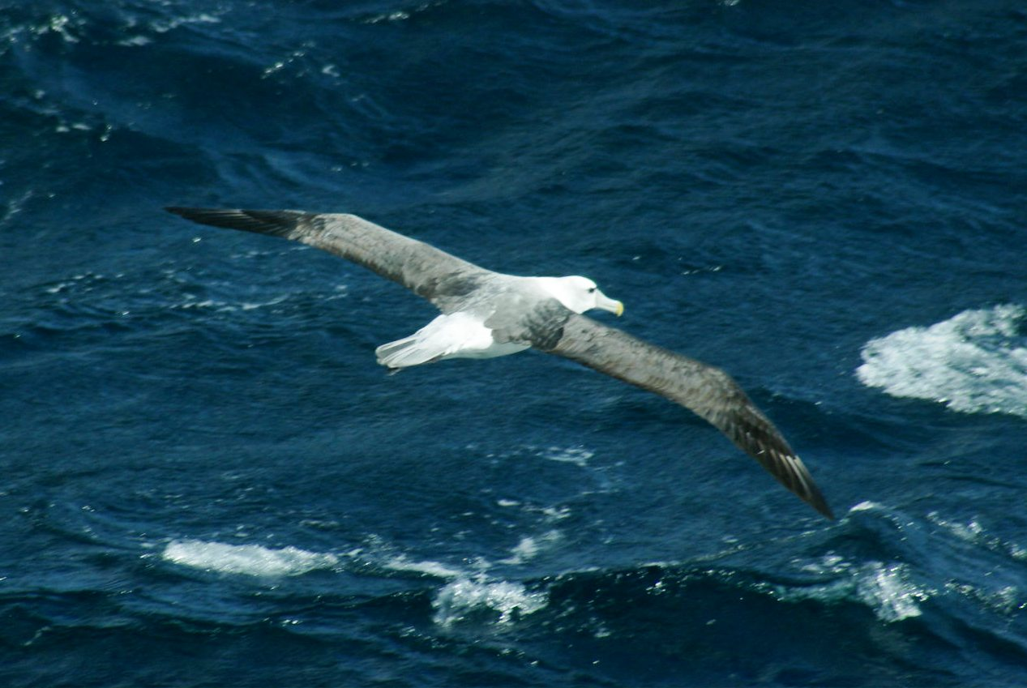
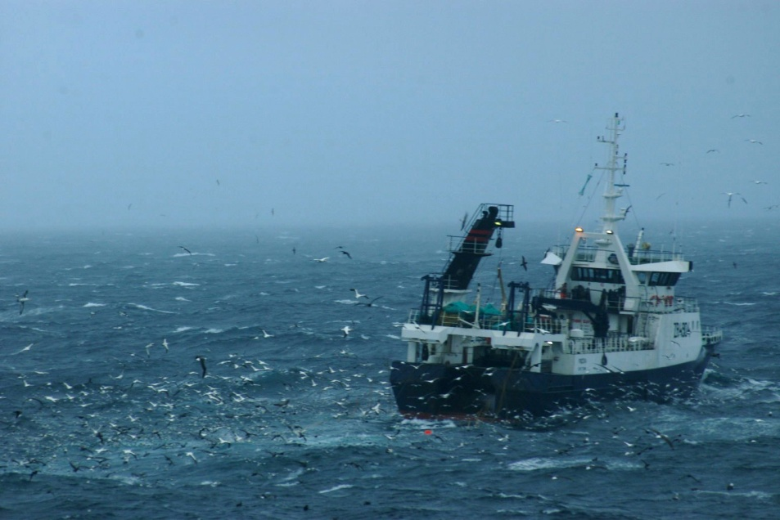
5. Contribution to international agreements to which South Africa is a party
E.g. ACAP and CCAMLR
Notes:
Distribution of Japanese fishing effort for Southern blue tuna

Slide 13
Logistical challenges experienced
2017/18

Slide 14
Generator problems
In December 2017, 2 generators were leaking oil and team relied on 3rd generator. Indian Vessel, Ivan Pappanin delivered oil to the island
In March 2018, mechanical failure on 3rd generator, and the team relied on emergency generator until the arrival of the SA Agulhas II on the 11th April 2018, when 2 generators were repaired.
In preparing for the 2018 relief voyage, the Department of Public Works was intending to take two reconditioned engines to Marion Island. However only one engine was ready at the time of departure. The DPW team had to exchange parts on various engines to get 2 engines functioning on the Island.
In an emergency voyage in May 2018, DPW took two engines to Marion Island. Both engines were successfully installed, commissioned and tested.

Slide 15
Other logistical challenges 2018
Engine oil - 2017 team had sufficient oil, however due to excessive oil leaks, oil supply ran low in Dec 2017; 960L new oil delivered to Marion with Indian vessel.
Domestic hot water geyser – at Main base started leaking on 22 Feb 2018. Temporarily fixed within 1st week of takeover and later replaced with new geyser by DPW. There was no hot water at main base for the period the geyser was faulty (three and a half weeks). The Emergency base had hot water as it operates independently.
Food item shortages: 2nd consignment of food delivered to Marion with Indian vessel.

Slide 16
Medical Evacuation: return from Marion May 2018
Crew member on Agulhas II fell ill during the voyage and received treatment from the onboard ship’s doctor.
The vessel departed Marion Island on 3 May 2018 intending to perform some oceanographic sampling which added two days to the return duration.
Patient condition worsened and a medical evacuation was declared - All research work was cancelled and ship instructed to steam to nearest port.
Patient was flown off to Vincent Palotti when Vessel was in helicopter range. This happened on 6 May 2018. The vessel arrived in Port on 7 May 2018.

Slide 17
Steps taken to address concerns raised
Meeting held with DST and NRF (March 2018) to discuss issues jointly and prepare a response to concerns raised by the science community
Meetings held with DPW to request new generators and restoration of power systems
Meetings held with Science Community (March 2018) to articulate challenges and deliberate on possible contemplated solutions
2017 Team returned from Marion on 7 May 2018
Debriefing session with 2017 overwintering team members (May 2018)
Meeting with Group leaders of the 2018 takeover (May 2018) voyage to discuss takeover specific challenges

Slide 18
Specific issues raised by PCEA
The leadership model - on Marion had a Leader and Deputy. However in the current team, new approach has been adopted, namely an “exco” type leadership comprising of a Leader and Deputy from the support staff and also a leader from the research staff.
Dispute Resolution, the leaders will together manage team members and will have access to the Management in DEA.
Code of conduct: Grievance and disciplinary procedures are applied in accordance with the Government prescripts. Employment contract includes a clause that a team member will be responsible for the cost of returning them to the mainland for any reason other than Medical Evacuation. All team members have been informed of DEA policies and Public Service Code of Conducts during team training.
Wellness – Arrangement with DEA wellness program (Careways) and any team member may at any time make contact with Careways for counselling support. Antarctic Medic (schooled in emergency medicine and trauma – similar to paramedic XXSome programs have doctors that form part of the staff complement and checks on medical reports and medical supplies etc.

Slide 19
Specific issues raised by PCEA
Screening protocol - tightening the screening process – DEA has an MOU with SA Military Health Services and in discussion to formulate appropriate psychometric testing.
Salary scales - DEA currently job evaluating all expedition posts and in the process of increasing some of the salary levels and will continue to benchmark with other Antarctic Programs. On contract duration, consideration being given to extending the contracts to 18 months.
Food management system: in the past, teams managed their own food supplies – however new diets (Banting, Low carb, etc.) result in uneven depletion of food stocks. To improve food management, DEA will include a Chef.
Alcohol – Each person is limited to 100 kg of cargo. Alcohol is allowed as part of this 100kg. Consideration being given to options for controlling amount of alcohol.

Slide 20
THANK YOU FOR YOUR ATTENTION

