Slide 1
Presentation to portfolio committee of higher education and training
Presenter: H Ntlatleng
President: SACPO
Date: 08 August 2018

Slide 2
TABLE OF CONTENT
Introduction
Background
Challenges regarding the certification of TVET Students
Remedial actions
Recommendations

Slide 3
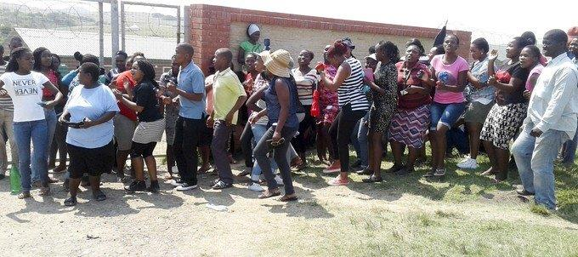
Students at King Sabata Dalindyebo college in Elliotdale marched because of delayed exam results. Archive photo: Nombulelo Damba-Hendrik
Student Protests: 2016

Slide 4
Introduction
The protests by students from Technical and Vocational Education and Training (TVET) Colleges are the result of long years of neglect of these colleges which have always played second fiddle to the universities.
The White Paper sites some of the challenges experienced in the TVET sector: poor governance and management, unqualified and underqualified lecturers, lack of adequate infrastructure and funding, poor programme differentiation and inadequate support for students.
There is general agreement in TVET circles that the establishment of the Department of Higher Education and Training (DHET) has helped refocus and reposition the colleges. However many unresolved issues still affect the image and standing of TVETs in the eyes of the public.

Slide 5
MEDIA STATEMENT
Multitudes of TVET college certificates have been cleared and ready for collection
The Department of Higher Education and Training (DHET) has been working tirelessly in collaboration with college management, the State Information and Technology Authority (SITA) and the quality assurer UMALUSI in a massive mop up project to clear outstanding NC (V) certificates for Technical and Vocational Education and Training (TVET) Colleges going as far back as 2007.
Since last year, the Department has managed to process and release large volumes of pending NC (V) certificates on a weekly basis to colleges. So far over 250 000 certificates have been administered and cleared by UMALUSI.
Furthermore, all the November 2016 TVET college examination results have been certified in accordance with national policy requirements for the issuing of certificates within three months of the publication of results. These exclude additional certificates that are still pending due to procedural irregularities such as data capturing errors and authentication of identity numbers and other personal information.
All the backlog and current certificates have since been dispatched and distributed to individual TVET colleges.
Students are advised to approach their colleges to verify the availability of their certificates and, if not available, to immediately lodge queries with college management.
Colleges are expected to immediately report queries on certificates directly to the Department for further investigation where after affected students will be notified by their respective colleges on the outcome of their queries.
Meanwhile the Department has made substantial progress in a parallel project initiated to accelerate the issuing of outstanding National N Diplomas and it is expected that all applications received up until 31 March 2017 will be finalised no later than the end of July 2017

Slide 6
Introduction
The presentation seeks to give a general overview of all challenges experienced per province
Most challenges are similar in different colleges and different provinces
The inputs were provided by 7 provinces but are representative of all nine provinces
The colleges that participated are
WC: South Cape College, College of Cape Town, Boland College, false bay
NW: Taletso TVET ( submitted a number of outstanding certificates)
NC: Northern Cape Rural
EC: Port Elizabeth College, Buffalo City
FS: Motheo, Maluti, Goldfields, Flavius Mareka
LP: Capricorn, Waterberg
GP: Tshwane South, Sedibeng, Ekurhuleni West College
KZN: Majuba

Slide 7
Background
For the past two years Colleges across the country were battling to get responses from DHET with regards to diploma applications
Towards the end of 2016, colleges were given a verbal instruction to hold all diploma applications till further notice, during that time the national office was in a process of overhauling the screening process and had a backlog of approximately 160 000 diploma applications
Umalusi and SITA have been at loggerheads over the crisis of backlogged certifications since the introduction of NC(V)
Seemingly, the new certification requirements were possibly not properly programmed into the SITA system to ensure systematic certification processes

Slide 8
Background
The Directorate: National Examinations and Assessments appears to be severely understaffed and is currently not able to adequately cope with the demands of certification and examination administration
On the 22nd of May 2018, the colleges received communication from the Resulting and Certification unit (DHET), indicating that they are busy concluding 2014/04,2016,11 and 2918/08 certificates and colleges were requested to submit consolidated schedules for all candidates affected. It further stated that 2017 certificates will follow in due course
From the first cohorts of students who completed NCV qualifications in 2009, certificates were not created and issued to candidates
DHET reported that they were still in a process of procuring printing system
In 2014, the colleges received communication that the DHET was ready to create certificate and schedules of qualifying students had to be submitted, to date, certificates are coming in batches to examination centres

Slide 9
Challenges per Province

Slide 10
1. Challenges: Western Cape
Centres are unable to keep track of certification of different levels e.g. students that have failed on numerous times and wrote during different exam cycles,
Student on higher levels are still awaiting certification for the lower levels they completed.
The certificates are printed by UMalusi on DHET requests, as a result colleges cant make direct requests
It is a challenge to get feedback from DHET regarding outstanding certificates and diplomas
Incorrect details on the certificates
Students sometimes receive the higher level certificates before the one for the lower level
Backlog from DHET in printing certificates
DHET is sending subject certificates instead of Umalusi final certificates, thus resulting in students unhappiness as they can not use the subject certificate as a qualifications

Slide 11
Challenges: Western Cape
ETDP SETA has a backlog of certificates for all ETDP SETA accredited programmes
Projects cannot be concluded as per planned timelines because student are not certified impacting on final tranche payments to colleges from funders

Slide 12
2. Challenges: Eastern Cape
Current year(s) students receive more attention than the old outstanding certificates
No feedback on applications made
Challenges with the issuing and applications not brought to the attention of the college
Students have been waiting since 2010 for their NCV Umalusi and Report 191 certificates
One college submitted 167 diploma applications and only received 50
Untraceable Diploma application and the host employer to assist applicant are no longer contactable

Slide 13
Challenges: Eastern Cape
Candidates who passed one NCV level or Nated level over 2 exam are battling to get their certificates
Candidates with condones were not certificated
Candidates who completed years ago without certificates were given confirmation letters instead of certificates
Declined diplomas are not communicated to the colleges
Applications for diplomas are kept for more than the specified
Delivery of certificates to wrong centres/colleges and those college do not redirect them without redirecting to the relevant colleges or DHET

Slide 14
3. Challenges: Gauteng
Some colleges sighted that they have hardly received any NCV certificates, even those that specially applied for on demand due to them being needed for applying for internships (2013,14,15, 16,17)
The number of certificates released for which the students qualify for is dismal
A huge backlog dating to 2015 is still currently experienced
There was an instance in 2017 where 206 applications were made for Engineering studies in one college and only 47 were issued. The 159 are still outstanding
Students who completed in 2009 have not yet received their certificates even though they passed within the same academic year

Slide 15
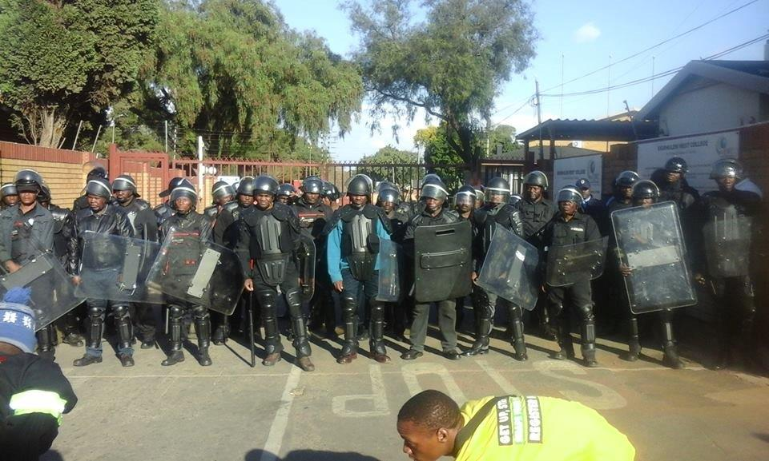
Student protest gains momentum :Certificate backlog leaves thousands in limbo, 2017
Police in riot gear prevent protesting students from entering Ekurhuleni West College in Gauteng during a nationwide shutdown of TVET colleges in 2017 . Photo: Yonke Twani

Slide 16
4. Challenges: Limpopo
Processing of the application of the diploma certificates (2013 to 2017))
Combining of programme subjects to obtain certification (from 2009-2016)
Candidates who passed one NCV level or Nated level over 2 exam are still struggling to get their certificates (2016)

Slide 17
5. Challenges: Free State
Report 191 Engineering and Business Studies: All students who did not complete the level in one trimester or semester were not certificated (2016-2017)
Diploma Applications: Some colleges did not receive feedback about some of the applications that were sent in 2014-2016
Report 191 Business Management: Students who were places in the finance department were never certificated
Some students are still awaiting replacement certificates as the original ones are lost (2014-2017)
Some certificates are send back to DHET because of mistakes recorded and correct ones are never returned (2014-2017)

Slide 18
Challenges: Free State
Several NCV L4 certificates were not issued, some dating back to 2007
Criteria for issues diploma is not consistently applied
Some campuses did not receive their certificates from
DHET for 2015 to 2017
No progress report on outstanding diploma and certificates since 2011 until2017
2011-2017 business students, engineering and NCV certificates not received

Slide 19
6. Challenges: Northern Cape
Challenges are in terms of issuing of consolidate certificates (2016,2017)
Turnaround time in issuing the certificates is a problem. A student will complete in November and only gets issued a certificate in March (2015/16/17
Students who passed subjects in different examinations do not receive their certificates(2013-2017)
Subjects statements are printed instead of National Certificates where a student passes all subjects

Slide 20
7. Challenges: KZN
In the period of 2014-2016, a college in KZN received a total of 160 diplomas out of 1210 total applications made
However in 2017, there were improvements in the diploma application processes and a number of diplomas were approved as received
Report 191 Business Studies Certificate: N4-N6 Business studies certificates for all students who completed in one examination seating are received accordingly, however, students who complete a level in different examination seating have to apply for a certificate and due to processes not being streamline there are notable delays
Report 191 Engineering Studies: There were major delays from 2016, only N1, N2 and N4 certificates were received and N3 N5,N6 were not forthcoming for 3 trimesters. Furthermore, no Engineering certificates were received in 2017 due to an alleged technical system breakdown at SITA

Slide 21
Remedial actions undertaken by Colleges
Regular follow-ups with DHET undertaken
Established a central exam office to deal with queries
Applications are tracked through a central database kept at the college (CT)
Students are requested by the college to re-apply if no response was received within 6 months
Applicants are advised to find another host employer and redo the training

Slide 22
Recommendations
DHET to provide colleges with a dedicated personnel that will communicate regularly with management at colleges
Regular training and workshops to empower and educate TVET college management to support students when submitting their diploma applications is required
Task team to be established dealing with all Backlogs
Colleges to have accurate and up to date records of all certificates received against students who are eligible for certification at all times
Adequately capacitate the DHET Directorate: National Examinations and Assessment to be able to be responsive to the issues of certification and examinations in the TVET Sector

Slide 23
Thank you

