Slide 1

2017/18
PRELIMINARY BUDGET OUTCOMES
22 JUNE 2018

Slide 2
PRESENTATION LAYOUT
Response to the recommendations of the Committee (2016/17 report)
Provincial economic growth and PGDS
Summary of revenue performance
Summary of expenditure outcome
2017/18 provincial cash position
Accruals and payables
Recommendations
2

Slide 3
PURPOSE
To brief the Select Committee on Finance on 2017/18 preliminary budget outcomes.
3

Slide 4
SYNOPSIS OF THE PRESENTATION
Provinces faces unfavourable socio-economic conditions:
  Provincial economy declined by 0.2 percent in 2017
  High unemployment rate of 32.8% in the first quarter of 2018
  Traditional sectors of the economy that provided work opportunities continue to decline
  Undiversified economy—mainly reliance on government and trade sectors
Increasing demands for services in the face of constrained resources—mainly reflected within social sector departments.
Continuing pressure on compensation as a result of annual increments—especially on Education and Health.
Province spent 99.6% of the allocated budget of R33.161 billion.
  The province requested rollovers totaling R189 million, mainly relating to grants.
Overall improvement on irregular expenditure as well as fruitless and waste expenditure (year-on-year).
The province exceeded revenue target of R1.111 billion by R11.8 million.
4

Slide 5
RESPONSES TO RECOMMENDATIONS OF THE COMMITTEE
PT to conduct effective fiscal oversight over entities to ensure good governance and financial management.
  FS already has oversight role over entities, these incl. budget & expenditure matters and governance matters.
Rationalisation of public entities.
  FS already rationalized entities—from five to two i.e. FDC (Schedule 3D) and FSGTLA (Schedule 3C).
PT to work with Health to maximise revenue collection from patient fees.
  PT works closely with Health on issues of revenue. PT started a Task Team on RAF and Lesotho outstanding patients’ fees.
  REA funding to address HR capacity—Case Management
  CFO Forum on integrated IT system to enhance processes and revenue
5

Slide 6
RESPONSES TO RECOMMENDATIONS OF THE COMMITTEE
Provinces to strictly adhere to PFMA and SCM principles in all areas of service delivery, particularly on implementation of infrastructure projects.
  Province has institutionalized SCM Forums with the view to strengthen capacity and compliance to procurement processes and prescripts (SCM Practitioners are part of the forums)
  Developed relationship with CIDB to ensure alignment and compliance to SCM processes.
  Institutionalization of IDMS within the province encourages compliance to infrastructure procurement and attainment of value for money spent.
  Province received an amount of R6.4 million towards co-funding to bolster infrastructure.
6

Slide 7
RESPONSES TO RECOMMENDATIONS OF THE COMMITTEE
Termination of intervention in Departments of Health and Education to allow the departments to stabilise.
  Health intervention terminated with effect from 15 February 2018.
    Audit Outcomes of Health improved from qualified to unqualified
    Capacity built within infrastructure resulted in awarding of incentive grants for two consecutive years—R67 million and R85 million for 2017/18 and 2018/19 respectively.
    Cash management improved in the last four years—close the year with positive balance.
    Reduction of irregular expenditure—from R300 million in 2016/17 to R20.9 million in 2017/18 (year-on-year).
  Termination on Education planned for second quarter of 2018/19.
    Reduction of unauthorized expenditure from R229 million in 2016/17 to R130 million in 2017/18 (year-on-year).
    Irregular expenditure declined from R339 million to R313 million—more work is still done to deal with challenges of irregular expenditure(PT assisted in appointing service provider to identify and address IE problems)
    Also received incentive grant of R133 million for 2018/19.
7

Slide 8
PROVINCIAL SOCIO-ECONOMIC PROFILE
8

Slide 9
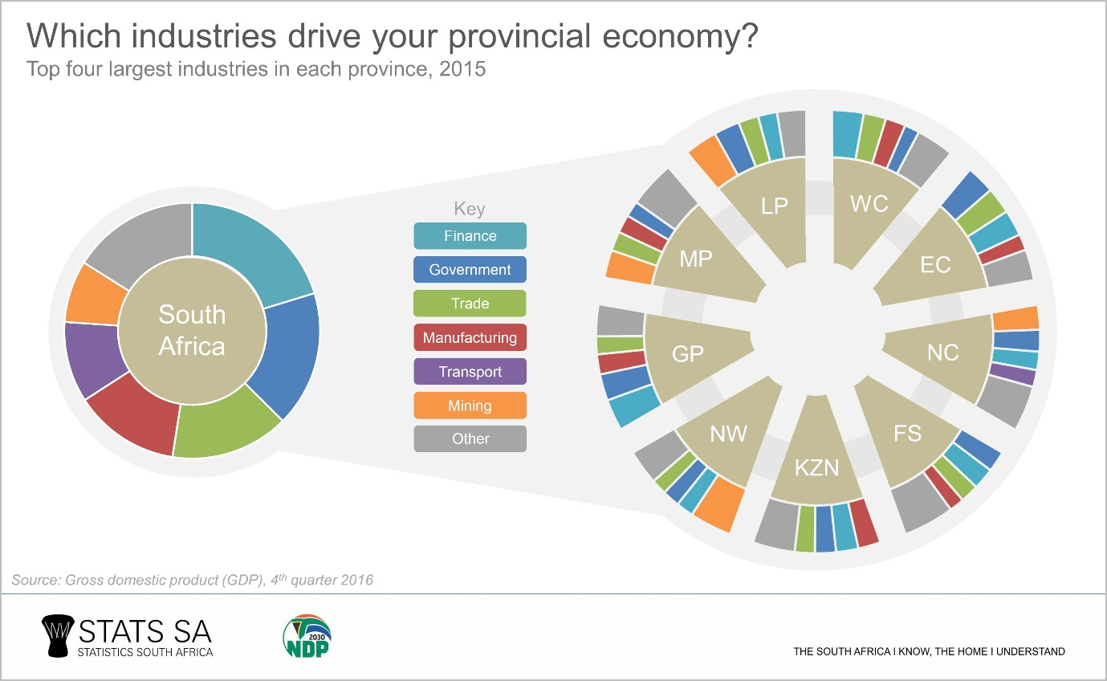
FREE STATE ECONOMY IN CONTEXT
9

Slide 10
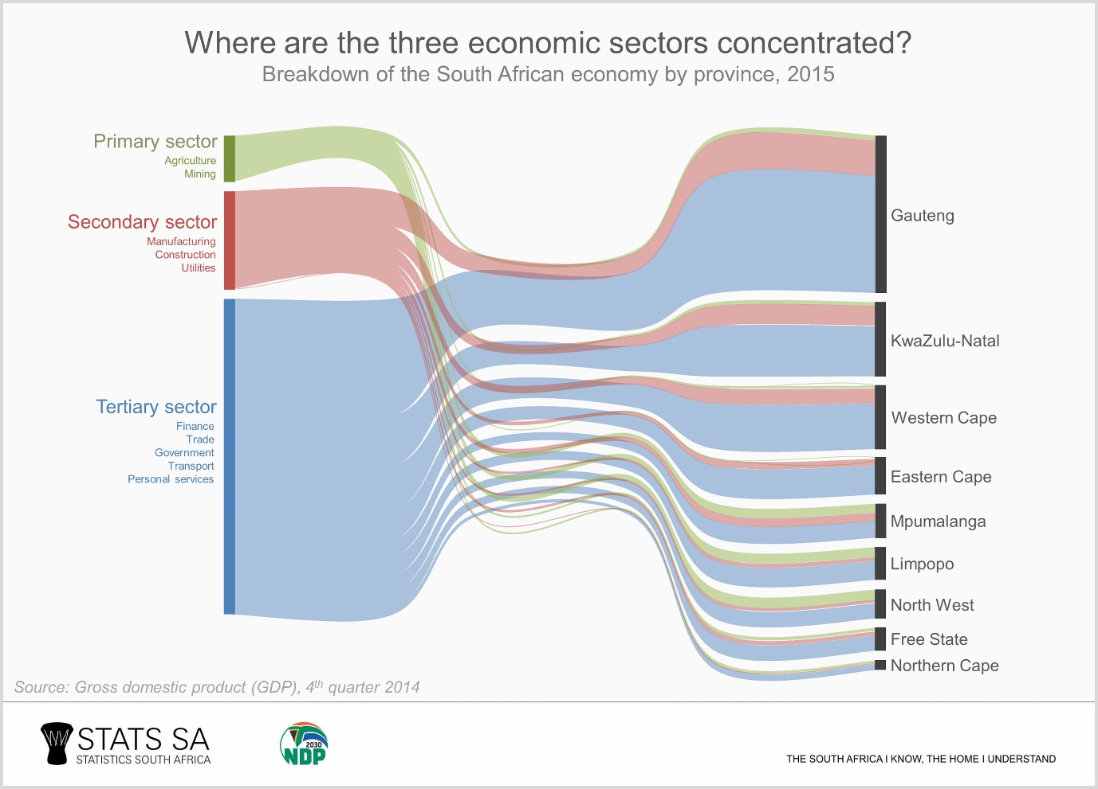
FREE STATE ECONOMY IN CONTEXT
10

Slide 11
SALIENT SOCIO-ECONOMIC-FEATURES OF THE FREE STATE
2nd smallest population, mainly due:
  Low fertility rates
  Out-migration
5th lowest headcount poverty rate
2nd smallest economy, underlined by:
  Lacklustre growth performance overall
  Largely undiversified economy with high reliance on government sector
High unemployment, mainly due to:
  High and rising participation rate
  Low absorption rate
  Concentration of employment in few sectors
11

Slide 12
EFFORTS TO ADDRESS THE SOCIO-ECONOMIC-FEATURES
Reverse out-migration
  Use our strengths to change the perceptions on the province
Accelerate growth through transformation and inclusivity:
  Implementation of SIPs projects
  Strengthen linkage between general government spending and the provincial economy
  Strengthen and capacitate LED Units in municipalities and enhance their role
  Gender mainstreaming (GRB Project)
Enhance job creation and employability of the labour force
  Labour-intensive public works
  Education, training and skills development
  Quality of life issues
12

Slide 13
OVERVIEW OF THE FREE STATE PGDS
Free State Vision 2030
By 2030, the Free State shall have a resilient, thriving and competitive economy that is inclusive with immense prospects for human development formation anchored on the principles of unity, dignity, diversity, equality and prosperity for all.
Inclusive economic growth and sustainable job creation
Education, Innovation and Skills Development
Sustainable Rural Development
Improved Quality of Life
Build Social Cohesion
Good Governance
13

Slide 14
FSGDS—PILLARS & DRIVERS
PILLAR 1: INCLUSIVE ECONOMIC GROWTH AND SUSTAINABLE JOB CREATION | PILLAR 2: EDUCATION, INNOVATION AND SKILLS DEVELOPMENT | PILLAR 3: IMPROVED QUALITY OF LIFE | PILLAR 4: SUSTAINABLE RURAL DEVELOPMENT | PILLAR 5: BUILD SOCIAL COHESION | PILLAR 6: GOOD GOVERNANCE
Driver 1: Diversify and expand agricultural development and food security | Driver 6: Ensure an appropriate skills base for growth and development | Driver 7: Curb crime and streamline criminal justice performance | Driver 13: Mainstream rural development into growth and development planning | Driver 14: Maximise arts, culture, sports and recreation opportunities and prospects for all communities | Driver 15:Foster good governance to create a conducive climate for growth and development
Driver 2: Minimise the impact of the declining mining sector and ensure that existing mining potential is harnessed |  | Driver 8: Expand and maintain basic and road infrastructure
 |  | Driver 9: Build sustainable human settlements
Driver 3: Expand and diversify manufacturing opportunities |  | Driver 10: Provide and improve adequate health care for citizens
Driver 4: Capitalise on transport and distribution opportunities
 |  | Driver 11: Ensure social development and social security services for all citizens
Driver 5: Harness and increase tourism potential and opportunities
 |  | Driver 12: Integrate environmental concerns into growth and development planning
14

Slide 15
PROGRESS ON PGDS
Agri-park in Parys which presents opportunities in agro-processing which includes manufacturing of chips, sunflower oil, peanut butter and biofuels, marketing, training and extension services.
Bituminous coal is mined and converted to petrochemicals at Sasolburg.
Discovery of coal in Hennenman.
Industrial Parks: Botshabelo, East End, Bloemdustria, Hamilton, MAP-SEZ.
Partnership with CUT wrt. development of prototypes for manufacturing of equipment.
Attraction and facilitation of investments, e.g. R120 million mixed facility in Warden.
Ghariep Fish Hatchery already operational.
Transportation of goods: Upgrading of strategic roads such as portion of N1 between Kroonstad and Vensterburg (connection point to North West) and N8 between Botshabelo and Thaba Nchu.
Feasibility study completed for Harrismith Logistic Hub.
N8 Corridor development continues to attract investment—New Busamed hospital already operational and construction of residential properties continues.
15

Slide 16
PROGRESS ON PGDS (cont.…)
Maluti-a-Phofung SEZ with an investment pipeline of R2.6 billion was officially launched - it will initially be a logistics hub between Durban and Johannesburg, relieving some of the pressure on Durban’s port by offering alternative storage, staging and packaging services, and later on it will prioritize the development of automotive, agro-processing, textiles, information technology, pharmaceuticals and general processing businesses.
Partnerships with health sector—such as PPP at Pelonomi and Universitas Hosp.
New Provincial Tourism Strategy with 5 tourism routes has been adopted and in implementation is already underway.
  Skills development – that is supported through the provincial Bursary Programme.
  Implemented crime prevention strategy 2014 which is a blue print for crime fighting in the province.
16

Slide 17
PROGRESS ON PGDS (cont….)
Anti gangsterism campaigns—Form of moral regeneration (schools, sport against crime, seminars, public educations, meeting with ex-gangsters).
Rehabilitation and maintenance of 6 730 km surfaced roads and continuous demand driven re-graveling and blading of 22 000 km of gravel roads.
Vrede/Memel, Vredefort/Parys, Harrismith/Oliviershoek, Kroonstad through route, Harrismith internal road phase 1, Tumahole Phase 2, Monontsha border post—Some of the projects completed.
Catalyst projects in Human Settlements.
Exploring opportunities related to the green economy, e.g. Dealesville & Bethulie Solar Parks; Biofuels in Bothaville.
Several opportunities created, e.g. MACUFE, Flower Festival, International Powerboat Competition.
Addressing Fraud and Corruption through, amongst others, institutionalization of Fraud Awareness Week + Training + Conference.
There are governance structures such as audit committees in municipalities and provincial departments.
17

Slide 18
EVIDENCE-BASED RESOURCE ALLOCATION
Year | No. of Studies undertaken by PT Staff | No. of Studies Outsourced | Focus Areas
2013/14 | 4 | 0 | Quality of Education; Effectiveness of Treasury; Public School Infrastructure; Impact of EPWP Provincial Resorts; Fiscal Multiplier Effects; Government Expenditure Patters; Impact of Infrastructure Impact of EPWP; State of LED in FS; Poverty and Inequality; Economic Transformation and Skills Development; MACUFE 2015*; Municipal Resorts* Nexus between government spending and economic growth; Youth Unemployment; Local Economic Development – Xhariep as Case Study
2014/15 | 4 | 0
2015/16 | 5 | 2
2016/17 | 3 | 0
2017/18 | 3 | 0
Total | 19 | 2 | * Denotes Outsourced Studies
% Distribution | 95% | 5%
18
Notes:
In total, 15 studies were initiated since 2013/14, of which 14 (i.e. 93.3% were completed). Only study rolled-over from 2015/16 was on State of LED in Free State. In addition, FS Treasury quarterly publishes Analysis of Provincial Labour Market Trends and annually publishes the Provincial Economic Review and Outlook (PERO) as well as the District Economic Profiles (DERO).

Slide 19
EVIDENCE-BASED POLICY MAKING
Annual Provincial Treasury Research Colloquium
  2.5 days
  12 guest speakers
  32 research papers on 4 out of the 6 pillars of the FSGDS, of which 10 were from PhD and M-students
  6 strategic partnerships, of which 2 are from the private sector
Research for 2018/19
  Gender Responsive Budgeting in the Free State
  Development Policy Implementation Failures and their impact on the Free State
19

Slide 20
EVIDENCE-BASED RESOURCE ALLOCATION
Some Key Research Findings on the Free State | Some Key Recommendations
Poverty rates in the province have declined (using all three poverty lines) Poverty severity is substantially higher in rural areas Inequality has declined over the years, but still remains high Confirmation of structural change in the composition of the provincial economy, both in terms of output and employment High levels of unemployment amongst the less educated in particular and Africans in general Provincial labour force dominated by semi-skilled and unskilled labourers, underpinned by racial dynamics Skills profile of current labour force does not support both the current and future economic trajectory of the province. Youth unemployment too high and key in entrenching cycle of poverty Missing link between government spending and economic growth | Deliberate, conscious and sustained fiscal interventions to be directed towards small towns and rural areas in the province Revive and expand manufacturing to give the provincial economy a productive base to support the tertiary sector (and reduce reliance on government) Develop a comprehensive skills development strategy/plan (and align the provincial bursary programme therewith) Review the province’s EPWP design and implementation mechanisms to address skills development and creation of decent jobs. Youth Entrepreneurship Development Programmes Need to review budget structure of the province
20
Notes:
Although it does not impact directly on socio-economic transformation, Provincial Treasury has done a number of studies of which the findings could be used to improve the impact of our programmes on the socio-economic transformatio in the province. The slide highlights some of the findings and recommendations that have been made.
Improvement in local procurement i.t.o. Targeted procurement through suppliers from the province

Slide 21
SUMMARY OF PROVINCIAL REVENUE COLLECTION
21

Slide 22
PROVINCIAL REVENUE COLLECTION
Health received R30 million from Lesotho end of March 2018. Could not be included due to time constraint.
22

Slide 23
ECONOMIC CLASSIFICATION
23

Slide 24
REVENUE TRENDS
24

Slide 25
MAIN CHALLENGES ON REVENUE
  Services (outstanding patients’ fees) provided to Lesotho Ministry of Health—flow of payments unpredictable.
  Recovery of patients’ fees not satisfactory—mainly due to lack of effective systems (e.g. IT and HR) and socio-economic conditions of patients.
  Budget constraints of entities such as RAF do impact on revenue expected by the province.
25

Slide 26
ON-GOING INTERVENTIONS TO ENHANCE REVENUE
  Established close working relationship with Road Accident Fund to enhance recovery systems.
  Engagements with the Ministry of Health in Lesotho on outstanding invoices continuing and bearing fruits.
  Task Team work on rental of properties continues—between Provincial Treasury and Public Works and Infrastructure.
  Work closely with all provincial departments regarding the potential revenue projects.
  Annual review of tariffs assist in enhancing revenue.
  Participate in Revenue Workgroup initiated by National Treasury—sharing of best practices.
  Revenue Enhancement Strategy still on-going—aim to fund projects with potential to raise revenue.
26

Slide 27
SUMMARY OF EXPENDITURE: PRE-AUDITED 2017/18
27

Slide 28
SUMMARY OF PROVINCIAL EXPENDITURE
Over-expenditure due to: Education spent R10.3 billion (101.4%) of R10.2 billion
Health spent R6.3 billion (100.5%) of R6.2 billion
PRT spent R773.3 million (106.2%) of R728.5 million
Compensation of employees:
Health budget R2.5 billion and spent R2.6 billion or 103.7% Pressure on Medicines, NHLS, EMS
Goods & Services:
Spending on Buildings & Other Fixed Structure @ 91.4% (R1.8 billion ) of a R1.9 billion
Capital Expenditure
NPI expenditure @ 94.3% (R1.7 billion) of R1.8 billion
Households expenditure @ 96.6% (R1.6 billion) of R1.656 billion
Health over spent by 8.1%
DESTEA over by 1.4%
PRT over by 1.4%
Transfers & Subsidies
LTSM
Municipal services
NHLS
Transfers to schools
NGOs
Rates and taxes
Infrastructure
Machinery and equipment
Budget of R6.056 billion and preliminary outcome of R5.991 billion (98.9 %)
Budget of R19.9 billion with a preliminary outcome of R20.1 billion or 100.9 % .
Medicine
EMS
Budget of R2.4 billion and preliminary outcome of R2.1 billion (89.9%)
Budget of R4.7 billion and preliminary outcome of R4.6 billion (97.0%)
Budget: R33.162 billion
Expenditure: R33.020 billion
Percentage Spent: 99.6%
28
Notes:
Education:
The Department has overspent on Compensation of Employees due to insufficient budget allocation in 2017/18 financial year.
Health:
The department has overspent mainly on G&S on items such as inter facility patient transport, medicine and medico legal claims
PRT:
The department has overspent mainly on Compensation of Employees due to limited funding

Slide 29
SUMMARY OF PROVINCIAL EXPENDITURE
29
Notes:
Education:
The Department has overspent on Compensation of Employees due to insufficient budget allocation in 2017/18 financial year.
Health:
The department has overspent mainly on G&S on items such as inter facility patient transport, medicine and medico legal claims
PRT:
The department has overspent mainly on Compensation of Employees due to limited funding

Slide 30
COMPENSATION OF EMPLOYEES
Wage agreements will further put pressure on COE budgets
30

Slide 31
GOODS AND SERVICES
31

Slide 32
TRANSFERS AND SUBSIDIES
32

Slide 33
CONDITIONAL GRANTS EXPENDITURE (1 of 2)
33

Slide 34
CONDITIONAL GRANTS EXPENDITURE (2 of 2)
34

Slide 35
FOCUS ON HEALTH
Pressures mainly on medicine, laboratory services, operating leases and EMS
35

Slide 36
FOCUS ON HEALTH…core items
36

Slide 37
FOCUS ON EDUCATION
37

Slide 38
FOCUS ON EDUCATION…core items
Section 20 schools budgeted within goods and services of Programme 2
38

Slide 39
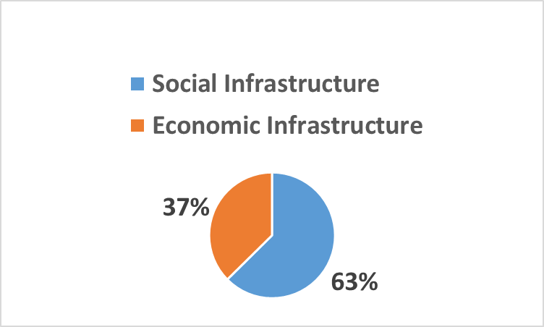
INFRASTRUCTURE EXPENDITURE
SPENDING
39
Notes:
Health: Advertised posts that have not yet been filled and faulty invoices provided by suppliers which delay payments made.
Soc Dev: Initial cash flow issues by the contractor delayed progress which improved at the end of year.
Agric & RD: Underspending due to the Mohoma Mobung project that was deferred to the new financial year due to the late approval DESTEA the of EIA (approved on 29/03/2018).
SACR: The under spending is as a result of the National Training Center which was subject to a legal opinion following the findings of AGSA.

Slide 40
PROVINCIAL CASH BALANCES
40

Slide 41
PROVINCIAL CASH BALANCES
41

Slide 42
UNAUTHORIZED EXPENDITURE
42

Slide 43
FRUITLESS & WASTEFUL EXPENDITURE (Year-on-year)
43

Slide 44
IRREGULAR EXPENDITURE (year-on-year)
Reduction of 61%
44

Slide 45
ACCRUALS & PAYABLES
45

Slide 46
AUDIT OUTCOMES
DEPARTMENTS | 2011/12 | 2012/13 | 2013/14 | 2014/15 | 2015/16 | 2016/17
1. Premier | Clean | Clean | Qualified | Clean | Unqualified | Qualified
2. Provincial Legislature | Clean | Unqualified | Clean | Clean | Clean | Clean
3. DESTEA | Qualified | Qualified | Unqualified | Unqualified | Qualified | Qualified
4. Provincial Treasury | Clean | Clean | Clean | Clean | Qualified | Clean
5. Health | Qualified | Qualified | Qualified | Qualified | Qualified | Unqualified
6. Education | Unqualified | Unqualified | Qualified | Unqualified | Qualified | Qualified
7. Social Development | Unqualified | Unqualified | Unqualified | Unqualified | Unqualified | Unqualified
8. COGTA | Unqualified | Unqualified | Unqualified | Unqualified | Unqualified | Unqualified
9. Public Works | Qualified | Qualified | Unqualified | Clean | Unqualified | Unqualified
10. Police, Roads & Transport | Qualified | Unqualified | Unqualified | Unqualified | Unqualified | Unqualified
11. Agriculture & RD | Unqualified | Unqualified | Unqualified | Unqualified | Adverse | Adverse
12.Sport, Arts, Culture & Recreation | Unqualified | Clean | Clean | Clean | Qualified | Qualified
13. Human Settlements | Qualified | Qualified | Qualified | Qualified | Qualified | Qualified
46

Slide 47
RECOMMENDATIONS
It is recommended that the Committee:
Notes the socio-economic review and outlook of the province.
Notes that the province spent R33.020 billion or 99.6 percent of the allocated budget of R33.161 billion, resulting in an underspent by R141.0 million and that the under expenditure is mainly influence by conditional grants.
Notes that the province spent R20.171 billion or 100.9 percent on compensation of employees.
Notes that recent wage agreement will put pressure on the provincial fiscal framework.
Notes that spending on grants totaled R7.250 billion or 96.6 percent of the allocated budget of R7.507 billion and R189 million of the R257 million under expenditure has been requested for rollovers.
Notes that the province attained (overachieved) on its projected revenue target of R1.111 billion (over collected by R11.8 million).
Notes the negative cash position of the province as at end of the financial year.
Notes the progress achieved with regard to Provincial Growth and Development Strategy.
47

Slide 48

48

