Slide 1
Scopa meeting: 13 June 2018
Briefing by Provincial Treasury
Cape Town
Mr Hoosain, Mr Hardien and
Ms Ebrahim

Slide 2
3.1 Mitigation mechanism to ensure that underspending remains within 2 %

Slide 3
Current mechanisms within PT
During 2016/17 PT had mechanisms in place to manage expenditure
PT continued with these mechanisms during 2017/18 and implemented additional mechanisms
Planning and compilation of the budget
Strategic planning sessions are held to determine the objectives and targets
Presentations at MTEC 1 and 2 engagements to demonstrate the proposed impact of the budget, the responsiveness to the provincial priorities and the credibility and sustainability of the proposed MTEF Budget.
Budget for CoE determined by the budgeting for “warm bodies”, provision for ICS and the identification of critical posts to be filled. (Difficult to anticipate the number of exits)
Goods and services budget based on needs of department to achieve objectives and targets
Transfer payments based on needs of municipalities determined via a number of engagements

Slide 4
Current mechanisms within PT
Monitoring and reporting
Monthly In Year Monitoring Reports are compiled, discussed at Top Management meeting and submitted to PT and NT.
For 2016/17 and 2017/18, the focus was particularly on CoE given that all departments needed to be on a sustainable fiscal path CoE committee was established: Critical posts were identified, recruitment action plans compiled, progress on the filling of funded vacancies, per recruitment plan, presented at monthly Top Management meetings. Managers provided reasons for not adhering to the dates as per the recruitment action plan.
Expenditure on key contracts are monitored monthly and the status of these contracts are discussed at Top Management meetings.
Gazetting of transfers brought forward to 3rd quarter.

Slide 5
Current mechanisms within PT
Adjustments Estimate
Process were used to surrender funds that will not be utilized due to -
posts filled later than anticipated;
staff exiting the department;
difference in uptake of interns;
delays in project starting time; and
transfer payments not taken up by municipalities.

Slide 6
Additional mechanisms implemented for 2018/19
Zero based budgeting will be done as efficiency measures were introduced, and budget will be aligned accordingly.
Better alignment between planning and budgeting processes, e.g. finalisation of procurement plans prior to finalising budget.
Given that CoE has been stabilized via approved post lists, the focus for 2018/19 is on managing expenditure on contract/consultants.
Gazetting of transfers brought forward soon after the conclusion of 2nd quarter.
Notes:
Count the number of indicators
Change all 1st quarter to 1st quarter
The overall achievement percentage is determined by the technical assessment report
When numbers are updated, update the names
Change the footer to 1st quarter

Slide 7
3.2 Consequence management mechanism mitigating any future losses of IT equipment

Slide 8
Loss of IT equipment
All cases that involve the loss of IT equipment are investigated by Internal Control
If loss occurred through negligence – cost of the loss is recovered from official
In addition if case constitutes Financial Misconduct, cases are referred to Employee Relations for further investigation
If loss occurred through Financial Misconduct disciplinary procedures are followed
Notes:
Count the number of indicators
Change all 1st quarter to 1st quarter
The overall achievement percentage is determined by the technical assessment report
When numbers are updated, update the names
Change the footer to 1st quarter

Slide 9
3.3 PT Circulars issued to Departments during 2016/17 and 2017/18

Slide 10
List of circulars issued to Departments during 2016/17 and 2017/18
NT instructions are taken up in provincial treasury circulars.
The PT circulars looks at the NT instruction holistically, and ensures that the intent of the instruction has been covered
In many instances, the PT circulars are in more detail than the NT instruction.
List of circulars provided
Notes:
Count the number of indicators
Change all 1st quarter to 1st quarter
The overall achievement percentage is determined by the technical assessment report
When numbers are updated, update the names
Change the footer to 1st quarter

Slide 11
3.4 Pronouncement of emerging risks which relates to accounting, performance management/reporting and compliance matters

Slide 12
Emerging Risks
MCS: Componentisation of assets
Departments are encouraged to componentise assets in their asset registers as it will become a requirement in future. The effective date to componentise assets has not been determined yet.
MCS: Inventory Disclosure
Departments are encouraged to develop their Inventory Management systems as the Inventory Disclosure Note will become a requirement in the future. The effective date has been postponed until a date determined by the Accountant-General
Treasury Regulations
The Treasury Regulations are currently being revised, which may introduce a number of new requirements.

Slide 13
Emerging risks
National Instruction Notes
National Instruction Notes are being issued by National Treasury on a continuous basis in terms of S76 of the PFMA
Provincial Treasury will review these Instruction Notes and reissue them to the various departments and entities on a selective basis.
Accounting Manual on Transfer Payments
National Treasury is currently drafting an Accounting Manual to distinguish between “Goods and Services” and “Transfer Payments”. This can possibly affect the future classification of these transactions.

Slide 14
Emerging risks
B-BBEE CERTIFICATES
Footnote 3 in the Treasury Instruction 4A of 2016-2017 noted that the CSD( Central Supplier Database) does not verify B-BBEE status level and set a future date for verification of B-BBEE status (1 October 2016).
The OCPO (Office of the Chief Procurement Officer failed to achieve this deadline and up to now the CSD does not verify the B-BBEE Status of suppliers
The instruction did not exempt institutions from complying with the PPPF Act requirements for obtaining a valid evidence of B-BBEE level status( eg. Sworn affidavits).

Slide 15
Emerging risks
CENTRAL SUPPLIER DATABASE
The OCPO introduced the CSD on 1 September 2015 accessible on www.csd.gov.za, which will reduce the administrative burden on both the supplier and the administrator.
The system verifies and validates information with SARS, CIPC and the Department of Home Affairs amongst others. The system was mandatory from 1 April 2016 for all suppliers to National, Provincial and Entities at these two spheres of government.
CSD is the master supplier information and should not be modified by the WCSD and all suppliers registered on the CSD should not be excluded or disadvantaged in any way.
eTENDERS PORTAL
Suppliers who meet all the compliance requirements can access opportunities on www.etenders.gov.za. The portal enable suppliers to have access to tenders published on the platform. The compulsory implementation of this portal was 1 April 2016.

Slide 16
Emerging risks
PUBLIC SERVICE REGULATIONS
The new Public Service Regulations effective from 1 August 2016 as gazetted, still poses a number of risks for the Departments that need to be addressed in subordinate and administrative directives as well as Circulars by the Department of Public Service and Administration (DPSA) in order to give further guidance on its implementation.
LOCAL CONTENT
Over the past two Financial years there has been an increase in the number of instances identified by Management, as well as through the audit process, relating to non-compliance with Preferential Procurement Regulation relating to local content. The areas of non-compliance include:
Commodities designated for local content and production, which were procured from suppliers who did not submit a declaration on local production and content, as required by the regulations.
Commodities designated for local content and production, which were procured from suppliers who did not meet the prescribed minimum threshold for local production and content, as required by the regulations.

Slide 17
3.5 Disclosure on financial statements: Economic classification – “Transfer payments” and “Goods and services”

Slide 18
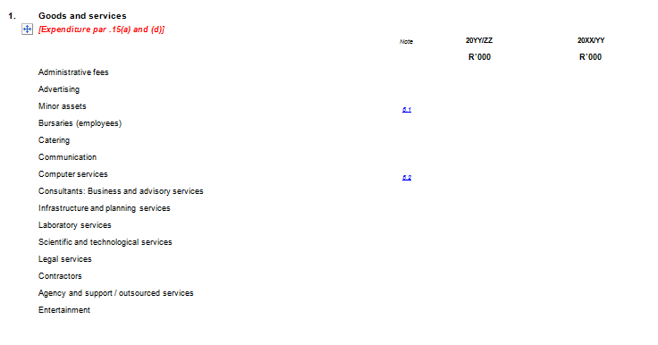
Disclosure requirements: Goods and Services
The disclosure for goods and services is detailed into what has been purchased, with further details found in the notes to the AFS.

Slide 19
Disclosure requirements : transfer payments
Transfers and Subsidies disclosure requires to whom funding has been made available.
This detail is found further in the annexures that is in the AFS.

Slide 20
3.6 SCM regulations issued by National- and Provincial Treasury for the 2016/17 financial year

Slide 21
SCM regulations issued by National Treasury
List of regulations provided
Notes:
Count the number of indicators
Change all 1st quarter to 1st quarter
The overall achievement percentage is determined by the technical assessment report
When numbers are updated, update the names
Change the footer to 1st quarter

Slide 22
PREFERENTIAL PROCUREMENT POLICY FRAMEWORK REGULATIONS, 2017 (PPPFR)
Update to SCOPA

Slide 23
BACKGROUND
On 22 June 2016 Cabinet resolved that the Provincial Treasury approaches Cabinet for policy guidance on the implementation of the Preferential Procurement Regulations once gazetted for implementation.
WCG via the Provincial Treasury and the SCM cadre engaged on and completed the following preliminary tasks before the regulations were promulgated:
PT provided comments to initial draft regulations (14 August 2015) and attended and partook in the NT SCM Modernisation Committee meeting and various workshops with the NT where the regulations were discussed
Legal opinion solicited via legal services (Adv. Rosenberg) and summarized legal context provided to PT (07 August 2015)
Concluded a financial and technical impact assessment on the draft regulations Gazetted for comment and provided formal comment dated 15 July 2016 via the MEC for Finance;
Additional comment on legal and constitutional inconsistencies were provided to NT on 29 July 2016;
Many of the comments provided by the WCG were taken up except the comments raised on the prequalification and 30% sub-contracting requirements. New inclusions not commented on by WCG nor consulted on by the NT is the negotiation process as envisaged in regulation 6 and 7.
The Preferential Procurement Regulations, 2017 (PPR) was issued via Government Gazette 40553 on 20 January 2017 which is applicable from 1 April 2017.

Slide 24
PPR IMPLEMENTATION CHALLENGES; RISKS AND IMPACT
Ultra vires the PPPF Act and unconstitutional Double preferencing; value for money Encourages fronting, collusion Not aligned to PPPFA, B-BBEE Act and CIDB regulations
Premium will increase from 7.71% (R832million to 10,13% (R1.094billion) which is = R262million extra
(based on 2015/16 expenditure)
DOES NOT INCLUDE IMPACT OF OTHER COST DRIVERS
Raising of 80/20 threshold from R1M to R50M
Raising of 80/20 threshold from R1M to R50M
Prequalification criteria focusing on black owned SMMEs (i.e. military veterans; youth & disabled
Prequalification criteria focusing on black SMMEs
Compulsory if feasible (contradiction)
Industries diverse, sub-contracting not always possible and negative impact on VFM and/ pricing
Impact existing sub-contracting model (CIDB)
30% sub-contracting
> R30 million contracts
How local content fits into the context of the constitutional objectives of unfair discrimination
Ultra Vires the PPPFA: Special Condition of tender is included within the 20 or 10 points of the 80/20 and 90/10 points scoring system
Cost of Verification past onto procuring institutions (Increase in pricing)
Local Production and Content (special condition)

Slide 25
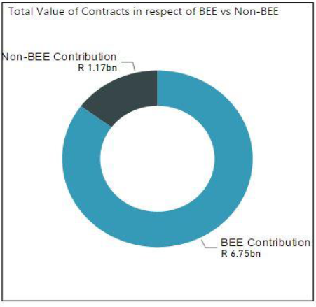
WCG SUPPLIER BASE – CONTRACT AWARDS for 2015/16
The table and charts below reflect the commitment value based on contract awards for the 2015/16 financial year and procurement spend matched to suppliers on our WCSD that was presented to Cabinet:
BBBEE Level | # Entities | Contract Commitments
1 | 1175 | R 572.76M
2 | 245 | R 4540.87M
3 | 166 | R 1048.70M
4 | 701 | R 333.18M
5 | 36 | R 78.80M
6 | 37 | R 77.80M
7 | 31 | R 84.13M
8 | 73 | R 9.80M
BEE Contribution | 2464 | R 6.75 bn
Non-compliant contributor | 2597 | R 1.17bn
Non-BEE Spend | 2597 | R 1.17bn
96%
of the total BEE contribution
85%

Slide 26
PROPOSALS APPROVED BY CABINET
CABINET NOTED :
the progress made by the Western Cape Government (WCG) in respect of preferential procurement since the implementation of the PPPR 2011.
CABINET APPROVED:
ISSUANCE OF AN INTERIM STRATEGY AS WELL AS SUPPLY CHAIN MANAGEMENT GOVERNANCE REQUIREMENTS VIA PROVINCIAL TREASURY INSTRUCTIONS THAT:
Apply its discretion NOT to implement the pre-qualification criteria (i.e. regulation 4);
Apply its discretion NOT to implement regulation 6(9)(a)-(c) and 7(9)(a)-(c);
Makes provision for empowerment assessments to be conducted for all procurement above R10 million (EME threshold) and also allowing departments to lower the threshold should its analysis so dictate; and
Makes provision for the implementation of regional indicators to target local suppliers via our e-procurement system and rotation of suppliers.
DEVELOPMENT OF AN ECONOMIC PROCUREMENT POLICY that is aligned to PSG1 that covers job creation and infrastructure development and is aligned to the MTBPS in conjunction with DEDAT and DotP.
BROADER TRANSFORMATION POLICY
Promote private sector spend on economic growth; and
Further strengthen the partnership with the private sector by enabling access to the WCG supplier database.

Slide 27
PROGRESS ON CABINET DECISIONS
CABINET DECISION | PROGRESS
Issuance of an interim strategy as well as supply chain management governance requirements via provincial treasury instructions that: | Issuance of PT Circular 12 and 15 Information sessions with depts. Full review of PTIs currently underway Statistics as it relates to the PPPFR provided to depts. via quarterly SCM Performance Insight reports Challenges in implementing empowerment impact assessments () hence PT in process of developing an EIA toolkit to assist department with process
Development of an economic procurement policy | 1st draft Economic Procurement Brief canvassed with SCM Forum in July 2017 and recommendations made to GTAC 2nd draft economic procurement policy brief received and Task team met on 25 August 2017 to provide final input into brief. 1st Draft Policy tabled with PT by DotP policy team on 15 April 2018. PT and key stakeholders provided comments to be taken up into policy
Broader transformation policy | Longer term objective

Slide 28
WCG REFLECTIONS ON PPPFR IMPLEMENTATION FOR 2017/18

Slide 29
PREFERENTIAL PROCUREMENT SPEND 2017-18

Slide 30
PREFERENTIAL PROCUREMENT SPEND 2017-18

Slide 31
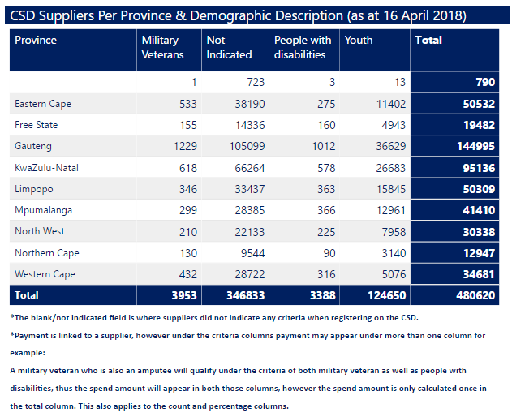
DEMOGRAPHIC REPRESENTATION ON CSD

Slide 32
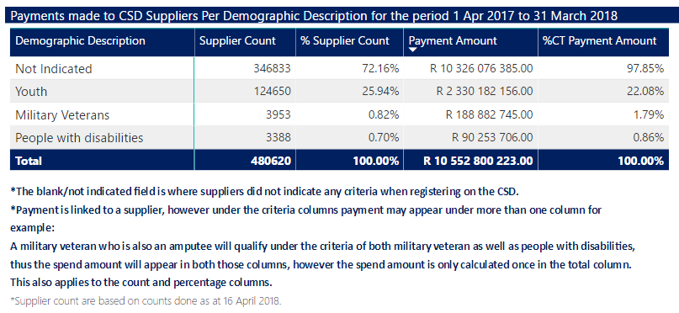
WCG PROCUREMENT SPEND 2017-18 IRO DEMOGRAPHICS

Slide 33
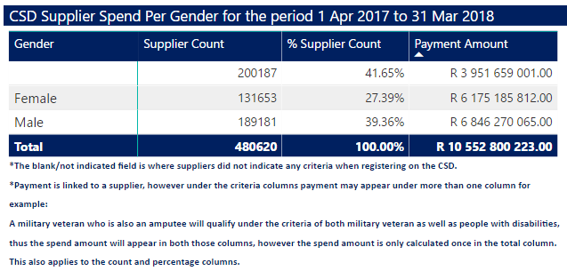
WCG SPEND 2017-18 PER GENDER

Slide 34
Mr Z Hoosain Mr I Smith
HOD Acting DDG: Governance
Tel: 021 483 3749 and Asset Management
Tel: 021 483 8223
Mr A Hardien
CD: Financial Governance Ms N Ebrahim
and Accounting Acting CD
Tel: 021 483 6025 Tel: 021 483 6645

