Slide 1
REPORT TO SCOPA ON ESKOM ACCOUNT 13 JUNE 2018 Thaba Chweu Local Municipality

Slide 2
Index
Delegation
Background
Municipal Sources of Revenue
Eskom Account Information
Creditor’s Information
Budget
Interventions
Key Recommendations

Slide 3
Thaba Chweu Delegation
Selina Mashego-Sekgobela Hon. Executive Mayor
Thoka Kgoale Municipal Manager
Sinenhlanhla Manqele Acting Director Technical Services
Michael Mashilo Acting Deputy CFO

Slide 4
BACKGROUND

Slide 5
Introduction
The purpose of the presentation is to provide information in relation to the following:
Reasons why the Municipality is defaulting on the Eskom Bulk Purchases Account
Revenue streams available to the Municipality
Interventions to address the Eskom account

Slide 6
Overview
Thaba Chweu Local Municipality (TCLM) is a Category B municipality located in the north-western region of the Mpumalanga Province in the Ehlanzeni District;
It is one of four municipalities in the district;
The escarpment divides the district into eastern and western halves. It is located on the far north-eastern part of the district;
It shares its northern boundaries with Limpopo;
The municipality is on the Lowveld escarpment of Mpumalanga, with an average elevation of 1 400m above sea level and altitudes varying from 600 to 2 100m;
The current population is 101 895, population growth rate of 0.8% per annum (2016).
Current indigent registration is recorded at 4580 as at May 2018.
The municipality experience economic in-migration due to job opportunities in mining and forestry sectors – which also attract illegal immigrants (resulting in the mushrooming of informal settlement)
The municipality has 14 Wards and 27 Councillors;
There are three main towns: Lydenburg (Mashishing), Sabie and Graskop

Slide 7
Municipal Snapshort
Opportunities:
Tourism growth – home to many tourism attractions in Mpumalanga
Proximity to Maputo Corridor
Proximity to strategic locations: Gauteng, Mozambique, Polokwane, Nelspruit, Swaziland, etc.
Available municipal land (for agriculture and commercial development – mostly serviced)
Thaba Chweu is home to few mines, including Xstrata Alloys’ Smelter
There exist a plentora of business opportunities in the agriculture and forestry industries ready to be harnessed.
Challenges:
Unemployment and Low household income – although significantly lower than the national average
Declining of economic sectors – mining, agriculture and forestry
Export-oriented economy – no beneficiation
Exclusivity of the Tourism Sector – limited transformation in the tourism sector
Aging infrastructure – dilapidated roads affecting the local economy
Escalating Eskom Debt and power interruptions affecting the local economy
Informal Settlement - land invasion leading to illegal connection of basic services
Culture of non-payment of services
Negative Audit Opinion (Disclaimer opinion)

Slide 8
Municipal Snapshort
Opportunities:
Duma PPP substation project
.
Challenges:
Low revenue collection
PPP halted due some disputes.
Project that was meant to bring more relief/ reduce the exceeding of NMD.
Political and administrative instability
Poor financial controls
Invasion of houses by some public servants
High vacancy rate at Senior management
Deepened malfeasances.
Municipal suffers from the loss of institutional memory.
TCLM not having a permanent Municipal Manager for the past 5 years only managed to fill the position in May 2017
Inadequate Public buy in Duma Project.
Resistance by community to install smart meters.
Spread land invasions

Slide 9
Economic plans & opportunities
There has been an overall improvement in the provision of basic services within Thaba Chweu Local Municipality.
The Gross Value Added for Thaba Chweu Local Municipality has doubled between years 2006 and 2016.
Thaba Chweu is the biggest mining contributor in the entire district.
Investment in Tourism products - development of Africa’s first Gorge Retail Centre with glass lift and viewing areas (PPP); Mashishing Park – township tourism adventure centre.
Opportunities in the energy sector – construction of the 40MVA, 132/22KV substation and Co-gen plant.
Development of Transit Node (shopping complex in Matibidi) in the pipeline with filling station, convenience shop, fast-food outlets, truck stop and vehicle repair station.
Development of an industrial park in the pipeline - with offices, workshops and factories to supply goods and services to mines and local businesses.
Mega Human Settlement Development underway - disposal of 170 invaded houses and disposal of about 3000 serviced stands and housing packages.

Slide 10
Basic Services Backlogs
Type of service | Total number of Households (2016) | No of Households with access to services | Households backlog levels | % Backlog
Water services | 37 210 HH | 32 724 HH | 4 486 HH | 12%
Sanitation services | 37 210 HH | 36 400 HH | 810 HH | 2%
Electricity services | 37 210 HH | 33 091 HH | 4 119 HH | 11%
Roads services | 37 210 HH | 166 KM | 416 KM | 71%

Slide 11
MUNICIPAL SOURCES OF REVENUE

Slide 12
Revenue Sources
Description | Budget 2017/2018 | Adjustment Budget 2017-2018 | Monthly Budget | Monthly Billed | Monthly Receipt | Actual to date | % Received
Rates | R 98 051 000 | R 96 724 830 | R 8 170 917 | R 6 440 601 | R 6 440 601 | R 96 583 000 | 99%
Service Charges: Electricity | R 181 436 000 | R 182 705 229 | R 15 119 667 | R 13 757 755 | R 13 757 755 | R 124 358 000 | 68%
Service Charges: Water | R 50 259 371 | R 48 347 616 | R 4 188 281 | R 3 648 649 | R 3 648 649 | R 33 960 000 | 70%
Service Charges: Sewerage | R 17 787 624 | R 15 089 066 | R 1 482 302 | R 1 357 245 | R 1 357 245 | R 12 555 000 | 83%
Service Charges: Refuse | R 21 911 772 | R 21 911 773 | R 1 825 981 | R 1 575 975 | R 1 575 975 | R 14 055 000 | 64%
Rental of Facilities | R 3 225 011 | R 3 225 010 | R 268 751 | R 258 862 | R 54 384 | R 2 504 000 | 78%
Interest Earned | R 19 196 168 | R 19 196 169 | R 1 599 681 | - | R 2 946 778 | R 18 190 000 | 95%
Fines | R 1 853 473 | R 1 853 473 | R 154 456 | - | R 181 811 | R 1 499 000 | 81%
Other Income | R 22 446 843 | R 23 075 684 | R 1 870 570 | - | R 1 277 802 | R 159 535 000 | 691%
Total | R416 167 262 | R412 128 850 | R34 680 606 | R27 039 087 | R31 241 000 | R460 258 000 | 112%

Slide 13
Billing vs. Households
Service | Total households | Accounts billed | Variances | Reasons for Variances | Intervention
Water | 37 210 HH | 9 904 HH | 27 306 HH | Excludes rural areas that are not metered Excludes informal settlement Complexes (Flats & Business) have only one meter supplying the property | The municipality has appointed the Valuer to assist with the reconciliation of Deeds data to valuation roll and financial system.
Electricity | 37 210 HH | 15 597 HH | 21 613 HH | Excludes areas supplied directly by Eskom Complexes (Flats & Business) have only multiple meter per unit Excludes informal settlement | The municipality has appointed the Valuer to assist with the reconciliation of Deeds data to valuation roll and financial system.
Sanitation | 37 210 HH | 9 904 HH | 27 306 HH | Excludes rural areas that are not metered Excludes informal settlements and farms | The municipality has appointed the Valuer to assist with the reconciliation of Deeds data to valuation roll and financial system.
Refuse removal | 37 210 HH | 11 076 HH | 26 134 HH | Excludes rural areas that are not metered Excludes informal settlements and farms | The municipality has appointed the Valuer to assist with the reconciliation of Deeds data to valuation roll and financial system.

Slide 14
Billing vs. Households (narrative)
The total active accounts with electricity charges are 15 597 households, while the total households are 37 210;
± 21 000 households are Eskom customers (this mainly includes Leroro, Matibidi, Moremela, Coromandel, Draaikraal, Shaga and Farms);
These customers are the main defaulters in paying municipal services:
Government: R15 902 259.45
Business: R 11 224 799.60
Households: R 128 854 817.64
Farms: R 126 850 896.70
Total: R 282 832 773.38

Slide 15
Debt Collection
The municipality has identified Top 120 customers.
Further to the above, we are implementing the Credit Control and Debt Collection policy:
The municipality is in the process of procuring a debt collector,
Negotiate acceptable payment arrangements with the defaulters,
Disconnection of electricity for the defaulting customers.

Slide 16
Debtors Age Analysis
Description | 0- 30 days | 31-60 days | 61 – 90 days | Over 91 days | Total
Water | R 4 429 568.87 | R 2 092 296.41 | R 1 808 337.90 | R 52 914 580.02 | R 61 244 783.20
Electricity | R 8 274 966.36 | R 2 681 625.22 | R 2 093 867.62 | R 41 333 400.11 | R 54 383 859.31
Property rates | R 6 677 749.38 | R 2 987 664.49 | R 2 758 253.41 | R 101 149 253.88 | R 113 572 921.16
Other | R 3 196 235.66 | R 1 705 904.25 | R 1 529 994.13 | R 47 199 075.67 | R 53 631 209.71
Total | R 22 578 520.27 | R 9 467 490.37 | R 8 190 453.06 | R 242 596 309.68 | R 282 832 773.38

Slide 17
ESKOM ACCOUNT INFORMATION

Slide 18
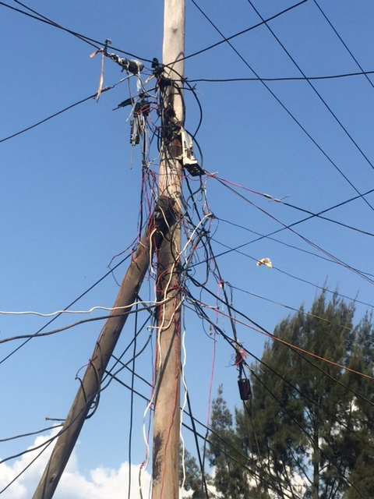
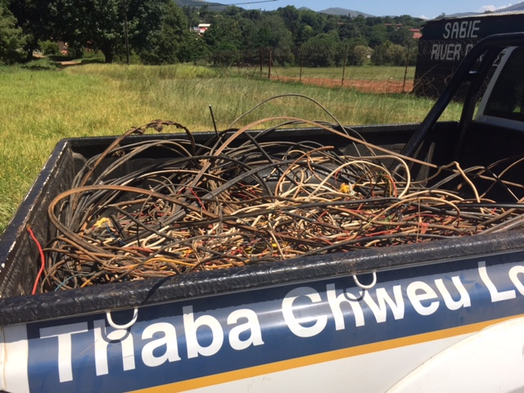
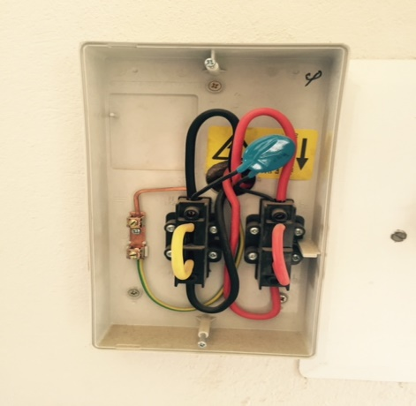
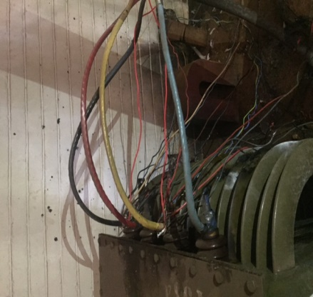
Eskom outstanding account: 2014 - 2018
Fin Year | 2013/2014 | 2014/2015 | 2015/2016 | 2016/2017 | 2017/2018
Amount Outstanding as at the end of each year | R207 879 369 | R282 129 769 | R357 833 144 | R 408 567 679 | R 464 368 136

Slide 19
Eskom Bulk Billing vs. Payments by Municipality: 2014 to 2018
FIN YEAR | PURCHASES | INTEREST ON OVER DUE | VAT | TOTAL BILL | PAYMENT TO ESKOM
2017/2018 | R126 206 348,73 | R18 367 771,94 | R17 869 091,47 | R162 443 212,14 | R113 531 875,49
2016/2017 | R147 073 140,33 | R8 672 100,37 | R20 356 264,26 | R176 101 504,96 | R121 917 995,28
2015/2016 | R136 249 863,77 | R42 243 824,31 | R19 074 980,96 | R197 568 669,04 | R109 679 676,35
2014/2015 | R116 160 854,40 | R34 400 643,43 | R16 356 916,30 | R166 918 414,13 | R98 927 194,57
TOTALS | R525 690 207,23 | R103 684 340,05 | R73 657 252,99 | R703 031 800,27 | R444 056 741,69

Slide 20
Electricity Purchase vs. Sales
MONTH | ESKOM BILLING | BILLING ON CONVENTIONAL METERS | PREPAID | TCM BILLING & PREPAID COMBINED | REVENUE (BILLING) | REVENUE (PREPAID) | COMBINED REVENUE COLLECTED | PAID TO ESKOM
17-Jul | R22 349 196,59 | 7 774 155,75 | 7 510 843,47 | 15 284 999,22 | -3 968 693,62 | -7 510 843,47 | -11 479 537,09 | R33 198 087,88
17-Aug | R22 119 635,13 | 7 380 950,19 | 7 584 785,55 | 14 965 735,74 | -5 892 160,52 | -7 584 785,55 | -13 476 946,07 | R342 088,54
17-Sep | R13 694 932,06 | 5 686 333,08 | 6 824 253,63 | 12 510 586,71 | -6 179 628,76 | -6 824 253,63 | -13 003 882,39 | R14 650 678,80
17-Oct | R12 657 745,64 | 6 764 318,73 | 5 902 655,54 | 12 666 974,27 | -5 891 213,32 | -5 902 655,54 | -11 793 868,86 | R14 600 193,05
17-Nov | R12 392 422,56 | 6 630 719,19 | 6 048 817,37 | 12 679 536,56 | -5 973 777,67 | -6 048 817,37 | -12 022 595,04 | R3 151 334,01
17-Dec | R11 721 919,26 | 6 616 244,66 | 6 432 351,32 | 13 048 595,98 | -5 625 424,33 | -6 432 351,32 | -12 057 775,65 | R14 960 603,98
18-Jan | R13 120 697,59 | 5 896 685,07 | 6 510 053,93 | 12 406 739,00 | -4 896 663,33 | -6 510 053,93 | -11 406 717,26 | R10 453 812,11
18-Feb | R12 184 558,00 | 6 799 333,79 | 6 172 282,00 | 12 971 615,79 | -4 977 894,44 | -6 172 282,00 | -11 150 176,44 | R2 077 980,98
18-Mar | R13 356 793,70 | 6 877 948,52 | 6 962 780,91 | 13 840 729,43 | -5 757 152,90 | -6 962 780,91 | -12 719 933,81 | R12 862 977,35
18-Apr | R13 368 182,62 | 7 762 803,69 | 6 843 671,85 | 14 606 475,54 | -6 701 881,92 | -6 843 671,85 | -13 545 553,77 | R -
18-May | R15 477 128,99 | 6 422 153,87 | 8 238 920,03 | 14 661 073,90 | -4 534 500,80 | -8 238 920,03 | -12 773 420,83 | R1 887 709,00
TOTAL | R162 443 212,14 | 74 611 646,54 | 75 031 415,59 | 149 643 062,13 | -60 398 991,61 | -75 031 415,59 | -135 430 407,20 | R108 185 465,70

Slide 21
CREDITOR’S INFORMATION

Slide 22
Creditors Age Analysis: 2013 - 2018
Thaba Chweu Local Municipality MP32 | 0-30 Days | 31-60 Days | 61-90 Days | 91-120 Days | 121-150 Days | 181 Days-1 Year |  | Total
 | Amount | Amount | Amount | Amount | Amount | Amount |  | Amount
Bulk Electricity (Eskom) | 13 314 974 | 16 586 075 | 6 404 560 | 8 235 053 | 13 563 780 | 8 016 518 | 398 247 175 | 464 368 136
Trade Creditors | 7 882 648 | 5 062 957 | 469 489 | 2 456 | 1 181 078 | 816 865 | 11 635 675 | 27 051 168
Auditor General | - | 670 578 | -2 055 967 | - | 144 406 | 2 786 394 | - | 1 545 410
Other (MP Prov Govern) | - | - | - | - | - | - | 10 160 365 | 10 160 365
Total | 21 197 623 | 22 319 610 | 4 818 082 | 8 237 509 | 14 889 264 | 11 619 777 | 420 043 215 | 503 125 079
Top 1 Creditor (MBB/Okhela) | - | - | - | - | - | - | 7 053 257 | 7 053 257
Top 2 Creditor(ESKOM HOLDINGS) | 2 304 687 | 2 140 143 | - | - | 1 181 078 | - | - | 5 625 908
Top 3 Creditor (SEBATA MUNICIPAL SOLUTIONS) | 2 464 727 | - | - | - | - | - | - | 2 464 727
Top 4 Creditor (MAYIVUTHE CONTRACTORS) | - | 1 175 732 | - | - | - | - | - | 1 175 732
Top5 Creditor (MINATLOU TRADING) | - | - | - | - | - | - | 771 917 | 771 917
Top 6 Creditor (NTSUMI TELECOMMUNICATION) | - | - | - | - | - | - | 725 921 | 725 921
Top 7 Creditor (RTMC ) | - | - | - | - | - | - | 708 120 | 708 120
Top 8 Creditor(MCC SECURITY & PROJECTS) | - | - | - | - | - | - | 652 023 | 652 023
Top 9 Creditor (AES CONSULTING) | - | - | - | - | - | 616 865 | - | 616 865
Top10 Creditor (VALUERS AFRIKA) | 159 277 | 385 119 | - | - | - | - | - | 544 396
 | R 4 928 691 | R 3 700 994 | R - | R - | R 1 181 078 | R 616 865 | R 9 911 239 | R 20 338 867
 | R 26 126 314 | R 26 020 605 | R 4 818 082 | R 8 237 509 | R 16 070 342 | R 12 236 641 | R 429 954 453 | R 523 463 947

Slide 23
Court Orders - Liability
Claimant | Description | Adherence to Direct payments | Total direct payments
Court Order for Ralebipi | Court settlement for termination of employment contract | Yes | R 300 000.00
Court Order for HJP Oonseln | Warrant of Execution against the municipality for failure to credit the consumer account properly | Yes | R 264 888.00
CW Bond for Legal fees as per the Court order | Motor bike accident claimed by the applicant against the municipality | Yes | R 700 000.00
Eskom for Legal fees | Court Interdict by the Business Chamber | Yes | R 1.2 million
Lekoko as settlement | Applicant claiming monies for professional services rendered | Yes | R 700 000.00
 |  |  | R 3 164 888.00

Slide 24
BUDGET

Slide 25
Budget: 2017/18
SUMMARY | BUDGET 2017-2018 | ADJUSTMENT BUDGET 2017-2018 | MONTHLY ACTUAL | ACTUAL 2017-2018 | VARIANCE
Total Revenue | R 655 811 262 | R 671 552 038 | R31 241 000 | R567 437 000 | R 104 115 038
Total Expenditure | (R 675 755 262) | (R 682 517 997) | R61 685 009 | R499 787 567 | (R182 730 430)
Surplus/(Deficit) | (R 19 944 000) | R 10 965 939 | (R 30 444 009) | R 67 649 433 | (R 78 615 392)

Slide 26
INTERVENTIONS

Slide 27
Technical challenges and Interventions
Problem statement/Challenge | Prior Intervention | Progress to date | Proposed intervention | Action Date | Resources/Budget needed | Sources
Illegal connections and tampering of meters | Embarked on a programme of installation of smart meters | A total of 4006 smart meters have been installed, however there was a serious community resistance. | Public participation | December 2018 | PPP | PPP
2. Inadequate meter reading | Meter reading is done in-house | Meters are read on monthly basis | Skilling of meter readers | July 2018 | R 150,000.00 | Own
3. Tariffs not cost reflective (peak and off peak and standard Tariffs) | Higher tariff increases submission made to NERSA, were rejected. Introduced winter and summer tariff to business and industrial customers from 2016/17 | 19% loss as per the distribution losses | Further requested a tariff increase of 6.84% overall and 12% only on consumption for business for 2018/19, still awaiting approval from NERSA. | July 2018 | R0

Slide 28
Technical challenges and Interventions
Problem statement/Challenge | Prior Intervention | Progress to date | Proposed intervention | Action Date | Resources/Budget needed | Sources
4. Inadequate maintenance on electrical infrastructure | Managed to budget for 5% for repairs and maintenance due to limited financial resources. | In a process of appointing contractors for infrastructure maintenance in 2018/19 | To source additional funds for maintenance | Ongoing | R 12 million | Own
5. Interest charges on Eskom balance at R5.7 million per month | Attempted to negotiate interest waiver with Eskom | Interest still charged on payment arrangement amount and current debt | Negotiate interest waiver with Eskom | Jul-Aug 2018 | Nil | -
6. Indigent registration | Registration of indigent consumers | 4580 indigent household have been registered | Daily registration at the Satellites and main building | Ongoing | Opex | -

Slide 29
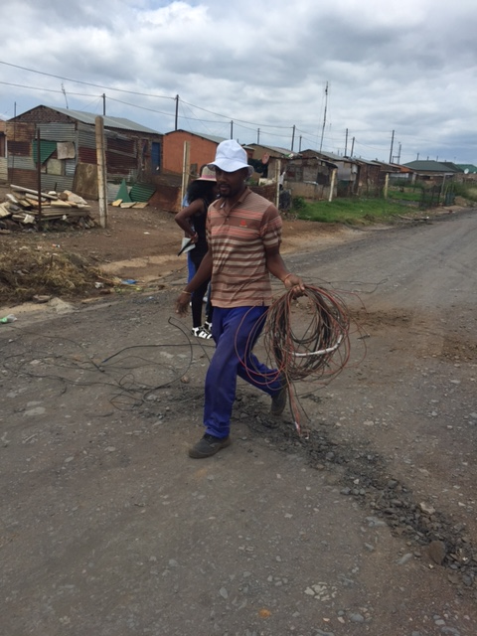
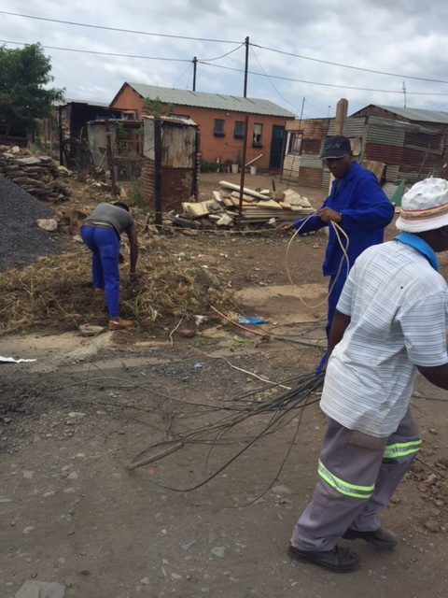
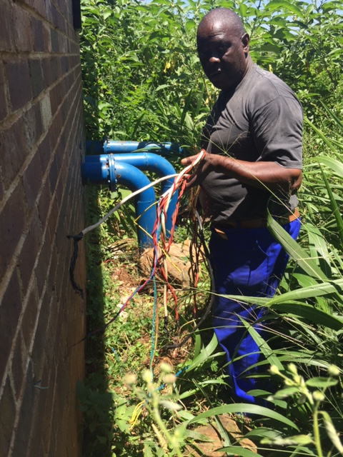
Technical Challenges and Interventions
HOUSEHOLDS ELECTRIFICATION PROJECTS FOR 2018-2019 FINANCIAL YEAR (INEP)
AREA | NO OF HOUSEHOLDS | POTENTIAL REVENUE | COSTS
Mashishing Ext 6 | 241 | R 216 900.00 | R 3 735 500.00
Feasibility Study on the upgrade of Sabie and Simile Substations | 01 | (connect around 850 HH) | R 1 199 500.00
TOTAL | 241 (New Connections) | R 216 900.00/ANNUM | R 4 935 000.00

Slide 30
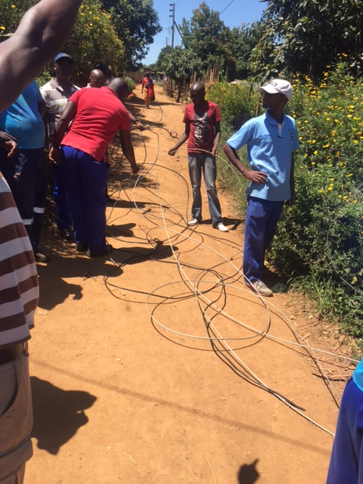
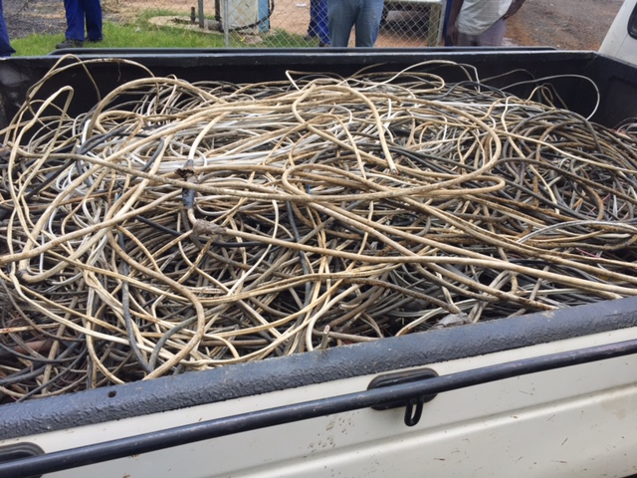
Technical Challenges and Interventions
INFORMAL SETTLEMETS ELECTRIFICATION PROJECTS FOR 2018-2019 FINANCIAL YEAR (INEP)
AREA | NO OF HOUSEHOLDS | POTENTIAL REVENUE | COSTS
Sabie Ext 10 | 100 | R 1 080 000.00 | R 1 400 000.00
Simile (Nkanini area) | 248 | R 2 678 400.00 | R 3 596 000.00
Mashishing Ext 6 | 406 | R 4 384 800.00 | R 5 000 000.00
Construction of Mashishing Substation 5MVA, 22/11KV | 01 | R 0.00 | R 2 100 000.00
TOTAL | 754 (New Connections) | R 8 143 200.00/ANNUM | R 12 096 000.00

Slide 31
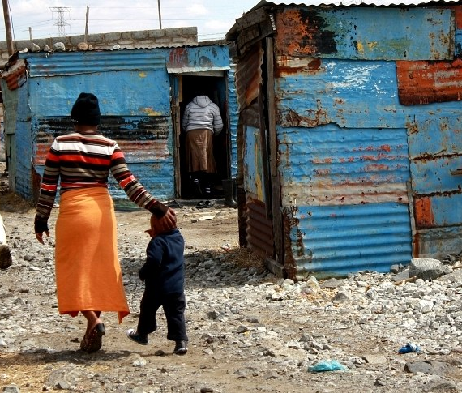
Technical Challenges and Interventions
EMERGING INFORMAL SETTLEMETS – ILLEGAL CONNECTIONS
AREA | NO OF HOUSEHOLDS | POTENTIAL REVENUE | COSTS
Simile (Nkanini area) | 500 | R 400 000.00 | R 7 750 000.00
Phola Park | 150 | R 120 000.00 | R 2 325 000.00
Nkandla | 238 | R 160 000.00 | R 3 689 000.00
Manjenje | 310 | R 80 000.00 | R 4 805 000.00
Riverside | 180 | R 64 000.00 | R 2 790 000.00
TOTAL | 1 720 | R1 376 000.00 | R 21 359 000.00

Slide 32
Technical Challenges and Interventions
Thaba Chweu Mega Human Settlement Development:
Council approved the sale of land parcels projected to generate revenue solely to service the Eskom debt. Although there are challenges, the project is underway;
The Housing Development Agency’s services have been secured to assist with capital raising and implementation (valuations, infrastructure condition assessments, sales and bond applications, design and construction etc.) of the mega project;
The project entails; disposal of 170 invaded houses and disposal of about 3000 serviced stands and housing packages.
Revenue Projections from the projects:
Target | No of units | Ave Unit Costs | Ave Revenue | Projected Profit
Sites | 3000 | R 120 000,00 | R 360 000 000,00 | R 333 800 000,00
Chinese Housing | 100 | R 260 000,00 | R 26 000 000,00 | R 22 830 000,00
Gap Housing | 980 | R 378 936,00 | R 253 757 280,00 | R 76 127 184,00
Middle income | 588 | R 583 908,00 | R 272 777 904,00 | R 81 833 371,20
Upper Middle income | 392 | R 988 182,78 | R 340 327 649,76 | R 102 098 294,93
Totals |  |  | R 1 252 862 833,76 | R 616 688 850,13
BNG | 70 | R 110 000,00 | R 7 700 000,00 | R 7 700 000,00

Slide 33
Technical Challenges and Interventions
Thaba Chweu Mega Human Settlement Development:
Opportunities:-
Skills Development and Skills transfer in various fields
Enterprise and supplier development
Job creation
Local preferential procurement/ sub-contracting
Socio-economic development
Women development and ownership – Real Estate
Challenges:-
Illegal occupation of houses and sites and consumption of services at no cost by mostly by the public servants( including the Municipal Officials).
Resistance from invaders occupying houses to buy or vacate the houses – resulting in stalling the sale process
Most erven not being registerable due to outstanding Town Planning processes and approvals (Proclamation)
Historical anomalies – multiple land use agreements locks the potential for development and poses a risk to the project
Infrastructure conditions assessment unveils the extent of the aging infrastructure in areas to be developed.
Interventions:-
The Development Partners are in the process of securing the services of the Social Facilitator to ensure a problem-free disposal process and thus assist the municipality to unlock financial resources
Town Planning processes are underway, there is a regular interaction with Surveyor General and the Deeds office
Plans are being developed to repair infrastructure works to ensure that buyers of the units will purchase units with proper services

Slide 34
Technical Challenges and Interventions
Proposition to Eskom in line with the Human Settlement Housing Development:
Eskom historical debt free!
Sale of 170 houses over 3 months (100 sales and 70 BNG), Sale of 897 stands and 588 housing packages – R350mil raised. Indicative timelines: 18 months from December 2017 – project underway
Proposition to Eskom for a partnership: R350million paid over phase 1 project term (ring-fenced) – suppression of interest
Monthly payments of the current account, smart metering and revenue generation initiatives
Eliminate wastage by: removing illegal connections, formalising illegal settlements, electrifying illegal settlements
Current account, Revenue Enhancement
Eskom Capital Debt less interest
HDA planning processes and sales

Slide 35
Technical Challenges and Interventions
SMART METER INSTALLED TO DATE
Total METERS INSTALLED
Type | Total
Single Phase | 3862
DCU | 134
Three Phase | 245
Large Power User | 0
Total | 4241

Slide 36
KEY RECOMMENDATIONS

Slide 37
QUICK WINS
Thorough consultation with all stakeholders on the Duma PPP project.
High level political and administrative support to iron out the Eskom impasse and HDA related challenges.
Urgent employment of suitably qualified Senior managers.
Joint tackling of electricity theft.
Accelerate removal of illegal connections and adherence to deadlines.
Development of monitoring and evaluation strategy for reconnections.
Full support for project Revenue Enhancement Team.
Allocation of full time/ dedicated electricians under project revenue enhancement.
Accelerate formalisation of informal settlements.
Security support services during removal of illegal connection operations;

Slide 38
QUICK WINS
Development of monitoring and evaluation strategy for reconnections;
Full support for project Revenue Enhancement Team;
Allocation of full time/ dedicated electricians under project revenue enhancement;
Accelerate installation of smart meters for all municipal supply areas;
Security support services during removal of illegal connection operations;
Accelerate the appointment of the Social Facilitator for the Human Settlement project;
Continuously engage Eskom on the capital debt ring-fencing and linkage of the same to the Human Settlement project.
Secure political and administrative willpower to turn the Municipality around

Slide 39
Thank You

