Slide 1
LOAs and ICT Modernisation Project Mr Edward Mamadise Chief Executive Officer Portfolio Committee on Trade and Industry 13 JUNE 2018

Slide 2
NRCS representation
Mr. Edward Mamadise (Chief Executive Officer)
Bongani Khanyile (General Manager Electro-technical)
Meisie Katz (General Manager – Foods)
Edward Matemba (Manager Strategy and Risk)
Alfred Sekhula (Acting CIO)

Slide 3
Scope of Presentation
Background
LOAs
Status Report Electro-technical
Challenges
Proposed Solutions
ICT Modernisation Project

Slide 4
NRCS Strategy, Mission and Vision
NRCS Strategic Goals
Mission & Vision
To ensure an optimally capacitated institution
To develop, maintain and administer compulsory specifications and technical regulations
To maximise compliance with all specifications and technical regulations
To inform and educate our stakeholders about the NRCS
Mission
Vision
A credible and respected regulator for the protection of the public, the economy and the environment
To develop compulsory specifications and technical regulations, and maximise compliance of regulated products and services

Slide 5
Legislative Mandate
Mandate of the NRCS is derived from the following Acts.
National Regulator for Compulsory Specifications Act
(Act No. 5 of 2008)
Legal Metrology Act
(Act No. 9 of 2014)
National Building Regulations and Building Standards Act
(Act No. 103 of 1977)
The Foodstuffs, Cosmetics and Disinfectants Act
(Act 54 of 1972)

Slide 6
Industries regulated by NRCS that require pre-market Approval
Industry Sector | Product regulated / Service rendered
Automotive | Vehicles, Replacements components
Chemicals, Materials and Mechanicals | Cement, chemicals, detergents, Personal protective equipment, safety shoes, building materials, treated timber, plastic bags, solar water heaters, plumbing equipment
Electro-technical | Electrical appliances and products, electronic appliances and products
Legal Metrology | measuring instruments used for a prescribed purpose and gaming equipment

Slide 7
Premarket Approvals - LOAs

Slide 8
RISK BASED APPROACH INTERVENTIONS
RBA Policy implementation
RBA policy developed and approved by NRCS CEO end March 2018
Held policy workshops with staff during April 2018
NRCS wide implementation plan being drafted
Approvals targets
Targets per inspector now being set according to the risk mix of applications allocated to that particular inspector. This has the impact of, for example, doubling the target in the case where all allocated applications are low risk e.g. from 6 to 12.
International Electrical Commission System of Conformity Assessment Schemes for Electro-technical Equipment and Components (IECEE Certification Body Scheme)
Now separating CB Scheme applications to process them via an expedited process (Identified ~ 600 of such applications in the system in May 2018)

Slide 9
OTHER INTERVENTIONS
Capacity increase
Temporary capacity increase from market surveillance inspectors, who have started working on CB Scheme applications in May 2018, with plans to follow up with low risk applications
Adding two administrators to Electrotech approvals, from other business units within the organisation, to deal with administrative duties such as allocating applications, capturing, etc.
Have currently decentralised capturing of finished applications by using administrative staff in PE and Durban to deal with capacity constraints
Plan to deploy an additional manager in approvals, from internal resources, to reorganise the work along areas of specialisation
Candidate inspectors
Since the last presentation, they have further been trained on an additional compulsory specification, VC9006 (geysers, covering the safety and energy efficiency)

Slide 10
IMPACT OF INTERVENTIONS
Approvals statistics 2017/18 Period
Although the throughput was less than the previous financial period, the turnaround time improved to 75% approved within 120 days compared to 37% in the previous financial period
Approval Type | Applications carried over from 2016/17 | Applications received in 2017/18 | Total work load in 2017/18 | Applications approved in 2017/18 | Applications closed in 2017/18 | Applications carried over to 2018/19
LOA | 2907 | 13127 | 16034 | 9253 | 1545 | 5236
RCC/AC | 53 | 159 | 212 | 117 | 53 | 42
TOTAL | 2960 | 13286 | 16246 | 9370 | 1598 | 5278

Slide 11
IMPACT OF INTERVENTIONS
Approvals statistics
A stock take of applications in the system was undertaken on 5 June 2018 and there were no applications above 120 days)

Slide 12
ICT

Slide 13
Project Overview
The Modernization Project is a suite of interdependent strategies that the NRCS plans to deploy to deal with organisational challenges
Purpose
Revenue qualification.
Automation of NRCS operational processes which include collaboration with other key Stakeholders i.e. SARS and Customs
Automation of the NRCS approval system - LOA issuance
Implementation of Internal support systems - ERP

Slide 14
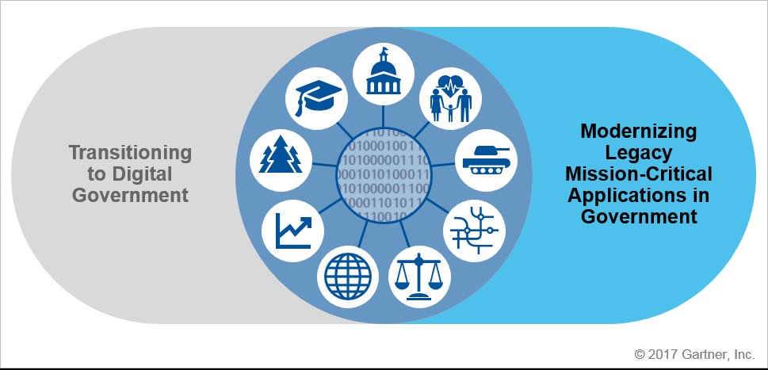
Modernisation in Nutshell.
Modernization program covers the upgrade, integration or replacement of legacy applications, digitising way of doing things, driven by factors such as rising costs and a need for organizational agility.

Slide 15
Current ICT Systems
JDE Edwards – ERP systems with only financial and SCM module working. This system is currently out off support from oracle (the owners of the systems)- it need to be changed to new systems.
Siebel CRM – the systems was procured to automate the approval and inspection processes, to this stage only Electro technical clients use the systems for LOA application but internally the application is processed outside the systems because the CRM is not user friendly and not all required capabilities are configured on CRM.

Slide 16
Project Plan
Task Description | Status | Dependence | Start date
BSC- drafting of specification for a resource Service Provider to assist NRCS | 100% complete | Approved Business case
BAC- Presentation, bid document approved | 100% complete | 1 | 23/02/2018
Advertising Bid for a resource company | on track 100% | 2 | 9/3/2018 - 3/4/2018
Evaluation of Bid | 100% | 3 | 5/04/2018 - 6/04/2018
Tender award & Kickoff meeting | 65% | 8 | 2/7/2018
Business process analysis and signoff | 0% | 9 | 9/7/2018 - 31/7/2018
BSC modernisation systems Terms of Reference | 0% | 10 | 6/8/2018 - 24/08/2018
BAC- Presenting Modernisation Terms of reference to BAC for approval | 0% | 11 | 30/8/2018 - 31/8/2018
Advertising the bid | 0% | 12 | 7/9/2018 - 1/10/2018
Evaluating Bids | 0% | 13 | 2/10/2018 - 5/10/2018
Letter of appointment | 0% | 15 | 26/10/2018
Implementation of modernisation project |  | 19 | 7/2/2019 - 6/2/2020
 | 0%
Project closure | 0% | 20 | 7/2/2020

Slide 17
Reasons for delays
Inadequate IT resources – NRCS IT department does not have the adequate skills to take on this project
The timeline have been extended due to the need to appoint a service provider, to assist NRCS with business process mapping and needs analysis
Appointment of CIO - To expedite the appointment of CIO, failed to obtain a suitable candidate through the normal recruitment process. The NRCS is embarking on a new process, utilizing a recruitment agency and the appointment will be done before end of September 2018.

Slide 18
Thank You

