Slide 1

LIMPOPO DEPARTMENT OF HEALTH
STATUS OF HOSPITALS
BRIEFING TO PARLIAMENTARY PORTFOLIO COMMITTEE ON HEALTH
PARLIAMENT, CAPE TOWN
13 JUNE 2018

Slide 2
Presentation Outline
Introduction
Background
DHS and strengthening PHC
Governance and leadership
Access
Quality of care
Referral systems
Medical equipment
Pharmaceutical management
TB management
Health Care waste management
Infrastructure management
Human Resources services
Finance services
Laundry services
Information Technology
Risk Management
Security Management
Conclusion

Slide 3
INTRODUCTION(1)
The Province of Limpopo is situated in the north of the Republic of South Africa.
It shares borders with the provinces of Gauteng, Mpumalanga and North West.
It also shares borders with the Republics of Mozambique in the east, Zimbabwe in the north and Botswana in the west.
Limpopo Province is the fifth most populated province in the country with a population of 5.87 million people in 2017 (Stats SA, 2017).

Slide 4
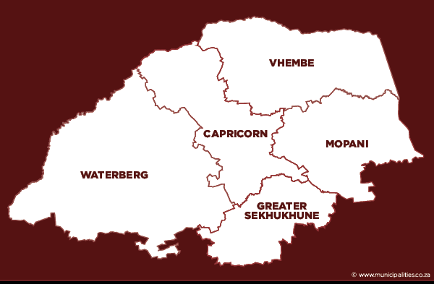
INTRODUCTION (2)
Limpopo province is the fifth most populous province in South Africa
Consists of five districts:
  Capricorn
  Mopani
  Sekhukhune
  Vhembe
  Waterberg
Consist of 462 clinics, 28 CHCs, 30 district hospitals, 5 regional hospitals, 2 tertiary hospitals, 4 specialised hospitals
Notes:
What is the actual population of LP from the latest Stats SA report disaggregated by district. Did we count the 3 mental health hospitals (Hayani, Thabamoopo and Evuxakeni)?

Slide 5
INTRODUCTION (3)
Our Mandate is derived from Outcome 2 of a Long and Healthy Life for All.
The Department has adopted National Development Plan (NDP) framework in order to improve Health care delivery system.
The delivery system mainly focus on prevention of illnesses , promotion of healthily lifestyle , rehabilitation and cure of diseases
Notes:
Where are the most problematic areas (Vhembe and Mopani)? What happened this year, did we have an outbreak? And what has that done to efforts towards elimination?

Slide 6
GOVERNANCE AND LEADERSHIP
Name of Entity | Legislative Mandate | Status
Hospital boards | National Health Act,61 of 2003,section 41 | 37 hospital boards appointed, no hospital boards appointed for the specialised hospitals
Mental Health Review boards | Mental Health Care Act, Act 17 of 2002 | 5 appointed and 3 functional. Mopani MHRB non functional and dissolved. Cases managed by Vhembe MHRB Sekhukhune MHRB non functional due to resignations. Cases being managed by Capricorn MHRB.
District Health Councils | National Health Act,61 of 2003,section 31 | 2 functional (Vhembe, Mopani) 3 non-functional (Waterberg, Capricorn, Sekhukhune)
Districts AIDS councils |  | 4 functional Waterberg district not functional

Slide 7
DISTRICT HEALTH SYSTEM

Slide 8
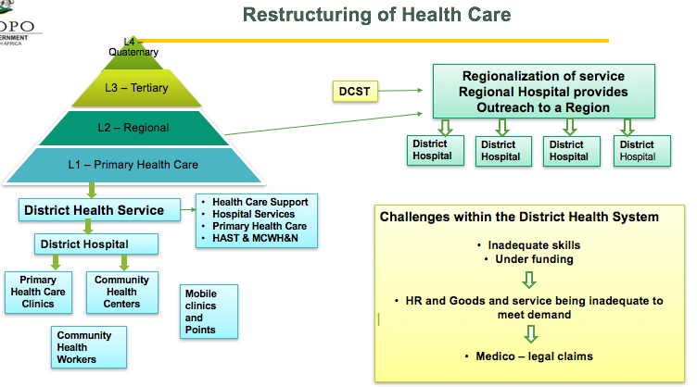

Slide 9
REFERRAL SYSTEM
25 PHC
Tshilidzini
Donald Fraser
31 PHC
Siloam
17 PHC
LTT
6 PHC
Mesina
3 PHC
Elim
28 PHC
Malamulele
19 PHC
2 PHC to Pietersburg
WF Knobel
12 PHC
Capricorn district hospitals
Lebowakgomo
14 PHC
Seshego
12 PHC
Helena Franz
21 PHC
Botlokwa
8 PHC
SGM
SBAH
Zebediela
7 PHC
15 PHC
Kgapane
21 PHC
Van Velden
7 PHC
Pietersburg/ Mankweng!#
Letaba
Dr CN Phatudi
12 PHC
Maphuta Malatji
10 PHC
Nkhensani
29 PHC
Sekororo
11 PHC
Voortreker
11 PHC
George Masebe
15 PHC
25 PHC to Mankweng
Mokopane
Witpoort
3 PHC
Ellisras
4 PHC
Warmbaths
6 PHC
FH Odendaal
4 PHC
! Direct referral from district hospitals also allowed where capacity not available at regional level
# provincial referral for Neonatal ICU
** Sekhukhune referral for orthopaedics and O&G
* Sekhukhune referral for Ophthalmology
Thabazimbi
10 PHC
St Ritas**
9 PHC
Jane Furse
22 PHC
Mecklenburg
9 PHC
Dilokong
18 PHC
Philadelphia*
4 PHC
Groblersdal
8 PHC
Matlala
7 PHC
SBAH= Steve Biko Academic Hospital DGM= Dr George Mukhari

Slide 10
MORTALITY PATTERNS

Slide 11
LEADING CAUSES OF DEATH (1)
The classification of causes of death followed the Global burden of disease study as recommended by WHO
Four main classification of diseases
  Type 1 Communicable diseases, maternal causes perinatal conditions and nutritional diseases
  Type 1a HIV/AIDS and TB
  Type 2 Non-communicable diseases
  Type 3 Intentional and Unintentional injuries

Slide 12
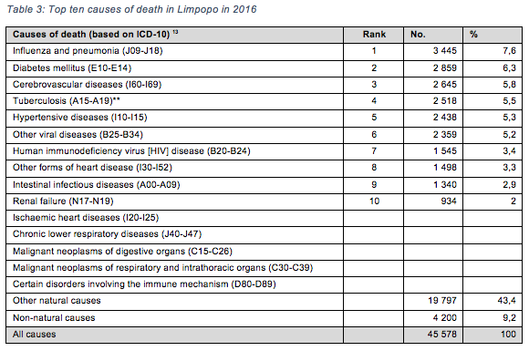
TOP TEN CAUSES OF DEATH (VITAL REGISTRATION) STATS SA

Slide 13
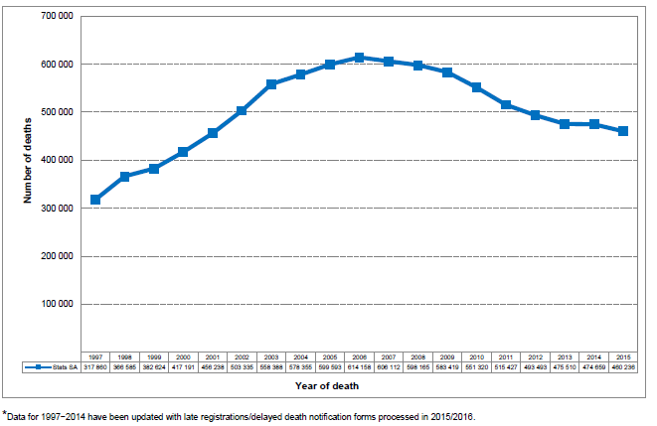
NUMBER OF REGISTERED DEATHS BY YEAR OF DEATH 1997 - 2015

Slide 14
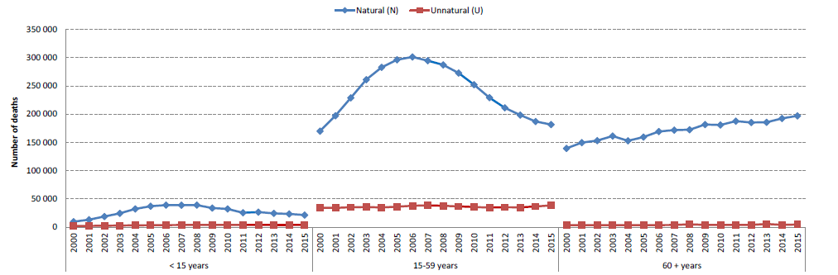
NATURAL AND UNNATURAL DEATHS

Slide 15
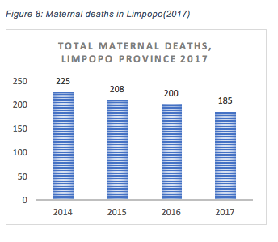
MATERNAL DEATHS

Slide 16
MALARIA
HIV/AIDS
TB

Slide 17
MALARIA
Malaria is endemic in the province
Strategies for elimination in place
Notes:
Where are the most problematic areas (Vhembe and Mopani)? What happened this year, did we have an outbreak? And what has that done to efforts towards elimination?

Slide 18
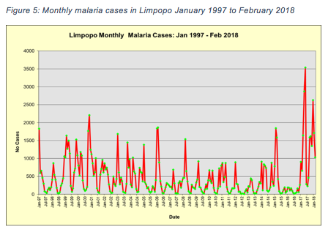
MALARIA CASES

Slide 19
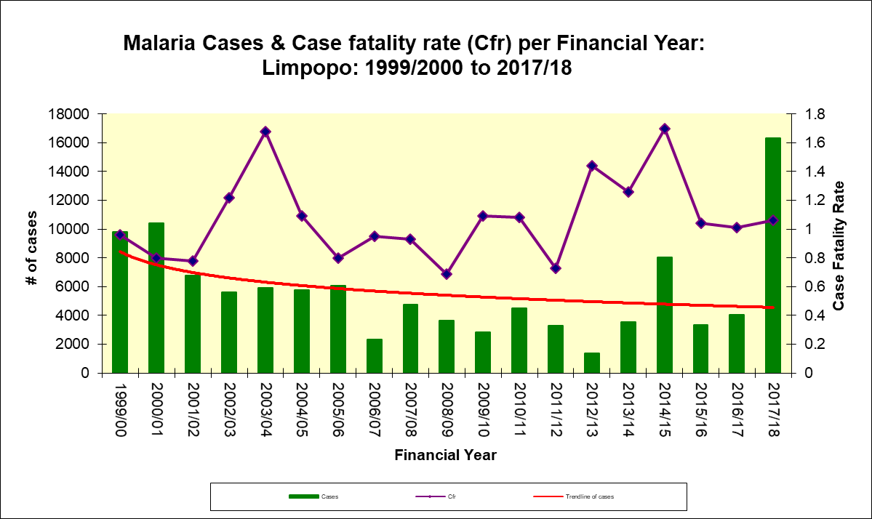
MALARIA CFR

Slide 20
Challenges in Malaria management
Shortage of resources including human resources
Aging workforce and vehicles
High cost of chemicals which led to insufficient DDT
High case fatality rate
Cross border cases that come into the country for treatment report local address and no travel, so end up being reported as local cases, though they are actually imported

Slide 21
CHALLENGES WITH MALARIA
Challenge | Impact
Budget Constraints | High vacancy rate, unable to fill posts
 | Unreliable vehicles due to high mileage and poor condition
 | Shortages of commodities (DDT, Malaria rapid diagnostic kits, Coartem)
 | Inadequate entomological surveillance
 | Rationed Indoor Residual Spraying with poor coverage
Data Management | Delayed reporting unable to provide real-time data
 | Two surveillance systems not talking to one another: Malaria Connect and Malaria Information System
 | Reporting by the private sector still a challenge
 | Availability of data to other programmes, e.g. CDC to activate outbreak response activities is a challenge

Slide 22
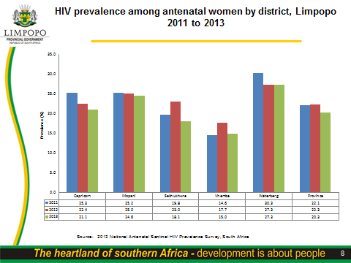
Notes:
Are there explanations for the trends?

Slide 23
HIV & AIDS
Programme / Sub-programme:
Performance Indicator | Actual Achievement 2014/15 | Actual Achievement 2015/16 | Actual Achievement 2016/17 | Planned Target 2017/18 | Actual Achievemen t 2017/18 | Deviation from planned target to Actual Achievement 2017/18
ART client remaining on ART end of month - total | No baseline | No baseline | 2090929 | 336 452 | 329 044 | (7 408)
TB/HIV co-infected client on ART rate | No baseline | No baseline | 55.7% (5467/9816) | 93% (10161/10925) | 94.4% (8 256/8 772) | 1.4%
HIV test done – total | 1535403 | 1516487 | 2035347 | 1024546 | 1 721 676 | 697 130
Male condom distributed | No baseline | No baseline | 68.4% (123436695) | 87 085 290 | 90 930 032 | 3 8 44 742

Slide 24
TUBERCULOSIS
TB remains the leading cause of morbidity and mortality globally with 2 billion new TB infections and 2 million TB deaths reported annually
TB is the seventh leading cause of death worldwide and second to HIV/AIDS
Tuberculosis (TB) is the leading cause of death among people living with HIV (PLWH)
Globally, an estimated 13% of TB cases are co-infected with HIV and
at least one-third of the nearly 33 million PLWH are infected with the bacterium that causes TB
The dual epidemic is particularly pervasive in Africa, where 80% of the total global burden of dual HIV/TB cases is found
Tuberculosis is, an important health problem
TB is the leading causes of death and disability among the economically active segment of the world’s population
Notes:
Did we request data from the TB Program? Perhaps a local perspective would be more relevant for planning.

Slide 25
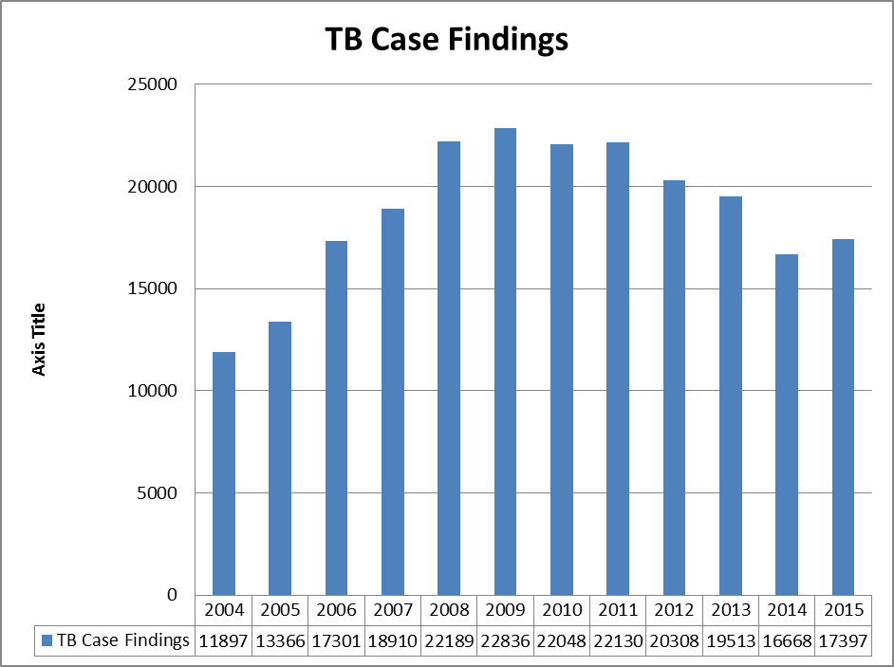
TB Case finding
Notes:
What do these numbers mean? Can we calculate rates if we know population size? What does the graph tell us? Are we doing well or bad?

Slide 27
TB OUTCOMES(1)
Performance Indicator | Actual Achievement 2016/17 | Planned Target 2017/18 | Actual Achievement 2017/18 | Comment on deviations
TB client lost to follow up rate | 5.2% (256/4920) | 4.3% (240/5582) | 4.2% (644/15 262) | Active attachment of TB patients to Direct Observe Treatment and tracking of interrupters within 48 hrs has led to the improvement.
TB death rate | 7% (345/4920) | 8.2% (458/5582) | 11.6% (1 764/12 346) | Late presentation resulting in starting treatment when disease is advanced.
TB MDR treatment success rate | 59.1% (264/447) | 60% (257/427) | 58.5% (245/419) | Non-adherence to treatment due to side-effect and Long MDR TB treatment duration
TB symptom 5yrs and older start on treatment rate | No baseline | 80% | 92.2% (4 734/5 134) | Improved case finding and active linkage of TB tested positive patients to care
TB client treatment success rate | 83.2% (4092/4920) | 83% (4634/5582) | 80.9% (12 346/15 262) | Non-adherence to TB treatment due to side effects and stigma as well as immigration and migration.

Slide 28
TB OUTCOMES
The TB/HIV co-infected client initiated on ART rate has improved from 55.7% during 15/16 FY to 94.4% during 17/18 FY and this improvement is due to the implementation of the Universal Test and Treat policy (UTT) and improved TB/HIV integration.
The TB programme managed to initiate 92.2% of TB diagnosed patients on treatment versus a target of 80%; this achievement is more than the 90 90 90 targets for TB and HIV.
The achievement of TB treatment initiation rate is due to active linkage of TB diagnosed patients to care through the WBOTS.
The TB patient’s loss to follow up rate has reduced from 5.2% during 16/17 FY to 4.2% during 17/18 FY; the achievement is due to attachments of patients to Direct Observed Treatment and tracking of interrupters within 48 hours.

Slide 29
CHALLENGES
Budget deficit over the past 4 years (2014/15 to 2017/18) with budget expenditure exceeding allocated budget → negative impact on the implementation of key priorities for health in the province :
  Limited 24 hour PHC services
  Lack of specialist services in regional, specialized and tertiary institutions
  Curtailment of purchasing of key medical equipment and their maintenance
  Curbing maintenance, renovations and upgrading of facilities
Policy pronouncement some of which are unfunded
Inappropriate staffing with more personnel in management and support functions but also poor skills mix, thus resulting in limited critical clinical and non-clinical personnel at health institutions.
Leadership and management challenges( incl. impact of organized labour) at some facilities due to non-filling of CEO, clinical manager, nursing manager and PHC facility manager positions that at times have compromised accountability and lack of continuity.
These shortcomings pose a major risk to the business of the department i.e. the treatment and management of patients.
Increasing burden of medico legal claims (See Next Slide)

Slide 30
MEDICO LEGAL CLAIMS AND ACTIVE MANAGEMENT OF LITIGATIONS
NUMBER OF MEDICO LEGAL CLAIMS UNRESOLVED | FINANCIAL IMPLICATIONS
796 | R 4 346 796 768.51

Slide 31
TOTAL NUMBER OF CLAIMS UNRESOLVED
FINANCIAL YEAR | NUMBER OF CASES
2014/15 | 203
2015/16 | 122
2016/17 | 222
2017/18 | 249
TOTAL | 796

Slide 32
TOTAL NUMBER OF CLAIMS UNRESOLVED
NATURE OF CLAIM | TOTAL NUMBER
Cerebral Palsy | 250
Orthopaedics, Surgical &Others | 347
Obstetric and Gynaecology | 199
TOTAL | 796

Slide 33
TOTAL NUMBER OF CLAIMS RESOLVED
FINALISED CASES | NUMBER OF CASES
Cases averted through ADR | 30 cases
Through mediation or settlements | 6 cases
Through court orders | 27 cases
TOTAL | 33 cases

Slide 34
TOTAL NUMBER OF CLAIMS RECEIVED
FINANCIAL YEAR | NUMBER OF CASES | AMOUNT
2015/16 | 11 | R 6 883 452.99
2016/17 | 14 | R 74 174 281.15
2017/18 | 08 | R 23 728 150
TOTAL | 33 | R 104 785 884.14

Slide 35
Access and quality of care

Slide 36
Levels of Care
Hospitals (24-hour operation)
  LEVEL 1: District Hospitals
    Family physicians and medical officers based in district hospitals provide services to the catchment population - core specialists provide outreach from regional hospitals
  LEVEL 2: Regional Hospitals (5 Regional Hospitals
    8 Core specialist services (Limpopo does not yet include Radiology)
  LEVEL 3: Tertiary Hospitals (T1 tertiary services)
    Core specialist services and specialist services
    All medical and surgical disciplines, multidisciplinary trauma, ICU, PICU, NICU, Burns
  LEVEL 3: Central Hospital (T2 tertiary services)
    Cardiology/Cardiothoracic (Medical, Paediatric, Surgical)
    Comprehensive Oncology (Medical, Paediatric, Surgical, Gynae, Radiation)
    Nephrology and Urology (Medical, Paediatric, Renal Dialysis, Transplant)
  LEVEL 4: National Referral Services (T3 quaternary care)
    No services in Limpopo planned – referred elsewhere
  SPECIALISED: Psychiatric and MDR TB hospitals
    Long term admission of psychiatric patients
    Forensic observation

Slide 37
District hospitals

Slide 38
Current situation
Limpopo Department of Health (LDOH) has 41 hospitals as follows:
District | Type of hospital |  |  |  |  | Total
 | District | Regional | Specialised | Tertiary | Central
Capricorn |  | 0 | 1* | 2 | 0
Mopani | 6 | 1 | 1* | 0 | 0
Sekhukhune | 5 | 2 | 0 | 0 | 0
Vhembe | 6 | 1 | 1* | 0 | 0
Waterberg | 7 | 1 | (1**) | 0 | 0
Province | 30 | 5 | 4 | 2 | 0 | 41
* Psychiatric hospitals
** Modimolle MDR TB hospital gazetted in April 2018 and in the process of commissioning. Previously operated as a unit of Warmbath district hospital

Slide 39
SUMMARY BED STATUS
District |  | Type of hospital
 |  | District | Regional | Specialised | Tertiary
Capricorn | Approved | 1020 | 0 | 400 | 1319
 | Usable | 776 | 0 | 365 | 1013
Mopani | Approved | 1216 | 400 | 400
 | Usable | 874 | 215 | 354
Sekhukhune | Approved | 998 | 938 | 0
 | Usable | 679 | 616 | 0
Vhembe | Approved | 1640 | 530 | 290
 | Usable | 1156 | 400 | 233
Waterberg | Approved | 1014 | 376 | 0
 | Usable | 699 | 266 | 0
Province | Approved | 5888 | 2244 | 1090
 | Usable | 4184 (71%) | 1497 (67%) | 952 (87%)

Slide 40
CLINICAL SERVICES IN DISTRICT HOSPITALS
Clinical assessment and management of patients in
  Casualty
  General Outpatient department
  Obstetric Antenatal Ward
  Obstetric Labour ward
  Obstetric Postnatal ward
  Neonatal Ward
  Paediatric Ward
  Medical Wards
  Surgical Wards
  Intensive care unit (large hospitals)
  High care units / beds
  HIV outpatient service
  High risk antenatal clinic
  Paediatric and other special clinics
Medical procedures
Daily theatre cases for elective conditions, including tubal ligations, D&C’s, orthopaedic cases, Caesarean section
Emergency theatre cases, especially emergency caesarean sections
Procedures done in casualty including abscess drainage, application of plaster of paris
Assistance with Termination of pregnancy cases

Slide 41
Work load Index: Small District Hospitals
 | Inpatient beds - total | Average Monthly Emergency headcount | Average monthly OPD headcount | Average Patient Day Equivalent | Average CS per Month | Average deliveries per month
Groblersdal | 52 | 471 | 3308 | 2462 | 27 | 128
Louis trichardt | 55 | 370 | 3875 | 2793 | 31 | 115
Thabazimbi | 55 | 98 | 2164 | 1853 | 24 | 94
Botlokwa | 56 | 288 | 4319 | 2985 | 30 | 111
Witpoort | 59 | 110 | 2890 | 2193 | 17 | 92
van Velden | 74 | 967 | 3330 | 3044 | 40 | 121
Zebediela | 74 | 734 | 2330 | 3040 | 26 | 142
Messina | 80 | 216 | 3879 | 2648 | 23 | 110
Voortrekker | 91 | 765 | 2678 | 3361 | 37 | 142
Notes:
Small hospitals have an index of workload of 210 – 374 per day, and 35 – 68 per after hours shift

Slide 42
Work load index: Medium sized district hospitals;
 | Inpatient beds - total | Average Mnth Emergency headcount | Average mnthly OPD headcount - | Average Patient Day Equivalent | Average CS per Month | Average deliveries per month
Maphuta Malatji | 104 | 519 | 5458 | 4803 | 52 | 209
WF Knobel | 110 | 543 | 3070 | 3230 | 35 | 140
Elisras | 120 | 349 | 3293 | 3188 | 34 | 111
Matlala | 120 | 145 | 4188 | 3807 | 48 | 146
Mecklenberg | 121 | 392 | 3084 | 2930 | 35 | 219
FH Odendaal | 122 | 430 | 3833 | 3247 | 27 | 118
Dr CN Phatudi | 130 | 1082 | 5962 | 4853 | 29 | 149
Sekororo | 132 | 381 | 3209 | 3476 | 38 | 165
Warmbaths | 133 | 449 | 3570 | 4002 | 36 | 129
Helena Frans | 136 | 915 | 4051 | 4273 | 41 | 213
George Masebe | 143 | 181 | 3153 | 3797 | 36 | 130
Seshego | 175 | 1578 | 4623 | 5628 | 39 | 255
Kgapane | 178 | 350 | 5071 | 5588 | 60 | 296
Dilokong | 186 | 997 | 5063 | 5052 | 62 | 347

Slide 43
Large district hospitals - workload
 | Inpatient beds - total | Average Monthly Emergency headcount | Average mnth OPD headcount - | Average Patient Day Equivalent | Average CS per Month | Average deleries per month
Malamulela | 195 | 1000 | 3539 | 5284 | 52 | 332
Jane Furse | 200 | 1053 | 6588 | 6859 | 94 | 414
Lebowakgomo | 220 | 1456 | 7471 | 8435 | 93 | 280
Siloam | 220 | 421 | 5006 | 7385 | 56 | 248
Nkhensani | 223 | 964 | 4696 | 7920 | 64 | 376
DFH | 286 | 542 | 6529 | 8368 | 80 | 390
Elim | 320 | 250 | 9832 | 9837 | 70 | 277

Slide 44
Regional hospital

Slide 45
Regional hospitals
General “specialist” services to the district
  500 000 – 1,5 million people
  Referral services for 6 – 7 district hospitals and 50 – 150 PHC clinics
  Clinical services to patients in the sub-district (~ 200 000)
24-hour service in each key discipline
  Clinical
  Referral
Provided by a “specialist” lead team in each discipline
Team provides support services to the district

Slide 46
Key regional specialist services
(Defined by National Tertiary Service Policy)
Paediatrics and neonatal care
Obstetrics and Gynaecology
Anaesthesia
Surgery and orthopaedics
Internal medicine
Psychiatry
Radiology
Family medicine
  Emergency referral services
  Specialist Inpatient clinical services
  Specialist outpatient clinical services
  Intensive care services for all patients – neonates, children, mothers, adults
  Surgery and Anaesthesia

Slide 47
Infrastructure and staff norms
Neonatal
Neonatal unit
  3,5 beds / 1000 deliveries in the hospital
  1,5 beds / 1000 deliveries in the entire district
Paediatric ward and ICU
  20% beds required for the hospital
Paediatric
  20% of beds in the facility
Intensive care beds
  3 – 8 beds
Paediatricians
  1 per 40 000 population

Slide 48
Infrastructure and support services
Norms for facilities required in Paediatric
Neonatal unit
  3,5beds / 1000 deliveries in the hospital
  1,5 beds / 1000 deliveries in the entire district
Paediatric ward and ICU
  20% beds required for the hospital
Training, outreach and support
  Intern training and supervision
  COSMO training
  MO / Reg supervision
  Monitoring of services and outcomes
  Clinical support visits to district hospital

Slide 49
Obstetrics and Gynaecology
Emergency O&G
Standard O&G
Ultrasound, prenatal diagnosis
Basic urogynaecology
Mid trimester abortions
Basic oncology
menopause and screening programmes
Preliminary infertility investigations
Labour ward, antenatal and postnatal and gynae wards
High care and ICU
Maternity theatre
Gynae theatre
High risk clinic
Gynae clinics\
Support to district hospitals
Clinical training and support
Clinical governance

Slide 50
Surgical and Orthopaedic service
General surgery
General orthopaedics
Accident and emergency
Regional burns service
24 hour level II trauma service
Visiting Sub-specialty services
  Opthalmology
  ENT
Male and female wards, paediatric ward
Daily theatre services
Accident and emergency
ICU and High care
Ambulatory clinics
  General surgery and subspecialty services
Clinical training and support to district hospitals
Clinical governance

Slide 51
Anaethesia and ICU
Anaesthetic services
  Maternity theatre
  Main theatre
  A+E
  Radiology
  Pre-anaesthetic services
Intensive care units
  Main Adult and Paediatric ICU
    24 hour cover
  Support to Neonatal ICU

Slide 52
Internal medicine
MTS
General Internal Medicine
Echocardiography, Stress ECG
Regional ICU Service
Diabetes / Endocrine clinic
GIT incl. endoscopy, proctoscopy, sigmoidoscopy, colonosocopy (with Gen Surg)
Regional Dialysis Service & Organ Donation
Geriatric Care
Genetic Nurse & Counselling
Oncology palliation and basic care
Neurology basic care
Spirometry & oximetry
Basic Rheumatology
Basic infectious diseases
Inpatient services
Intensive care
Ambulatory services
  Cardiac
  Pulmonology
  Geriatric
  Diabetes
  Neurology
  Oncology
  Rheumatology
  Infectious diseases and HIV
Clinical teaching and support
Clinical governance

Slide 53
Family Medicine
Clinical ambulatory services
  General medical and surgical, mother and child
    Gateway
    Community health centres
    PHC clinics
    Community
    District hospitals
Training and support
  Interns , MO’s, registrars
  PHC workers
Clinical governance
  Primary health care service

Slide 54
Doctors required at regional hospital
Minimum and ideal number of doctors for district hospitals | Interns |  | MO’s or registrars |  | Specialists
 | Min | Ideal | Min | Ideal | Min | Ideal
Obstetrics and Gynaecology | 3 | 6 | 6 | 8 | 3 | 5
Paediatrics and Neonatal care | 3 | 6 | 6 | 8 | 3 | 5
Anaesthesia | 1 – 2 | 3 | 4 | 8 | 3 | 5
Internal Medicine | 3 | 6 | 4 | 8 | 3 | 5
Surgery | 3 | 6 | 4 | 8 | 2 | 4
Orthopaedics | 1 - 2 | 3 | 4 | 8 | 2 | 4
Family and Emergency Medicine | 1 – 2 | 3 | 6 | 8 | 1 | 2
Psychiatry | 1 – 2 | 3 | 2 | 4 | 1 | 2
Clinical Management |  |  | 2 | 2
Total | 18 | 36 | 38 | 62 | 17 | 29

Slide 55
CURRENT SPECIALIST STAFFING: REGIONAL HOSPITALS
Discipline | Region | Waterberg | Vhembe | Mopani | Greater Sekhukhune |  |  | Capricorn
 | Population served | 682 301 | 1 322 159 | 1 092 563 | 998 085 |  |  | 120 8273 + Total Limpopo
 | Regional Hospital | Mokopane | Tshilidzini | Letaba | St Ritas | Philadelphia | Total | Pietersburg* | Mankweng*
Anaesthesia | Specialists | 0 | 0 | 0 | 1 | 0 | 1
 | Foreign Q (MO) | 1 | 1 | 1 | 1 | 1 | 5
Family medicine | Specialists* | 1 | 1 | 0 | 0 | 0 | 2
 | Foreign Q MO) | 1 | 3 | 0 | 0 | 0 | 4
Internal Medicine | Specialists | 0 | 0 | 0 | 0 | 0 | 0
 | Foreign Q (MO) | 0 | 2 | 1 | 2 | 0 | 0
OBGYN | Specialists | 1 | 1 | 0 | 0 | 0 | 2
 | Foreign Q (MO) | 0 | 1 | 2 | 2 | 0 | 5
Paediatrics | Specialists | 2 | 2 | 1 | 0 | 0 | 5
 | Foreign Q (MO) | 0 | 0 | 2 | 2 | 2 | 6
Surgery and Orthopaedics | Specialists | 0 | 0 | 0 | 1 | 0 | 1
 | Foreign Q (MO) | 1 | 3 | 3 | 3 | 1 | 11
Psychiatry | Specialists |  |  | 1
 | Foreign Q (MO)
Total | Total specialists | 4 | 4 | 1 | 1 | 0 | 10
 | Total FQ spec | 3 | 10 | 9 | 10 | 4 | 31

Slide 56
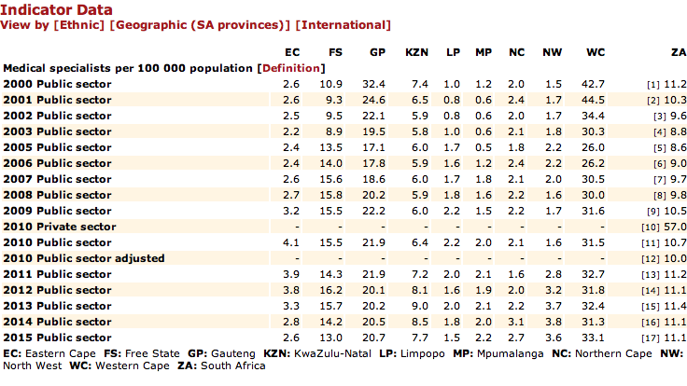
Notes:
Limpopo has the lowest number of specialist per population in the country

Slide 57
SPECIALISED HOSPITALS

Slide 58
ACCESS: SPECIALISED HOSPITALS
Long term stay for psychiatric hospitals
Forensic observation services: Hayani and Thabamoopo
Child psychiatry services: Thabamoopo services
Maximum security facility: Hayani
MDR TB Hospital: Modimolle

Slide 59
ACCESS: STATUS PSYCHIATRIC HOSPITALS
Long term stay for psychiatric hospitals
Forensic observation services: Hayani and Thabamoopo
Child psychiatry services: Thabamoopo services
Maximum security facility: Hayani

Slide 60
BACKGROUND MENTAL HEALTH SERVICE
There are six (06) General Hospitals with Psychiatric wards (Donald Fraser, Elim, Siloam, Malamulele, Mankweng and Matlala)
There are three (03) Specialised Psychiatric Hospitals (Hayani, Evuxakeni, Thabamoopo)
Two general hospitals have non–functional Psychiatric wards (Tshilidzini and Letaba)
A state of the art Psychiatric ward is about to be commissioned at Letaba Hospital

Slide 61
BACKGROUND MENTAL HEALTH SERVICE
All hospitals (40) in the province manage Psychiatric patients and refer them to appropriate facilities when necessary
In addition, there are:
Three (03) community residential facilities – under the department of Social Development
One (01) Licensed Sub – Acute Psychiatric Hospital with 38 beds (deals with voluntary mental health care users only)
There is no licensed acute Psychiatric hospital in the province
There are no child / adolescent outpatient clinics. Child and adolescent mental healthcare users are admitted to separate sections of the mental health care facilities only if they cannot be managed as inpatients in other healthcare facilities or as outpatients
Mental Health Care facilities are the last resort for admitting children

Slide 62
CURRENT STATUS OF THE SPECIALISED PSYCHIATRIC HOSPITALS
 | HAYANI | EVUXAKENI | THABAMOOPO
When was Hospital built | 1969 | 1984 | 1972
Approved beds | 390 | 400 | 400
Usable Beds | 234 | 354 | 365
Average UBUR | >100% (236 Patients) | 76,9% ( 342 patients) | 76% ( 368 patients)
Overcrowding | Maximum security ward 54pt (33 beds) Wards A + B | None | Wards D 79 pts (36) Wards B 64 pts (34)
Category of patients | Assisted: 72 pts | Assisted: 240 pts | Assisted: 184 pts
 | Involuntary: 116 pts | Involuntary: 43 pts | Involuntary: 60 pts
 | State patients: 48 | State patients: 0 | State patients = 89
 | Forensic pts: 0 | Forensic pts: 0
 | Approximately 100 patients are is admitted for Social Reasons and can benefit from a step – down facility | 36 patients are admitted for Social reasons and can be discharged to a step – down facility | 143 pts in ward B and D have been there some since 1972 and qualify to be in a step down facility
 |  | Mpumalanga has requested Limpopo to admit 23 of patients since they do not have facilities for mental health care | Holding cells has 107 pts (waiting for observation and admission)
Cost per PDE (3rd Quarter) | R1565,00 | R1234,50 | R1768,00

Slide 63
LIST OF AWAITING TRIAL DETAINEES REFFERED FOR OBSERVATION BY THE COURTS AT THABAMOOPO HOSPITAL
This are patients from court who are awaiting mental observation by the psychiatrist
Key: Panel cases are those who committed serious offences like murder, rape etc., and they need two or more psychiatrists to observe them before the judge can give final verdict in court.
Single Psychiatrist cases are those who committed minor offences like common robbery and they need one psychiatrist for observation
Type of patients | Number
Panel Cases | 78
Single psychiatrist patients | 171
Grand total | 249

Slide 64
TERTIARY, CENTRAL AND ACADEMIC SERVICES

Slide 65
Tertiary
Academic complex
  2 Tertiary hospitals
    Pietersburg Hospital (T1 and T2)
      504 usable beds
    Mankweng Hospital (T1 and T2)
      509 usable beds
    Thabamoopo
0 central hospitals
  Limpopo Central hospital in planning

Slide 66
Specialist numbers

Slide 67
Specialist needs in tertiary hospitals
 | HCD |  | Pietersburg |  |  |  | Mankweng |  |  |  | Totals
 | HCD | HCD Need | HCU | Need | Spec | Need | HCU | Need | Spec | Need | Current specialists | Need
Anaesthesia | 1 | 0 | 1 | 0 | 0 | 4 | 1 | 0 | 0 | 2 |  | 6
Critical Care |  |  | 0 | 1 | 0 | 4 | 0 | 0 | 0 | 1 | 0 | 6
General Surgery | 0 | 1 | 0 | 1 | 0 | 4 | 1 | 0 | 0 | 4 | 1 | 10
Cardiothoracic Surgery |  |  | 1 | 0 | 1 | 2 |  |  |  |  | 2 | 2
Neurosurgery |  |  | 1 | 0 | 0 | 4 |  |  |  |  | 1 | 4
Opthalmology | 0 | 0 |  |  |  |  | 0 | 1 | 0 | 4 | 0 | 5
Otolayrngology | 1 | 0 | 1 | 0 | 1 | 1 |  |  |  |  | 3 | 1
Paediatric Surgery | 0 | 0 |  |  |  |  | 0 | 1 | 0 | 4 | 0 | 5
Plastic Surgery | 1 | 0 |  |  |  |  | 0 | 0 | 0 | 3 | 1 | 3
Urology |  |  | 0 | 1 | 1 | 4 |  |  |  |  | 1 | 5
Diagnostic Radiology & Imaging | 0 | 1 | 0 | 1 | 1 | 4 | 1 | 0 | 1 | 2 | 3 | 8
Nuclear Medicine | 0 | 0 | 0 | 0 | 2 | 0 | 0 | 0 | 0 | 0 | 2 | 0
Family Medicine | 1 | 0 | 0 | 0 | 0 | 0 | 1 | 0 | 3 | 0 | 5 | 0
Emergency medicine | 0 | 0 | 1 | 1 | 0 | 3 | 0 | 0 | 1 | 1 | 2 | 5
Forensic Medicine | 1 | 0 | 1 | 0 | 2 | 1 | 0 | 0 | 0 | 0 | 4 | 1
Internal Medicine | 1 | 0 | 0 | 0 | 2 | 2 | 0 | 1 | 0 | 3 | 3 | 6
Cardiology |  |  | 0 | 0 | 0 | 1 | 0 | 0 | 0 | 0 | 0 | 1
Haematology |  |  |  |  |  | 1 |  |  |  |  |  | 1
Nephrology |  |  | 1 | 0 | 0 | 1 | 0 | 0 | 0 | 0 | 1 | 1
Neurology |  |  | 0 | 0 | 1 | 1 | 0 | 0 | 0 | 0 | 1 | 1
Pulmunology |  |  |  | 1 |  |  |  |  |  |  |  | 1
Rheumatology |  |  |  | 1 |  |  |  |  |  |  |  | 1
Medical Oncology |  |  |  | 1 |  |  |  |  |  |  |  | 1
Radiation Oncology | 1 | 0 | 0 | 0 | 0 | 2 |  |  |  |  | 1 | 2
Dermatology | 1 | 0 | 1 | 0 | 0 | 2 |  |  |  |  | 2 | 2
 | HCD |  | Pietersburg |  |  |  | Mankweng |  |  |  | Totals
 | HCD | HCD Need | HCU | Need | Spec | Need | HCU | Need | Spec | Need | Current specialists | Need
Obstetrics and Gynaecology | 1 | 0 | 0 | 1 | 2 | 2 | 1 | 0 | 4 | 0 | 8 | 3
Gynae Oncology |  |  |  |  |  | 1 |  |  |  |  |  | 1
Reproductive Medicine |  |  |  |  |  | 1 |  |  |  | 1 |  | 2
Maternal and Foetal Medicine |  |  |  |  |  | 1 |  |  |  | 1 |  | 2
Orthopaedics | 0 | 1 | 0 | 1 | 0 | 2 | 0 | 1 | 0 | 1 | 0 | 6
Paediatrics | 1 | 0 | 2 | 1 | 2 | 2 | 1 | 0 | 0 | 2 | 6 | 5
Neonatology |  |  | 0 | 0 | 0 | 1 | 1 | 0 | 0 | 1 | 1 | 2
Paed Pulmunology & CC |  |  | 1 | 0 | 1 | 1 | 0 | 0 | 0 | 0 | 2 | 1
Paediatric Oncology |  |  | 0 | 1 | 1 | 0 | 0 | 0 | 0 | 0 | 1 | 1
Paediatric Cardiology |  |  | 0 | 1 | 0 | 1 | 0 | 0 | 0 | 0 | 0 | 2
Paediatric Nephrology |  |  |  |  |  | 1 |  |  |  |  |  | 1
Paediatric Neurology |  |  |  |  |  | 1 |  |  |  |  |  | 1
Psychiatry: Thabamoopo | 0 | 1 | 1 | 0 | 0 | 2 | 1 | 0 | 2 | 0 | 4 | 3
Child and Adolescent Psychiatry |  |  |  |  | 0 | 1 |  |  |  |  | 0 | 1
Forensic Psychiatry |  |  |  |  | 0 | 1 |  |  |  |  | 0 | 1
Public Health | 1 | 0 | 0 | 0 | 1 | 0 | 0 | 0 | 1 | 0 | 3 | 0
Dental specialties
Maxillofacial |  |  | 1 | 0 | 0 | 1 | 0 | 0 | 1 | 0 | 2 | 1
Orthodontics |  |  | 1 | 0 | 1 | 1 | 0 | 0 | 1 | 0 | 3 | 1
Prosthodontics |  |  | 0 | 0 | 0 | 2 | 0 | 0 | 0 | 0 | 0 | 2
Periodontics |  |  | 0 | 0 | 0 | 2 | 0 | 0 | 0 | 0 | 0 | 2
Oral Pathology |  |  | 0 | 0 | 0 | 1 | 0 | 0 | 0 | 0 | 0 | 1
TOTAL | 11 | 4 | 12 | 13 | 17 | 57 | 8 | 4 | 11 | 30 | 59 | 108

Slide 68
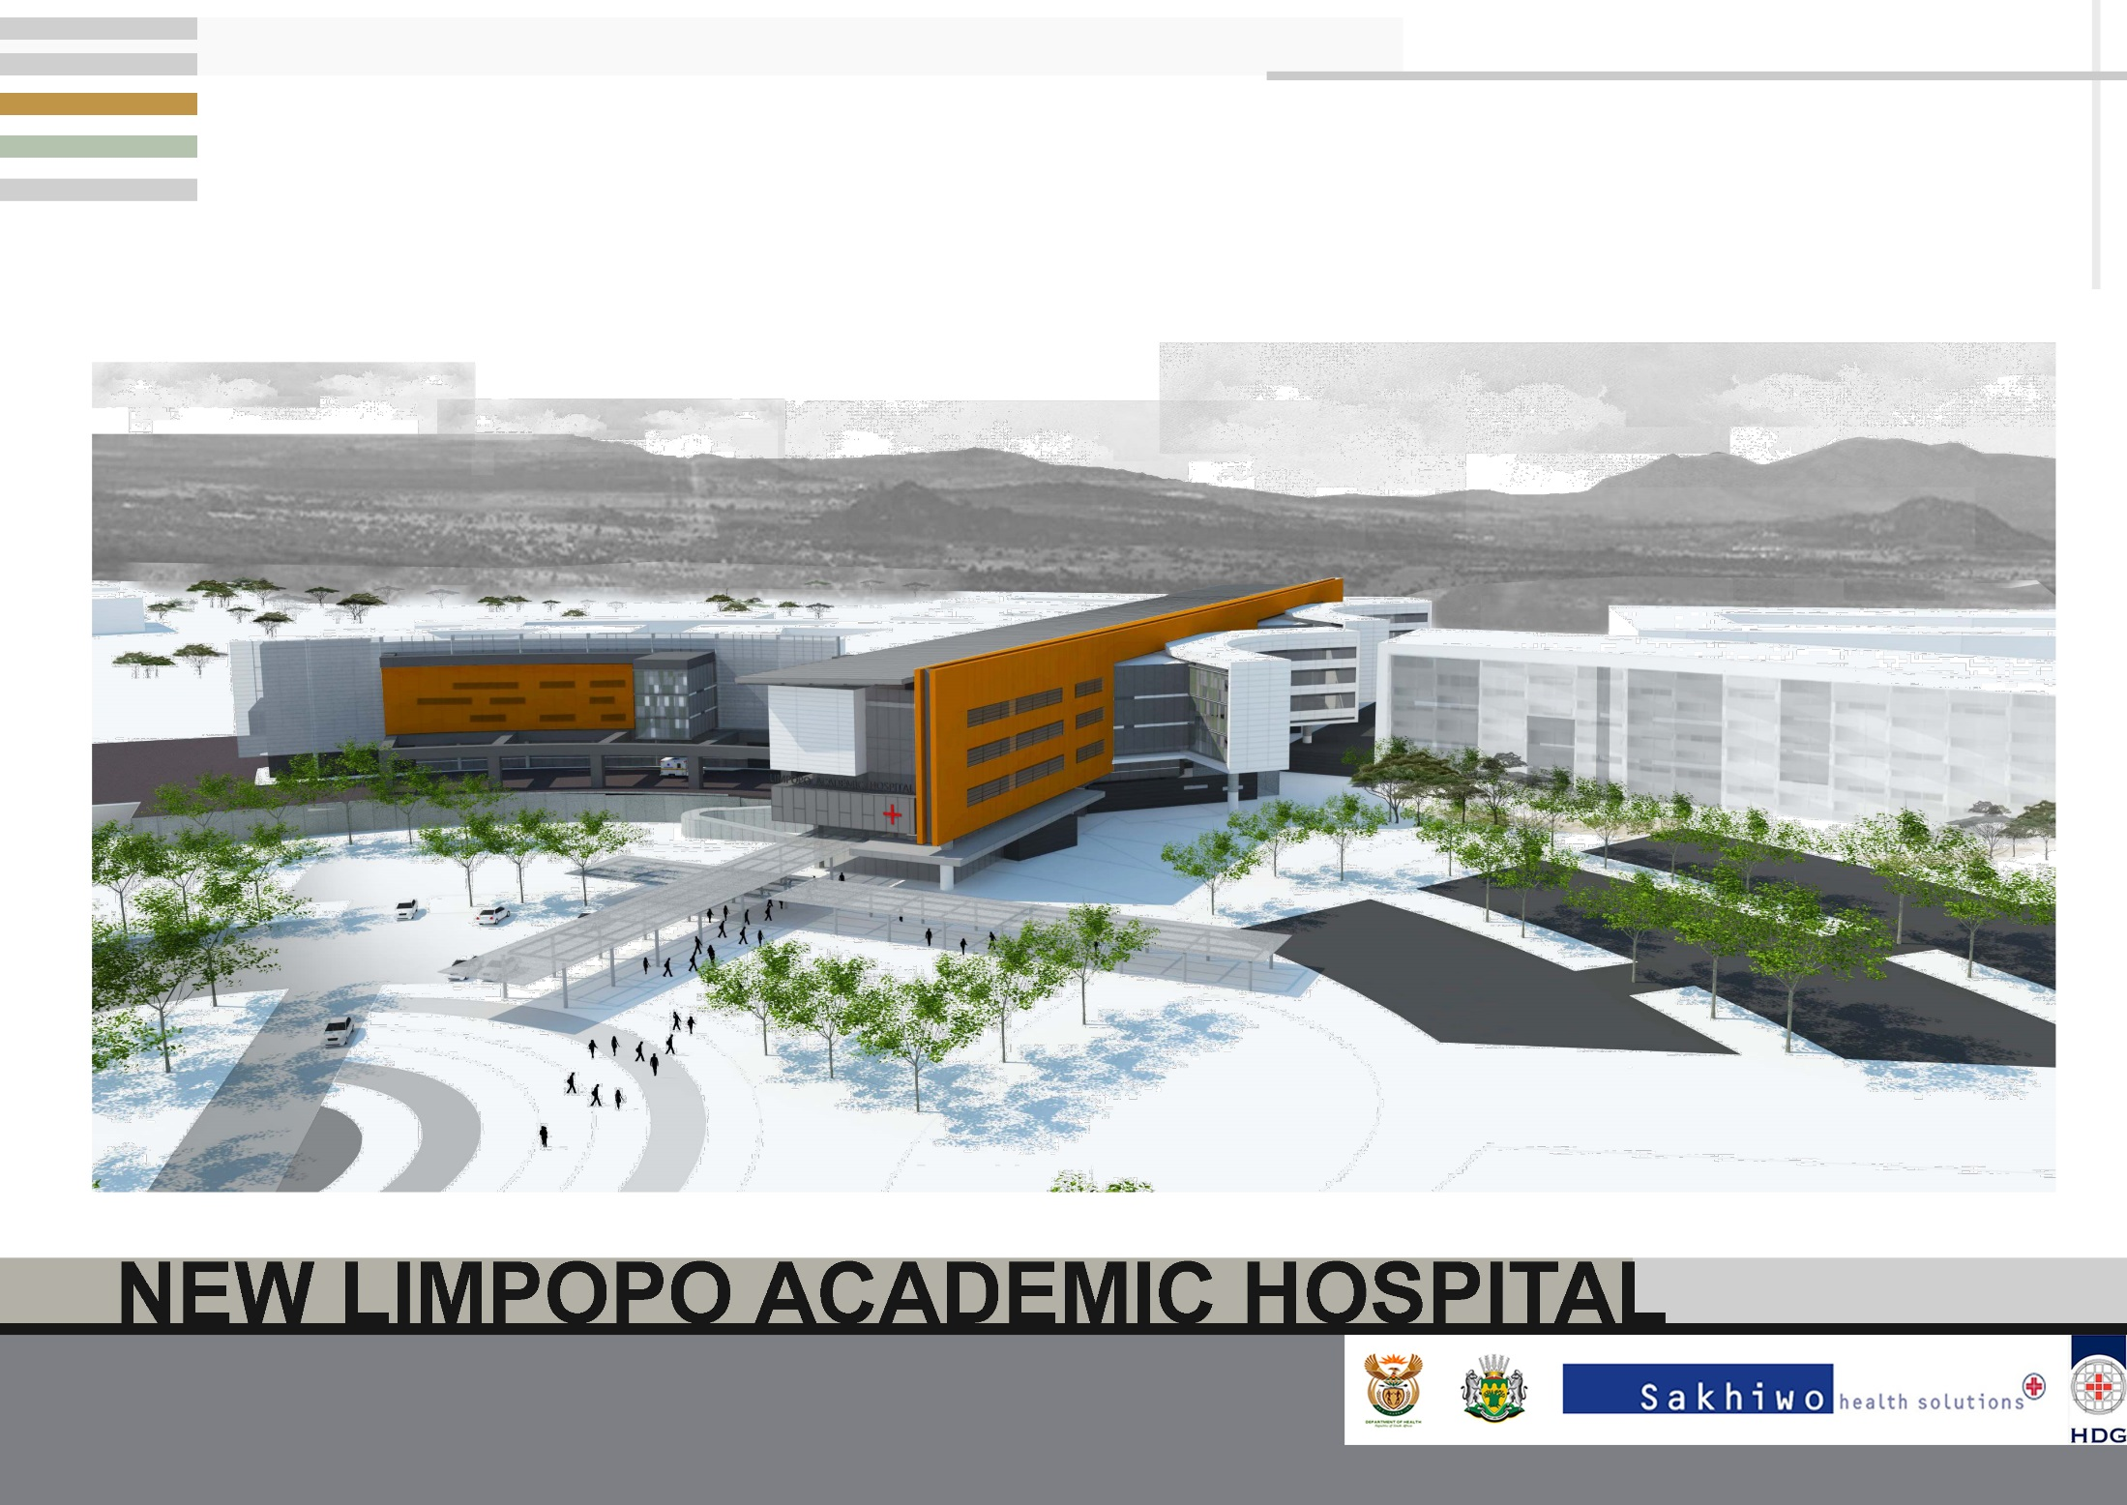
Limpopo Central Hospital
11th June 2018

Slide 69
Definitions of “Central Hospital” and “Academic complex”
‘Academic complex’ The National Health Act (NHA) and National Tertiary Health Service Policy (NTHSP) have no definition of an “academic hospital”
The NHA refers to ‘Academic Complexes’ and defines them in Section 51 as follows:
  “academic health complexes, may consist of one or more health establishments at all levels of the national health system, including peripheral facilities, and one or more educational institutions working together to educate and train health care personnel and to conduct research in health services”
“Central Hospitals” (GG R185_Categories_of_Hospitals_March_2012) provides for
must provide tertiary hospital services (T1) and central referral services(T2) and may provide national referral services(T3);
must provide training of health care providers;
must conduct research;
receives patients referred to it from more than one province;
must be attached to a medical school as the main teaching platform; and
must have a maximum of 1200 beds
The financing implication of getting this right is that Central Hospitals are the financial responsibility of National government budget, not the provincial equitable share (PES). This also affects the post definitions and staff rotations.

Slide 70
Limpopo Central Hospital and Limpopo Academic Complex
Limpopo Central Hospital: Phase 1
  488 Beds
    T1 and T2 services for most clinical disciplines
Phase 2
  Additional 200 beds
  Total of 688 beds
    Cater for T2 services in all clinical disciplines
  Limpopo Academic Complex
  Capricorn Regional hospital (Pb)
    90 L3 Beds
      T1, T2, Oncology, Renal and Urology
    320 L2 Beds
  Mankweng District Hospital
    36 L3 Beds
      T1 T2 Ophthalmology
    473 L1 Beds
      Some L2 O&G, Paeds
  Thabamoopo
    20 L3 Beds
      T1 Psychiatry
  All Regional hospitals and some district hospitals

Slide 71
Finance
Capital Costs
  488 beds LCH = ~ R3bn
  New infrastructure and some demolition for Capricorn Regional (Pieterburg) ~ R300m
  Refurbish Mankweng District
Recurrent cost
  R800 m additional / year
  This will be systematically introduced through NTSG and HPTDG from 2019/2020
  Investment in Health technology
    Linac x 2
    PACS x 2
    MRI x 1
  Invest in specialists and specialist nurses for all regional and tertiary

Slide 72
NATIONAL CORE STANDARDS
Type of hospital | TARTGET: Hospital achieved 75% and more on National Core Standards self-assessment rate (2017/18) | STATUS: Hospital achieved 75% and more on National Core Standards self-assessment rate (2017/18)
District | 10/30 | 15/30
Regional | 5/5 | 5/5
Specialised | 3/3 | 2/3
Tertiary | 2/2 | 2/2

Slide 73
Summary Hospitals services
ITEM | CHALLENGE | IMPACT | INTERVENTION
1. Infrastructure | Most of the hospitals are old and dilapidated Some hospitals still without the necessary IT Infrastructure Incomplete projects due to non payment of service providers | Poor delivery of health services Poor communication Inability to modernise services | Continue with HRP Need special funding Improve on maintenance of infrastructure Payment of service providers to complete projects
2. Machinery and Equipment | Lack of equipment , old and out-dated equipment( Anaesthetic machines, x-ray machines) Challenges with maintenance of non-high tech equipment | Poor delivery of clinical services Risk of Medico-legal consequences Creation of backlogs Unnecessary interruptions of patient treatment and management | Standardisation of medical equipment Improve on maintenance of equipment Centralised budget Increase allocation of funds for machinery and equipment Conditional Grants to assist with funding of specialised services in Regional and some district hospital

Slide 74
Summary Hospital services (2)
ITEM | CHALLENGE | IMPACT | INTERVENTION
3. Human Resources | Most Management posts occupied by personnel on acting capacity CEOs and Clinical Manager’s posts in some hospitals still vacant Key posts are still in high vacancy rate( Doctors and nurses) | Poor leadership and management of institutions Risk of medico legal litigations | Vacant Posts of Key Management to be filled Deploy all contract (bursary) doctors to the needy hospitals Recruit and retain health professionals.
4. Finance and Budgeting | Insufficient budget to cater for the needs of the hospital SCM in hospitals is ineffective. - Food supply( SCM) Constant challenges with suppliers especially on that one supplier for all the hospitals On-going quotation system . lack of segregation of duties due to shortages of staff | Delays in payment of suppliers Delays in procurement Audit | General increase of the Hospital budget Scientific budget allocation Prioritise key strategic financial management positions

Slide 75
PHARMACEUTICAL SERVICES

Slide 76
PHARMACEUTICAL(1)
During the 2017/18 financial year, medicine availability was as follows:
  Hospital level: 90,67%
  PHC level: 87,2%
The current overall medicine availability is 95% for ARV’s and 87% for essential medicines.
The main factors impacting on medicine availability are:
  Budget pressures that at the end of the financial year, resulting in suppliers putting accounts on hold. The medicine accounts payable at the end of 2017/18 financial year was R410 million, eg 47% of the R862,228,000 allocated for medicines in the 2018/19 financial year.
  International & National shortage of certain items.

Slide 77
PHARMACEUTICAL (2)
Medicine delivery & management models:
  Tertiary procure medicines directly while Regional Hospitals procure all items through the Direct Delivery (DDV) Model, with ARVs procured by all hospitals on the DDV model.
  The distribution of medicines from the Depot to district hospitals and PHC is outsourced.
  All hospitals use the Rx Solution platform for managing stock levels.
  The Pharmaceutical Depot is in the process of implementing a new Warehouse Management System, using the G-commerce platform for procurement.
  Limpopo would be the 2nd province implementing the system to go live in July 2018.

Slide 78
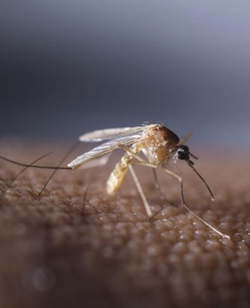
Malaria: The costly mosquito
Malaria consumables March to October
 | 2016 | 2017 | Increase
IV Artesunate | R3 059 212.80 | R10 391 261.88 | X3.4
Malaria test kit | R1 846 444.39 | R2 981 272.78 | X1.6
Coartem | R227 251.82 | R1 702 813.62 | X7.5
Artesunate: sole supplier, manufactured in India
Price increased from R160/ vial (April 2017) to R360/vial (October 2017) i.e. > 200% price increase in 6 months
More than R2.9 million spent for one drug (Artesunate) in two weeks.

Slide 79
Challenge: Upward adjustment contraceptive price
Product in question: Norethisterone Enanthate (Nur-Isterate®)- long acting injectable for women who require progesterone only for contraception. It is a SA Essential Medicine ( Catergory A)
  Previously on contract(NT) price @ R11,54 VAT incl.
  Contract expired Sep 2017 and no new contract was awarded
Pharmaceutical depot obtained Quote on 02/Feb/2018 for adjudication @ R11,54 (On Friday 9th)
Supplementary contract loaded by NT 09 Feb 2018 (RT-283 2017) held by National Treasury @R24 per vial
NB. SEP (Single Exit Price) = R12. New contract price is twice the SEP

Slide 80
HEALTH TECHNOLOGY

Slide 81
MEDICAL EQUIPMENT
In ensuring the availability of Health Technology equipment within the Provincial Health system, procurement and commissioning were done as follows, over the past two financial years:

Slide 82
EQUIPMENT LIST PER HOSPITAL
Hyperlink to excel spreadsheet
  Procured in 2017/18
  Current asset register

Slide 83
Availability Speciality Medical equipment
Equipment | Availability | Comment
Oncology (Lin Acc) | 2 | 1 is condemned 1 is 15 years old, due for replacement in 2018/19 can only manage 25-30 patients per day instead of 50 creating a backlog
CT scan | 2 | Both Functional
MRI | 1 | >10 years old. Due for replacement
Mammogram | 2 | Both Functional
Dialysis | 22 | Outsourced through PPP
C-Arm | 7 | Only 3 Functional
CATH lab | 1 | To be commissioned in July 2018, delay due to air-conditioning and laminar flow challenges.
PACS RIS | 0 | Tender advertised, budgetary constraints

Slide 84
Current Surgical Backlog
Surgical Domain | Pieters-burg | Mank-weng | Letaba | Mokopane | Phila-delphia | St Ritas | Tshilidzini | TOTAL
General Surgery | 300 | 70 | 0 | 152 | 0 | 230 | 131 | 883
Orthopaedics | 500 | 236 | 8 | 80 | 7 | 11 | 21 | 863
Gynaecology | 94 | 44 | 0 | 37 | 0 | 0 | 239 | 414
Cardio-thoracic | 234 |  |  |  |  |  |  | 234
Neurosurgery | 50 |  |  |  |  |  |  | 50
ENT | 180 |  |  |  |  |  |  | 180
Maxillo facial | 110 |  |  |  |  |  |  | 110
Urology | 582 |  |  |  |  |  |  | 582
Opthalmology |  | 23550 |  |  |  |  |  | 23550
TOTAL | 2050 | 23900 | 8 | 269 | 7 | 241 | 391 | 26866

Slide 85
Oncology backlog
AVERAGE WAIT TIMES AND CURRENT BACKLOG FOR ADULT AND CHILD PATIENTS
Waiting time from point of diagnosis to radiotherapy treatment
 | WAITING TIME | BACKLOG
HEAD AND NECK | 12 months | 38
LUNG | 12 months | 0
BREAST | 12 months | 46
CERVIX | 12 months | 92
PROSTRATE/COLORECTAL | 12 months | 9
UTERUS | 12 months | 10
OESOPHAGUS | 12 months | 1
PEDIATRIC CANCERS | 2 months | 0

Slide 86
Emergency medicine services

Slide 87
EMERGENCY MEDICAL SERVICES AND PATIENT TRANSPORT
Through an ongoing investment in the ambulance fleet, the ambulance per population ratio has increased from 1 ambulance to 47,290 population served (in 2013/14) to 1:27 297 in 2017/18.
EMS transported a total of 228,408 clients in the 2017/18 financial year.
The service is fully insourced, with only aero-medical services outsourced.
The Department is currently in the process of installing tracking devices in 656 vehicles in the EMS fleet, consisting of ambulances, planned patient transport vehicles, rescue and response vehicles.

Slide 88
EMS
Performance indicator | Annual Target | Annual Performance | Comments
Ratio of ambulance per population | 1:29 000 | 1:27 297 | Procurement of ambulances ensured improved ratio
EMS P1 urban response under 15 minutes rate | 72% | 42.01% (247/588) | Factors related to # of calls, distances, roads contribute to performance
EMS P1 rural response under 40 minutes rate | 72% | 39.12% (2297/5871) | See above
EMS inter-facility transfer rate | 17.9 % (10,785/ 60,284 | 19% (43,392/228,408) | Focus remains on primary calls

Slide 89
Management/ Staff
EMS is functioning without a Head EMS, Operational Manager, with 3 of the 5 district EMS manager’s posts vacant.
23 of 57 Station Manager’s Vacant
CURRENT QUALIFICATION | NUMBER
BAA | 1207
AEA | 638
ECT | 10
ALS (N DIP/B TECH/BHSC/CCA) | 26
TOTAL | 1881

Slide 90
Challenges
High demand for service from communities, resulting in high usage & travelling.
High usage + poor rural roads = high maintenance cost eg 64% of vehicles > 120,000 km
Shortage of skilled paramedics & vacant management posts (eg no Director, Operational Manager & Managers in 3 x districts)
Overtime in access of 30%.

Slide 91
The status of Health Care Risk Waste management
HCRW service provider appointed for 3yrs (November 2015-October 2018) comprehensive service
Service is rendered to all Hospitals, PHC, Emergency medical services, depot and 18 TVET colleges wherein health services are rendered.
Service involves collection, storage, transportation, treatment and disposal of all categories of Health care risk Waste (HCRW)- General infectious, Sharps, Pathological, Condemned soiled linen and matrasses Pharmaceutical, Cytotoxic. Fluorescent Light Bulbs
It also includes the provision of all HCRW container as and when required by facilities and training to employees
Specification for the new contract has been developed and will soon be advertised
Coordination of the service under Environmental Health directorate

Slide 92
HCRW MANAGEMENT
 | CHALLENGE | IMPACT | INTERVENTION
Infrastructure | Poor infrastructural design especially in old facilities | Lack of appropriate waste storages | Newly built hospitals are designed to have appropriate HCRW storage facilities Existing storages to be upgraded to meet the standards.

Slide 93
Progress towards the adoption of community health workers
LDoH database has a total of 10 558 CHWs contracted by NGOs and paid stipend through the HAST grant
Ward attendants posts advertised where requirement is experience in home base care
  1031 posts advertised
  Advert closed 20 May 2018

Slide 94
INFRASTRUCTURE

Slide 95
Situational analysis: Health infrastructure
Item | Comment
Ageing infrastructure | no longer fit for purpose Does not account for population growth and new burden of disease
Capital budget | dependent on the conditional grant of R537 million per annum still implementing the 2011-12 projects as a result of Section 100 which arrested implementation of capital projects→ Reprioritization for ‘crisis point’ projects such as theatres, laundries, replacement of chiller plants and stand-by generators → Limited delivery of new health facilities/ upgrades for health facilities
Maintenance | reactive rather than preventative maintenance. The current budget of R192 million for maintenance and health technology against a required R900 million per annum clearly shows the incongruence between need and available funding.

Slide 96
Infrastructure
DEPARTMENT OF HEALTH SOURCES OF FUNDING FOR INFRASTRUCTURE
BUDGET ALLOCATIONS FOR 2018/19, 2019/20 AND 2021/22MTEF ESTIMATES
Source of Funding | 2016/17 [Adjusted] | 2017/18 [Adjusted] | 2018/19 | 2020/21 | 2021/22
Health Facility Revitalization Grant | 379,089 | 508,144 | 536,898 | 461,000 | 486,355
Equitable share - Infrastructure Maintenance | 357,072 | 154,028 | 192,379 | 198,249 | 210,346
GRAND TOTAL | 736,161 | 662,172 | 729,277 | 659,249 | 696,701

Slide 97
Notes on Funding Allocations
The budget for Health Facility Revitalization Grant (HFRG) does not follow a pattern of increment
The amount of budget made available is significantly below the needs of the Province
The inconsistencies in the budget allocation impacts negatively on projects in the pipeline.
There is a zero budget for Equitable Share capital projects in the 2018/19 MTEF; Province solely dependent on HFRG for capital
The general increase in the Equitable Share maintenance budget has enabled scheduled maintenance works to be addressed at a minimal level. Maintenance works is largely reactive.
Industry norm for maintenance is 2%-4% of the build value per annum.
3% of R 30 billion = R 900m. This is the annual budget needed to maintain hospitals and PHC facilities only.
The maintenance budget inclusive of infrastructure and health technology is R 198m in 2018/19 which is 22% of the R 900m needed annually.
The total build value of the hospitals and primary health care (PHC) facilities is R25 + R5 billion= R 30 billion

Slide 98
Address the backlog in capital projects….
Facilities Completed 16/17
Facility Name | Completed Project Name/Description
1. Letaba Hospital | Maternity and Victim Empowerment Centre.
2. Mecklenburg Hospital | OPD, Pharmacy, X-Ray and New Hospital Entrance
3. Nkomo B PHC | Replacement of existing Nkomo PHC on the same site incorporating the adjacent site.
4. Tshikundamalema PHC | Replacement of existing Tshikundamalema PHC on the same site incorporating adjacent site
5. Homulani PHC | Replacement of existing Homulani PHC on the same site
6. Elim Boiler | Upgrade of Boilers and New Boiler House
7. Old Nkhensani EMS Station | Old Nkhensani EMS Station: Upgrade / repurpose of existing buildings at the Old Nkhensani hospital Site into an EMS station (cost centre)
8. Grace Mugodeni EMS Station | Grace Mugodeni EMS Station: New EMS Station within the existing Grace Mugodeni community health centre's site
9. Malamulele Hospital | Ten bedroom staff accommodation at Malamulele Hospital
10. Voortrekker Hospital | OPD and Casualty
11. Mankweng Hospital | Forensic Pathology Laboratory

Slide 99
Address the backlog in capital projects….
Facilities Completed 17/18
Facility Name | Completed Project Name/Description
1.Matlala Hospital | Health Support Centre and OPD Revamp
2.Zebediela Hospital | Hospital Mortuary
3.Provincial Office | EMS Head Office
4.Thabazimbi Hospital | New Forensic Mortuary
5.Witpoort Hospital | Replacement of Theatre Chiller
6.Donald Fraser Hospital | Replacement of Theatre Chiller
7.Voortrekker Hospital | Replacement of Theatre Chiller
8.Pietersburg Hospital | Replacement of Theatre Chiller
9.FH Odendaal Hospital | Replacement of StandBy Generator

Slide 100
Address the backlog in capital projects….
Projects Targeted for Completion 18/19
Facility Name | Project Name / Description | Progress
1.Sekgakgapheng PHC | Sekgakgapheng PHC : Replacement of existing PHC on a new site
2.Bela Bela PHC | Bela Bela PHC : Replacement of existing PHC within the original site
3.Sterkspruit PHC | Replacement of the existing Sterkspruit PHC on a new site | Completion Achieved on the 01 June 2018
4.Pienaarsriver PHC | Pienaarsrivier: New PHC | Completion Achieved on the 6 June 2018
5.Schoongezicht PHC | Replace existing Schoongezicht PHC on a new site incorporating current PHC site | Completion Achieved on the 16 April 2018
6.Makeepsvlei PHC | Replacement of existing Makeepsvlei PHC on the same site
7.Mamushi PHC | Replacement existing Mamushi PHC on a new site

Slide 101
Address the backlog in capital projects….
Projects Targeted for Completion 18/19
Facility Name | Project Name / Description | Progress
8.Mothiba PHC | Replacement of Mothiba PHC on a new site
9.Mokopane Hospital | Mokopane Hospital: Staff Accommodation 10 room unit
10.Letaba Hospital | Medical and Admissions Records' Facility at Letaba Hospital
11.George Masebe Hospital | Maternity
12.Dr. C.N. Phatudi Hospital | OPD, Casualty and Pharmacy | Beneficial Occupation Granted in November 2017; project still has to reach practical completion
13.Philadelphia Hospital | OPD & Casualty | Beneficial Occupation Granted in December 2017; project still has to reach practical completion
14.Maphutha Malatjie Hospital | Completion of linen store, ring roads, flooring, paving and storm water drainage. Platforms, paving and services for relocatable units. Relocatable units and repurposing of the dining hall into meeting hall. Renovation of the burnt staff accommodation unit. Commissioning of kitchen equipment.

Slide 102
Address the backlog in capital projects: critical electromechanical equipment
Projects Targeted for Completion 18/19
Facility Name | Project Name / Description
Tshilidzini Hospital | Replacement of Theatre Chiller
Messina Hospital | Replacement of Theatre Chiller
Thabazimbi Hospital | Replacement of Theatre Chiller
Ellisras Hospital | Replacement of Theatre Chiller
Mokopane Hospital | Replacement of Maternity Theatre Chiller
Philadelphia Hospital | Replacement of Theatre Chiller
Helena Franz Hospital | Replacement of Theatre Chiller
Kgapane Hospital | Replacement of Standby Generator
St. Ritas Hospital | Replacement of Standby Generator

Slide 103
Address the backlog in capital projects….
Projects in Construction due for completion in 19/20 MTEF
Facility Name | Project Name / Description
1.Maphutha Malatjie Hospital | OPD, Casualty, X-Ray, , Pharmacy, Health Support and Helipad.
2.Letaba Hospital | Contract A5: Workshop, Replacement of the Burnt Surgical Ward, 72 hours Water Standby Storage & Mechanical Works at Letaba Hospital, Completion of A2, Medical Waste Facility.

Slide 104
Address the backlog in capital projects….
Laundry Programme Started in 17/18
Facility Name | Project Name / Description | Progress
1.Philadelphia Hospital | Renovation of the existing laundry | Site handed over on 23-Jan-18
2.FH Odendaal MDR-XDR Site | Renovation of existing building into a laundry | Site handed over 11-Jan-18
3.Mokopane Hospital | Renovation of the existing laundry | Site handed over 11-Jan-18
4a.Letaba Hospital | New Archive Facilities, including general site and decanting | Site handed over 11-Jan-18
4b.Letaba Hospital | Upgrade existing laundry | Dependent on the completion of 4a
5.Messina Hospital | Renovation of existing laundry | Site handed over 13-Dec-17

Slide 105
Address the backlog in capital projects….
Laundry Programme Started in 17/18
Facility Name | Project Name / Description | Progress
6.Donald Frasier Hospital | Renovation of existing laundry | Site handed over 17-Jan-18
7.Louis Trichardt Hospital | Renovation of existing laundry | Site handed over 13-Dec-17
8.Ellisras Hospital | Renovation of existing laundry | Site handed over 10-Jan-18
9.Witpoort Hospital | Renovation of existing laundry | Site handed over 10-Jan-18
10.Tshilidzini Hospital | Renovation of existing building into a laundry | Tender closed 7/3/2018, Bid Evaluation Completed. Awaiting Bid Award
11.Mankweng Hospital | Renovation of the existing laundry | Tender closed 7/3/2018, Bid Evaluation Completed. Awaiting Bid Award
12.Pietersburg Hospital | Renovation of existing building into a laundry | Tender not yet advertised

Slide 106
Address the backlog in capital projects….
Notes on Laundry Upgrades
The laundry project implementation includes:
  The building contract
  Installation of auxiliary mechanical works after the building contract has been completed
  Purchase and installation laundry equipment
  Purchase of other equipment & furniture

Slide 107
Address the backlog in maintenance
Panel of Contractors 3 year contract [February 2017 to February 2019] available for the following Maintenance Type of Works:
  Air-conditioning
  Boiler services and related works
  Electrical services
  Firefighting services
  General building
  Kitchen and laundry services
  Medical gas services
  Pest control
  Plumbing and drainage works
  Refrigeration
  Silent call system
  Steam reticulation and condensate services
  Water treatment services

Slide 108
INFRASTRUCTURE: CHALLENGES
Delivery of projects is delayed due to amongst others the following:
Contractor performance
Community demanding 30% share of the work
  Legal requirement for 30% community stake came into effect after projects had commenced
  Not all projects are amenable to community stake as recognised in the Treasury Instruction note.
Community demanding labour rates and community liaison rates far above the norm

Slide 109
Maintenance
Facility Maintenance Plans include:
Activities that are critical to health care services – for example theatre chiller plants, compressors, standby generators, gas installations, cleanliness, etc.
Activities that are achievable annually: Scheduled maintenance
Activities that are implemented over an MTEF; renovations; painting; etc. Preventative maintenance

Slide 110
Approach To Maintenance
Maintenance centralization and decentralization at Provincial and Institutions appropriately
Dedicated Departmental Program Manager
Supported by a combination of Facility Based Technical Services Teams, Maintenance Term Contracts and Collaborations with Department of Public Works, Roads and Infrastructure to:
  Compile specifications and documentation
  Inspectorate for monitoring, evaluation, quality control and feed back
Call center for water and sanitation breakdowns

Slide 111
Maintenance Challenges
Ageing Infrastructure and equipment
Inadequate maintenance budgets
Understaffing in the maintenance division at all levels
  Numbers
  Mixture of Skills and Competencies (maintenance professionals, technicians and artisans)
  Ageing staff

Slide 112
Interventions.
Re-look into maintenance organizational establishments; complexity of facilities and skills required
Improve on Maintenance Management – from facility level to Provincial Office (human resource capacity)
Filling up of posts with maintenance professionals, technicians and artisans Re-establish infrastructure stores; electrical bulb, switches, plumbing materials, etc.
Expand the water and sanitation call center to include all breakdowns

Slide 113
STATE OF HOSPITALS’ LAUNDRY SERVICES
NO HOSPITALS | LAUNDRY SERVICE STATUS
 | OUT-SOURCED | IN-SOURCED | UNDER REFURBISHMENT | NOT YET REFURBISHMENT
40 | 23 | 17 | 13 | 27
SNAPSHOT ANALYSIS OF LAUNDRY STATUS:
The Main Challenges:
Aging laundry infrastructure and equipment
High staff turn over rate
Inadequate funds to address identified challenges

Slide 114
STATE OF HOSPITALS’ LAUNDRY SERVICES
INTERIM SOLUTIONS:
The department has accredited service providers to render laundry services as and when a need arises for all hospitals.
The department identified 13 hospitals as a turnkey points for refurbishment, however the challenge will remain with HR issues after refurbishment.
LONGTERM SOLUTION:
The department plans to build laundry hubs in each district to cater for hospitals within the district.

Slide 115
RISK MANAGEMENT

Slide 116
RISK MANAGEMENT
Departmental Risk Management Policy, Strategy, Implementation Plan
Risk Management Committee (RMC) in place and appointed in compliance with Sections 38 and 40 of the PFMA,
Independent RMC chairperson appointed
Risk register in place recommended by both Audit and Risk Management oversight Committees and approved by the Head of Department.
  The progress thereof is reported to the Transversal Risk Management Unit at Provincial Treasury on a quarterly basis
29/40 hospitals have an appointed (psychiatric hospitals are serviced by the head office)

Slide 117
SECURITY MANAGEMENT

Slide 118
SECURITY MANAGEMENT
Item | Status
PRIVATE SECURITY | Contract period: From: 1 MAY 2017 End: 30 April 2020 Number of companies: 36 (provide list) Total amount: R Total number of guards: 3409
INCIDENTS MANAGEMENT | 77 Incidents Reported and managed for the Fin year. 25 involved robbery of Firearms.
SECURITY COMMITTEES | Security Assessments for 40 Hospitals conducted. 40 security committee Established by EA

Slide 119
SECURITY MANAGEMENT (cont.)
Item | 2017/18 2018/19 SUMMARY REPORT | PROGRESS
SECURITY COMMITTEES | Training for security committees conducted: Provincial Security Committee:26/02/2018 ALL DEMS; Heads of Corporate Services; Heads of Vertical Programs and All Security Managers.
ESTABLISHMENT OF COMMUNITY BASED SECURITY FORUMS | The Department has commenced with a program to establish Broader Community Based Security Forums. | The 1st Phase was the establishment of Internal Security Committees completed in March 2018. 2nd Phase in the induction commenced on 1/06/2018 30/06/2018. The SAPS and SSA has been roped in. Internally; Legal Services; Health Branch, Contract management and Communication has been roped in.

Slide 120
SECURITY MANAGEMENT(cont.)
Item | 2017/18 2018/19 SUMMARY REPORT | PROGRESS
PRIVATE SECURITY | CONTRACT PERIOD: FROM: 1 MAY 2017 END: 30 APRIL 2020 NUMBER OF COMPANIES: 36 TOTAL NUMBER OF GUARDS: 3409
ESTABLISHMENT OF COMMUNITY BASED SECURITY FORUMS | The Department has commenced with a program to establish Broader Community Based Security Forums. | The 1st Phase was the establishment of Internal Security Committees completed in March 2018. 2nd Phase in the induction commenced on 1/06/2018 30/06/2018. The SAPS and SSA has been roped in. Internally; Legal Services; Health Branch, Contract management and Communication has been roped in.

Slide 121
SECURITY MANAGEMENT
SCREENING AND VETTING | Number of screening (suitability check) requests processed: 5619 for Fin year 2017/2018. Vetting=13. | Capacity challenges at SSA. | Outside Departmental authority matter raised at appropriate forums.

Slide 122
CORPORATE SERVICES

Slide 123
HUMAN RESOURCES MANAGEMENT
Erstwhile unscientific structure and personnel determination
Shortage of personnel in key areas that compromises service delivery
A huge compensation of employees bill that is overheating
Challenge in the retention of key personnel – especially specialists -a high turn over is mostly in core business
HR related accruals and pressure to increase or resistance to reduction thereof

Slide 124
CORE PERSONNEL
Job Title Description | Approved posts | Filled posts | Vacant Posts | Vacancy Rate
Specialists | 402 | 93 | 309 | 76.87%
Medical Officers | 2206 | 874 | 1332 | 60.38%
Medical Officers Comm Serv | 373 | 153 | 220 | 58.98%
Medical Officers Intern | 257 | 213 | 44 | 17.12%
Dentists | 294 | 192 | 102 | 34.69%
Dentists Comm Serv | 52 | 13 | 39 | 75.00%
Professional nurses | 7325 | 4919 | 2406 | 32.85%
Professional nurses Comm serv | 579 | 58 | 521 | 89.98%
Staff nurse | 4265 | 2686 | 1579 | 37.02%
Nursing assistant | 4896 | 3299 | 1597 | 32.62%
Pharmacists | 369 | 375 | -6 | -1.63%
Pharmacists Comm serv | 70 | 61 | 9 | 12.86%
Pharmacists Intern | 90 | 55 | 35 | 38.89%
Allied Health Professionals | 3095 | 1413 | 1682 | 54.35%
Health Professionals Assistants (various) | 1112 | 586 | 526 | 47.30%
Health Professionals Total | 25385 | 14990 | 10395 | 40.95%

Slide 125
SUPPORT PERSONNEL
Job Title Description | Approved posts | Filled posts | Vacant Posts | Vacancy Rate
Level 14 | 3 | 1 | 2 | 66.67%
Level 13 | 20 | 12 | 8 | 40.00%
Level 12 | 40 | 8 | 32 | 80.00%
Level 11 | 138 | 30 | 108 | 78.26%
Level 10 | 103 | 12 | 91 | 88.35%
Level 9 | 471 | 207 | 264 | 56.05%
Level 8 | 908 | 296 | 612 | 67.40%
Level 7 | 1411 | 563 | 848 | 60.10%
Level 6 | 525 | 107 | 418 | 79.62%
Level 5 | 2622 | 1106 | 1516 | 57.82%
Level 4 | 2277 | 622 | 1655 | 72.68%
Level 3 | 3251 | 1253 | 1998 | 61.46%
Level 2 | 4649 | 1744 | 2905 | 62.49%
Support Personnel Total | 16418 | 5961 | 10457 | 63.69%
GRAND TOTAL | 41803 | 20951 | 20852 | 49.88%

Slide 126
TERMINATIONS AND
TOP FIVE REASONS FOR TERMINATIONS
Terminations for 2017 / 18 Financial Year for all categories in the Department are 1852.
Top Five Reasons why employees choose to leave the Department based on Exit Interviews for 2017 / 18 financial Year:
Stress and work pressure
Lack of prospects for advancement
Poor working conditions (lack of medical equipment)
Domestic and family reasons
Promotion to other Departments / Private Sector / Parastatal

Slide 127
Key HR Interventions
Restructuring – Review of the organizational structure on the basis of a new service delivery model
Prioritization and rationalisation of Human Resources - Reduction of High level positions - merging of Braches and Sub-Branches
Filling of critical core and non-core positions such as Cleaners, Ward Attendants, Porters to improve service delivery

Slide 128
Progress in Filling Posts In Core Business

Slide 129
RECRUITMENT:
PROGRESS ON FILLING OF PRIORITISED POSTS
No of posts approved in terms of recruitment plan | Posts Filled
MO: Community Service | 140
MO: Interns | 101
Dentist: Community Service | 15
Pharmacist: Community Service | 44
Pharmacist: Interns | 47
Allied Health Professionals | 137
Nursing: Community Service | 289
Clinical Associates Personnel | 4
Director: Communication | 1

Slide 130
RECRUITMENT:
PROGRESS ON FILLING OF PRIORITISED POSTS CONT…
No of posts approved in terms of recruitment plan | Total posts Filled | Posts on shortlisting phase | Posts on Interviews phase
Senior Clinical Managers: (12) Knobel; Lebowakgomo; Dilokong; Donald Frazer; Letaba; Nkhensani; Mokopane; Malamulele; Siloam; Jane Furse; St Ritas (Elim was not shortlisted) | None | N/A | Interviews conducted on 18 April 2018
Senior Clinical Managers [Heads of Institutions]: (2) Voortrekker; Mecklenburg; | None | N/A | Interviews conducted on 18 April 2018
Chief Executive Officers: (7) St Ritas; Mokopane; Jane Furse; Kgapane and Siloam; Pietersburg; Mankweng | None | N/A | Interviews conducted on 19 April 2018 and 28 May 2018 (Pietersburg)

Slide 131
RECRUITMENT:
PROGRESS ON FILLING OF PRIORITISED POSTS CONT…
No of posts approved in terms of recruitment plan | Total posts Filled | Posts on shortlisting phase | Posts on Interviews phase
Operational Manager: Emergency Medical Services (EMS): (1) | None | Shortlisted. No suitable candidate was found post to be re-advertised.
Head of EMS: (1) | None | Shortlisted, on 08 February 2018. No suitable candidate was found; post to be re-advertised. Profile being reworked | N/A
Head of Forensic Medical Services: (1) | None | Interviewed | Appointed. Started on 1 June 2018
Chief Director: Clinical Support Service: (1) | None | Shortlisted on 08 February 2018 | N/A

Slide 132
State of ICT
Fragmented healthcare systems used in one department
Untimely system downtime due to old ICT infrastructure
Fragmented databases for the Provincial Health Information System leading to duplicate of patient file, loss of logical history, etc.
SITA connectivity too expensive for the department to keep up with broadband policy targets (SA Connect)
  50% of health facilities at 10Mbps by 2016
High vacancy rate remains a challenge and results in high service outsourcing cost

Slide 133
ICT Interventions
1050 computers procured to replace obsolete ones
  Delivery is expected before end of June 2018
Centralize the Health Information System to ensure;
  one patient one file in the province
  that the department is always in possession of the patient file to minimize medico legal claims
  access to patient history by clinicians from any healthcare facility in the province
Connectivity
  use RT15 contract to improve connectivity (Access to broadband)
  bid to procure network and security equipment to be publish by SITA between June and July 2018
  to date 273 of 477 Primary HealthCare facilities connected through Wi-Fi from LDoH and NDoH
  also 37 of 44 datalines upgraded to at least 2Mbps
Reduce vacancy rate
  advertise and fill at least four critical ICT positions (dependent on approval by Provincial Treasury)
Notes:
Additional Notes on Datalines
SITA is still using copper for the datalines in most of the facilities. These facilities were at 1Mbps and are now upgraded to 2Mbps with the exception of the remaining 7. SITA infrastructure, where these copper based datalines are connected, is old and cannot handle any copper dataline that is more than 2Mbps. The only way to get to more than 2Mbps in these facilities is to increase the number of physical datalines. For example, a 10Mbps dataline in Matlala Hospital will require 5 x 2Mbps datalines. Datalines from SITA are expensive and adding physical datalines to get the higher bandwidth requires additional funds. An alternative solution to resolve this challenge will be investigated as the new solutions requires more bandwidth.
In areas where SITA’s service providers have upgraded their infrastructure to Fiber cable, datalines has been upgraded to 6Mbps or 10Mbps as indicated in the next slide.

Slide 134
Datalines Upgrade Progress
No. of upgrades requested = 44
Datalines upgraded = 37
Outstanding = 7
 | 10Mbps | 6Mbps | 2Mbps | 1Mbps | 512Kbps
No. of Datalines | 3 | 9 | 27 | 4 | 1

Slide 135
RISK MANAGEMENT

Slide 136
RISK MANAGEMENT
Departmental Risk Management Policy, Strategy, Implementation Plan
Risk Management Committee (RMC) in place and appointed in compliance with Sections 38 and 40 of the PFMA,
Independent RMC chairperson appointed
Risk register in place recommended by both Audit and Risk Management oversight Committees and approved by the Head of Department.
  The progress thereof is reported to the Transversal Risk Management Unit at Provincial Treasury on a quarterly basis
29/40 hospitals have an appointed (psychiatric hospitals are serviced by the head office)

Slide 137
SECURITY MANAGEMENT

Slide 138
SECURITY MANAGEMENT
Item | Status
PRIVATE SECURITY | Contract period: From: 1 MAY 2017 End: 30 April 2020 Number of companies: 36 (provide list) Total amount: R Total number of guards: 3409
INCIDENTS MANAGEMENT | 77 Incidents Reported and managed for the Fin year. 25 involved robbery of Firearms.
SECURITY COMMITTEES | Security Assessments for 40 Hospitals conducted. 40 security committee Established by EA

Slide 139
SECURITY MANAGEMENT (cont.)
Item | 2017/18 2018/19 SUMMARY REPORT | PROGRESS
SECURITY COMMITTEES | Training for security committees conducted: Provincial Security Committee:26/02/2018 ALL DEMS; Heads of Corporate Services; Heads of Vertical Programs and All Security Managers.
ESTABLISHMENT OF COMMUNITY BASED SECURITY FORUMS | The Department has commenced with a program to establish Broader Community Based Security Forums. | The 1st Phase was the establishment of Internal Security Committees completed in March 2018. 2nd Phase in the induction commenced on 1/06/2018 30/06/2018. The SAPS and SSA has been roped in. Internally; Legal Services; Health Branch, Contract management and Communication has been roped in.

Slide 140
SECURITY MANAGEMENT(cont.)
Item | 2017/18 2018/19 SUMMARY REPORT | PROGRESS
PRIVATE SECURITY | CONTRACT PERIOD: FROM: 1 MAY 2017 END: 30 APRIL 2020 NUMBER OF COMPANIES: 36 TOTAL NUMBER OF GUARDS: 3409
ESTABLISHMENT OF COMMUNITY BASED SECURITY FORUMS | The Department has commenced with a program to establish Broader Community Based Security Forums. | The 1st Phase was the establishment of Internal Security Committees completed in March 2018. 2nd Phase in the induction commenced on 1/06/2018 30/06/2018. The SAPS and SSA has been roped in. Internally; Legal Services; Health Branch, Contract management and Communication has been roped in.

Slide 141
SECURITY MANAGEMENT
SCREENING AND VETTING | Number of screening (suitability check) requests processed: 5619 for Fin year 2017/2018. Vetting=13. | Capacity challenges at SSA. | Outside Departmental authority matter raised at appropriate forums.

Slide 142
FINANCIAL MANAGEMENT

Slide 143
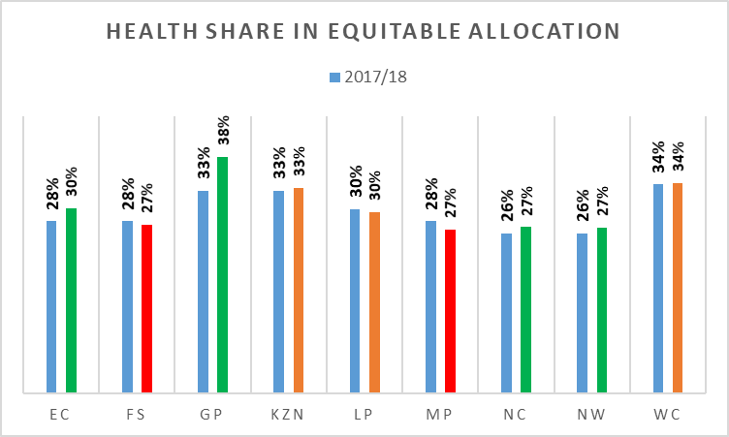
Health Dept share in Total Provincial Equitable Share Allocation
(2017/18 vs 2018/19) – per Province

Slide 144
Allocation – Per Econ Classification

Slide 145
BUDGET BREAKDOWN PER PROGRAMME OVER THE 2018 MTEF AND % GROWTH

Slide 146
BUDGET BREAKDOWN PER ECONOMIC CLASSIFICATION OVER THE 2018 MTEF AND % GROWTH

Slide 147
COMPENSATION OF EMPLOYEES AND GOODS AND SERVICES BUDGET ALLOCATION FOR A 10 YEAR PERIOD ENDING 2021

Slide 148
Programme 2: District Hospitals 2017/18 and 2018/19 Budget Allocations Per Economic Classification

Slide 149
Programme 4: Regional Hospitals 2017/18 and 2018/19 Budget Allocations Per Economic Classification

Slide 150
Programme 4: Psychiatric/Mental Hospitals 2017/18 and 2018/19 Budget Allocations Per Economic Classification

Slide 151
Programme 5: Tertiary Hospitals 2017/18 and 2018/19 Budget Allocations Per Economic Classification

Slide 152
2017/18
SPENDING PER PROGRAMME

Slide 153
2017/18
SPENDING PER PROGRAMME

Slide 154
Notes
The under-spending of R218 million is as a results of non-delivery by suppliers, delayed processes to award contracts for laundry & ITC upgrading projects, late submission of invoices by suppliers and savings due to re-arrangement of funding to Non-Profit Institutions.
A rollover to the amount of R173 million (80% of R218 million) has been requested to cater for the commitments made prior to financial year end.
Strategies to address under-spending
Improve on the planning of infrastructure and ITC projects
Regular interactions with suppliers of goods and services to ensure timeous delivery.
Strengthen monitoring of programmes

Slide 155
2018/19 Budget Shortfall – per Econ Classification

Slide 156
FRUITLESS & WASTEFULL EXPENDITURE REPORT FOR 5 YEAR PERIOD ENDING MARCH 2018

Slide 157
Notes to
Fruitless and Wasteful expenditure
Causes
  The department incurred fruitless and wasteful expenditure amounting to R2.2 million in 2017/18 due to general litigation, backdated termination, interest charged on the late settlement of accounts (due to insufficient funds).
Strategies to address and prevent recurrence
  In terms of the late settlement of accounts due to insufficient funds within goods and services, the department is engaging Provincial Treasury to revisit baseline budget allocation.
  Implement departmental turn around strategy
  The strategy to deal with backdated termination was developed and is being implemented.

Slide 158
IRREGULAR EXPENDITURE FOR THE 5 YEAR PERIOD ENDING MARCH 2018

Slide 159
Notes to Irregular Expenditure
The actual Irregular Expenditure incurred on a year to year basis has shown a tremendous decline from a record high of R544 million in 2014/15 to a R45 million in 2017/18. This represent a total percentage reduction of 92%.
Irregular Expenditure as at 31 March 2018 represented a total balance of R1 214 943 which a total of + R950 000 000 has been investigated internally and presented to NT for condonement.

Slide 160
STATE OF HOSPITALS’ LAUNDRY SERVICES
NO HOSPITALS | LAUNDRY SERVICE STATUS
 | OUT-SOURCED | IN-SOURCED | UNDER REFURBISHMENT | NOT YET REFURBISHMENT
40 | 23 | 17 | 13 | 27
SNAPSHOT ANALYSIS OF LAUNDRY STATUS:
The Main Challenges:
Aging laundry infrastructure and equipment
High staff turn over rate
Inadequate funds to address identified challenges

Slide 161
STATE OF HOSPITALS’ LAUNDRY SERVICES
INTERIM SOLUTIONS:
The department has accredited service providers to render laundry services as and when a need arises for all hospitals.
The department identified 13 hospitals as a turnkey points for refurbishment, however the challenge will remain with HR issues after refurbishment.
LONGTERM SOLUTION:
The department plans to build laundry hubs in each district to cater for hospitals within the district.

Slide 162
CONCLUSION
The committee to note that the chronic underfunding of the department has the suffocation of the hospital services leading to:
  Shortage of speciality services in both nursing and clinical services
  Shortage of equipment
  High accruals in pharmaceutical
  Failure to upgrade infrastructure to be fit for purpose and demand
  Depletion of goods and services
  Increasing burden of medico-legal contingency liability
Despite the above, the department has developed a Turn around strategy which was approved by EXCO

Slide 163


