Slide 1
Presentation to the Portfolio Committee of Justice and Correctional Services JICS Annual Report (2016/2017) Date: 12 June 2018 Presented by Mr. Masondo Mike

Slide 2
PRESENTATION FOCUS
VISION AND MISSION STATEMENT
OVERVIEW OF THE MANDATE OF JICS
ORGANISATIONAL STRUCTURE
DIRECTORATE LEGAL SERVICES
INSPECTIONS
INVESTIGATIONS
MANDATORY REPORTS
Judicial Inspectorate for Correctional Services

Slide 3
PRESENTATION FOCUS (cont.)
USE OF FORCE
NUMBER OF INTERNAL AND EXTERNAL COMPLAINTS RECEIVED PER CLUSTER
ICCV POST ESTABLISHMENT
DIRECTORATE : SUPPORT SERVICES
HUMAN RESOURCES
FINANCE
Judicial Inspectorate for Correctional Services

Slide 4
VISION AND MISSION STATEMENT
Vision
To uphold the human dignity of inmates through independent, proactive, and responsive oversight.
Mission
To impartially, investigate report and make recommendations on the conditions of Correctional Centres and Remand Detention Facilities and of the treatment of inmates for the protection of the human rights of inmates.
Judicial Inspectorate for Correctional Services

Slide 5
LEGISLATIVE MANDATE
The Judicial Inspectorate is established by section 85 (1) of the Correctional Services Act 111 of 1998, as amended (CSA)
Section 85 (2) provides that “the object of the Judicial Inspectorate is to facilitate the inspection of correctional centres in order that the Inspecting Judge may report on the treatment of inmates in correctional centres and on conditions in correctional centres.”
Judicial Inspectorate for Correctional Services

Slide 6
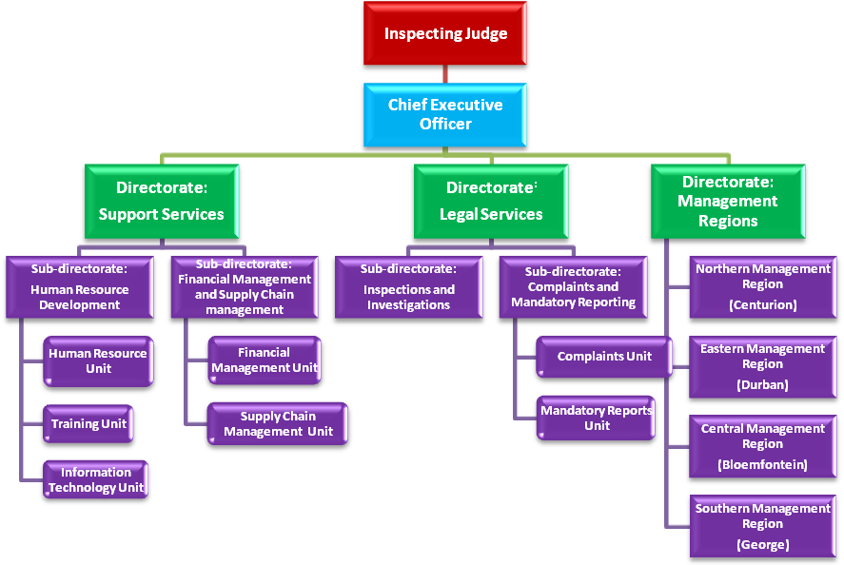
SENIOR LEVEL ORGANISATIONAL STRUCTURE (JICS)
Judicial Inspectorate for Correctional Services

Slide 7
DIRECTORATE : LEGAL SERVICES
INSPECTIONS CONDUCTED
Strategic objective | Strategic indicator | Actual achievement 2015/16 | Planned target 2016/17 | Actual achievement 2016/17 | Deviation from planned target to actual achievement for 2016/17 | Comment on deviations
Provide effective independent oversight relating to the treatment of inmates and the conditions in the correctional facilities and PPPs | Percentage of correctional facilities and PPP facilities inspected on the conditions and treatment of inmates | 33% (81/243)* | 33% (81/243) | 33% 81/243) | None | N/A
Reasons for all deviations
No deviations over 3 year cycle of inspection target
Strategy to overcome areas of under performance
N/A
Changes to planned targets
Nil
Judicial Inspectorate for Correctional Services

Slide 8
LIST OF CORRECTIONAL CENTRES INSPECTED
28 inspections conducted in the following management areas :
Western Cape | Durban and Eastern Cape | Gauteng and LMN | Free State and Northern cape
Oudshoorn Medium A | Waterval Medium A | Johannesburg Female | Victoria West
Knysna | Dundee | Leeuwkop Juvenile | Middleburg
George | Flagstaff | Devon | Christiana
Pollsmoor Medium A | Bizana | Makadu | Kuruman
St Albans Medium B | Port Shepstone | Thohoyandou female | Tswelopele
Brandvlei Maximum and Brandvlei Medium | East London Medium A | Mordderbee | Bethlehem
Queenstown | Bergville | Barbeton Farm Medium A and B | Harrismith
Judicial Inspectorate for Correctional Services

Slide 9
LIST OF CORRECTIONAL CENTRES INSPECTED
28 inspections conducted in the following management areas:
Western Cape | KZN and Eastern Cape | LMN and Gauteng | Free State and Northern Cape
Malmesbury Medium (new) | Ladysmith | Heidelberg | Boshoff
Springbok | Pietermaritzburg | Johannesburg Medium C | Barkly West
Stutterheim | Engcobo | Litchenburg | Vereeniging
Middledrift | Mqanduli | Zeerust | Senekal
Warmbokveld | Nkandla | Losperfontein | Ventersburg
Riebeeck west | Ingwavuma | Britz | Somerset East
Kirkwood | Sevontein | Modimolle | Jansenville
Judicial Inspectorate for Correctional Services

Slide 10
LIST OF CORRECTIONAL CENTRES INSPECTED
24 inspections conducted in the following management areas:
Western Cape | KZN and Eastern Cape | LMN and Gauteng | Free State and Northern Cape
Grahmstown | Durban Medium C, | Britz | Potchefstroom
Fort Beaufort | Mount Fletcher | Modimolle | Cradock
Robertson | Umzi Mkhulu | Rusternberg | Upington
Worcester Male | Tabankulu | Thohoyandou Medium A | Barkly East
Polsmoor Medium C | Durban Juvenile. | Lydenburg | Lindley
 | Durban female | Middleburg | Kroonstad Medium B
 |  | Thohoyandou Medium B
Judicial Inspectorate for Correctional Services

Slide 11
FOCUS AREAS OF INSPECTIONS
Areas of focus;
Population and rate of overcrowding
Specialist staff
Structure & Maintenance of the Facilities
Health care
Rehabilitation
Mentally ill state patients
Judicial Inspectorate for Correctional Services

Slide 12
INVESTIGATIONS
17 investigations were conducted relating to the following;
Inmate on inmate assault
Official on inmate assault
Unlawful segregations
Lack of adequate bedding
Inmates unhappy about eligibility for release on parole not being processed
Unlawful cavity search of inmates and assault
Judicial Inspectorate for Correctional Services

Slide 13
MANDATORY REPORT
Unnatural deaths
52 deaths from, prima facie, unnatural causes was reported. The adjudication of the actual cause of death is often delayed for want of the medico-legal autopsy and other scientific reports . Suicides comprised 27 of the total.
Unnatural causes from 2011 to 2017
Judicial Inspectorate for Correctional Services

Slide 14
MANDATORY REPORT continued..
Natural causes
497 inmates died from natural causes. Gauteng recorded the highest, 127. The below graph depicts the decrease in the number of natural deaths within DCS.
Judicial Inspectorate for Correctional Services

Slide 15
Judicial Inspectorate for Correctional Services
Judicial Inspectorate for Correctional Services

Slide 16
USE OF FORCE
Reported use of force 2010/2011 – 2016/2017
Judicial Inspectorate for Correctional Services

Slide 17
COMPLAINTS RECIEVED
INTERNAL AND EXTERNAL STAKEHOLDER COMPLAINTS
Cluster 1: Appeal, bail and legal representation matters – 48 received from inmates, families, VS’s and inspections
Cluster 2: Conversion of sentence, medical release, parole, re-classification, rehabilitation programmes and remission – 97 recieved
Cluster 3: Communication with family and transfers – 157 recieved
Cluster 4: Conditions, food and health care – 71 recieved
Cluster 5: Elements of violence – 298 received
Cluster 6: Corruption – 1 recieved
Judicial Inspectorate for Correctional Services

Slide 19
DIRECTORATE SUPPORT SERVICES: HUMAN RESOURCES
JICS Post establishment
Filled permanent | 63
Vacant | 5
Contract | 17
Judicial Inspectorate for Correctional Services

Slide 20
DIRECTORATE SUPPORT SERVICES: FINANCE
BUDGET ALLOCATION
JICS was allocated a budget of R65 309 000.00 for the 2016-2017 financial year. The budget is inclusive of R883 000.00 for minor assets.
ITEMS | BALANCE
Total Budget Allocation | R65,309,000.00
Compensation of Employees | R57,380,000.00
Minor Assets (less than R5000) | R883,000.00
Goods and Services | R7,046,000.00
Judicial Inspectorate for Correctional Services

Slide 21
DIRECTORATE SUPPORT SERVICES: FINANCE
BUDGET EXPENDITURE
The expenditure for the financial year amounts to R42 195 401.40. JICS underspent by 35.39% (R23 113 598.60) of the total budget due to the following reasons:
Compensation of Employees – under spending of 38% (R21 823 801.58) due to the delay in the appointment of permanent employees and the outstanding 18 permanent posts which were not filled.
Goods & Services – The allocated budget was R7 046 000 and the expenditure was R6 334 999, amounting to a cost saving of R711 000. 89.8% of the budget was spent.
Finance leases - Overspent by 3.107% due insufficient allocation to the budgetary item.
Judicial Inspectorate for Correctional Services

Slide 22
Quarterly Report 1 October – 31 December 2017

Slide 23
INSPECTING JUDGE: UPDATE
JICS Independence:
- Sonke Litigation: Move towards “government component”
- Attacks and Intimidation of JICS staff
- Resistance in KZN: Access Denied
- Mandatory Reporting System Dysfunctional
Finances: Budget Cuts
Accommodation
- Head Office/Northern Regional Office
- Opening of JICS Regional Management Offices
Thematic Reports
- Unacceptable state of various Correctional Facilities (health, security)
- “Blood on the Floor”
- Other
Assault Case: Portfolio Committee Feedback
Nelson Mandela Rules International Conference
JICS Profile - JICS Spokesperson
JICS Staff/Restructuring and Filling of Vacancies
Judicial Inspectorate for Correctional Services

Slide 24
UPDATE BY THE INSPECTING JUDGE: STAFF, OFFICE SPACE AND ACCOMMODATION
Staff
At the assumption of office by the IJ on 1 April 2016 JICS was understaffed. In view of its important task, it still is. However, significant progress has been made.
The organogram shows the staff position of JICS in April 2016:
In his May 2016 speech the Minister indicated that 42 new positions had been allocated to JICS. This was much welcomed. Due to differences of interpretation amongst JICS, DCS and Treasury, it was not easy to have these positions formalised and filled.
Most of the JICS positions have now been filled, especially because of the energetic efforts of Mr Misser (who took office as CEO in September 2017) and Mr Eddie Brewis (who joined JICS late in 2016 to head Human Resources).
The updated organogram and staff equity of 9 February 2018 can be opened at this link.
Judicial Inspectorate for Correctional Services

Slide 25
UPDATE BY THE INSPECTING JUDGE: STAFF, OFFICE SPACE AND ACCOMMODATION
Office Space and Accommodation
The head office of JICS used to be on the ninth floor of the Standard Bank building, Thibault Square, Cape Town. The Northern Management Region (NMR) has been housed in Centurion, Gauteng.
The Centurion office space is inadequate for the NMR.
For various reasons the head office is in the process of being relocated to Tshwane and Cape Town will house the Western Cape Management Region. For a while the IJ, CEO and several head office staff members have used the Centurion accommodation of the NMR. As was observed first-hand by the Minister and staff of the Ministry, this situation was completely untenable.
Since the IJ took office in April 2016, JICS has repeatedly attempted to secure office space for the head office and NMR, by appealing to and working with DCS and the Department of Public works. The process has been slow and frustrating and it is uncertain if any progress has been made.
Judicial Inspectorate for Correctional Services

Slide 26
UPDATE BY THE INSPECTING JUDGE: STAFF, OFFICE SPACE AND ACCOMMODATION
Office Space and Accommodation
The IJ, CEO and others are in the process of moving to the 33rd floor of the Poyntons Building in Pretoria. JICS truly appreciates the fact that DCS has made space available on a temporary basis.
The offices are a decent size and the view of Northern- and Southern Pretoria is scenic, however much renovation is needed. The route from the parking basement is long and arduous. No elevator goes to the 33rd floor. Only one elevator is partially functional. The journey from the IJ’s (currently completely empty) office to the street takes at least 20 minutes, often much longer.
It might also not be good for the perceived independence – or lack thereof – of JICS to be seen to be housed by DCS.
Judicial Inspectorate for Correctional Services

Slide 27
WORD OF APPRECIATION
The IJ wishes to thank Mr Lennard De Souza and his team of inspectors; Mr Umesh Raga, Mr Professor Mohlaba and Ms Shariefa Wesson for diligently handling inspections, investigations and complaints.
Appreciation goes to all the ICCVs without whom JICS cannot do its work; Ms Mpho Mtshali for putting this report together; the newly appointed Spokesperson, Ms Emerantia Cupido, for her last-minute assistance. Mr Mosala Sello for his indispensable role; regional managers: Mr Mike Prusent, Mr Murasiet Mentoor, Shadrack Sibanyini, and Ms Lala Mabaso; the CEO, Mr Misser, and all other JICS staff for their immense contribution.
Last but not least, I thank Adv. Michael Masutha, Minister: Justice and Correctional Services; Mr. Thabang Makwetla, Deputy Minister: Correctional Services; as well as Mr. Arthur Fraser, National Commissioner: Correctional Services, for their continued support.
Judicial Inspectorate for Correctional Services

Slide 28
QUESTIONS
THANK
YOU

