Slide 1
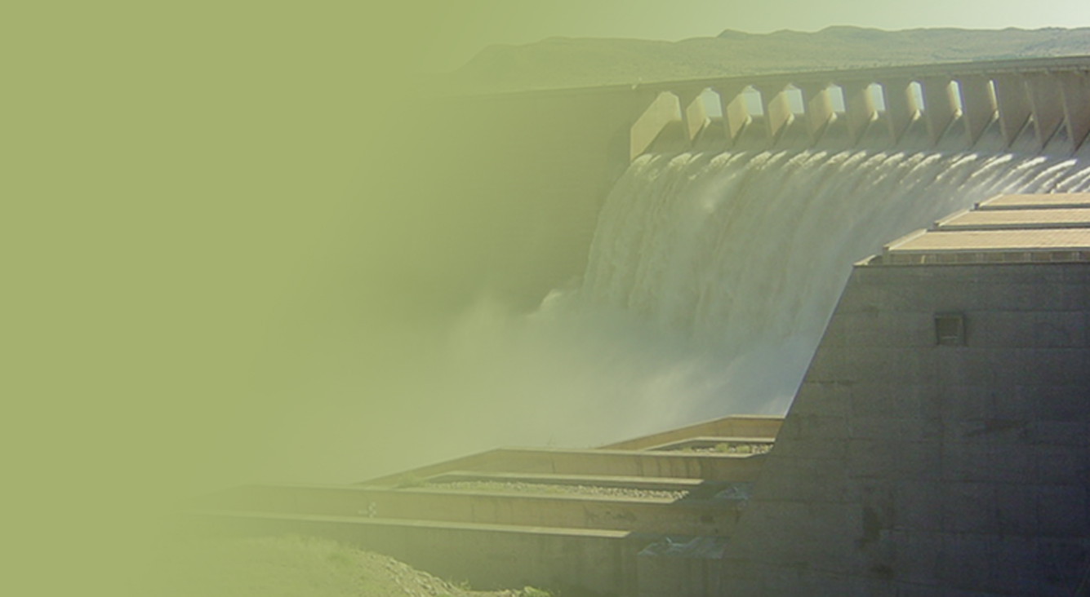
Standing Committee on Public Accounts Public Hearing
Deviations and Expansions for 2016/17 Financial Year
Water Trading Entity (WTE)
Presented by: Paul Nel
PRESENTATION TITLE
Presented by:
Name Surname
Directorate
Date

Slide 2
PRESENTATION OUTLINE
Deviations for 2016/17
Contract Expansions for 2016/17

Slide 3
DEVIATIONS – 2016/17
The accounting officer has authority to approve deviations emanating from emergency appointments and sole service providers. After approval by the Accounting Officer, National Treasury (NT) needs to be notified.
Deviations from the appointment of preferred service providers require approval by the National Treasury.
The WTE had 18 deviations made up as follows:
Emergency 1: R646 million (within AO delegation)
Sole service provider 7: R16 million (within AO delegation)
Preferred service provider 4: R7million (all approved by NT)
Preferred service provider (before issuance on NT instruction note) 5: R17 million
Not approved by NT and cancelled 1: R308 thousand

Slide 4
EXPANSIONS/VARIATIONS – 2016/17
39 Contract expansions (variation orders) were approved during the 2016/17 financial year.
Within accounting officers delegation (less than 15%) 9: R37million
Within accounting officers delegation (above 15% but before issuance on NT instruction note) 1: R123 thousand
Within accounting officers delegation (no monetary implications, extension of time only) 28: R0
Above accounting officers delegation (above 15%) 1: R21million (approved by National Treasury)

