Slide 1
Briefing to the portfolio committee on health
CAPE TOWN

Slide 2
Introductory Remarks
Thank you for the opportunity to present the situation from the Western Cape
We have covered the areas as requested – if more detail is required it can be provided.
The Annual Performance Plan (APP) and the Annual Report for the Department are other main sources of information on plans and performance.
The focus is mainly on hospitals but some areas related to DHS and PHC.

Slide 3
Governance & Leadership

Slide 4

Long term Vision : Healthcare 2030 - the Road to Wellness
https://www.westerncape.gov.za/assets/departments/health/healthcare2030.pdf

Slide 5
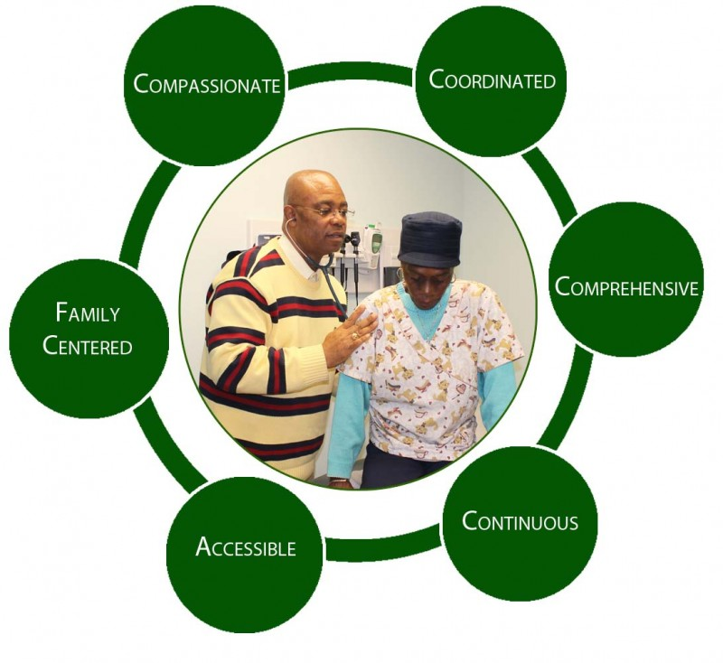
Our Vision: Healthcare 2030 – Aligned to the NDP
People centred care
Transformational Leadership and Governance
Integrated Systems Approach
Shift to Wellness: Universal Health Coverage

Slide 6
Governance & Leadership
Health is a basic Human right and the provincial Health Department has a Constitutional role and responsibility in this regard. It needs to optimally organise itself for good governance of its mandate.
Good governance imperatives related to the above need to address:
  The governance of the health system and the strengthening of the health system (governance of Health), as well as;
  The joint action of the health and non-health sectors, of the public private sectors and of the citizens for improved health (governance for health).
The Accounting Officer/HOD and senior team responsible for both
Governance arrangements furthermore clarify decision-making across all levels, and delegated authority
Established governance arrangements for strategy, ensuring accountability, effective monitoring and evaluation, and managing operations within the Department.
Subscribe to King IV Governance guidelines for performance, accountability, ethical culture and sustainability/legitimacy
Unqualified audit for 13 years

Slide 7
Top Executive Health Governance Arrangements
Head of Department
OPEXCO
Top Management
(TEXCO)
MEC: Health
M&E
FMC
DHS Exco
Central Hospital Exec
Strategic Governance Exec

Slide 8
Governance & Leadership
TEXCO : Provides policy and strategy for the Department and is the top decision –making management structure of the Department
Strategic Governance Exec (SGE) : The SGE is an executive body that acts as the strategic catalyst to promote synchrony, symmetry and alignment. The SGE advises the HOD and makes recommendations to the TEXCO as the top decision-making body.
OPEXCO : Oversees the service delivery mandate of the Department, and integrate clinical support services for reliable and responsive services. Opexco has 2 sub-committees - DHS Exco and Central Hospitals Exco
FMC : to monitor performance related to financial management accounting functions and SCM across the department. sectors, programmes and decentralised entities
M&E : performance review approach to monitor and evaluate performance and progress and against milestones and targets towards achieving milestones and targets of the Dept.

Slide 9

Other Statutory Governance structures
  Provincial Health Council
  District Health Councils in all districts
  Hospital Boards and Clinic Committees :
    Legislation amended in 2017 and regulations passed in 2018
    Implementation in progress
    Formalises the establishment of clinic committees.

Slide 10
Governance for Health:
Whole of Society Approach (WoSA)

Slide 11
Value Proposition and Strategic Intent
To positively change the story of people in the WC
Use a learning lens where WoG and WoS connect and collaborate towards a shared purpose
Integrate economic and social transformation strategies
To achieve safe, socially connected, resilient and empowered citizens and communities with equitable access to services and opportunities
Use a range of policy parameters through a lens of the Bill of Rights to ensure global connectedness, yet local relevance.

Slide 13
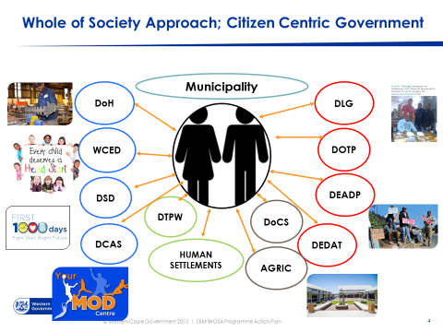
Citizen centric approach

Slide 14
Quality of Care

Slide 15
Total Health Service outputs : 2017/18
The Department remains under significant service pressures. Some of the outputs of the Department for the 2017/18 year include:
  14.1 million primary care contacts (this does not include contacts in home and community based care setting).
  92 816 babies were delivered during 2017/18.
  85 822 children under 1 year, immunised: The Department achieved 81.2% immunisation coverage during the 2017/18 period.
  537 706 separations ( mainly patients admitted) in acute hospitals.
  256 821 patients on ART;
  A total of 492 303 emergency cases were attended to of which 29.5 % were priority one

Slide 16
Health Outcomes
The WC has amongst the best health outcomes in the country:
  Life Expectancy :
    Increased over last 15 years
    Men : 66,8yrs
    Women : 71,8yrs
  In facility 57 per 100 000 in facility maternal mortality ratio.
  In facility neonatal mortality rate : 9 per 1 000 live births
  Infant Mortality rate : 19,3
  U5MR : 23,5
  0.5 % cent mother to child HIV transmission rate. This is one of the major achievements in recent years and has changed the life course projections of children in this province
  80.2 per cent TB treatment success rate

Slide 17
Complaints and Compliments per Category
Total number of complaints
= 4887
Total number of compliments = 11816

Slide 18
Complaints & Compliments
Care and Professional Treatment:
Highest number of Complaints 1 586 (32%) Greatest number of Compliments 8 357 (71%)
The complaints in this category :
Dissatisfaction with care and treatment received
  Poor service delivery
  Facilities require more doctors
Compliments in this category:
  Good service
  Excellent care and professional treatment
  Competent caring and compassionate staff.
Waiting Times
2nd highest number of complaints 1106 (23% ) only 237 (2%) compliments y.
The complaints in this category:
  Waiting times to see health professionals
  Waiting times for appointments
  Waiting times at pharmacies
The compliments in this category:
  Reduced waiting times for chronic medication were patients receive medicines from the Chronic Dispensing Unit
Staff Attitudes
3rd highest number of complaints 930 (19% ) of the total number of compliments however this category also received 2 141 compliments (18%) of the total number of compliments.

Slide 19
Strategies for Improving the Patient Experience of Care:
Care and Professional Treatment
Strengthening Clinical Governance
IT system enhancements reduce load on staff
Outreach programmes
NCS and IC
Waiting Times
Appointment Systems
Patient flow management to reduce the number of attendances and eliminating touch points which do not add value.
Registry hygiene project
Alternate sites for the dispensing of chronic medication
Monitoring Waiting times
Manage Waiting lists for elective surgery
Help desks and queue marshals
Improving NCS and IC
Staff Attitudes
Staff wellness programmes
Managing and assisting staff involved in complaints related to staff attitudes
Leadership Behaviour’s Charter on Values
Staff recognition, leadership development, culture change

Slide 20

National core standards: self-assessments
2017/18 (54 hospitals)
 | ACTUAL
District Hospitals | 81.12%
General Hospitals | 88.76%
TB Hospitals | 85.52%
Psychiatric Hospitals | 87.88%
Rehab Hospital | 95.97%
Specialized Hospital Mowbray Maternity | 75.38%
Central & Tertiary Hospitals | 80.56%

Slide 21
Ideal Clinic Status 2017/18
IDEAL CLINIC
179/ 191 (94%) facilities conducted status determination to determine their Ideal Clinic Status,
106 (59%) achieved Ideal Clinic Status.

Slide 22
Landscape of the Western Cape Department of Health

Slide 23
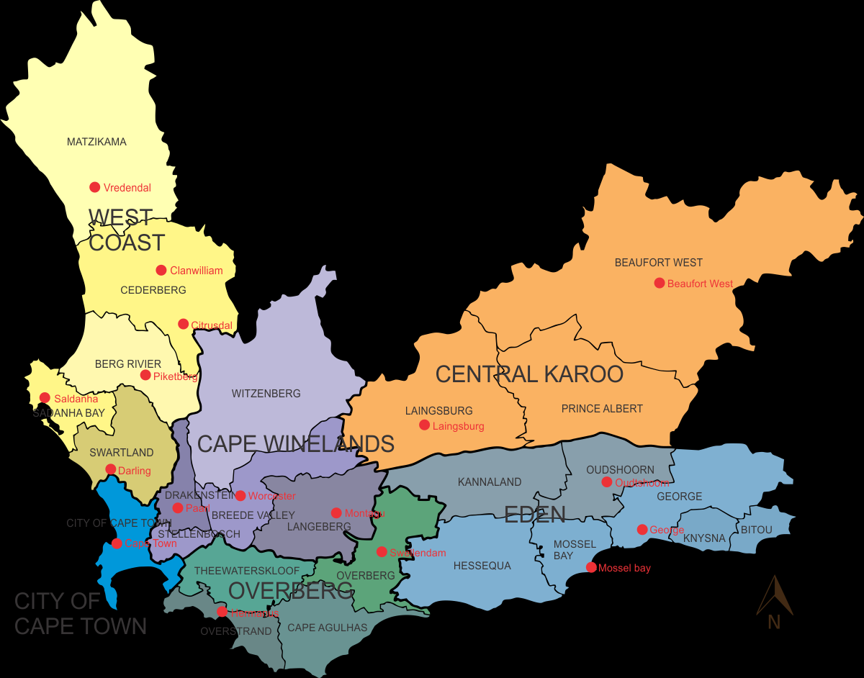
Western Cape Health district and Sub district areas
Total population : 6 510 312
The 2017 mid-year population by StatsSA

Slide 24
Service Continuum
Service delivery platform for 2030
Community Based Services
Facility Based Services
Regional Hospitals (L2)
Tertiary & Central Hospitals (L3)
District Hospital (L1)
Specialised Services
(EMS & FPS)
Specialised Hospitals
TB, Psychiatry, Rehabilitation, Dental
Acute Care
Primary Health Care

Slide 25
Geographic Based Integrated model of care
Central/ Tertiary Hospital
FPS
FPS
EMS
EMS
Regional Hospital
Spec Hospital
Spec Hospital
District Hospital
District Hospital
District Hospital
CHW team
CHW team
PHC facility
PHC facility
CHW team
CHW team
Inter-mediate care

Slide 26
District Health Service Profiles

Slide 27
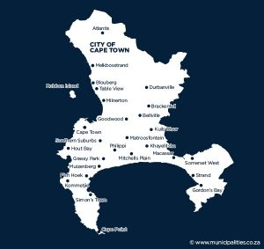
Cape Metropole
Sub-districts (8):
  Population estimates 2018/19:
  Total population 4 140 564
  Children under 5 years 336 046
  Geographic area: 129,462 km2
Population density: 1,530 m²
  Access PHC utilisation rate: 2.3
About two-thirds live in the metropolitan area of Cape Town, which is also the provincial capital
Facilities | City of Cape Town | PGWC | TOTAL
Clinic | 70 |  | 70
Community Day Centre | 12 | 33 | 45
Community Health Centre |  | 10 | 10
Satellite Clinic | 15 |  | 15
Mobile Service | 4 | 2 | 6
District Hospital |  | 9 | 9
Specialised TB Hospital |  | 2 | 2
Regional Hospitals | New Somerset Hospital
 | Mowbray Maternity Hospital
Specialised Psychiatric Hospital | Alexandra Hospital
 | Lentegeur Hospital
 | Stikland Hospital
 | Valkenberg Hospital
Specialised Rehabilitation Unit | Western Cape Rehabilitation Centre

Slide 28
Metro Health Services
Expected patient volumes for 2018/19:
  PHC headcounts = 9 644 822
  PHC utilisation rate = 2.3
  Inpatients (separations) in district hospitals = 148 499
  Bed utilisation rate = 94%
  Average length of stay = 3.9
Expected HAST outcomes 2018/19:
  Clients remaining on ART = 205 256
  HIV tests done = 94 0365
  TB client treatment success rate = 81.3%
Leading underlying natural causes of death, 2015:
[Source: Mortality and causes of death in South Africa, 2015: Findings from death notification, Statistical Release P0309.3]
  Diabetes mellitus (7.5%)
  HIV (6.3%)
  Ischaemic heart disease (5.7%)
  Cerebrovascular disease (4.9%)
  TB (4.5%)
  Chronic lower respiratory disease s (4.4%)
  Malignant neoplasms (4.3%)
  Malignant neoplasms of respiratory and intrathoracic organs (4.2%)
  Hypertensive diseases (4.1%)
  Other forms of heart disease (3.1%)
Expected MCWH and First 1 000 days outcomes 2018/19:
  Antenatal visits before 20 weeks = 66.6%
  Infant 1st PCR test positive around 10 weeks rate = -0.7%
  Immunisation coverage under 1 year = 79.9%
  Total number of deliveries = 61 124
  Delivery in 10 to 19 years in facility rate = 8.9%
  Cervical cancer screening coverage 30 years and older = 54.4% (60 730)
  School Grade 1 learners screened = 29 988

Slide 29
NUMBER OF BEDS: METRO HEALTH SERVICES
Regional Hospital | New Somerset Hospital | 334
 | Mowbray Maternity Hospital | 205
Specialised Psychiatric Hospital | Alexandra Hospital | 300
 | Lentegeur Hospital | 722
 | Stikland Hospital | 318
 | Valkenberg Hospital | 360
 | TOTAL | 1700
Specialised Rehabilitation Unit | Western Cape Rehabilitation Centre | 156
District Hospitals
City of Cape Town Metropolitan Municipality
Sub-district | Facility | Beds
Eastern | Eerste River Hospital | 150
 | Helderberg Hospital | 162
Cape Town Southern Health sub-District | False Bay Hospital | 76
 | Victoria Hospital | 184
Cape Town Western Health sub-District | Wesfleur Hospital | 50
Khayelitsha Health sub-District | Khayelitsha Hospital | 300
Klipfontein Health sub-District | GF Jooste Hospital | 30
Mitchells Plain Health sub-District | Mitchells Plain Hospital | 361
Tygerberg Health sub-District | Karl Bremer Hospital | 311
TOTAL |  | 1624
Specialised TB Hospital | Brewelskloof TB Hospital | 199
 | Brooklyn Chest Hospital | 349
 | DP Marais TB Hospital | 260
 | Harry Comay TB Hospital | 85
 | Malmesbury Infectious Disease Hospital | 49
 | Sonstraal TB Hospital | 84
 | TOTAL | 1026

Slide 30
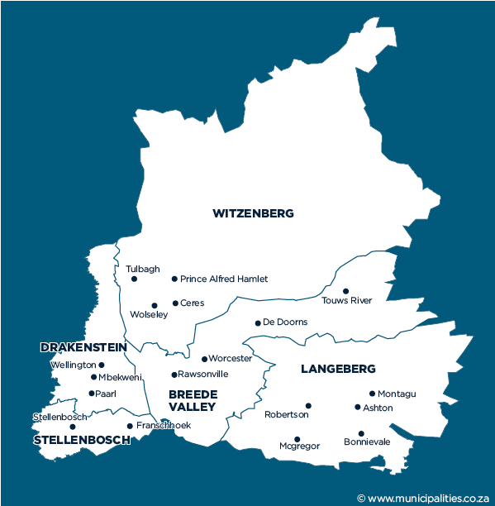
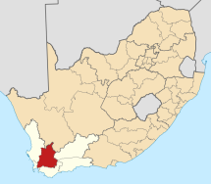
Rural Health Services - Cape Winelands District
Sub-districts (5):
  Drakenstein
  Stellenbosch
  Witzenberg
  Breede Valley
  Langeberg
Facilities:
  6 community day centres (CDCs)
  39 fixed clinics
  5 satellite clinics
  28 mobiles
  4 district hospitals
  1 specialised TB hospital
  Population estimates 2018/19:
  Total population 916 385
  Children under 5 years 80 611
  Geographic area: 21 473 km²
  Population density: 43
Rural district with the highest population density

Slide 31
Rural Health Services - Cape Winelands District
Expected patient volumes for 2018/19:
  PHC headcounts = 1 647 613
  PHC utilisation rate = 1.8
  Inpatients (separations) in district hospitals = 27 290
  Bed utilisation rate = 77.9%
  Average length of stay = 2.7 days
Expected HAST outcomes 2018/19:
  Clients remaining on ART = 32 119
  HIV tests done = 196 865
  TB client treatment success rate = 80.6% (7 188)
Leading underlying natural causes of death, 2015:
[Source: Mortality and causes of death in South Africa, 2015: Findings from death notification, Statistical Release P0309.3]
  HIV disease (7.2%)
  Cerebrovascular diseases (6.9%)
  Diabetes mellitus (6.7%)
  Tuberculosis (6.6%)
  Chronic lower respiratory diseases (6.2%)
  Ischaemic heart diseases (5.5%)
  Malignant neoplasms (5.0%)
  Malignant neoplasms of resp & intrathoracic organs (5.0%)
  Hypertensive diseases (3.3%)
  Other forms of heart disease (3.2%)
Expected MCWH and First 1 000 days outcomes 2018/19:
  Antenatal visits before 20 weeks = 75.5% (13163)
  Infant 1st PCR test positive around 10 weeks rate = 1.0% (1 290)
  Immunisation coverage under 1 year = 67.9% (15 827)
  Total number of deliveries = 14 352
  Delivery in 10 to 19 years in facility rate = 11.9%
  Cervical cancer screening coverage 30 years and older = 55.3% (22 525)
  School Grade 1 learners screened = 9 756

Slide 32
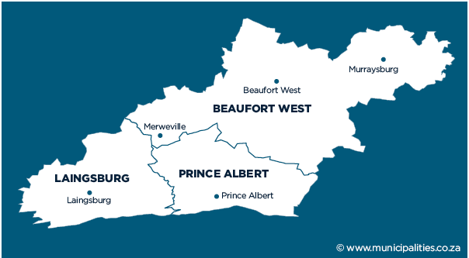
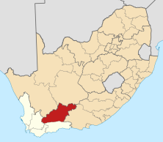
Rural Health Services – Central Karoo District
Sub-districts (3):
  Beaufort West
  Laingsburg
  Prince Albert
Facilities:
  1 community day centre (CDC)
  8 fixed clinics
  3 satellite clinics
  7 mobiles
  4 district hospitals
  0 specialised TB hospitals
  Population estimates 2018/19:
  Total population 76 828
  Children under 5 years 7 110
  Geographic area: 38 854 km²
  Population density: 2
This district has the smallest population BUT covers the largest geographic area

Slide 33
Rural Health Services – Central Karoo District
Expected patient volumes for 2018/19:
  PHC headcounts = 207 363
  PHC utilisation rate = 2.7
  Inpatients (separations) in district hospitals = 10 879
  Bed utilisation rate = 70.1%
  Average length of stay = 2.8 days
Expected HAST outcomes 2018/19:
  Clients remaining on ART = 1 970
  HIV tests done = 36 098
  TB client treatment success rate = 83.5% (599)
Leading underlying natural causes of death, 2015:
[Source: Mortality and causes of death in South Africa, 2015: Findings from death notification, Statistical Release P0309.3]
  Chronic lower respiratory diseases (9.1%)
  Tuberculosis (6.7%)
  Cerebrovascular diseases (6.2%)
  HIV disease (5.2%)
  Diabetes mellitus (5.2%)
  Hypertensive diseases (5.2%)
  Malignant neoplasms (4.1%)
  Malignant neoplasms of resp & intrathoracic organs (4.0%)
  Ischaemic heart diseases (4.0%)
  Other forms of heart disease (3.8%)
Expected MCWH and First 1 000 days outcomes 2018/19:
  Antenatal visits before 20 weeks = 74.7% (1239)
  Infant 1st PCR test positive around 10 weeks rate = 1.1% (94)
  Immunisation coverage under 1 year = 72.3% (1 349)
  Total number of deliveries = 1 000
  Delivery in 10 to 19 years in facility rate = 15.8%
  Cervical cancer screening coverage 30 years and older = 73.9%
  School Grade 1 learners screened = 1 119

Slide 34
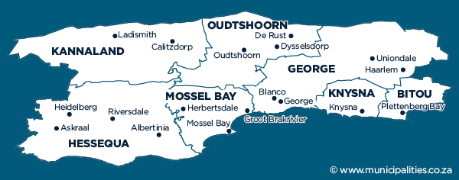
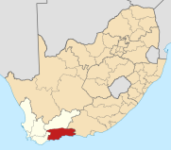
Rural Health Services – Eden District
Rural district with the 2nd highest population
Sub-districts (7):
  Kannaland
  Hessequa
  Oudtshoorn
  Mossel Bay
  George
  Knysna
  Bitou
Facilities:
  6 community day centre (CDC)
  36 fixed clinics
  13 satellite clinics
  21 mobiles
  6 district hospitals
  1 specialised TB hospitals
  Population estimates 2018/19:
  Total population 628 623
  Children under 5 years 53 492
  Geographic area: 23 331km²
  Population density: 27

Slide 35
Rural Health Services – Eden District
Expected patient volumes for 2018/19:
  PHC headcounts = 1 429 466
  PHC utilisation rate = 2.3
  Inpatients (separations) in district hospitals = 41 690
  Bed utilisation rate = 83.0%
  Average length of stay = 2.9 days
Expected HAST outcomes 2018/19:
  Clients remaining on ART = 25 837
  HIV tests done = 149 862
  TB client treatment success rate = 78.1% (4 849)
Leading underlying natural causes of death, 2015:
[Source: Mortality and causes of death in South Africa, 2015: Findings from death notification, Statistical Release P0309.3]
  Tuberculosis (7.0%)
  HIV disease (6.7%)
  Cerebrovascular diseases (6.6%)
  Ischaemic heart diseases (6.4%)
  Diabetes mellitus (6.2%)
  Chronic lower respiratory diseases (5.8%)
  Malignant neoplasms of resp & intrathoracic organs (4.9%)
  Malignant neoplasms (4.6%)
  Other forms of heart disease (3.7%)
  Hypertensive diseases (3.4%)
Expected MCWH and First 1 000 days outcomes 2018/19:
  Antenatal visits before 20 weeks = 80.5% (8 919)
  Infant 1st PCR test positive around 10 weeks rate = 1.5% (986)
  Immunisation coverage under 1 year = 92.5% (10 670)
  Total number of deliveries = 8 899
  Delivery in 10 to 19 years in facility rate = 13.3%
  Cervical cancer screening coverage 30 years and older = 71.7% (16 494)
  School Grade 1 learners screened = 2 444

Slide 36
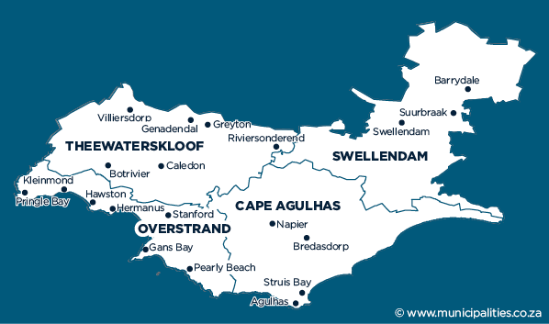
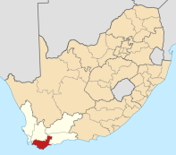
Rural Health Services – Overberg District
Sub-districts (4):
  Theewaterskloof
  Overstrand
  Cape Agulhas
  Swellendam
Facilities:
  2 community day centres (CDCs)
  17 fixed clinics
  9 satellite clinics
  14 mobiles
  4 district hospitals
  0 specialised TB hospital
  Population estimates 2018/19:
  Total population 293 506
  Children under 5 years 23 991
  Geographic area: 12 239 km²
  Population density: 24
District with the 2nd lowest population in the Western Cape (after the Central Karoo)

Slide 37
Rural Health Services – Overberg District
Expected patient volumes for 2018/19:
  PHC headcounts = 746 642
  PHC utilisation rate = 2.5
  Inpatients (separations) in district hospitals = 18 681
  Bed utilisation rate = 70.7%
  Average length of stay = 2.8 days
Expected HAST outcomes 2018/19:
  Clients remaining on ART = 12 987
  HIV tests done = 79 942
  TB client treatment success rate = 87.4% (1 755)
Leading underlying natural causes of death, 2015:
[Source: Mortality and causes of death in South Africa, 2015: Findings from death notification, Statistical Release P0309.3]
  Ischaemic heart diseases (7.1%)
  Cerebrovascular diseases (6.6%)
  Malignant neoplasms of resp & intrathoracic organs (6.5%)
  Diabetes mellitus (6.1%)
  Chronic lower respiratory diseases (5.6%)
  Tuberculosis (5.0%)
  Malignant neoplasms (4.9%)
  Hypertensive diseases (4.0%)
  Other forms of heart disease (3.3%)
  Influenza and pneumonia (2.8%)
Expected MCWH and First 1 000 days outcomes 2018/19:
  Antenatal visits before 20 weeks = 78.6% (4 488)
  Infant 1st PCR test positive around 10 weeks rate = 0.4% (553)
  Immunisation coverage under 1 year = 67.3% (4 684)
  Total number of deliveries = 3 137
  Delivery in 10 to 19 years in facility rate = 13.8%
  Cervical cancer screening coverage 30 years and older = 51.5% (7 502)
  School Grade 1 learners screened = 3 633

Slide 38
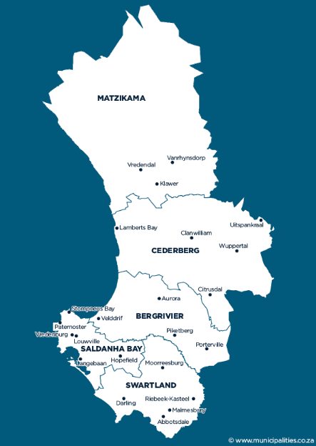
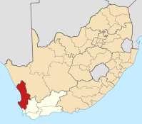
Rural Health Services – West Coast District
Sub-districts (5):
  Matzikama
  Cederberg
  Bergrivier
  Saldanha Bay
  Swartland
Facilities:
  1 community day centre (CDC)
  26 fixed clinics
  23 satellite clinics
  14 mobiles
  7 district hospitals
  2 specialised TB hospital
  Population estimates 2018/19:
  Total population 459 683
  Children under 5 years 41 996
  Geographic area: 31 119 km²
  Population density: 15
2nd largest surface area - several towns and small dwellings are spread across the district

Slide 39
Rural Health Services – West Coast District
Expected patient volumes for 2018/19:
  PHC headcounts = 822 490
  PHC utilisation rate = 1.8
  Inpatients (separations) in district hospitals = 37 398
  Bed utilisation rate = 87.4%
  Average length of stay = 2.7 days
Expected HAST outcomes 2018/19:
  Clients remaining on ART = 11 831
  HIV tests done = 109 435
  TB client treatment success rate = 81.9% (3 849)
Leading underlying natural causes of death, 2015:
[Source: Mortality and causes of death in South Africa, 2015: Findings from death notification, Statistical Release P0309.3]
  Tuberculosis (7.9%)
  Diabetes mellitus (7.4%)
  Cerebrovascular diseases (7.2%)
  Chronic lower respiratory diseases (6.6%)
  Ischaemic heart diseases (5.8%)
  Hypertensive diseases (4.6%)
  HIV disease (4.6%)
  Malignant neoplasms (4.4%)
  Malignant neoplasms of resp & intrathoracic organs (3.7%)
  Other forms of heart disease (2.5%)
Expected MCWH and First 1 000 days outcomes 2018/19:
  Antenatal visits before 20 weeks = 73.9% (6 446)
  Infant 1st PCR test positive around 10 weeks rate = 1.2% (483)
  Immunisation coverage under 1 year = 74.7% (8605)
  Total number of deliveries = 4 264
  Delivery in 10 to 19 years in facility rate = 15.3%
  Cervical cancer screening coverage 30 years and older = 46.6% (11 220)
  School Grade 1 learners screened = 2 232

Slide 40
NUMBER OF BEDS: RURAL HEALTH SERVICES
Cape Winelands District Municipality
Sub-district | Facility | Beds
Langeberg | Montagu Hospital | 40
 | Robertson Hospital | 50
Stellenbosch | Stellenbosch Hospital | 85
Witzenberg | Ceres Hospital | 86
TOTAL |  | 261
Eden District Municipality
Sub-district | Facility | Beds
George | Uniondale Hospital | 13
Hessequa | Riversdale Hospital | 50
Kannaland | Alan Blyth Hospital | 30
Knysna | Knysna Hospital | 90
Mossel Bay | Mossel Bay Hospital | 90
Oudtshoorn | Oudtshoorn Hospital | 123
TOTAL |  | 396
Central Karoo District Municipality
Sub-district | Facility | Beds
Beaufort West | Beaufort West Hospital | 57
 | Murraysburg Hospital | 14
Laingsburg | Laingsburg Hospital | 20
Prince Albert | Prince Albert Hospital | 29
TOTAL |  | 120
Overberg District Municipality
Sub-district | Facility | Beds
Cape Agulhas | Otto Du Plessis Hospital | 30
Overstrand | Hermanus Hospital | 71
Swellendam | Swellendam Hospital | 51
Theewaterskloof | Caledon Hospital | 50
TOTAL |  | 202
West Coast District Municipality
Sub-district | Facility | Beds
Bergrivier | LAPA Munnik Hospital | 10
 | Radie Kotze Hospital | 31
Cederberg | Citrusdal Hospital | 34
 | Clanwilliam Hospital | 50
Matzikama | Vredendal Hospital | 75
Saldanha Bay | Vredenburg Hospital | 81
Swartland | Swartland Hospital | 41
TOTAL |  | 322

Slide 41
Rural Regional Hospitals
Hospital | No of Beds
George | 272
Paarl | 331
Worcester | 271

Slide 42
Central Hospitals
Type of Hospital | Facility | Beds
National Central Hospital | Groote Schuur Hospital | 975
 | Tygerberg Hospital | 1384
 | TOTAL | 2359
Tertiary Hospital | Red Cross War Memorial Children's Hospital | 272

Slide 43
Emergency services and Patient Transport

Slide 44
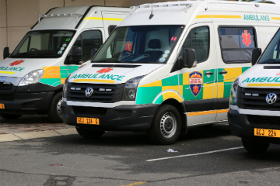
EMERGENCY SERVICES AND PATIENT TRANSPORT
  49 stations (excluding 6 satellite bases) in 5 rural district and 4 Cape Town divisions
  A total of 492 303 emergency cases were attended to in 2017/18.
  Urban Response for priority one calls within 15min : 59,5%
  Rural Response within 40 min : 79,3%
  Response times affected by :
  13% calls in Red Zones
  Staff off owing PTSD
  Having to wait for SAPS to accompany ambulances in these zones.

Slide 46
Patient transport
  The HealthNet pick-up points for patients has been reviewed and improved across all rural districts, in order to improve the experience of patients, that have to be transported to bigger centres for specialist appointments.
  Healthnet within metro is being reviewed and its impact on inter-facility transfers will impact on freeing up ambulances and their response times.
  Electronic booking system has been developed and operating since MARCH 2016 and available to all facilities on network.
A FLEET OF 79 Vehicles
46-Tango
33-HT Tango
Shared EMERGENCY CENTRE OPERATORS
130 OPERATIONAL PERSONNEL
7 MANAGERS

Slide 47
Referral system

Slide 48
REFERRAL SYSTEM
  Referral systems in the department are decentralised, supported by Standard Operating Procedures within the geographic Area
  This includes:
    Minor illness or injuries are treated at Primary Health Care facilities such as a Clinic or a Community Health Centre (CHC). This should be the patient's first entry point into the public health service as many services are offered. A specially trained nurse will treat the patient and refer you to a doctor if your condition requires it.
    More serious conditions are referred to the next level of care which is a District Hospital. Should the patient's condition need further investigation or intervention, the nurse or doctor will make an appointment for them at the District Hospital closest to their home.
  The Department is putting mechanisms in place to implement electronic referral systems. Electronic discharge record has been rolled out over the last 2 years.

Slide 49
Geographic Population based approach
Metro
West
Tertiary
Metro
East
GSH/ RCWMCH
TBH
5 Rural
Districts
MMH
NSH
GH
Paarl
WH
KBH
ERH
HH
KH
KlF
MPH
VH
WFH
DHx7
DHx7
DHx7
FBH
PHC
PHC
PHC
PHC
PHC
PHC
PHC
PHC
PHC
PHC
PHC
CBS
CBS
CBS
CBS
CBS
CBS
CBS
CBS
CBS
CBS
CBS

Slide 50
TB Management

Slide 51
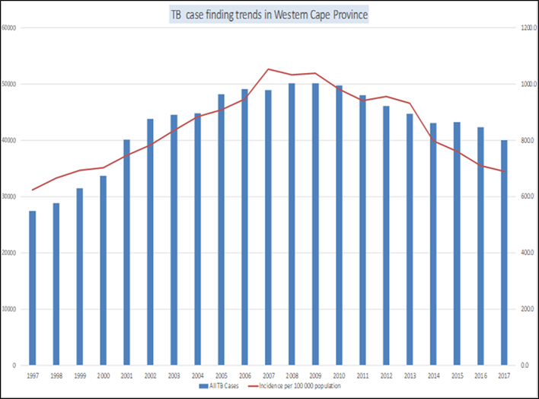
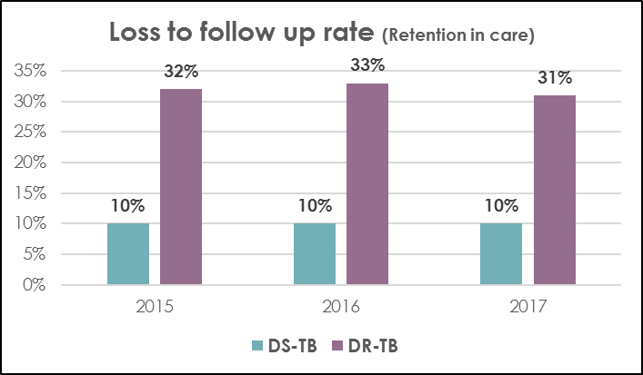
TB management, defaulter rate and prevalence
Challenges:
  Initial loss to follow up rate
  Retention in care
  Socio-economic (alcohol and drug abuse) determinants has a great impact on the high loss to follow-up rate
  Reporting of HIV+ patients initiated on TB prophylaxis (IPT)
Strides/ Achievements:
  Decrease in number of patients diagnosed with TB
  Decentralized TB services to PHC facility
  Early initiation on TB treatment:
    12-48 hours for DS-TB
    5-12 days for DR-TB after diagnosis.
  Two new TB agents introduced to DR-TB treatment regimens
  Implementation of the shorter DR-TB regimen - decreases the patients treatment journey from 24 months to 9 months
  Introduction of Urine TB LAM – screening test for early detection of TB in HIV positive patients
Notes:
According to the data the incidence rate in TB is decreasing. The peak can be noted in 2007, where after a gradual decrease is noted. This could be attributed to the introduction and sustainability of the ART programme and the GeneXpert which enabled patients to be initiated on treatment earlier.
The initial loss to follow up (ILTFU) rate is the number of patients who tested positive for TB but who was not commenced on treatment. DR-TB ILTFU rate average 20%. This is obtainable by the weekly Rifampicin resistant alerts received from NHLS. The districts, with the assistance from the Provincial Office, has implemented Quality Improvement plans to monitor the ILTFU on a weekly basis and early recalls of the patients who was not initiated on treatment.
The challenges with retention in care is attributed to the long duration of treatment with mild-severe adverse drug reaction. A shorter regimen, with more palatable treatment, endorsed by WHO, was implemented.
Reporting of IPT initiation remains a challenge as facilities are still not reporting. Intervention with regard to data management continues.
Early initiation of treatment is due to the implementation of the GeneXpert lab test which ensures that the patients lab results are available within 12-48 hours, hence the patient receive an appointment date in two days to return for their results. Previously it could take 72 days before a patient was commenced on DR-TB treatment due to the type of test that was done.
The two new DR-TB agents, Bedaquiline and Linezolid proves to have improved DR-TB treatment outcome. In addition Bedaquiline can also be used as drug- substitution for adverse drug reactions, such as Ototoxicity
The majority of the patients become loss to follow-up due to the long duration of the treatment. With the shorter regimen we foresee that more people will complete treatment

Slide 52
Community Based Services ( CBS)

Slide 53
COMMUNITY HEALTH WORKERS
1. The Dept contracts 90 NPOs, who appoint 3700 CCWs.
2. The functions of CCWs are moving from vertical specific (e.g HIV) to being generalised.
3. The main focus areas include prevention and promotion, adherence, follow from discharge.
4. Work 4 hours a day
5. Intention is to improve coverage and expand to 8 hour day depending on the availability of funds.
6. In 2017/18, 1154 CCWs were trained – formal accredited training leading to qualification in Ancillary Health Care
7. Paid proportional to R3000 per month

Slide 54
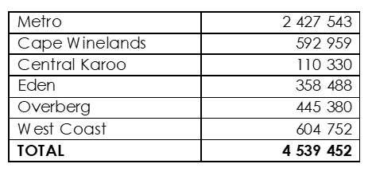
Stats on Home visits per district

Slide 55
Management of pharmaceuticals

Slide 56

FACTORS INFLUENCING MEDICINE AVAILABILITY
Medicine Availability
Pharmaceutical Contracts
Campaigns
Rational Medicine Use
Expired stock
Poor stock management
Seasonal demands
Transport systems
Sustainable finance
Donations
Chronic Dispensing Unit

Slide 57
Cape Medical Depot (CMD)
Provides for strategic stock holding within Dept.
Vehicle for ordering and delivery of medicines and vaccines.
Anticipate and pro-actively manage shortages
Interaction with suppliers – contract mx, penalties for non performance
Monitors irrational ordering practices.
Total items on Stock Masterfile = 2200
: 800 Pharmaceutical items
: 900 Non-pharmaceutical items
: 500 Direct Delivery Voucher lines
Oudtshoorn sub-depot services Eden and Central Karoo Districts

Slide 58
Monitoring Systems:
Medicine Availability JAC
  Overview of stock holding across JAC sites available at substructure/District/CMD
  Reflects stock on hand and orders placed for item at facility level
  Redistribution of stock arranged
  Top 20 reports by volume/ expenditure: mechanism to investigate irregular/ irrational ordering patterns

Slide 59

FACILITY LEVEL
Systems in place to monitor medicine availability
  System in place to proactively manage low stock levels, to escalate stock-outs from facility level and to immediately address medicine stock-outs when they occur
  SOP 4.5.1: Early warning systems for stock shortages

Slide 60
DIRECT DELIVERY OF MEDICINES
  The 3 Central Hospitals procure medicines directly from suppliers, independent of Cape Medical Depot.
  The Chronic Dispensing Unit uses direct delivery for 30 items; CMD responsible for procurement and payment of Direct Delivery orders.
  All other hospitals use a combination of orders via the depot and direct deliveries. CMD responsible for procurement and payment of Direct Delivery orders
  The current service model is reviewed from time to time

Slide 61
COMMUNICATION PROTOCOL (1)
  Reporting of medicine stock-outs
  The Cape Medical Depot compiles weekly report of medicines which are out of stock – referred to as “Dues-out report”
  The report is widely distributed to all relevant stakeholders including HOD and NDoH: Directorate Access to Affordable Medicines
Information provided in the report:
Medicine description Quantity on order
Quantity owed to facilities Expected date of delivery
Alternative pack sizes available PPTC recommendation
Suppliers’ communication with further information

Slide 62
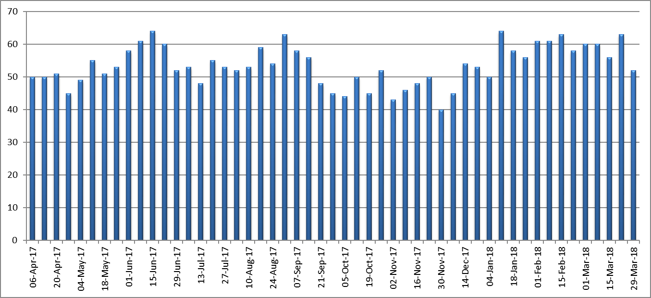
DUES OUT 2017/2018

Slide 63
Human Resources

Slide 64

HUMAN RESOURCES
In 2017/18 the Department had 31 549 employees of which:
  93% of employees are appointed in a permanent capacity.
  63% cent are health professionals
  37% administrative support staff
  72% are female and 28 per cent are male.
  30% are Black; 15 % are White, 53% are Coloured and 2% are Indian.
  51% of senior management positions are held by females.
  185 employees are classified as disabled.

Slide 65
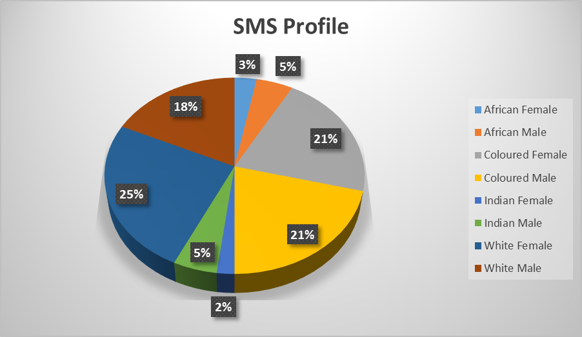
HUMAN RESOURCES

Slide 66
Distribution of Staff across the Department
Budget Programme | No of Staff
Prog. 1 | 688
Prog 2 | 12 096
Prog 3 | 1973
Prog 4 | 6362
Prog 5 | 9132
Prog 6 | 284
Prog 7 | 776
Prog 8 | 83
Approx 95% of staff within service programmes 2-5 + SP7.3 (FPS)

Slide 67
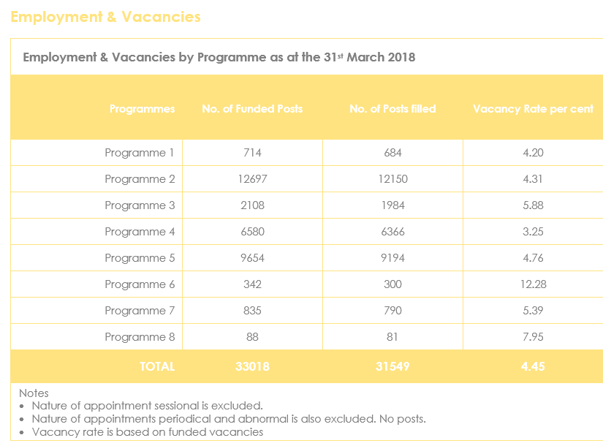
Vacancy rates per Budget programme

Slide 68
PM highlights
Have 31 549 staff
Barrets Survey to assess values alignment :
  26% entropy in 2011 to 18% in 2017.
  Improvement of 2 % in each of 4 assessments
Main Challenges :
  Impact of Increase in public sector wage bill
  Budget pressures limits filling of posts
  Staff safety
  Intractable service pressures

Slide 69
Infrastructure,
Health Technology,
Laundry and Waste Mx

Slide 70
Infrastructure ( Facilities Mx)
Status of Hospitals on the following
  Medical equipment
  Maintenance services
  Laundry services
  Management of healthcare waste
  Planning and maintenance of infrastructure

Slide 71
Medical Equipment
Fit-for-purpose equipment available at point of need

Slide 72
Service Delivery Strategy
  Evidence-based decision-making in support of optimal and equitable distribution of medical equipment resources (allocative efficiency).
  Life-cycle management (LCM) principles applied to optimise service potential and impact of medical equipment (operational efficiency).
  Safe and appropriate utilisation of medical equipment across all services.
  Hub-and-Spoke Maintenance to reduce medical equipment service/repair downtime
  Establishment of an integrated medical equipment maintenance and management system.

Slide 73
Service Configuration
  Funded by Equitable Share – R110m (ES) + Health Facility Revitalisation Grant – R62,5m (HFRG)
  Procurement :
    ES-funded equip by hospitals,
    HFRG-funded equip by Dir.: Health Technology
  In-house maintenance by clinical engineering workshops ;
    Groote Schuur + Tygerberg + Red Cross Children's Hospitals
    provincial workshop in Goodwood
    low-scale capability at George, Worcester, Khayelitsha and New Somerset Hospitals.
    total staff complement (technicians and technical assistants) of 64
  Complex Equipment maintenance - outsourced service and maintenance contracts

Slide 74
Service Challenges
  Insufficient budget (increasingly so) for replacement of ageing equipment
  Increasing maintenance workload not matched by corresponding increase in resources (human and financial)
  Sub-optimal allocative and operational management of medical equipment assets

Slide 75
Medical equipment
  Profile of medical equipment needs available by type of service
  Annual procurement plan based on needs and funding
  Integrated medical equipment maintenance and management system in partnership with stakeholders (including PT, NDoH and NT)
  Integrated Health Technology Strategy for WCGH including health technology assessment and innovation
  Implementation of medical equipment SOPs (Standard Operating Procedures) across the equipment life-cycle (from initial needs assessment to final disposal)
  Implementation of Hub & Spoke Maintenance service model and ensuring in-house clinical engineering/maintenance service sustainability
  Improved asset management and utilisation of medical equipment across all service levels and geographical areas.

Slide 76
Facilities management and Maintenance Service
Provide an efficient and effective maintenance service

Slide 77
Facilities Management Strategy
  Greater focus on maintenance of existing assets, thereby increasing functional lifespan
  Improving energy security & water security (monitoring of utility consumption)
  Reduced utilisation of medical gas
  WCG- Health is responsible for day to day, routine and emergency maintenance
  WCG-TPW is responsible for scheduled maintenance and capital projects, while WCG Health remains accountable.

Slide 78
Service Configuration
  Two in-house engineering workshops: Bellville (located at Karl Bremer Hospital)) and Zwaanswyk – assisting hospital workshops and health facilities by providing expertise and engineering support for maintenance work
  Third engineering workshop at Lentegeur in process of being established
  Routine, Day to Day and Emergency maintenance is undertaken by the professional engineering services team
  The mobile workshops provides maintenance services to all but central and tertiary hospitals (which have their own workshops).

Slide 79
Service Challenges
  Limited resources (human and financial) available
  Increasing operational costs (utilities)
  Maintenance backlog
  Scarce technical skills and great competition with private sector
  Western Cape Drought

Slide 80
Service Strategies to mitigate Challenges
  Improve capacity and efficiency
    Hub & Spoke model
  Utilities management
    Monitor usage (smart metering) and address issues
    Behaviour changes interventions
    Engineering interventions
  Maintenance backlog
    Monitoring and reporting
    Alternative procurement strategies
    Use of EPWP grant
  Western Cape drought
    Increased water usage monitoring and early leak detection
    Fixing water leaks has been prioritised
    Installation of water tanks to all health facilities
    Establish functional boreholes

Slide 81
Laundry Service
Provide an efficient and effective laundry service

Slide 82
Service Delivery Strategy
Keeping a balance between in-house and outsourced service, considering the following factors:
  In house capacity and return of capital investment
  Industry capacity, geographical location, and economic opportunities
  Risk mitigation for ensuring continuity in the services (e.g. industrial actions)
  Cost comparisons for assessing value for money

Slide 83
Service Configuration
  In-house Service (63% of the total service)
    Two regional laundries in Metro and surrounding areas (serving 21 hospitals)
      Lentegeur Laundry was recently upgraded (building and equipment) and is a very resource efficient facility,
      Tygerberg Laundry requires some upgrade, currently busy with a feasibility study for exploring few options.
    Some rural hospitals have an on-premise laundry and linen bank (13 hospitals)
  Out-sourced Service (37% of the total service) – serving 18 hospitals)
    Mostly in the rural districts (Eden, Cape Winelands, etc)
    Groote Schuur Hospital: very efficient laundry and linen management contract

Slide 84
Service Statistics (2017/18)
  In-house Service (63% of the total service)
    Total pieces treated: 13 million
    Total Cost: R66 million
    Average cost per piece: R5,03
    Cost breakdown:
      Personnel: 53%, Steam: 18%, Electricity: 9%, Water & Sewer: 7%, Detergent: 4%, Transport 4%, and Maintenance 3%, and Leases 3%
    Current workforce at regional laundries
      91 staff member at Tygerberg Laundry
      110 staff member at Lentegeur Laundry
  Out-sourced Service (37% of the total service)
    Total pieces treated: 7,7 million
    Total Cost: R29,4 million
    Average cost per piece: R3,80

Slide 85
Service Challenges
  Linen Losses
    19,87% of losses during 2016/17
  Cost of in-house service
      Mainly driven by salary wages
  Operations & Maintenance of industrial laundry equipment
      Cost linked to exchange rate
      Aging equipment
      Utility costs
  Western Cape Drought
    Water usage, availability, and cost

Slide 86
Service Strategies to mitigate Challenges
  Reducing Linen Losses:
    Performing regular linen audits, training and awareness campaign at facilities for performing physical stock counts,
    Exploring option to use Radio Frequency Identification Devices (RFID)
  Cost of in-house service
      Reducing G&S cost items
      Efficient use of staff and logistics (e.g. transport and routes)
  Operations & Maintenance of industrial laundry equipment
      Maintenance plan for new equipment
      Capital investment for replacing equipment considering the total cost of ownership (service life, maintenance, operations, etc)
      Energy and water saving equipment
  Western Cape Drought
    Water Security Programme: use of underground water (from boreholes)
    Optimised tunnel washers and washer-extractors use and loads

Slide 87
Management of Healthcare Waste

Slide 88
Service Delivery Strategy
World Health Organisation’s Core Principles
  A holistic approach to healthcare waste management should include :
      a clear delineation of responsibilities
      occupational health and safety programs
      waste minimisation and segregation
      the development and adoption of safe and environmentally sound technologies
      capacity building.

Slide 89
Service Delivery Framework
  Policy Framework for the Management of Health Care Risk Waste within WCG Health approved 15 September 2016
  Use of different technologies for treating HCRW reducing the amount of medical waste to be incinerated (source of pollution) – non-burn treatment technologies
  Total Ban of Mercury ( Minimata Declaration – SA is a signatory)

Slide 90
Service Configuration
Current
  Two service providers are responsible for the collection of HCRW
  One service provider is responsible for the removal and treatment of heavy metal waste
  One sterilisation heat friction system which treats infectious waste on-site
  Planned
  Incremental additional use of alternative technologies for the in hospital treatment of infectious and sharp waste and the disposal as general waste
    Reduce costs for infectious waste treatment
    Environmental friendly (transport and incinerator)

Slide 91
Service Statistics
  Benchmarks for weight of waste per bed by type of hospital developed.
  Generation of HCRW is also cyclical with peaks during winter and over December and January
  Last year 2 057 ton of HCRW from hospitals have been incinerated
  Upgrade of stores and provision of fridges for anatomical waste in recent years

Slide 92
Service Challenges & Mitigation Strategies
Service Challenges
  Only one HCRW disposal facility in Western Cape
  Limited HCRW service providers in the country
  Contribution to environmental pollution with the use of incinerators
  Increasing cost of the services
  Service Strategies to Mitigate Challenges
  Use of alternative on-site technologies
  Continuous training and awareness programmes for health operators
  Ensure adequate physical space and technology is available for HCRW

Slide 93
Planning and Maintenance of Infrastructure

Slide 94
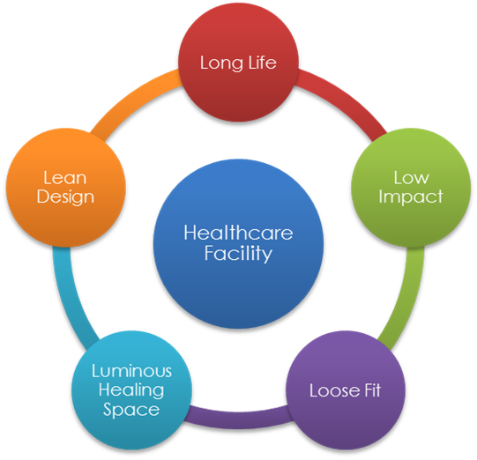
5Ls Strategy
  Long life
    Focus on infrastructure life cycle including
    maintenance
  Low Impact
    Sustainable use of natural resources and low
    carbon footprint
  Loose Fit
    Flexibility, expandability, adaptability
  Luminous Healing Space
    Healing environment for patient
    Efficient and pleasant working environment for staff
  Lean Design and Construction
    Integrated design and construction

Slide 95
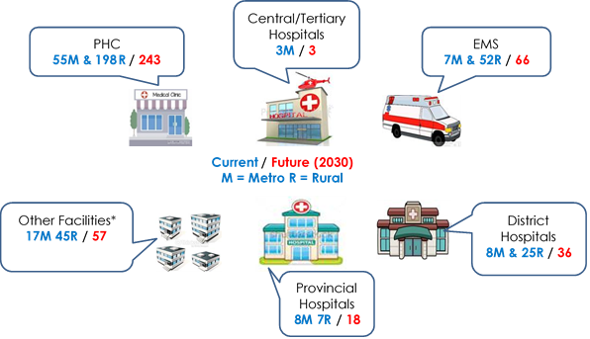
Service Configuration – Immovable Asset Portfolio

Slide 96
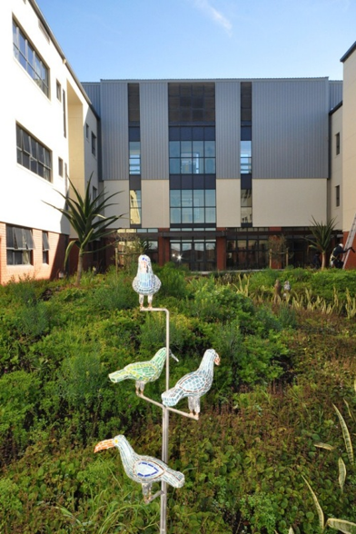
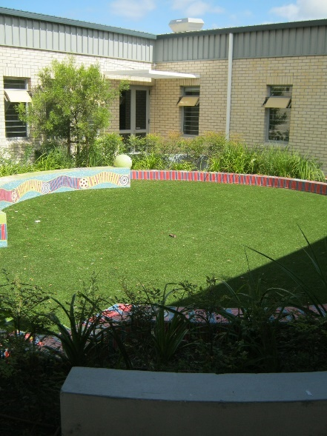
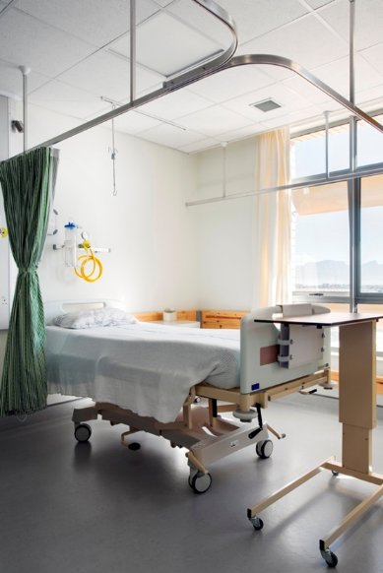
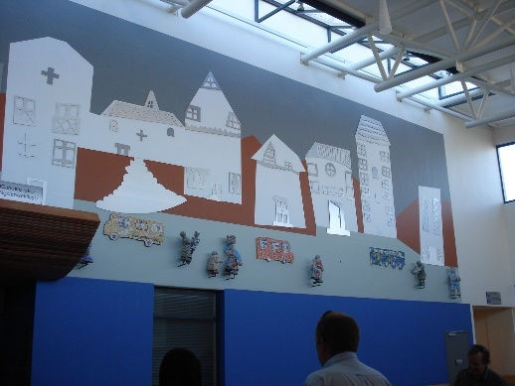
Infrastructure Priorities
Hospitals in the Metro and Rural (total number 52)
  Modernise (upgrade and extension) Emergency Centre
  Provide or upgrade acute psychiatric units
  Focus on maintenance and fire compliance
  Improve water and energy efficiencies
  Use of alternative water resources (underground water) instead of municipal water

Slide 97
Service Statistics
Maintenance and Infrastructure Backlog
  C5 new facilities (preventative maintenance)
  C4 facilities which require scheduled maint.
  C3 facilities which require upgrade
  C2 facilities which require rehabilitation
  C1 facilities beyond repairs
Condition Status | State owned |  | Leases
 | Health Facilities | Office Accommodation | Health Facilities
C5 | 9% | 4%
C4 | 35% | 21% | 18%
C3 | 52% | 63% | 63%
C2 | 3% | 13% | 19%
C1 | 1%

Slide 98
Capital projects Completed in 2017/18
  The new District Six CDC in Cape Town
  The new Hillside Clinic in Beaufort West
  The replacement of Napier Clinic
  The replacement of Prince Alfred Hamlet Clinic
  The new Bulk Store at Karl Bremer Hospital
  The new Emergency Centre at Stellenbosch Hospital
  The CT Scan and Ward Completion project at Khayelitsha Hospital
  The upgrading of the Emergency Centre at Tygerberg Hospital

Slide 99
Planned activities: Medium to Long Term
  The three Regional Hospitals have been revitalised over the past ten years
  New Regional Hospitals are planned: Klipfontein (to replace GF Jooste) and new Tygerberg
  Tygerberg Hospital Central to be replaced (mega project)
  District Hospitals: Helderberg, Swartland, and Victoria to be replaced
  New Metro District Hospital: Northern Hospital (Kraaifontein)

Slide 100
Challenges (1)
Maintenance Backlog
  Currently estimated R1 billion
  2017/18 Budget allocation split: 49,76% for Capital, and 50,24% for Maintenance
  Capital infrastructure new, replacement, upgrade, additions, refurbishment, and rehabilitation backlog
  Mainly related to Primary Health Care facilities (clinics, community day centre, and community health centre)
  Due to not suitable location, accessibility, adequate ventilation, insufficient space for providing full service package (hospitals and PHC)
  New hospitals are required mainly due to increasing population and urban developed areas to be serviced

Slide 101
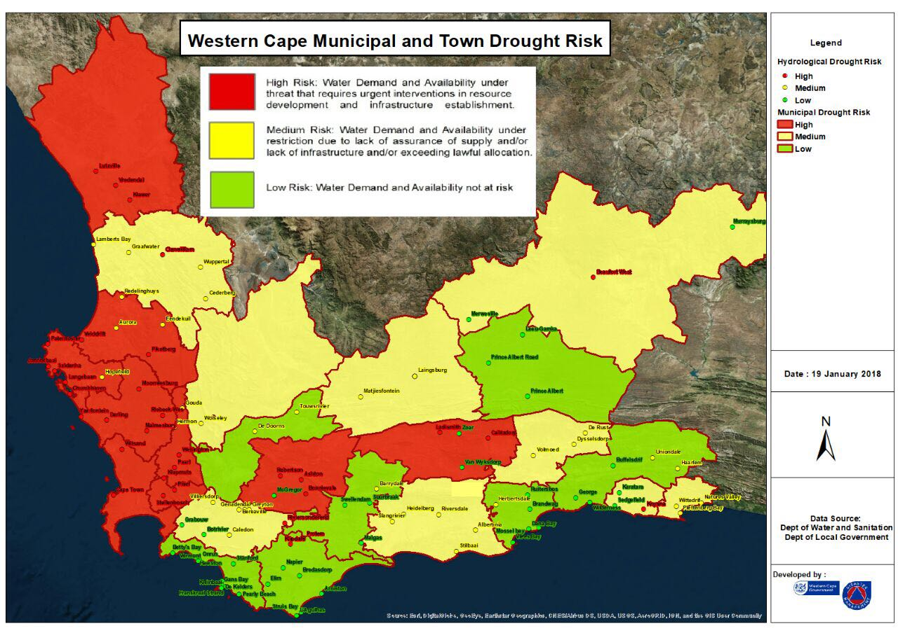
Challenges (2)
Drought, extreme climate events, and other disasters
  Reprioritisation of projects for providing alternative water source to hospital and primary health facilities
  Fire at Swartland Hospital, which destroyed most of the main hospital building
  Eden fire and Western Cape storm (9 June 2017)

Slide 102
Service Strategies to Mitigate Challenges
Maintenance Backlog
  Maintenance programme remains the highest priority in the budget allocation
  Focus on preventative maintenance for new facilities (built in the last 15 years)
  Strengthen the in-house maintenance capacity at all level
  Improve efficiency with the implementation of the hub & spoke model
  Capital infrastructure new, replacement, upgrade, additions, refurbishment, and rehabilitation backlog
  Project priorities where maximum impact on health outcomes is predicted
  Phasing approach to construction and commissioning
  Alternative procurement strategies (e.g. development and construct, target costs) for getting better value for money
  Drought, extreme climate events, and other disasters
  Water security programme at all hospitals affected by the drought
  Increase infrastructure resilience in dealing with climate change effects
  Focus on fire compliance at all facilities

Slide 103
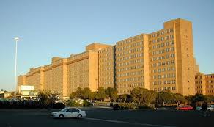
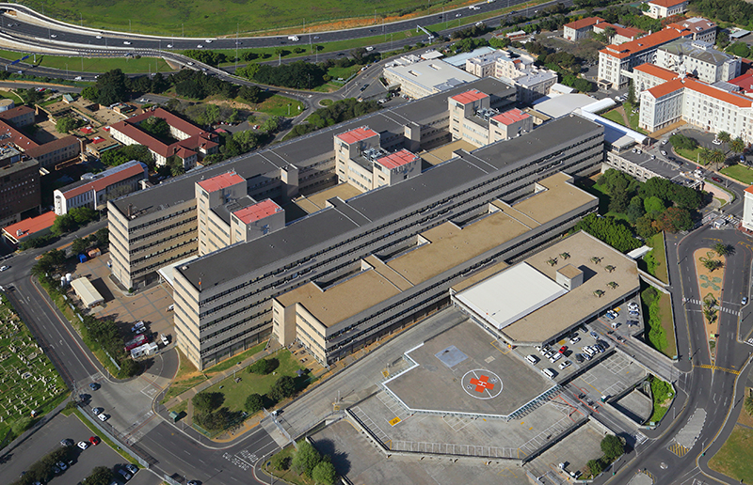
Central and Tertiary Hospitals
Tygerberg Hospital (central hospital)
  Current hospital is to be replaced due to physical conditions, suitability, and functionality (CSIR 2005)
  New Central Hospital (same site)
  New Regional Hospital (new site)
  Maintenance plan for existing hospital
  Partnership with Universities
  Alternative water supply
  Groote Schuur Hospital (central hospital)
  On going maintenance and alternative water supply
  Upgrade projects – Neonatal Unit and Neuroscience (in col. with UCT)
  Upgrade and extension of Emergency Centre
  Upgrade of engineering services
  Red Cross War Memorial Children hospital (Tertiary hospital)
  Of going maintenance and alternative water supply
  Partnership with the Children Hospital Trust for capital projects
  Alternative water supply

Slide 104
FINANCIAL SYSTEMS

Slide 105
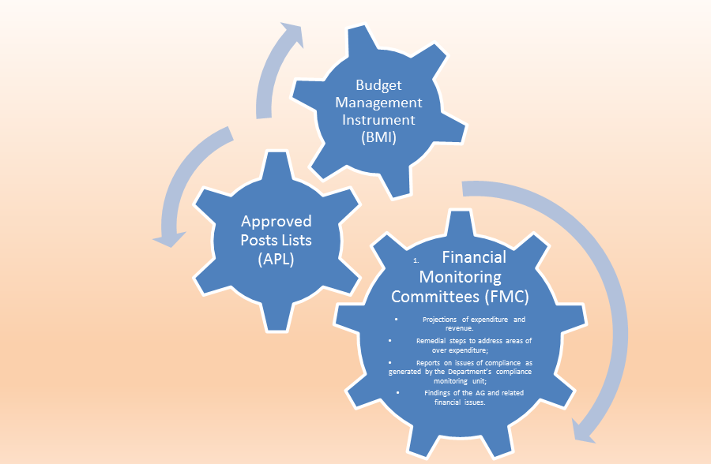
Budget Management tools

Slide 106
Budget Management Instrument (BMI)
1. The BMI is an excel tool that has been developed by the Department and used to project and monitor expenditure. Each facility receives such a spreadsheet, which includes all relevant information from BAS and PERSAL required for projections, including:
  Expenditure history, per month per item
  List of all staff and their costs
  Draft projection prepare by Head Office
2. The projections are completed by the facilities, checked by the regional offices and reported by Sector Management to Head Office. The BMIs enable the Department (or Institutional Head), to identify red flags and allows us to:
  Interrogate reasons for under/over expenditure
  Implement steps to curb under/over expenditure

Slide 107
Approved Posts Lists (APL)
  The WCG: Health staff costs comprise approximately 58% of the total costs.
  The Approved Post List (APL) is a tool that has been developed by the department to assist Institutional Heads to convert the staff budgets into a plan, indicating the number and categories of staff that will be appointed. These plans (APLs) are signed off by the regional offices and posts on PERSAL are activated accordingly. No posts may be filled unless it is on the APL.
  To employ staff additional to the existing establishment, managers are required to justify the creation of additional posts and be able to show that the posts are funded
  All posts are advertised by People Management (Head Office)
  Changes to the APL can be requested utilising the HF2 form. This form allows for adding and deleting posts, and even for moving funds from other budgets such as ‘Goods and Services’. The overall budget may not be increased, unless approved by the Head of the Department (HOD).
  This tool has been a great help to the department to remain within budget. It is a preventative control; prevent over-expenditure before it happens.

Slide 108
Financial Monitoring Committees (FMC)
  The FMC is chaired by the HOD and is attended by the various programme managers, the CFO and support staff. They meet monthly to discuss:
  Projections of expenditure and revenue.
  Remedial steps to address areas of over expenditure;
  Reports on issues of compliance as generated by the Department’s compliance monitoring unit;
  Findings of the AG and related financial issues.
  The Programme managers account for their financial performance and explain variations
  Each region (district or substructure) also has a monthly FMC. These meetings are attended by the CEO’s of the relevant Institutions.

Slide 109
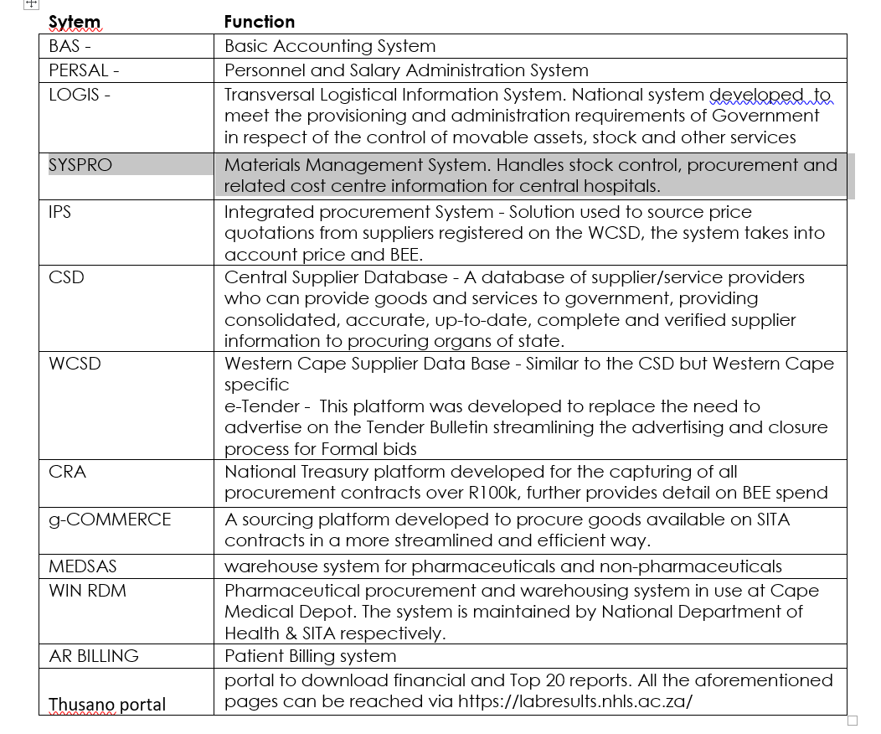
IT systems related to Financial and SCM
Dept has 54 Logis sites

Slide 110
INFORMATION TECHNOLOGY

Slide 111
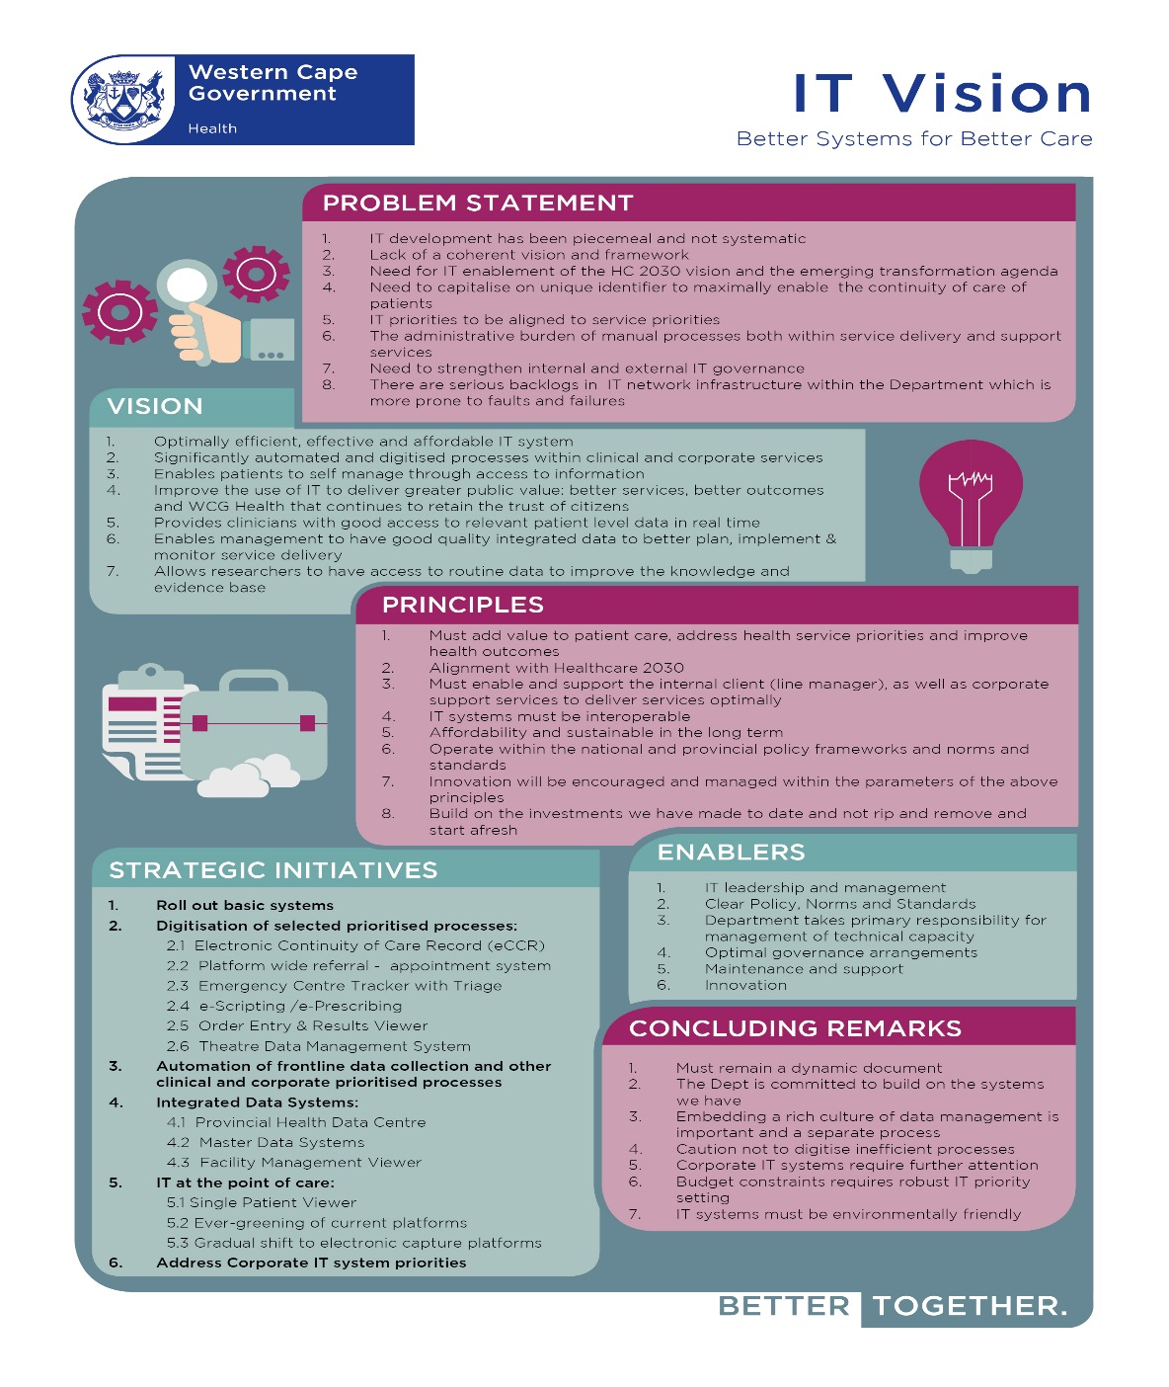
INFORMATION TECHNOLOGY

Slide 112
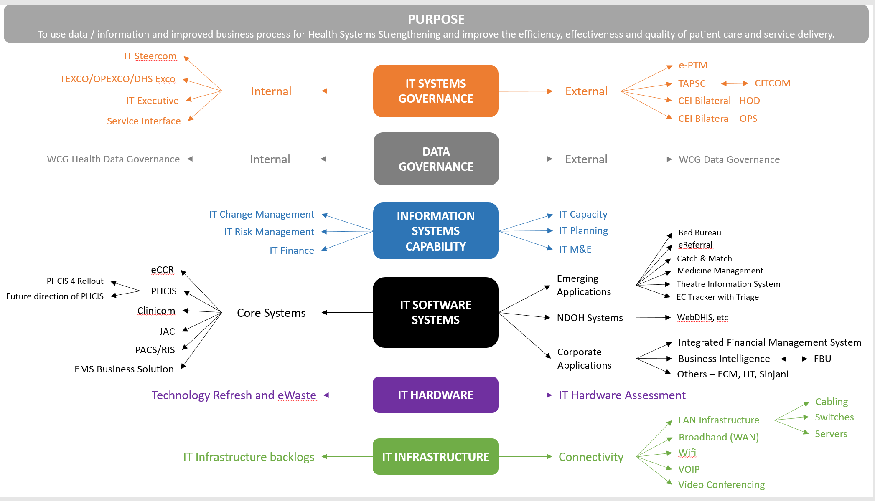

Slide 113
RISK MANAGEMENT

Slide 114
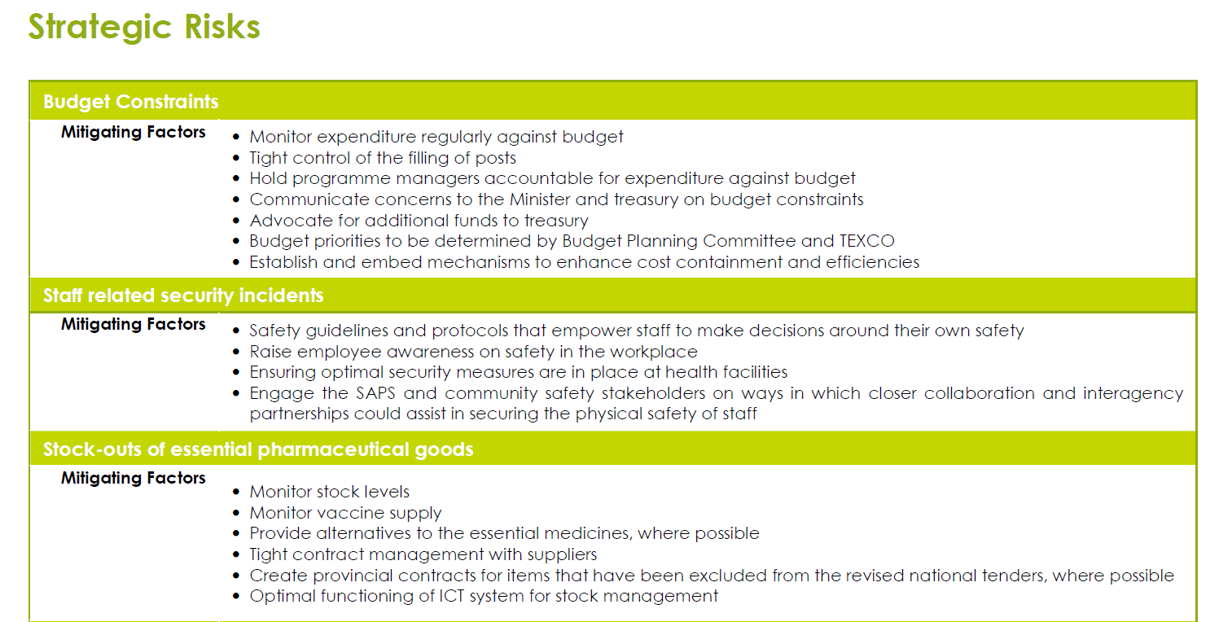
Strategic Risks : 2018/19

Slide 115
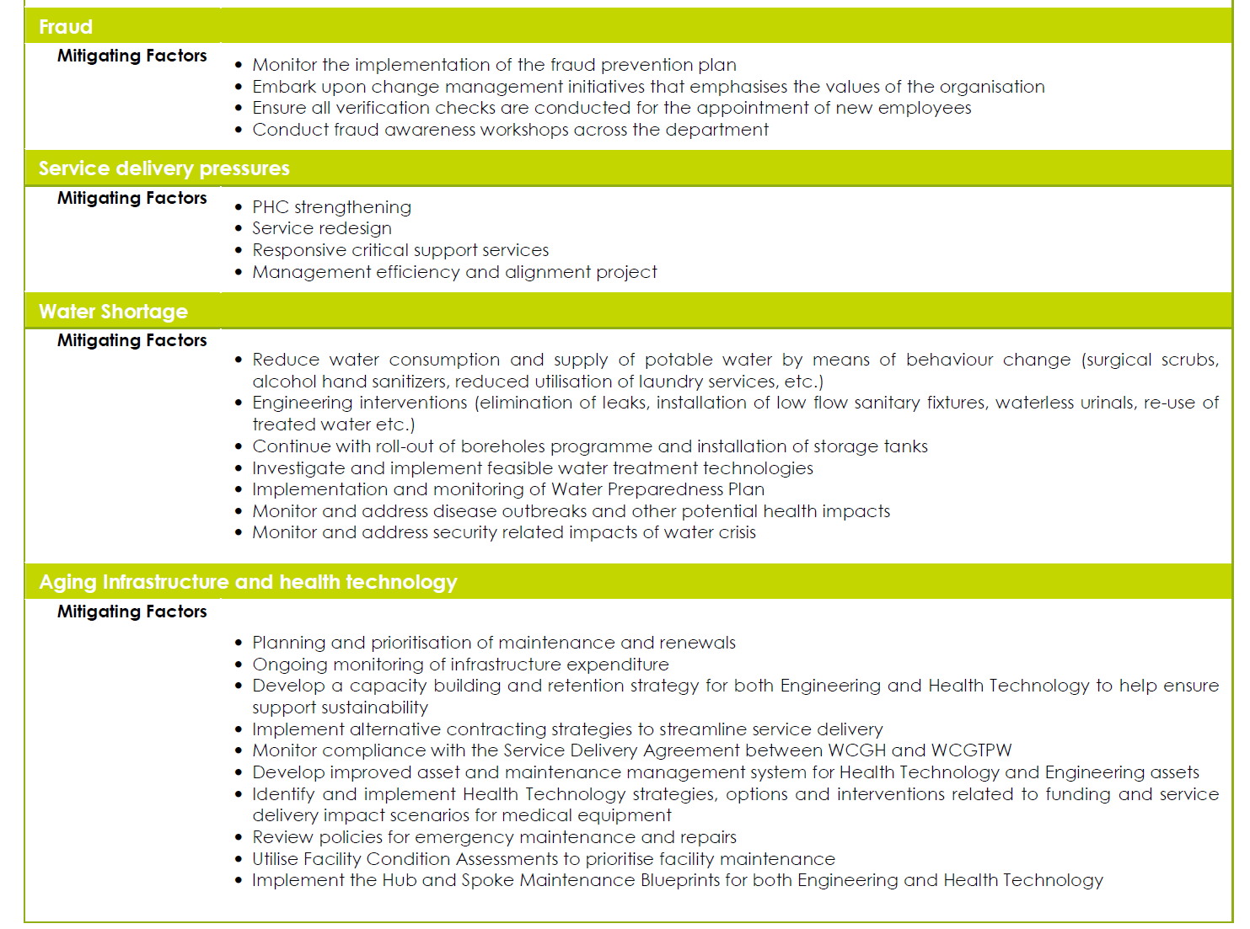

Slide 116
Risk Mx
Risk champion = CD : Strategy and Health support
Dept Risk committee - fully functional - Meets quarterly.
Risk owners designated for each strategic risk
Risk record completed by Risk owners quarterly.
DRC assesses risk against likelihood and impact and scores them as extreme, high, moderate and low.
Report tabled at Top Mx and Audit Committee.
Programme mx responsible for Risk Mx at programme level.

Slide 117
SECURITY SERVICES

Slide 118
Security Services
In the main, security services are outsourced and managed thro contracts at facility level.
Also have about 90 in – house security level
Have a close working relationship and MOU with Dept of Community Safety(DOCS)
High Risk :
  Gang violence
  EMS hijackings and Incidents
  Psychiatric patients in EC
  Service protests
.

Slide 119
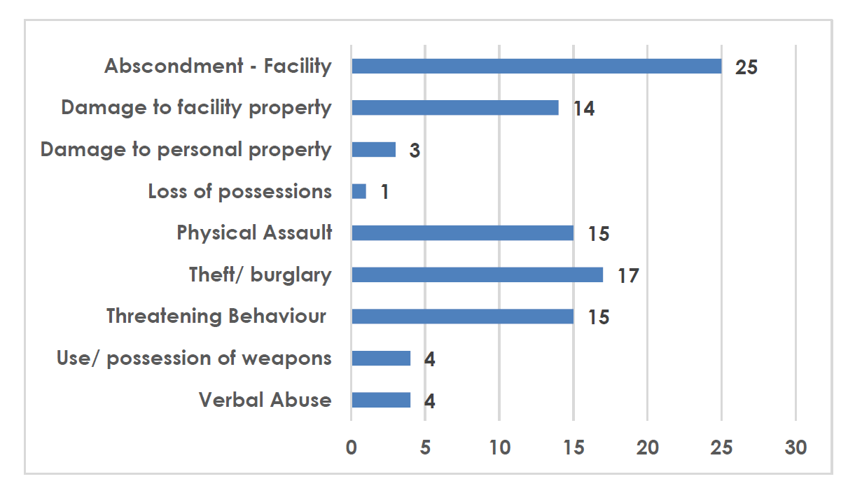
Snapshot of type of incidents ( April 2017 )

Slide 120
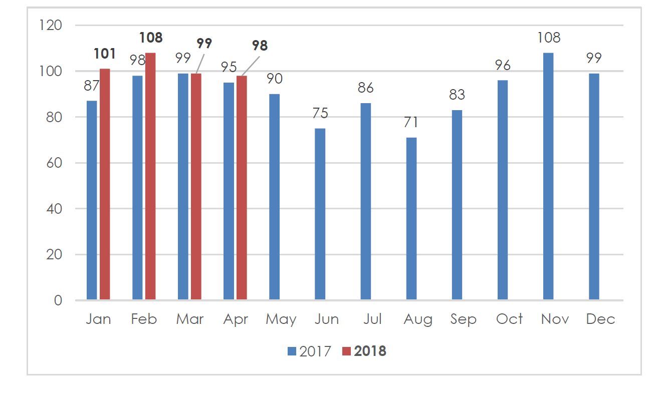
Frequency of incidents (April 2017 vs April 2018)

Slide 121
Questions & Discussion

Slide 122
THANK YOU

Slide 123
Dr B Engelbrecht
Head : Health
021 483 4473
Beth. Engelbrecht@westerncape.gov.za

