Slide 1
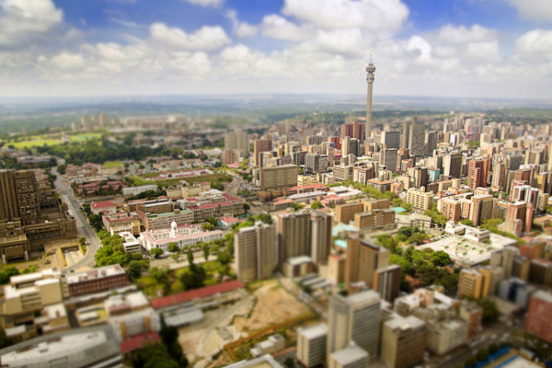
Gauteng Department of Human Settlements
2017/18 PERFORMANCE OF THE HUMAN SETTLEMENT DEVELOPMENT GRANT

Slide 2
1. PURPOSE OF THE PRESENTATION
Overview
Purpose of the Presentation
To present the Departmental expenditure performance on the Human Settlements Development Grant (HSDG) for the 2017/18 Financial Year. The presentation will also cover the progress made on addressing the performance challenges.

Slide 3
2. EXECUTIVE SUMMARY - PERFORMANCE 2017/18 FY
NON-FINANCIAL PERFORMANCE
The Department planned to deliver 16 965 stands and 32 064 housing units. A total of 7 910 stands and 17 558 housing units were delivered, 47% stands and 55% housing units. The variance against the annual targets amounts to 9 055 stands and 14 506 housing units.
FINANCIAL PERFORMANCE
During the period April 2017 - March 2018, the Department was originally allocated R5 528 050 000 for programmes and subsequently there was a downward adjustment of R150 000 000 and had an approved roll-over of R43 705 000 and consequently received R5 421 755 000 whereas expenditure for the year was R5 302 694 000. Therefore expenditure for 2017/18 financial year was 98% of the funds received with a variance of R119 061 000.
Therefore, the housing opportunities created during this financial year are 25 468 (52%) whilst total expenditure is at 98% (R5 302 694 000).

Slide 4
3. IMPROVEMENT PLAN

Slide 5
3.1 MANAGING THE DELIVERY VALUE CHAIN
Pipeline development
USDG Alignment
Municipal Serviced sites
Municipal Planning
Planning
CFO-Supply Chain Management – Payment of Services
Project Management
Construction management
Weekly reporting
Legal Services : Contracting and litigation
Monthly Delivery Assurance
Quarterly and Annual reporting
Quality Assurance
Beneficiary management and Public Participation
IT and Information Management
Tittle Deeds
Hand- Over houses with Title deeds

Slide 6
3.2 WORK PROGRAMME: FOCUS AREAS
CHALLENGE | ACTIONS | PROGRESS
Planning for project implementation | Budget realignment to move funds to performing projects Review 2017/18 Business Plan Ensure better planning for the 2018/19 NHBRC projects enrolment HSDG and USDG alignment, Spatial integration Transformation objectives
Supply chain Management | All outstanding supply chain management bids to be concluded. Contracts and service level agreements should be prepared while awaiting the conclusion of the supply chain management. Procurement of 2017/18 projects be concluded Appointment of PRT’s in line with Dep. new SCM process
Contract Management | Conclude all outstanding contracts Ensure that all contracts are enforced, and identify contractors/consultants who are not adhering to their contracts and take necessary action.
Payment of Contractors | A report on the status of all outstanding invoices, and identify challenges and causes of delays in payment of service providers Implement an invoice tracking system encompassing the entire value chain from the contractor submitting the invoice until payment is effected Ensure a payment system that pays within 14 days of approval of invoice

Slide 7
3.2 WORK PROGRAMME FOCUS AREA (Cont.)
CHALLENGE | ACTIONS | PROGRESS
Project Management Capacity | Beef up in-house capital projects management capacity. Ensure weekly performance reports per project and per each contractor A weekly update on contractor, project and programme performance should be submitted to the HOD Ensure that all service providers adhere to the contracts and service level agreements
Public participation, engagement and community relations | Ensure effective public participation during the planning phase of each project Undertake project profiling to anticipate any community dynamics which may negatively affect projects Ensure effective communication of delivery Work to achieve community ownership of projects
Institutional Capacity | Ensure proper support measures and Rescue Plan Determine project management capability in each Region, and provide support in ensuring capacity development
Monitoring and Evaluation | Proper and effective projects monitoring and evaluation systems Weekly reports on the performance of each region projects and contractor for all HSDG projects

Slide 8
3.2 WORK PROGRAMME FOCUS AREA (Cont.)
CHALLENGE | ACTIONS | PROGRESS
Misalignment of Plans Some of our projects are outside SDF prioritization areas of municipalities. This results in competing priorities with municipalities resulting in little funding being directed to GDHS projects | - GDHS developments to follow municipal prioritization areas through involvement in Integrated Planning Processes of the Municipalities and alignment of plans.
Bulk infrastructure: Throughout Gauteng there are serious bulk infrastructure limitations. These threaten the continuity of almost all our projects (especially mega projects). | - The responsibility of bulk infrastructure installation and upgrades is the Department of Water and Sanitation. Municipalities also responsible through the Municipal Infrastructure Grant to upgrade & maintain

Slide 9
3.2 WORK PROGRAMME FOCUS AREA (Cont.)
CHALLENGE | ACTIONS | PROGRESS
Misalignment of financial years between the province and local government (Municipalities), which negatively affects performance reporting for the two spheres of government | Technical and Political Inter-governmental Relations Forums have assisted the two parties to identify bottle-necks with a view to addressing them as and when they arise. (E.g. Management of redemption claims)
Late signing of Implementation Protocols (IPs) by municipalities, hence the delay in the transfer of funds to municipalities | Strict timeframes to be adhered to for the expedition of signing of IPs, otherwise funds may be re-directed to where they can be effectively utilised.

Slide 10
4. DEPARTMENTAL ANNUAL PERFORMANCE

Slide 11
4.1 2017/18 ANNUAL NON-FINANCIAL PERFORMANCE - PROGRAMME 3
Region | Annual Target |  | Annual Delivery |  | % Delivery
 | Stands | Housing Units | Stands | Housing Units | Stands | Housing Units
Joburg | 2 600 | 5 856 | 2 092 | 3 549 | 80% | 61%
Ekurhuleni | 5 442 | 6 651 | 1 383 | 4 416 | 25% | 66%
Tshwane | 1 387 | 6 912 | 0 | 3 938 | 0% | 57%
Sedibeng | 3 748 | 4 258 | 1 865 | 2 082 | 50% | 49%
Westrand | 3 788 | 4 425 | 2 570 | 2 457 | 68% | 56%
Head Office (Social Housing GPF) | 0 | 0 | 0 | 569 | 0% | 0%
Head Office (FLISP OPEN MARKET) | 0 | 1 582 | 0 | 547 | 0% | 35%
1.1a Individual housing subsidies (R0 - R3 500) credit linked | 0 | 2 380 | 0 | 0 | 0% | 0%
Grand Total | 16 965 | 32 064 | 7 910 | 17 558 | 47% | 55%
Annual Performance
@ 47% stands @55% housing units @52% housing opportunities

Slide 12
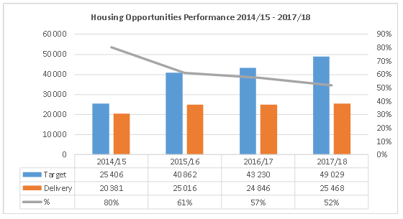
4.2 FINANCIAL YEAR HOUSING OPPORTUNITIES PERFORMANCE TREND
Whilst performance has dropped in percentage terms, influenced by targets set for individual years, the
constant delivery trend is notable in terms of the overall outputs per financial year.

Slide 13
4.3 WORK IN PROGRESS – April to March 2017/18
Annual Work In Progress as certified from April 2017 – March 2018
Region | Foundations | Wall Plates | 90% completions/ Roof
Joburg | 1316 | 1623 | 1008
Tshwane | 2115 | 2477 | 1376
Ekurhuleni | 3311 | 3337 | 129
Sedibeng | 1518 | 1577 | 94
Westrand | 1904 | 1702 | 777
Social housing GPF | 0 | 0 | 94
Head office FLISP | 0 | 0 | 0
Gauteng | 10164 | 10716 | 3478
The figures above are reflective of validated data using QA inspection certificates to record achievements per milestone from April to March 2017/18.

Slide 14
4.4 WORK IN PROGRESS – Closing balances as 31 March 2018
2017/18 Work In Progress - Closing Balances
Region | Foundation | Wall Plate | 90% completions/ Roof
Ekurhuleni | 1235 | 1441 | 1
Joburg | 532 | 973 | 180
Tshwane | 1024 | 2057 | 524
Sedibeng | 630 | 736 | 87
Westrand | 620 | 834 | 43
Total | 4041 | 6041 | 835
The figures above are reflective of construction work in progress, as validated by QA inspection certificates during 2017/18 financial year. However, this work was not converted to completed housing units by close of 2017/18 financial year.

Slide 15
4.5 TITLE DEEDS PERFORMANCE
MTSF Objective | Provincial MTSF Target | ACTUAL DELIVERY PROGRESS |  |  |  | Deficit (MTSF Target)
 |  | 2014/15 | 2015/16 | 2017/18 | Total to date: 31/03/18
Title Deeds: Pre-1994 housing stock Post-1994 housing stock New Developments | 12 808 | 2 690 | 2 746 | 2 812 | 8 248 | 4 560
 | 152 903 | 9 603 | 16 166 | 19 522 | 45 291 | 107 612
 | 152 301 | 884 | 0 | 0 | 884 | 151 417
CHALLENGES | MITIGATION
Missing beneficiaries. Disputes among family members, where initial approved beneficiaries are deceased (parents). Some townships are not yet proclaimed. | Advertisement sent out for missing beneficiaries. Discussion with the Department of Justice to issue estate of the deceased and Deeds office to registering family title deeds. The Gauteng Planning Commission has started a process with Ekurhuleni which will result in the regularized townships not yet proclaimed. GDHS has started a process of getting township establishment for all unregistered townships (this will assist in title deeds registrations). The MEC in his capacity as CoGTA MEC is dealing with matter through IGR sessions.

Slide 16
5. DEPARTMENTAL ANNUAL FINANCIAL PERFORMANCE

Slide 17
5.1 2017/18 APPROPRIATION
The Department’s main appropriation was R 5, 528b and later that was adjusted downwards R 150m.
The Department had an approved roll-over from the 2016/17 financial year of R 43,7m.
As at 31 March 2018 the department’s actual HSDG expenditure was R 5,302b which translates to 98% actual expenditure.
There was an unspent HSDG of R 119m which the Department has applied for roll-over thereof into the new financial year, the outcome of the application is still outstanding from National Treasury.

Slide 18
5.2 2017/18 TRANSFERS TO MUNICIPALITIES
The Department holds municipalities responsible for transfers made at two fora, one at the MEC/MMC technical IGR and the other through the compulsory monthly reporting meetings;
Details of transfer to municipalities are as follows:
Municipality | Gazetted Amount | Amount Transferred
COJ | R 292 314 710 | R 292 314 731
COT | R 185 740 616 | R 184 101 996
COE | R 51 203 000 | R 51 203 160
Mogale City | R 105 269 000 | R 105 269 000
Merafong City | R 139701500 | R 139 701 000
RandWest City | R 71 100 000 | R 71 100 000
Total | R 845 328 826 | R 843 689 887

Slide 19
5.3 2017/18 TRANSFERS TO ENTITIES
Name of Agent | Budget (As per BP) | Transfers 2017/18 FY
Gauteng Partnership Fund [GPF] | R 337 029 320 | R 296 573 820
Housing Development Agency [HDA] | - | R 858 400 000
SUBTOTAL | R 337 029 320 | R 1 154 973 820
TOTAL [Municipalities & entities] | R 1 182 357 646 | R 1 998 663 707
The amounts transferred are committed and outputs thereof are expected to be reported in the 2018/19 Financial Year.

Slide 20
THANK YOU

