Slide 1

Portfolio and Select Committees
Quarters 3&4 2017/18 Reports
March 2018

Slide 2

Synopsis 3rd and 4th Quarter 2017/18
Results
 | Quarter Four |  |  | Year to Date
Programme | Off target | Work in progress | On target | Off target | Work in progress | On target
Park Operations | 1 | 1 | 7 | 1 |  | 9
Transformation |  | 2 | 3 |  |  | 5
Commercialisation/Tourism |  |  | 6 |  |  | 7
Corporate Governance | 1 | 2 | 5 | 1 |  | 8
Total

Slide 3
Programme One: Conservation & Park Operations
Strategic objective: to ensure the world heritage values are conserved

Slide 4
SO: To ensure the World Heritage Values are conserved
Performance indicator | Baseline | Annual target 2017/18 | Qu3 target | Qu3 Actual | Qu4 target | Qu4 Actual | YTD Actual | Achievements/Challenges/Corrective Measures
Number of park management meetings | New indicator | 6 | 2 | 1 | 1 | 1 | 6 | KPI not met in Q3. KPI met in Q4 On track in terms of year to date as 3 meetings took place in the 2nd quarter.
Number of new environmental audits | 5 | 6 | 2 | 2 | 1 | 2 | 7 | KPI met Q3: Audit on Mkuze abattoir Audit on Mkuze dump site completed Q4: Ezemvelo mechanical workshop Ezemvelo sugarloaf campsite
Number of follow-up environmental audits | New indicator | 5 | 2 | 2 | 1 | 1 | 6 | KPI met Q3: Follow-up audit on Katanga Cleaning Services and Bhangazi Bush Lodge: Q4: False Bay campsites
Number of environmental monitors deployed | 30 | 30 | 0 | 0 | 0 | 87 | 117 | KPI met 30 monitors remain deployed across the Park in Q1, Q2 and Q3. Q4: additional 87 monitors deployed sue to additional funding

Slide 5
SO: To ensure the World Heritage Values are conserved
Performance indicator | Baseline | Annual target 2017/18 | Qu 3 target | Qu 3 Actual | Qu 4 target | Qu 4 Actual | YTD Actual | Achievements/Challenges/Corrective Measures
Number of hectares of invasive plants treated | 15500ha | 46000ha (revised target) 25000ha (original target) | 16750 | 21393 | 16750 | 14132 | 59530 | KPI met in Q3 & not in Q4. On track in terms of year to date Good progress was evident in the 2nd and 3rd quarters.
Number of kilometres of accessible coastline cleaned | New indicator | 320 | 320 | 320 | 320 | 320 | 320 | KPI met Every quarter 320km of the coastline is cleaned
Percentage completion of annual burning programme | New indicator | 100 | 0 | 23 (350ha) | 0 | 0 | 55 (1470ha) | KPI not met The burning programme is variable depending on weather and other factors. It was possible to begin earlier in the season. Continued work on a ground fire that was a result of an uncontrolled fire impacted on available resources and time in mop-up and monitoring work.

Slide 6
SO: To ensure the World Heritage Values are conserved
Performance indicator | Baseline | Annual target 2017/18 | Qu 3 target | Qu 3 Actual | Qu 4 target | Qu 4 Actual | YTD Actual | Achievements/Challenges/ Corrective Measures
Percentage applications processed iro developments in the buffer zone | 80 | 80 | 80 | 80 | 80 | n/a | 100 | KPI met. In total 7 applications were received (with all the relevant information) and processed.
Percentage of identified unauthorised activities actioned legally | 100 | 100 | 100 | 100 | 100 | 100 | 100 | KPI met. Q3: unauthorised business operating in the Park Q4: unauthorised event and unauthorised and unauthorised unmanned aerial vehicle flying in the Park
Percentage completion of infrastructure maintenance programme | 100 | 100 | 25 | 25 | 25 | 25 | 100 | KPI met. Maintenance is undertaken by third party providers. The schedule of work as set out in the contract was complied with.

Slide 7
Programme Two: Transformation
Strategic objective: to optimise the empowerment in all activities of the Park in a way that will improve the livelihoods of previously-disadvantaged

Slide 8
SO: to improve access to work and income generation activities
Performance indicator | Baseline | Annual target 2017/18 | Qu 3 target | Qu 3 Actual | Qu 4 target | Qu 4 Actual | YTD Actual | Achievements/Challenges/Corrective Measures
Number of temporary jobs created | 1400 | 1221 | 450 | 123 | 452 | 425 | 1857 | KPI not met in Q3 and Q4. On track in terms of year to date. Most of the land-care contractors started work in Q2 and their statistics were reported in Q2
Number of training days | 4800 | 4800 | 1200 | 616 | 1200 | 1393 | 4981 | KPI not met in Q3. There were delays in procuring training service providers.
Number of people participating in SMME and skills development programmes | 142 | 100 (revised target) 50 (original target) | 20 | 27 | 10 | 0 | 101 | KPI met in Q3 and not in Q4 On track in terms of year to date. Additional funding had been sourced. The target has been revised to accommodate this.

Slide 9
SO: to improve access to work and income generation activities
Performance indicator | Baseline | Annual target 2017/18 | Qu 3 target | Qu 3 Actual | Qu 4 target | Qu 4 Actual | YTD Actual | Achievements/Challenges/Corrective Measures
Number of bursaries awarded | 20 | 31 | 0 | 0 | 0 | 10 | 32 | Kpi met. At the start of the academic year there were 26 students on the programme. Four dropped out bringing the number down to 22. New students will be recruited in the last quarter.
Moderated BEE spend as a percentage of qualifying expenditure | 76 | 76 | 76 | 78 | 76 | 79 | 79 | KPI met.

Slide 10
Programme Three: Tourism/Commercial
Strategic objective: to optimise the Park’s revenue generation in a commercially- and environmentally-sustainable manner, that fosters job creation and empowerment of historically-disadvantaged communities

Slide 11
SO: to improve financial sustainability
Performance indicator | Baseline | Annual target 2017/18 | Qu 3 Target | Qu 3 Actual | Qu 4 Target | Qu 4 Actual | YTD Actual | Achievements/Challenges/Corrective Measures
Revenue from commercial sources | R15.9m | R18.4m | 5.5 | 7.5 | 3.7 | 4.8 | 21.9 | KPI met Increase in paid visitors and activity permits. Take-over of 2 additional park gates in Q3
Visitor entries | 506 860 | 520 000 | 156 000 | 171 185 | 104 000 | 119 391 | 527 085 | KPI met
Percentage lapsed concessions tendered | New indicator | 80 | 80 | 14 | 80 | 100 | 100 | KPI not met in Q3 but met in Q4 2 Licences were tendered and adjudicated in the 3rd quarter. A further tender process was done in the 4th quarter.
Percentage implementation of plan iro new tourism developments | New indicator | 60 | 20 | 20 | 10 | 10 | 60 | KPI met Gate entrances and craft markets 95% complete. St Lucia precinct development – groundwork for entrance done, ground cleared for market area . Expression of Interest for Bhangazi Development advertised

Slide 12
SO: to improve financial sustainability
Performance indicator | Baseline | Annual target 2016/17 | Qu 3 Target | Qu 3 Actual | Qu 4 Target | Qu 4 Actual | YTD Actual | Achievements/Challenges/Corrective Measures
Number events implemented | 3 | 2 (revised target) 3 (original target) | 0 | 1 | 0 | 0 | 3 | KPI met Dukuduku sport tournament was held in Dec The trail run and MTB cycling events took place in Q2
Percentage implementation of PR programme | 100 | 100 | 25 | 33 | 25 | 34 | 119 | KPI met 2 expo’s 23 editorials 5 media junkets 2 tour operator site visits 24 newsflashes 12 radio slots 63 meetings with leadership 4 community awareness events
Percentage Implementation of infrastructure programme | 90 | 90 | 25 | 25 | 25 | 31 | 95 | KPI met Signage schedules completed for E&W Shores. Infrastructure: Tower, gate entrances, Charters Creek campsite, field ranger accommodation and craft market underway.

Slide 13
Programme Four: Corporate Governance
Strategic objective: to ensure that iSimangaliso’s operations are properly funded and cost-effectively managed while maintaining an appropriate system of internal control and reporting of accounting, management, and statutory information

Slide 14
SO: to make research relevant to park management and transform the research sector
Performance indicator | Baseline | Annual target 2017/18 | Qu 3 Target | Qu 3 Actual | Qu 4 Target | Qu 4 Actual | YTD Actual | Achievements/Challenges/Corrective Measures
Percentage of new approved research programmes that relate to management | New indicator | 50 | 15 | 54 | 5 | 57 | 51 | KPI met In total 18 of the 35 applications received were relevant and relate to management. As iSimangaliso does not have funding for research at best it can shape the research proposals submitted to it to improve their relevance for Park management. It has enjoyed a higher success rate thus far this year
Implementation of effective monitoring programme for the Park | New indicator | Monitoring of impacts of St Lucia restoration programme | Review report completed | Review report completed | Review report completed | Review report completed | Review report completed for each quarter | KPI met A system to monitor various aspects of the Lake St Lucia system has been installed which yields reports that track the condition of the system.
Number visitor market surveys | 2 | 2 | 0 | 1 | 1 | 0 | 2 | KPI not met in Q4 On track in terms of year to date. Visitor survey took place over the Easter period in Q1 Peak period survey was done in Q3

Slide 15
SO: to make research relevant to park management and transform the research sector
Performance indicator | Baseline | Annual target 2017/18 | Qu 3 Target | Qu 3 Actual | Qu 4 Target | Qu 4 Actual | YTD Actual | Achievements/Challenges/Corrective Measures
Percentage completion of the environmental education plan | 100 | 100 | 32 | 12 | 10 | 7 | 108 | KPI not met for Q3 & Q4 On track in terms of year to date 537 learners visited iSimangaliso through field trips in Q3 and 333 in Q4. 4849 learners in total for year.
Percentage implementation of plans to mitigate impact of identified threats to rare and endangered species and ecosystems | Initiation of implementation | 100 | 55 | 30 | 10 | 25 | 100 | KPI not met for Q3 On track in terms of year to date
Percentage completion of plans requested/required this financial year | New indicator | 80 | 15 | 5 | 35 | 5 | 20 | KPI not met A consultant has identified tourism development sites, and preliminary workshops were held with land claimant trusts in Q1. This process temporarily put on hold due to the departure of the CEO, who was leading the tourism planning process.

Slide 16
SO: effective financial management
Performance indicator | Baseline | Annual target 2016/17 | Qu 3 Target | Qu 3 Actual | Qu 4 Target | Qu 4 Actual | YTD Actual | Achievements/Challenges/Corrective Measures
Unqualified audit | Unqualified audit | Unqualified audit |  |  |  |  | Unqualified opinion | No targets for Q1 Clean audit in Q2
Percentage retention of skills | 80 | 90 | 90 | 97 | 90 | 100 | 91 | KPI met 1 staff resigned in Q1 3 staff members resigned in Q2 1 staff member resigned and 1 discharged on medical grounds in Q3
Assessment of and percentage implementation of business improvements | New indicator | 100 | 30 | 10 | 30 | 40 | 90 | KPI not met in Q3 Documentation of work flows, analysis of future core business applications completed and some data capturing and import tools developed. Documentation completed end of February 2018

Slide 17
SUMMARY OF FINANCIAL RESULTS: DECEMBER 2017

Slide 18
2017/18 Quarter 3 Financial Performance cont.
Income exceeds the budget by R65.1m for the period April to December 2017. This difference is due to differences in the basis of preparation of the budget (modified cash basis as required by the PFMA) and the financial statements (GRAP as required by the PFMA and the application of GRAP23).
Accounting revenue for the period ended 31 December is R160m. The accounting surplus for the period is R76.1m. This is a non-cash surplus and is the result of the accounting policies relating to grants (GRAP23). In other words R83.9m has been recognised into income in respect of capital expenditure. The reciprocal expense reflects in the balance sheet under the fixed assets.

Slide 19
2017/18 Quarter 3 Financial Performance cont.
Expenditure is below budget by R11.0m.
Depreciation is lower than anticipated due to delays in the completion of the assets, as a result of the snags.
Personnel costs are lower than budget due to a restructuring process undertaken by a consultant appointed by DEA.
Professional fees is slightly higher due to environmental related services on the St Lucia Precinct. This will even itself out in the next quarter
Other expenditure is slightly lower due to a delay in the take-over of 2 Park gates from Ezemvelo.

Slide 20
2017/18 Quarter 4 Financial Performance

Slide 21
2017/18 Quarter 4 Financial Performance cont.
Income exceeds the budget by R72.6m for the period April to March 2018. This difference is due to differences in the basis of preparation of the budget (modified cash basis as required by the PFMA) and the financial statements (GRAP as required by the PFMA and the application of GRAP23).
Accounting revenue for the period ended 31 March is R199.2m. The accounting surplus for the period is R82.6m. This is a non-cash surplus and is the result of the accounting policies relating to grants (GRAP23). In other words R116.6m has been recognised into income in respect of capital expenditure. The reciprocal expense reflects in the balance sheet under the fixed assets.

Slide 22
2017/18 Quarter 4 Financial Performance cont.
Expenditure is below budget by R10m.
Personnel costs are lower than budget due to a restructuring process undertaken by a consultant appointed by DEA.
Depreciation is lower than anticipated due to delays in the completion of the assets, as a result of the snags.
Other expenditure is higher by R3.3m mainly due to the demolishing of certain infrastructure assets in the Park.

Slide 23
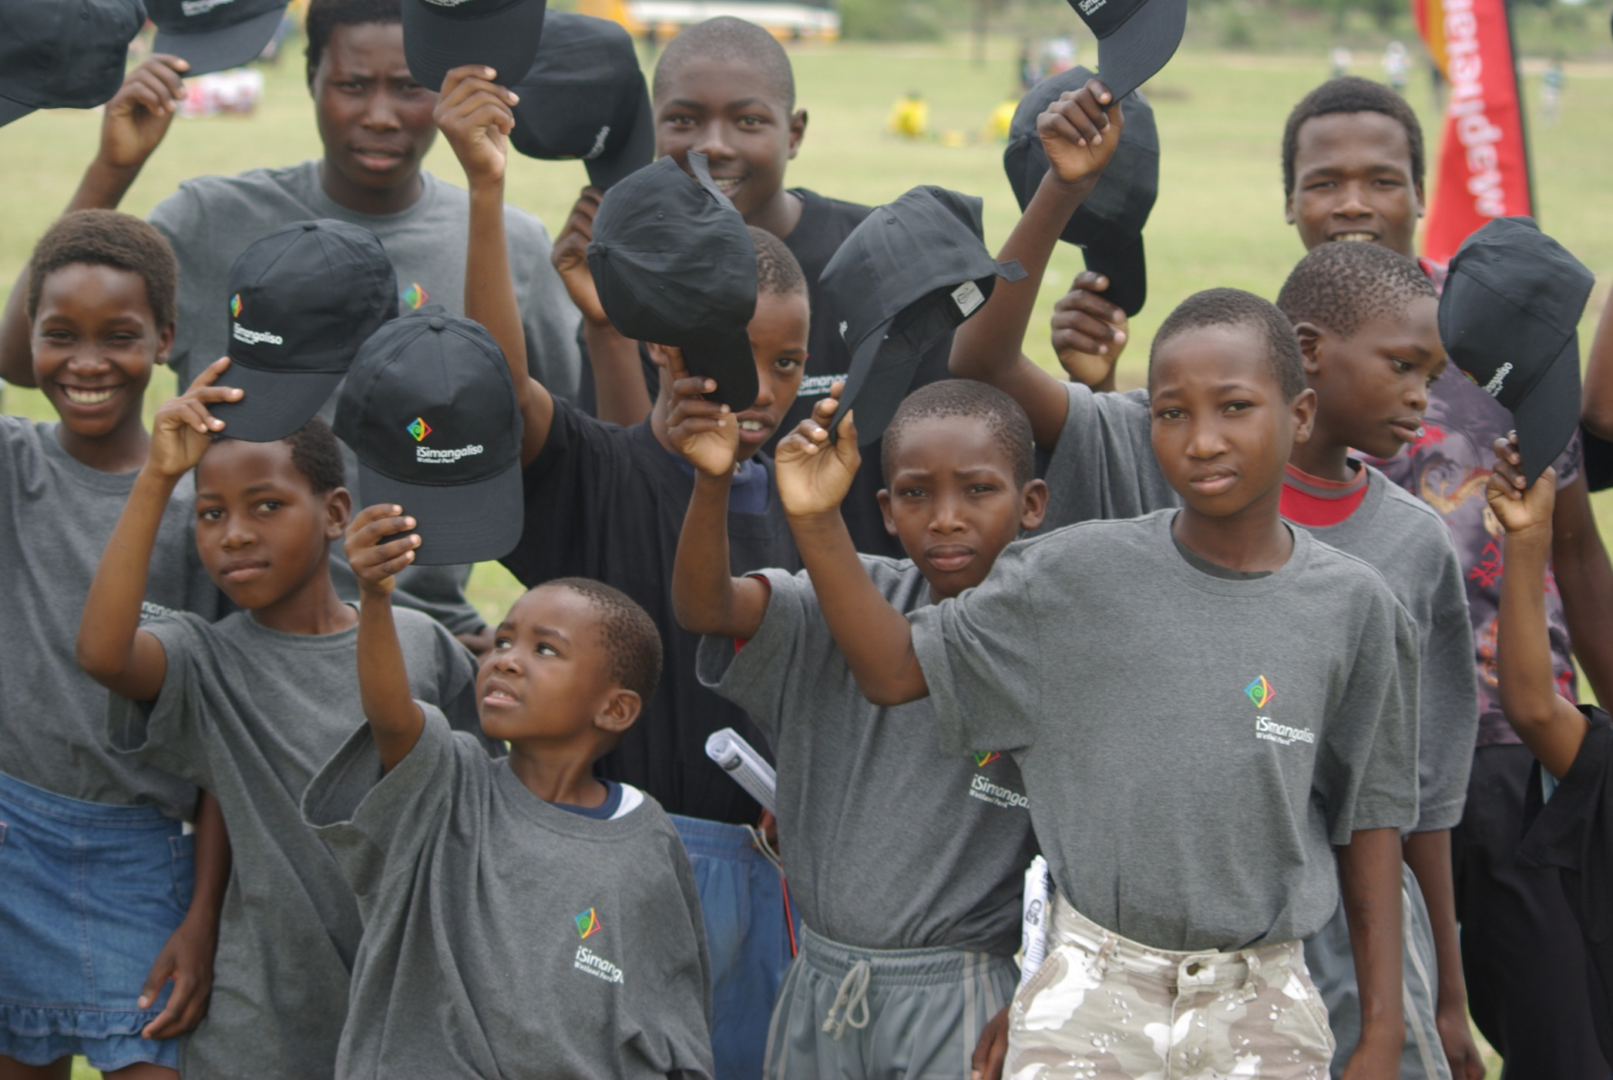
SIYABONGA – THANK YOU

