Slide 1
report to the select committee ON APPROPRIATIONS infrastructure delivery in the wced fourth quarter 2017/18
30 May 2018

Slide 2
ORIGINAL INFRASTRUCTURE BUDGET 2017/18
Composition of the 2017/18 budget
Amount allocated to maintenance was R 412,7m (=23,7% of budget)
SOURCE | EIG | ES | Total | %
 | 0,000 | 0,000 | 0,000
ORIGINAL BUDGET | R 1 093 580 | R 520 464 | R 1 614 044 | 100
REVISED BUDGET | R 1 149 111 | R 588 620 | R 1 737 731 | 100

Slide 3
PROGRESS AS AT THIRD QUARTER 2017/18
Expenditure as at 31 December 2017 was as follows:
 | EIG | ES | Total | %
 | 0,000 | 0,000 | 0,000
Expenditure at 31 Dec 2017 (3rd Q) | R 821 097 | R 381 322 | R 1 202 419 | 69,2
Expenditure as at 31 March 2018 (4th Q) | R 1 149 111 | R 525 867 | R 1 674 978 | 96,4
Under-expenditure as at 31 March 2018 | R 0 | R 62 753 | R 62 753 | 3,6

Slide 4
PROJECTS DELIVERED DURING 2017/18
PROJECTS | APP Targets (2017/18) | END 3RD Q | END 4TH Q
New Schools (including replacement schools) | 9 | 10 | 10
Additional classrooms | 47 | 10 | 47
Gr R Classrooms | 33 | 21 | 21
Scheduled Maintenance | 64 | 41 | 64
Emergency maintenance | - | 258 | 322
Halls | 10 | 6 | 10
Fencing | 20 | 20 | 20
Storm Damage | - | 40 | 130
Mobile units placed | - | 103 | 216
Hostel Refurbishments | 10 | 1 | 9

Slide 5
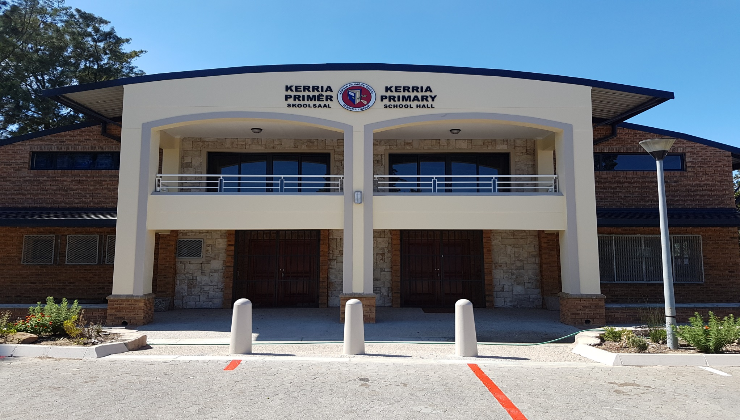
SCHOOL HALL

Slide 6
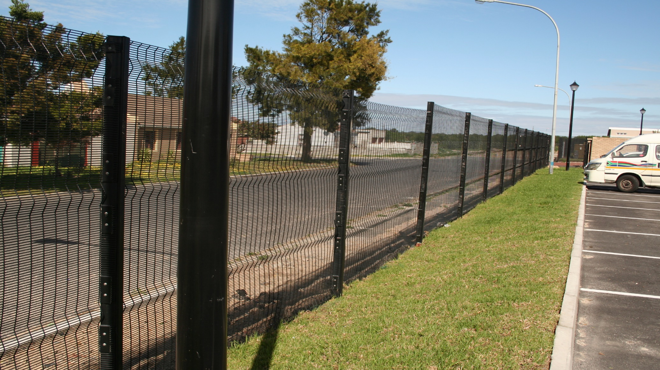
FENCING

Slide 7
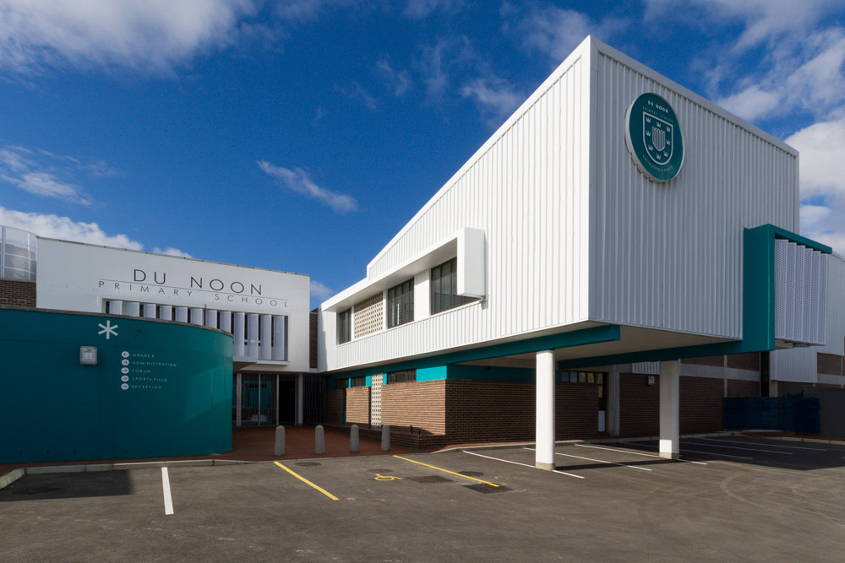
NEW SCHOOL

Slide 8
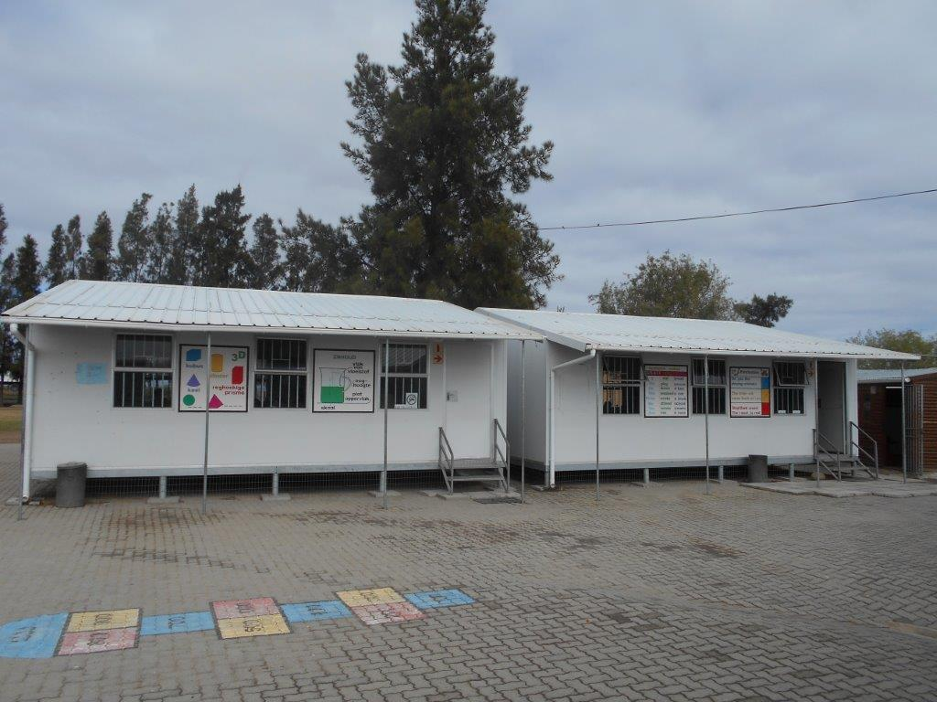
MOBILE CLASSROOMS

Slide 9
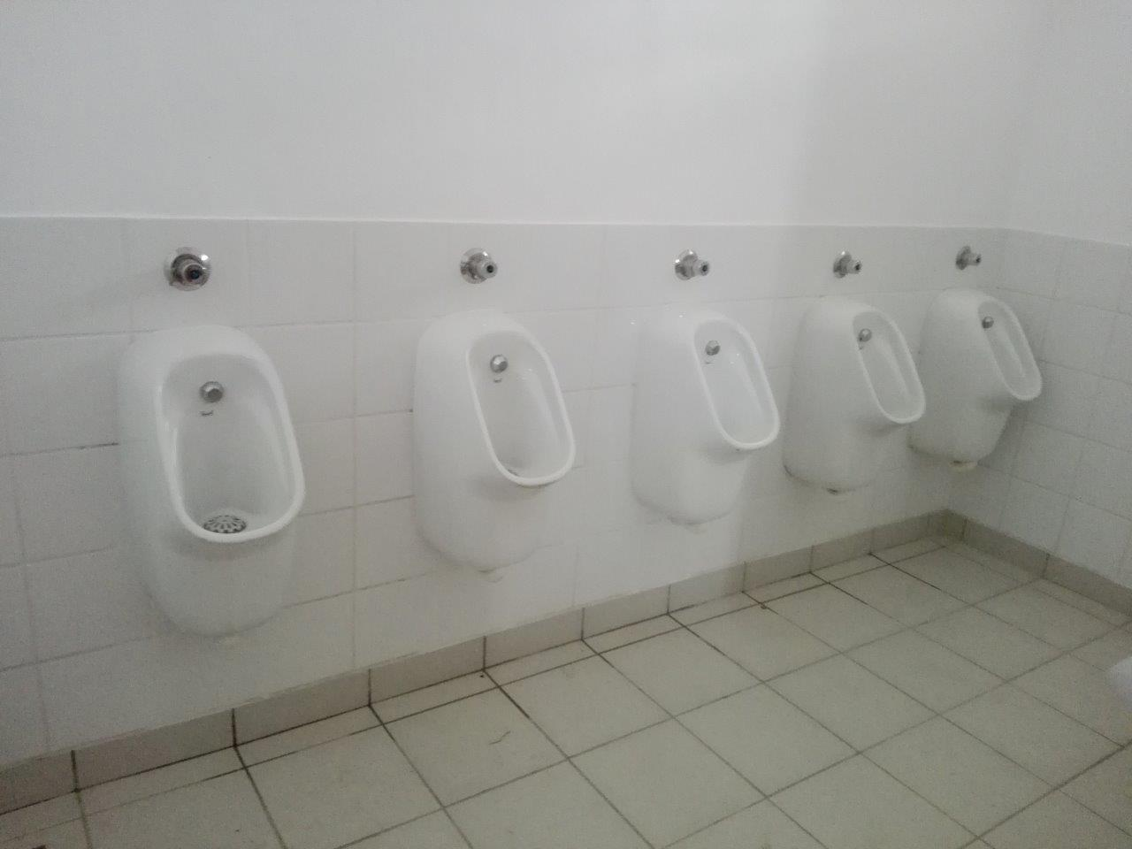
ABLUTION FACILITIES

Slide 10
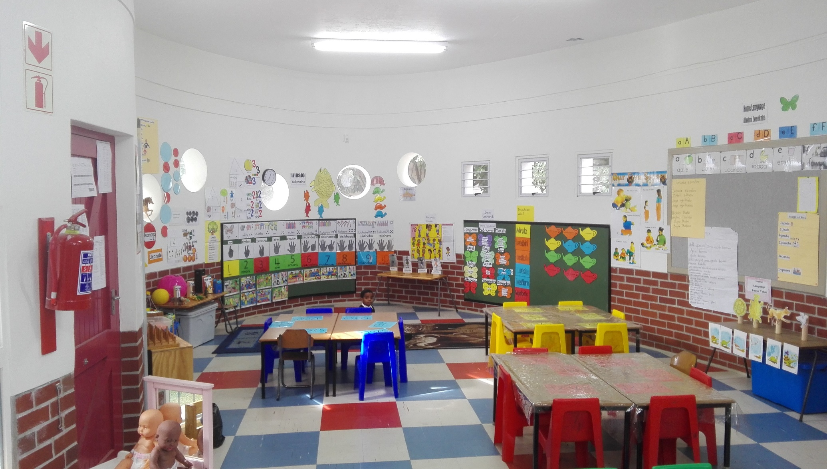
GRADE R FACILITIES

Slide 11
DROUGHT INTERVENTIONS
By the end of the 4th Quarter 2017/18 the following drought intervention projects were in progress:
 | Project Description | Projects Completed
1 | Water restrictors | 91
2 | Smart water meters | 187
3 | Testing borehole water | 232
4 | Repair non-functioning boreholes | 201
5 | Procure fire extinguishers | 11 000
6 | Develop a GIS tool to assess water security at schools | On going

Slide 12
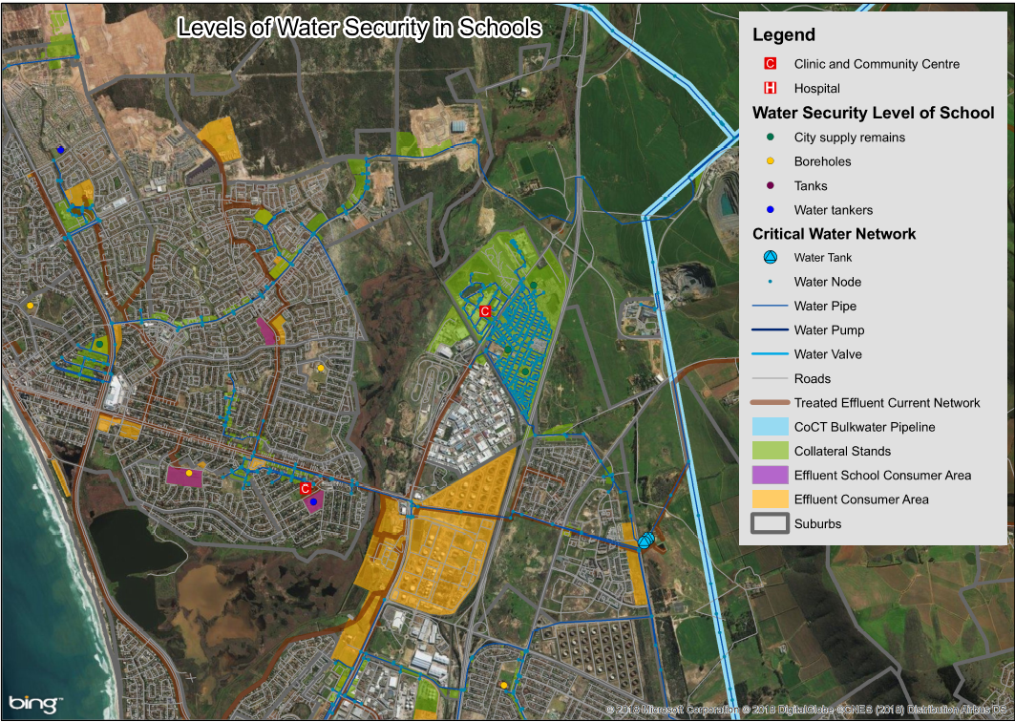
DEVELOPED A GIS TOOL

Slide 13
ONGOING RISKS/CHALLENGES
Annual learner growth of average 18 000. Results in overcrowding.
Success of learner retention in the system.
Infrastructure budget remains constant – no significant growth.
Steep escalation of infrastructure delivery cost
Backlog in the maintenance of existing stock is growing.
Non-availability of appropriate land, especially in the Metropole.
Non-performing contractors, especially on maintenance projects.

