Slide 1


^{when the sun rises}
^{we work hard to deliver}
MPUMALANGA 4TH QUARTER EIG PERFOMANCE
SELECT COMMITTEE ON APPROPRIATIONS
30 MAY 2018

Slide 2

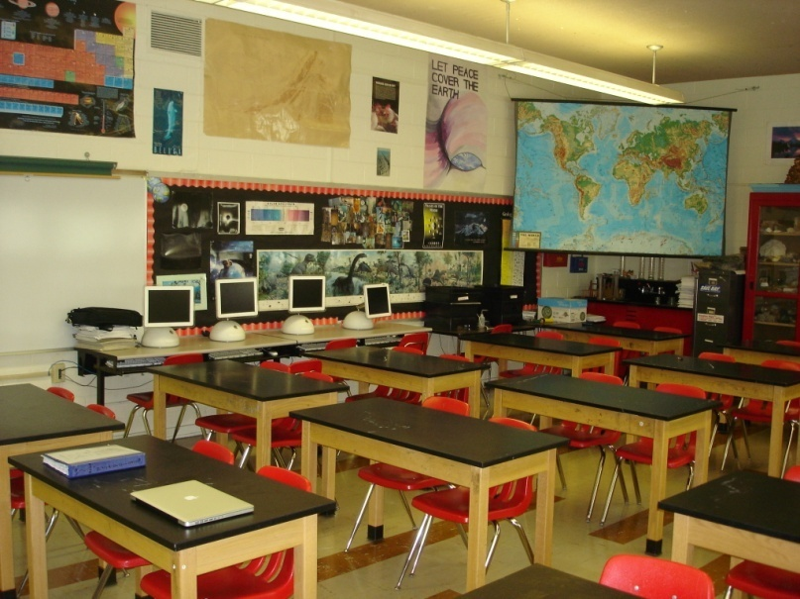
PRESENTATION OUTLINE
PURPOSE
INTRODUCTION
2017/18 INFRASTRUCTURE BUDGET OVERVIEW
EIG PERFOMANCE HIGHLIGHTS
EIG IMPLEMENTATION CHALLENGES
INTERVENTIONS
RECOMMENDATIONS

Slide 3
PURPOSE OF THE PRESENTATION
To present the Education Infrastructure Grant (EIG) 4th quarter performance report to the Select Committee on Appropriations.

Slide 4
2017-18 INFRASTRUCTURE BUDGET OVERVIEW
A total infrastructure budget allocation for 2017-18 FY was of R 1, 085 781 billion , which was adjusted to R995, 781 million as broken down below:-
Funding Source | Original Budget Allocation R’000 | Revised Budget Allocation R’000
Education Infrastructure Grant | 750 184 | 750 184
Equitable Share | 413 000 | 243 000
EPWP | 2 597 | 2 597
TOTAL | 1 165 781 | 995 781
The R413 million ES portion allocation was adjusted to R243 million taking MDOE entire infrastructure budget to R995 781 000.

Slide 5
EDUCATION INFRASTRUCTURE GRANT PERFORMANCE HIGHLIGHTS

Slide 6
PROGRAMMES FUNDED THROUGH THE EIG
Programme | Allocated Budget (R’000)
New & Replacement | 193 510
Upgrade and Additions | 379 433
Maintenance | 113 662
Refurbishment, Renovations and Rehabilitation | 30 129
Goods & Services | 33 450
GRAND TOTAL | 750 184

Slide 7
NON-FINANICIAL PERFOMANCE OF CAPITAL PROGRAMMES FUNDED THROUGH THE EIG
Programme | 2017/18 Total Projects (Projects at Different Stages) | 2017/18 Targets | 2017/18 Actual Achieved | 2017/18 Expenditure per Category
New and replacement (1 achieved out of 2 new schools and 5 achieved out of 7 replacement schools) EID Funded | 47 | 3 | 1 | R187 071 091,30
Upgrades and Additions (Basic services (102 achieved out of 121 Sanitation targets, 66 achieved out of 77 Water targets and 7 achieved out of 8 Electricity targets)) | 420 | 206 | 175 | R385 574 443,86
Rehabilitation, Renovation & Refurbishments | 27 | 8 | 8 | R 17 759 374,18
Maintenance (8 achieved out of 3 planned Scheduled maintenance, 43 storm damage repairs and 5 arson damage repairs) | 126 | 126 | 56 | R 77 721 416,19
GRAND TOTAL | 606* | 343 | 240 | R668 126 325,53
* The 606 is the total number of EIG funded projects at all stages (final accounts, planning and design, implementation) in 2017/18 financial year and incurred expenditure.

Slide 8
EIG EXPENDITURE PATTERN : 2015/16 TO 2017/18
The EIG 4th QTR performance is indicated below:
Financial year | EIG Budget Allocation (R’000) | Expenditure as at FY End |  | Accruals (R’000) | Actual Expenditure + Accruals
 |  | (R’000) | %
2017/18 | 750 184 | 701 278 | 93,4% | 48 891 | 750 169
2016/17 | 792 655 | 682 998 | 86,2% | 109 000 | 791 998
2015/16 | 857 247 | 852 745 | 99.5% | 0 | 852 745
From the diagrammatic and table indicated , the following could be summarised : MDOE has spent 93.4% of the EIG in the 2017-18 FY which is 7.2 % higher than in 2016-17 and 6.1 % lower than in 2015-16 FY. Although improved with 49% less in 2017-18 FY, Accruals continue to be a challenge, with a potential risk of reduced implementation of targeted projects as rollovers cannot be guaranteed. Underspending and subsequent Accruals are a current potential risks negatively affecting MDOE EIG allocation as evident in 2016-17 and 2017-18 If contributing factors could be eliminated vis. Late submission of high volumes of invoices during FY end , MDOE could be in a position to spend the allocated budget accordingly.

Slide 9
EIG IMPLEMENTATION CHALLENGES

Slide 10
CHALLENGES
The following are generic challenges facing project delivery and performance.
Late appointment of service providers by the Implementing Agent (IA).
2. Poor project and construction management practices by the Implementing Agent resulting in the following:
2.1. Late /non submission of the invoices on monthly basis for work done: This results in the Department experiencing high influx of invoices during the month of March beyond the departmental capacity to process, thus resulting in accruals as demonstrated in the historic expenditure trend indicated in slide 7.
2.2. Delays in the submission of the Final Accounts due to delays and non attendance to snag lists to ensure project closures.
2.3. Poor Monitoring of service providers performance viz. contractors and Principal Agents to ensure compliance and adherence to the general conditions of contracts.
2.4. Non-implementation of consequence management on poorly performing service providers.
2.5. The general deficiencies on programme management (2.1 to 2.4) points to the IA’s capacity in implementing the department’s large infrastructure portfolio together with other client departments. Thus having a only one IA for the province is a challenge.

Slide 11
CHALLENGES cont.…
3. Community facilitation bottlenecks affecting project progress (mostly at implementation stage). This is due to sporadic cases of :
3.1. local sub-contracting.
3.2. local interference with project scope.
3.3. Communal land disputes where the sites have been identified and confirmed and later contested during project implementation stage.
4. Project costs allocations such as contingency and retention also affect the expenditure due to:
4.1. Contingency fees (5% of the project contract amount) are only paid as and when required.
4.2. Retention fees (5% of the project contract amount) are only released at the final account stage.
5. Challenge in attracting registered professional in the fields of engineering and architectural fields by the Department.

Slide 12
CHALLENGES cont.…
Deficiencies on the Department’s Infrastructure Planning Business Process Flow Mapping leading to;
6.1 Some identified and prioritized needs are found not to be required at the time of implementation.
6.2 The process of cancellation of needs in 6.1 and replacement with other shelf projects requires time affecting the actual targeted implementation targets and projected expenditure.

Slide 13
INTERVENTIONS
Through the DORA Funding, the MDoE has been able to increase its in-house technical capacity through the appointment of professionally registered personnel, with only 5 professional posts that still need to be filled.
The Service Level Agreement between the Client and Implementing Department have been reviewed to strengthening areas of cooperation, project implementation and contract and construction management.
The Implementing Agent should finalize the Community Facilitation Strategy to guide project facilitation and engagement.
Project oversight committees are in place to ensure programme delivery such as Premier’s Provincial Infrastructure Coordinating Committee, Joint Operations Committee and Programme Operations Management Meeting.
The Department is in the process of submitting a request to the EXCO seeking approval for considering multiple implementing agents for the department’s portfolio.
The updated schools’ infrastructure database uploaded on the Education Facilities Management Systems (EFMS) is now used for confirmation of needs validity.

Slide 14
  6. RECOMMENDATION
It is recommended that the Select Committee on Appropriations notes the MDOE presentation on 2017/18 4th Quarter EIG performance and the interventions to improve going forward.

Slide 15
THANK YOU

