Slide 1
FINANCIAL PERFORMANCE 4th quarter:
2017/18 FY
Physical RESOURCE MANAGEMENT AND PROPERTY ADMINISTRATION

Slide 2
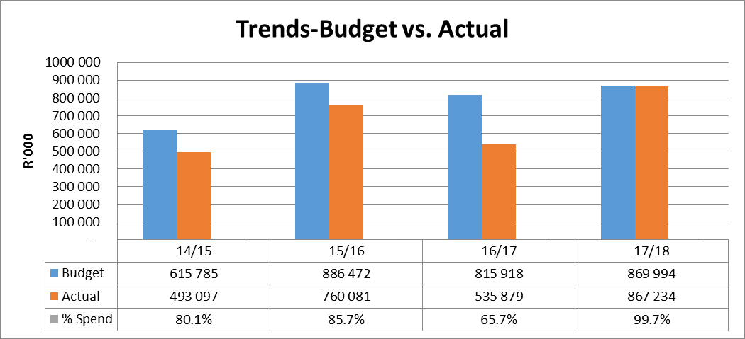
Department performance per grant: 2017/18: historic trends

Slide 3
Department performance per grant: 2017/18: summary

Slide 4
Department performance per grant: 2017/18: Economic classification

Slide 5
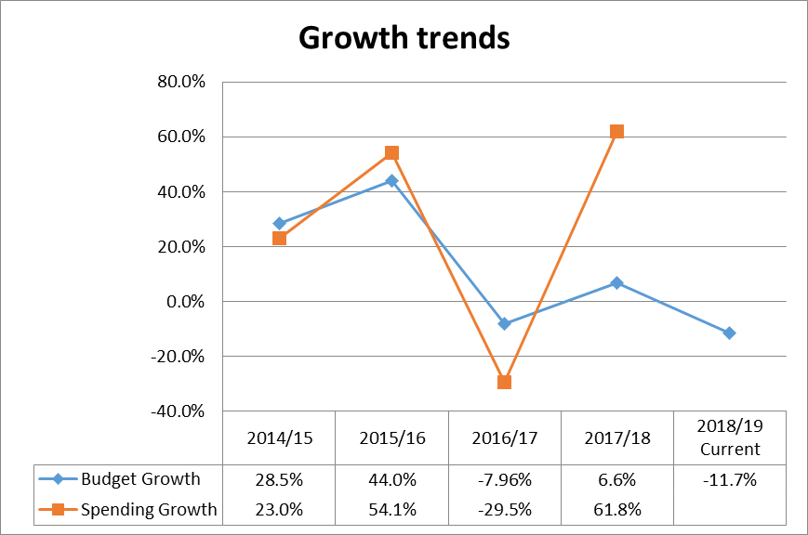
Department performance per grant: 2017/18: growth trends

Slide 6
Department performance per grant: 2017/18: nature of investment

Slide 7
Budget and EXPENDITURE: 2017/18 As at 31 mar 2018 Per grant: education infra: (EIG)
Project Name | 2017/18 Main Budget R000' | 2017/18 Adjus Budget R000' | 2017/18 Commitment R000' | Actual Exp as at end Mar R000' | 2017/18 Avail Budget as at end Mar R000'
ABLUT FAC:EDUC&LEARNERS-01/17/18 | 11 166 | 11 166 | - | 13 565 | -2 399
ABLUT FAC:EDUC&LEARNERS-08/13/14 | 3 722 | 6 722 | 1 296 | 3 021 | 2 406
ADDITIONAL CLASSROOMS-02/17/18 | 11 541 | 11 541 | 828 | 14 303 | -3 590
ADDITIONAL CLASSROOMS-07/13/14 | 3 847 | 3 847 | - | 4 378 | -531
ADMINISTRATION BLOCKS-03/17/18 | 10 756 | 10 756 | 2 133 | 7 145 | 1 478
ADMINISTRATION BLOCKS-06/13/14 | 3 585 | 3 585 | - | 3 526 | 59
ALTERNATIVE ELECT SUPPLY-14/15/6 | 3 000 | 1 000 | - | 2 287 | -1 287
BETH:REHOPOTSWE:BOHLOKONG-1/13/4 | 11 358 | 14 358 | 893 | 11 564 | 1 901
BFN:CALEB MOTSHABI (DOE05/14/15) | 8 401 | 10 401 | - | 10 332 | 69
BFN:EUREKA HOST:EX PRINT-02/13/1 | 7 363 | 9 363 | - | 8 304 | 1 059

Slide 8
Budget and EXPENDITURE: 2017/18 As at 31 mar 2018 Per grant: education infra: (EIG)..cnt
Project Name | 2017/18 Main Budget R000' | 2017/18 Adjus Budget R000' | 2017/18 Commitment R000' | Actual Exp as at end Mar R000' | 2017/18 Avail Budget as at end Mar R000'
BFN:GRASSLAND (DOE04/14/15) | 9 025 | 16 025 | 2 721 | 11 635 | 1 669
BFN:GRASSLAND SECONDARY-06/14/15 | 10 479 | 13 479 | - | 12 635 | 844
BFN:MATLA (DOE22/12/13) | - | 5 000 | 391 | 4 311 | 298
BOTHAVILLE:TSHEHETSO (07/16/17) | 12 000 | 1 | - | - | 1
BOTSHABELO:TLHOLO P/S-25/13/14 | 4 879 | 6 879 | 981 | 4 642 | 1 256
BREDA (DOE09/15/16) | 5 000 | 1 | 71 | 3 092 | -3 161
CLOCOLAN:RUANG TSEBO(DOE05/15/6) | 8 480 | 13 480 | 2 206 | 12 491 | -1 217
CONNECT:MUNIC SEWERLINE-08/14/15 | 1 014 | 1 014 | - | 1 989 | -975
CONNECT:MUNIC SEWERLINE-21/17/18 | 3 040 | 3 040 | 1 590 | 2 922 | -1 472
CONV:FULL SERV SCHOOLS-11/15/16 | 7 008 | 7 008 | 27 | 6 621 | 360

Slide 9
Budget and EXPENDITURE: 2017/18 As at 31 mar 2018 Per grant: education infra: (EIG)..cnt
Project Name | 2017/18 Main Budget R000' | 2017/18 Adjus Budget R000' | 2017/18 Commitment R000' | Actual Exp as at end Mar R000' | 2017/18 Avail Budget as at end Mar R000'
DAYTODAY GEN MAINT SCHLS-05/17/8 | 102 609 | 200 612 | 15 736 | 157 407 | 27 469
DAYTODAY GEN MAINT SCHLS-22/13/4 | 28 373 | 28 373 | 5 822 | 31 857 | -9 306
FACILITIES MANAGEMENT-06/17/18 | 4 875 | - | - | - | -
FACILITIES MANAGEMENT-21/13/14 | 1 625 | - | - | - | -
FARM SCHOOLS REFURBISHM-07/17/18 | 4 477 | - | - | 589 | -589
FARM SCHOOLS REFURBISHM-20/13/14 | 1 493 | - | 252 | - | -252
FINAL ACCOUNTS/FEES(DOE03/13/14) | 8 000 | - | - | 5 252 | -5 252
FRANKFORT:TSEBO ULWAZI(10/16/17) | 12 000 | 1 | 1 664 | 1 225 | -2 889
GRADE R FACILITIES (DOE10/13/14) | 16 423 | 5 828 | 669 | 9 960 | -4 801
HERTZOGVILLE:MALEBOGO-02/14/15 | 10 188 | 12 188 | 4 231 | 6 163 | 1 794

Slide 10
Budget and EXPENDITURE: 2017/18 As at 31 mar 2018 Per grant: education infra: (EIG)..cnt
Project Name | 2017/18 Main Budget R000' | 2017/18 Adjus Budget R000' | 2017/18 Commitment R000' | Actual Exp as at end Mar R000' | 2017/18 Avail Budget as at end Mar R000'
HOOPSTAD:GM POLORI (DOE02/15/16) | 8 980 | 11 980 | - | 9 902 | 2 078
HOSTELS (DOE16/13/14) | 4 604 | 4 604 | 161 | 24 | 4 419
HOSTELS (DOE20/17/18) | 13 811 | 83 811 | 11 063 | 40 308 | 32 440
INVENTORY:IT EQUIPMENT(32/17/18) | - | 2 000 | - | 2 001 | -1
INVENTORY:SCHOOL FURNIT-FRN/15/6 | 7 350 | 32 350 | 5 126 | 3 999 | 23 225
LABORATORIES (DOE05/13/14) | 3 342 | 3 342 | - | 3 234 | 108
LABORATORIES (DOE08/17/18) | 10 027 | 10 027 | 148 | 21 751 | -11 873
LEBONENG (DOE08/15/16) | 5 720 | 1 | 102 | 704 | -805
MAKABELANE-NEW HOSTEL-16/15/16 | 6 600 | - | - | 5 931 | -5 931
MATH LABS (DOE18/13/14) | 16 948 | - | - | 16 948 | -16 948

Slide 11
Budget and EXPENDITURE: 2017/18 As at 31 mar 2018 Per grant: education infra: (EIG)..cnt
Project Name | 2017/18 Main Budget R000' | 2017/18 Adjus Budget R000' | 2017/18 Commitment R000' | Actual Exp as at end Mar R000' | 2017/18 Avail Budget as at end Mar R000'
MOBILE CLASSROOMS (DOE09/17/18) | 2 512 | 52 512 | 23 459 | 24 271 | 4 782
MOBILE CLASSROOMS (DOE11/13/14) | 838 | 838 | - | 737 | 102
MOBILE RELOCATION (34/17/18) | - | 200 | - | 813 | -613
MOOIFONTEIN (DOE07/15/16) | 7 000 | 9 000 | - | 15 080 | -6 080
MORENA TSHOHISI MOLOI (01/16/17) | 6 900 | 1 | - | 5 330 | -5 329
NEW S/S (OLD ZAMDELA)-DOE03/16/7 | 9 000 | - | - | 2 828 | -2 828
NO PROJECTS | 21 000 | 18 000 | - | 25 088 | -7 088
NUTRITION CENTRES (DOE10/17/18) | 9 811 | 11 811 | 1 196 | 10 070 | 545
NUTRITION CENTRES (DOE13/13/14) | 3 270 | 3 270 | 255 | 3 015 | -
ORANJEKRAG (DOE10/15/16) | 2 000 | 1 | - | 2 000 | -1 999

Slide 12
Budget and EXPENDITURE: 2017/18 As at 31 mar 2018 Per grant: education infra: (EIG)..cnt
Project Name | 2017/18 Main Budget R000' | 2017/18 Adjus Budget R000' | 2017/18 Commitment R000' | Actual Exp as at end Mar R000' | 2017/18 Avail Budget as at end Mar R000'
PARTN:KAGISO TRUST SHANDUKA-40 | 12 000 | 50 000 | 9 131 | 53 072 | -12 202
PARTN:KAGISO TRUST(ADM BLOCK)-23 | 3 500 | - | - | 960 | -960
PARTNERSHIPS (DOE23/13/14) | 6 000 | 3 900 | - | 4 221 | -321
PARYS: NEW PRIMARY (DOE05/16/17) | 9 500 | 1 | - | - | 1
PARYS: NEW SECONDARY (06/16/17) | 11 387 | - | - | 6 939 | -6 939
PERIMETRE FENCING (DOE/19/17/18) | 6 837 | 4 837 | - | 3 706 | 1 131
PERIMETRE FENCING (DOE14/13/14) | 2 279 | 2 279 | - | 2 238 | 41
PM FEES:ILISO CONSULT:15/13/14-1 | 4 581 | 4 581 | 1 469 | 2 774 | 338
PM FEES:MK&ASSOC CONSULT-26/17/8 | - | 8 000 | - | 13 065 | -5 065
PM FEES:MPHATI CONSULTNG-25/17/8 | - | 10 000 | - | 15 547 | -5 547

Slide 13
Budget and EXPENDITURE: 2017/18 As at 31 mar 2018 Per grant: education infra: (EIG)..cnt
Project Name | 2017/18 Main Budget R000' | 2017/18 Adjus Budget R000' | 2017/18 Commitment R000' | Actual Exp as at end Mar R000' | 2017/18 Avail Budget as at end Mar R000'
PM FEES:MPS CONSULTING-15/13/4-2 | 3 619 | 3 619 | - | 3 286 | 333
PM FEES:NALA CONSULTING-27/17/18 | - | 10 000 | - | 22 877 | -12 877
PM FEES:PHETOGO CONSULT-28/17/18 | - | 10 000 | - | 14 583 | -4 583
PMFEES:ETSHO CONSULTING-29/17/8 | - | 10 000 | 1 762 | 6 284 | 1 955
PROV SCHL WATER & SAN PR-15/15/6 | 3 410 | 3 410 | 6 | 3 334 | 70
RENOVATIONS (DOE11/17/18) | 16 671 | 15 377 | 52 | 46 846 | -31 521
RENOVATIONS (DOE17/13/14) | 5 557 | 5 557 | - | 9 728 | -4 171
SAS(AMELIA)MOSES MASIKE/BEKEZELA | 11 039 | 14 039 | 1 547 | 16 507 | -4 015
SAS:KAHOBOTJHA-SAKUBUSHA-21/12/3 | 1 400 | 3 400 | 54 | 4 166 | -820
SAS:KATLEGO-MPUMELELO (08/16/17) | 9 500 | 1 | 617 | 682 | -1 297

Slide 14
Budget and EXPENDITURE: 2017/18 As at 31 mar 2018 Per grant: education infra: (EIG)..cnt
Project Name | 2017/18 Main Budget R000' | 2017/18 Adjus Budget R000' | 2017/18 Commitment R000' | Actual Exp as at end Mar R000' | 2017/18 Avail Budget as at end Mar R000'
SASOLB:KOPANELANG THUTO-20/12/13 | 5 414 | 5 414 | 2 192 | 1 236 | 1 986
SPECIAL SCHOOLS (DOE09/13/14) | 625 | 625 | - | 597 | 28
SPECIAL SCHOOLS (DOE22/17/18) | 1 875 | 1 875 | - | 1 875 | -
STORM DAMAGES (DOE 19/13/14) | 7 000 | 11 000 | 1 003 | 4 701 | 5 296
THABA NCHU:BOITUMELONG-07/14/15 | 2 000 | 1 | - | - | 1
TROMPSBURG:NEW SPEC/S (06/15/16) | 9 800 | 1 | 4 292 | 1 466 | -5 757
TWEELING:NEW PRIMARY(DOE09/16/7) | 8 500 | 1 | 774 | 3 206 | -3 980
UNACCEPTABLE STRUCTURES-23/17/18 | 2 000 | 1 | - | 1 062 | -1 061
VILJOENSKROON:DR SELLO-01/15/16 | 9 500 | 1 | 64 | 1 375 | -1 438
VOGELFONTEIN (DOE 02/16/17) | 6 700 | 1 | - | 1 610 | -1 609

Slide 15
Budget and EXPENDITURE: 2017/18 As at 31 mar 2018 Per grant: education infra: (EIG)..cnt
Project Name | 2017/18 Main Budget R000' | 2017/18 Adjus Budget R000' | 2017/18 Commitment R000' | Actual Exp as at end Mar R000' | 2017/18 Avail Budget as at end Mar R000'
VREDE:THEMBALIHLE (DOE 04/15/16) | 8 280 | 14 280 | - | 17 330 | -3 050
WELKOM:ADELAIDE TAMBO (03/14/15) | 10 539 | 16 539 | 3 184 | 14 800 | -1 445
WELKOM:HANI PARK P/S (31/12/13) | 6 922 | 1 000 | 477 | 19 775 | -19 253
WELKOM:SILUNDOKUHLE-DOE03/15/16 | 8 760 | 3 760 | 2 006 | 5 994 | -4 240
WELKOM:UPGR:KOPANO COMPL-05/13/4 | 1 000 | - | - | 1 000 | -1 000

Slide 16
Budget and EXPENDITURE: 2017/18 As at 31 mar 2018 Per grant: EPWP INTERGRATED GRANT..(EPWP)
Project Name | 2017/18 Main Budget R000' | 2017/18 Adjus Budget R000' | 2017/18 Commitment R000' | Actual Exp as at end Mar R000' | 2017/18 Avail Budget as at end Mar R000'
FACILITIES MANAGEMENT-06/17/18 | 1 500 | - | - | - | -
FACILITIES MANAGEMENT-21/13/14 | 500 | - | - | - | -
HR REMUNERATION (33/17/18) | - | 1 506 | - | 1 501 | 5
INVENT:DISTR TO SCHOOLS-31/17/18 | - | 494 | 177 | 238 | 79

Slide 17
Budget and EXPENDITURE: 2017/18 As at 31 mar 2018 Per grant: infrastructure ENHANCEMENT
Project Name | 2017/18 Main Budget R000' | 2017/18 Adjus Budget R000' | 2017/18 Commitment R000' | Actual Exp as at end Mar R000' | 2017/18 Avail Budget as at end Mar R000'
BETHLEHEM DISTR OFFICE-12/17/18 | 600 | 600 | 72 | 394 | 134
DAYTODAY GEN MAINT-BUILD-01/13/4 | 500 | 500 | - | 823 | -323
DAYTODAY GEN MAINT-BUILD-04/17/8 | 4 500 | 4 500 | 697 | 3 803 | -
KOFFIEFONTEIN ERC OFFICE-16/17/8 | 1 000 | 1 000 | - | 925 | 75
KROONSTAD ERC (DOE/17/17/18) | 1 200 | 507 | 57 | 450 | -
QWAQWA:EX PARLIAM BUILD-03/15/16 | 1 000 | 1 000 | 394 | 581 | 25
SASOLBURG DISTR OFFICE-15/17/18 | 1 200 | 693 | 0 | 692 | 1
TEMPE WAREHOUSE (DOE 03/16/17) | 1 278 | 1 278 | 97 | 1 181 | -
THEJANE P/S (MOTHEO ERC)-14/17/8 | 1 000 | 1 000 | - | 988 | 12
TSHIYA ERC (DOE/13/17/18) | 2 000 | 2 000 | 360 | 1 640 | -
WELKM:KOPANO OFFICE COMP-18/17/8 | 2 000 | 2 000 | 5 | 1 928 | 67

Slide 18
Department performance
COMPLETED PROJECTS
ASIDI CLAIM
SPENDING 2017/18
COMPLIANCE
PFMA SECTION 42 TRANFERS: 4 BATCHES
IMPROVED SUBMISSION
IRM
BUDGET SPENDING
99,9 %
ASIDI CLAIMS
BATCH 1 (58 PROJECTS) – R 96 080 436,1
BATCH 2 (65 PROJECTS) – R 63 619 755,61
BATCH 3 (85 PROJECTS) – R 228 055 959, 59
BATCH 4 (28 PROJECTS) – R 122 574 758,00
KCM
QUARTERLY REPORTS
COMPLIANCE CERTIFICATES
18

Slide 19
CHALLENGES IN 2017/18
1. BUDGET PRESSURES
The unit is currently running more projects than allocated budget, this is as a result of of the fifth tranche that was withheld 2016/17 due to slow spending.
2018/19 financial year budget cuts due to funding of free education.
Budgeting for radical eradication pit toilets
Projects implemented for longer period than planned due to various challenges on sites.
2. MISCLASSIFICATION OF CURRENT VS CAPITAL EXPENDITURE
Projects handed over to DPW&I for implementation which take long to commence on site.
Ongoing projects running at a slow pace due to contractors capacity and challenges on site.
3. WORK REGISTERS
Due to mis-classication in payments, the quality of reporting in work registers is compromised.
Notes:
BUDGET PREASSURES
Flowing from 2016/17 FY R86,9 Million which was the fifth and last trench was withheld due to underspending ( Delays in procurement) – this lead to contracted projects which were suppose to be implemented in 2016/17 FY to be implemented in 2017/18 FY putting a strain in 2017/18 budget, and this has replica effect on MTEF.
The reduction of EIG allocation in 2018/19 coupled with price inflation makes it difficult for the province adequately fund current running projects
Eradicating PIT TOILETS in 2018/19 forces the unit to reprioritise the budget at the expense of currently running projects which might create contractual challenges.
MISCLASSIFICATION
Capital Projects handed over to implementing agent, which are not implemented timely are attributing to uncertainty of when will the funds be spent and given the dilapidated state of most of our facilities these funds are then used to maintain facilities – this unfortunately happens late in to the financial year, causing misclassification

Slide 20
Impact of accruals on the current 2018/19FY
Source of fund
R755 337 m R 105 957 m R649 930 m
Education Infra Grant 2018/19
Accruals
Education Infra Grant 2018/19

Slide 21
WAYFORWARD
All projects which are planned but not contracted will be deferred to outer years in the MTEF to rationalise the U-AMP with the budget(incl. indicative) allocations.
Budgeting in line with SCOA classifications.
Filling of critical vacant posts in the Physical Resources Management chief directorate including the districts.
The implementation of “concurrence” between the HOD for Dept. of Education and DPW & I related to project planning and implementation.
The payment of contractors within 30 days to enable physical progress on sites.

Slide 22
THANK YOU

