Slide 1

PRESENTATION TO SELECT COMMITTEE ON APPROPRIATIONS
EDUCATION INFRASTRUCTURE GRANT AND ASIDI PERFORMANCE
30 MAY 2018

Slide 2
PRESENTATION OUTLINE
Purpose
PART A:
2.1 Provincial Infrastructure Programme
2.2 Accelerated School Infrastructure Delivery Initiative
3. PART B:
3.1 Sanitation Audit Report
3.2 Draft Costed Plan
4. Recommendation

Slide 3
1. PURPOSE
To present to the Select Committee on Appropriations the performance of the Education Infrastructure Grant and the School Infrastructure Backlogs Grant.

Slide 4
2. PART A
Provincial Infrastructure Programme
& Accelerated School Infrastructure Delivery Initiative

Slide 5
2.1
PROVINCIAL INFRASTRUCTURE PROGRAMME

Slide 6

TOTAL INFRASTRUCTURE EXPENDITURE – MARCH 2018
PROVINCE | Allocated Budget 2017/18 ('000) | Adjustments ('000) | Total Adjusted Budget ('000) | Total Spent as at end March 2018 ('000) | % Spent of Adjusted Budget
Eastern Cape | 1,636,750 | 22,000 | 1,658,750 | 1,659,620 | 100%
Free State | 679,913 | 198,081 | 877,994 | 869,091 | 99%
Gauteng | 1,742,829 | 382,011 | 2,124,840 | 1,976,661 | 93%
KwaZulu-Natal | 2,308,147 | 194,877 | 2,503,024 | 2,504,124 | 100%
Limpopo | 810,523 | 298,568 | 1,109,091 | 1,096,188 | 99%
Mpumalanga | 1,165,781 | -80,000 | 1,085,781 | 899,719 | 83%
North West | 1,076,331 | 0 | 1,076,331 | 1,072,989 | 100%
Northern Cape | 623,578 | 0 | 623,578 | 609,595 | 98%
Western Cape | 1,614,044 | 146,509 | 1,760,553 | 1,675,123 | 95%
TOTAL | 11 657 896 | 1 162 046 | 12 819 942 | 12 363 110 | 96%

Slide 7
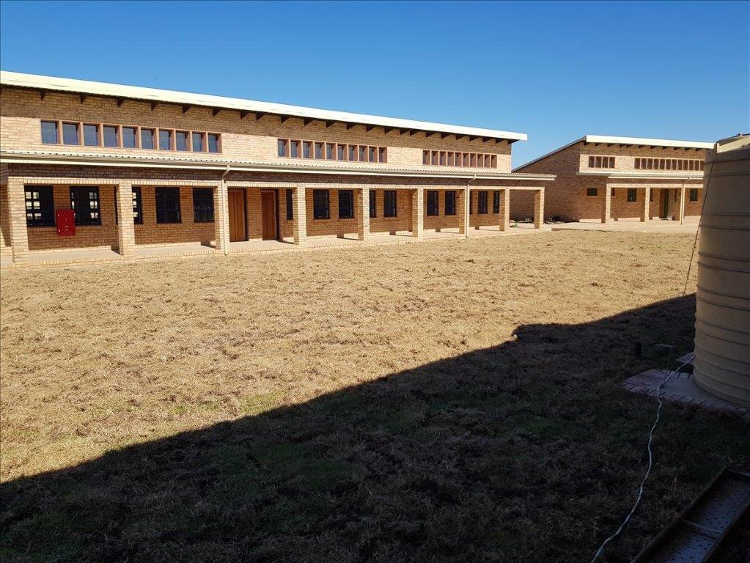
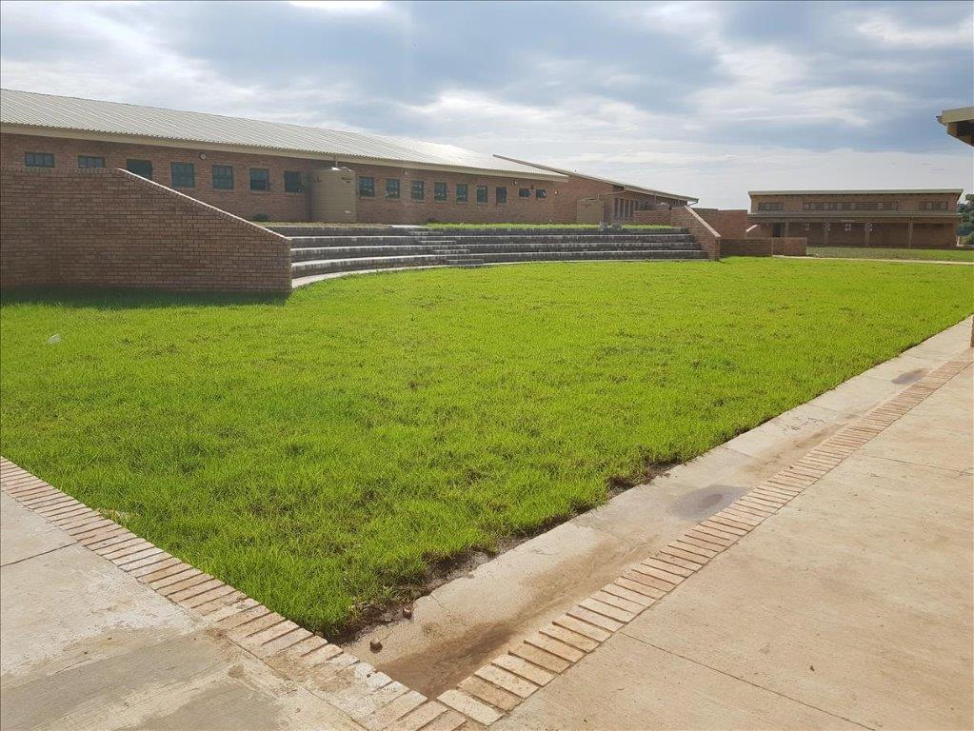
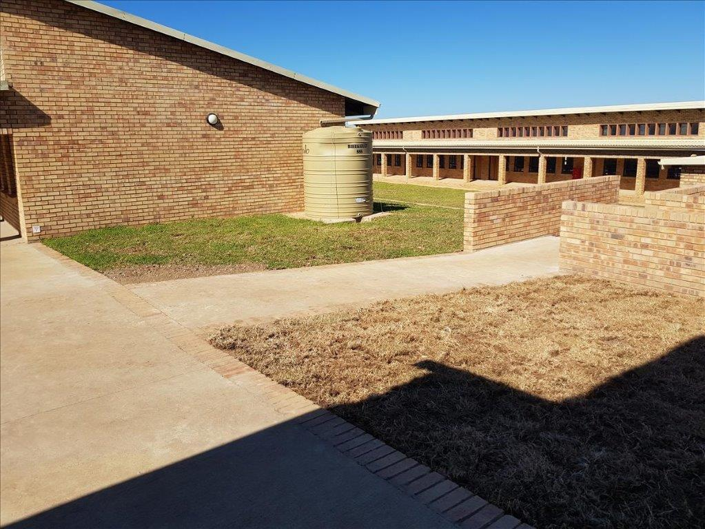
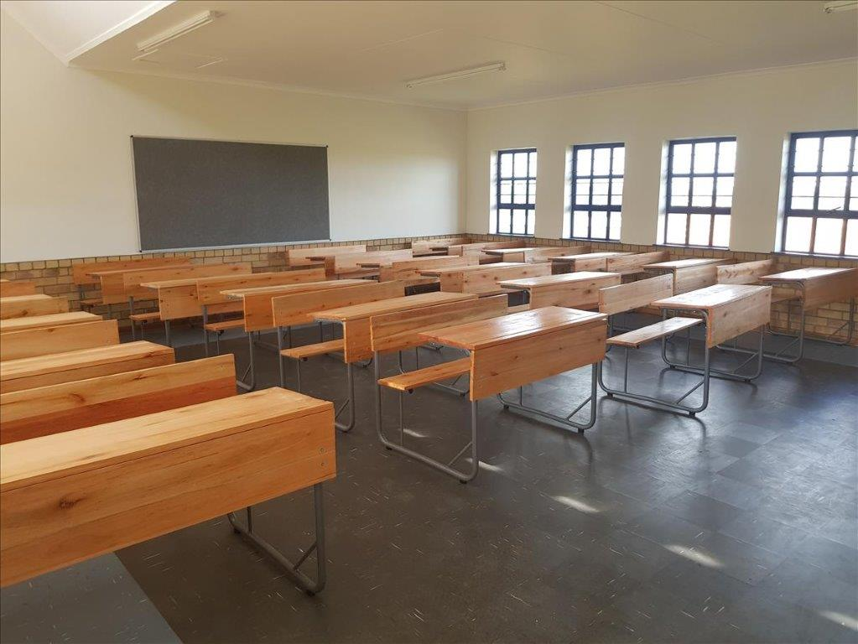
BHEKIZULU SSS – (EC)

Slide 8
EDUCATION INFRASTRUCTURE GRANT – MARCH 2018
PROVINCE | Allocated Budget 2017/18 ('000) | Adjustments ('000) | Total Adjusted Budget ('000) | EIG Transfers to PEDs ('000) | Total Spent as at end March 2018 ('000) | % Spent of EIG Transferred as at end March 2018 | % Spent of Adjusted Budget
Eastern Cape | 1,581,750 |  | 1,581,750 | 1,581,750 | 1,582,837 | 100% | 100%
Free State | 661,635 |  | 661,635 | 661,635 | 852,091 | 129% | 129%
Gauteng | 1,468,146 | 0 | 1,468,146 | 1,468,146 | 1,446,158 | 99% | 99%
KwaZulu-Natal | 1,993,146 | 339,996 | 2,333,142 | 2,333,142 | 2,333,382 | 100% | 100%
Limpopo | 810,523 | 81,718 | 892,241 | 892,241 | 900,171 | 101% | 101%
Mpumalanga | 750,184 | 0 | 750,184 | 750,184 | 698,762 | 93% | 93%
North West | 1,074,331 | 0 | 1,074,331 | 1,074,331 | 1,070,355 | 100% | 100%
Northern Cape | 612,267 | 0 | 612,267 | 612,267 | 609,361 | 100% | 100%
Western Cape | 1,093,580 |  | 1,093,580 | 1,093,580 | 1,121,835 | 103% | 103%
TOTAL | 10 045 562 | 421 714 | 10 467 276 | 10 467 276 | 10 614 952 | 101% | 101%

Slide 9
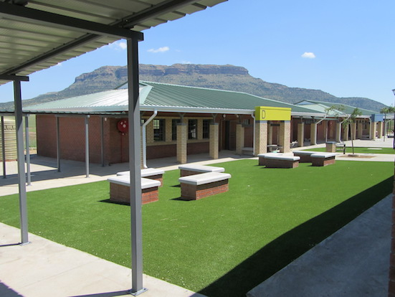
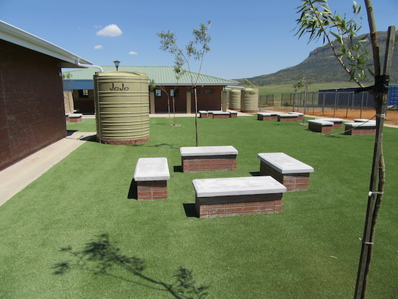
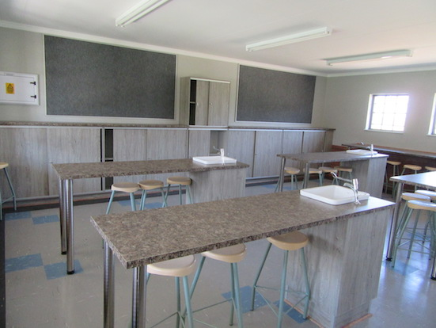
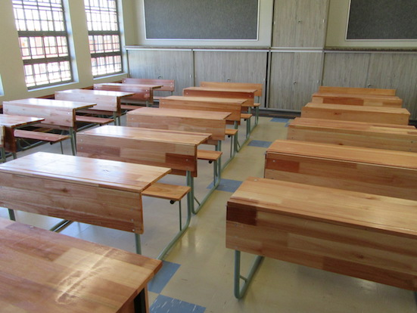
THABA-PACHOA – (FS)

Slide 10

MAINTENANCE
Prov | No. of Maint’nce Projects in 2017/18 FY | Overall Adjusted Infrastructure Budget ('000) | Maint’nce Budget ('000) | %ge Maint’nce Budget to Total | Total Expenditure as at end March 2018 ('000) | %ge Expenditure on Maint’nce Relative to Maint’nce Budget
Eastern Cape | 372 | R 1,658,750 | R 283,737 | 17% | R 529,224 | 187%
Free State | 66 | R 877,994 | R 364,412 | 42% | R 355,509 | 98%
Gauteng | 922 | R 2,124,840 | R 673,227 | 32% | R 625,048 | 93%
KwaZulu-Natal | 3277 | R 2,414,834 | R 853,949 | 35% | R 834,497 | 98%
Limpopo | 89 | R 852,339 | R 362,515 | 43% | R 351,713 | 97%
Mpumalanga | 77 | R 1,085,781 | R 106,163 | 10% | R 109,747 | 103%
North West | 258 | R 1,076,331 | R 115,807 | 11% | R 106,841 | 92%
Northern Cape | 96 | R 623,578 | R 163,792 | 26% | R 156,841 | 96%
Western Cape | 68 | R 1,760,553 | R 626,751 | 36% | R 603,696 | 96%
TOTAL | 5,225 | R 12,475,000 | R 3,550,353 | 28% | R 3,673,116 | 103%

Slide 11
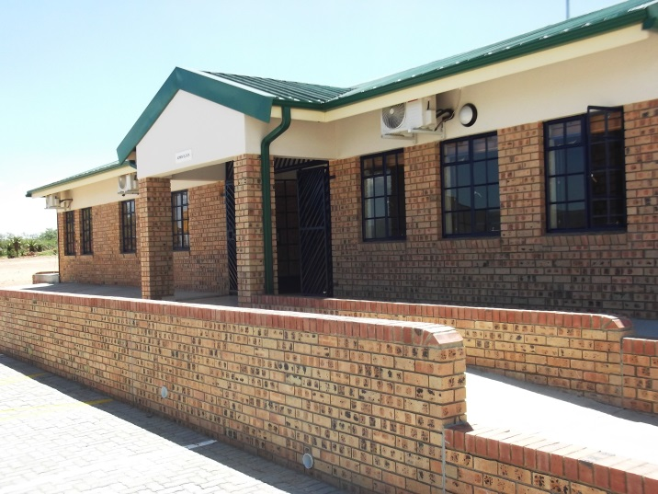
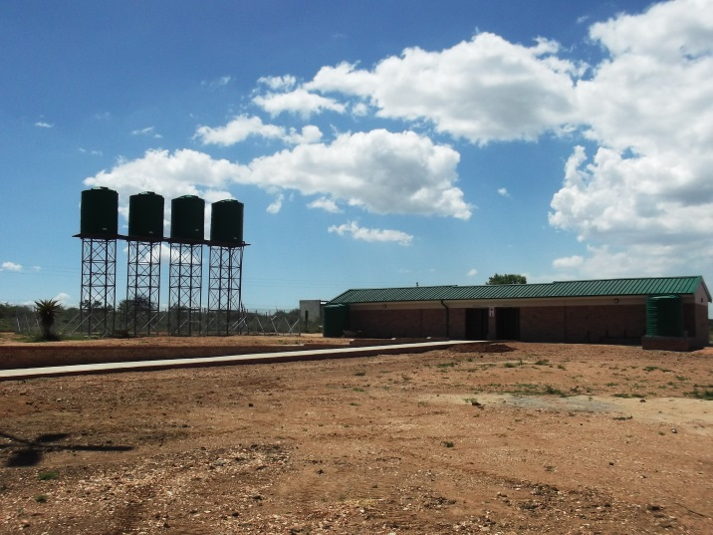
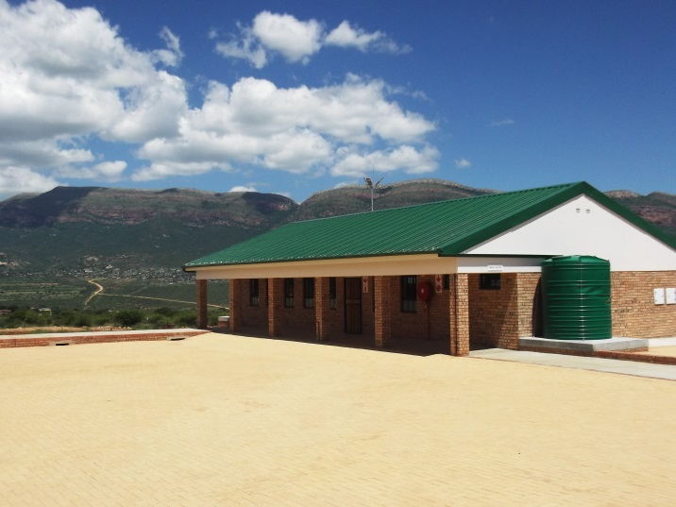
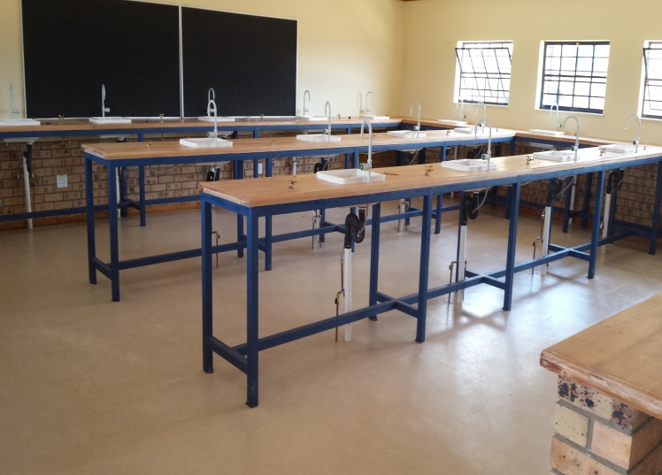
MOLEPO PS (LP)

Slide 12
SECTOR PERFORMANCE: DELIVERABLES AGAINST TARGETS
No.: |  | Target | Delivered | Balance
1 | Number of New Schools | 35 | 13 | -22
2 | Replacement schools | 30 | 23 | -7
3 | Full Service Schools | 40 | 4 | -36
4 | Provision/replacement of Sanitation | 731 | 659 | -72
5 | Provision/upgrade of Water | 538 | 819 | 281
6 | Provision/upgrade of Electricity | 293 | 208 | -85
7 | Maintenance Projects | 1513 | 1624 | 111
8 | Libraries Project | 109 | 26 | -83
9 | Laboratories Projects | 140 | 89 | -51
1 | School Halls | 36 | 16 | -20
11 | Technical Workshops | 14 | 4 | -10
12 | Nutrition Centers | 74 | 52 | -22
13 | Additional Classrooms | 2023 | 2299 | 276
14 | Grade R Classrooms | 782 | 551 | -231
15 | Administration Blocks | 91 | 36 | -55
16 | Provision/upgrade of fence | 124 | 199 | 75
17 | Provision/upgrade of sport field | 47 | 9 | -38
18 | Special Schools | 8 | 5 | -3
19 | Natural Disasters Projects | 277 | 188 | -89
20 | Guard House | 45 | 17 | -28
21 | Boarding Schools | 2 | 3 | 1
The table illustrates Sector performance against the set targets across the 21 Sub – Programmes.

Slide 13
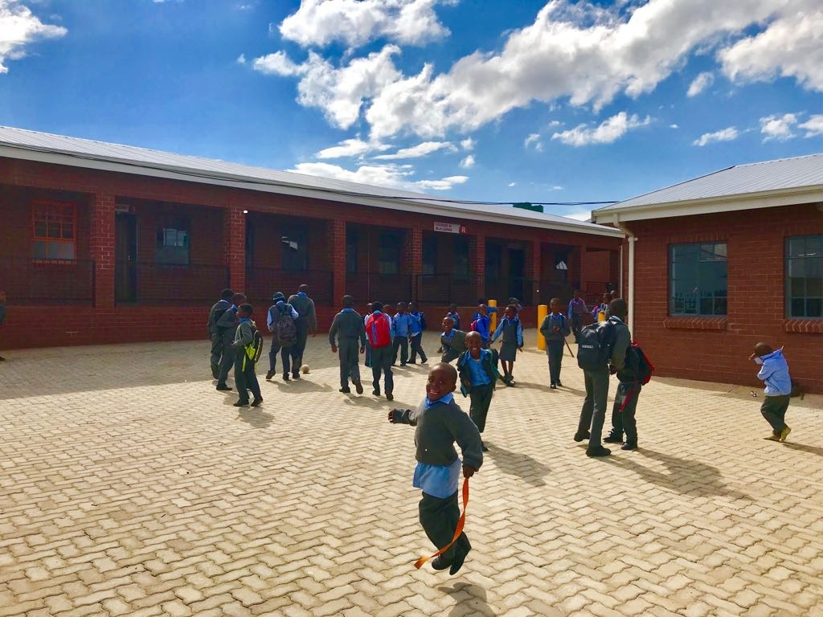
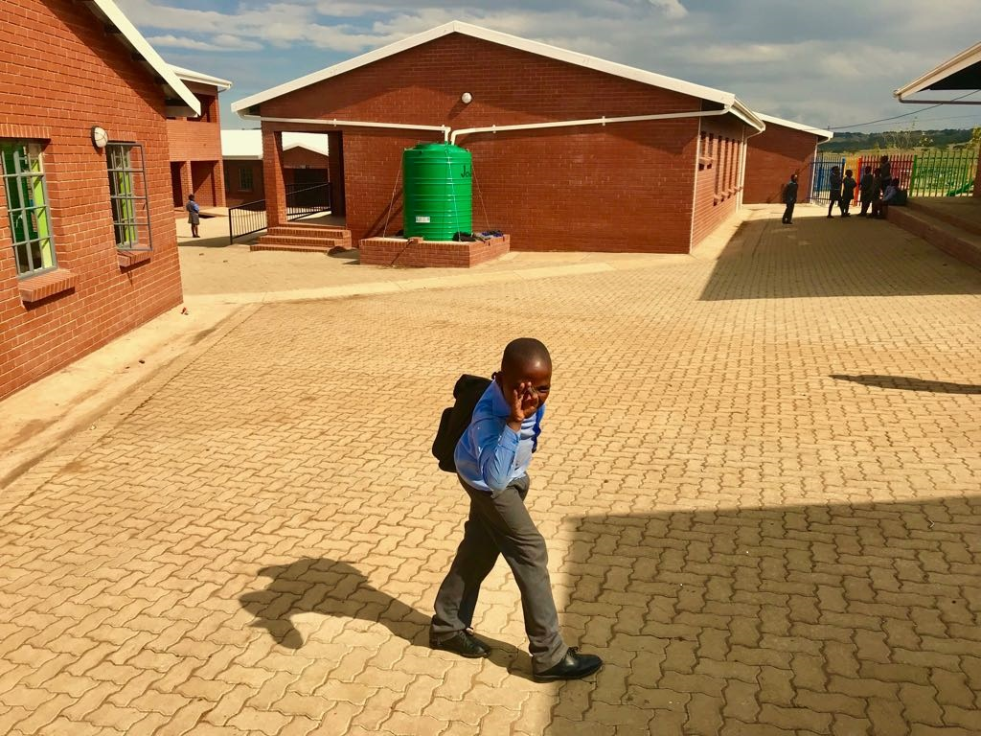
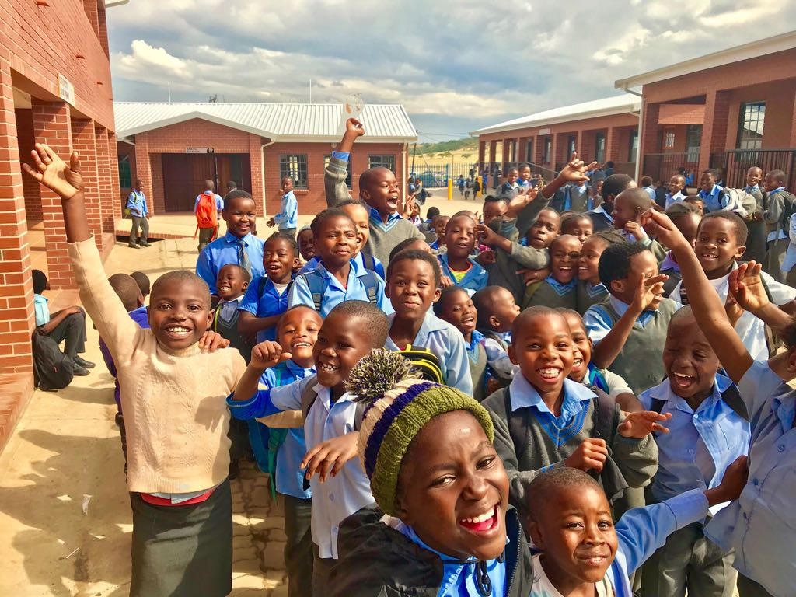
EHLANHLENI PS - KZN

Slide 14
NEW / REPLACEMENT: COMPLETED SCHOOLS
SUMMARY OF PROJECTS COMPLETED FOR THE 2017/18 FINANCIAL YEAR
Province | TARGET 2016/17 | NEW SCHOOLS |  |  |  |  | TARGET 2016/17 | REPLACEMENT SCHOOLS |  |  |  |  | TOTAL SCHOOLS TARGETED | TOTAL COMPLETED | PROGRESS
 |  | 1 Q | 2 Q | 3 Q | 4 Q | TOTAL |  | 1 Q | 2 Q | 3 Q | 4 Q | TOTAL
Number of Schools
Eastern Cape | 0 | 0 | 0 | 0 | 0 | 0 | 8 | 2 | 1 | 3 | 0 | 6 | 8 | 6 | 75%
Free State | 1 | 0 | 0 | 0 | 0 | 0 | 0 | 0 | 0 | 0 | 0 | 0 | 1 | 0 | 0%
Gauteng | 12 | 0 | 0 | 1 | 0 | 1 | 1 | 0 | 0 | 2 | 3 | 5 | 13 | 6 | 46%
Kwazulu Natal | 7 | 1 | 0 | 2 | 2 | 5 | 3 | 0 | 1 | 0 | 0 | 1 | 10 | 6 | 60%
Mpumalanga | 1 | 0 | 0 | 0 | 1 | 1 | 7 | 0 | 3 | 0 | 2 | 5 | 8 | 6 | 75%
Limpopo | 5 | 0 | 2 | 0 | 0 | 2 | 1 | 0 | 1 | 0 | 0 | 1 | 6 | 3 | 50%
Northern Cape | 0 | 0 | 0 | 0 | 0 | 0 | 0 | 0 | 0 | 0 | 0 | 0 | 0 | 0 | 0%
North West | 6 | 0 | 0 | 0 | 1 | 1 | 7 | 0 | 2 | 0 | 0 | 2 | 13 | 3 | 23%
Western Cape | 3 | 0 | 1 | 2 | 0 | 3 | 3 | 0 | 1 | 2 | 0 | 3 | 6 | 6 | 100%
14

Slide 15

PROVINCIAL BREAKDOWN: DELIVERABLES AGAINST TARGETS
No.: | PROGRAMME | COMPLETED PROJECTS
 |  | EC |  | FS |  | GP |  | KZN
 |  | Target | Delivered | Target | Delivered | Target | Delivered | Target | Delivered
1 | Number of New Schools | 0 | 0 | 1 | 0 | 12 | 1 | 7 | 5
2 | Replacement schools | 8 | 6 | 0 | 0 | 1 | 5 | 3 | 1
3 | Full Service Schools | 0 | 4 | 0 | 0 | 0 | 0 | 0 | 0
4 | Provision/replacement of Sanitation | 273 | 280 | 10 | 8 | 13 | 23 | 150 | 126
5 | Provision/upgrade of Water | 188 | 283 | 0 | 0 | 13 | 303 | 150 | 175
6 | Provision/upgrade of Electricity | 107 | 12 | 8 | 8 | 13 | 143 | 150 | 33
7 | Maintenance Projects | 37 | 9 | 56 | 41 | 750 | 1156 | 300 | 245
8 | Libraries Project | 50 | 0 | 3 | 1 | 13 | 2 | 20 | 19
9 | Laboratories Projects | 67 | 0 | 12 | 4 | 13 | 0 | 20 | 14
1 | School Halls | 0 | 0 | 6 | 5 | 13 | 0 | 0 | 0
11 | Technical Workshops | 0 | 0 | 0 | 0 | 0 | 0 | 0 | 3
12 | Nutrition Centers | 0 | 0 | 1 | 1 | 13 | 2 | 20 | 24
13 | Additional Classrooms | 586 | 343 | 61 | 4 | 572 | 975 | 400 | 460
14 | Grade R Classrooms | 98 | 8 | 12 | 3 | 473 | 480 | 120 | 40
15 | Administration Blocks | 0 | 0 | 1 | 1 | 13 | 3 | 20 | 8
16 | Provision/upgrade of fence | 0 | 90 | 0 | 0 | 0 | 4 | 50 | 47
17 | Provision/upgrade of sport field | 0 | 0 | 0 | 0 | 13 | 3 | 2 | 0
18 | Special Schools | 0 | 2 | 0 | 0 | 2 | 1 | 0 | 0
19 | Natural Disasters Projects | 0 | 37 | 8 | 0 | 53 | 0 | 150 | 82
20 | Guard House | 0 | 0 | 0 | 0 | 13 | 2 | 20 | 6
21 | Boarding Schools | 0 | 1 | 1 | 0 | 0 | 0 | 1 | 1

Slide 16
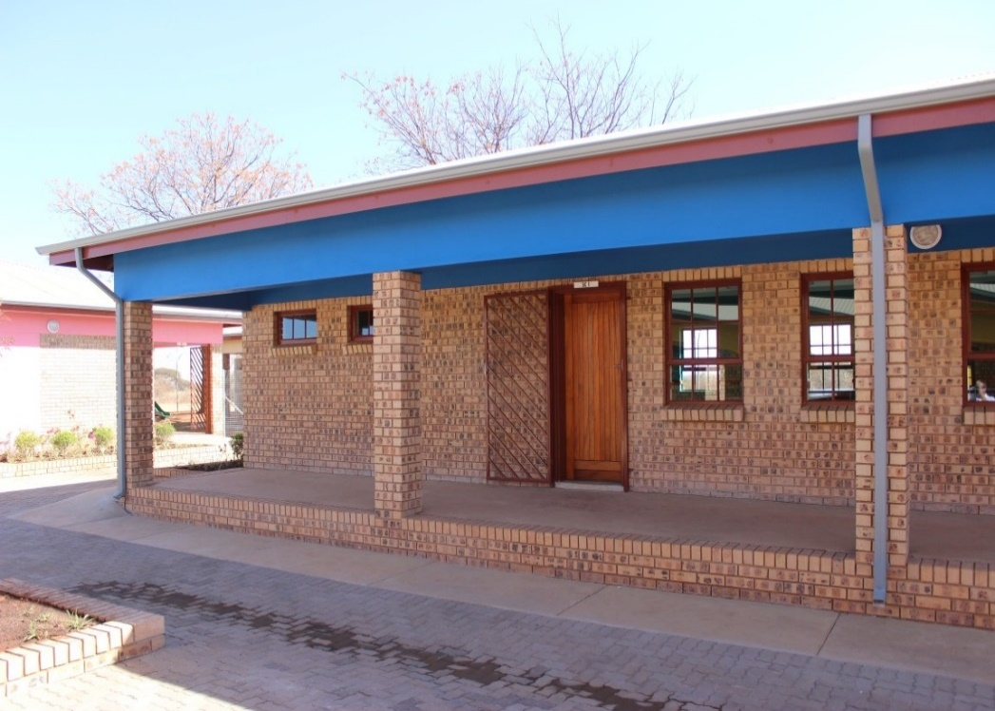
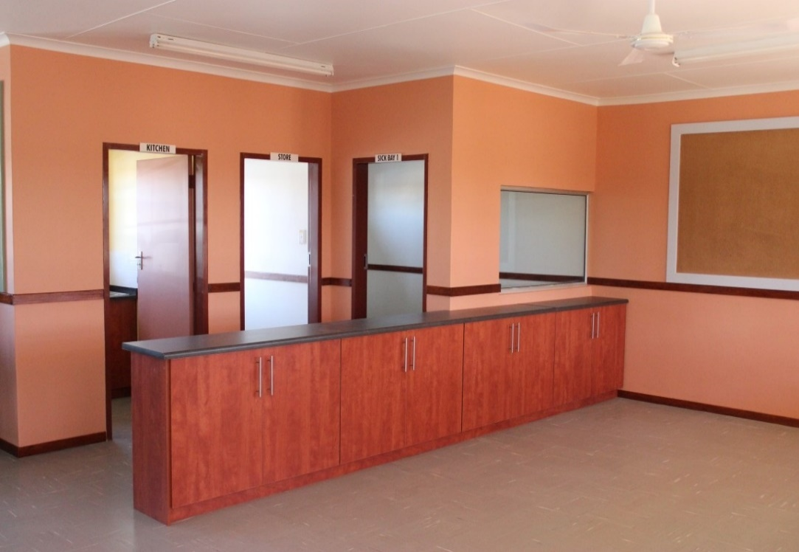
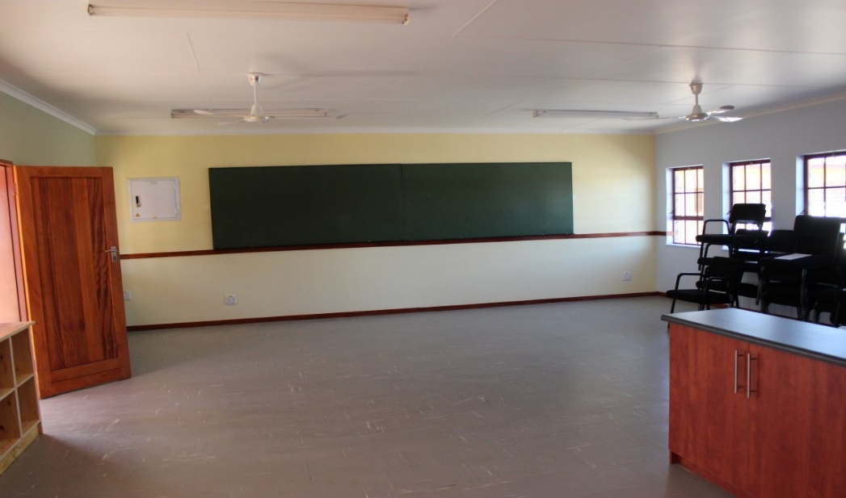
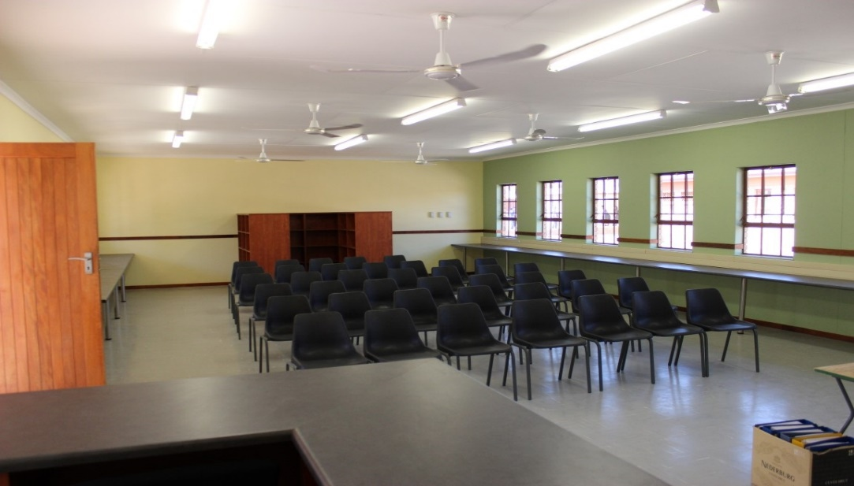
LODING PS - (MP)

Slide 17

PROVINCIAL BREAKDOWN: DELIVERABLES AGAINST TARGETS
No.: | PROGRAMME | COMPLETED PROJECTS
 |  | MP |  | LP |  | NC |  | NW |  | WC
 |  | Target | Delivered | Target | Delivered | Target | Delivered | Target | Delivered | Target | Delivered
1 | Number of New Schools | 1 | 1 | 5 | 2 | 0 | 0 | 6 | 1 | 3 | 3
2 | Replacement schools | 7 | 5 | 1 | 1 | 0 | 0 | 7 | 2 | 3 | 3
3 | Full Service Schools | 28 | 0 | 0 | 0 | 1 | 0 | 11 | 0 | 0 | 0
4 | Provision/replacement of Sanitation | 121 | 95 | 101 | 89 | 13 | 24 | 50 | 14 | 0 | 0
5 | Provision/upgrade of Water | 77 | 5 | 58 | 43 | 32 | 7 | 20 | 3 | 0 | 0
6 | Provision/upgrade of Electricity | 7 | 1 | 0 | 0 | 8 | 9 | 0 | 2 | 0 | 0
7 | Maintenance Projects | 72 | 72 | 151 | 3 | 50 | 29 | 26 | 20 | 71 | 49
8 | Libraries Project | 6 | 1 | 3 | 1 | 1 | 0 | 13 | 2 | 0 | 0
9 | Laboratories Projects | 0 | 0 | 4 | 5 | 0 | 0 | 13 | 55 | 11 | 11
1 | School Halls | 0 | 0 | 0 | 0 | 1 | 1 | 6 | 0 | 10 | 10
11 | Technical Workshops | 1 | 1 | 12 | 0 | 0 | 0 | 1 | 0 | 0 | 0
12 | Nutrition Centers | 4 | 1 | 29 | 20 | 1 | 0 | 6 | 4 | 0 | 0
13 | Additional Classrooms | 62 | 34 | 9 | 300 | 38 | 31 | 248 | 105 | 47 | 47
14 | Grade R Classrooms | 3 | 1 | 41 | 5 | 8 | 4 | 12 | 5 | 15 | 5
15 | Administration Blocks | 7 | 3 | 34 | 15 | 3 | 1 | 13 | 5 | 0 | 0
16 | Provision/upgrade of fence | 6 | 3 | 0 | 17 | 33 | 9 | 9 | 3 | 26 | 26
17 | Provision/upgrade of sport field | 2 | 2 | 1 | 0 | 0 | 2 | 24 | 1 | 5 | 1
18 | Special Schools | 3 | 0 | 1 | 0 | 0 | 0 | 1 | 1 | 1 | 1
19 | Natural Disasters Projects | 61 | 44 | 5 | 22 | 0 | 0 | 0 | 3 | 0 | 0
20 | Guard House | 6 | 1 | 0 | 8 | 0 | 0 | 6 | 0 | 0 | 0
21 | Boarding Schools | 0 | 0 | 0 | 0 | 0 | 0 | 0 | 1 | 0 | 0

Slide 18
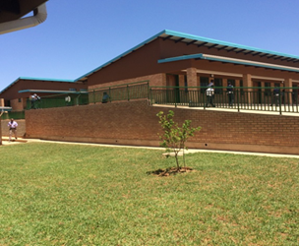
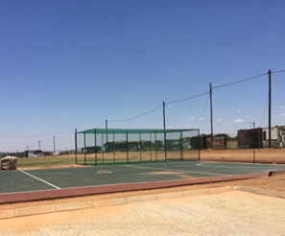
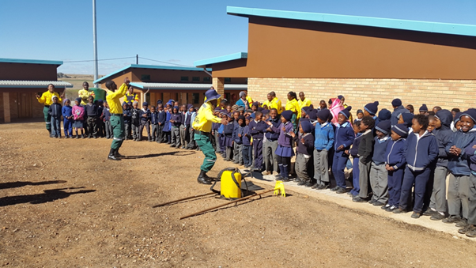
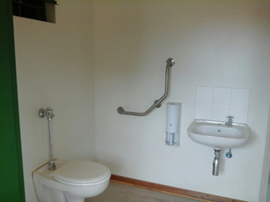
TOEVLUG PS – (NW)

Slide 19

CHALLENGES & MITIGATIONS
 | PROVINCE | CHALLENGES | MITIGATIONS
1 | Eastern Cape | Over-commitment. | A number of projects are being put on hold to avoid over-commitment. PIAs have been instructed that they cannot award any tenders without prior approval from the Department
2 | Free State | Provision of water could not be achieved because the identified farm schools were closed during 2017/18 financial year. The closing process was delayed due to farm laborer migrations which the province does not have control over. Added to that the parents did not want to move their children away from home to schools with hostel facilities. The additional classrooms and Grade R classrooms were implemented by PW due to the litigation process all projects were put on hold. There were delays in the procurement process but we have put in place mechanisms to fast track the process, already we have completed facilitates while others are still in construction phase. | The schools that were closed will be removed from the list of schools without basic services and therefore there are no schools without water. As soon as the litigation process has been finalized, we will then start with the procurement process to deliver the classrooms as initially planned. In the first quarter of the new financial year we will be able to hand-over a number of completed projects.
3 | KwaZulu Natal | The most prominent challenge experienced within the province being that of inadequate cash flows. This results in service providers terminating work on site. This has a domino effect as the targets are not met. | Engagement with the top management is underway in ways to release the infrastructure funding as per the allocation and ensure that the EIG is utilized in adherence to the conditions.

Slide 20
CHALLENGES & MITIGATIONS
 | PROVINCE | CHALLENGES | MITIGATIONS
4 | Gauteng | The allocated budget was reduced hence the targets had to be revised to be in-line with the adjusted allocation. | Realignment to the allocation, all the new schools that were to be constructed with alternative technology were deferred to commence in the next financial year.
5 | Limpopo | The department had budgetary pressures due to over commitments. | Slow-down of implementation of the set target, to push the completion to the next financial year. The 2018/19 deliverables adjusted in order to cater for the current commitments to avoid over budget pressure in the next financial year.
6 | Mpumalanga | Poor performance of contractors leading to delay in delivery of projects. | Closely monitor poor performing contractors and ensure that the Implementing Agent enforces contractual disciplinary measures to non performing contractors.

Slide 21
CHALLENGES & MITIGATIONS
 | PROVINCE | CHALLENGES | MITIGATIONS
7 | Northern Cape | Slow performing contractors. Reprioritized projects due to emergency maintenance. Delayed commencement of projects on site. | Terminated non performing contractors. Engagement with the implementing agents to ensure that the projects are completed in 2018/19. Close monitoring of the implementation.
8 | North West | Inadequate capacity of implementing agents SCM slow process on procurement delivery Community unrest & labor disputes Slow performance of contractors due to labor and contractual disputes | Provincial treasury is addressing the matter under legal attention Monthly engagements with the relevant unit of the department Improvement on the engagements with communities to ensure all the stakeholders are considered. Hold programme performance meetings with IA and contractor disputes.
9 | Western Cape | Delay in receiving practical completion certificate from the consultants, hence some projects cannot be declared completed without documentation. Some projects delay due to the contractor abandoning site . | Upon receiving the practical completion certificates the projects will be reported in the 1st Quarter. The contract of the contractor that abandoned the site was cancelled. A new contractor is being appointed to complete the project and the site was handed-over on the 24/04/2018.

Slide 22
EDUCATION INFRASTRUCTURE GRANT
Provinces | Column A | Column B
 | Allocation | MTEF Estimates
 | 2018/19 | 2019/20 | 2020/21
 | R'000 | R'000 | R'000
Eastern Cape | 1 479 828 | 1 394 253 | 1 547 060
Free State | 755 337 | 643 932 | 714 506
Gauteng | 1 373 073 | 1 283 691 | 1 424 381
KwaZulu-Natal | 1 866 435 | 1 794 644 | 1 991 333
Limpopo | 1 011 680 | 1 068 836 | 1 275 292
Mpumalanga | 838 551 | 730 112 | 810 132
Northern Cape | 568 766 | 450 709 | 500 106
North West | 1 002 988 | 900 412 | 999 095
Western Cape | 1 021 076 | 919 146 | 1 019 882
Unallocated |  | 1 128 423 | 1 184 844
Total | 9 917 734 | 10 314 159 | 11 466 632

Slide 23
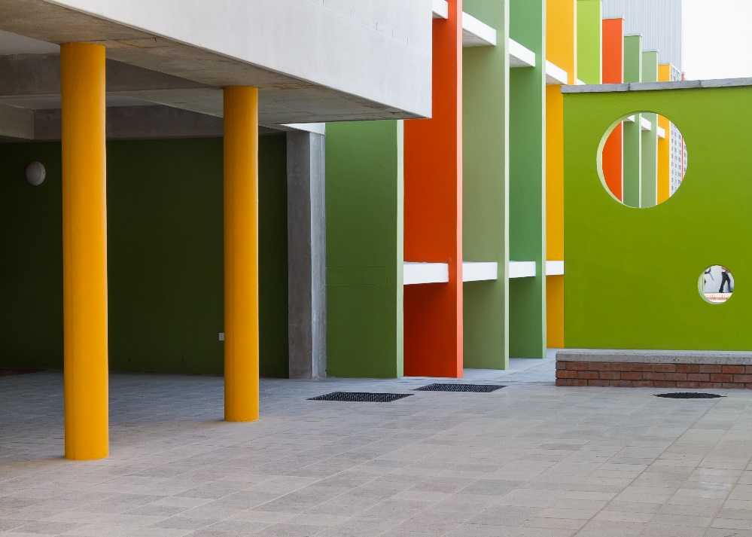
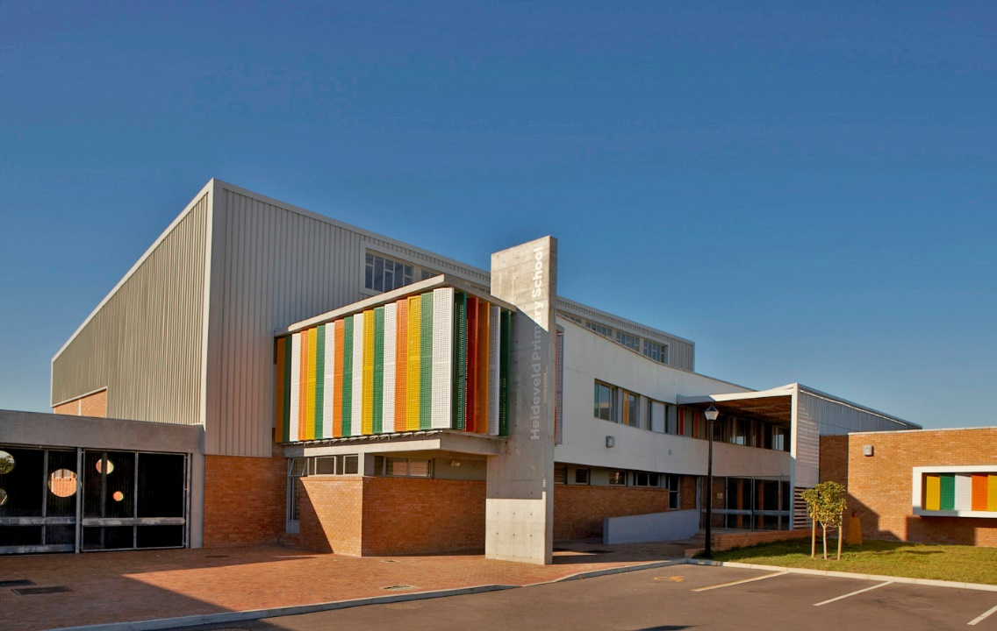
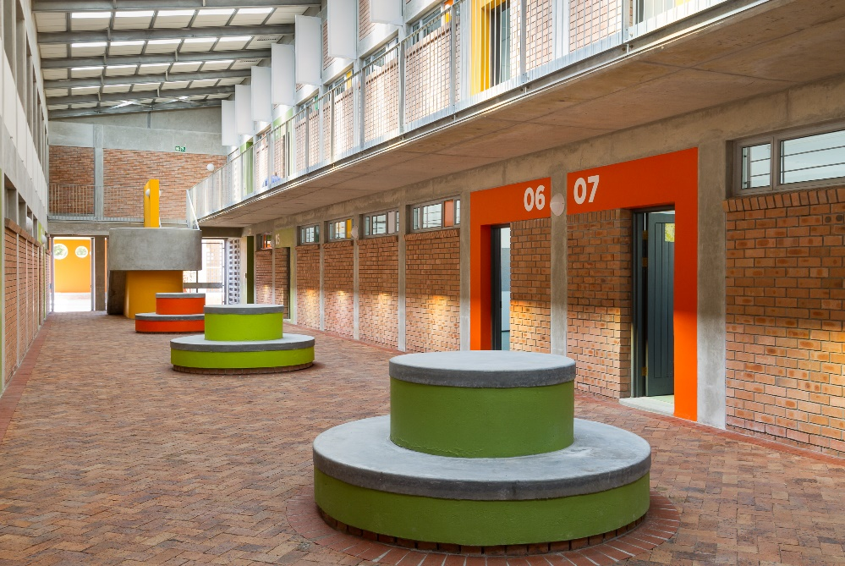
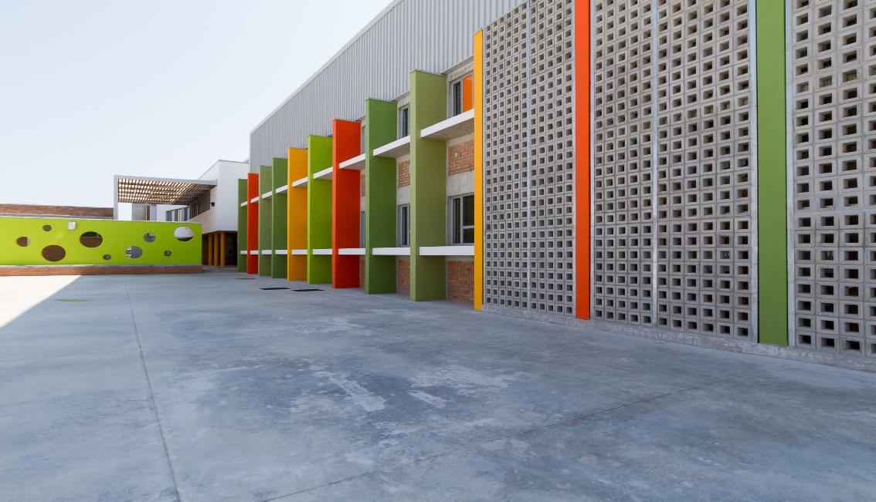
HEIDEVELD PS (WC)

Slide 24
SCHOOL INFRASTRUCTURE DELIVERY PROVINCIAL PLAN FOR 2018/19 MTEF
PROGRAMME | 2018/19 | 2019/20 | 2020/21 | 2018/19 | 2019/20 | 2020/21 | 2018/19 | 2019/20 | 2020/21 | 2018/19 | 2019/20 | 2020/21
 | EC |  |  | FS |  |  | GP |  |  | KZN
Number of New Schools | 4 | 3 | 3 | 8 | 4 | 3 | 10 | 11 | 16 | 9 | 7 | 3
Replacement schools | 4 | 4 | 3 | 5 | 0 | 0 | 1 | 1 | 4 | 1 | 2 | 2
Full Service Schools | 0 | 0 | 0 | 1 | 1 | 1 | 0 | 0 | 0 | 2 | 1 | 2
Provision/replacement of Sanitation | 169 | 178 | 185 | 87 | 6 | 6 | 12 | 13 | 21 | 150 | 150 | 180
Provision/upgrade of Water | 169 | 178 | 185 | 10 | 10 | 10 | 12 | 13 | 21 | 150 | 150 | 180
Provision/upgrade of Electricity | 32 | 5 | 12 | 10 | 10 | 10 | 12 | 13 | 21 | 100 | 100 | 170
Maintenance Projects | 18 | 20 | 35 | 65 | 27 | 20 | 40 | 40 | 50 | 320 | 370 | 385
Libraries Project | 28 | 30 | 33 | 2 | 6 | 2 | 11 | 13 | 21 | 10 | 12 | 13
Laboratories Projects | 0 | 0 | 0 | 8 | 4 | 10 | 11 | 13 | 21 | 15 | 12 | 13
School Halls | 0 | 0 | 0 | 0 | 1 | 0 | 11 | 13 | 21 | 0 | 0 | 0
Technical Workshops | 0 | 0 | 0 | 0 | 0 | 0 | 0 | 0 | 0 | 0 | 0 | 0
Nutrition Center | 0 | 0 | 0 | 10 | 18 | 18 | 11 | 13 | 21 | 15 | 10 | 10
Additional Classrooms | 260 | 285 | 250 | 81 | 39 | 50 | 350 | 350 | 300 | 200 | 210 | 220
Grade R Classrooms | 13 | 13 | 23 | 35 | 18 | 30 | 200 | 200 | 300 | 50 | 50 | 80
Administration Blocks | 0 | 0 | 0 | 8 | 10 | 6 | 11 | 13 | 21 | 10 | 10 | 10
Provision/upgrade of fence | 0 | 0 | 0 | 0 | 9 | 10 | 11 | 13 | 21 | 40 | 40 | 30
Provision/upgrade of sport field | 0 | 0 | 0 | 0 | 0 | 0 | 11 | 13 | 21 | 10 | 9 | 5
Special Schools | 0 | 0 | 0 | 0 | 0 | 1 | 0 | 1 | 1 | 1 | 2 | 2
Boarding Schools | 1 | 2 | 2 | 1 | 3 | 3 | 0 | 0 | 0 | 2 | 2 | 2
Guard House | 4 | 3 | 3 | 0 | 0 | 0 | 11 | 13 | 21 | 10 | 9 | 5
Natural Disasters Projects | 0 | 0 | 0 | 0 | 0 | 0 | 0 | 0 | 0 | 150 | 150 | 180

Slide 25
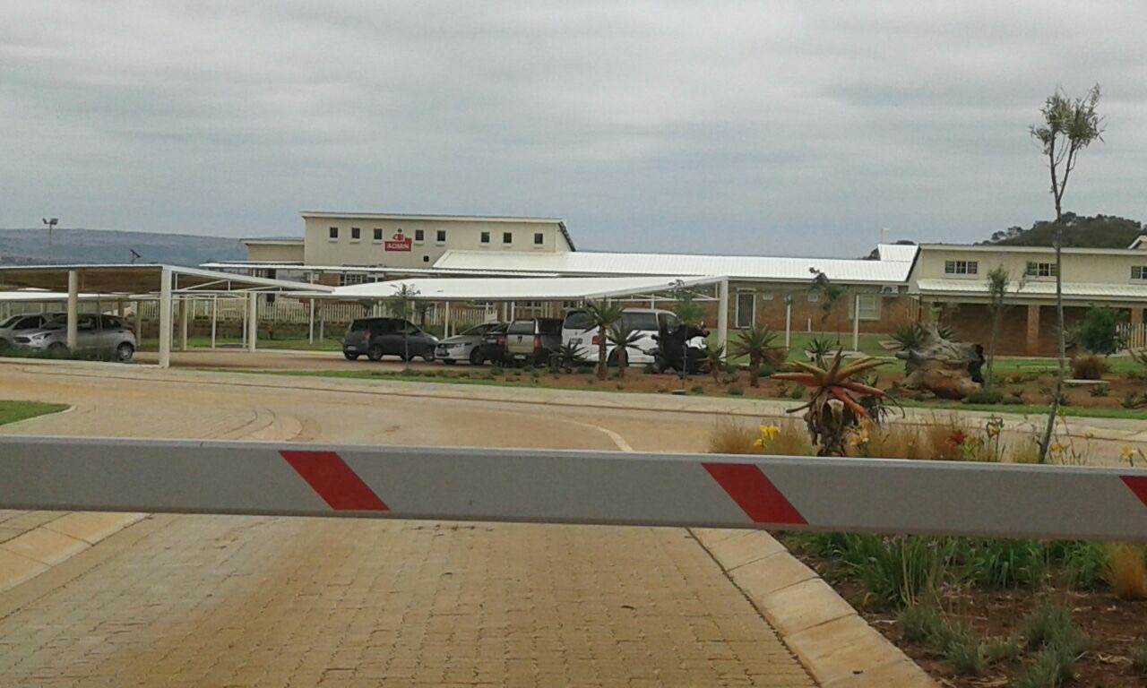
STEVE TSHWETE BOARDING SCHOOL

Slide 26
SCHOOL INFRASTRUCTURE DELIVERY PROVINCIAL PLAN FOR 2018/19 MTEF
PROGRAMME | 2018/19 | 2019/20 | 2020/21 | 2018/19 | 2019/20 | 2020/21 | 2018/19 | 2019/20 | 2020/21 | 2018/19 | 2019/20 | 2020/21 | 2018/19 | 2019/20 | 2020/21
 | LP |  |  | MP |  |  | NC |  |  | NW |  |  | WC
Number of New Schools | 1 | 4 | 1 | 2 | 1 | 7 | 2 | 2 | 2 | 6 | 2 | 1 | 7 | 6 | 2
Replacement schools | 7 | 1 | 7 | 2 | 7 | 9 | 2 | 2 | 1 | 9 | 5 | 5 | 3 | 8 | 8
Full Service Schools | 28 | 0 | 28 | 0 | 0 | 0 | 0 | 0 | 0 | 4 | 5 | 7 | 0 | 0 | 0
Provision/replacement of Sanitation | 121 | 1 | 121 | 121 | 85 | 53 | 28 | 14 | 12 | 50 | 12 | 12 | 10 | 14 | 11
Provision/upgrade of Water | 77 | 0 | 77 | 57 | 3 | 0 | 9 | 15 | 4 | 5 | 10 | 11 | 10 | 14 | 11
Provision/upgrade of Electricity | 7 | 6 | 7 | 5 | 1 | 0 | 11 | 8 | 1 | 0 | 0 | 2 | 10 | 14 | 11
Maintenance Projects | 72 | 41 | 72 | 23 | 29 |  | 50 | 54 | 42 | 15 | 48 | 15 | 54 | 173 | 131
Libraries Project | 6 | 0 | 6 | 4 | 3 | 9 | 4 | 4 | 3 | 15 | 7 | 6 | 0 | 0 | 0
Laboratories Projects | 0 | 7 | 0 | 1 | 1 | 3 | 8 | 8 | 6 | 15 | 7 | 6 | 9 | 0 | 0
School Halls | 0 | 1 | 0 | 2 | 0 | 3 | 4 | 5 | 4 | 15 | 7 | 6 | 9 | 0 | 0
Technical Workshops | 1 | 0 | 1 | 0 | 0 | 0 | 6 | 5 | 4 | 0 | 0 | 0 | 0 | 0 | 0
Nutrition Center | 4 | 2 | 4 | 4 | 3 | 10 | 99 | 78 | 74 | 15 | 5 | 8 | 10 | 15 | 11
Additional Classrooms | 62 | 18 | 62 | 87 | 104 | 166 | 12 | 12 | 10 | 19 | 26 | 22 | 79 | 68 | 58
Grade R Classrooms | 3 | 0 | 3 | 8 | 3 | 5 | 5 | 5 | 4 | 8 | 10 | 4 | 28 | 73 | 66
Administration Blocks | 7 | 4 | 7 | 4 | 5 | 10 | 14 | 15 | 6 | 15 | 7 | 5 | 10 | 15 | 11
Provision/upgrade of fence | 6 | 4 | 6 | 9 | 1 | 10 | 4 | 4 | 3 | 6 | 5 | 0 | 10 | 15 | 11
Provision/upgrade of sport field | 2 | 6 | 2 | 4 | 3 | 6 | 4 | 4 | 3 | 14 | 8 | 10 | 10 | 15 | 11
Special Schools | 1 | 0 | 3 | 0 | 1 | 1 | 0 | 0 | 0 | 0 | 0 | 1 | 0 | 0 | 1
Boarding Schools | 0 | 0 | 0 | 1 | 0 | 1 | 0 | 0 | 0 | 0 | 0 | 1 | 0 | 0 | 0
Guard House | 1 | 4 | 1 | 9 | 1 | 10 | 0 | 0 | 0 | 15 | 7 | 6 | 0 | 0 | 0

Slide 27
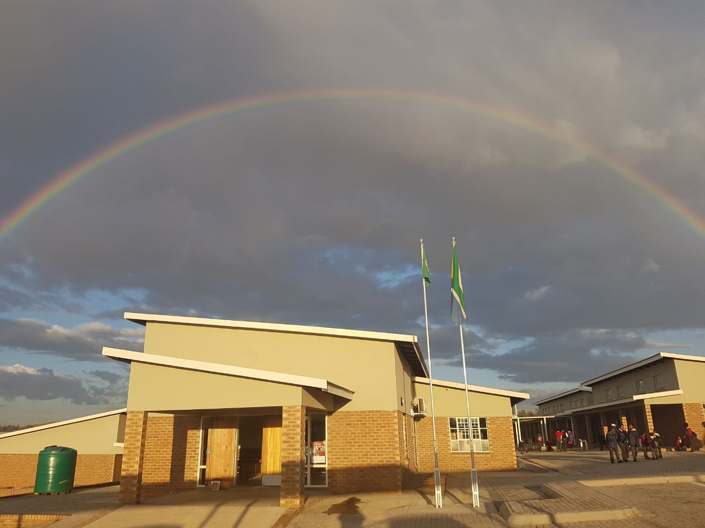
DHUVA PRIMARY SCHOOL

Slide 28
2.2
ACCELERATED SCHOOL INFRASTRUCTURE DELIVERY INITIATIVE

Slide 29
INAPPROPRIATE STRUCTURES
PROGRESS
Provinces | Implementing Agents (IA) | Projects being Implemented | Design & | Construction Progress |  |  |  | Projects in Construction | No of Projects Completed
 |  |  | Procurement | <25% | 25%-49% | 50%-74% | >75%
 | DBSA | 114 | 6 | 9 | - | - | 1 | 10 | 98
 | IDT | 31 | 3 | 10 | 4 | 2 | - | 16 | 12
EC | CDC | 31 | 5 | 3 | - | 1 | 1 | 5 | 21
 | DRPW | 16 | 0 | - | - | 1 | 1 | 2 | 14
 | NDPW | 20 | 4 | 16 | - | - | - | 16 | -
 | DBE# 29 | 29 | 29 | - | - | - | - | 0 | -
 | DBE# 57 | 57 | 34 | 23 | - | - | - | 23 | -
Sub-Total | - | 298 | 81 | 61 | 4 | 4 | 3 | 72 | 145
FS | IDT | 6 | 0 | - | - | - | 2 | 2 | 4
 | DBSA | 19 | 0 | - |  | - | 3 | 3 | 16
 | FSDoE | 5 | 0 | 5 | - | - | - | 5 | -
Sub-Total | - | 30 | 0 | 5 | 0 | 0 | 5 | 10 | 20
KZN | Adopt-A-School | 3 | 0 | - | - | - | 2 | 2 | 1
WC | WCED | 25 | 0 | - | - | - | - | - | 25
MP | DBSA | 5 | 0 | - | - | - | - | - | 5
NW | DBSA | 2 | 0 | - | - | - | - | - | 2
NC | DBSA | 1 | 0 | - | - | - | - | - | 1
LP | DBSA | 3 | 0 | - | - | - | - | - | 3
Total |  | 367 | 81 | 66 | 4 | 4 | 10 | 84 | 202

Slide 30
SANITATION
PROGRESS
PROVINCES | No of Projects being implemented | No of Projects Completed | No of projects at Planning, Design & Procurement | No of projects under Construction | No of projects with construction progress <25 % | No of projects with construction progress at 25% - 49% | No of projects with construction progress at 50% - 74% | No of projects with construction progress of more than >75%
LP | 437 | 88 | 31 | 318 | 240 | 2 | 0 | 76
EC | 298 | 171 | 52 | 75 | 61 | 1 | 4 | 9
FS | 39 | 12 | 0 | 27 | 0 | 0 | 0 | 27
KZN | 116 | 103 | 11 | 2 | 0 | 0 | 2 | 0
NC | 13 | 13 | 0 | 0 | 0 | 0 | 0 | 0
NW | 18 | 10 | 8 | 0 | 0 | 0 | 0 | 0
GP | 14 | 14 | 0 | 0 | 0 | 0 | 0 | 0
MP | 38 | 38 | 0 | 0 | 0 | 0 | 0 | 0
WC | 19 | 19 | 0 | 0 | 0 | 0 | 0 | 0
TOTALS | *992 | 468 | 102 | **422 | 301 | 3 | 6 | 112
TOTALS | 992 | 468 | 102 | 422 | 301 | 3 | 6 | 112
* 741 is the baseline number of projects as per initial scope of ASIDI
* Due to changes in the scope, the number of projects has increased to 992
** The projects under construction are planned to be completed in the 2018/19 FY.

Slide 31
WATER
PROGRESS
PROVINCES | No of Projects being implemented | No of Projects Completed | No of projects at Planning, Design & Procurement | No of projects under Construction | No of projects with construction progress <25 % | No of projects with construction progress at 25% - 49% | No of projects with construction progress at 50% - 74% | No of projects with construction progress of more than >75%
EC | 548 | 271 | 106 | 171 | 42 | 24 | 5 | 100
MP | 36 | 36 | 0 | 0 | 0 | 0 | 0 | 0
FS | 67 | 53 | 0 | 14 | 0 | 0 | 0 | 14
GP | 0 | 0 | 0 | 0 | 0 | 0 | 0 | 0
KZN | 214 | 206 | 8 | 0 | 0 | 0 | 0 | 0
LP | 364 | 104 | 0 | 260 | 222 | 2 | 3 | 33
NC | 5 | 5 |  | 0 | 0 | 0 | 0 | 0
NW | 15 | 3 | 11 | 1 | 0 | 0 | 0 | 1
WC | 3 | 3 |  | 0 | 0 | 0 | 0 | 0
TOTALS | *1252 | 681 | 125 | **446 | 264 | 26 | 8 | 148
TOTALS | 1252 | 681 | 125 | 446 | 264 | 26 | 8 | 148
* 1120 is the baseline number of projects as per initial scope of ASIDI
* Due to changes in the scope, the number of projects has increased to 1252
** The projects under construction are planned to be completed in the 2018/19 FY.

Slide 32
ELECTRICITY
PROGRESS
Province | IA | No of schools being implemented | No. of schools at planning, design procurement (IDMS) | Construction | No. of schools with progress <25 % | No. of schools with progress at 25% - 49% | No. of schools with construction | No. of schools with construction progress at >75% | No. of schools at PC
 |  |  |  |  |  |  | progress at 50% - 74%%
EC | Eskom | 210 | 0 | 11 | 0 | 0 | 0 | 11 | 202
FS | FS DoE | 55 | 0 | 2 | 0 | 0 | 0 | 2 | 50
GP | GP DoE | 2 | 0 | 0 | 0 | 0 | 0 | 0 | 2
KZN | Eskom | 63 |  | 5 |  |  |  | 5 | 58
LP | Eskom | 5 | 0 | 0 | 0 | 0 | 0 | 0 | 5
MP | Eskom | 48 | 0 | 3 | 0 | 0 | 0 | 3 | 45
NW | Eskom | 2 | 0 | 0 | 0 | 0 | 0 | 0 | 2
NC | N/A | 0 | 0 | 0 | 0 | 0 | 0 | 0 | 0
WC | WC DoE | 8 | 0 | 0 | 0 | 0 | 0 | 0 | 8
 |  | 0 | 0 | 0 | 0 | 0 | 0 | 0 | 0
Total |  | 393 | 0 | 21 | 0 | 0 | 0 | 21 | 372
* 916 is the baseline number of projects as per initial scope of ASIDI |  |  |  |  |  |  | 30
* Due to changes in the scope, the number of projects has decreaesd to 393
**FS_DoE reports that all their electricity projects are completed. DBE is in the process of verifying their completenes

Slide 33
ASIDI EXPENDITURE
Financial Year | Budget Allocation per FY (‘000) | Audited Expenditure (‘000) | Under / Over Expenditure (‘000) | %
2011/12 | R 700 000 | R 76 084 | R 623 916 | 11%
2012/13 | R 2 065 000 | R 860 259 | R 1 204 741 | 42%
2013/14 | R 1 955 981 | R 1 392 307 | R 563 674 | 71%
2014/15 | R 2 540 827 | R 2 543 153 | R -2 326 | 100%
2015/16 | R 2 046 186 | R 1 622 420 | R 423 766 | 79%
2016/17 | R 2 180 581 | R 1 315 835 | R 864 746 | 60%
2017/18 | R 1 755 235 | R 1,786,396 | R -31 161 | 102%

Slide 34
ASIDI EXPENDITURE

Slide 35
SCHOOL INFRASTRUCTURE BACKLOGS GRANT
Provinces | Column A | Column B
 | Allocation | MTEF Estimates
 | 2018/19 | 2019/20 | 2020/21
 | R'000 | R'000 | R'000
Eastern Cape | 1 133 512 | 1 075 327 | 828 591
Free State | 73 257 | 49 466 | -
Gauteng | - | - | -
KwaZulu-Natal | - | - | -
Limpopo | 113 046 | 44 689 | -
Mpumalanga | - | - | -
Northern Cape | - | - | -
North West | 976 | - | -
Western Cape | - | - | -
Unallocated | 151 035 | 157 566 | 140 445
Total | 1 471 826 | 1 327 048 | 969 036
BUDGET 2018 MTEF R3 767 910

Slide 36
PART B
Sanitation Audit Report & Draft Costed Plan

Slide 37
3.1
SANITATION AUDIT REPORT

Slide 38
THE CHALLENGE
  Schools without sanitation;
  Schools with pit toilets;
  Schools provided with sanitation but pit toilets not demolished;
  Schools with inadequate sanitation;
  Sanitation not fit for purpose (age appropriate);
  Schools with insufficient sanitation.

Slide 39


AUDIT RESULT
PROVINCE | Number of schools | PITLATRINES |  | GRADE R | INUSUFFICIENT SANITATION
 |  | Schools (Sites) with pit latrines ONLY and Unacceptable sanitation | Schools (Sites) with combination of proper sanitation but pits not demolished | Schools (Sites) need of Grade R | Schools (Sites)
Eastern Cape | 3157 | 1598 | 323 | 2810 | 2863
Free State | 223 | 156 | 0 | 209 | 338
Gauteng | 656 | 0 | 5 | 325 | 435
KwaZulu Natal | 2842 | 1377 | 1465 | 2001 | 59
Limpopo | 694 | 658 | 853 | 428 | 614
Mpumalanga | 1111 | 127 | 405 | 740 | 984
North West | 192 | 192 | 0 | 189 | 431
Northern Cape | 118 | 0 | 15 | 118 | 328
Western Cape | 747 | 0 | 0 | 482 | 174
TOTALS | 9740 | 4108 | 3066 | 7302 | 6226
**A school (site) may belong to more than 1 sub-programme hence each sub-programme to be read separately**

Slide 40
3.2
DRAFT COSTED PLAN

Slide 41
RATIONALE FOR COSTING
Audit of all sanitation by provinces submitted to DBE.
Direct verification with schools.
Costing exercise- a desktop study based on audit received from provinces and requires verification by means of site visits and preparation of site specific estimates.
Filtered ASIDI and provincial sanitation programmes in all provinces.
Assumed for the purpose of the estimates that all toilets will be built in brick and mortar and will generally be dry sanitation.
Made provision for demolition of unsafe pit latrines and casting a slab over pits.
Assumed that some schools will require a borehole and elevated water tanks.
Made provision for IA fees and disbursements at 5%.
PSP fees and disbursements at 12%.
It should also be noted that the cost estimates are based on the analysis of sanitation costs, and allows for a programme that will draw from economies of scale, by clustering projects, so that contractors from CIDB Grade 6 are utilised. The smaller the contracts, the higher the cost per seat.
The estimates are dependent on the implementation programme. Will probably change depending on when the projects will be implemented and the choices that are made around material, procurement strategy, technology, etc

Slide 42
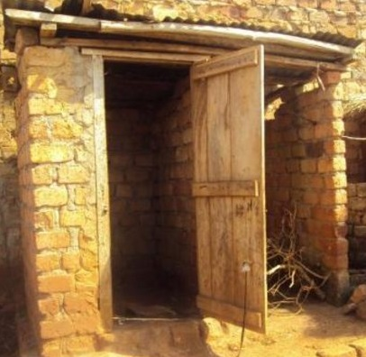
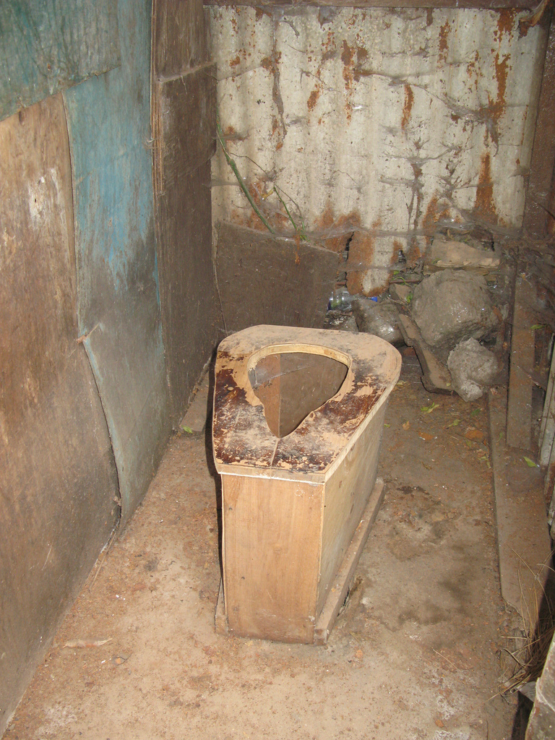

Slide 43
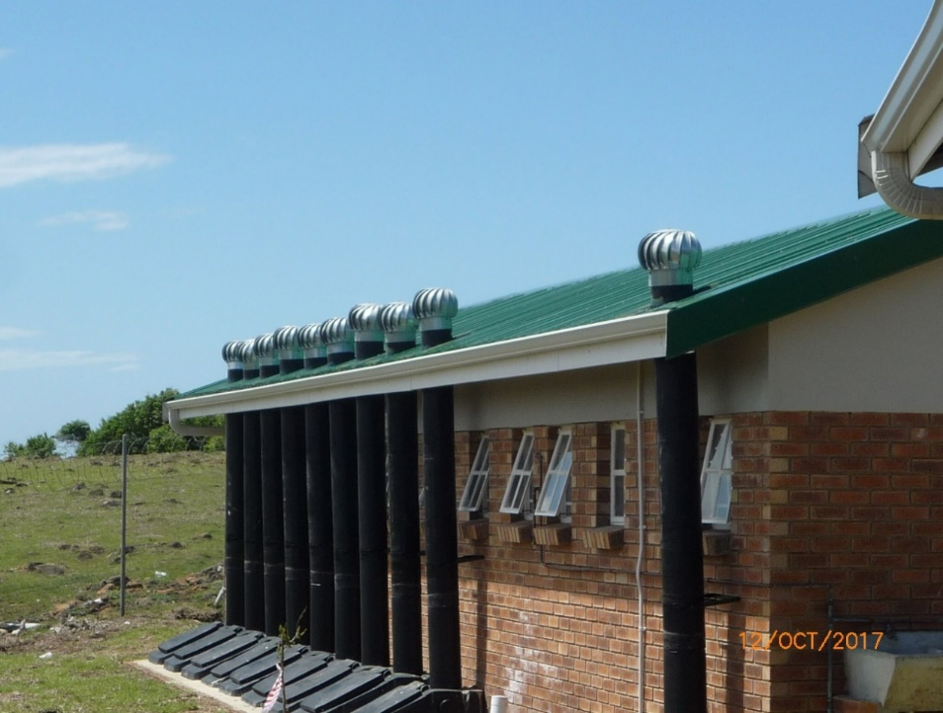
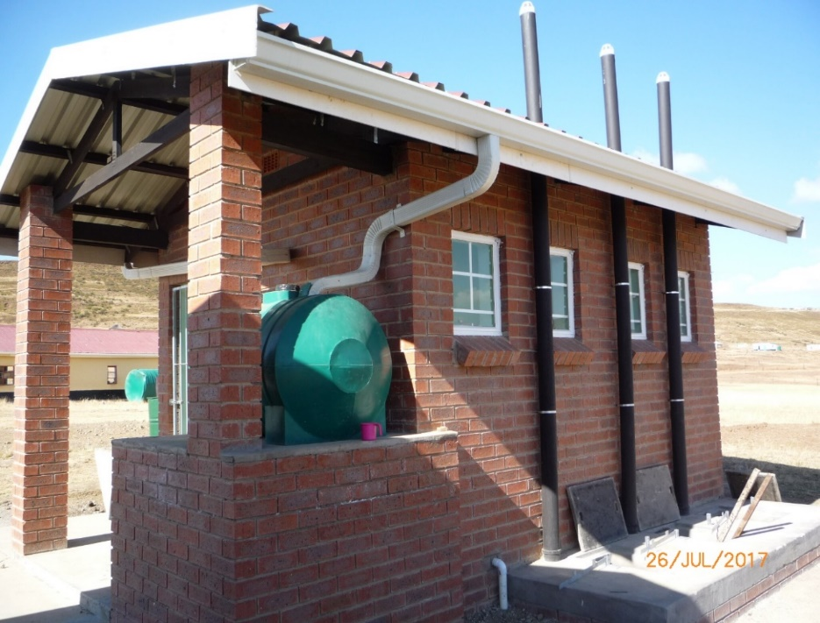
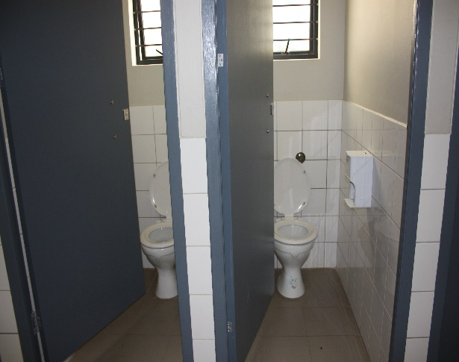
TECHNOLOGY
EnviroLoo
Ventilated Improved Pit latrines (VIP’s)
Water borne sanitation

Slide 44
SUMMARY OF SANITATION ONLY

Slide 45
SUMMARY OF SANITATION AND DEMOLITIONS

Slide 46
SUMMARY OF BOREHOLES ONLY

Slide 47
CONSOLIDATED COSTS
Included in the Costs above are the following
  New VIP toilets
  Demolition
  Provision of Boreholes to some of the schools
  Preliminaries
  Contingencies
  Escalation
  PSP fees @ 12%
  Implementing Agents fees @ 5%

Slide 48
GAUTENG AND WESTERN CAPE
Province | Count of school name | Sum of Seats (Primary) | Sum of Seats (Secondary) | Estimate Construction Cost | Estimate PSP Fees | Estimate IA Fees | Norms Estimated Total
Gauteng | 747 | 3 957 | 528 | 429 548 463.04 | 51 545 815.56 | 24 054 713.93 | 505 148 992.53
Western Cape | 656 | 3 252 | 228 | 202 439 711.14 | 24 292 765.37 | 11 336 623.84 | 238 069 100.51
Total | 1 403 | 7 209 | 756 | 631 988 174.18 | 75 838 580.93 | 35 391 337.77 | 743 218 093.04

Slide 49
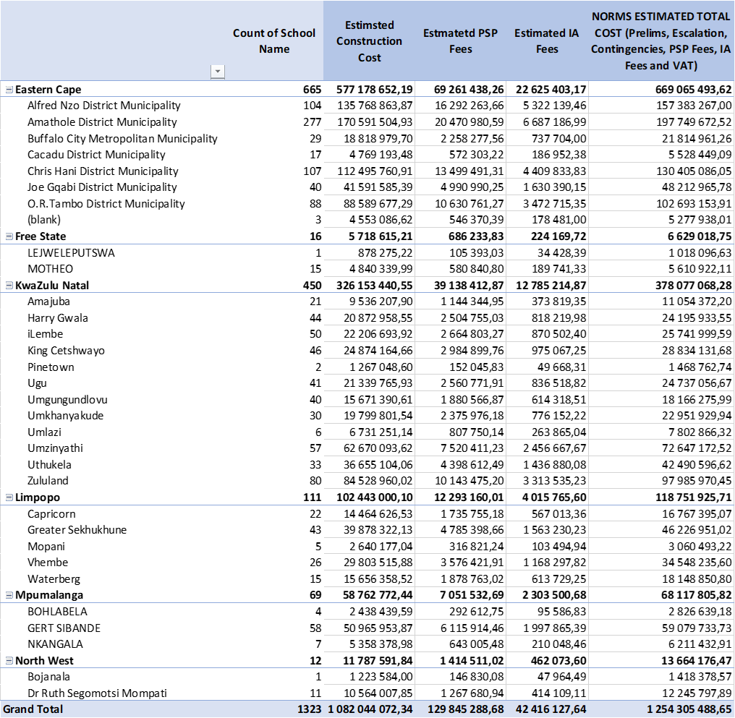
LOW ENROLMENT PRIMARY SCHOOLS

Slide 50
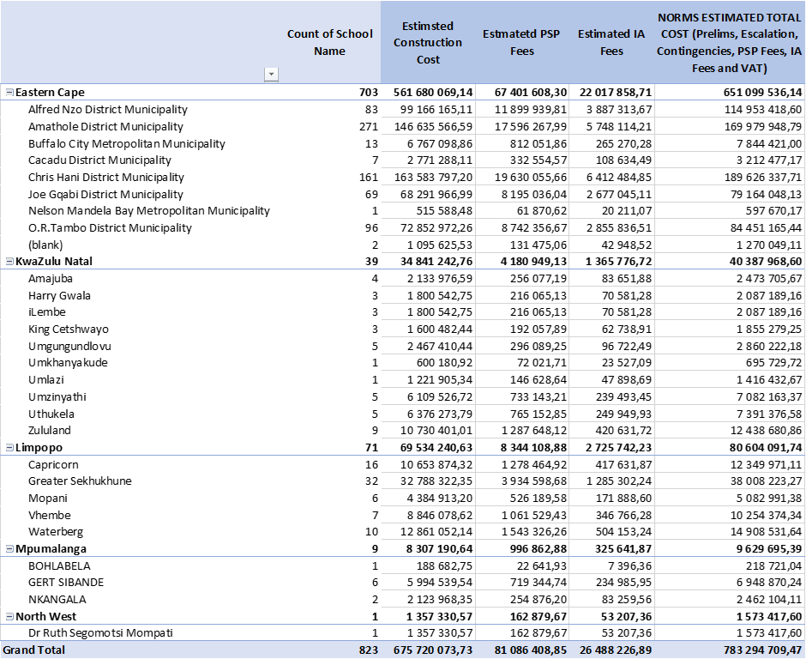
LOW ENROLMENT SECONDARY SCHOOLS

Slide 51
IMPLEMENTATION
It is envisaged that the intervention will be implemented through a multi- pronged approach:
The first set of projects will be those budgeted for through the provincial programmes and the Accelerated School Infrastructure Delivery Initiative (ASIDI) for the current financial year. These projects will be monitored by the DBE to ensure that they are carried out expeditiously and completed in the current financial year. Provinces will have to reprioritise budgets to accommodate additional projects in the current and subsequent financial years;
Partnership with the private sector and development agencies is vital to leverage their technical capacities and resources to complement limited government resources. The National Education Collaboration Trust (NECT) will be utilised to coordinate private sector funding and implement these on behalf of the Department; and
For the balance of the projects, the scope of work of the ASIDI will have to be extended to reap the benefit of the current momentum on the implementation of the sanitation sub-programme.
For demolitions: Community mobilization, use of EPWP and NARYSEC (DLDR),

Slide 52

IMPLEMENTATION AND FUNDING PROPOSALS
Re-organisation of funding to address sanitation challenges, especially for the Education Infrastructure Grant;
PEDs to reprioritize infrastructure plans to address sanitation;
The comprehensive plan to address all sanitation challenges;
Address the issue of maintenance of sanitation in schools; and
Extend the scope of ASIDI to take advantage of momentum on the water and sanitation programme;
Additional funding to be solicited from NT on the basis of the costed plan.

Slide 53
4.RECOMMENDATION
It is recommended that the Select Committee on Appropriations discusses the performance of the Education Infrastructure Grant and the School Infrastructure Backlogs Grant.

