Slide 1
PROMOTION AND EVALUATION OF THE CONSTITUTIONAL VALUES AND PRINCIPLES
PORTFOLIO COMMITTEE ON PUBLIC SERVICE AND ADMINISTRATION AS WELL AS PLANNING, MONITORING AND EVALUATION
30 MAY 2018

Slide 2
OVERVIEW OF THE PRESENTATION
Mandate of the PSC on the Values and Principles
Background and Context
Constitutional Values and Principles (CVPs)
Objectives of the CVPs
CVP Progress thus far
Conclusion

Slide 3
MANDATE OF THE PSC ON THE CONSTITUTIONAL VALUES AND PRINCIPLES (CVPs)
The PSC is mandated by the Constitution (1996) to carry out particular functions with regard to the values and principles contained in the Constitution. In particular –
Section 196 (4) (a) mandates the PSC to promote the values and principles throughout the Public Service; and
Section 196 (4) (e) requires of the PSC to provide an evaluation of the extent to which the values and principles set out in section 195 are complied with.
Parliament resolved that the PSC should report on the implementation of the CVPs in all spheres of government, organs of state and public enterprises on an annual basis.
The NDP further affirms the importance of the CVPs in society (social cohesion) and the PSC’s role of promoting the CVPs in building a Capable State.
Furthermore, Chapter 2 of the Public Administration Management Act (2014), emphasises the importance of values-driven public institutions in building a Capable State.

Slide 4
BACKGROUND AND CONTEXT
During the late 90s, the PSC developed what it called the Public Service Transversal M&E System.
Since 2001, the PSC produced over 170 reports on the evaluation of the CVPs in the Public Service based on the system .
Out of need, in 2015 the PSC embarked on an explorative and revitalisation journey of its work around the CVPs. The focus of this venture is both on the:
Promotion of the CVPs, and
Evaluation on whether departments adhere to the principles as contained in Section 195 of the Constitution.
It is important for the PSC to ensure that there is a shared and common understanding of the CVPs in the Public Service, what they hope to achieve how they will be evaluated.

Slide 5
BACKGROUND AND CONTEXT (“Out of need”…previous PSC work)
Have we examined the planning approaches and re-organisation of government machinery? Are we not ‘inspecting’ within confines of models due for change, in respect to:
Revision of the approach to Public Administration for the new dispensation?
Governance that has not defined ‘the glue’ in the political-administrative interface?
Different disciplines in public administration still relate in a hierarchy (largely informed by distrust)?
General work ethic problems
The disjuncture even between institutional compliance and citizen satisfaction is worrying

Slide 6
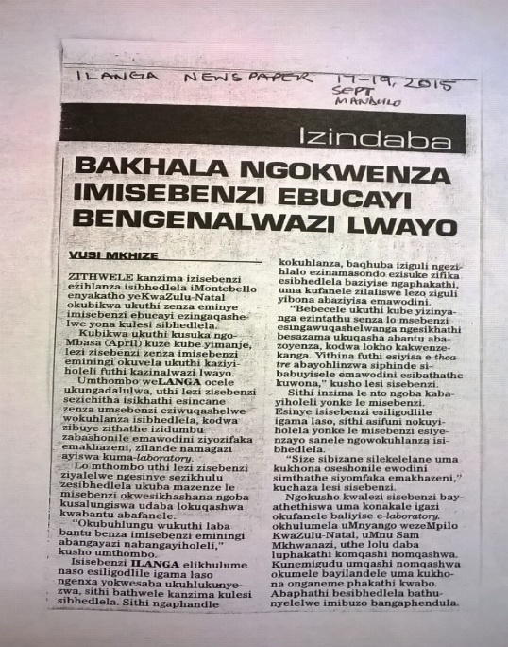
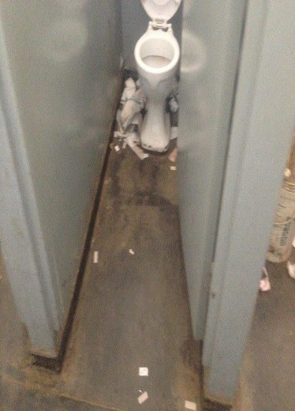
BACKGROUND AND CONTEXT (‘Inspecting/working within confines’ – the citizen is unhappy )

Slide 7
BACKGROUND AND CONTEXT (Planning Monitoring & Evaluation in Context)
Because of the context of (colonial) distrust, African planning and public administrative systems were inducted into institutional fundamentalism
The intention was to produce mediocrity of an auto-pilot type that would not challenge an unfair political vision
PM&E hardly has challenged that:
There has been limited scope to think outside of pre-conceived planning frameworks and imported intelligence
Thus the discourse is developmental, but Public Administration is stiff and archaic (feel free to contest!)

Slide 8
BACKGROUND AND CONTEXT (Planning and Administration)
Community Imperatives
Institutional due diligence
Oversight/Governance
The Economic Tussle – the ‘community’ broadens

Slide 9
BACKGROUND AND CONTEXT (Planning and Administration)
Community Imperatives ☹
(Community becomes faceless,
with participation projects to legitimise institutions)
Institutional due diligence
Oversight/Governance
The Economic Tussle – the ‘community’ broadens

Slide 10
BACKGROUND AND CONTEXT (The NDP is clear what the packing order is)

Slide 11
HENCE THE PSC’s REVIVIAL JOURNEY SINCE 2015: THE CONSTITUTIONAL VALUES AND PRINCIPLES
PROMOTION AND EVALUATION

Slide 12
Public Service Values and Principles Chapter 10, section 195 (1) Constitution (CVPs)
a) A high standard of professional ethics must be promoted and maintained.
b) Efficient economic and effective use of resources must be promoted.
c) Public administration must be development oriented.
d) Services must be provided impartially, fairly, equitably and without bias.
e) People’s need must be responded to and the public must be encouraged to participate in policy making.

Slide 13
Values and Principles (cont.)
f) Public administration must be accountable.
g) Transparency must be fostered by providing the public with timely, accessible and accurate information.
h) Good human resource management and career development practices to maximize human potential must be cultivated.
i) Public administration must be broadly representative of the South African people with employment and personnel management practices based on ability, objectivity, fairness and the need to redress the imbalances of the past to achieve broad representation

Slide 14
CONSTITUTIONAL VALUES AND PRINCIPLES
Professional Culture
Services must be provided impartially, fairly, equitable and without bias
Transparency must be fostered
Professional Behavior
High standard of professional ethics must be maintained
People’s needs must be responded to and encouraged to participate in policy making
Human dignity, equality, human rights and freedoms
Non-racialism and non-sexism
Supremacy of the Constitution and rule of law
Regular elections, accountability, responsiveness and Openness
Systems/Oversight
Efficient, economic & effective use of resources
Public administration must be development-orientated
Public administration must be accountable
Institutional
Good Human resource management and career development;
Public administration must be broadly representative
14

Slide 15
OBJECTIVES OF THE CVPs
PROMOTION:
To promote the internalisation of values and principles in the daily activities of public servants with the intention of changing behaviours and attitudes.
To build a cohort of public servants that embrace the founding values and the public administration related values and principles.
To promote good governance in the public service.
To promote the values and principles in order to establish common and shared understanding and the PSC’s expectations prior to conducting evaluations.
EVALUATION:
Evaluate whether the intention of the public administration values and principles is achieved at an outcome level.
Determine how institutional processes can be changed to make sure that the public service is values driven rather than (only) by law and regulations.
Ensure contextual application of the values and principles.
Identify systemic public administration issues, which are currently hampering the development of the public service, rather than a list of deficiencies, and make recommendations to change key features of the institution of the public service.
Make recommendations, issue directions and provide advise as provided for in the PSC’s mandate.

Slide 16
PROGRESS THUS FAR
PROMOTION
The PSC has developed promotional framework, which identifies various promotional activities for the CVPs. The following highlights some of the promotional activities undertaken:
Engagements with stakeholders (EAs, HoDs, G&A Cluster, Portfolio Committees)
Consultation with government officials at Departmental level
Consultation with institutions supporting democracy (Chapter 9) academia.
Engagement with media houses (SABC)
EVALUATION
Extensive work has gone into the development of a theoretical framework document, which provides the theory and understanding of the CVPs.

Slide 17
PROGRESS THUS FAR (cont…)
The theoretical framework defines each principle, sets out the scope and content, and proposes a number of performance indicators for each principle.
Based on the framework, an indicator-based tool (also referred to as the institutional evaluation tool) was developed to conduct evaluations of Public Service departments against the CVPs. The tool contains evaluation standards, rating scales, data sources, data collection methods, data tables and evaluation methodology.
The tool does not contain a comprehensive list of service standards but only carefully selected standards associated with the indicators chosen by the PSC for evaluation purposes.
This tool moves away from mere compliance to measuring the achievement of the principles at the outcome level.
The tool was piloted during 2017 at Correctional Services, Water and Sanitation and NW Economy and Enterprise Development.
The PSC is further piloting the tool at Social Development sector, National Treasury and Human Settlements.

Slide 18
REFINEMENT OF THE EVALUATION TOOL (cont…)
Based on the lessons drawn from the pilots, the PSC identified the need to customise its evaluation tool.
Although all the CVPs apply to all departments, the PSC classified the CVPs in a logical manner taking into consideration that departments have different mandates and effect those through different modes of stakeholder interface.
For instance, some departments deal with the public on a daily basis, some deal with requests for infrastructure and technical assessments so that the citizen is served, others provide overall oversight, regulation and monitoring for the entire jurisdiction efficiency.
The PSC used these differences as basis to customise the CVP institutional evaluation tool.
The CVPs have been classified according to:
PROFESSIONAL BEHAVIOUR
A high standard of professional ethics must be promoted and maintained
People’s needs must be responded to and the public must be encouraged to participate in policy making.
PROFESSIONAL CULTURE IMPERATIVE
The provision of services in an impartial, fair and equitable way, without bias
Fostering transparency.
The PSC has categorised the CVPs and customise the tool in a logical manner to apply to the different modes of stakeholder interface departments use to effect their specific mandates was identified.
Some departments deal with the public on a daily basis, some deal with requests for infrastructure and technical assessments so that the citizen is served, others provide overall oversight, regulation and monitoring for the entire jurisdiction efficiency.
The PSC used these differences as basis to customise the CVP institutional assessment tool.

Slide 19
REFINEMENT OF THE EVALUATION TOOL (cont…)
1. The customisation process commenced with the classification of the CVPs which were analysed according to whether they are geared towards:
PROFESSIONAL BEHAVIOUR
A high standard of professional ethics must be promoted and maintained
People’s needs must be responded to and the public must be encouraged to participate in policy making
PROFESSIONAL CULTURE
Services must be provided impartially, fairly, equitably and without bias
Transparency must be fostered

Slide 20
REFINEMENT OF THE EVALUATION TOOL (cont…)
SYSTEMIC EFFICIENCY
Public administration must be development-oriented
Efficient, economic and effective use of resources must be promoted
Public administration must be accountable
INSTITUTIONAL IMPERATIVES
Cultivation of good human resource management and career development practices
A representative public administration with employment and personnel management practices based on ability, objectivity, fairness and the need to address the imbalances of the past

Slide 21
REFINEMENT OF THE EVALUATION TOOL (cont…)
2. Departments were classified according to the logic of their mandates, under the following headings:
CLASSIFICATION OF DEPARTMENTS | EXAMPLE OF DEPARTMENTS
Citizen Development and Social Logistics | Departments of Social Development, Health, Education
Governance/oversight | Departments of Planning, Monitoring & Evaluation, Public Service & Administration, Justice & Constitutional Development.
Diplomacy and International Interest | Departments of International Relations, State Security Agency, Defence and Military Veterans.
Economic | Departments of Trade & Industry, Economic Development, Small Business Development
Environmental | Departments of Environmental Affairs, Energy
Infrastructural | Departments of Public Works, Transport.

Slide 22
REFINEMENT OF THE EVALUATION TOOL (cont…)
3. The indicators were prioritized for each cluster into categories of importance.
This entailed, for instance, that for the Citizen Development and Social and Logistical cluster, departments need to be relevant to the “condition of the citizen” – the indicators that has to do with how people are dealt with on a daily basis will be the key category of indicators and will carry the biggest weighting in scoring the departments on their implementation of the CVPs.
In this instance, the specific indicators will thus include:
maintaining a high standard of professional ethics and
responsiveness to needs of the citizens

Slide 23
CATEGORY 1 VALUES FOR CITIZEN DEVELOPMENT AND SOCIAL LOGISTICS DEPARTMENTS
Professional Culture
Services must be provided impartially, fairly, equitable and without bias
Transparency must be fostered
Professional Behavior
High standard of professional ethics must be maintained
People’s needs must be responded to and encouraged to participate in policy making
Human dignity, equality, human rights and freedoms
Non-racialism and non-sexism
Supremacy of the Constitution and rule of law
Regular elections, accountability, responsiveness and Openness
Systems/Oversight
Efficient, economic & effective use of resources
Public administration must be development-orientated
Public administration must be accountable
Institutional
Good Human resource management and career development;
Public administration must be broadly representative
23

Slide 24
CATEGORY 1 VALUES FOR OVERSIGHT AND INFRASTRUCTURAL DEPARTMENTS
Professional Culture
Services must be provided impartially, fairly, equitable and without bias
Transparency must be fostered
Professional Behavior
High standard of professional ethics must be maintained
People’s needs must be responded to and encouraged to participate in policy making
Human dignity, equality, human rights and freedoms
Non-racialism and non-sexism
Supremacy of the Constitution and rule of law
Regular elections, accountability, responsiveness and Openness
Systems/Oversight
Efficient, economic & effective use of resources
Public administration must be development-orientated
Public administration must be accountable
Institutional
Good Human resource management and career development;
Public administration must be broadly representative
24

Slide 25
REFINEMENT OF THE EVALUATION TOOL (cont…)
4. The PSC is instituting a balance of quantitative and qualitative evaluations
The roll out of the evaluation will be in a two-pronged approach:
Year 1 assessment: – Objective indicators/Quantitative
Year 2 Assessment: – Qualitative Tool – based on key questions related to values (this too is objective!)

Slide 26
REFINEMENT OF THE EVALUATION TOOL (moved a long way since this) A High Standard of Professional Ethics Dimensions: Promoting Ethical conduct; Strengthening Mechanisms to support Ethics; Enhancing Ethical Culture
Dimension 1 | Indicator
Promoting ethical conduct | A system of routine observation, feedback and discussion of ethical issues and behavior within the workplace
 | Observance of behavior of public servants in frontline offices
 | % of officials involved in misconduct (financial and other) cases
 | Number and cost of financial misconduct cases
 | Number, average duration and cost of precautionary suspensions as a result of alleged corruption
 | Requirements around professional ethics built into adverts

Slide 27
REFINEMENT OF THE EVALUATION TOOL (cont…) The Efficient, Effective and Economical Use of Resources
Dimension | Indicator
Input | Timeousness of procurement
 | Time it takes to fill a post
 | Post provisioning norms
 | Value for money of procurement
Processes (and systems) | Process time measures are developed
 | Good process controls are in place
 | Unit performance management well-institutionalised
 | Payment of invoices within 30 days
Outputs | There are no audit findings on predetermined objectives
 | Department’s service standards are achieved
Outcomes | Outcomes achieved
 | Programme evaluation conducted
Ratios between the above dimensions | Predetermined objectives achieved vs expenditure against budget
 | Cost-benefit (costing of options/delivery models/service levels, financial modeling, expenditure reviews)

Slide 28
REFINEMENT OF THE EVALUATION TOOL (towards a CVP Departmental Report)
5. The PSC is exploring the placement of Departmental Reports on Adherence to CVPs in public arena – Annual Reports

Slide 29
CONCLUSION
The Values and Principles Project aims to achieve the type of public administration that South Africans aspire to have, as espoused in the Constitution.
It is ambitious since its aim is to motivate departments to adhere and embed the values and principles in their own daily work.
The work will yield reports that will nudge departments to systemic compliance, as well as value-driven efficiency and impact.
Interface with other Public Service Commissions in Africa shows that revamping work ethic is high on the agenda of reviving the “Public Service will”.

Slide 30
RE A LEBOGA

