Slide 1
PPHC service delivery IN THE METRO
District health plan by district

Slide 2
COMDEV BRIEFING
Briefing requested:
The collaboration between the Provincial Department of Health and the City of Cape Town on the basket of health services rendered in the communities of the Western Cape*
The District Health Plan for each district on the burden of disease and the response strategies of the Department
*The City of Cape Town renders PPHC only in the metropole and no responsibility in rural areas areas

Slide 3
SOURCE DOCUMENTS
Ideal clinic facility profile Western Cape Government Health (WCGH) 2018
City of Cape Town (CCT) Facility profile 2017
Routine Data
District Health Expenditure Review (DHER) 2016/2017
District Health Plans (DHP) 2018/2019

Slide 4
MORTALITY: All districts

Slide 5
DEMOGRAPHICS: Cape Town
 |  |  |  | Dependent population
Subdistrict | f2017-2018 | f2018-2019 | % Dependent population based on 2011 Census | f2017-2018 | f2018-2019
CT Eastern SD | 605842 | 621703 | 88.3% | 534678 | 548675
CT Khayelitsha SD | 399036 | 400753 | 95.0% | 379130 | 380761
CT Klipfontein SD | 380306 | 379924 | 91.5% | 347908 | 347559
CT Mitch Plain SD | 545877 | 552050 | 92.6% | 505707 | 511426
CT Northern SD | 411958 | 419737 | 78.1% | 321798 | 327874
CT Southern SD | 544576 | 548581 | 80.1% | 436382 | 439591
CT Tygerberg SD | 653277 | 661555 | 89.7% | 585676 | 593098
CT Western SD | 544073 | 556260 | 81.8% | 444832 | 454795
District | 4084946 | 4140564 | 87.2% | 3561600 | 3610092
Uninsured population (76.76%) | 3135604 | 3178297

Slide 6
Cape Metro BOD

Slide 7
SERVICE CONTINUUM
Service delivery platform for 2030
Community Based Services
Facility Based Services
Regional Hospitals (L2)
Tertiary & Central Hospitals (L3)
District Hospital (L1)
Specialised Services
(EMS & FPS)
Specialised Hospitals
TB, Psychiatry, Rehabilitation, Dental
Acute Care
Primary Health Care

Slide 8
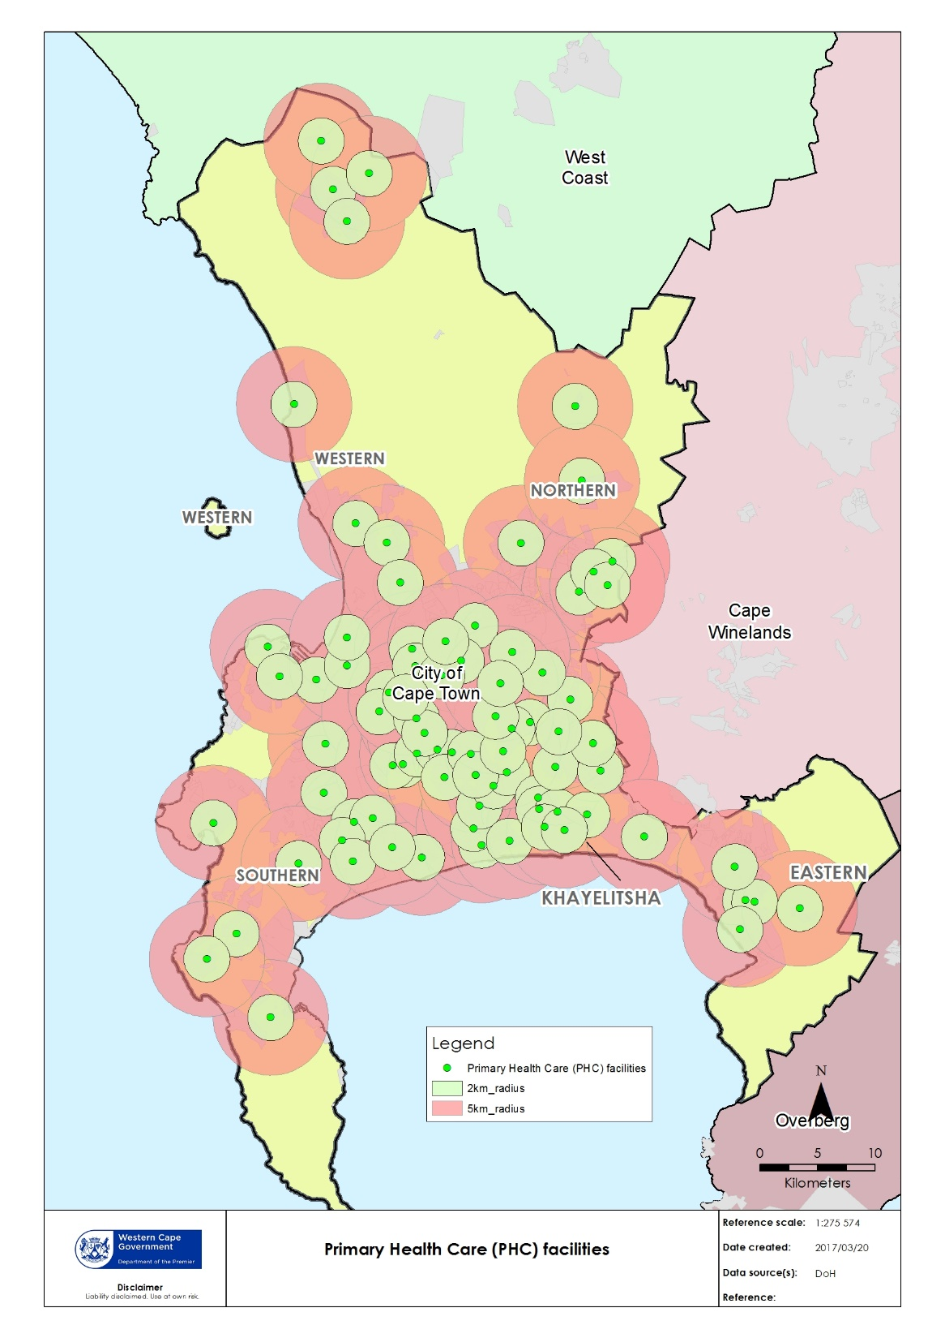
PRIMARY HEALTH CARE (PHC) FACILITIES: Metropole

Slide 9
PHC FACILITIESSERVICE DELIVERY PLATFORM: Metropole

Slide 10
PHC HEADCOUNTS: Metropole
Sub-district | City of Cape Town | MDHS | Grand Total | City of Cape Town | MDHS | Grand Total
Cape Town Eastern Health sub-District | 346629 | 720926 | 1067555 | 12.4% | 10.6% | 11.2%
Cape Town Northern Health sub-District | 260958 | 419918 | 680876 | 9.4% | 6.2% | 7.1%
Cape Town Southern Health sub-District | 311594 | 724541 | 1036135 | 11.2% | 10.7% | 10.8%
Cape Town Western Health sub-District | 284557 | 942319 | 1226876 | 10.2% | 13.9% | 12.8%
Khayelitsha Health sub-District | 422365 | 999291 | 1421656 | 15.2% | 14.7% | 14.9%
Klipfontein Health sub-District | 291050 | 838101 | 1129151 | 10.4% | 12.4% | 11.8%
Mitchells Plain Health sub-District | 468383 | 680979 | 1149362 | 16.8% | 10.0% | 12.0%
Tygerberg Health sub-District | 400174 | 1450397 | 1850571 | 14.4% | 21.4% | 19.4%
Grand Total | 2785710 | 6776472 | 9562182 | 100.0% | 100.0% | 100.0%

Slide 11
PHC & CBS HEADCOUNTS: Relative contributions
Sub-district | City of Cape Town | MDHS
Cape Town Eastern Health sub-District | 32.5% | 67.5%
Cape Town Northern Health sub-District | 38.3% | 61.7%
Cape Town Southern Health sub-District | 30.1% | 69.9%
Cape Town Western Health sub-District | 23.2% | 76.8%
Khayelitsha Health sub-District | 29.7% | 70.3%
Klipfontein Health sub-District | 25.8% | 74.2%
Mitchells Plain Health sub-District | 40.8% | 59.2%
Tygerberg Health sub-District | 21.6% | 78.4%
Grand Total | 29.1% | 70.9%
Sub-district | Total CBS Headcount | %
Cape Town Eastern Health sub-District | 254 786 | 10,4
Cape Town Northern Health sub-District | 178 751 | 7,3
Cape Town Southern Health sub-District | 148 800 | 6,1
Cape Town Western Health sub-District | 136 719 | 5,6
Khayelitsha Health sub-District | 416 673 | 17,0
Klipfontein Health sub-District | 228 159 | 9,3
Mitchells Plain Health sub-District | 320 985 | 13,1
Tygerberg Health sub-District | 766 011 | 31,3
Grand Total | 2 450 884 | 100,0

Slide 12
COLLABORATION
Geographical collaboration is operationalised via formal structures (Integrated Service Delivery Management Teams- ISDMTs) to render services.
Province supports the CCT with certain medical supplies, medical equipment, stationary, medical services and operational activities.
  This support is not reflected as part of SLA and transfer payment agreement
Transversal SLA
Local arrangements
Financial support by Province
Funding Description | 2017/18 Budget | 2018/19 Budget
Integrated Nutrition Programme | 5 572 000 | 5 928 000
Comprehensive Health (subsidy, vaccines, TB) | 297 392 000 | 313 451 000
Comprehensive Health (lab costs, medicine, staff) | 217 701 000 | 224 414 000
Total Allocation | 520 665 000 | 543 793 000

Slide 13
COLLABORATION
Joint facilities and facilities in close proximity impacts on effective and efficient health care delivery
9 Joint Facilities
  Various facilities that are in close proximity to each other e.g. Maitland CDC and Maitland clinic.
Khay East (Nolungile)
Klip Mplain (Heideveld)
Klip Mplain (Nyanga)
North Tyg (Bellville South)
North Tyg (Durbanville)
North Tyg (Goodwood)
North Tyg (Parow)
North Tyg (Ravensmead)
North Tyg (Scottsdene)

Slide 14
Basic Package of Care
Emergency Treatment room (not an emergency centre / not 24hr)
School health services
Nutrition support
Mental Health Chronic Care
Integrated Management of Childhood Illness (IMCI)-sick children
Minor Adult aliments
Human Immunodeficiency Virus (HIV)
Tuberculosis (‎TB)
Non Communicable Diseases
Antenatal Care(ANC)/Postnatal care (PNC)
Prevention of Mother to Child Transmissions (PMTC)
EPI
Well-baby
Family planning
Cancer screening

Slide 15
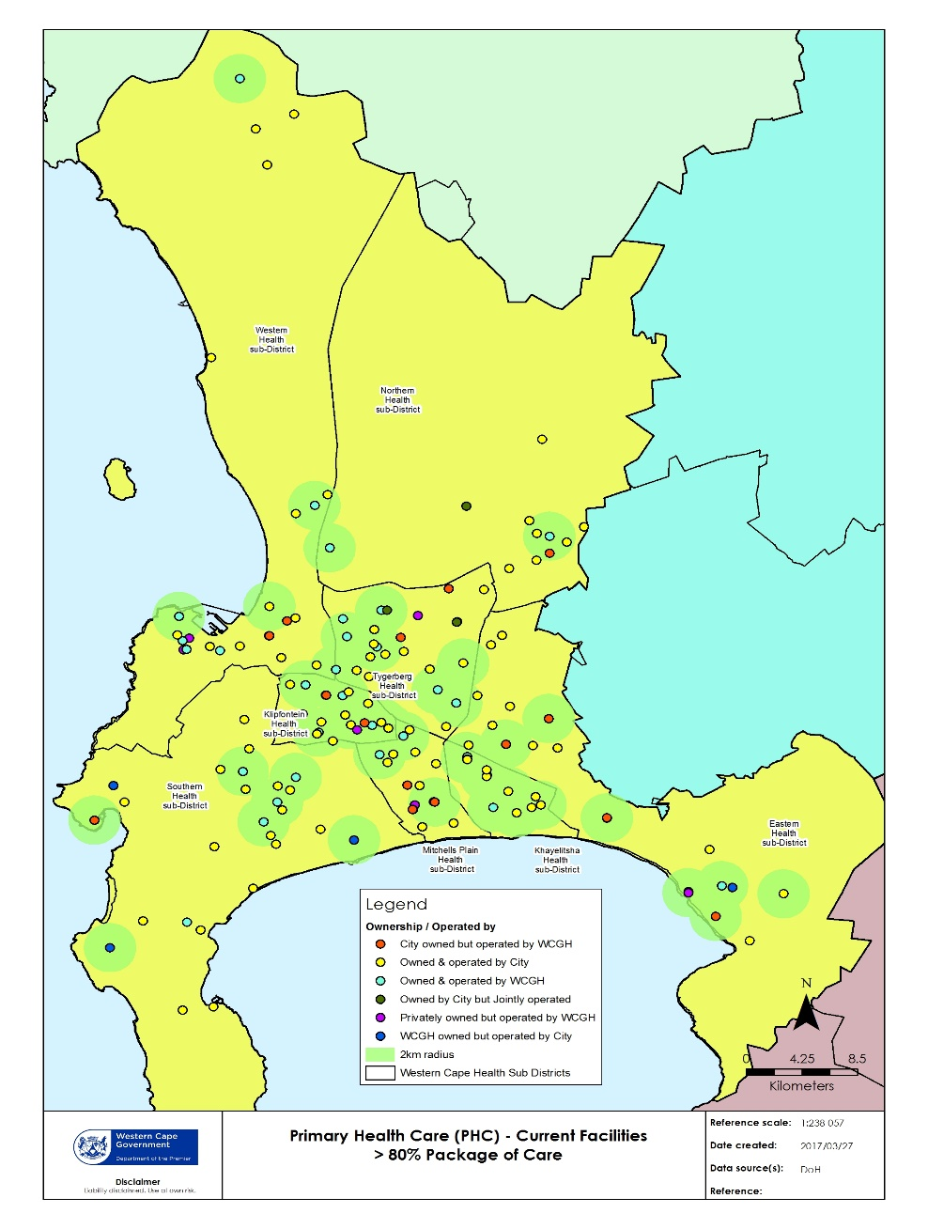
PHC FACILITIES WITH MORE THAN 80%
OF THE FULL PACKAGE OF CARE
Mostly WCGH facilities

Slide 16
Emergency Treatment (not 24rh EC)
All WCGH health facilities support 24EC’s by delivering emergency treatment at health facilities, supported by a referral system to hospitals
Not all CCT facilities (as per facility profile report of 2017) provides basic emergency treatment:

Slide 17
GEOGRAPHICAL ACCESS to 24 hour services
24hr EC (9) | MOU (12)
Site B CHC | Site B CHC
Gugulethu CHC | Gugulethu CHC
Mitchells Plain CHC | Mitchells Plain CHC
Retreat CHC | Retreat CHC
Kraaifontein CHC | Kraaifontein CHC
Delft CHC | Delft CHC
Elsiesriver CHC | Elsiesriver CHC
Du Noon CHC
Vanguard CHC | Vanguard CHC
 | Bishop Lavis CDC
 | Hanover Park CHC
 | Michael M CDC
 | Macassar CDC

Slide 18
SERVICES MOSTLY PROVIDED BY Metro Health Services
School health
  Integrated school health package only delivered by WCGH facilities
  Schools in the geographical drainage of City facilities are supported by WCGH facilities
  This support is not reflected as part of SLA and transfer payment agreement
Nutrition support
  Nutrition support being provided by WCGH dieticians to all PHC facilities
  Dieticians deliver services at City facilities
  This support is not reflected as part of SLA and transfer payment agreement
Mental Health Care Chronic
    Support being provided by WCGH to CCT
    Mental health nurses provide services at City facilities
    Treatment of referred patients from CCT facilities at WCGH facilities
      This support is not reflected as part of SLA and transfer payment agreement

Slide 19
CHILD HEALTH
Both WCGH and CCT provides child health services
All CCT facilities provides IMCI services where appropriate
9 facilities which do not provide IMCI:
  6 joint facilities (Heideveld CDC, Parow CDC, Durbanville CDC, Bellville South CDC, Goodwood CDC, Ravensmead CDC)
  Reed street
  Kensington
  Maitland CDC (close proximity to Maitland clinic)
  Certain medical products are provided to CCT facilities to support the management of childhood illness. This support is not reflected as part of SLA and transfer payment agreement

Slide 20
MATERNAL CARE
Antenatal care (ANC)/Post Natal Care (PNC)
Limited ANC and PNC being provided by City Health

Slide 21
Minor Adult Ailments
All WCGH facilities provide services to adults with minor ailments

Slide 22
PACKAGE OF CARE
HIV
Both WCGH and CCT provides screening and testing services
ART services for WCGH are services provided across the health care platform

Slide 23
PACKAGE OF CARE
TB
Both WCGH and CCT provides screening and testing services
TB treatment sites mostly at City Health facilities
Non Communicable Diseases (NCD) treatment
Biggest burden of disease for the City of Cape Town Health District
All WCGH health facilities provides NCD treatment
Limited services provided by City Heath facilities

Slide 24
City has been expanding service package
WCGH started to do more screenings in the community and thus not reflective in stats

Slide 25
CAPE METRO DISTRICT HEALTH PLAN
2018/2019 – 2020/21

Slide 26
DISTRICT ASPIRATIONS AS PER DHP
Strengthening the health care delivery platform through Community Oriented Primary Care (COPC) approach:
  Limiting disease outbreaks through hygiene campaigns during the drought, ensuring or advocating for appropriate access to hydration for high risk groups
  Address the burden of chronic diseases of lifestyle
  Address the burden of HIV/TB through the 90-90-90 strategy
  Address the child and women mortality and morbidity
  Increase focus on interpersonal collaboration to address the impact of violence and trauma on the health care system
  Reduce duplication and fragmentation
Focus on achieving quality standards
Reduced wastage at pharmacy services
Reorganize and prioritise service delivery at district hospital level to ensure equitable access to service pressure areas
Address environmental health needs

Slide 27
DHP: ADDRESSING THE BURDEN OF CHRONIC DISEASES OF
LIFESTYLE
Cataract surgery in uninsured population
Action taken on increased HBA1C
Action taken on BP above 140/90
Annual foot exams done on diabetic clients
Improve mental health services within district health platform

Slide 28
DHP: ADDRESSING THE BURDEN OF HIV/TB
HCT total (including male proportion)
ART RIC
Condom distribution: male condoms
TB Success rate
Initial lost to follow-up
DR-TB Success Rate

Slide 29
DHP: ADDRESSING CHILD AND WOMEN MORTALITY AND
MORBIDITY
Immunisation coverage
Infant exclusive breastfed
Antenatal bookings before 20wks
Post-natal follow-up at 6wks
Couple year protection rate

Slide 30
DHP: INCREASE FOCUS ON INTERSECTORAL COLLABORATION TO
ADDRESS THE IMPACT OF VIOLENCE AND TRAUMA
ON THE HEALTH CARE SYSTEM
Strengthening of community based services platform to address the mental health care needs of patients

Slide 31
DHP: FOCUS ON ACHIEVING QUALITY
Achieving ideal clinic status
Waiting time survey conducted
Implementing patient safety reporting
NCS – 75% and more for hospitals

Slide 32
DHP: REDUCING WASTAGE AT PHARMACY SERVICES
Decrease patient waiting time at pharmacy
Reduce non-collections
Reduce wastage due to expired medications

Slide 33
DHP: REORGANISE AND PRIORITISE SERVICE DELIVERY
AT DISTRICT HOSPITAL LEVEL TO ENSURE
EQUITABLE ACCESS TO SERVICE PRESSURE AREAS
Equitable access to theatre

Slide 34
DHP: ADDRESSING THE ENVIRONMENTAL HEALTH NEEDS
Provision of quality basic services in the informal settlements
Ensuring adequate standard of food and water quality
Render effective vector control
Ensure adequate standard of air quality

Slide 35
RURAL DISTRICT HEALTH

Slide 36
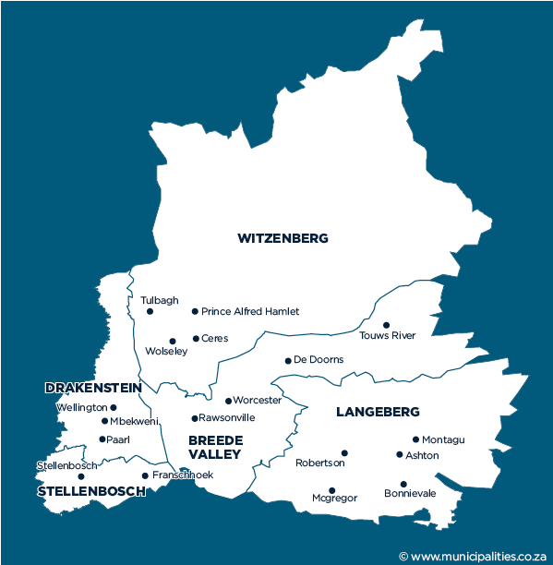
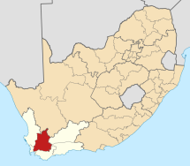

Rural Health Services - Cape Winelands District
Sub-districts (5):
  Drakenstein
  Stellenbosch
  Witzenberg
  Breede Valley
  Langeberg
Facilities:
  6 community day centres (CDCs)
  39 fixed clinics
  5 satellite clinics
  28 mobiles
  4 district hospitals
  1 specialised TB hospital
  Population estimates 2018/19:
  Total population 916 385
  Children under 5 years 80 611
  Geographic area: 21 473 km²
  Population density: 43
Rural district with the highest population density

Slide 37
Rural Health Services - Cape Winelands District
Expected patient volumes for 2018/19:
  PHC headcounts = 1 647 613
  PHC utilisation rate = 1.8
  Inpatients (separations) in district hospitals = 27 290
  Bed utilisation rate = 77.9%
  Average length of stay = 2.7 days
Expected HAST outcomes 2018/19:
  Clients remaining on ART = 32 119
  HIV tests done = 196 865
  TB client treatment success rate = 80.6% (7 188)
Leading underlying natural causes of death, 2015:
[Source: Mortality and causes of death in South Africa, 2015: Findings from death notification, Statistical Release P0309.3]
  HIV disease (7.2%)
  Cerebrovascular diseases (6.9%)
  Diabetes mellitus (6.7%)
  Tuberculosis (6.6%)
  Chronic lower respiratory diseases (6.2%)
  Ischaemic heart diseases (5.5%)
  Malignant neoplasms (5.0%)
  Malignant neoplasms of resp & intrathoracic organs (5.0%)
  Hypertensive diseases (3.3%)
  Other forms of heart disease (3.2%)
Expected MCWH and First 1 000 days outcomes 2018/19:
  Antenatal visits before 20 weeks = 75.5% (13163)
  Infant 1st PCR test positive around 10 weeks rate = 1.0% (1 290)
  Immunisation coverage under 1 year = 67.9% (15 827)
  Total number of deliveries = 14 352
  Delivery in 10 to 19 years in facility rate = 11.9%
  Cervical cancer screening coverage 30 years and older = 55.3% (22 525)
  School Grade 1 learners screened = 9 756

Slide 38
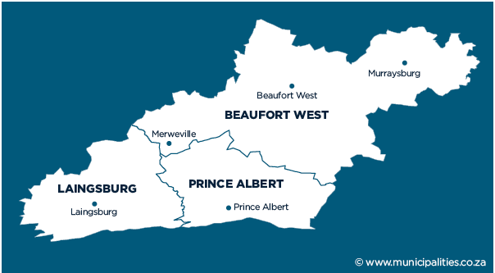
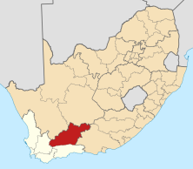
Rural Health Services – Central Karoo District
Sub-districts (3):
  Beaufort West
  Laingsburg
  Prince Albert
Facilities:
  1 community day centre (CDC)
  8 fixed clinics
  3 satellite clinics
  7 mobiles
  4 district hospitals
  0 specialised TB hospitals
  Population estimates 2018/19:
  Total population 76 828
  Children under 5 years 7 110
  Geographic area: 38 854 km²
  Population density: 2
This district has the smallest population BUT covers the largest geographic area

Slide 39
Rural Health Services – Central Karoo District
Expected patient volumes for 2018/19:
  PHC headcounts = 207 363
  PHC utilisation rate = 2.7
  Inpatients (separations) in district hospitals = 10 879
  Bed utilisation rate = 70.1%
  Average length of stay = 2.8 days
Expected HAST outcomes 2018/19:
  Clients remaining on ART = 1 970
  HIV tests done = 36 098
  TB client treatment success rate = 83.5% (599)
Leading underlying natural causes of death, 2015:
[Source: Mortality and causes of death in South Africa, 2015: Findings from death notification, Statistical Release P0309.3]
  Chronic lower respiratory diseases (9.1%)
  Tuberculosis (6.7%)
  Cerebrovascular diseases (6.2%)
  HIV disease (5.2%)
  Diabetes mellitus (5.2%)
  Hypertensive diseases (5.2%)
  Malignant neoplasms (4.1%)
  Malignant neoplasms of resp & intrathoracic organs (4.0%)
  Ischaemic heart diseases (4.0%)
  Other forms of heart disease (3.8%)
Expected MCWH and First 1 000 days outcomes 2018/19:
  Antenatal visits before 20 weeks = 74.7% (1239)
  Infant 1st PCR test positive around 10 weeks rate = 1.1% (94)
  Immunisation coverage under 1 year = 72.3% (1 349)
  Total number of deliveries = 1 000
  Delivery in 10 to 19 years in facility rate = 15.8%
  Cervical cancer screening coverage 30 years and older = 73.9%
  School Grade 1 learners screened = 1 119

Slide 40
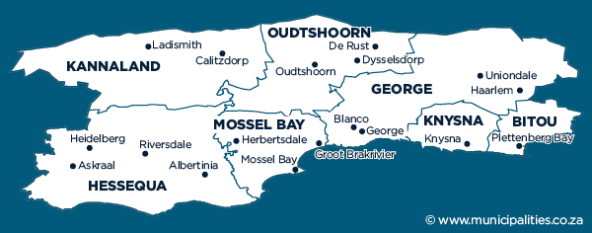
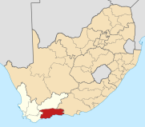
Rural Health Services – Eden District
Rural district with the 2nd highest population
Sub-districts (7):
  Kannaland
  Hessequa
  Oudtshoorn
  Mossel Bay
  George
  Knysna
  Bitou
Facilities:
  6 community day centre (CDC)
  36 fixed clinics
  13 satellite clinics
  21 mobiles
  6 district hospitals
  1 specialised TB hospitals
  Population estimates 2018/19:
  Total population 628 623
  Children under 5 years 53 492
  Geographic area: 23 331km²
  Population density: 27

Slide 41
Rural Health Services – Eden District
Expected patient volumes for 2018/19:
  PHC headcounts = 1 429 466
  PHC utilisation rate = 2.3
  Inpatients (separations) in district hospitals = 41 690
  Bed utilisation rate = 83.0%
  Average length of stay = 2.9 days
Expected HAST outcomes 2018/19:
  Clients remaining on ART = 25 837
  HIV tests done = 149 862
  TB client treatment success rate = 78.1% (4 849)
Leading underlying natural causes of death, 2015:
[Source: Mortality and causes of death in South Africa, 2015: Findings from death notification, Statistical Release P0309.3]
  Tuberculosis (7.0%)
  HIV disease (6.7%)
  Cerebrovascular diseases (6.6%)
  Ischaemic heart diseases (6.4%)
  Diabetes mellitus (6.2%)
  Chronic lower respiratory diseases (5.8%)
  Malignant neoplasms of resp & intrathoracic organs (4.9%)
  Malignant neoplasms (4.6%)
  Other forms of heart disease (3.7%)
  Hypertensive diseases (3.4%)
Expected MCWH and First 1 000 days outcomes 2018/19:
  Antenatal visits before 20 weeks = 80.5% (8 919)
  Infant 1st PCR test positive around 10 weeks rate = 1.5% (986)
  Immunisation coverage under 1 year = 92.5% (10 670)
  Total number of deliveries = 8 899
  Delivery in 10 to 19 years in facility rate = 13.3%
  Cervical cancer screening coverage 30 years and older = 71.7% (16 494)
  School Grade 1 learners screened = 2 444

Slide 42
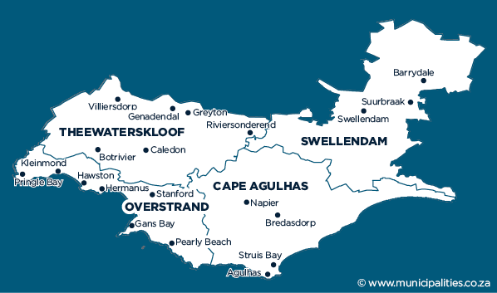
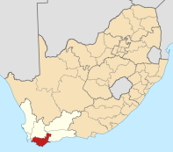
Rural Health Services – Overberg District
Sub-districts (4):
  Theewaterskloof
  Overstrand
  Cape Agulhas
  Swellendam
Facilities:
  2 community day centres (CDCs)
  17 fixed clinics
  9 satellite clinics
  14 mobiles
  4 district hospitals
  0 specialised TB hospital
  Population estimates 2018/19:
  Total population 293 506
  Children under 5 years 23 991
  Geographic area: 12 239 km²
  Population density: 24
District with the 2nd lowest population in the Western Cape (after the Central Karoo)

Slide 43
Rural Health Services – Overberg District
Expected patient volumes for 2018/19:
  PHC headcounts = 746 642
  PHC utilisation rate = 2.5
  Inpatients (separations) in district hospitals = 18 681
  Bed utilisation rate = 70.7%
  Average length of stay = 2.8 days
Expected HAST outcomes 2018/19:
  Clients remaining on ART = 12 987
  HIV tests done = 79 942
  TB client treatment success rate = 87.4% (1 755)
Leading underlying natural causes of death, 2015:
[Source: Mortality and causes of death in South Africa, 2015: Findings from death notification, Statistical Release P0309.3]
  Ischaemic heart diseases (7.1%)
  Cerebrovascular diseases (6.6%)
  Malignant neoplasms of resp & intrathoracic organs (6.5%)
  Diabetes mellitus (6.1%)
  Chronic lower respiratory diseases (5.6%)
  Tuberculosis (5.0%)
  Malignant neoplasms (4.9%)
  Hypertensive diseases (4.0%)
  Other forms of heart disease (3.3%)
  Influenza and pneumonia (2.8%)
Expected MCWH and First 1 000 days outcomes 2018/19:
  Antenatal visits before 20 weeks = 78.6% (4 488)
  Infant 1st PCR test positive around 10 weeks rate = 0.4% (553)
  Immunisation coverage under 1 year = 67.3% (4 684)
  Total number of deliveries = 3 137
  Delivery in 10 to 19 years in facility rate = 13.8%
  Cervical cancer screening coverage 30 years and older = 51.5% (7 502)
  School Grade 1 learners screened = 3 633

Slide 44
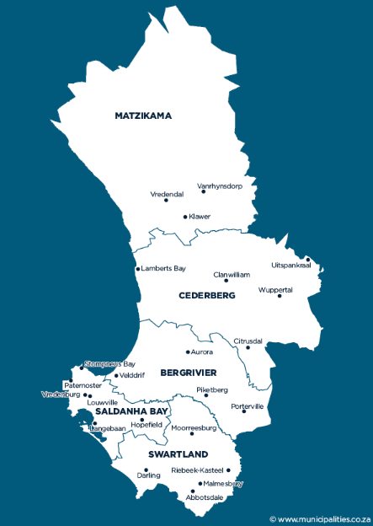
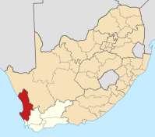
Rural Health Services – West Coast District
Sub-districts (5):
  Matzikama
  Cederberg
  Bergrivier
  Saldanha Bay
  Swartland
Facilities:
  1 community day centre (CDC)
  26 fixed clinics
  23 satellite clinics
  14 mobiles
  7 district hospitals
  2 specialised TB hospital
  Population estimates 2018/19:
  Total population 459 683
  Children under 5 years 41 996
  Geographic area: 31 119 km²
  Population density: 15
2nd largest surface area - several towns and small dwellings are spread across the district

Slide 45
Rural Health Services – West Coast District
Expected patient volumes for 2018/19:
  PHC headcounts = 822 490
  PHC utilisation rate = 1.8
  Inpatients (separations) in district hospitals = 37 398
  Bed utilisation rate = 87.4%
  Average length of stay = 2.7 days
Expected HAST outcomes 2018/19:
  Clients remaining on ART = 11 831
  HIV tests done = 109 435
  TB client treatment success rate = 81.9% (3 849)
Leading underlying natural causes of death, 2015:
[Source: Mortality and causes of death in South Africa, 2015: Findings from death notification, Statistical Release P0309.3]
  Tuberculosis (7.9%)
  Diabetes mellitus (7.4%)
  Cerebrovascular diseases (7.2%)
  Chronic lower respiratory diseases (6.6%)
  Ischaemic heart diseases (5.8%)
  Hypertensive diseases (4.6%)
  HIV disease (4.6%)
  Malignant neoplasms (4.4%)
  Malignant neoplasms of resp & intrathoracic organs (3.7%)
  Other forms of heart disease (2.5%)
Expected MCWH and First 1 000 days outcomes 2018/19:
  Antenatal visits before 20 weeks = 73.9% (6 446)
  Infant 1st PCR test positive around 10 weeks rate = 1.2% (483)
  Immunisation coverage under 1 year = 74.7% (8605)
  Total number of deliveries = 4 264
  Delivery in 10 to 19 years in facility rate = 15.3%
  Cervical cancer screening coverage 30 years and older = 46.6% (11 220)
  School Grade 1 learners screened = 2 232

Slide 46
THANK YOU

