Slide 1


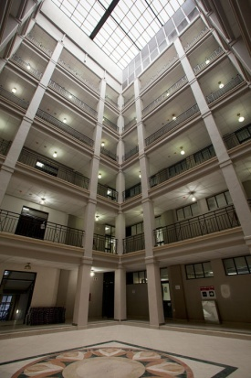




PMTE OPERATIONALISATION and Financial Sustainability
HEAD PMTE – Mr Jacob Maroga
Portfolio Committee on Public Works - 22 MAY 2018

Slide 2

EFFECTING the journey towards the end-state
OPERATIONALISING THE STATE’S PROPERTY BUSINESS
Analyse
Methods of Delivery (client expectation)
Identify Risks &
Constraints
5
Revisit original mandate (State’s intention)
Confirm PMTE services & how it’s provided
Analyse
methods of delivery
Revise
Model
1
2
3
4
Short
Term
Medium
Term
Long
Term

Slide 3

SECTION A
CONTEXT:
Revisiting the Intention - Addressing the State’s Property Management Challenge

Slide 4
1. CABINET’s INTENTION
State Property Agency
The 1997 DPW White Paper: Towards the 21st century encapsulated the State’s Property Challenges and recommended various interventions with respect to:
  Property Investment Management
  Property & Facilities Management
  Construction Project Management
In May 1999, Cabinet approved, in principle, the creation of a State Property Agency (SPA) to effectively manage the State’s immoveable assets based on these recommendations
In October 2001 the development of a business case for the SPA was sanctioned and a report on the Impact of the SPA on the Provincial Public Works Departments was developed
In March 2002, a draft SPMC Bill and a business case proposal were submitted to the Governance and Administration Cabinet Committee
The aim was to make provision for a ring-fenced operation, to be responsible for:
  … the strategic and operational management of the fixed asset portfolio of the State to derive benefits for the State from its property portfolio and for that purpose to provide for the establishment of [at that point in time], the State Property Management Company, a public company wholly owned by the State; to provide for the governance and management of that company; to define the objects, powers, duties and operational and financial accountability of that company; to provide for the establishment of a regulator to oversee the exercise of its powers and duties by the State Property Management Company; and to provide for matters incidental thereto.

Slide 5
2. NATIONAL TREASURY interim solution / mechanism
The bill was referred back by Cabinet to be re-aligned with the original mandate – State Property Agency, not company - and in consultation with National Treasury and DPSA.
A joint NT / DPSA Technical Committee was engaged from May 2002 and recommended a trading entity as an interim mechanism towards the end-state (SPA)
In 2006 the establishment of the PMTE was approved by National Treasury as an Interim Mechanism (Trading Account) in response to:
  State Public Finance Management reforms including the passing of the PFMA in 1999
  The Devolution of Budgets and accommodation charges 2006
  The subsequent passing of GIAMA in 2007
NT’s trading entity conditions and the objectives of the DPW Interim Mechanism and Trading Entity Business Cases were not fully complied with.

Slide 6
3. THE NEED FOR TURNAROUND
NT briefing note 2011
Minister of Finance communication on poor DPW performance
Post 1994 the above mentioned immovable asset related budget reforms have been introduced and implemented since the inception of the DPW, a significant component of which was designed to lead to the operationalisation of a ring-fenced property management operation.
In 2011 a briefing note from the Minister of Finance to the Minister of Public Works, articulated the challenges that needed to be addressed for DPW to fulfil its mandate effectively and included inter alia:
  unstable strategic direction due to high turnover of political and executive leadership;
  the need for the department to articulate and implement a consistent or stable strategic direction that takes cognisance of Government’s desired long-term property management arrangements;
  the need to develop and apply business-like principles of efficiency in the acquisition, usage and disposal of government immovable assets
  the need to conduct research on how different countries in the world are managing their respective governments’ real property portfolio
  the need for the PMTE to take over the implementing functions of DPW to enable DPW to focus on developing norms and standards for the sector as well as coordinating the EPWP
  underspending of budgets ascribed to inefficiencies in the DPW;
  failure by the DPW to develop the capacity required to manage its large real estate portfolio;
  an incomplete asset register;
  corruption and fraud;
  exorbitant leases;
  outstanding debt owed to municipalities.

Slide 7
4. 7 YEAR PLAN
Improving State
Property Management
TIMELINE
In response to the challenges faced by the Department, the Minister launched the Seven Year Business Improvement Plan in 2012 aimed at:
  Fighting Fraud & Corruption
  Improving Business
  To address the original Cabinet Directive to strengthening the ability of the State to manage its property portfolio in an efficient, effective and economic manner, a property management improvement programme was designed and made the responsibility of a capacitated PMTE and included:
  Full Operationalisation of PMTE in line with 2006 approval
  Lease review and business improvement process
  Audit and payment of municipal rates and taxes
  Re-building a complete and credible immovable asset register

Slide 8
JOURNEY transitional dynamics
The process of addressing major historic issues – creates new, although less significant issues
DPW consolidated
Disclaimer
DPW
END-STATE
Clean
Turnaround Interventions
PMTE
Adverse
DPW
Clean
Unqualified
Ongoing Interventions
No verified IAR
(assets @ R1)
2. Cash based Acc
Govt transversal systems
Capacity constraints
Skills limitations
Disclaimed audit outcomes
1. Verified IAR
Deemed Cost issue
Componentisation issue
2. GRAP adopted
Accrual issue
Acc systems in place
Functional ERP not in place
Operational data not reflected
HR Capacity transferred
Skills limitations
addressed only through natural attrition
Verified IAR
Accurate Deemed Cost
Componentisation supports FMS
2. GRAP adopted
Accruals addressed
ERP in place
Business Processes & systems aligned
Operations Automated
HR Capacity aligned to institutional best practice
5. Skills targeted to new operating model

Slide 9

SECTION B
END - STATE
State Property Management Vehicle

Slide 10
1. CONCEPTUALIZING the end state
4x Characteristics to become a leading citizens’ serving vehicle:
Agile
Innovative
Connected
Transparent
anticipate, adapt, react quickly and cost effective
capable to incubate ideas and delivery models, and accelerate its impact
collaboration with stakeholders and other
sectors of society to deliver
services through partnership/
co-creation/design
accountable for actions and outcomes

Slide 11
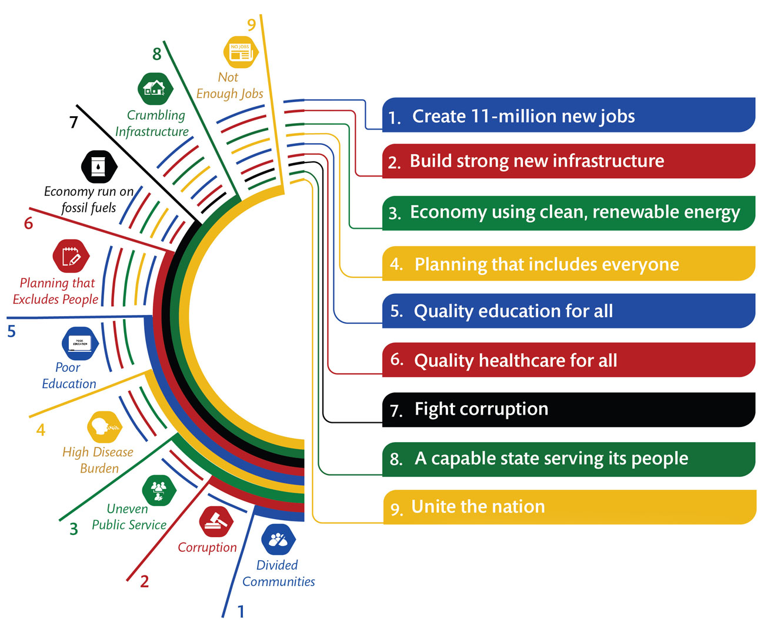
OUR RESPONSIBILITY – to plan the journey to 2030
PROBLEM TODAY
poverty, inequality & unemployment
THE PLAN 2030
prosperity & equity
NDP

Slide 12
2. END STATE practical realities
THE FUTURE IS OUR CHOICE
The NDP unfolds the challenges we face
PMTE creates opportunities to address:
OUR CHALLENGE?
Tight fiscal and economic space requires us to do more with less ($)
Map course for future development
Poverty alleviation, unemployment and inequality
Redefine service delivery
STIMULATE SOCIO ECONOMIC ACTIVITY
Developmental agenda
DELIVER AFFORDABLE SERVICES
Deal with uncertainty while delivering services that are affordable, in context of deficit reducing budget cuts.
Decrease dependency & increase sustainability
Infrastructure Development
Inclusive Growth
Manufacturing
Industrialization
NB! We have to recognise property as an important socio-economic lever to exert visible impact in driving capital formation, investment growth and social development.

Slide 13
3. OBLIGATION revisiting our mandate
improve the nature or quality of the actual service delivered by client
to improve the manner in which Client delivers services
CONSIDERING OUR IMPACT ON SERVICE DELIVERY AS THE PMTE
DPW’s Key Mandate is being the custodian & manager of National Government’s immovable assets.
DPW acknowledges that it directly impact the efficiency and effectiveness of all client departments and their ability to deliver services to the public
  DPW
  Must enable National Government to deliver services through the provision of convenient and accessible accommodation
TWO SIDES
National DPW |  | Provincial Departments | Municipalities | Other (SoE’s, Entities etc.)
SAPS Defence Justice DCS | DHA Arts & Cul DSD DoL etc. | Health Education Housing Major Infrastructure | Metropolitan Local District | Transnet ACSA Sanral

Slide 14
4. CONSIDERATIONS operationalising the state’s property management vehicle
Operationalisation = 2x SIDES
Regulatory Compliance
(Interim Mechanism)
Substantive form of the entity
(End-State)
NT 2006 Conditions for establishing the entity
NT Regulation 19 compliance
NT expectations for full operationalisation
DPSA resources (PSR / PSA)
Vision: What are we trying to achieve?
Stakeholder Expectations:
  Public (Service Delivery)
  Client Departments
  Portfolio Committee
  Cabinet
  Employees
Institutional Relationship with DPW
  Performance compacts
  Reporting
  Governance
Business
  Form
  Model
  Skills

Slide 15
5. STAKEHOLDER EXPECTATION operationalising the state’s property management vehicle
CABINET
Ring-fenced and focused service delivery agency with responsive administrative and operational arrangements to:
  Optimize the State’s Property Business
  Expedite / enhance service delivery
  Introducing “new money” to become less reliant on the fiscus
  Bring savings to the State
Direct accountability to address conflict of interest between policy setter & implementer
Attracting and retaining technical property skills through competitive / market related rates
NATIONAL TREASURY
National Treasury has been consistent of its expectations of the PMTE to provide its plans for a full cost recovery based business and funding model, which will direct the PMTE’s financial sustainability in the medium to long term.
Compartmentalized and ring-fence Property Business to separate DPW as the regulator from PMTE as the implementer.
Application of business-like principles of efficiency in the acquisition, usage and disposal of government immovable assets

Slide 16
6. TRADING ENTITY what is?
PFMA: Regulation 19 – salient points:
“head of the trading entity” refers to either –
the accounting officer appointed in terms of section 36(3)(b) of the Act; or
an official assigned to head the trading entity in terms of section 44(1)(a) of the Act.
a trading entity is regarded as an entity operating within the administration of a department. All obligations on departments in these regulations apply to trading entities, unless the context indicates otherwise.
The Accounting Officer of the Department operating a trading entity must ensure that the head of the trading entity complies with the PFMA and Treasury Regulations.
The accounting officer of a department operating a trading entity must formulate a policy and reporting framework for the head of the trading entity.
The head of the trading entity is accountable to the accounting officer of the department operating that trading entity and must forward all reports or approvals required in the PFMA via the accounting officer of the department.

Slide 17
7. END-STATE government component
CABINET APPROVAL
In 2014, Cabinet approved the Business Case for the PMTE and the Feasibility Study for the establishment of a Government Component as the eventual institutional form
Commenting on the Feasibility Study, the Minister of DPSA recommended that:
  The name of PMTE change to “State Property Management Agency” once established as a Government Component as it is not advisable to reflect the financial management model (a trading entity) in the name of the entity and more importantly, identifying the State as the main recipient of services in the title.
In 2015 Cabinet endorsed progress on operationalisation of PMTE
In 2017 Cabinet noted strategic funding challenges of the PMTE but reiterated the need for a dedicated State Property Agency – sighting the 18 years failure to comply with original directive

Slide 18
7. END-STATE government component
What is a Government Component? - PSA SECTION 7A
Relatively new construct (2007 ) and is created by Presidential Minute and Ministerial Notice.
 | DPW | TRADING ENTITY | GOVERNMENT COMPONENT | PUBLIC ENTITY
STATUS
Legal Status | Department of State | Not a separate juristic person | Not a separate juristic person | A separate juristic person outside the Public Service
Governance | Executive Authority Accounting Officer | Executive Authority Accounting Officer Head (Optional) | Executive Authority Board is optional Head/CEO is Accounting Officer | Has Governing Board as Accounting Authority
Independence | None |  | Separate from Department but linked to policy | Autonomous from Department
Accountability to Executive Authority | Constitution and Legislation |  | Direct accountability to Executive Authority | Regulated by the Act establishing the entity
Accountability to Department | All obligations on department apply to trading entity |  | None, but have reporting duties | None
Mandate | Constitution, Legislation and PSA |  | Derived from delegation or assignment from the Executive Authority | Derived from Act establishing the entity
Main Funding | Parliament via Department | Parliament via Department & own revenue | Parliament via Department & own revenue | Parliament via Department & own revenue
PFMA | Applicable DG is Accounting Officer |  | Applicable Head of GC is Accounting Officer | Applicable Board is Accounting Authority

Slide 19
7. END-STATE government component
 | DPW | TRADING ENTITY |  | GOVERNMENT COMPONENT | PUBLIC ENTITY
ACCOUNTING
Account | Modified Cash basis |  | GRAP | GRAP | GRAP
Revenue | Unable to retain surplus funds from operations |  | Ability to generate and retain surplus funds from operations (approval by NT) | Ability to generate and retain surplus funds from operations (approval by NT) | Ability to generate and retain surplus funds from operations (approval by NT)
EMPLOYEE CONDITIONS
PSA | Applicable |  |  | Applicable | Not Applicable
Law Governing employees | PSA and regulations, and sectorial determinations |  |  | PSA and regulations, and sectorial determinations | Act Establishing the entity LRA, and other
Conditions of Service | PSA and Public Service Regulations |  |  | Public Service Regulations | Policies as determined by entity
Remuneration | PSA and Public Service Regulations |  |  | Determined by bargaining processes, but occupation specific dispensation is possible | Determined by entity’s board, subject to NT and DPSA guidelines
Pension fund membership | GEPF |  |  | GEPF | Depends on entity GEPF may apply
Employee Relations | Governed by Public Service Regulations |  |  | Governed by Public Service Regulations | Governed by entity’s policies
Deployment | Anywhere within Public Service |  |  | Anywhere within Public Service | Only within entity

Slide 20
7. END-STATE government component
PSA SCHEDULE 3 - NATIONAL GOVERNMENT COMPONENTS
Centre of Public Service Innovation
Government Pensions Administration Agency
Government Printing Works
Government Technical Advisory Centre
Municipal Infrastructure Support Agent
South African Development Partnership Agency

Slide 21

SECTION C
REVISING INSTITUTIONAL ARRANGEMENTS
giving effect to the State’s intention

Slide 22
EFFECTING the journey towards the end-state
OPERATIONALISING THE STATE’S PROPERTY BUSINESS
Analyse
Methods of Delivery (client expectation)
Analyse
Methods of Delivery (client expectation)
Identify Risks &
Constraints
Full cost recovery / sustainability
5
Revisit original mandate (State’s intention)
Confirm PMTE services & how it’s provided
Analyse
methods of delivery
Revise
Model
1
2
3
3
4
Short
Term
Medium
Term
Long
Term
Consider pros and cons of current approaches
Revising business processes
Analyze how support services must be reorganized to support implementing functions
Prioritize HR and general capacity requirements of each area
Develop alternate operational improvement mechanisms for each area
Information Technology requirements
Risks and constraints of delivery, with mitigation plans

Slide 23

SECTION D
Operationalisation and Financial Sustainability

Slide 24
1. WHAT DOES IT MEAN? full cost recovery
Unfunded
R11.8 billion p/a
On the fiscal baseline

Slide 25
2. PMTE/NT CONUNDRUM connecting the dots
Dichotomy of Full cost recovery vs. what is affordable to Government vs. Financial sustainability vs. retention of disposals’ proceeds
PORTFOLIO
Vacant
7%
Client Department Take-up
93%
PRIVATE
Clean
Financial Sustainability
Client Recovery
48%
Required
Bridging the Gap
Client baseline
Unfunded 48%
Client Recover
52%
FISCUS
FULL COST RECOVERY

Slide 26
2. DEFINING THE PROBLEM
Baseline 10 Year Forecast
CUMULATIVE OPERATIONAL FUNDING GAP OVER NEXT 12 YEARS
Funding Gap R11.8 billion
Marketing
Ave
On the fiscal baseline
Forecast qualifications:
Reported actuals for 2015/16 and 2016/17
Full year budget for 2017/18
MTEF for 2018/19 – 2020/21
Forecast method: Weighted Average
Operational expenses (Capital Payments excluded)
DPW Augmentation excluded
2018/19 | 2019/20 | 2020/21 | 2021/22 | 2022/23 | 2023/24 | 2024/25 | 2025/26 | 2026/27 | 2027/28 | 2028/29 | 2029/30 | 2030/31
MTREF | MTREF | MTREF | FY1 | FY2 | FY3 | FY4 | FY5 | FY6 | FY7 | FY8 | FY9 | FY10
-R4.8bn | -R8.58bn | -R13.34bn | -R18.44bn | -R23.84bn | -R29.56bn | -R35.59bn | -R41.93bn | -R48.58bn | -R56.55bn | -R62.82bn | -R70.41bn | -R78.32bn

Slide 27
3. IMMOVABLE ASSET COMMITMENTS
practical realities
Subsidise NT tariffs
Investment Fund/ CRF
Improve facilities
State owned properties
Allocated to clients
R4.5 bn “baseline*” iro client allocated offices & facilities
User Charge Model informs tariff & gap based on industry practise after affordability adjustment
Own Use
HO and RO etc
(support function/ cost to core business)
Excess
Current Lease-Outs
Land
Investment Portfolio
Non – Core properties & land “surplus ito GIAMA”
Optimisation opportunities
Potential Disposals
Funding Gap
expectation
3%
On the fiscal baseline
4%
93%
Efficiencies & Optimisation

Slide 28
3. IMMOVABLE ASSET COMMITMENTS practical realities
Current Accommodation budget (fiscal baseline) is not sufficient to cover the current funding gap to adequately manage the portfolio
  Excess capacity alone (7%) – cannot cover the funding gap.
Current excess assets have a deemed cost of approximately R7.4bn
Even if the assets are disposed, the proceeds are once off, whilst on the other hand the funding gap is annual recurring cost
Therefore ongoing discussions on funding strategy (fiscus, revenue generation initiatives & cost savings; leveraging private sector funding)
To determine the efficiencies, analysis is being done on the operating cost ratio vs. portfolio value and benchmarked against private sector

Slide 29
FINANCIAL MODEL
supporting financial sustainability
Inputs revenue line for property portfolio
Funding Strategy
Funding Options
Marketing
Ave
4
3
5
Financial Sustainability
User Charges Model
Financial Model in SAS environment
Informed by functional data to support revenue generation initiatives
1
2
Currently +/- 80% of revenue collected

Slide 30
5. IMMOVABLE ASSET REGISTER
architectural construct
Land Parcels
Facility
Building
Lift
Assets and system of assets
Sub Assets
Conveyor
CURRENT
GRAP Compliant IAR
IAR at component level
Enables operational decisions to enhance efficiencies
TO BE

Slide 31
6. VALUE CHAIN & DEPENDENCIES within PMTE articulated through the ERP strategy
Core Business Processes: asset register management , property management , facilities management and project delivery management
Off the Shelf
Property Management
Fin Model
RISK
Non-functioning modules poses a major risk to operational efficiency of the PMTE and consequential negative audit findings
UCM
Off the Shelf
Billing & Accounting
Asset Register Management
Off the Shelf
Management Facilities
Off the Shelf
Project Delivery Management

Slide 32

SECTION E
FUNDING STRATEGY
Key initiatives

Slide 33
1. SCENARIO JOURNEY
and link to Quick wins
Revenue Generation Scenarios Identified
Disposal non core/High value surplus (lease or sale)
Disposal of non core residential units
Sale of Advertising space
Commercial occupancy efficiency/densities Expired leases (rationalisation (fund f/out), renegotiation) ,Targeting phasing out of private leases in
Review profitability of commercial letting out contracts
Big Ticket high hanging fruits e.g. precinct developments
Harbours -Land (long lease) sale, Commercial leasing, Advertising
Maximise/optimize value in strategically located assets
Telecoms point of presence
Disaster recovery/storage facilities (Government/Private sector)
Quick Wins
“Quick wins formulated” Scenarios | Rm
A. Lease-in’s (Avg cost savings on variable costs) | 351
B. Potential non-core “Holding Cost to the State” | 267
C. Lease-out revenue gap to benchmark | 469
Total Impact on Baseline (excluding Potential sales or new leases) | 1087
We can process quick wins using “assumptions” functionality in Finance Model
The OFSP team formulated quick wins based on research and available data
However this does not replace scenarios but provides high level indicator of what is possible
It has been agreed that further work (Flip side) on the “quick win” scenario’s will be completed by management and can be incorporated via the assumptions functionality within the financial model
The remaining original scenarios can also be included via the assumptions although at a much higher level of detail i.e. Sale of advertising space

Slide 34
Monetisation activities should be prioritised and planned according to realisation – e.g.
2. KEY INITIATIVES
monetisation & prioritisation framework
high
1
9
9
3
2
7
6
10
Dispose Non-Prime Residential Properties
Office Accommodation Optimisation
Lease-in Vs Rental Operational Cost Review
Charge Back Model Implementation (User Pays)
Dispose Non-Prime Land
10
Financial Impact of Property
8
5
4
low
short
Duration to implement
long

Slide 35
QUICK WIN A
potential savings – Leasing In
Scenario Name |  | Additional Information | The Next Steps and way forward to complete |  | Timeline
1 | Lease In – potential savings to the Fiscus | Potential Cost Saving: R 351 Million (compared to NT target) Justification for management fee |  | Validate and confirm the potential saving on an individual lease-by-lease basis Eg. Confirm the SAPS leases that will move into Telkom towers and consider relocation costs | 30 June 2018
Line Function Responsibility: REMS |  |  |  | Agree on the principles of re-negotiations and targeted savings to be achieved in line with NT pronouncements | 30 June 2018
Research Methodology Applied |  |  |  | Negotiation timelines for leases already expired | 30 Sept 2018
Several discussions with REMS on the approach and principles Obtained lease schedule with the top 50 and other landlords Excluded SAPS leases that are linked with the move to Telkom towers Reworked the lease schedule according to the lease contracts end dates (Ageing) Factored a 15% saving on the leases (top 50 and the remainder) Applied a probability range of 60 %, 40 % and 20% to the possible saving (top 50 landlords and remainder) |  |  |  | Negotiation timelines for leases still active to commence 3 months prior to expiry date | Ongoing
Sources of Information |  |  |  | Monthly progress reports to be tabled to PMTE EXCO | Ongoing
Lease In schedule (Database) Top Landlord analysis - updated Archibus information - 1_Workings.xlsx
1
2
3
4
5

Slide 36
QUICK WIN B
potential savings – Cost to Hold Unutilised Property
Quick Win Name |  | Additional Information | The Next Steps and way forward to complete |  | Timeframes
B | Cost of holding unutilized Properties (outside a facility) | Potential Cost Saving: R 267 Million |  | Validate the extent of identified unutilised properties per region | 31 May 2018
Line Function Responsibility: REMS |  | Vacant Land: R231million |  | Identify potential other unutilised properties (expand population) | 30 June 2018
Research Methodology Applied |  | Residential: R35million |  | Determine cost of holding these properties based on last two years historic data. (There could possibly be more records added to the ‘Cost of holding of Unutilised Properties’) | 31 Aug 2018
Extracted data from PMIS Identified the unutilised offices, residential accommodation and vacant land outside of a facility from the IAR Applied average cost over two years linked to these properties (2015/2016 & 2016/2017) Applied an annual CPI increase (4.42%) for forecasting Applied a phased in factor for the forecast (20% in Yr1, 30% in Yr2, 30% in Yr3 and 20% in Yr4) Regional view |  | Offices: R1million |  | Determine the feasibility for sale / lease / refurbishment of each unutilised asset. | 30 Sept 2018
 |  |  |  | Make appropriate recommendations relating to all unutilised properties to the IAIC | 31 Oct 2018
Sources of Information
PMIS_REGPL report (2015/2016 & 2016/2017), IAR Property Portfolio
1
2
3
4
5

Slide 37
QUICK WIN C
potential additional revenue on leased-out
Quick Win Name |  | Additional Information | The Next Steps and way forward to complete |  | Timeframes
C | Lease outs - Gap to Benchmark | Potential Cost Savings: R 470 Million |  | Validate the rate and contract renewal date of all leased-out properties to private tenants per region | 30 June 2018
Line Function Responsibility: REMS |  |  |  | Benchmark rates against Rode report and identify variance per property | 31 July 2018
Research Methodology Applied |  |  |  | Select all properties with a variance of more than 20% (PMTE rates lower than Rode) | 31 August 2018
Obtained a Rode benchmark report Applied current rates to the Rode report on the C grade properties (C is the lowest grade) Applied an annual CPI increase (4.42%) for forecasting Applied a phased in factor for the forecast (20% in Yr1, 30% in Yr2, 30% in Yr3 and 20% in Yr4) 55% of lease out portfolio could be benchmarked to Rode report |  |  |  | Determine the market feasibility to increase PMTE rates to a comparative rate to Rode | 31 October 2018
 |  |  |  | Reports to be tabled to PMTE EXCO on the outcome of the feasibility determination process | 30 November 2018
Sources of Information |  |  |  | Negotiations should commence 3 months before expiry of leases that can be reasonably be increased with a view to contract at a Rode related rate. | Ongoing
IAR Property Portfolio Lease out schedule (Database) PMIS data Rode Report (RRO_2017_2.pdf)
1
2
3
4
5
6

Slide 38



3. OTHER SCENARIOS sale of advertising space
Possible buildings to be used for advertising have been identified
Initial scope was limited to Gauteng, Western Cape and Kwazulu-Natal
Returns will depend on the demand per advertising location
The nature and extent of PMTE financial benefits will depend on nature and extent of contractual terms

Slide 39
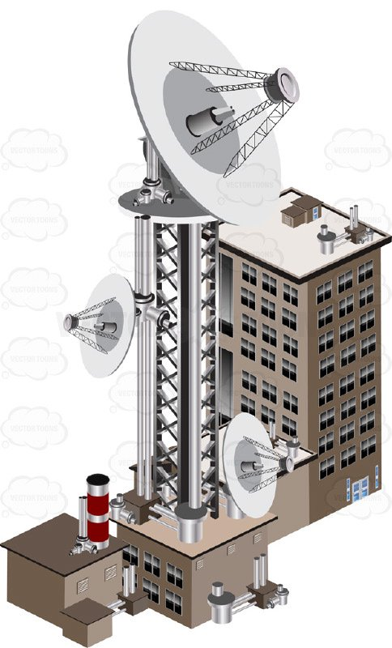
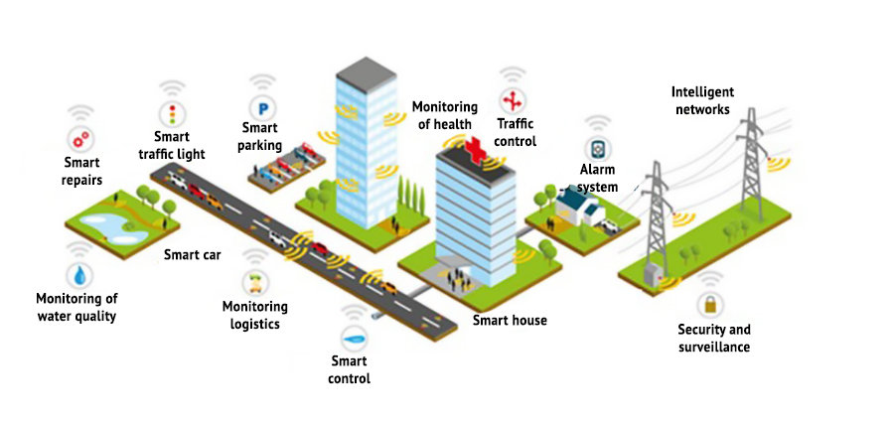
4. OTHER SCENARIOS telecoms point of presence
PMTE buildings required to facilitate and erect communication equipment
Proposal received from Broadband Infraco (SOE)
Nature and extent of Broadband Infraco services underwritten by Cabinet
Possible returns to be determined based on actual locations to be made available

Slide 40
5. OFSP
monetisation framework
Steering Committee
ENGAGE MARKET
GOVERNANCE
MINISTER
DG
Head PMTE
IAIC
MinMEC
National Treasury
OPERATIONS
OFSP Dashboard
OTHER CUSTODIANS
Transparent centralised data | transactions | national GIS footprint| transaction pipeline | dashboard
Provincial DPW x 9
DRDLR
Portfolio analysis by dedicated OFSP resources
Vetting by line functions
Pre-qualified opportunities
Panel of transaction Advisors qualifies & advises
Qualified
opportunities
Provincial HS x 9
OFSP CENTRES OF EXCELLENCE
PANEL OF INDUSTRY EXPERTS
& PROFESSIONALS
Monetisation buckets & working groups
Framework | Mechanism | Process | Target | Roadmap
Key monetisation principles & definitions required
USER CHARGES MODEL
FINANCE MODEL
FUNDING STRATEGY
Baseline Revenue & costs
New Revenue Generation
Longer term Initiatives
Property
Disposal Non-core
Sale of Advertising Space
Equity stake
Finance
Lease-in portfolio
Rental stock
Large relocation deals
Legal
Telecom point of presence
PPP Precincts
(Socio) Economic
UCM & baseline operating costs
Tax
Office space std & optimisation
Disaster Recovery/Storage
Sale & lease back
Long term letting
Planning
Rating Valuations
Land use optimisation

Slide 41
6. RECOMMENDATIONS
FOR PORTFOLIO COMMITTEE TO NOTE:
The context of Cabinet’s original Intention to address the State’s Property Management Challenge;
The conceptualised end-state and cabinet’s approval for the establishment of a Government Component;
The revised institutional arrangements to give effect to the Business Case;
Progress made with the establishment of the Operationalisation and Financial Sustainability Programme; and
Key initiatives identified in support of the funding strategy.

Slide 42


End
National Department of Public Works (NDPW)
Head Office: Public Works
CGO Building
Cnr Bosman and Madiba
Pretoria Central
Private Bag X65
Pretoria
0001
Website: http://www.publicworks.gov.za
  THANK YOU

