Slide 1
PREFERENTIAL PROCUREMENT PROCESS
Feedback to SCOF
N. Ebrahim

Slide 2
PPPFR IN CONTEXT FOR WCG

Slide 3
BACKGROUND PROVINCIAL PPPFR IMPLEMENTATION
On 22 June 2016 Cabinet resolved that the Provincial Treasury approaches Cabinet for policy guidance on the implementation of the Preferential Procurement Regulations once gazetted for implementation.
WCG via the Provincial Treasury and the SCM cadre engaged on and completed the following preliminary tasks before the regulations were promulgated:
PT provided comments to initial draft regulations (14 August 2015) and attended and partook in the NT SCM Modernisation Committee meeting and various workshops with the NT where the regulations were discussed
Legal opinion solicited via legal services (Adv. Rosenberg) and summarized legal context provided to PT (07 August 2015)
Concluded a financial and technical impact assessment on the draft regulations Gazetted for comment and provided formal comment dated 15 July 2016 via the MEC for Finance;
Additional comment on legal and constitutional inconsistencies were provided to NT on 29 July 2016;
Many of the comments provided by the WCG were taken up except the comments raised on the prequalification and 30% sub-contracting requirements. New inclusions not commented on by WCG nor consulted on by the NT is the negotiation process as envisaged in regulation 6 and 7.
The Preferential Procurement Regulations, 2017 (PPR) was issued via Government Gazette 40553 on 20 January 2017 which is applicable from 1 April 2017.

Slide 4
LEGISLATIVE FRAMEWORK
Section 216
Section 38 of the PFMA and Chapter 16A of NT regulations
CONSTITUTION
Chapter 13: Financial Matters
Section 217 (2): an organ of state may implement a procurement policy providing for categories of preference in contracts and for protection and advancement of persons… disadvantaged by unfair discrimination
Section 217(3) National legislation must prescribe a framework for the above policy
Section 217 (Procurement)
Section 217 (1)
Procurement generally in terms of the 5 pillars (fair, equitable, transparent, competitive & cost-effective
PREFERENTIAL PROCUREMENT POLICY FRAMEWORK ACT No. 5 of 2000
PPPFA Regulations 2017 (new)
Purpose:
To provide a uniform legal instrument through which government would set aside 30% of appropriate categories of state procurement for purchasing from SMMEs, cooperatives, townships and rural enterprises.
PPPFA Regulations 2011
PPPFA Regulations 2001
Purpose:
Revised Regulations, aligned with the aims of the Broad Based Black Economic Empowerment Act and its associated Codes of Good Practice. The revised regulations are also in line with government’s Industrial Policy Action Plan.
Purpose:
To enhance the participation of Historically Disadvantaged Individuals (HDIs) and the small, medium and micro enterprises (SMMEs) in the public sector procurement system

Slide 5
PPR IMPLEMENTATION CHALLENGES; RISKS AND IMPACT
Ultra vires the PPPF Act and unconstitutional Double preferencing; value for money Encourages fronting, collusion Not aligned to PPPFA, B-BBEE Act and CIDB regulations
Premium will increase from 7.71% (R832million to 10,13% (R1.094billion) which is = R262million extra
(based on 2015/16 expenditure)
DOES NOT INCLUDE IMPACT OF OTHER COST DRIVERS
Raising of 80/20 threshold from R1M to R50M
Raising of 80/20 threshold from R1M to R50M
Prequalification criteria focusing on black owned SMMEs (i.e. military veterans; youth & disabled
Prequalification criteria focusing on black SMMEs
Compulsory if feasible (contradiction)
Industries diverse, sub-contracting not always possible and negative impact on VFM and/ pricing
Impact existing sub-contracting model (CIDB)
30% sub-contracting
> R30 million contracts
How local content fits into the context of the constitutional objectives of unfair discrimination
Ultra Vires the PPPFA: Special Condition of tender is included within the 20 or 10 points of the 80/20 and 90/10 points scoring system
Cost of Verification past onto procuring institutions (Increase in pricing)
Local Production and Content (special condition)

Slide 6
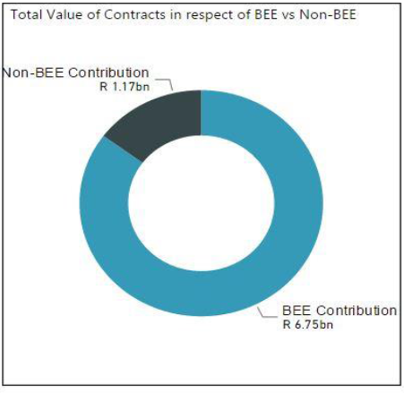
WCG SUPPLIER BASE – CONTRACT AWARDS for 2015/16
Presented to Cabinet
The table and charts below reflect the commitment value based on contract awards for the 2015/16 financial year and procurement spend matched to suppliers on our WCSD that was presented to Cabinet:
BBBEE Level | # Entities | Contract Commitments
1 | 1175 | R 572.76M
2 | 245 | R 4540.87M
3 | 166 | R 1048.70M
4 | 701 | R 333.18M
5 | 36 | R 78.80M
6 | 37 | R 77.80M
7 | 31 | R 84.13M
8 | 73 | R 9.80M
BEE Contribution | 2464 | R 6.75 bn
Non-compliant contributor | 2597 | R 1.17bn
Non-BEE Spend | 2597 | R 1.17bn
96%
of the total BEE contribution
85%

Slide 7
PROPOSALS APPROVED BY CABINET
  CABINET NOTED :
the progress made by the Western Cape Government (WCG) in respect of preferential procurement since the implementation of the PPPR 2011.
  CABINET APPROVED:
  ISSUANCE OF AN INTERIM STRATEGY AS WELL AS SUPPLY CHAIN MANAGEMENT GOVERNANCE REQUIREMENTS VIA PROVINCIAL TREASURY INSTRUCTIONS THAT:
Apply its discretion NOT to implement the pre-qualification criteria (i.e. regulation 4);
Apply its discretion NOT to implement regulation 6(9)(a)-(c) and 7(9)(a)-(c);
Makes provision for empowerment assessments to be conducted for all procurement above R10 million (EME threshold) and also allowing departments to lower the threshold should its analysis so dictate; and
Makes provision for the implementation of regional indicators to target local suppliers via our e-procurement system and rotation of suppliers.
  DEVELOPMENT OF AN ECONOMIC PROCUREMENT POLICY that is aligned to PSG1 that covers job creation and infrastructure development and is aligned to the MTBPS in conjunction with DEDAT and DotP.
  BROADER TRANSFORMATION POLICY
Promote private sector spend on economic growth; and
Further strengthen the partnership with the private sector by enabling access to the WCG supplier database.

Slide 8
PROGRESS ON CABINET DECISIONS
CABINET DECISION | PROGRESS
Issuance of an interim strategy as well as supply chain management governance requirements via provincial treasury instructions that: | Issuance of PT Circular 12 and 15 Information sessions with depts. Full review of PTIs currently underway Statistics as it relates to the PPPFR provided to depts. via quarterly SCM Performance Insight reports Challenges in implementing empowerment impact assessments hence PT in process of developing an EIA toolkit to assist department with process
Development of an economic procurement policy | 1st draft Economic Procurement Brief canvassed with SCM Forum in July 2017 and recommendations made to GTAC 2nd draft economic procurement policy brief received and Task team met on 25 August 2017 to provide final input into brief. 1st Draft Policy tabled with PT by DotP policy team on 15 April 2018. PT and key stakeholders provided comments to be taken up into policy
Broader transformation policy | Longer term objective

Slide 9
PPPFR PROCESS
WCG – A HOLISTIC APPROACH TO PROCUREMENT PLANNING, PROCUREMENT STRATEGY AND SOCIO-ECONOMIC TRANSFORMATION

Slide 10

CONFORMANCE TO PERFORMANCE
Public procurement frameworks characterized by an unstable tension between the public expectations of transparency and accountability and efficiency and effectiveness of resource management;
Complexity of procurement environment
Conflicting stakeholder interests;, views and claims at the political, business, community, management, legal and technological levels within the SCM arena

Slide 11
PUBLIC PROCUREMENT
PUBLIC PROCUREMENT – A POWERFUL TOOL !!!
Governments have long used public procurement as a tool to promote socioeconomic objectives. These objectives are sometimes referred to as ‘horizontal’ or ‘collateral’ considerations as they are additional to the primary purpose of public procurement.
In formulating public procurement policies these considerations are wide ranging, from promoting labour laws to encouraging local industrial development to supporting environmentally sustainable practices.
The case for public procurement as a tool to promote participation by SMMEs and /or black owned businesses is compelling from a developmental and economic perspective
Public procurement is a powerful tool to achieve socioeconomic objectives because it operates at the intersection of the government’s regulatory and buying powers. Governments are market regulators and market participants.
Governments spend trillions of dollars annually purchasing the goods, works and services they require to fulfil their public functions

Slide 12
WHY GOVERNMENT PURCHASING AFFECTS MARKETS
Public procurement is a powerful tool to promote socioeconomic objectives because it operates at the intersection of the government’s regulatory and buying powers (McCrudden, 2004).
Governments have the power to regulate market participants by encouraging markets through competition laws or by restraining markets through social regulation, such as health and safety laws.
UNITENDED CONSEQUENCES if legislation is not responsive to the business requirements of government:
  Distortion of the market: some private sector companies will automatically be precluded from competing for government contracts where a minimum B-BBEE status level or other pre-qualification criteria is imposed as a barrier to participation;
  Uncompetitive behaviour, fronting by suppliers, collusion and double dipping in order to meet the pre-qualification/ sub-contracting criteria;
  Risk of litigation;
  Lack of uniformity in the application of pre-qualifying criteria and sub-contracting given that it is discretionary;
  Expectations of the market: less budget, less employment and other opportunities. jobs.

Slide 13
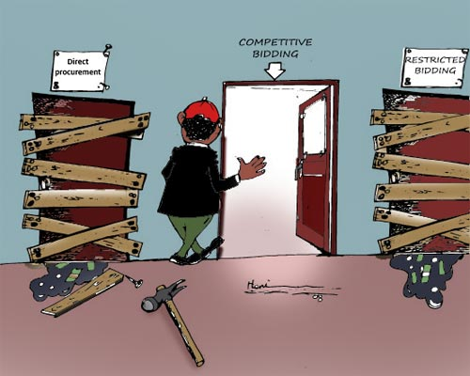
PUBLIC PROCUREMENT SYSTEMS
Traditionally and from a legislative perspective the SCM function is broader but the 3 main areas for procurement activities are the following are:
Acquisition Planning (Demand Management)
Source Selection (Acquisition Management)
Contract Administration (Contract Management)
THESE ARE ALSO THE VERY ACTIVITIES THAT ARE RED FLAGGED IN THE NT 2015, SCM REVIEW AS DEFICIENT WITHIN GOVERNMENT

Slide 14
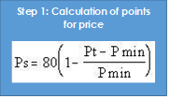
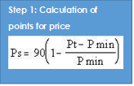
PPPFR 2017 – TECHNICAL PROCESS - COMPLIANCE
Determine and stipulate applicable preference points system
80/20
90/10
Applied for all price quotations and bids above R30 000 up to R50 M (all applicable taxes included)
Applied for all bids above R50 M
Below R500 000 (IPS)
Above R500 000 (open bidding)
Open bidding (eportal, GTB)
Evaluation:
price and preference
Step 2: Calculation of points for B-BBEE status level of contributor
Step 2: Calculation of points for B-BBEE status level of contributor

Slide 15
PPPR 2017 – TECHNICAL PROCESS - COMPLIANCE
Other
Considerations
Functionality Evaluation
First stage – Evaluation of functionality
Second Stage – Evaluation in terms of preference point systems
SUB-CONTRACTING AS A CONDITION OF TENDER
(IN WCG)
Evaluation of bids based on a stipulated minimum threshold for local production and content:
First stage – Evaluation in terms of the stipulated minimum threshold for local production and content
Second stage- Evaluation in terms of the 80/20 or 90/10 preference point systems
If it is unclear which preference point system will be applicable the institution must advertise the tender stating that the tender will be evaluated on either the 80/20 or 90/10 preference point system.
Breaking deadlock
Award of contracts to tenderers not scoring highest points
Cancellation of tender
Remedies

Slide 16
WHAT ARE THE TRADE - OFFS
Implementing certain a policy objectives or principles may conflict with the achieving others e.g. B-BBEE (PPPR requirements) vs. Local Content vs Green procurement
Public procurement frameworks characterized by an unstable tension between the public expectations of transparency and accountability and efficiency and effectiveness of resource management;
Complexity of procurement environment
Conflicting stakeholder interests;, views and claims at the political, business, community, management, legal and technological levels within the SCM arena
The challengefor government is to find the appropriate balance among the different competing objectives and priorities

Slide 17
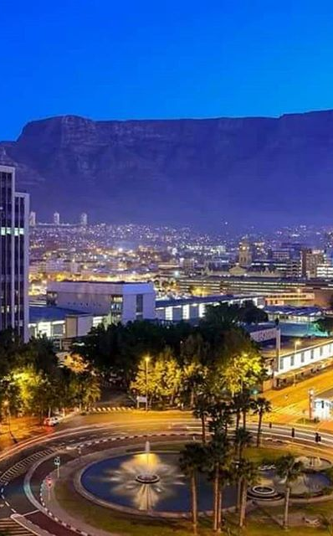
GLOBAL TRENDS DRIVING SOURCING & PROCUREMENT
RSA CONTEXT
ECONOMIC VOLITILITY
volatility in markets
slow economic growth
High expense ratio
decreased stock evaluation
downgrades
SOCIO-POLITICAL PICTURE
corruption
no confidence
service delivery protests
GREATER RISK
Disaster requirements
SCM disruption
financial risk &fraud
commodity risk
MORE COMPETITION
Pricing pressures
New sources of competition
decreased budgets & spending
REGULATORY CHANGES
SCM reform and new regulations
increased disclosure in process & commodities
compliance driven by audit approach
ACCELERATING TECHNOLOGICAL CHANGE
changing business models
Faster innovation cycles
expanding partnerships & channels
leveraging big data for decisions

Slide 18
STRATEGIC SOURCING
CONVENTIONAL APPROACH
Strategic Sourcing is the collaborative and structured process of critically analysing an organisation’s spending and using this information to make business decisions about acquiring commodities and services more effectively.
It is the systematic process that directs supply chain managers to plan, manage, and develop the supply base in line with the government organisation’s strategic objectives.
DYNAMIC APPROACH
It is a process to better understand the categories of goods and services within your portfolio, their intended use and their supply markets based on rigorous analysis, in order to identify the leverage points and develop the appropriate sourcing strategy which reduces the total cost to government and / or increase the benefits / value of the service / commodity to government.
The WCG context looks at a more integrated model when addressing strategic procurement. This thinking is taken into context in its procurement strategy.
The WCG model aims at shifts in the business model from one that is transactional in nature to one that focuses on outcomes.
Setting a limited number of mutually desired outcomes provides focus for high-level results such as lower cost structures, faster turnaround times, higher service levels and greater customer satisfaction rather than on achieving the lowest cost per transaction.

Slide 19
Why? Focus on Procurement Planning?
DEMAND MANAGEMENT
ACQUISITION MANAGEMENT
WCG
Procurement Cycle
Business Case development
Demand management
Specification Development
BID Evaluation
Contracting
Disposal
Business cases are not a standard strategic process, and buy versus develop the capacity in-house is not adequately addressed.
Tools and templates for planning are tactical-focused and do not drive strategic planning adequately.
Specification are not based on prior project management tools and therefore become an SCM task as opposed to business strategy.
Evaluation criteria are cost and BBEEE focused and do not take into account other corporate strategies such as localisation.
Absence of negotiating, supplier development and supplier performance tracking strategies and systems.
Lack of comprehensive strategic disposal strategy, leaving value on the table for cost, environmental, and localisation.
Gaps in strategic activities
STRATEGY DEVELOPMENT
CONTRACTING & SUPPLIER MANAGEMENT
Applicable Strategic
Processes
Comprehensive Spend Analysis
Comprehensive Market Analysis
Commodity Strategy
Negotiation
Contract Management Framework
Supplier Development
Lack of corporate strategy, tools and systems to adequately implement.
Lack of corporate strategy, tools and systems to adequately implement.
Transversal coordination brings value, however further opportunities lie within deep commodity strategies.
Lack of corporate strategy, tools and systems to adequately implement.
Lack of rigor in contract management.
No centralised supplier performance database.
Lack of capacity.
Supplier development strategy, processes or tools within the department. Initiative driven from PT.
Gaps in strategic activities
Key activities in the current procurement cycle are still very tactical without much strategic input

Slide 20
Demand Management lacks planning rigor
Best practices for moving from goals to strategy to implementation
PSGs
What’s missing
Lack of rigor and formality with project management practices to support project definition points.
Incomplete annual departmental procurement plan due to overall lack of planning.
Without progressing definition points, Line Management are defining their needs through the specifications process, thereby turning project definition into a SCM task, rather than a business driver strategy.
Results are often poor quality specifications and therefore poor delivery of goods and services.
Annual Departmental Procurement Plan
Definition Point
APP Strategy
Definition Point
Project High Level Scope Statement / Operational Growth
Definition Point
Project Initiation Document / Operational Growth Needs Defined
Definition Point
Tender Specification

Slide 21
WCGs POSITION
The WCG context looks at a more integrated model when addressing strategic procurement. This thinking is taken into context in its procurement strategy.
The WCG model aims at shifts in the business model from one that is transactional in nature to one that focuses on outcomes.
Setting a limited number of mutually desired outcomes provides focus for high-level results such as lower cost structures, faster turnaround times, higher service levels and greater customer satisfaction rather than on achieving the lowest cost per transaction.

Slide 22
The Case for Strategic Sourcing
The Problem Statement
The Business Problem:
Lack of perspective of what is important.
Ambiguity
Complexity
Lack of capacity across the organisation
Lack of a burning platform – project catalyst
Symptoms of a problem are being felt throughout the process, and by all stakeholders.
We are achieving clean audits. We are for the most part in compliance with SCM regulations, and we are procuring what is needed to meet service delivery.
At the grass roots level - the culture is filled with animosity, the processes are disaggregated and inconsistent, the administrative burden is overwhelming, and the staff do not know what to focus on.

Slide 23
Strategic approach to procurement
Diagram 2. Strategic approach to procurement
Legend
Value add
Level of effort
Stage in process
Initiate project
Identify need & analyse the market
Specify requirements
Plan approach to market & evaluation
Approach market & select supplier
Negotiate & award contract
Manage contract & relationship
Review
This diagram illustrates a strategic approach to procurement which methodically works through each stage in the procurement process. The time taken to plan, research and analyse add significant value to identifying solutions that will meet the needs. A focus on relationship development and management means that less time is spent resolving issues and more time applied to assessing quality in delivery and identifying opportunities for cost savings and benefit gains. A strategic approach delivers greater value.

Slide 24
The Business Opportunity
The Problem Statement
Implementation of Strategic Sourcing is a major project for WCG, NT and other provinces.
However strategic sourcing is not the silver bullet.
We cannot hope to implement this strategic practice unless it is built from a strong foundation.
Strategic sourcing requires an increase in the attention, focus and strategy that we put towards commodities and /or towards our business strategy. In the long term this will yield efficiencies – however in the short term this will require more effort – not less.
So how will we do this when can’t even keep up with things now?

Slide 25
PROCUREMENT STRATEGY
 | FOCUS AREA | SPECIFIC DETAIL FOCUS
Part1: Procurement Governance, Objectives and Targets | Organisational Objectives Procurement Targets Alignment to Organisational Objectives Governance Framework for Procurement | Organisational objectives and business strategy Performance expectation of procurement function through setting targets Business drivers for procurement objectives e.g. spend visibility and savings Governance framework for procurement operations
Part 2: Procurement Planning | Analysis of Procurement Spend Supplier Analysis Category Management Contract Management Forecast Benefits | Strategic Analysis of procurement activity Overview of suppliers of the organisation Assessing complexity at the level of category, related capability and market factors Areas of focus /risk for contract management Identify benefits/elements of success for performance reporting
Part 3: Procurement Analysis | Strategic Situation Analysis Risk Analysis Capability Development Initiatives Policy, Procedures, processes and systems initiatives Planned budget allocation | Swot analysis on how robust strategy and planning is Risk identification and consequences are integrated into the procurement decision making Initiatives to improve the entity’s procurement capability Funding requirements and service delivery considerations, process efficiencies, performance management and value for money etc.
Part 4: Procurement Implementation | Performance Management and Monitoring | Overall supply chain (measurement to test that the entity is efficiently and effectively using its resources in the attainment of its objectives and wider government objectives Commodity strategies Opportunities for transversal contracting, framework agreements/specific engagement model contracting

Slide 26
The Roadmap
The Way Forward
Phase 1: Find Time
  Efficiency
  Decrease the transactional workload
  Consolidate and streamline
  Build a culture of trust
Phase 2: Build the Foundation
    Build management infrastructure
    Build efficient systems and processes
    Centralise and make transversal
    Recruit, retain and build the right skills and competencies
    Foster the culture
Phase 3: Strategic Sourcing Continuous Improvement
    Commodity strategies
    Build collaborative systems
    Continuous improvement
    Reinforce the culture
    Measure Strategic Sourcing success
Change Management, Culture Shift
Ensure Capacitation and Ongoing State of Readiness

Slide 27
The Basic Strategic Sourcing Intent
The Way Forward
The basic intent of Strategic Sourcing is about building knowledge
for better/Informed decision making.
Know
Informed Decisions
Your Departmental:
1. Business Needs
2. Spend History/Forecast
3. Commodity
4. Suppliers
5. Internal Processes

Slide 28
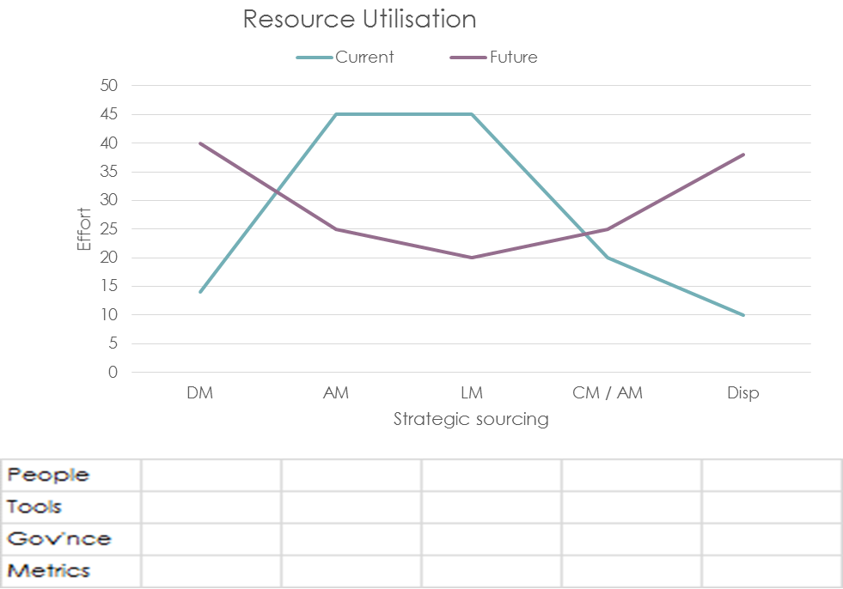
What needs to be done for each knowledge area?
The Way Forward
Internal Processes
People
    Enough resources
    Training programs
    Career path
    Culture
Tools
    E-procurement system
    Processes
    Policies, regulations and processes in line with strategy
    templates and other mechanisms to automate
Governance
    Collaborative teams
    Clear and implementable strategy
    Strategic alignment and visibility of SCM principles throughout the entire system

Slide 29
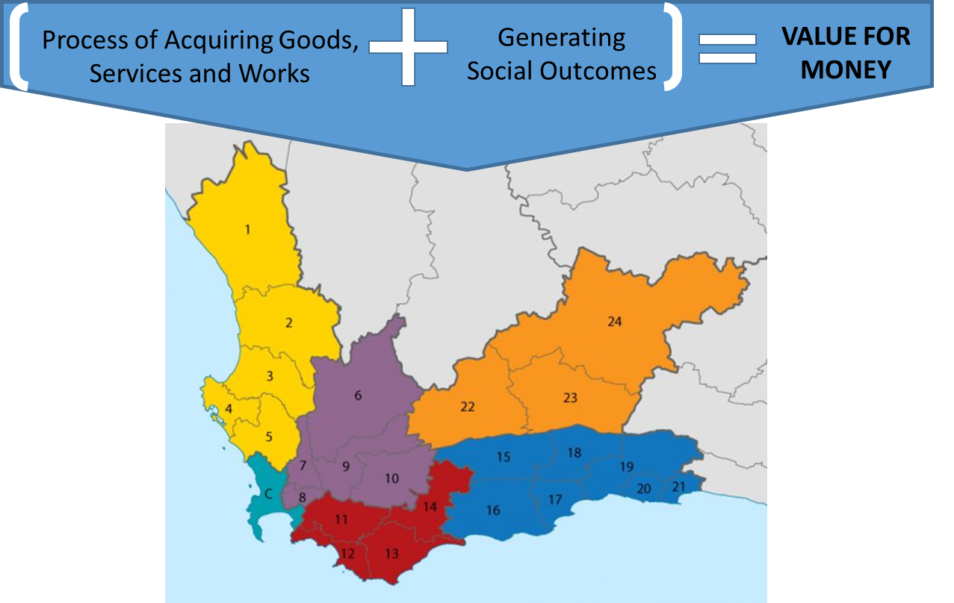
Orientation: Value for Money
Pillars of Public Procurement
Value for Money
Open and Effective Competition
Ethics and Fair Dealing
Accountability and Reporting
Equity
Public money spent achieves as much public benefit as possible
Notes:
It is not about looking for trade-offs amongst stakeholders or applying the “trade-off” principle which generally suggest a win/lose scenario, but rather about new business models in society today where public value is as important as shareholder value
Social objectives must be a part of mainstream procurement practices and organisational approaches, in the same way as occupational health and safety and environmental management are business as usual practices for all levels of government today

Slide 30
Summary of Considerations
1: develop a Socio-economic Value Procurement Framework
2: use the Procurement Plan to Conduct an Opportunity Analysis
3: develop a common WCG Baseline / “comprehensive integrated map or catalogue” of initiatives
4: identify and engage with intermediaries that can organise labour / social benefit enterprises/ social movements
5: use the MERO and the PERO as the leading baseline
6: Include Social Outcomes in the Existing Procurement Cycle
7: develop a communications plan that creates the necessary TRUST with all stakeholders

Slide 31
“Socio-economic Value Procurement Framework”
INTENDED OBJECTIVES/ OUTCOMES | MECHANISMS TO ACHIEVE THAT GOAL
Increasing Local Employment | Employment opportunities stipulated in contract Establish a social benefit supplier (business that exists for a public or community benefit) Purchase from a social benefit supplier
Purchase of Goods & Services including a social outcome | Social Benefit requirements are stipulated in contract Purchase from a social benefit supplier Establish a social benefit supplier
Increasing Employment of people from disadvantage backgrounds | Training /and or employment opportunities for disadvantage groups in specific location Purchase from a social benefit supplier Establish a social benefit supplier
Capacity Building in the local community | Promotional activities Social procurement investment map
Raising awareness | Promotional activities Social procurement investment map
Notes:
EQUITY
advance the development of SMMEs and HDIs;
promote women and physically handicapped people;
create new jobs;
promote local enterprises in specific provinces, in a particular region, in a specific local authority, or in rural areas; and
support the local product

Slide 32
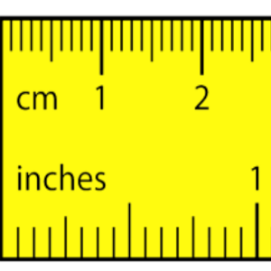
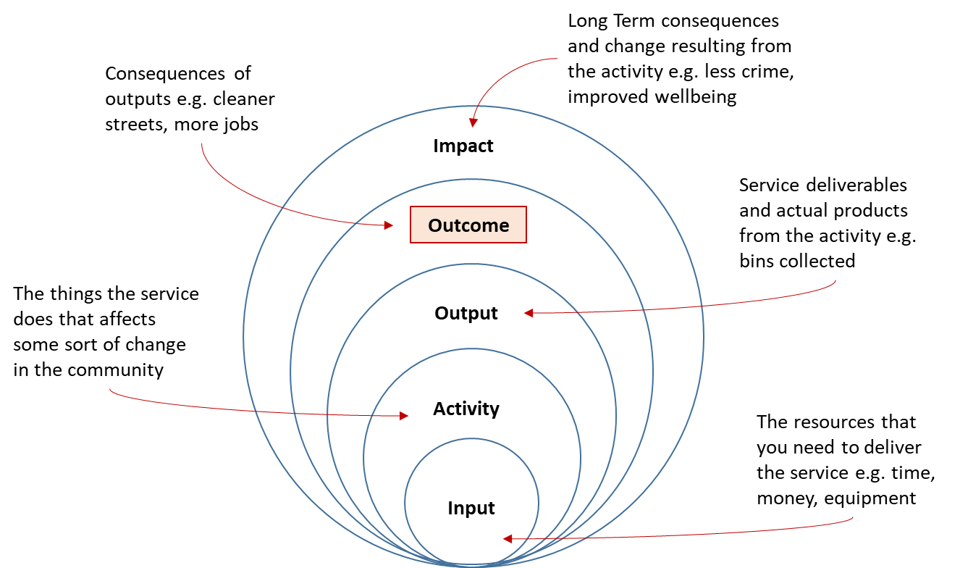
Measurement Logic: Start with Outcome
“ Outcome” is defined in Social Value Procurement Framework

Slide 33
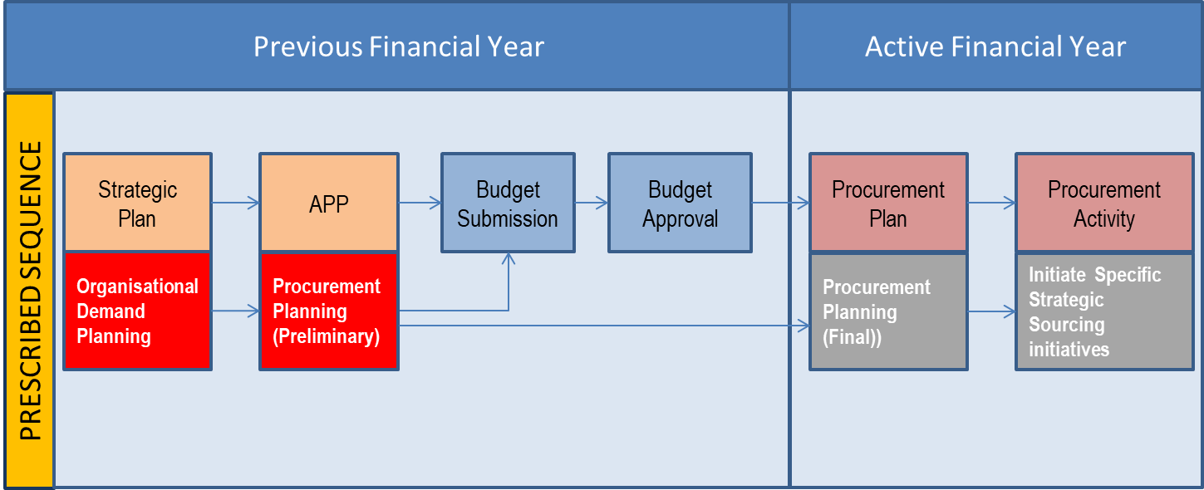
Use Procurement Plan - Conduct Opportunity Analysis
The Procurement Plan is already institutionalised in WCG
Notes:
The Procurement Plan and its suite of templates have been successfully implemented in the WCG. Over the past 4 years it has been integrated and links with the Strategic Plan, Annual Performance Plan and the Budget.

Slide 34
Social Value Opportunity Views
PROCUREMENT PLAN DETAILS | SOCIAL VALUE TARGET
Item Timing Acquisition Method, Business Owner, Link to APPs and Other | Increasing Local Empowerment
 | Purchase of goods including social outcome
 | Increasing Employment of people from Disadvantaged backgrounds
 | Capacity building in the Local Community
 | Raising Awareness

Slide 35
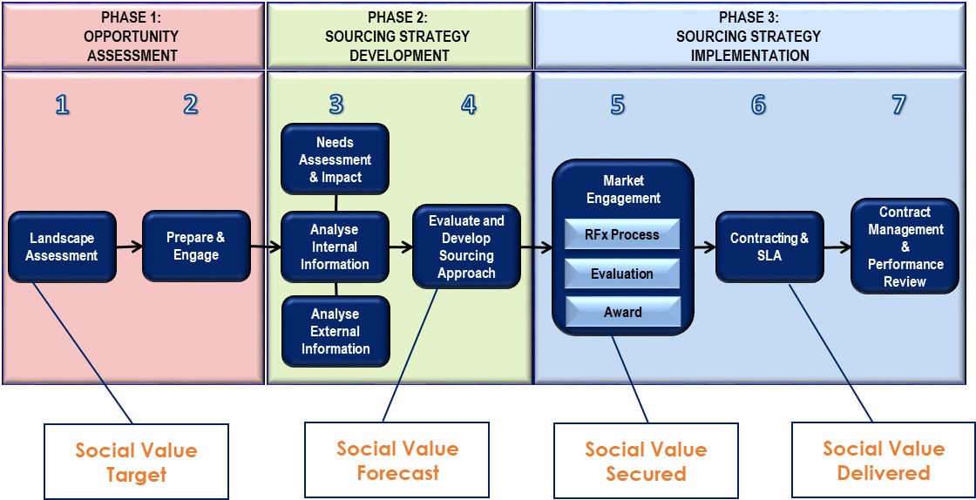
Include Social Outcomes in the Existing Procurement Cycle
Notes:
Using the Strategic Procurement Framework developed by National Treasury the Social Value perspective is included at a process step
Social Value Target – at the beginning of the project
Social Value Forecast - more realistic overview of what outcomes may be achievable after market research.
Social Value Secured - once the contract is awarded, those outcomes are secured
Social Value Delivered - they are based on actual contract deliverables

Slide 36
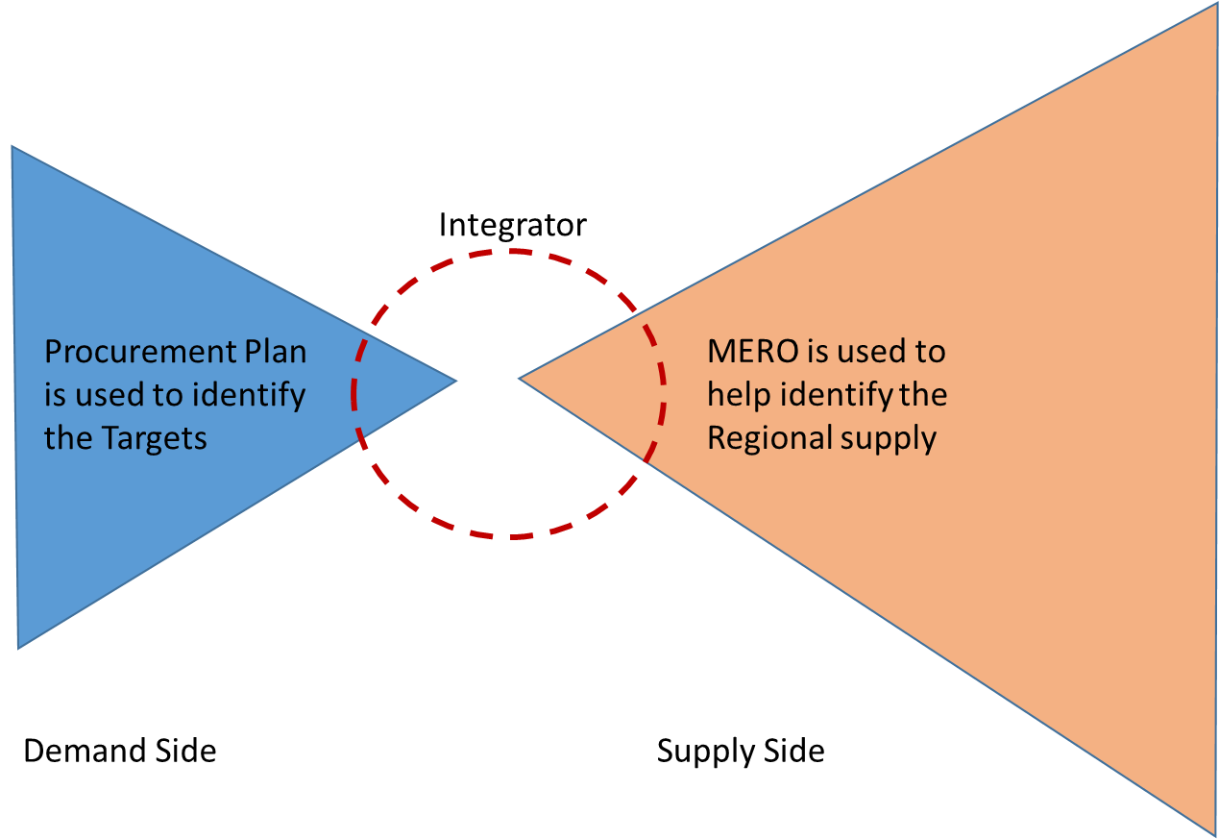
USE THE MERO AND THE PERO AS THE LEADING BASELINE
Publish MERO on the WCSDB so all suppliers have the opportunity to understand the regional needs and opportunities
Notes:
The Inclusive Development Index (IDI) is an annual assessment of 103 countries’ economic performance that measures how countries perform on eleven dimensions of economic progress in addition to GDP. It has 3 pillars; growth and development; inclusion and; intergenerational equity – sustainable stewardship of natural and financial resources.
The IDI is a project of the World Economic Forum’s System Initiative on the Future of Economic Progress, which aims to inform and enable sustained and inclusive economic progress through deepened public-private cooperation through thought leadership and analysis, strategic dialogue and concrete cooperation, including by accelerating social impact through corporate action.

Slide 37
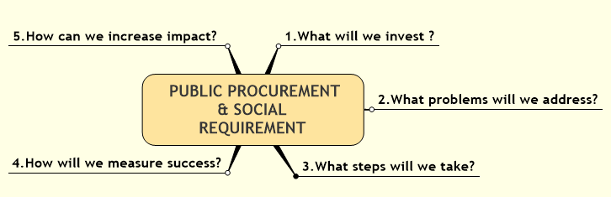
Communication Plan
A communications plan that creates the necessary TRUST with all stakeholders

Slide 38

HOLISTIC PROCESS FOR PPPFR IMPLEMENTATION
PROCUREMENT SYSTEM
PROCUREMENT SYSTEM that focuses on PROCUREMENT STRATEGY (EPP); Integrates budgeting and procurement planning that is linked to supply and demand of spending options, risk profiling and opportunity assessment, sourcing methodology and value impact
MONITORING & EVALUATION & REPORTING
  Setting clear objectives and monitoring , communicating and reporting achievements, challenges and further work required
ACQUISITION THROUGH BACKEND PROCESSES
  E-procurement, capacitation and Development (users and suppliers)
PROCUREMENT PLANNING AND DEMAND MANAGEMENT
  Analysis, opportunity assessment and risk profiling as well as Empowerment Impact Assessment
PROCUREMENT STRATEGY
  Context understanding one’s environment and business approach

Slide 39
WCG REFLECTIONS ON PPPFR IMPLEMENTATION FOR 2017/18

Slide 40
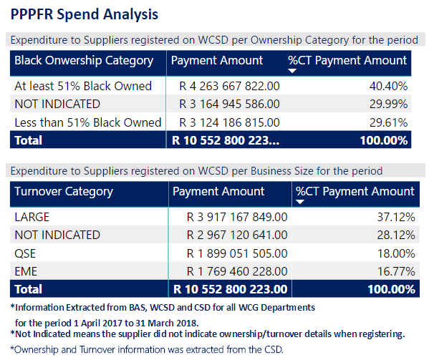
PREFERENTIAL PROCUREMENT SPEND 2017-18

Slide 41
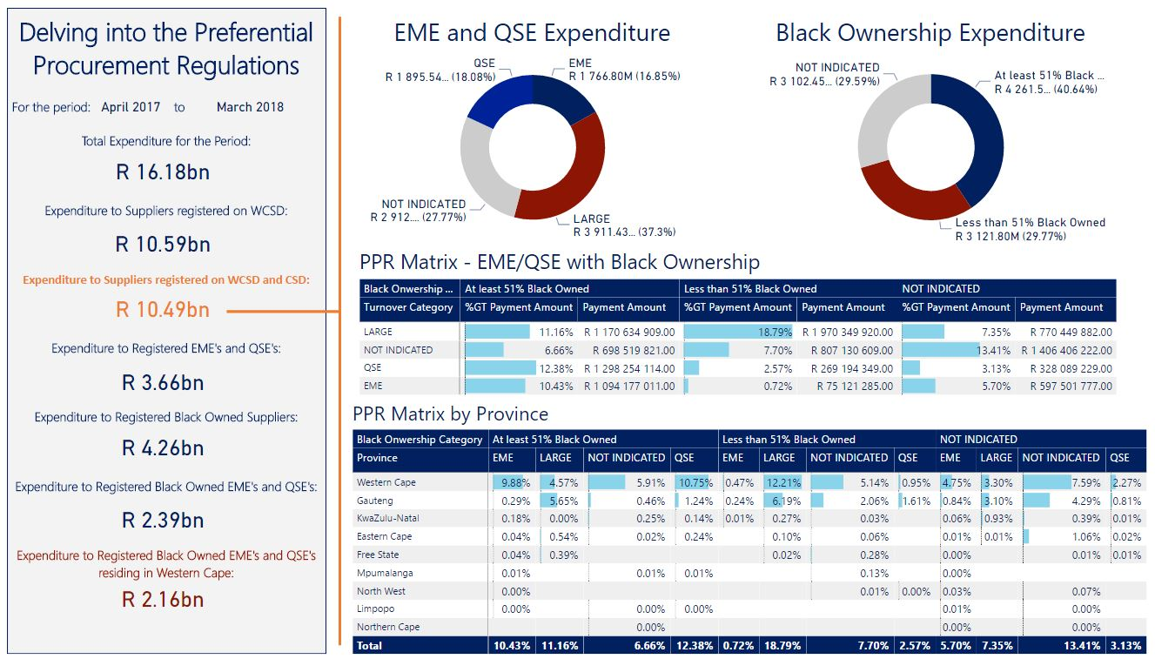
PREFERENTIAL PROCUREMENT SPEND 2017-18

Slide 42
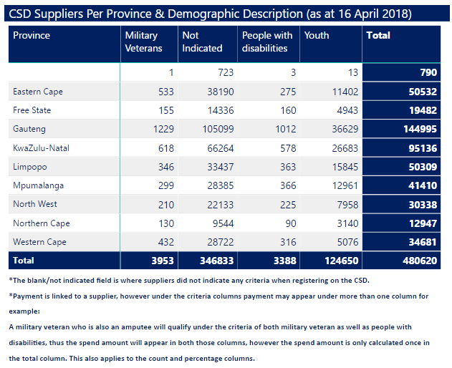
DEMOGRAPHIC REPRESENTATION ON CSD

Slide 43
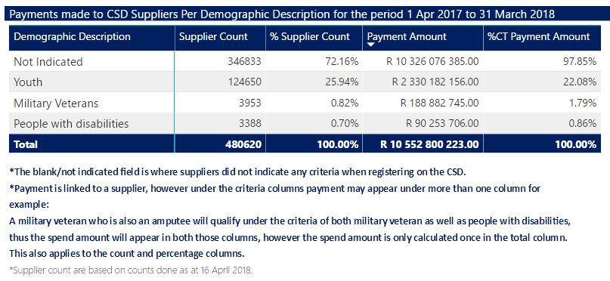
WCG PROCUREMENT SPEND 2017-18 IRO DEMOGRAPHICS

Slide 44
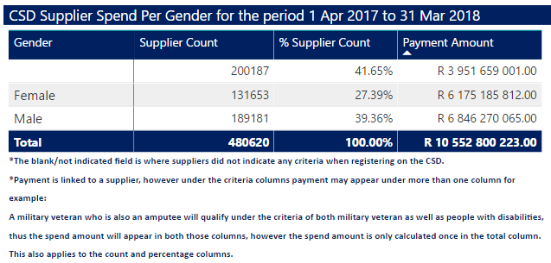
WCG SPEND 2017-18 PER GENDER

Slide 46
NADIA EBRAHIM
ACTING HEAD :ASSET MANAGEMENT
021-483 4748
Isac.smith@westerncape.gov.za

