Slide 1

Update on the Review of the STI Institutional Landscape
Portfolio Committee on Science and Technology
16 May 2018

Slide 2
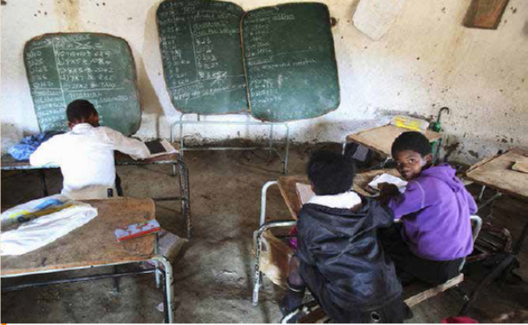
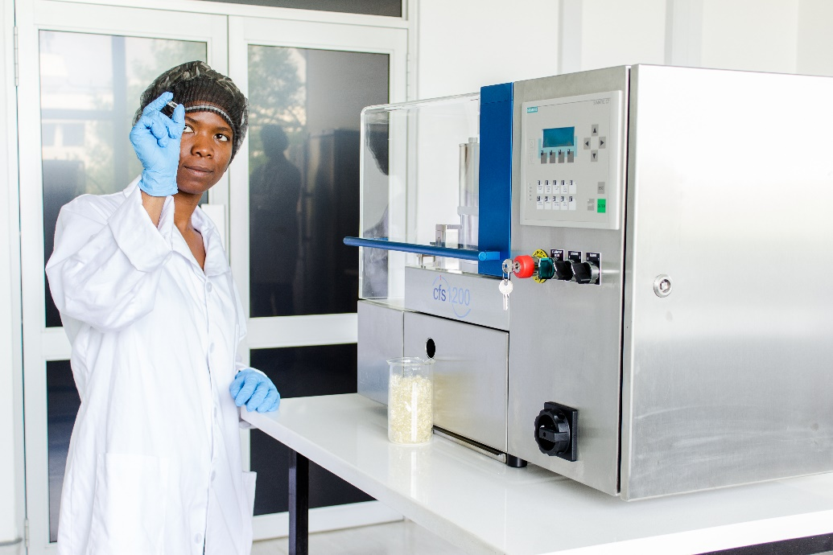
STIIL Review Terms of Reference
Minister Pandor appointed the STIIL Panel in November 2015
1. Is the current STIIL able to optimally assist in the achievement of the country's developmental priorities?
2. Does the current structure and function enable the STIIL to effectively respond to socio-economic needs?
3. If no to either of the above, what are the measures needed to address the inadequacies?

Slide 3
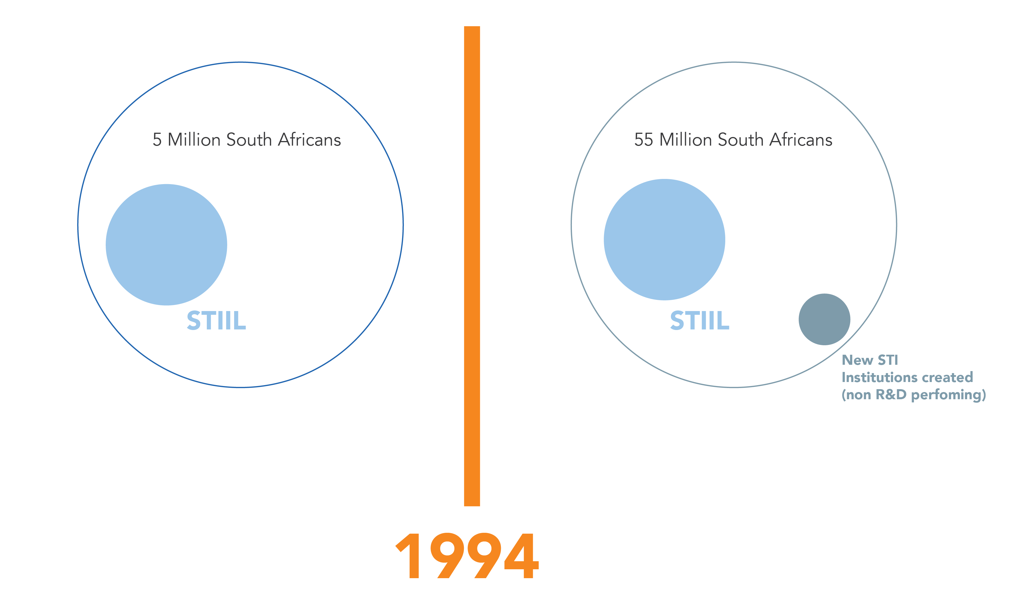
STIIL Pre and Post 1994

Slide 4
STIIL Review Panel Members
Dr Lucienne Abrahams (from September 2015)
Dr Thulani Dlamini (September 2015 to April 2017)
Prof Anne Grobler (from September 2015)
Dr Azar Jammine (from November 2015)
Prof Rasigan Maharajh (from September 2015)
Mr Sullivan o’Carroll (from February 2016)
Prof Bongani Mayosi (September 2015 to May 2016)
Dr Boni Mehlomakulu (September 2015 to December 2016)- Chairperson
Mr Mafika Mkwanazi (from February 2016)
Prof Loyiso Nongxa (September 2015 to July 2016)
Prof Helen Rees (September 2015 to August 2016)
Prof Zeblon Vilakazi (from September 2015)
Dr Thomas Auf der Heyde (from February 2017)*

Slide 5
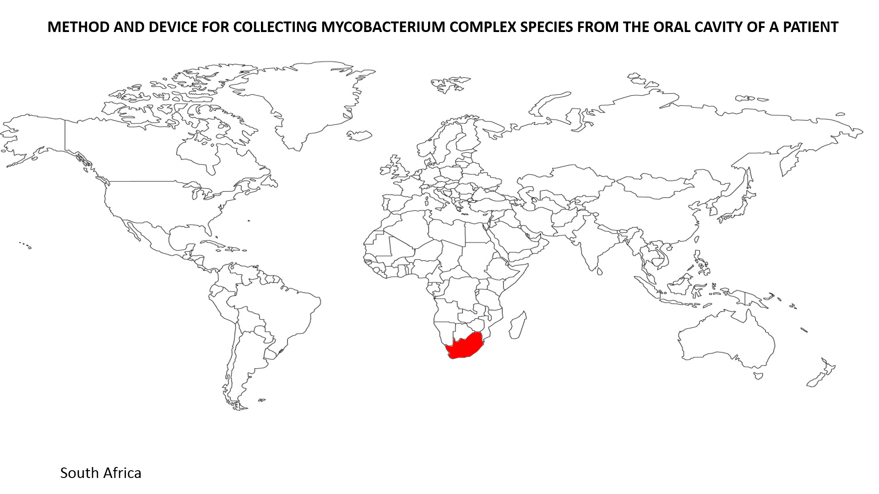
International comparisons
Cuba
Brazil
Russia
India
China
USA

Slide 6
Key findings of international comparisons (1)
All six countries have an NSI that reflects the particular attributes of the country’s evolutionary history.
Cuba- STI institutions well organized and steered through relatively uncomplicated system.
India- Similar structural similarities to South Africa. However NSI remains small and is under utilized by the productive sector. Governance system bureaucratic.
Brazil- its NSI system resemblances the South African situation. Its STI institutions are orientated towards addressing socio-economic and political challenges

Slide 7
Key findings of international comparison (2)
Russia- highly effective during the Cold War and well capacitated. With the demise of the USSR, public sector was forced into austerity. Russia has taken measures to prevent further deterioration of its research institutions.
USA- STI institutions operate with wide degrees of autonomy and conjoined in the maintenance of USA hegemomy. The main beneficiaries of its STI institutions are private enterprises.
China- STI institutions well coordinated and steered through a planning structure similar to Cuba. Now rivals USA as fastest growing emerging economy due to massive investments in STI.

Slide 8
Current STIIL Governance
Legislative framework: PRIs are mostly governed by dedicated acts of parliament of varying ages. No overarching policy or legislative framework defining the role of PRIs within the collective context currently exists.
Science and Technology Activities Report: The STA report is the only quantitative indicator that provides some insight into the extent to which public science and technology organisations allocate funds to the different types of research under the SMM.
Strategic Management Model (SMM) as approved by Cabinet in 2004.

Slide 9
The Strategic Management Model (SMM)
PROPOSED ACTION | STATUS OF IMPLEMENTATION
Transfer of CSIR from the dti to the DST | Effected with new budgeting requirements (2004-2006).
Institutional mechanism to coordinate tertiary education research funding | Effected. MoU between DoE and the DST (2005). Good working relationship with DHET through an MoU.
Appointment of DST representatives to Boards of ARC, MRC, Mintek, SANBI, Necsa, NERI and the WRC. | Effected in 2005, but its effectiveness is doubtful in terms of strategic alignment.
Revision of the Science Vote process for budgeting purposes | Effected by transfer of responsibilities to line ministries, but with dilution of the DST’s leverage.
Creation of research and tech transfer support service in the DST (2005/6) | Not done. Administrative support, but no legislative authority for the DST.
Implementation of the MTEF S&T Expenditure Plant (2005 for 2006/2007) | Implemented with continued development. Cabinet approved that a budget coordination framework be developed in 2017.
Drafting a policy on governance standards for S&T institutions (2005) | Not effected. Generic national governance standards are applied.
Drafting a policy on publicly funded intellectual property (2004) | Effected through IPR Act in 2008, which has become one the perceived regulatory issues/obstacles in the STII landscape.
Drafting coordinated legislation to operationalise the SMM (2004) | Not effected. STIIL review panel proposes the formulation and implementation of a parliamentary act to define the role and authority of the DST.

Slide 10
STIIL REVIEW RECOMMENDATIONS (1)
Recommendation 1: Develop an overarching policy framework for PRIs, describing their purpose, functions, national relevance and governance for the next 30 years w.r.t. strategic mandates of the DST and alignment with other line departments.
Recommendation 2: Review mandates of PRIs re. ability to support
the newly established policy framework,
the respective line ministries’ imperatives,
research, innovation and human capital development,
the diversification of knowledge production & inter-disciplinary R&I into emerging knowledge fields,
a more balanced geographic spread of R&D practice, institutional presence, investment and innovation impact, and
a more directed focus on social innovation, in particular the need for R&D for educational innovation. Establishment of processes for regular 3-5 year collaborative reviews to re-envisaging mandates.

Slide 11
STIIL REVIEW RECOMMENDATIONS (2)
Recommendation 3: Establish an evaluation framework to assess and compare the efficiency levels thus enabling informed strategic measures to improve productivity across the STII landscape.
Recommendation 4: Expand the STII landscape through establishment of new PRIs, and necessary restructuring of existing institution informed by
relevant strategic need and opportunity,
the extent of existing public sector investment,
financial implications of the various models for establishment (e.g., centralised or devolved; physical or virtual), and
extent of current capacity (scientific, technical, organisational, infrastructural).

Slide 12
STIIL REVIEW RECOMMENDATIONS (3)
Recommendation 5: Design & establish a national regulatory policy framework that is coherent and consistent, so as to enhance alignment of existing regulation and to close regulatory gaps in the STII landscape.

Slide 13
Implementing the STIIL Roadmap
Based on the recommendations of the review, the Department will pursue a roadmap for the expansion of the STIIL
  Development of reference framework of imperatives for PRI landscape
  Gaps in PRI landscape
  Roadmap for diversification of PRI landscape
  Model for PRIs
Demand led STIIL establishment to be informed by the NDP Vision 2030 and the aspirations of the New White Paper on Science and Technology and the Decadal Plan
Supply side establishment Informed by areas where we have excelled and/ or possess geographic/ competitive advantage

Slide 14
Concluding remarks
NACI is busy with a foresight exercise that will inform the Decadal Plan (October 2018)
The STIIL Roadmap will be an input into the new Decadal Plan (December 2018)

Slide 15
THANK YOU

