Slide 1
standing committee ON PUBLIC ACCOUNTS Report: DATED 14 DECEMBER 2017
Parliamentary Chamber
7 Wale Street, 6th Floor
|
|

Slide 2
Resolution issued on 14 December 2017
The Department briefs the committee on the funds that were spent on the Wolwekloof Academy from the 2014/15 financial year to date. In addition the Department must indicate the value for money that was derived from the Wolwekloof Academy from the 2014 financial year to date, including the exit strategy that has been developed.

Slide 3
Background information on Wolwekloof
During November 2013 the Department of Transport and Public Works invited all Departments, interested in the utilisation of the Wolwekloof site to forward applications. During the same time we received an invitation from National Treasury to submit business plans for available donor funding (GBS)
On 26 March 2014 the Department applied to the DTPW for the utilisation of the Wolwekloof site. The Department also prepared a business plan on Youth Development based on the proven Chrysalis Youth Development Programme with the main difference being the modular versus residential programme.
A Funding proposal (business plan) was approved by National Treasury to the value of R40.8million over three years. This allocation was approved with the proviso that it was ring-fenced for Wolwekloof site and Youth Training.
After various site visits and in a partnership concluded with the Department of Local Government (DLG) the Wolwekloof site was assigned to the Department of Community Safety (DoCS) on 10 April 2014 for the purpose of running the Youth Safety Academy and the training of mainly “Working for Fire” volunteers via the DLG. MOU was signed on 31 July 2014.
The Wolwekloof Community Safety Academy forms part of Programme 3 Provincial Policing functions and more specifically Sub Program 3.1: Safety Partnership. The purpose of the sub – program is to increase safety by means of sustainable partnership with community based organisations working for safety.

Slide 4
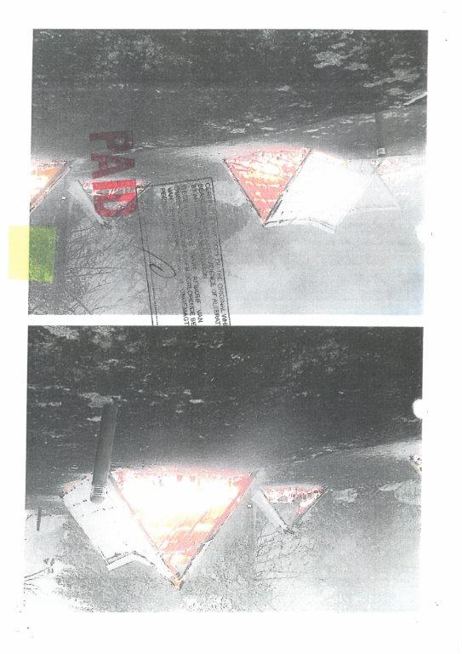
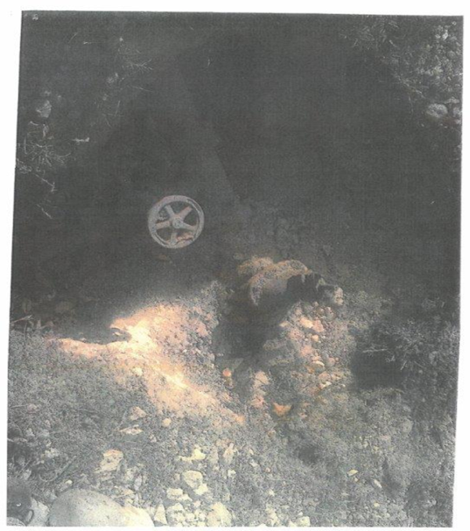
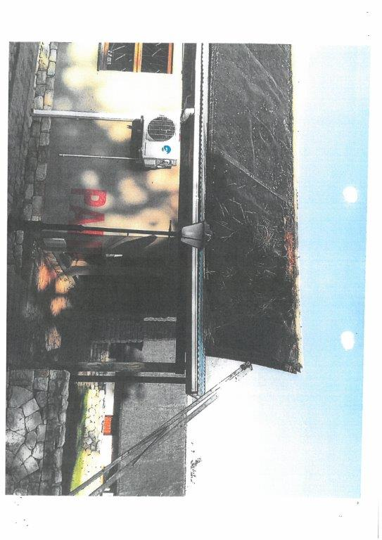
Background information on Wolwekloof (Continue)
During the first year of operation the side was extensively damaged by wild fires. The emergency cost to repair damage to the infra-structure due to the devastating fire amounted to R472 703.00.
Furthermore, some of the water reticulations system was found to be contaminated with asbestos and were unable to accommodate the number of people on site during training programmes. As a result mobile ablution units had to be hired at a cost of R197 899.00 and R150 462.00 during 2015 and 2016 respectively.
The infra - structure at the time the Department received the Wolwekloof site posed various risks.

Slide 5
Expenditure breakdown 2014/15 – 2016/17 financial year
Category | 14/15 | 15/16 | 16/17
COE | 313 391 .30 | 1 318 858.02 | 2 115 105.27
Goods and Services
Advertising | 72 346.48 | 570 439.47 | 245 879.32
Catering: Departmental Activities | 87 885.00 | 788 897.80 | 1 861 575.22
Computer Services | - | 234 108.41 | 246 336.14
Cons Supplies | 779 049.68 | 419 654.65 | 472 581.20
Fleet Services | 44 595.58 | 243 025.84 | 161 342.89
Contractors | 3 223 635.72 | 837 867.05 | -
Inv: Other Supplies | - | - | 532 052.00

Slide 6
Expenditure breakdown 2014/15 – 2016/17 financial year
Category | 14/15 | 15/16 | 16/17
Inv: Cloth Mat & Accessories | 530 363.80 | - | 838 573.73
Operating Payment (EPWP stipend to students) | 3837.80 | 479 749.52 | 2 078 140.75
Minor Assets | 602 915.81 | 248 824.80 | 43 620.64
Property Payments | 546 842.60 | 485 213.10 | 1 720 424.81
Travel and Subsistence | 195 299.76 | 87 649.07 | 18 715.90
Rental & Hiring | - | 308 882.48 | 416 838.09
Training & Development | - | - | 1 319 973.37

Slide 7
Expenditure breakdown 2014/15 – 2016/17 financial year
Category | 14/15 | 15/16 | 17/18
Households (HH)
H/H: Other Transfers | 1 179 440.00 | 1 440 000.01 | -
Machinery and Equipment
Other Machinery & Equipment | 1 595 739.04 | 507 148.28 | 70 315.09
Transport Equipment | 2 945 023.14 | 421 174.21 | 444 185.40
Non Profit Institutions (NPI)
Total Expenditure for Financial Year | 12 176 778.01 | 10 136 757.51 | 13 416 753.89

Slide 8
Internal Audit report on Wolwekloof - March 2016
During the 2015/16 financial year Internal Audit (DOTP) was requested to conduct an internal audit on Wolwekloof based on the following risk identified.
Risk Statement:
The Wolwekloof Youth Academy may not be fully ready for student intake due to unsuitable infra - structure and lack of appropriate operational processes.
The detailed audit report recommended management to implement action plans to mitigate risks pertaining to:
Wolwekloof Infra - structure;
Occupational Health and Safety;
Telecommunications infra - structure;
Wolwekloof Monitoring and Reporting and
Memorandum of Understanding.

Slide 9
Wolwekloof - Value for money
198 students were trained during the 3 year period and were deployed in the following areas:
Region | Placement institution/Municipal Partners | Total
Cape Winelands | Drakenstein Municipality | 23
 | Witzenberg Municipality | 15
Central Karoo | Beaufort West Municipality | 21
 | Hessequa Municipality | 13
 | Laingsburg Municipality | 16
 | Prince Albert Municipality | 10
Overberg | Cape Agulhus Municipality | 16
 | Overstrand Municipality | 18
 | Swellendam Municipality | 12

Slide 10
Wolwekloof - Value for money (Continue)
The following training was provided at Wolwekloof Academy:
Orientation phase (3 weeks)
Skills Phase inclusive of First Aid Levels 1-3, Basic Fire fighting, disaster management & emergency evacuation and handling of hazardous material (HAZMAT) (2 weeks)
Accredited Law Enforcement for 166 Peace Officers (6 days)
During the time, Working for Fire volunteers and other fire-prevention personnel received training which was facilitated by DLG at Wolwekloof.
Region | Placement institution | Total
 | Theewaterskloof Municipality | 17
Overberg | Bergrivier Municipality | 10
 | Saldanha Bay Municipality | 4
Eden | Bitou | 23
Grand Total |  | 198

Slide 11
Sustainability of the Wolwekloof training facility
The following challenges were experienced by DOCS:
Non existent IT Network infra –structure;
Flooding;
Extreme weather conditions;
Inadequate electricity installation;
Limited Water supply;
Derelict buildings – require demolishment;
Risk of Fires and
Poor road infrastructure.
The GBS funding came to an end on 31 March 2017 and no applications for funding was considered for the 2017/18 financial year.
Due to the serious challenges in relation to the sustainability for occupancy and the budget required to address all infra-structure and other challenges the Department is unable to render further programmes at the Wolwekloof site.

Slide 12
Wolwekloof Exit Strategy
On 11 November 2015 the Department requested NT to lift the specific facility limitations on the GBS funding.
On 11 March 2016, NT approves the request based on the infrastructure challenges being experienced.
On 28 March 2017 the Department informed the DTPW of it’s intention to exit the Wolwekloof site.
An agreement has been reached with the Chrysalis Academy during the 2017/18 financial year to increase its annual intake by 100 Youth which shall be recruited from the rural areas which were previously serviced by the Wolwekloof Academy.
Assets with a total value of R1 385 737.97 and Consumables to the value of R576 005.45 is in the process of being transferred from Wolwekloof Academy to the Chrysalis Academy.
Training courses at the Chrysalis Academy is now fully accredited (until 2020) which was achieved through the partnership and funding of Wolwekloof.
The Wolwekloof site was handed back to the DTPW on 01 April 2018.

Slide 13
The Department of Community Safety
Office of the Head of Department
+27 (21) 483 3929
+27 (21) 483 6412
Hod.Comsafe@westerncape.gov.za

