Slide 1
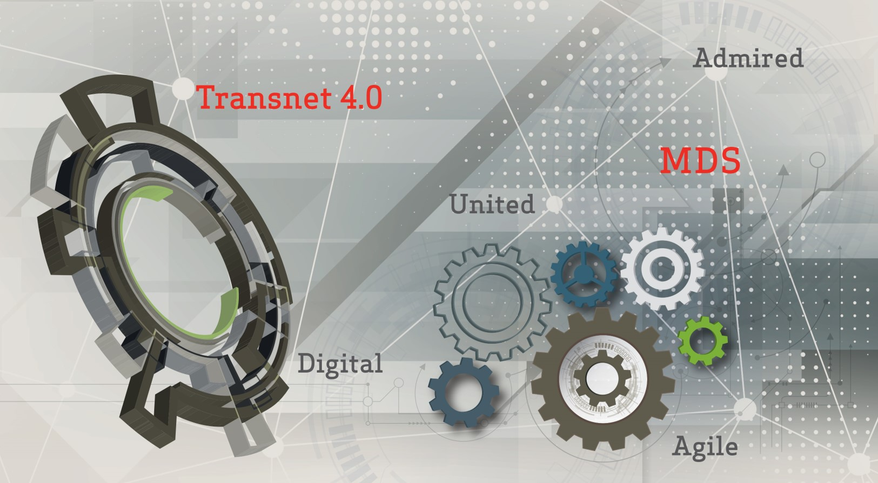
Portfolio Committee on Public Enterprises
2018/19 Corporate Plan
April 2018

Slide 2
Executive summary
The Corporate Plan is prepared on an annual basis by the Transnet Group Leadership Team and was approved by the Transnet Board of Directors on 22 February 2018 and submitted to the Department of Public Enterprises and National Treasury on 27 February 2018.
The Corporate Plan details the strategy, objectives and plans in line with the requirements of the Shareholder as agreed in the Statement of Strategic Intent and the Shareholder’s Compact as well as provide important information to stakeholders, including investors and funders, in their assessment of Transnet’s financial standing and their evaluation of the risks faced by each of the Operating Divisions and the Company as a whole, as well as associated mitigating actions.
The preparation of the Corporate Plan follows a structured process and flows from the following activities within Transnet:
  The setting of strategic direction, associated objectives and targets using and informing the requirements of the Shareholder’s Compact;
  The alignment of volumes based on inputs from customers, financial plans, funding requirements, operational plans, capital investments and risk management strategies across the Company through a strategic planning and budgeting process;
  Various cross-divisional and cross-functional workshops, reviews and approval sessions with key stakeholders including the Board of Directors and the Group Leadership Team of Transnet; and
  A process to obtain the commitment from internal stakeholders to clearly define deliverables for the performance agreements to be concluded for 2018/19.

Slide 3
Organisational Structure
Transnet Freight Rail (TFR)
Transnet’s largest operating division (by revenue and assets), specialising in heavy haul and general freight transportation
Transnet Engineering (TE)
Group of product focused businesses in the manufacture, upgrading, repair and maintenance of railway rolling stock and associated transport equipment
National Ports Authority (TNPA)
Responsible for the safe, efficient, effective and economic functioning of the national ports system, which it manages, controls and administers on behalf of the Government
Transnet Port Terminals (TPT)
Provides cargo handling services to a wide spectrum of customers, including shipping lines, freight forwarders and cargo owners
Transnet Pipelines (TPL)
Major transporter of multi-product hydrocarbon and methane-rich gas through a network of 3,800km of strategic petroleum and gas pipeline infrastructure, across 5 provinces
Transnet International Holdings (TIH)
Approved by the Board, DPE and the Minister of Finance, TIH coordinates Transnet’s activities beyond South Africa and is fully operational from 1 April 2018.
Vision
Snapshot
Fuelling Africa’s growth and development as the leading provider of innovative supply chain solutions
Transnet is the custodian of rail, ports and pipelines
Total assets of R362.4bn and 52,294 employees (Sep ‘17)
Mission
Linking economies; connecting people; growing Africa!
Transnet SOC Ltd
Operating Divisions
Transnet Freight Rail
53% of Revenues*
Transnet Engineering
11% of Revenues*
Transnet National Ports Authority
16% of Revenues*
Transnet Port Terminals
15% of Revenues*
Transnet Pipelines
5% of Revenues*
Transnet International Holdings
Specialist Units
Transnet Property
Transnet Group Capital
Transnet Foundation
*Reportable segment revenue as of Sep ’17 (interim) financials

Slide 4
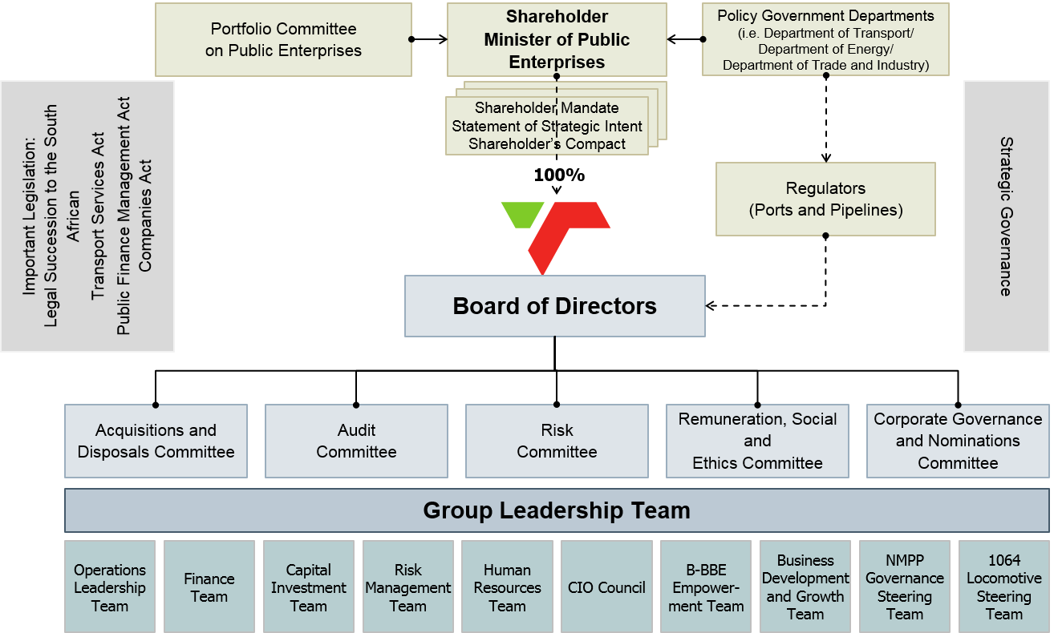
Governance Structure and Relations

Slide 5

Transnet Highlights
1
GROWING REVENUE, EBITDA AND MARGIN
  Transnet continues to deliver strong financial results with 2017/18 EBITDA expected to increase by more than 15%.
2
REGULATED AND TAKE-OR-PAY REVENUE BASE
  59% of Transnet’s revenue secured through regulated entities (TNPA and TPL) and take-or-pay contracts (TFR).
  Regulated entities (33%) and take or pay contracts (40%) represent 73% of the Group’s EBITDA.
3
STRATEGIC ROLE IN THE ECONOMY
Transnet’s integrated system of freight rail, ports and pipelines covers the most economically important freight corridors of South Africa.
4
FINANCIAL STABILITY
Low gearing (<45%), strong cash interest cover (3 times) and a high EBITDA margin (44%) position Transnet well for future growth opportunities.
5
ECONOMIC AND DEMOGRAPHIC GROWTH ON THE CONTINENT POSITIONS IT WELL FOR THE FUTURE
Increasing rate of trade and globalization across the African continent.
Strong cross–border infrastructure investment opportunities via Transnet International Holdings (TIH).
6
MDS* IS ON TRACK AND TRANSNET 4.0 PROVIDES THE COMPANY A LONG TERM VISION
The MDS remains on track with R153bn invested over the past five years.
Financial stability enables Transnet to continue its capital investment programme and Transnet 4.0 strategy.
*MDS: Market Demand Strategy

Slide 6
Overview volume and financial performance trends
 | 2014/15 | 2015/16 | 2016/17 | 2017/18 LE
VOLUMES
General freight (GFB) (mt) | 90.6 | 84.0 | 88.1 | 93.0
Export coal (mt) | 76.3 | 72.1 | 73.8 | 77.0
Export iron ore (mt) | 59.7 | 58.1 | 57.2 | 60.0
Total rail volumes (mt) | 226.6 | 214.2 | 219.1 | 230.0
Containers (TPT) ('000 TEUs) | 4 571 | 4 366 | 4 396 | 4 600
Petroleum (Mℓ) | 17 186 | 17 426 | 16 978 | 17 021
FINANCIALS (R million)
Revenue | 61 152 | 62 167 | 65 478 | 73 062
EBITDA | 25 588 | 26 250 | 27 557 | 31 530
Capital investment | 33 565 | 29 561 | 21 438 | 23 147
Total assets | 328 439 | 356 393 | 351 635 | 367 785
Total borrowings | 110 377 | 134 517 | 124 780 | 125 461
RATIOS
EBITDA margin (%) | 41.8 | 42.2 | 42.1 | 43.2
Gearing (%) | 40.0 | 43.1 | 44.4 | 43.4
Cash interest cover (times)* | 3.2 | 3.0 | 2.8 | 2.7-3.0
Return on total average assets (%) | 6.4 | 3.7 | 4.6 | 5.5
Net debt/EBITDA (times) | 3.7 | 4.1 | 4.2 | 3.8
Issuer Rating | Moody’s | Standard and Poor’s
Foreign currency rating | Baa3/ratings under review | BB/stable outlook
Local currency rating | Baa3/P-3/ratings under review | BB+/stable outlook
National scale rating (NSR) - long and short term | Aa1.za/Aa3.za/P-1.za | zaAA+/zaA-1+
BCA/SACP | baa3 | bbb-
* Excluding working capital changes.

Slide 7

Transnet of tomorrow: Responding to key trends through Transnet 4.0
Trends affecting the logistics sector
 | DIVERSIFICATION INTO LOGISTICS VALUE-ADDED SERVICES | INDUSTRY CONSOLIDATION | DIGITISATION OF OPERATIONS | THE ‘UBERISATION’ OF FREIGHT
OPPORTUNITIES WE ARE PUSHING | New value added services to existing customer base and beyond | Transnet to partner/acquire small/niche SA logistics players | Digitised value-add services to customers and lowering operating costs | New Transnet business offering ‘asset light’ products and services
Transnet 4.0 growth clusters: R100bn revenue by 2020
Freight solutions
World-class, customer-centric end-to-end freight solutions:
Added capabilities and partnerships to enhance general freight positioning (4PL)
Africa dimension – port and rail concessions
Foster regional trade
Advanced manufacturing
Africa’s own rail, ports and transport OEM
  Customer focused packaged
  asset life cycle solutions
  (design, finance, building, maintain, replace)
Elements and Opportunities from the 4th Industrial Rev.
Connecting and Computing power | Enabled real time asset and service quality monitoring
Analytics and intelligence | Optimised resource planning & predictive maintenance
Human-machine interfaces | Improved safety, accountability and capability building
Digital-physical transformation | Improved manufacturing productivity and inventory mnmt
Infrastructure and
spatial solutions
Logistics eco-systems to enable and accelerate economic growth:
Port and inland hubs
Optimise local, national and regional freight logistics networks
Split core and leveraged
Liquids and gas
Access and distribution of liquid and gas energy resources:
Liquefied natural gas (LNG) opportunity
Energy opportunities
Digital
Leveraging and monetising freight
and infrastructure related digital capabilities
  Examples: fibre and telecoms, data solutions, information driven businesses
Key initiatives for expanding markets
Sales-to-Market and segment specific strategies Service Improvements in support of strategic brand positioning Authentic pursuit of service excellence Promote innovation and creative approaches to market identification, market entry and service delivery

Slide 8

2018/19 Corporate Plan: We have taken a conservative view on South Africa’s macro-economy as it relates to GDP outlook
Medium-term outlook
2.1
2.4
  Some stronger growth is expected over the medium term in a stable economic environment. Latest BER indications reflect GDP growth of 1.4% for 2018. However we kept the conservative view (October 2017) on GDP growth for the 5- year plan.
SA GDP (%)
1.6
1.9
0.9
18/19
19/20
20/21
21/22
22/23
CPI (%)
  CPI was 4,0% in February 2018, down from 4,4% in January 2018. CPI is expected to moderate over the next 5 years, and remain within the upper-end of the 3%-6% target band.
4.8
5.1
5.4
5.7
5.7
Interest rates (prime) (%)
  Prime interest rates were reduced to 10.0% on 28 March 2018 and are expected to stabilize in the medium term.
  However, the weighted average cost of debt for Transnet is expected to increase due to the credit downgrade. The budget is based on 11.02% compared to average of 9.9% the last three years.
  10.3
  10.3
  10.3
  10.3
  10.3
R/$
  12.4
  12.6
  12.6
  13.1
  13.4
  The Rand is expected to remain stable against major currencies over the medium term.
Source: January 2018

Slide 9
2018/19 Corporate Plan: Business assumptions included in Financial Plan
  TNPA and TPL will not be corporatised during the corporate planning period (National Ports Act amended). The requirements of the Integrated Coastal Management (ICM) Act that expropriates National Ports Authority assets will be amended;
  Tariffs for both National Ports Authority and Pipelines will continue to be regulated. The Ports Regulator of South Africa (PRSA) will grant National Ports Authority an increase in line with expectations and National Energy Regulator of South Africa (Nersa) will continue to grant TPL tariff increases in terms of the established tariff methodology;
  Freight Rail and Port Terminals are free to set market-related tariffs without any economic regulation; and
  The R1.4 billion debt owed by the Passenger Rail Agency of South Africa (“PRASA”) will be paid and settled in full during 2018/19 (+120 days: R1 040 million)
  Execution of the Capital Investment Plan is efficient and effective at optimal cost levels (capital cost optimisation) and in line with budget.
A change in any of the assumptions will require a change in the Financial and Funding Plan execution to ensure the gearing and cash interest cover ratios are not breached.

Slide 10
2018/19 Corporate Plan: General Freight Volumes
+11,2
(12,0%)
GFB (mt)
Latest estimate
2018/19 Corporate Plan
  104,2
  111,3
  117,6
  121,0
  125,0
12.0% YoY growth mostly derived from domestic coal (non-Eskom), mineral mining, chrome, agriculture and bulk.
  93,0
2017/18 LE
2018/19
2019/20
2020/21
2021/22
2022/23
.
Agriculture and bulk liquid (mt)
Containers & Automotive (mt)
Cement & steel (mt)
+14.0%
+4.9%
+5.2%
11.2
11.8
12.3
12.6
12.9
10.2
10.7
11.3
11.6
12.1
12.5
16.3
17.1
17.2
17.3
17.4
17.8
9.8
2017/18 LE
2018/19
2019/20
2020/21
2021/22
2022/23
2017/18 LE
2018/19
2019/20
2020/21
2021/22
2022/23
2017/18 LE
2018/19
2019/20
2020/21
2021/22
2022/23
Coal (excl RBCT exports) (mt)
Mineral Mining & Chrome (mt)
Manganese (mt)
+17.1%
Aligned with customer contracts
+26.8%
-4.2%
24.6
27.7
30.0
30.3
32.7
26.9
29.6
32.2
33.9
34.1
14.3
13.7
13.7
14.2
14.7
15.0
19.4
23.0
2017/18 LE
2018/19
2019/20
2020/21
2021/22
2022/23
2017/18 LE
2018/19
2019/20
2020/21
2021/22
2022/23
2017/18 LE
2018/19
2019/20
2020/21
2021/22
2022/23
2017/18 LE = Latest estimate at the time of finalizing the 2018/19 Corporate Plan

Slide 11
2018/19 Corporate Plan: Rail, Port and Pipeline Volumes
Latest estimate
2018/19 Corporate Plan
.
Export coal (mt)
Export iron ore (mt)
Containers - Ports (million TEUs)
+3,0%
0,0%
0,0%
  77,0
  77,0
  77,0
  77,0
  79,0
  79,0
  60,0
  60,0
  60,0
  60,0
  60,0
  60,0
  4,9
  5,0
  5,2
  4,5
  4,6
  4,8
2017/18 LE
2018/19
2019/20
2020/21
2021/22
2022/23
2017/18 LE
2018/19
2019/20
2020/21
2022/23
2022/23
2017/18 LE
2018/19
2019/20
2020/21
2021/22
2022/23
Budget capped at 95% of 81.0mt take or pay contract.
Could exceed target when 81.0mt investment is completed.
Export iron ore volumes capped at terminal capacity constraints.
Additional 3.0mt can be railed once TPT’s environmental license is resolved.
Growth in the port container market adjusted in line with the current economic outlook.
Total dry bulk - Ports (mt)
Vehicles (‘000 units)
Petroleum (billion liters)
+2,3%
+4,8%
+2,9%
  192,7
  195,0
  196,7
  17,0
  17,5
  17,2
  17,7
  17,5
  18,1
  176,1
  180,1
  185,1
2017/18 LE
2018/19
2019/20
2020/21
2021/22
2022/23
2017/18 LE
2018/19
2019/20
2020/21
2021/22
2022/23
2017/18 LE
2018/19
2019/20
2020/21
2021/22
2022/23
Total dry bulk is expected to grow with 2.3%.
Growth in automotive market adjusted in line with the performance in vehicle sales.
A growth of 2.9% in petroleum volumes is expected in 2018/19 and the budget includes bi-annual refinery shut-downs.
2017/18 LE = Latest estimate at the time of finalizing the 2018/19 Corporate Plan
* GLT budget = 2018/19 Corporate Plan budget + stretch targets

Slide 12
2018/19 Corporate Plan: EBITDA profile
Latest estimate
2018/19 Corporate Plan
TFR (Rbn)
TE (Rbn)
TNPA (Rbn) (excl clawback)
6.8
7.0
7.4
7.8
8.2
8.7
+16.6%
>100%
+2.6%
2017/18
LE
2018/19
2019/20
2020/21
2021/22
2022/23
2017/18
LE
2018/19
2019/20
2020/21
2021/22
2022/23
2017/18 LE
2018/19
2019/20
2020/21
2021/22
2021/23
16.6% y-o-y growth to 2018/19 in line with the 241.2mt volume target and stringent cost management.
EBITDA for 2018/19 expected to grow to R101 million due to budgeted external sales.
In line with tariff application based on volume outlook and capex spend.
TPT (Rbn)
TPL (Rbn) (excl clawback)
TP* (Rbn)
0.9
1.0
0.6
0.7
0.8
0.6
+11.5%
+42.1%
+13.3%
2017/18
LE
2018/19
2019/20
2020/21
2021/22
2022/23
2017/18
LE
2018/19
2019/20
2020/21
2021/22
2022/23
2017/18 LE
2018/19
2019/20
2020/21
2021/22
2022/23
11.5% increase to 2018/19 in line with volume forecasts and budgeted tariff increase.
In line with tariff application based on volume outlook and capex spend.
Targeted improvement in property portfolio without significant restructuring.
*Excluding profit on disposals
TGC (Rbn)
TCC# (Rbn) (opex)
Group (Rbn) (including clawback)
37.9
41.7
44.4
48.8
53.6
+2.6%
31.5
(2.4)
(2.5)
(2.6)
+20.2%
(2.8)
(2.9)
(3.1)
2017/18 LE
2018/19
2019/20
2020/21
2021/22
2022/23
2017/18
LE
2018/19
2019/20
2020/21
2021/22
2022/23
2017/18 LE#
2018/19
2019/20
2020/21
2021/22
2022/23
TGC developed and implemented interventions to ensure it’s overhead cost structure is cost effective and in line with the reduced capital investment plan.
Budget reflects TCC optimization and stringent cost management initiatives.
20.2% growth is mainly due to volume increases in rail and ports sector backed by stringent cost management.
# Excluding Group-wide provisions .
2017/18 LE = Latest estimate at the time of finalizing the 2018/19 Corporate Plan

Slide 13
2018/19 Corporate Plan: Capital investments
CAPEX – (Rbn)
Latest estimate
2018/19 Corporate Plan
+11%
  38,6
  36,1
163,7
  25,6
  30,1
33,3
  23,1
2017/18 LE
2018/19
2019/20
2020/21
2021/22
2022/23
5-Year Total
Capital investment summary: Business unit allocation (Rm)
Capital investment summary: Major projects included in portfolio (Rm)
(1) Including loco and wagon copex performed by TE
(2) Manufactured by TE
Principles applied in crafting the capital investment portfolio:
      Key safety and regulatory investment projects to be prioritised first.
      Loco maintenance contracts to commence after warranty period.
      Deferred scope of NMPP to be funded through industry partnerships.
      New business, international and digital projects (mostly in feasibility stage) are allocated and limited to the R20.0bn (R15.0bn for the next 5 years) Transnet 4.0 war chest.
      Prioritise critical capital investments to sustain the business, improve service delivery and expansion projects in execution.
Comparative capex profile (Rbn):
2017/18 CP
(12.5)
(8.9)
2018/19 CP
101.5
89.0
  172.6
  163.7
3-Year Comparative
5-Year Comparative
2017/18 LE = Latest estimate at the time of finalizing the 2018/19 Corporate Plan

Slide 14
2018/19 Corporate Plan: Funding requirements
Cash surplus/(shortfall) after capital investments, plus loan redemptions and contingencies
(R billion)
Cash surplus/(shortfall)
Loan redemptions
Contingencies
(0,4)
  (5,4)
Limitations to raise debt despite technical affordability
Continued negative SOC narrative
Worsening SA Inc. outlook will deter investment
Continued breakdown of Dealer Panel’s market making ability
Tightened liquidity in the domestic market
  (6,8)
  (6,4)
  (7,1)
(6,3)
(17,0)
(8,0)
(12,7)
(13,1)
(11,1)
(0,7)
(15,5)
(0,3)
(18,2)
(17,4)
(18,8)
2018/19
2019/20
2020/21
2021/22
2022/23
Sources of funding (Rm)
R million | 2018/19 | 2019/20 | 2020/21 | 2021/22 | 2022/23
Commercial Paper | 2 055 | 3 000 | 2 500 | 2 700 | 2 870
Domestic Bonds | 2 000 | 2 000 | 5 000 | 5 300 | 5 000
DFI’s/ECA’s/GMTN | 4 483 | 3 000 | 8 000 | 6 173 | 7 000
Bank Loans/Other | 7 000 | 4 739 | 3 294 | 4 000 | 2 545
TOTAL | 15 538 | 12 739 | 18 794 | 18 173 | 17 415

Slide 15



2018/19 Corporate Plan: Key financial ratios
Ratio | Range (investment grade) | 2017/18 LE | 2018/19 CP Budget | 2019/20 | 2020/21 | 2021/22 | 2022/23
Cash interest cover | >2.5 | 2,7 | 2,5 | 2,7 | 2,9 | 3,1 | 3,3
Gearing | <50,0 | 43,4 | 43,5 | 43,5 | 43,0 | 42.7 | 40,9
Net debt / EBITDA | <4,0 | 3,77 | 3,32 | 3,18 | 3,11 | 2,98 | 2,72
FFO / Debt | >15,0 | 15,1 | 16,7 | 18,2 | 20,4 | 21,2 | 24,5
Debt / EBITDA | <4,0 | 3,9 | 3,4 | 3,3 | 3,2 | 3,1 | 2,8
EBIT/Interest expense | >1,0 | 1,3 | 1,5 | 1,6 | 1,8 | 1,8 | 2,0
FFO/Debt | >13,0 | 15,7 | 18.5 | 19,9 | 21.4 | 22.1 | 26.1
Debt / EBITDA | <4,0 | 3,8 | 3,3 | 3,2 | 3,1 | 3,0 | 2,7
FFO/Cash interest Coverage | >2,5 | 2.1 | 1.9 | 2.0 | 2.3 | 2.3 | 2.7
The Group Leadership Team is implementing a number of initiatives (not included in the conservative 2018/19 budget) to create further headroom in the financial ratios:
Diversification of Africa revenue streams through Transnet International Holdings (R1bn target);
Disposal of non-core properties (R1bn target);
New growth opportunities (TPL volume growth, integrated supply chain (diesel), Ngqura Waste Treatment, Island View lease, PSPs and fibre network) (R750m target); and
Improved rail tariff/yield mix (R500m target).
2017/18 LE = Latest estimate at the time of finalizing the 2018/19 Corporate Plan

Slide 16
Should funding be a challenge over the medium-term, Transnet will reduce the capital investment portfolio further
Revised capex profile (Rbn)
The current sub-investment grade economic climate is negatively impacting the liquidity in the debt markets. We have identified a number of measures that, to the extent necessary, can be implemented to mitigate this situation:
The capital investment profile for the first three years of the plan can be reduced by up to R22 billion by applying existing project prioritisation principles;
A forced reduction in capital investment levels will have a knock-on impact on projected volumes, possibly limiting growth rates to that of forecasted GDP growth. Operating expenditure will be reduced to maintain EBITDA margins. We are already implementing processes to critically review the need for all planned operating expenditure;
The continued management of working capital requirements through a number of already identified initiatives aimed particularly at reduced debtor and inventory levels (the Company is already actively pursuing concepts such as consignment stock);
There are a number of opportunities to further diversify the sources of funding that must be pursued; and
Accelerate the sale of non-core properties and/or identifying appropriate partnerships to extract value from under-utilised property assets.
If necessary, the Company is able to implement the above-mentioned initiatives that will reduce the funding requirement by as much as R18,1 billion for the first three-year period of the plan, which will reduce the funding requirement to only that needed to re-finance the maturing of existing debt.
Given the above, management is confident that there is sufficient flexibility in both the capital investment and operating plans to be able to adjust and pull the necessary levers to ensure that the Company does not experience any going concern and/or liquidity issues.
2018/19 Corporate Plan
Constrained funding
(8,1)
(8,3)
(5,6)
  33,3
  30,1
  25,6
  22,0
  25,0
  20,0
2018/19
2019/20
2020/21
Revised funding requirement (Rbn)
2018/19 Corporate Plan
Constrained funding
4,6
6,7
6,8
  (6,0)
  (10,3)
  (12,7)
  (11,7)
  (14,8)
  (18,5)
2018/19
2019/20
2020/21

Slide 17
2018/19 Corporate Plan: Safety, Environmental and Transformation KPI’s
Disabling injury frequency rate (DIFR) % |  | Transnet is committed to providing a safe and healthy working environment for all its stakeholders.
Cost of Risk (As a % of revenue) |  | The Company will strive to reduce the cost of risk as a percentage of revenue.
Carbon emissions >(YoY improvement kgCO2 /ton) |  | Year-on-year carbon emission reduction is expected to be >0.6 kgCO2/ ton for the next five years.
Employment Equity |  | The Company aims to continue structured initiatives to implement affirmative action measures to achieve Employment Equity (EE) targets and goals as set out in the EE Plan.
2018/19
2019/20
2020/21
2021/22
2022/23
2018/19
2019/20
2020/21
2021/22
2022/23
2018/19
2019/20
2020/21
2021/22
2022/23
Designated Categories (%) | 2018/19 | 2019/20 | 2020/21 | 2021/22 | 2022/23
Black | 89,0 | 90,0 | 90,0 | 90,0 | 90,0
Females at Group Leadership Team | 47,7 | 50,0 | 50,0 | 50,0 | 50,0
Females at Extended Leadership | 37,0 | 40,0 | 40,0 | 40,0 | 40,0
Females below Extended Leadership | 32,3 | 35,0 | 35,0 | 35,0 | 35,0
People with disabilities | 3,2 | 3,3 | 3,3 | 3,3 | 3,3

Slide 18
2018/19 Corporate Plan: The Human Capital strategy focusses on skills development and personnel retention
Planned intakes per annum (skills required)
Artisan trainees
Engineering trainees
Technician trainees
Sector specific
1 718
1 605
1 660
1 502
1 552
1 052
1 105
1 160
1 218
1 002
2018/19
2019/20
2020/21
2021/22
2022/23
Key initiatives
Deliver learning and development initiatives for targeted segments.
Design an integrated learning and development strategy to support the Transnet 4.0 while delivering on the MDS outcomes.
Total Headcount*
2018/19
2019/20
2020/21
2021/22
2022/23
*Headcount includes permanent staff only.

Slide 19
2018/19 Corporate Plan: World-class enterprise and supplier development remains the key socio-economic contributor
Targets (%)
2017/18 LE
2018/19
0%
+5%
+20%
0%
+20%
1,25
1,50
Local content
Skills development
SD value
Technology transfer / IP
Investment in plant
Enterprise and Supplier Development (ESD)
  Transnet partnered with Wits University to establish the Innovation and Research Centre for Black Entrepreneurs and Black Owned SMMEs;
  Implementation of Phuhliso Funding Programme – Providing funding to black-owned, black women-owned and black youth-owned small and medium-sized enterprises (SMEs) in the Ekapa Colony (Western Cape, Eastern Cape and Northern Cape) as well as guarantee facilities nationally;
  Transnet and Seed Academy established an ICT incubation program for black owned start-ups by providing practical training, mentoring and hands-on incubation to accelerate growth and success of start-up businesses;
  Establishment of Military Veterans Incubation Centers in KwaZulu Natal and Eastern Cape;
  Transnet partnered with FurnTech to offer business incubation and / or skills development in furniture manufacturing. This is focused specifically on People living with Disabilities in Limpopo Province; and
  Transnet Shanduka Black Umbrellas Programme: Port Elizabeth, Richards Bay, Lephalale and Burgersfort.
For the 2018/19 Transnet will be focusing on the following initiatives to better focus on Transnet’s Core Operations as per the Enterprise and Supplier Development Strategy, namely:
  To have fully operational Transnet Mega Hubs in: Saldanha Bay, Empangeni and Tubatse;
  To establish Supplier/Industrial Parks within Mega Hubs focusing on Textile sector (PPE), Testing Engineering/Fabrication components (FAI), Specialized Ports Driving services;
  To establish Manufacturing Supplier Park in Koedoespoort;
  To establish Youth Tooling Initiative;
  To participate in the Global Entrepreneurship Africa 22 ON Sloane for Transnet Black Youth Owned Suppliers;
  To establish the National Gazelles Programme for Transnet Suppliers;
  To conduct market research in the Vessel Building, Dredgers and Tugboats industry to improve the participation of black owned SMMEs;
  To establish Maritime SMME development Partnerships;
  To establish Youth and People with Disabilities development partnership with NEF (supplier Readiness Programme); and
  To establish Financial grants programme for TPT suppliers.
.

Slide 20
2018/19 Corporate Plan: Social stewardship
Transnet Foundation’s key programme spend (R million)
+7%
2018/19
2019/20
2020/21
2021/22
2022/23
Key initiatives planned for 2018/19
Socio-economic development
  Provide effective and efficient developmental initiatives in the health, education, employee volunteerism, sport and socio-economic infrastructure sectors that will contribute towards the transformation of South African communities.
  Business integration and alignment
  Deliver innovative developmental programmes in targeted Transnet communities based around mega projects to mitigate risks and threats against Transnet operations and assets;
  Evolve the key CSI initiatives, portfolios and operations to implement a CSI strategy that benefits communities located close to the mega projects from Transnet’s capital expenditure; and
  Collaborate with the schools of rail, engineering, maritime and security under the Transnet Academy, as well as Operating Divisions, to enable an integrated approach towards community development.

Slide 21
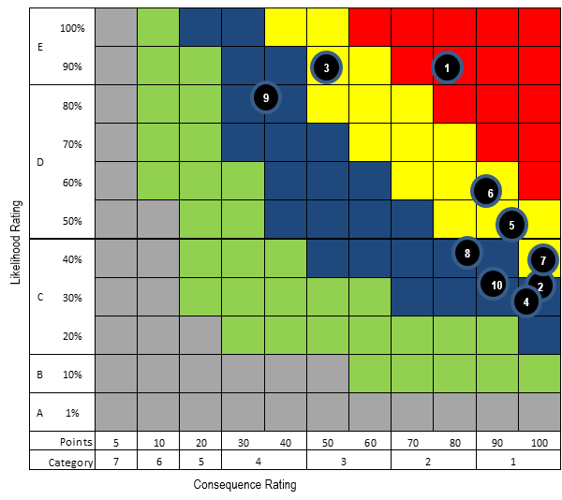
2018/19 Corporate Plan: Top 10 Strategic Risks
Ranking
Risk number and description
Pricing risk- High cost of rendering freight service is rendering price uncompetitive in certain commodities
Not realising the benefits from the capital investments
Deterioration in macro-economic environment due to global economic slowdown and slow recovery leading to capital projects becoming non-viable, including funding challenges
Inability to attract and sustain additional volumes as new capacity is created and to protect current volumes against new entrants, customer activism
Misalignment between operational readiness and new assets
People management – inadequately skilled staff in operations, not skilled for future operations
Inefficiencies in the value chain leading to lower volumes and financial instability
Changes in the regulatory environment (i.e. economic, technical and compliance) – spending on Capex based on assumptions that may be negatively impacted by subsequent changes in regulation
Inadequate ICT infrastructure and technology to enable business and to deal with disruptive innovation
Sustainability risks - energy supply, water shortage and adverse weather patterns
1
6
3
5
7
8
2
4
10
9

Slide 22
Conclusion
Transnet continues to deliver strong financial results despite the challenging economic environment:
    2017/18 EBITDA up by more than 15%
    Gearing at <45% and cash interest cover at 3 times are well within loan covenant requirements.
The Company has demonstrated sound resolve in the continued implementation of the MDS, by enforcing strong financial controls and continues to borrow on the strength of its balance sheet, without government guarantees.
The Group Leadership Team (GLT) and the Board are taking bold steps in reaction to changing market conditions in a pro-active way by:
  Reverting to a 5-year capital investment plan to ensure agility in medium-term planning and further reducing the portfolio from R172.6 billion to R163.7 billion (5-year comparative to 2017/18 Corporate Plan) through a robust capital prioritisation framework;
  Continued focus on cost-containment initiatives, operational efficiency improvements as well as securing diversified and new revenue streams.
Through financial agility, operational unity and perpetual innovation Transnet will continue to aggressively fuel Africa’s growth and develop as the leading provider of innovative supply chain solutions.

