Slide 1
Parliamentary Portfolio Committee on Environmental Affairs Public Hearings on the National Environmental Management Laws Amendment Bill
25-04-2018
Date : 25 April 2018
Time : 13:00 – 13:30
Venue : Good Hope Chamber, Good Hope Building

Slide 2
Transnet Comment re Ad Clause 5(b)
Ad Clause 5(b) of the Bill provides that a section 24G application may be submitted by a person in control of, or successor in title to, land on which a person has commenced with a listed or specified activity without an environmental authorisation.
This is concerning in that organs of state, by way of example, own vast vacant land throughout the country. Most of such vacant land is in obscure areas, making it impossible for landowners to monitor land usage and deploy security personnel to control access to such land.
There are instances where illegal activities are conducted on such land, which landowners has neither sanctioned or are aware of. Having regard to this potential risk, Transnet is of the view that the current section 24G(1) of the National Environmental Management Act, 1998 (“NEMA”) is sufficient in that the responsibility to apply Section 24G should be with the person who commenced with listed activities and not the person in control or successor in title to land.
2

Slide 3
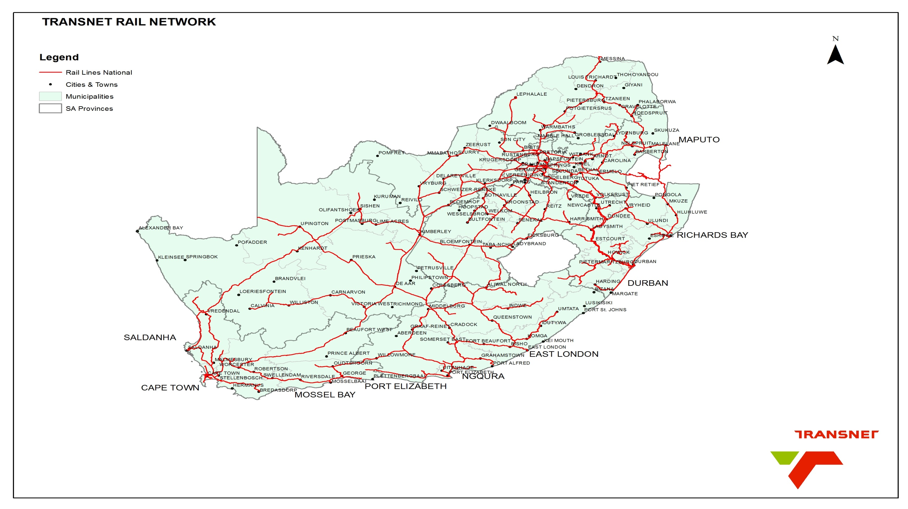

Slide 4
Transnet Comment re Ad Clause 5(b)
Example
The Department of Economic Development, Environmental Affairs and Tourism (“DEDEAT”) issues a notice in terms of Section 31L in respect of the commencement of listed activity without an Environmental Authorization at farm 45/1, Komga Magisterial District in the Eastern Cape Province. The listed activity which was said to have commenced without Environmental Authorization is “The excavation and removal of soil, sand or rocks in excess of 5m³ from a watercourse (natural spring) undertaken with the intention of constructing a dam”.
The site in which the alleged transgression occurred belongs to Transnet Freight Rail;
Illegal occupation by the community.
The bio-physical environment in which the activity was carried out was largely characterized by existence of wetland system which was impacted. The excavated soil from the wetland was used to build a barrier to block water flows from one section of the wetland to create a pan for livestock drinking;
The activity was carried out by the construction company Aristopix (Pty) Ltd which was contracted by community members of Draaibosch to construct a dam;
Neither Aristopix nor the community applied for the Environmental Authorisation from a Competent Authority; and
No request was presented by any of the community members or Aristopix representative(s) to Transnet for accessing the site and carrying out of the activity.
4

Slide 5
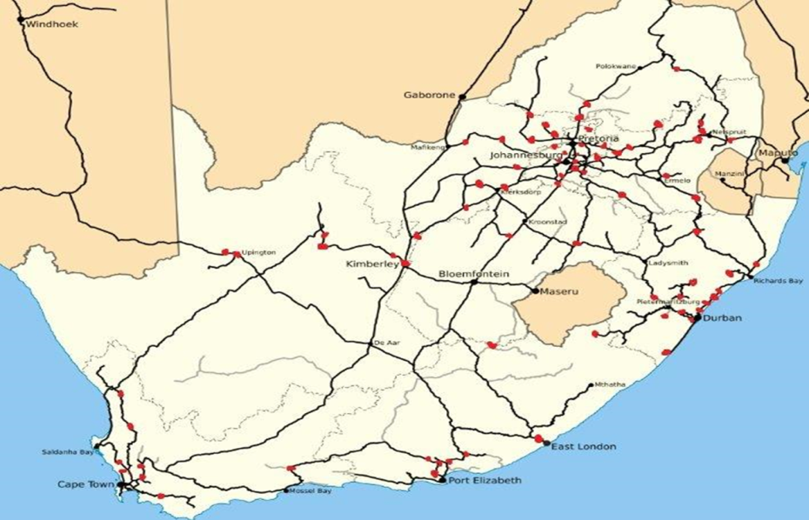
Transnet Comment re Ad Clause 5(b)
Informal Settlements on TFR Land Per Province
5

Slide 6
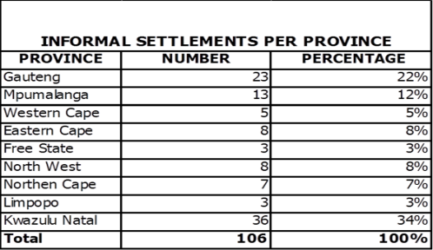
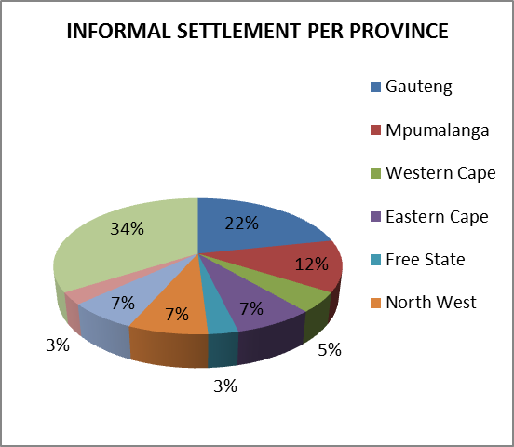
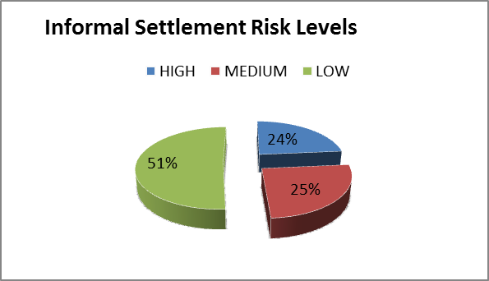
Transnet Comment re Ad Clause 5(b)
Informal Settlements on TFR Land Per Province
INFORMAL SETTLEMENT RISK LEVELS
HIGH | 25 | 24%
MEDIUM | 27 | 25%
LOW | 54 | 51%
Total | 106 | 100%
6

Slide 7
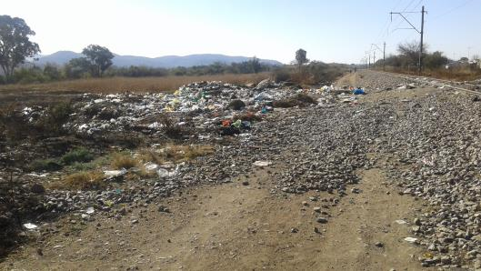
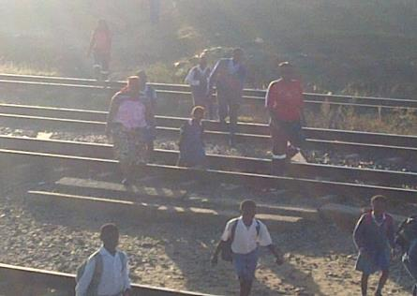
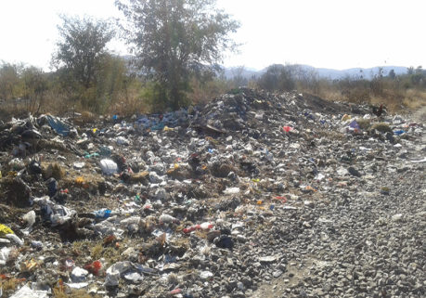
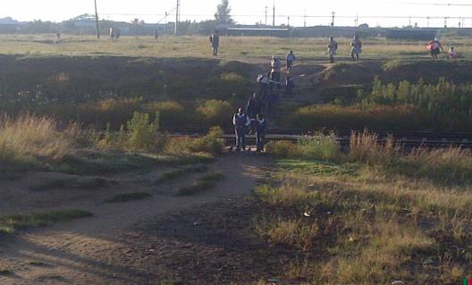
Transnet Comment re Ad Clause 5(b)
Informal Settlements on TFR Land Per Province
7

Slide 8
Transnet Comment re Ad Clause 5(b)
Illegal occupation has increased significantly since January 2018.
Engagements are taking place with various municipalities. Discussions are required at provincial and national level pertaining to this, due to the safety and security concerns with regard to the railway operations.
This proposed amendment will hold the landowner responsible where illegal occupation occurs.
8

