Slide 1
Department of Small Business Development (DSBD)
Briefing to the Portfolio Committee
DSBD 2018/19 Annual Performance Plan
Date: 25 April 2018

Slide 2
Outline
Reflection and Context for the 2018/19 APP
Part A: Strategic Overview
Strategic Framework
Situational Analysis
External Environment
Organisational Environment
Planned Policy Initiatives
Overview of 2018/19 Budget and MTEF Estimates
Part B: Programme Plans
Administration
Sector Policy and Research
Integrated Cooperatives Development
Enterprise Development and Entrepreneurship
Links to other plans

Slide 3
REFLECTION
Context for the 2018/19 Annual Performance Plan (APP)

Slide 4
Establishment of the Department
The establishment of the Department of Small Business Development (DSBD) is grounded in the National Development Plan (NDP)
The NDP aims to eradicate poverty, increase employment and reduce inequality by 2030. The NDP lays the foundation for long-term planning for this radical socio-economic agenda over the next 20 years. Its implementation will be a people-driven process to which everyone is able to contribute. Where appropriate, the plan will be adapted to meet changing conditions and incorporate key learnings.
Hence a dedicated department was established towards advancing the development of sustainable SMME’s and Cooperatives as key levers for job creation and the reduction of poverty and inequality; and with a specific focus on youth, women and people with disabilities, especially in rural areas and townships; as well as high-growth businesses with the potential to be catapulted to the centre of the mainstream economy to disrupt the concentration and structure of the economy
The Proclamation of DSBD in July 2014 included the designation as the Executive Authority for the Small Enterprise Development Agency (Seda)
The Economic Development Department (EDD) legally remains the Executive Authority of the Small Enterprise Finance Agency (sefa), a subsidiary of the Industrial Development Corporation (IDC). With effect October 2015, this public entity functionally reports to DSBD as its Executive Authority through an MoA between the Minister in line with a Cabinet directive and decision. However, this arrangement remains clumsy as the entity is required to report to two Portfolio Committees and Shareholder Compacts are unduly delayed because it has to be approved by the Boards of sefa and IDC and two (2) Ministers

Slide 5
Establishment of the Department
DSBD’s establishment was effected in terms of the process outlined by the guidelines on the National Macro Organisation of the State (NMOS) which determined that functions and resources be transferred from the Department of Trade and Industry to DSBD
Core Functions:
To comprise of the Broadening Participation Division (approximately 60 posts), the Industrial Development Incentives Administration Division (approximately 49 posts of which 30 from the Black Business Supplier Development Programme and 19 from the Cooperatives Incentive Scheme), the Trade and Investment South Africa (26 posts of the Export Development & Support), Consumer and Corporate Regulation Division (47 contract posts)
Subsequent to the written commitment to transfer a component of the Export Development and Support, due to a lack of understanding on the part of the DSDB and the dti at the time, 5 posts earmarked were not transferred on an assumption that SMMEs and Coops will never be ready of benefit from Export and Trade
The initial number agreed to as per the documentation was 189 posts but the final total employees transferred was 160. However, 45 of these posts (CCRD) never reflected on the DSBD establishment. Effectively only 115 posts were transferred (excludes Ministry support staff).
Programme 1 (Administration)
The initial indication by the dti of 10% of Programme 1 posts, constituted 50 posts
The outcome of the analysis of the de facto transfer is as follows:
15 posts were received
DSBD require an extra 24 posts in Programme 1
This number will still not equal the initial agreement of 50 posts
Challenge: In addition to the mandate of the Department being far greater than core business programmes transferred, the NMOS process remains incomplete. It has been indisputably concluded all the functions (staff and budgets) were not transferred to DSBD rendering the Department vulnerable to failure. DPSA is leading this process of resolving this tension.

Slide 6
Establishment of the Department
DSBD is one of the youngest departments established 4-years ago at the start of the term of the 5th Administration
The complexity of establishing an effective and efficient department is often underestimated. It requires inter alia:
Compliance with multiple Public Service and National Treasury frameworks, regulations and protocols
Right-sizing a given team from another department versus recruiting a fit-for purpose and mandate team
Building an understanding of the new mandate, sense of cohesion and commitment to a shared vision
Engendering work ethic around the public service motto of ”We belong. We care. We serve.”
Embracing a growing mandate and demand while delivering results with the same resources
Nonetheless the department, which only started operating as Budget Vote 31 on Small Business on 1 April 2015, is proud of achieving:
Ushered in our understanding of the Small Business Mandate since 2015 which has transformed into the Portfolio Approach which we currently employ
Two successive unqualified audit reports with significantly less audit findings in 2016/17 as compared 2015/16
Reducing the vacancy rate of 23% as 30 Sep-2015 to 11.9% at 31 March 2018
Exceeding the standard of 50% women in SMS positions since 2015/16
Achieved 100% payment of valid invoices within 30 days
Challenge: The department still has a long-way (2-3 years) to before it will stabilise. While its APP is determined by its budget, aspirational milestones include:
Approval and implementation of the final structure including the filling of DDG positions
Conclusion of the 2014 NMOS process and additional Cost of Employment budget to continue reskilling, development and recruitment of specialist skills like research, economic modelling, monitoring and evaluations; programme design, proposals writing, project management; a cadre with business acumen and an entrepreneurial philosophy
Institutionalised culture of compliance
A conducive organisational culture of respect, collegiality and service
Automated client interface systems to improve turnaround times and reduce time spent office bound

Slide 7
NDP and DSBD Mandate
The NDP envisions that if its full range of its recommendations are implemented, by 2030
The South African (SA) economy will grow at 5% per annum
With 60-80% of this the value being generated by SMMEs and expanding businesses.
Unemployment will be reduced to 6%
Through the creation of 11 million jobs with 90%, or 9.9 million, of new jobs the being created by SMMEs and expanding businesses
The establishment of DSBD in 2014 is one of the most concrete manifestations of the above NDP aspirations. It is mandated “to lead and coordinate an integrated approach to the promotion and development of entrepreneurship, small businesses and co-operatives, and ensure an enabling legislative and policy environment to support their growth and sustainability.”
DSBD has understood that the above targets would not be delivered by the department on its own. Instead it needed to vigorously champion its mandate so as to mobilise and coordinate resources and support from the entire ecosystem in service of the NDP targets
Notes:
l

Slide 8
Implementation of the DSBD Mandate
Within a relatively short period, the department effectively became the ‘big voice’ for small businesses, cooperatives, informal, rural and township businesses.
There is broad consensus that SMMEs can be engine of a growing and inclusive economy. All indicators are that this is do-able. As a result
January 2015: Government adopted the Nine-Point Plan to grow the economy, with “Unlocking the potential of SMMEs, cooperatives, informal, rural and township businesses” as one of the pillars of this Plan. DSBD is mandated to coordinate, guide, monitor and report on the performance of all government departments in advancing this priority. This has seen the emergence of sector strategies to advance SMMEs, e.g., ICT, Tourism, Public Employment and Human Settlements.
August 2017: Cabinet adopted the 2018/19 Mandate Paper which will inform the seven (7) government-wide budget priorities with effect from the 2019/20 financial year, first among these is “Job creation and small business development.”
February 2018: Unlocking a R2.1billion fund for SMMEs and Innovation as announced by the Minister of Finance
Notes:
l

Slide 9
2018/19 Cabinet Mandate Paper/Budget Priorities
JOB CREATION & SMALL BUSINESS DEVELOPMENT | LAND REFORM & AGRICULTURAL DEVELOPMENT
Implement 30% set-aside; Localisation; Integrated community development and community-based workers | Fast-track restitution settlement & redistribution; Implement farmer support; transform wildlife economy; Off-take agreements for SMMEs & cooperatives.
YOUTH DEVELOPMENT | COMPREHENSIVE SOCIAL PROTECTION, EDUCATION & SKILLS
Business opportunities for youth incl. internet; Capacitate youth enterprises, also in tourism & hospitality; Upscale labour intensive programmes, internships, learnerships & artisans | Implement NHI & HIV/Aids & TB Plan; Expand ECD (Integrated approach to health, social & learning elements); Different pathways to work; Free education for poor; Expand student accommodation
INFRASTRUCTURE SPENDING | INTEGRATED PLAN TO FIGHT CRIME
Maintain real infrastructure spend; Revitalise Township Industrial Parks & technology innovation hubs; Expand Agriparks; Rural roads, broadband & water infrastructure; Maintenance, also local. | Combat violent protests; Integrated Criminal Justice System & National Identification System; Fight corruption & economic crimes; Finalise border management and deployment
REGIONAL INTEGRATION & DEVELOPMENT
Advancing national interest – SADC, BRICS & Indian Ocean Rim Association
Notes:
l

Slide 10
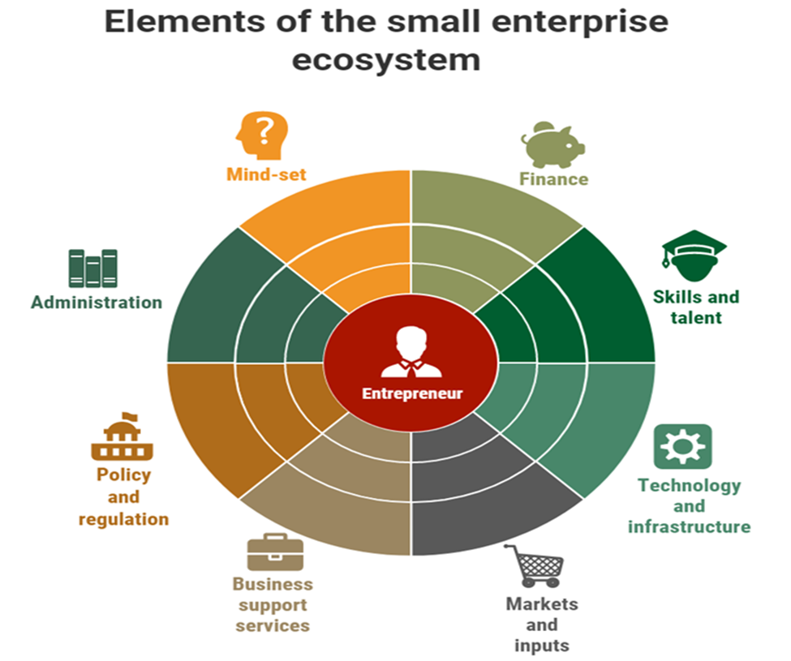
Ecosystem: SMME Perspective
Research commissioned confirmed the need to establish a sound Ecosystem to support entrepreneurs and that all elements of the entire ecosystem must be mobilised to resolve the challenges faced by SMMEs and Coops

Slide 11
Ecosystem: DSBD Perspective
DSBD approached its mandate, to mobilise and coordinate support for SMMEs and Cooperatives, from its own perspective of the Ecosystem based on the levers in its control as a National Department
State Owned Entities
Organised Business and Chambers
Development Finance Institutions
Schools
LED (Municipalities)
1. Access to development finance
2. Access to information support and resources offered by government and private sector
3. Access to training relevant to the life-cycle of businesses
4. Access to local and international markets including enterprise and supplier development
5. Mind-set: shift from Employee to Entrepreneur
6. Access to Infrastructure
7 Uncoordinated & fragmented government support inhibiting impact.
Inhibitors to the growth and sustainability of SMMEs & Coops
National Departments
Provincial Departments
Business Advisors & Mentors
Education & Training providers
Civil Society

Slide 12
Building a sound Small Business Ecosystem
In addition to the impact of championing the DSBD mandate on government policy decisions, as reflected in earlier slides, the Department has both mobilised and disrupted the existing ‘big business ecosystem’
Organised Business Formations: Multiple meetings with individual organisations and invitations to address the events of these structures, culminated in a Ministerial Consultative Forum with organised business, creating the platform for a social accord
Academic and Research Institutions: The main outcome of three Roundtables with academia, resulted in consensus and a commitment to strengthen entrepreneurship in tertiary education
Local Government: The Department initiated the inaugural National Local Economic Development (LED) Conference, co-hosted with COGTA on 9-10 November. As a result of this, LED has been placed at the centre of the Back-to-Basics Programme. We have a draft MOA with COGTA. The Ministers are working together, evidence that a sound intergovernmental relations platform which has been established.
Notes:
the Ogranisied Business Secto. l

Slide 13
Building a sound Small Business Ecosystem
Business Advisors: Research confirms that SMMEs exposed to Business Advisors have a far greater chance of success than those who do not have this exposure. Hence the Department co-hosted the Inaugural International Conference on Business Advising: The outcome of this is that the 50 000 strong community of business advisors, consultants and mentors, used by the entire government system, has now requested that the Department to lead the regulation and professionalization of this cadre.
Showcasing the talents of ICT SMMEs through partnership with and the co-hosting of Demo Africa 2017. 30 ICT SMMEs participated in an 8-week Bootcamp to refine their products after which they competed of the grand prize of 5 SMMEs being provided with an internship in Silicon Valley. One of the winners is a South African demonstrating that our SMMEs can be competitive in the 4th Industrial Digital Revolution environment and lead innovation in this space.
International Support: The Department has unlocked a 5-year Euro 52m fund for the “Employment Promotion through SMME’s Support Programme for the Republic of South Africa”. The Department leads the project implementation.
Challenge: The Department does not have a Partnership Management and Market Access policy or correctly skilled, dedicated capacity to drive this unit of work. The EU programme includes a dedicated Technical Assistance Team and the EU is keen to support the building and establishment of a Programme Management Unit in the department
Notes:
the Ogranisied Business Secto. l

Slide 14
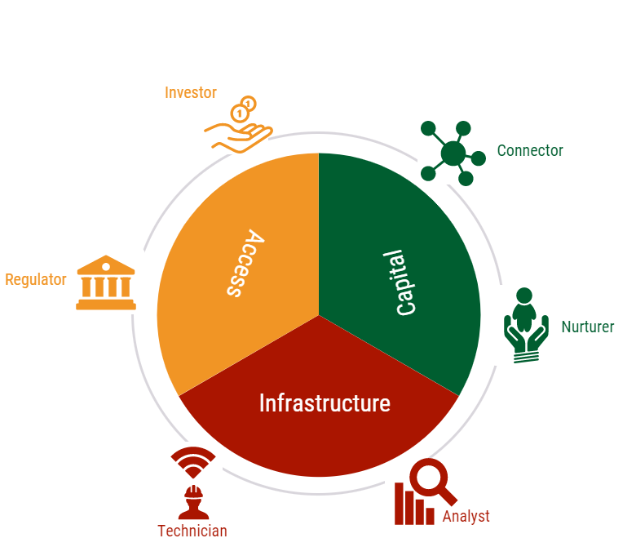
Building a Sound Ecosystem
The Department has to undergo a paradigm shift to be more effectively geared for roles it must play going forward in order to lead the construction of a vibrant and agile small business ecosystem

Slide 15
Part A: Strategic Overview

Slide 16
Strategic Framework

Slide 17
Strategic Framework
LEGISLATIVE and REGULATORY REQUIREMENTS
Constitution of the Republic of South Africa, 1996 (Act No 108 of 1996): Chapter 5, Section 92 on Accountability and Responsibilities of the Ministers and Deputy Ministers. Constitution of the Republic of South Africa, 1996 (Act No 108 of 1996): Chapter 10, Section 195 on Basic values and principles governing public administration. Public Finance Management Act (1999) – Chapter 4 on National Budgets. Treasury Regulations – Chapter 5, 6 and 30 (read in conjunction with Sections 38 (1) (a) (i) and 76 (4) (e) of the PFMA) in relation to Strategic Planning and Budgeting. Chapter 1, Part 3B of the Public Service Regulations, 2001 in relation to strategic planning, organisational structure and promotion of efficient, economic and effective human resource planning

Slide 18
Strategic Framework
AIM AND PURPOSE
To support the radical transformation of the economy through the promotion and development of sustainable and competitive entrepreneurs, small businesses and co-operatives, that contribute to job creation and economic growth.
MANDATE
To lead and coordinate an integrated approach to the promotion and development of entrepreneurship, small businesses and co-operatives, and ensure an enabling legislative and policy environment to support their growth and sustainability.
VISION
A radically transformed economy through integrated and effective enterprise development and entrepreneurship promotion.
MISSION
The coordination, integration and mobilisation of efforts and resources towards the creation of an enabling environment for the growth and sustainability of small businesses and co-operatives.

Slide 19
Approach to Implementing the Mandate
Balancing the dichotomy of supporting established SMMEs with high growth-potential and survivalist start-up, and informal businesses.
Growth-focussed Support
Established SMMEs with scope to grow
Greater employment multiplier
Greater ROI and sustainability for financing activities
Long-term higher impact on sustainable job creation
Transitioning SMMEs into the Black Industrialists with the Gazelles programme as he conduit
Poverty Reduction
Focus on micro and informal enterprises
Priority is sustainable livelihoods for the poorest in society
Focuses resources on the areas of greatest need
Lower employment multiplier
Greater promotion of social cohesion and economic dignity
Amplifies the pro-poor agenda
While the breadth of the mandate means that DSBD does not have the luxury of focussing purely on one or the other, a balance must be found.

Slide 20
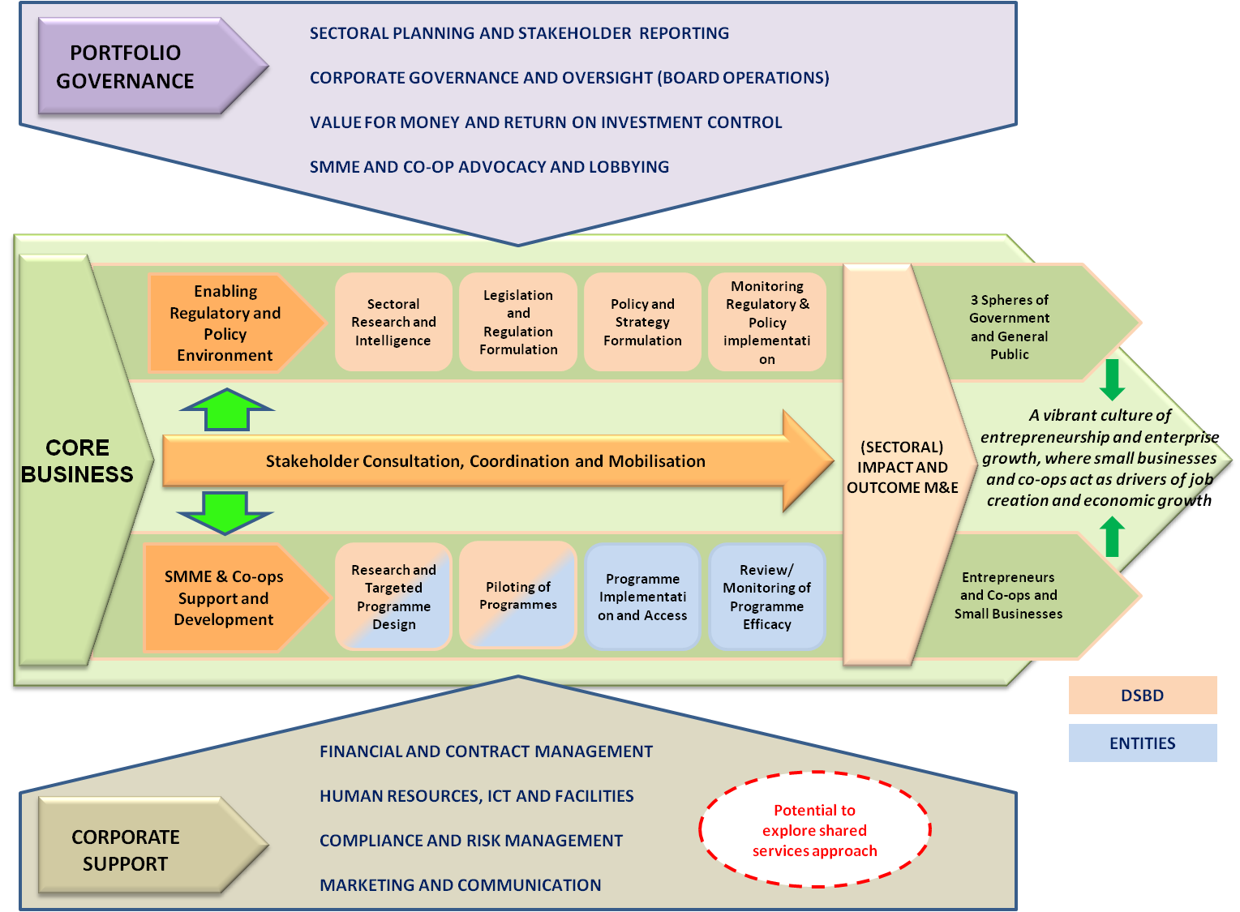
Value Chain Approach

Slide 21
Strategic Framework
 | Strategic Goals | Strategic Objectives
1. | Policy and planning coherence in the sector, that promotes an enabling ecosystem for SMME’s and co-operatives. | 1.1. Reduced regulatory burdens and a conducive legislative and policy environment for SMME’s and co-operatives. 1.2a An integrated approach to planning, monitoring and evaluation of the Cooperatives Sector, to inform policy decision making. 1.2b An integrated approach to planning, monitoring and evaluation of the SMME’s development sector, to inform policy decision making. 1.3. A comprehensive research agenda on key areas of support for SMME’s and co-operatives implemented. 1.4. Strengthened efforts to place SMME’s at the centre of the economic diplomacy agenda.
2. | Equitable access to responsive and targeted products and services that enable the growth and development of SMME’s and co-operatives. | 2.1.a. Oversight and coordination of the design and implementation of targeted financial support programmes to support new and existing co-operatives. 2.1.b. Oversight and coordination of the design and implementation of targeted financial support programmes to support new and existing SMME’s. 2.2.a. Oversight and coordination of the design and implementation of targeted non-financial support programmes to support new and existing co-operatives. 2.2.b. Oversight and coordination of the design and implementation of targeted non-financial support programmes to support new and existing SMME’s.

Slide 22
Strategic Framework
 | Strategic Goals | Strategic Objectives
3. | An enhanced contribution to socio-economic development outcomes by the sector. | 3.1. Demonstrated progress towards sector-wide SMME’s and co-operatives support achieving its intended socio-economic impact. 3.2.a. Sustainable partnerships to support the co-operatives development agenda. 3.2.b. Sustainable partnerships to support the SMME development agenda. 3.3: Informed and empowered communities and a responsive department
4. | Sound governance and the optimal utilisation of available resources. | 4.1 Demonstrated progress towards sector-wide SMME’s and co-operatives support achieving its intended socio-economic impact. 4.2a. Sustainable partnerships to support the co-operatives development agenda. 4.2.b. Sustainable partnerships to support the SMME development agenda. 4.3. Informed and empowered communities and a responsive department.
5. | A professional and capacitated SBD Sector | 5.1. Coordinated development of the skills pool across the sector 5.2. Strengthened human resource capability and a high performing organisation.

Slide 23
Strategic Framework
VALUES
Innovation
Living this value means that we will seek to:
Integrity
Professionalism
Living this value means that we will seek to:
Display a commitment to being “radical” in what we do;
Foster innovative ideas and solutions in order to deliver exceptional results; and
Continuously seek new and better ways to serve our clients.
Behave with integrity in all our actions, always acting in the best interest of the organisation.
Ensure open and transparent communication; and
Uphold ethical, honest behaviour;
Consistently honour our commitments;
Living this value means that we will seek to:
Serve with utmost respect, competence and professional mannerism;
Display punctuality, reliability, dependability and a commitment to meet deadlines; and
Cooperate with all role players.
Living this value means that we will seek to:
Living this value means that we will seek to:
Customer Centric
Commitment
Place customer service excellence at the centre of everything we do;
Create a nurturing environment by partnering with our clients and employees, and in the way in which we care and support them;
Always be available and accessible in providing public services to our society; and
Understand customer needs and respond timeously, efficiently and effectively to customer queries and requests.
Do what is needed to get the work done;
Be selfless, resolute, purposeful and steadfast;
Be committed to efforts of job creation, alleviating poverty and reducing inequality; and
Display a solution-driven attitude, and commitment to serve.

Slide 24
Situational Analysis

Slide 25
External Environment
Key shifts and emerging issues informing 2018/19 planning
(Considerate of NDP, MTSF and 9-Point Plan)
To strengthen the regulatory environment and ease of doing business.
As a portfolio (in collaboration with entities), ensure improvement in the support provided to SMMEs and Co-operatives (especially youth-owned enterprises).
Continue to strengthen collaboration with all stakeholders and sector role-players.
Assess ICT systems/needs utilised across the portfolio towards integration.

Slide 26
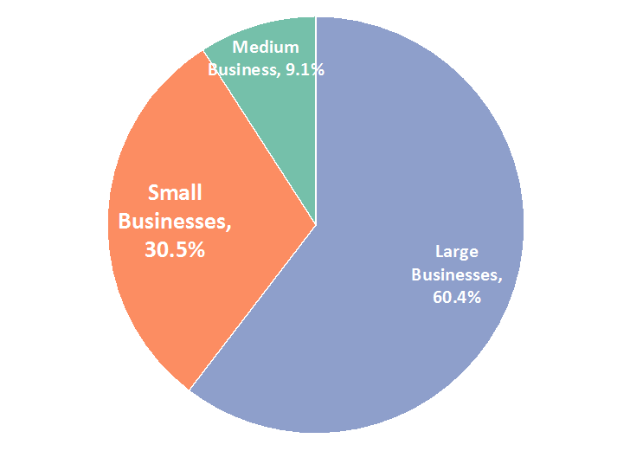
External Environment
Emerging Development Factors and Trends in Small Business & Co-operatives
The figure above reflects the significant contribution of registered small and medium enterprises to the total turnover of the private sector.
Source: Calculated by StatsSA from Quarterly Financial Statistics, December 2016

Slide 27
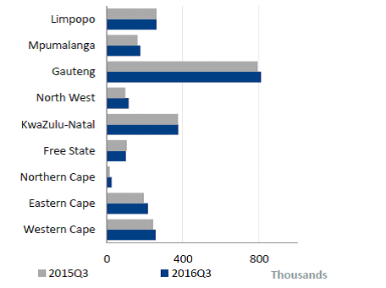
External Environment
Number of SMMEs in South Africa
The number of SMME’s in South Africa continues to trend upwards and by Q3 2016 the total number of SMME’s had increased to 2.34 million, a 4% year-on-year increase on the 2.25 million SMME’s in Q3 2015.
Source: BER Stellenbosch University, (StatsSA data)

Slide 28
External Environment
Where are small businesses making a contribution
*Enterprises with a VAT turnover of less than R2 000 000 are excluded from this survey
Source: Quarterly Financial Statistics December 2016

Slide 29
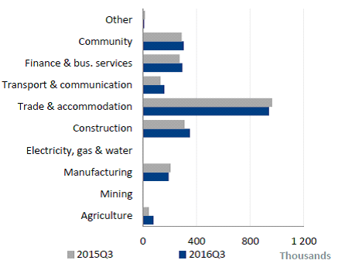
External Environment
SMMEs in the Service Industry
Reflected in the above figure, over the period Q3 2015 – Q3 2016, SMME’s in services fell by an average of 2.7%, primarily due to a drop in the number of SMME’s in the largest services industry – trade and accommodation. However, there were increases in the number of SMME’s in the other service industries.
Source: BER Stellenbosch University, (StatsSA data)

Slide 30
Organisational Environment

Slide 31
Organisational Environment
The Department reviewed its internal environment by reflecting on:
Organisational performance against the Strategic Plan and the Annual Performance targets since establishment of Department.
Performance Enemies: Key reasons for not achieving the set targets in 2016/17 and part of 2017/18.
The human, financial and technological challenges affecting performance.
Together with the Entities, the Department developed a Small Business Development Portfolio Strategic Approach to foster integrated planning and implementation, evaluate and review the delivery processes, services and products in response to the needs of stakeholders; and, to consolidate recommendations from Department of Monitoring and Evaluation (DPME) and National Treasury on the role of the Department as distinct from the roles of the public entities as the implementing agencies.
Redesign of the organisational structure and alignment to the mandate and approved budget structure for 2018/19 Financial Year is complete. The finalisation of the redesign is undertaken in consultation with Department of Public Service and Administration (DPSA) and National Treasury (NT)

Slide 32
Budget Programme Structure
Programme NO. | Programme Name | Sub-Programmes
Programme 1 | Administration | Ministry Departmental Management (Office of the DG) Corporate Management Financial Management Communications and Marketing
Programme 2 | Sector Policy and Research | Research Policy and Legislation (including IGR and Coordination) International Relations and Trade Promotion Monitoring and Evaluation
Programme 3 | Integrated Co-operatives Development | Co-operatives Development Co-operatives Programme Design and Support Supplier Development and Market Access Support
Programme 4 (New Programme in 2018/19) | Enterprise Development and Entrepreneurship | Enterprise and Supplier Development SMME Programme Design and Support SMME Competitiveness Entrepreneurship

Slide 33
ORGANISATIONAL STRUCTURE
MINISTER OF SMALL BUSINESS DEVELOPMENT
DEPUTY MINISTER OF SMALL BUSINESS DEVELOPMENT
DIRECTOR-GENERAL
DEPARTMENT OF SMALL BUSINESS DEVELOPMENT
CHIEF DIRECTORATE: FINANCIAL MANAGEMENT SERVICES
CHIEF DIRECTORATE: CORPORATE MANAGEMENT
BRANCH 2: SECTOR POLICY & RESEARCH
BRANCH 3: INTEGRATED COOPERATIVES DEVELOPMENT
BRANCH 4: ENTERPRISE DEVELOPMENT & ENTREPRENEURSHIP
CHIEF DIRECTORATE: GOVERNANCE & EXECUTIVE SUPPORT
DIRECTORATE: INTERNAL AUDIT
SUB-DIRECTORATE: RISK, ANTI-CORRUPTION & INTEGRITY MANAGEMENT

Slide 34
Planned Policy Initiatives

Slide 35
Planned Policy Initiatives
Policy | Intent
National Small Business Act (No. 102 of 1996 | Continue with the amendment of the Act in order ct to take into account latest shifts and trends in global and national economic and small business environment, and best practice in terms of small business development approaches. In the process of ensuring its alignment to the act, the Department will seek to identify gaps, in partnership with industry, in pursuit of covering all aspects of required support to the small business sector.
Integrated Strategy on the Promotion of Entrepreneurship and Small Enterprises | The evaluation of this Strategy having been concluded by DPME in Mar-18, DSBD can commence the review the Integrated Strategy on the Promotion of Entrepreneurship and Small Enterprises, in order to remain relevant and to accommodate recent economic activities and business cycles, and respond to identified trends and opportunities. The review will primarily be informed by the Improvement Plan which will be crafted in response to the findings and recommendations of the Evaluation Report; and to design programmes that are flexible and responsive to the vision of achieving radical economic transformation.
Midterm Review of the Co-operatives Strategy (2012-20220: | Conclude th Midterm Review of the Co-operatives Strategy (2012-2022), which may result in a revision of the Strategy and will inform the development of an integrated approach to co-operatives development.
Monitoring and Reporting Framework on the 30% Set-Aside Policy | The 2017 Public Sector Supply Chain Review confirmed that, in 2016/17, government spent over R700 billion on the procurement of goods and services, as well as construction works. If a 30% of that money were to be directed to SMME’s, as it is now provided for in the 2017 Regulations of the Preferential Procurement framework Act, it would make a significant contribution to the sustainability of the SMME and cooperatives sector. Apart from supporting by National Treasury) in the development of th new Publc Procurement Act , DSBD will develop guidelines as well as a monitoring and reporting framework to guide departments as to their engagement with this important matter.

Slide 36
Overview of Budget and
MTEF Estimates

Slide 37
Overview of 2018/19 Budget and MTEF Estimates
Programme (R’000) | Audited Outcome |  |  | Main Appropriation | MTEF
 | 2014/15 | 2015/16 | 2016/17 | 2017/18 | 2018/19 | 2019/20 | 2020/21
Administration | 22 376 | 66 447 | 98 925 | 121 597 | 124 729 | 134 448 | 143 216
Sector Policy and Research | 11 707 | 11 692 | 13 848 | 18 107 | 22 413 | 23 546 | 25 031
Integrated Cooperatives Development | 88 821 | 89 727 | 92 568 | 106 799 | 111 034 | 117 743 | 124 674
Enterprise Development and Entrepreneurship | 1 002 632 | 931 026 | 991 700 | 1 229 259 | 1 230 277 | 2 298 715 | 2 426 530
TOTAL | 1 125 536 | 1 098 892 | 1 197 041 | 1 475 670 | 1 488 453 | 2 574 452 | 2 719 451

Slide 38
Total Budget Allocation 2016 - 2019

Slide 39
Economic Classification of 2018/19 Budget and MTEF Estimates
Programme | Audited Outcome |  |  | Main Appropriation | MTEF
(R’000) | 2014/15 | 2015/16 | 2016/17 | 2017/18 | 2018/19 | 2019/20 | 2020/21
Compensation of Employees | 73 753 | 93 133 | 114 022 | 132 452 | 140 810 | 151 808 | 163 297
Goods and Services | 27 130 | 44 320 | 64 638 | 71 518 | 80 257 | 84 423 | 89 003
Transfers and Subsidies | 1 023 042 | 958 249 | 1 015 396 | 1 266 146 | 1 261 598 | 2 332 247 | 2 460 879
Payments for Capital Assets | 1 611 | 3 190 | 2 985 | 5 554 | 5 788 | 5 973 | 6 270
TOTAL | 1 125 536 | 1 098 892 | 1 197 041 | 1 475 670 | 1 488 453 | 2 574 451 | 2 719 449

Slide 40
Main Pressure Points
Compensation of Employees (CoE):
a)
Initial 2018/19 COE allocated R141,356 million.
R141,153 million committed (estimated at 7% annual adjustment)
Consists of 210 permanent posts
Decreased to R140.810 million for 2018/19 (as communicated in March 2018).
Shortfall of 343,000 due to decrease in compensation budget
Should the annual adjustment be less than 7% at 6% the Department will be within the COE budget at 139,834 million.
b) Resourcing the proposed functional structure
Require additional 70,523 million
Result in overall COE budget of R211, 333 million
Consists of 103 new posts – total of 313 posts
To be increased with approximately 35 new posts per annum over the medium term to allow for recruitment and selection processes.

Slide 41
Main Pressure Points (cont)
2. Goods and services: The 2018/19 budget is R80.257 million allocated as follows:
APP targets are allocated R18.799 million (23.4%)
ICT requirements: WAN/LAN/PBX: R3.598 million
25 Facilitated interactions with communities: R2.8 million
Recruitment targets: R550 thousand
AGSA Audits: R4.1 million
Research, Impact assessments: R8.251 million
Non APP targets are allocated R15.485 million (19.3%)
Investigations, SITA resource support services, ICT requirements: R8.574 million
LED and IDP engagements, Implementation business architecture to support SMMEs, Consultancy services, related costs: R6.642 million
Operational overheads are allocated R43.095 million (53.7%), mainly utilised for:
Office accommodation: R18.340 million
Travel and accommodation: R20.622 million
Training and development: R1.4 million
Change management: R1.8 million
Communication costs: R400 thousand
Transversal systems (BAS, Logis, Persal): R250 thousand

Slide 42
2018/19 Economic Classification
Economic Classification | 2018/19 R'000 | % Proportion
Compensation of Employees | 140 810 | 9.5%
Goods and Services | 80 257 | 5.4%
Transfers and Subsidies | 1 261 598 | 84.8%
Payments for Capital Assets | 5 788 | 0.4%
TOTAL | 1 488 453 | 100.0%

Slide 43
Transfers
Of the R1.448 billion allocated to the Department divided as follows: :
Seda is allocated R769.452 million (51.7%)
IDC receives R10 million (0.7%) whilst
DSBD remains with R709.001 million (47.6%) of the total allocation
Transfers and subsidies account for R1.262 billion (84.8%) of the allocated budget
DSBD is responsible administering and disbursing R482.146 million (38.2%) whilst (38.2%)million whilst
Seda is allocated R769.452 million (61%)
IDC is allocated R10 million (0.8%) of the allocated transfers and subsidies as illustrated below:
Area of allocation | 2018/19 | 2019/20 | 2020/21 | Proportion to total Transfers
SEDA | 769 452 | 815 861 | 854 167 | 61.0%
DSBD | 482 146 | 1 505 826 | 1 595 571 | 38.2%
IDC | 10 000 | 10 560 | 11 141 | 0.8%
Total Transfers | 1 261 598 | 2 332 247 | 2 460 879 | 100.0%

Slide 44
Transfers: details
Details |  | 2018/19 | 2019/20 | 2020/21 | TOTAL 2018 MTEF
Small Enterprise Development Agency | SEDA | 580 241 | 613 174 | 647 653 | 1 841 068
Small Enterprise Development Agency: Technology programme | SEDA | 144 622 | 152 281 | 160 261 | 457 164
Small Enterprise Development Agency: Capacity Building Programme | SEDA | 14 589 | 15 406 | 16 253 | 46 248
SEDA Gazelles Programmes | SEDA | 30 000 | 35 000 | 30 000 | 95 000
Total to SEDA |  | 769 452 | 815 861 | 854 167 | 2 439 480
IDC: customised Sector Programme | IDC | 10 000 | 10 560 | 11 141 | 31 701
Total to IDC |  | 10 000 | 10 560 | 11 141 | 31 701
BBSDP | DSBD | 270 953 | 286 126 | 301 863 | 858 942
Co-Operatives Incentive Scheme | DSBD | 83 318 | 87 984 | 92 823 | 264 125
National Informal Business Upliftment Scheme (NIBUS) | DSBD | 73 138 | 73 914 | 84 904 | 231 956
Enterprise Incubation Programme (EIP) | DSBD | 54 737 | 57 802 | 60 981 | 173 520
Enterprise Development Fund | DSBD | - | 1 000 000 | 1 055 000 | 2 055 000
TOTAL DSBD |  | 482 146 | 1 505 826 | 1 595 571 | 3 583 543
TOTAL |  | 1 261 598 | 2 332 247 | 2 460 879 | 6 054 724

Slide 45
PART B: PROGRAMME PLANS

Slide 46
PROGRAMME 1: ADMINISTRATION

Slide 47
Purpose of the Programme
The Programme is responsible for the provision of strategic leadership, management and support services to the Minister, Deputy Minister, Director General, and the Department. This is to ensure the successful implementation of the Department’s mandate through sustainable and integrated support services that are customer driven.
Sub-Programmes:
1. Ministry
2. Departmental Management (Office of the DG)
3. Corporate Management
4. Financial Management

Slide 48
Programme Strategic Goals And Objectives
STRATEGIC GOALS | STRATEGIC OBJECTIVES
Goal 3: Sound governance and the optimal utilisation of available resources. | Strategic Objective 3.1: Compliance and good governance ensured.
 | Strategic Objective 3.3: Efficient, integrated and streamlined business processes and systems.
Goal 4: An enhanced contribution to socio-economic development outcomes by the sector. | Strategic Objective 4.4: Informed and empowered communities and a responsive department.
Goal 5: A professional and capacitated SBD Sector. | Strategic Objective 5.2: Strengthened human resource capability and a high performing organisation.

Slide 49
Programme 1: The Budget and MTEF
Programme 1: Administration (R’000) | Audited outcome |  |  | Adjusted appropriation | Medium-Term Expenditure Estimates
 | 2014/15 | 2015/16 | 2016/17 | 2017/18 | 2018/19 | 2019/20 | 2020/21
Ministry | 22 376 | 29 898 | 29 691 | 33 102 | 29 176 | 30 729 | 32 924
Departmental Management | 0 | 15 232 | 14 514 | 19 312 | 19 976 | 21 041 | 22 489
Corporate Services | 0 | 21 317 | 33 456 | 46 956 | 51 178 | 56 220 | 60 295
Financial Management | 0 | 0 | 14 929 | 15 186 | 17 541 | 19 275 | 19 901
Communications | 0 | 0 | 6 335 | 7 058 | 6 858 | 7 183 | 7 607
Total | 22 376 | 66 447 | 98 925 | 121 614 | 124 729 | 134 448 | 143 216
Economic classification
Current payments | 21 264 | 63 479 | 96 022 | 116 840 | 119 135 | 128 674 | 137 149
Compensation of employees | 11 407 | 34 591 | 52 230 | 65 115 | 67 615 | 72 742 | 78 259
Goods and services | 9 857 | 28 888 | 43 792 | 50 725 | 51 520 | 55 932 | 58 890
Transfers and subsidies | 0 | 0 | 25 | 0 | 0 | 0 | 0
Households |  |  | 25 | 0 | 0 | 0 | 0
Payments for capital assets | 1 112 | 2 968 | 2 878 | 5 774 | 5 594 | 5 774 | 6 067
Transport equipment | 1 080 | 0 | 0 | 3 000 | 0 | 0
Other machinery and equipment | 32 | 2 951 | 2 850 | 2 774 | 5 594 | 5 774 | 6 067
Software and other intangible assets | 0 | 17 | 0 | 0 | 0 | 0 | 0
Payments for Financial Assets |  |  | 28
Total | 22 376 | 66 447 | 98 925 | 121 614 | 124 729 | 134 448 | 143 216

Slide 50
Programme 1: Objectives and MTEF Targets
Strategic Objective | Estimated Performance | Medium Term Targets
 | 2017/18 | 2018/19 | 2019/20 | 2020/21 (New Cycle)
3. Sound governance and the optimal utilisation of available resources
3.1: Compliance and good governance ensured. | 80% (30 of 37 standards) compliance with MPAT standards at level 3. | 100% compliance with MPAT standards at level 3. | 100% compliance with MPAT standards at level 3.5. | 100% compliance with MPAT standards at level 4.
 | <5% variance on annual budget. | <5% variance on annual budget. | <5% variance on annual budget. | <5% variance on annual budget.
 | 100% payments to eligible creditors processed within 30 days. | 100% payments to eligible creditors processed within 30 days. | 100% payments to eligible creditors processed within 30 days. | 100% payments to eligible creditors processed within 30 days.
 | Unqualified audit outcome for both financial and non-financial performance data for 2016/17. | Unqualified audit outcome for both financial and non-financial performance data for 2016/17. | Unqualified audit outcome for both financial and non-financial performance data for 2018/19. | Unqualified audit outcome for both financial and non-financial performance data for 2019/20.
3.3: Efficient, integrated and streamlined business processes and systems. | 1 ICT system project defined in the DSBD ICT Plan implemented. | 2 ICT system projects defined in the DSBD ICT Plan implemented. | 2 ICT system projects defined in the DSBD ICT Plan implemented. (ICT Plan reviewed and aligned to Strategic Plan). | 2 ICT system projects defined in the New DSBD ICT Plan implemented.

Slide 51
PROGRAMME 1: OBJECTIVES and MTEF TARGETS
Strategic Objective | Estimated Performance | Medium Term Targets
 | 2017/18 | 2018/19 | 2019/20 | 2020/21 (New Cycle)
4. An enhanced contribution to socio-economic development outcomes by the sector
4.4: Informed and empowered communities and a responsive department. | 55 facilitated interactions that deliver meaningful engagements with communities and the public. | 25 facilitated interactions that deliver meaningful engagements with communities and the public. | 30 facilitated interactions that deliver meaningful engagements with communities and the public. | 40 facilitated interactions that deliver meaningful engagements with communities and the public.
5. A professional and capacitated SBD Sector
5.2: Strengthened human resource capability and a high performing organisation. | 50% of women SMS representation. | 50% of women SMS representation. | 50% of women SMS representation. | 50% of women SMS representation.
 | 2% of PWD employed. | 2% of PWD employed. | 2% of PWD employed. | 2% of PWD employed.
 | <10% vacancy rate in funded posts. | <10% vacancy rate in funded posts. | <10% vacancy rate in funded posts. | <10% vacancy rate in funded posts.

Slide 52
Programme 1: Risk Identification and Mitigation
Strategic Goal | Strategic Objective | Identified Risk | Mitigation needed
A professional and capacitated SBD Sector | Coordinated development of the skills pool across the sector | Inadequate skills base | Alignment of structure with strategy and Annual Performance Plan
 |  |  | SLA with SITA to be in place as well as secured and independent network infrastructure, telephony and connectivity to SITA
 |  |  | Coordinate compliance with Portfolio Strategic Framework
 |  |  | Considered training, development and recruitment plan
Sound governance and the optimal utilisation of available resources | Sound institutional governance and oversight of the Small Business Development Portfolio | Non- compliance with legislative prescripts and non-application of the good governance principles | Implementation of institutional governance and oversight function through Governance Forums
 |  |  | Cross functional strategic planning for alignment of functions
 |  |  | Consistent and stronger consequence management

Slide 53
PROGRAMME 2: SECTOR POLICY AND RESEARCH

Slide 54
Purpose, Goals and Objectives
The Programme is responsible to create an enabling environment for the development and growth of sustainable small businesses and co-operatives through commissioning research; the development and review of policy and legislation; the coordination and promotion of sound intergovernmental relationships; promoting the sector interests in the regional and global arena; and effective monitoring and evaluation of programmes to ensure the desired impact is achieved in contributing toward the creation of employment and economic growth.
Sub-Programmes:
Research
Policy and Legislation (which includes IGR and Coordination)
International Relations and Trade Promotion
Monitoring and Evaluation

Slide 55
Programme Strategic Goals and Objectives
Strategic Goals | Strategic Objectives
Goal 1: Policy and planning coherence in the sector, that promotes an enabling ecosystem for SMME’s and co-operatives. | Strategic Objective 1.1: Reduced regulatory burdens and a conducive legislative and policy environment for SMME’s and co-operatives.
 | Strategic Objective 1.4: A comprehensive research agenda on key areas of support for SMME’s and co-operatives implemented.
 | Strategic Objective 1.5: Strengthened efforts to place SMME’s at the centre of the economic diplomacy agenda.
Goal 4: An enhanced contribution to socio-economic development outcomes by the sector. | Strategic Objective 4.1. Demonstrated progress towards sector-wide SMME’s and co-operatives support achieving its intended socio-economic impact.

Slide 56
Programme 2: The Budget and MTEF
Programme 2 (R’000) | Audited outcome |  |  | Adjusted appropriation | Medium-Term Expenditure Estimates
 | 2014/15 | 2015/16 | 2016/17 | 2017/18 | 2018/19 | 2019/20 | 2020/21
Research | 0 | 0 | 0 | 0 | 7 521 | 7 628 | 8 493
Policy,and Legislation | 11 707 | 11 692 | 13 644 | 7 229 | 4 852 | 4 947 | 4 940
Monitoring and Evaluation | 0 | 0 | 0 | 6 657 | 2 887 | 3 166 | 3 326
International Relations | 0 | 0 | 204 | 4 112 | 7 153 | 7 805 | 8 272
Total | 11 707 | 11 692 | 13 848 | 17 998 | 22 413 | 23 546 | 25 031
Economic classification
Current payments | 11 640 | 11 675 | 13 813 | 17 998 | 22 357 | 23 490 | 24 975
Compensation of employees | 9 783 | 9 908 | 10 252 | 10 799 | 10 779 | 10 819 | 11 627
Goods and services | 1 857 | 1 767 | 3 561 | 7 199 | 11 578 | 12 671 | 13 348
Transfers and subsidies | 22 | 0 | 0 | 0 | 0 | 0 | 0
Households | 22 | 0 | 0 | 0 | 0 | 0 | 0
Payments for capital assets | 45 | 17 | 35 | 0 | 56 | 56 | 56
Other machinery and equipment | 45 | 17 | 35 | 0 | 56 | 56 | 56
Total | 11 707 | 11 692 | 13 848 | 17 998 | 22 413 | 23 546 | 25 031

Slide 57
Programme 2: Objectives and MTEF Targets
Strategic Objective | Estimated Performance | Medium Term Targets
 | 2017/18 | 2018/19 | 2019/20 | 2020/21 (New Cycle)
1: Policy And Planning Coherence In The Sector, That Promotes An Enabling Ecosystem For SMME’S And Co-operatives
1.1: Reduced regulatory burdens and a conducive legislative and policy environment for SMME’s and co-operatives. | Eight (8) municipalities assisted to roll out SMME’s and co-operatives Red-Tape Reduction Programme. | Twelve (12) municipalities assisted to roll out SMME’s and co-operatives Red-Tape Reduction Programme. | Sixteen (16) municipalities assisted to roll out SMME’s and co-operatives Red-Tape Reduction Programme. | Twenty (20) municipalities assisted to roll out SMME’s and co-operatives Red-Tape Reduction Programme.
 | Two (2) Municipal Action Plans on SMME’s and co-operatives red tape reduction assessed. | Three (3) Municipal Action Plans on SMME’s and co-operatives red tape reduction assessed. | Four (4) Municipal Action Plans on SMME’s and co-operatives red tape reduction assessed. Initiate process for the local review of guidelines. | Complete process for the review of guidelines. Five (5) Municipal Action Plans on SMME’s and co-operatives red tape reduction assessed.
 | Four (4( National business processes and procedures analysed and redesigned per annum. Five (5) Local business processes and procedures analysed and redesigned per annum. | Five (5) SMME’s and co-operatives red tape reduction procedures analysed . | Eight (8) SMME’s and co-operatives red tape reduction procedures analysed | Ten (10) SMME’s and co-operatives red tape reduction procedures analysed .

Slide 58
Programme 2: Objectives and MTEF Targets
Strategic Objective | Estimated Performance | Medium Term Targets
 | 2017/18 | 2018/19 | 2019/20 | 2020/21 (New Cycle)
1: Policy and planning coherence in the sector, that promotes an enabling ecosystem for SMME’s and co-operatives
1.1: Reduced regulatory burdens and a conducive legislative and policy environment for SMME’s and co-operatives. | National Small Business Amendment Bill developed and submitted to Minister. | Amendment of the National Small Business Bill through legislative process. | Amendment of the National Small Business Bill through legislative process. | Amendment of the National Small Business Bill through legislative process.
 | Four (4) National coordinating forum on small business development convened. | Four (4) National coordinating forums on small business development and co-ops convened. | Four (4) National coordinating forum on small business development and co-ops convened. | Four (4) National coordinating forum on small business development and co-ops convened.
1.4: A comprehensive research agenda on key areas of support for SMME’s and co-operatives implemented. | Four (4) research reports on SMME’s and co-operatives key areas of support approved. | Five (5) research reports on SMME’s and co-operatives key areas of support approved. | Six (6) research reports on SMME’s and co-operatives key areas of support approved. | Seven (7) research reports on SMME’s and co-operatives key areas of support approved.
1.5: Strengthened efforts to place SMME’s at the centre of the economic diplomacy agenda. | Multi-year Strategy on International Relations, to advance SA trade positions and mandates that will promote investments and growth of SMME’s and co-operatives, submitted to Minister for approval. | Revised the Multi-year Strategy on International Relations, to advance SA trade positions and mandates that will promote investments and growth of SMME’s and co-operatives | Implementation of the Multi-year Strategy on International Relations, to advance SA trade positions and mandates that will promote investments and growth of SMME’s and co-operatives | Assessment of the Multi-year Strategy on International Relations, to advance SA trade positions and mandates that will promote investments and growth of SMME’s and co-operatives

Slide 59
Programme 2: Objectives and MTEF Targets
STRATEGIC OBJECTIVE | ESTIMATED PERFORMANCE | MEDIUM TERM TARGETS
 | 2017/18 | 2018/19 | 2019/20 | 2020/21 (New Cycle)
2: Equitable access to responsive and targeted products and services that enable the growth and development of SMME’s and co-operatives
2.2. Oversight and coordination of the design and implementation of targeted financial and non-financial support programmes to support new and existing SMME’s. | Annual programme evaluation report on selected financial and non-financial support programmes produced in Q4. | Annual programme evaluation report on selected financial and non-financial support programmes produced in Q4. | Annual programme evaluation report on selected financial and non-financial support programmes produced in Q4. | Annual programme evaluation report on selected financial and non-financial support programmes produced in Q4.
4: An enhanced contribution to socio-economic development outcomes by the sector
4.1. Demonstrated progress towards sector-wide SMME’s and co-operatives support achieving its intended socio-economic impact. | New indicator. | 2018 Annual Small Business Review Report approved for publication submitted to Minister | - | 2020 Annual Small Business Review Report approved for publication by Q3.
 | New Indicator | Draft National Accord to drive the Small Business Mandate | National Accord to drive the Small Business Mandate approved by Minister | Implementation of the National Accord in the new MTSF cycle
 | Development of monitoring framework with reporting templates. | Bi-Annual analysis of Government-wide Procurement Trend. | Bi-Annual analysis of Government-wide Procurement Trend. | Bi-Annual analysis of Government-wide Procurement Trend.

Slide 60
Programme 2: Risk Identification and Mitigation
Strategic Goal | Strategic Objective | Identified Risk | Mitigation needed
1: Policy and planning coherence in the sector, that promotes an enabling ecosystem for SMME’s and co-operatives. | 1.1 Reduced regulatory burdens and a conducive legislative and policy environment for SMME’s and co-operatives. | Resistance from affected stakeholders Resource constraints | Strengthen partnerships with, entities, COGTA, SALGA and provincial stakeholders.
 | 1.2 Integrated approach to planning, monitoring and evaluation of the SMMEs and Co-operatives sector, to inform policy decision making. | Inability to promote coherent planning through legislation and policies. Lack of cooperation by municipalities. | Strengthen partnerships with, entities, COGTA, SALGA and provincial stakeholders. DSBD representation on SEIAS Steering Committee
 | 1.3 A comprehensive research agenda on key areas of support for SMME’s and co-operatives implemented. | Uncertainty on priority sectors to target. Resource constraints. | National Accord with industry and sector prioritisation and approach. Leverage partnerships in Research
2. Equitable access to responsive and targeted products and services that enable the growth and development of SMMEs and cooperatives | Oversight and co-ordination of the design and implementation of targeted non- financial support programme to support new and existing SMMEs and Co-operatives | Non-alignment of SMMEs and Co-operatives programmes with the Department's mandate Absence of /non-compliance with current, relevant and accepted definitions of SMME Non-enactment of the 2014 Coop. Development Act | Strengthen Portfolio and sectorial integrated strategic planning approach and M&E and reporting systems. Finalise, build consensus and issue regulations on new SMME definitions

Slide 61
PROGRAMME 3: INTEGRATED CO-OPERATIVES DEVELOPMENT

Slide 62
Purpose of the Programme
The Programme is responsible to create an enabling environment that facilitates the establishment, growth and development of Co-operatives through the development and review of legislation and policy, the design, piloting and monitoring of the impact of support services and instruments; the championing of functional partnerships and cooperation agreements; and the advocacy and thought leadership in advancing economic growth, job creation and social cohesion. As custodians of the Cooperatives Development Act the Programme is responsible for providing leadership and implementation and governance oversight of the institutional arrangements arising from the Act.
Sub-Programmes:
1. Co-operatives Development
2. Co-operatives Programme Design and Support
3. Supplier Development and Market Access Support

Slide 63
Programme Strategic Goals and Objectives
Strategic Goals | Strategic Objectives
Goal 1: Policy and planning coherence in the sector, that promotes an enabling ecosystem for SMME’s and co-operatives. | Strategic Objective 1.2. An integrated approach to planning, monitoring and evaluation of the Co-operatives Sector, to inform policy decision making.
Goal 2: Equitable access to responsive and targeted products and services that enable the growth and development of SMME’s and co-operatives. | Strategic Objective 2.1. Oversight and coordination of the design and implementation of targeted financial and non-financial support programmes to support new and existing co-operatives.
Goal 4: An enhanced contribution to socio-economic development outcomes by the sector. | Strategic Objective 4.2. Sustainable partnerships to support the co-operatives development agenda.

Slide 64
Programme 3: The Budget and MTEF
Programme 3 (R’000) | Audited outcome |  |  | Adjusted appropriation | Medium-Term Expenditure Estimates
 | 2014/15 | 2015/16 | 2016/17 | 2017/18 | 2018/19 | 2019/20 | 2020/21
Cooperatives Development | 3 393 | 3 949 | 6 847 | 7 976 | 10 728 | 11 871 | 12 667
Cooperatives Programme Design and Support | 85 428 | 85 778 | 76 136 | 90 545 | 94 406 | 99 709 | 105 426
Supplier Development and Market Access Support |  |  | 9 585 | 8 278 | 5 900 | 6 163 | 6 581
Total | 88 821 | 89 727 | 92 568 | 106 799 | 111 034 | 117 743 | 124 674
Economic classification
Current payments | 13 821 | 14 696 | 28 689 | 28 049 | 27 682 | 29 724 | 31 815
Compensation of employees | 11 647 | 13 375 | 23 554 | 22 546 | 19 768 | 21 544 | 23 170
Goods and services | 2 174 | 1 321 | 5 135 | 5 503 | 7 914 | 8 180 | 8 645
Transfers and subsidies | 75 000 | 75 019 | 63 879 | 78 750 | 83 318 | 87 984 | 92 823
Public Corporations | 75 000 | 75 000 | 63 879 | 78 750 | 83 318 | 87 984 | 92 823
Households | 0 | 19 | 0 | 0 | 0 | 0 | 0
Payments for capital assets | 0 | 12 | 0 | 0 | 34 | 35 | 36
Other machinery and equipment | 0 | 12 | 0 | 0 | 34 | 35 | 36
Total | 88 821 | 89 727 | 92 568 | 106 799 | 111 034 | 117 743 | 124 674

Slide 65
Programme 3: Objectives and MTEF Targets
STRATEGIC OBJECTIVE | ESTIMATED PERFORMANCE | MEDIUM TERM TARGETS
 | 2017/18 | 2018/19 | 2019/20 | 2020/21 (New Cycle)
1: Policy and planning coherence in the sector, that promotes an enabling ecosystem for SMME’s and co-operatives
1.2. An integrated approach to planning, monitoring and evaluation of the Co-operatives Sector, to inform policy decision making.. | New indicator. | Four (4) Co-operative Forums convened per annum. | Four (4) Co-operative Forums convened per annum. | Four (4) Co-operative Forums convened per annum.
 | - | 100 Cooperatives and SMMEs linked to market and procurement opportunities in the public sector, state-owned entities and private sector | 100 Cooperatives and SMMEs linked to market and procurement opportunities in the public sector, state-owned entities and private sector | 100 Cooperatives and SMMEs linked to market and procurement opportunities in the public sector, state-owned entities and private sector
 | - | Two (2) Provinces supported to develop aligned provincial co-operatives strategies (Free State, Mpumalanga) | Two (2) Provinces supported to develop aligned provincial co-operatives strategies (North West, Limpopo) | Two (2) Provinces supported to develop aligned provincial co-operatives strategies (Northern cape, Western Cape)
 | New indicator. | Five (5) District municipalities supported to integrate co-operatives support into their Plans. | Ten (10) District municipalities supported to integrate co-operatives support into their Plans. | Fifteen (15) District municipalities supported to integrate co-operatives support into their Plans.

Slide 66
Programme 3: Objectives and MTEF Targets
STRATEGIC OBJECTIVE | ESTIMATED PERFORMANCE | MEDIUM TERM TARGETS
 | 2017/18 | 2018/19 | 2019/20 | 2020/21 (New Cycle)
2: Equitable access to responsive and targeted products and services that enable the growth and development of SMME’s and co-operatives
2.1. Oversight and coordination of the design and implementation of targeted financial and non-financial support programmes to support new and existing co-operatives. | Review of development impact of Co-operatives funded by the DSBD in 2015/16 produced. | Annual assessment on the development impact of co-operatives funded through the Co-operatives supported . | Annual assessment on the development impact of co-operatives funded through the Co-operatives supported | Annual assessment on the development impact of co-operatives funded through the Co-operatives supported.
 | 270 co-operatives supported financially through the CIS. | 122 co-operatives supported financially through the CIS. | N/A (Migrated to Entities) | -
 | 270 co-operatives supported through training. | 122 co-operatives supported through training. | N/A (Migrated to Entities) | -

Slide 67
Programme 3: Risk Identification and Mitigation
Strategic Goal | Strategic Objective | Associated Risk | Mitigation needed
1: Policy and planning coherence in the sector, that promotes an enabling ecosystem for SMME’s and co-operatives. | 1.2. An integrated approach to planning, monitoring and evaluation of the Co-operatives Sector, to inform policy decision making. | Unavailability of stakeholders and lack of programme implementation. The ecosystem rendered more complex through the introduction of more legislation/regulations by other spheres of government | Strengthen Portfolio strategic planning approach, M&E and reporting systems. DSBD representation on SEIAS Steering Committee
2: Equitable access to responsive and targeted products and services that enable the growth and development of SMME’s and co-operatives. | 2.1. Oversight and coordination of the design and implementation of targeted financial and non-financial support programmes to support new and existing co-operatives. | Lack of change management. Possible disruption of service delivery. | Strengthen Portfolio strategic planning approach, M&E and reporting systems. Well-considered capacity building, re-skilling and recruitment of staff
3: An enhanced contribution to socio-economic development outcomes by the sector. | 4.2. Sustainable partnerships to support the co-operatives development agenda. | Non-committal of potential investors and institutions. Delayed availability of funds, reneging on commitments. | Strengthen partnership management. Leverage Economic Cluster Forums and Cabinet.

Slide 68
PROGRAMME 4: ENTERPRISE DEVELOPMENT AND ENTREPRENEURSHIP

Slide 69
Purpose of the Programme
The Programme is responsible to create an enabling environment for the development and growth of sustainable small businesses through the development and review of legislation and policy; the design, piloting and monitoring of the impact of support services and instruments; the promotion of local economic development and entrepreneurship; championing functional partnerships; and advocacy and thought leadership in advancing economic growth and job creation. As custodians of the National Small Business Act, finalise the amendment , implementation and institutionalisation of the Act
Sub-Programmes:
1. Enterprise and Suppler Development
2. SMME Programme Design and Support
3. SMME Competitiveness
4. Entrepreneurship

Slide 70
Programme Strategic Goals and Objectives
Strategic Goals | Strategic Objectives
Goal 1: Policy and planning coherence in the sector, that promotes an enabling ecosystem for SMME’s and co-operatives. | Strategic Objective 1.3 An integrated approach to planning, monitoring and evaluation of the SMME’s development sector, to inform policy decision making.
Goal 2: Equitable access to responsive and targeted products and services that enable the growth and development of SMME’s and co-operatives. | Strategic Objective 2.2 Oversight and coordination of the design and implementation of targeted financial and non-financial support programmes to support new and existing SMME’s.
Goal 3: Sound governance and the optimal utilisation of available resources. | Strategic Objective 3.2 Sound institutional governance and oversight of the SBD Portfolio entities.

Slide 71
Programme 4: The Budget and MTEF Targets
Programme 4 (R’000) | Audited outcome |  |  | Adjusted appropriation | Medium-Term Expenditure Estimates
 | 2014/15 | 2015/16 | 2016/17 | 2017/18 | 2018/19 | 2019/20 | 2020/21
Enterprise Development and Supplier Development | 681 234 | 652 836 | 675 944 | 794 152 | 787 078 | 835 959 | 875 434
SMMEs Programme Design and Support | 288 729 | 235 635 | 282 540 | 268 545 | 290 968 | 1 307 266 | 1 379 581
SMME Competitiveness | 32 669 | 42 555 | 12 816 | 91 023 | 89 427 | 91 141 | 103 487
Entrepreneurship | 0 | 0 | 20 400 | 75 539 | 62 804 | 64 349 | 68 028
Enterprise Development and Supplier Development | 1 002 632 | 931 026 | 991 700 | 1 229 259 | 1 230 277 | 2 298 715 | 2 426 530
Economic classification
Current payments | 54 158 | 47 603 | 40 136 | 41 800 | 51 893 | 54 343 | 58 361
Compensation of employees | 40 916 | 35 259 | 27 986 | 33 992 | 42 648 | 46 703 | 50 241
Goods and services | 13 242 | 12 344 | 12 150 | 7 871 | 9 245 | 7 640 | 8 120
Transfers and subsidies | 948 020 | 883 230 | 951 492 | 1 187 396 | 1 178 280 | 2 244 263 | 2 368 056
Departmental agencies and accounts | 644 398 | 622 835 | 652 914 | 767 301 | 769 452 | 815 861 | 854 167
Public Corporations | 287 302 | 243 625 | 298 409 | 420 095 | 408 828 | 1 428 402 | 1 513 889
Non-profit institutions | 16 320 | 16 726 | 100 | 0 | 0 | 0 | 0
Households |  | 44 | 69 | 0 | 0 | 0 | 0
Payments for capital assets | 454 | 193 | 72 | 0 | 104 | 109 | 113
Other machinery and equipment | 454 | 193 | 72 |  | 104 | 109 | 113
Total | 1 002 632 | 931 026 | 991 700 | 1 229 259 | 1 230 277 | 2 298 715 | 2 426 530

Slide 72
Programme 4: Objectives and MTEF Targets
STRATEGIC OBJECTIVE | ESTIMATED PERFORMANCE |  | MEDIUM TERM TARGETS
 | 2017/18 |  | 2018/19 | 2019/20 | 2020/21 (New Cycle)
1: Policy and planning coherence in the sector, that promotes an enabling ecosystem for SMME’s and co-operatives
1.3. An integrated approach to planning, monitoring and evaluation of the SMME’s sector, to inform policy decision making. |  | Four (4) Stakeholder Forums conducted per annum. | Four (4) Stakeholder Forums conducted per annum. | Four (4) Stakeholder Forums conducted per annum. | Four (4) Stakeholder Forums conducted per annum.
2: Equitable access to responsive and targeted products and services that enable the growth and development of SMME’s and co-operatives
2.2. Oversight and coordination of the design and implementation of targeted financial and non-financial support programmes to support new and existing SMME’s. | Six (6) Informal Business Infrastructure partnership agreements secured. |  | Six (6) Informal Business Infrastructure partnership agreements secured. | Ten (10) Informal Business Infrastructure partnership agreements secured. | Fifteen (15) Informal Business Infrastructure partnership agreements secured.
 | 641 black SMME’s supported through the BBSDP |  | 677 black SMME’s supported through the BBSDP. | N/A (Migrated to Entities) | -
 | 1696 Informal businesses supported through the IMEDP. |  | 1000 Informal businesses supported through the IMEDP. | N/A (Migrated to Entities | -
 | New Indicator |  | 11 SMMEs incubators supported through the Enterprise Incubation Programme (EIP). | N/A (Migrated to Entities). | -

Slide 73
Programme 4: Objectives and MTEF Targets
Strategic Objective | Estimated Performance | Medium Term Targets
 | 2017/18 | 2018/19 | 2019/20 | 2020/21 (New Cycle)
4: An enhanced contribution to socio-economic development outcomes by the sector
4.3. Sustainable partnerships to support the SMME development agenda. | R10m leveraged through partnerships with sector stakeholders per annum | R5m worth of resources leveraged through partnerships with sector stakeholders. | R7.5m worth of resources leveraged through partnerships with sector stakeholders. | R10m worth of resources leveraged through partnerships with sector stakeholders.
5: A professional and capacitated SBD Sector
5.1. Coordinated development of the skills pool across the sector. | New | Draft framework of standards for professionalization of business Advisory services developed | Finalisation of framework of standards for professionalization of Business Advisory services. | -

Slide 74
Programme 4: Risk Identification and Mitigation
Strategic Goal | Strategic Objective | Associated Risk | Mitigation needed
1: Policy and planning coherence in the sector, that promotes an enabling ecosystem for SMME’s and co-operatives. | 1.3. An integrated approach to planning, monitoring and evaluation of the SMME’s development sector, to inform policy decision making. | Unavailability of stakeholders and lack of programme implementation. The ecosystem rendered more complex through the introduction of more legislation/regulations by other spheres of government | Strengthen Portfolio strategic planning approach and M&E and reporting systems. DSBD representation on SEIAS Steering Committee
2: Equitable access to responsive and targeted products and services that enable the growth and development of SMME’s and co-operatives. | 2.2. Oversight and coordination of the design and implementation of targeted financial and non-financial support programmes to support new and existing SMME’s. | Lack of change management. Possible disruption of service delivery. | Strengthened sector consultation in pursuit of consensus on a National Accord Well-considered capacity building, re-skilling and recruitment of staff
3: Sound governance and the optimal utilisation of available resources. | 3.2. Sound institutional governance and oversight of the SBD Portfolio entities. | Non-compliance with PFMA requirements. | Consistent and stronger consequence management Strengthen fraud risk management
4: An enhanced contribution to socio-economic development outcomes by the sector. | 4.3. Sustainable partnerships to support the SMME development agenda. | Non-committal of potential investors and institutions. Absence of/non-compliance with current, relevant and accepted definitions of SMMEs Delayed availability of funds, reneging on commitments. | Strengthen partnering engagements. Finalise, build consensus and issue regulations on new SMME definitions Leverage Economic Cluster Forums and Cabinet.
5: A professional and capacitated SBD Sector. | 5.1. Coordinated development of the skills pool across the sector. | Non-committal of potential investors and institutions. Resource constraints. | Strengthen consultation and partnership management .

Slide 75
PART C: LINKS TO OTHER PLANS

Slide 76
Links To Other Plans
The Department does not have links to the long-term infrastructure and other capital plans.
Conditional Grants are not applicable to the Department.
Two public entities report to the Department through Governance arrangements
Small Enterprise Development Agency (seda)
The Small Enterprise Finance Agency (sefa)
Monitoring of Public Entities:
The Minister, as the Executive Authority (EA) signs Shareholder Compacts with the Chairpersons of Boards, the Accounting Authority (AA)
These Compacts are monitored quarterly through the submission of quarterly reports; quarterly Governance Forums between the DG and CEOs; and, between the EA and the AA; and.
Annually through the tabling Annual Reports by entities.
Public-Private Partnership: There are none as per the National Treasury frameworks, however, the Department has three active PPP’s. One with SAB, one with Nestle, and the third with Property Point, all of which enable market access and offtake agreements for SMMEs and Cooperatives.
Materiality Framework: In place in terms of the Treasury Regulations.

Slide 77
THANK YOU

