Slide 1
Agrément South Africa
www.agrement.co.za
Slide 1
PRESENTATION TO THE PARLIAMENTARY PORTFOLIO COMMITTEE
FOR
THE DEPARTMENT OF PUBLIC WORKS
Strategic Plans, Annual Performance Plans and Budgets for the 2018/19 Financial Year
24 April 2018

Slide 2
Presentation Outline
www.agrement.co.za
Slide 2
Treasury regulations.
Annual Performance Plan overview.
Vision, Mission & Values.
Strategic Oriented Outcomes Goals.
Alignment between Strategic Goals & National Outcomes.
The Building Industry's 4 Levels of legislation.
Organisational environment.
Programme performance indicators.
Technical Assessments Targets.
Certification and Approval Targets.
Quality Assurance Targets.
Governance & Financial Performance Targets.

Slide 3
Treasury Regulations
Thursday, 19 April 2018
www.agrement.co.za
Slide 3
Agrément South Africa’s corporate governance practices commit the organisation to sound management principles.
integrity and efficiency.
Section 29.1 of the Treasury Regulations, 2005, promulgated in terms of the Public Finance Management Act (PFMA), 1999, requires the Agrément South Africa Board to prepare and submit an Annual Performance Plan for the forthcoming Medium Term Expenditure Framework (MTEF) for approval by the Executive Authority, the Minister of Public Works.
The approved Annual Performance Plan must be submitted to the National Treasury annually not later than 30 September.

Slide 4
Annual Performance Plan
The Annual Performance Plan of Agrément South Africa, a schedule 3A entity in terms of the Public Finance Management Act sets out the strategic outcomes for the period 2018/2019.
Plans based on strategic planning done and approved by the Board of Agrément South Africa.
The strategic outcomes are goal oriented and are aligned to the Annual Performance Plan of the Department of Public Works, which in turn is aligned to the National Treasury requirements and the Medium Term Strategic Framework of Government, the National Development Plan and the Minister of Public Work’s annual policy statement which is the road map for the financial year.

Slide 5
Annual Performance Plan
The Annual Performance Plan is outcomes-based and incorporates short, medium and long-term planning initiatives.
The mandate of Agrément South Africa are also reflected in its day to day operational plans.
In preparation of the Annual Performance Plan Agrément South Africa carefully analysed what had changed in the last financial year and incorporated what needs to be done differently while ensuring alignment with national priorities.
The Annual Performance Plan sets out annual targets which incorporates quarterly targets for each of the four quarters of the year.

Slide 6
Annual Performance Plan
The Board of Agrément South Africa’s mandate is to, among others, assess the fitness-for-purpose of non-standardised construction related products or systems for use in the construction industry, and for which no national standards exist.
Certification of products and systems contribute to their acceptance and the creation of a dynamic and innovative sustainable construction industry that contributes towards lowering green houses gasses emissions thus mitigating climate change and global warming. This will assist the country in meeting its global sustainability targets set by the United Nations.

Slide 7
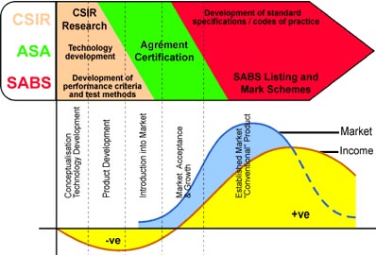
Typical Product Development Cycle
No Duplication of roles. Only Collaborative Synergies
Thursday, 19 April 2018

Slide 8
Vision & Mission
www.agrement.co.za
Slide 8
VISION: Agrément South Africa`s vision is to be a world-class centre for technical assessment.
MISSION: Enhance Agrément South Africa’s position as the:
acknowledged,
objective South African centre,
for the assessment and certification of non-standardised construction related products and systems,
for which there are no South African National Standards.

Slide 9
Mission
Agrément certificates demonstrate compliance with national building regulations, as specified in the certificate and enjoy deemed-to satisfy status in the National Building Regulations.
The key strategic objectives of Agrément South Africa outlined in the Annual Performance Plan are to:
support and promote the process of integrated socio-economic development in South Africa,
facilitate the introduction, application and utilisation of satisfactory innovation and technology development and at the same time minimising associated risks.
Products are scientifically tested in a controlled environment and after satisfactory performance there is ongoing quality management control and surveillance carried out: ISO9001

Slide 10
Values
Thursday, 19 April 2018
www.agrement.co.za
Slide 10
Aligned with the values espoused in the Constitution. :
People – striving to attain full potential in support of science.
Reputation – enhancing relevance, integrity, quality & delivery.
Ingenuity – realising full intellect of people creating solutions.
Diversity –respects the individual and multi-cultural heritage.
Energy – working together to achieve impact through passion, drive and agility.
Values are people cantered and follow the people first principles Batho-pele.
Create organisational moral standards, code of professional conduct
Acceptable standards of behaviour.

Slide 11
Strategic Outcome-Orientated goals
To promote introduction of innovative non-standard construction related products & systems for which there are no South African national standards.
Increase in certificated innovative construction products may increase uptake of innovation, which promotes and enhances the use of innovative and non-standard construction related products & systems.
Once non-standardised construction products are successfully assessed, certification is provided to meet accepted global standards within accepted global time frames. This is done using excellent project management principles to meet stakeholder expectations.
Uptake needs to be driven from the top-down to ensure holistic uptake due to the perceived high capital outlay in supply chain and other construction related activities.

Slide 12
Alignment between Strategic Goals & National Outcomes
www.agrement.co.za
Slide 12
Maintenance, strategic expansion, operational efficiency, capacity and competitiveness of our transport infrastructure. | Outcome 6: Efficient, competitive and responsive economic infrastructure network (NDP Chapter 4).
Assess products that contribute to the upgrading of accommodation within informal settlements and accommodation units within the gap market. | Outcome 8: Sustainable human settlements and an improved quality of household life.
Assess products that contribute to effective climate change mitigation and adaptation response and environmentally sustainable. | Outcome 10: Protected and enhanced environmental assets and natural resources.

Slide 13
Alignment between Strategic Goals & National Outcomes
www.agrement.co.za
Slide 13
Agrément South Africa will develop criteria & identify suitable experts to conduct assessment of construction products which may be used on roads and bridges.
Agrément South Africa is likely to experience an increase in application for certification of innovative appliances.
Agrément South Africa will contribute towards the evaluation, assessments and approving of existing infrastructure development technologies to better direct housing and human settlement investments,
fast track delivery,
ensure affordability and diversity of the products available in the market,
enhanced quality & quantity of innovative construction technologies.

Slide 14
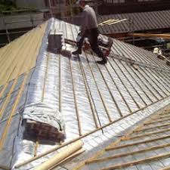
Alignment between Strategic Goals & National Outcomes
www.agrement.co.za
Slide 14
Agrément South Africa will support & encourage certification of products that utilise waste materials through development of criteria and identifying suitable experts to conduct the assessment of such products.
Reduced greenhouse gas emissions, climate change impacts and improved air/atmospheric quality.
Sustainable environmental management.

Slide 15
The Building Industry's 4 Levels of legislation + 1
LEVELS OF LEGISLATION
SOLUTIONS TO SATISFY THE REGULATIONS
1
Act 103 0f 1977
Building Industry is to be REGULATED
PERFORMANCE BASED REGULATIONS
Mandatory
2
Level 1
GOAL
Act 103 of 1977
NRCS: REGULATION KEEPER
Level 2
FUNCTIONAL REQUIREMENTS
Regulation 2008
3
Level 3
PERFORMANCE REQUIREMENTS
SANS 10400 2010
South African National Standards: SANS 10400
Process Level
EVALUATION
Voluntary
4
“Deemed to Satisfy”
the regulations
Rational
Assessment
Rational
Design
Agrément South Africa certificate. Act 11 of 2015
Other SANS documents: SANS 204, SANS 10252
Competent Person
Local Authority: Enforcer of REGULATIONS
5
1
2
3

Slide 16
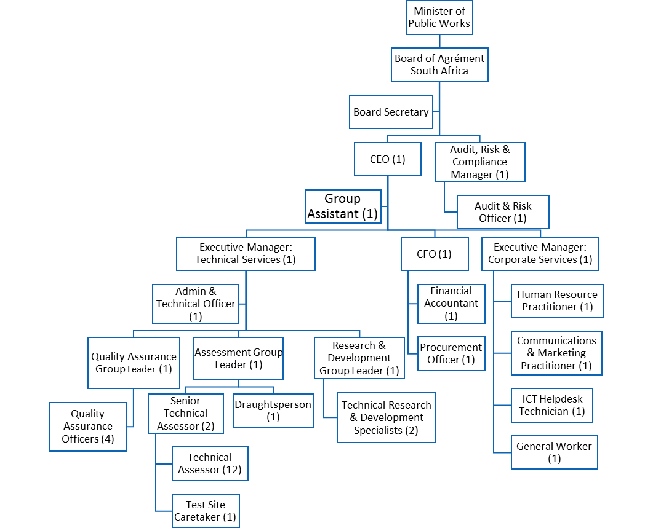

Slide 17
Industry structure
Thursday, 19 April 2018
www.agrement.co.za
Slide 17
Board
Technical Committee
Technical Agency
Agrément South Africa
Industry Technical Experts

Slide 18
Programme 1: Financial management 2018/19 – 2020/21
Programme performance indicators |  | Medium Term Targets
 |  | 2018/19 | 2019/20 | 2020/21
1 | % of irregular expenditure/budget | 0% | 0% | 0%
 | % of service providers paid within 30 days, after submission of all relevant documentation | 100% | 100% | 100%
3. | Response and implementation of audit findings on financial management | 100% | 100% | 100%

Slide 19
Short-term (2017/18 – 2018/19)
Test and implement practical budget and analysis tools, systems and procedures, Develop a mechanism of evaluating and reporting financial performance monthly, Develop standard operating procedures with turn-around times to ensure accurate measurement of supplier performance and SCM unit.
Medium/Long-term (2019/20 – 2021/22)
Raise awareness to Agrément South Africa staff of SCM process and standard operating procedures with continuous training including Bid Committee members and other role players, Develop Agrément South Africa suitable financial plan.

Slide 20
Corporate Services 2018/19 – 2020/21
Programme performance indicators |  | Medium Term Targets
 |  | 2018/19 | 2019/20 | 2020/21
 | Development of relevant policies and procedures. | 100% | 100% | 100%
 | Salary benchmarking. | 100% | 100% | 100%
 | Implement job descriptions linked to Key Performance Indicator’s. | 100% | 100% | 100%

Slide 21
Medium/Long-term (2019/20 – 2021/22)
HR manager should find the right talent and create the right environment in which people can perform, Cascading of employee performance to more levels within Agrément South Africa; Annually conduct customer satisfaction surveys, Build capacity within Agrément South Africa to be able to conduct customer satisfaction surveys in-house, Implement communication and customer relation plans, Conduct awareness surveys annually to determine whether initiative are improving the image and brand of Agrément South Africa, Measure progress, review and implementation communication and customer relations plans, Build internal capacity to conduct awareness surveys and compile reports, Implementation of brand awareness campaigns and communication strategies, Cascading of employee performance to all employees within Agrément South Africa, Develop a custom/tailored people strategy to the specific business requirements. This will allow Agrément South Africa to be more competitive in attracting scarce expertise, Concentrate on developing talent management skills in-house. These skills are needed all the time.

Slide 22
Short-term (2017/18 – 2018/19)
Assess gaps in the talent section, engagement and retention approach for Agrément South Africa, Outsource the services that Agrément South Africa needs only occasionally (e.g. targeted talent recruitment, selection program and process development, recruitment, assessments, employee surveys etc.), Implementation of automated employee performance management system, HR manager should have a clear understanding of what each piece of legislation requires for compliance, regardless of whether this entails the actions an entity must take or information it needs to provide, To develop teams through an integrated employee assessment system, Expand scope of current service providers or appoint service provider to conduct customer satisfaction survey, Develop communication and customer relations strategy information dissemination, Develop of communications strategy whereby the effective utilisation of different communication and information sharing platforms are identified and action plans developed, Implement communication and customer relations plans.

Slide 23
Information and communication technology 2018/19 – 2020/21
Programme performance indicators |  | Medium Term Targets
 |  | 2018/19 | 2019/20 | 2020/21
 | Information and communication technology (ICT) 2018/19 – 2020/21 | 100% | 100% | 100%
Short-term (2017/18 – 2018/19)
Develop integrated data migration system, To conduct business process review on a continuous basis, To upgrade and maintain cost-effective ICT infrastructure and capability, To guide and control responsible ICT utilisation of users.
Medium/Long-term (2019/20 – 2021/22)
To upgrade and maintain cost-effective ICT infrastructure and capability, To guide and control responsible ICT utilisation of users.

Slide 24
Technical Assessment Evaluations: Performance indicators and medium term targets 2018/19 – 2020/21

Slide 25
Products or Systems Certification: Performance indicators and medium term targets 2018/19 – 2020/21

Slide 26
Quality Assurance: Strategic objective and medium term targets for 2018/19 – 2020/21

Slide 27
Governance
The Minister of Public Works approved the Agrément South Africa’s 2018/19 Annual performance plan.
By undertaking technical assessments of innovative systems for and on behalf of the Government, Agrément South Africa has made a great contribution in the safe introduction of innovative technologies in the country with commensurate benefits.
Innovative systems have potential to teach people to take control over their future by giving them the means to create their own sustainable world class fit-for purpose accommodation by allowing them to build their own houses using modern advanced methodologies.

Slide 28
Governance
Agrément South Africa has excellent support systems, business enterprise processes & very strong linkages with global best practice organizations, processes and individuals.
Agrément South Africa is very well governed with strong internal control processes and systems.
The Board addresses issues of corporate governance to ensure compliance with treasury & national requirements.
This ensures proper fiduciary management within the Agrément South Africa.
Making a contribution to build a better South Africa by allowing the safe introduction of sustainable construction contributing towards global sustainability and mitigating green house gasses emissions and therefore mitigating the effects of global warming and climate change.

Slide 29
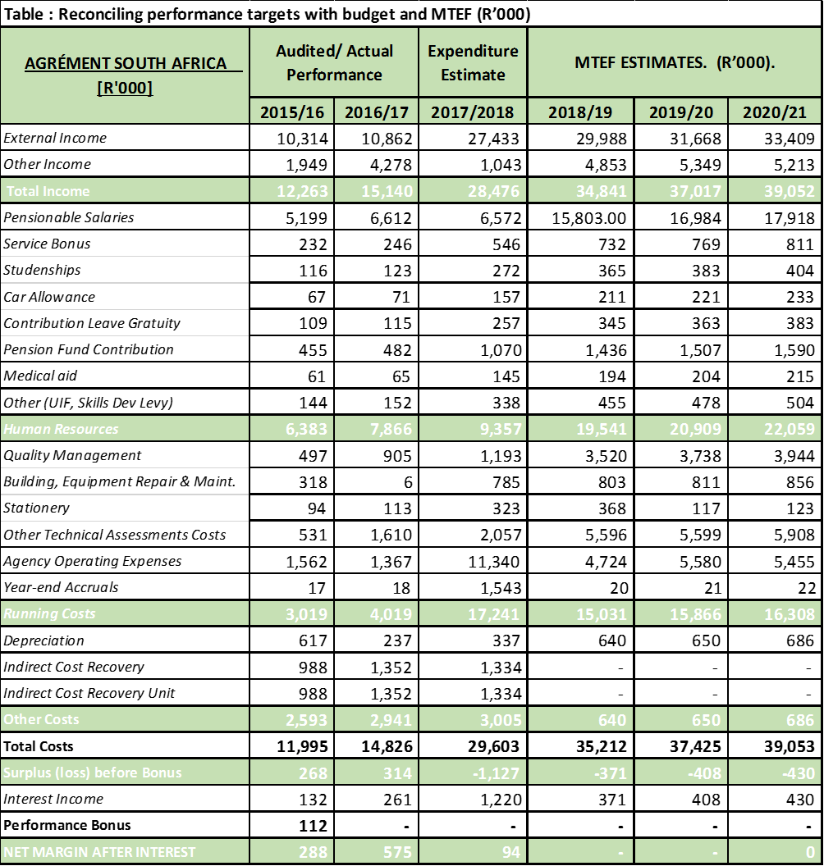

Slide 30
Financial Comments
Agrément South Africa has operated for 49 years under ministerial delegation of authority from the Minister of Public Works.
The annual grant funding is channeled from the National treasury through the Department of Public Works (DPW).
The funds are ring fenced & only used for Agrément South Africa.
The transactions are subject to the policies, procedures and governance processes as per national treasury regulations.
Finances are audited as required by national treasury regulations.
Agrément South Africa has received an unqualified audit report for the last few years and has been hailed as an example of good financial management.

Slide 31
Thank you… for Achieving excellent results TEAM: Together Everyone Achieves More.
Thursday, 19 April 2018
www.agrement.co.za
Slide 31
GOAL.
EFFORT.
SUPPORT.
CREATE A WINNING TEAM

