Slide 1
Strategic Plan 2015-2020 & Annual Performance Plan 2018/19
Presentation to the Portfolio Committee on Education and Training
Joe Samuels
19 April 2018

Slide 2
Overview of presentation
1. Setting the scene
2. Governance
3. SAQA & the NQF
4. SAQA’s contribution to national priorities
10. Financial Situation
5. Transformation within SAQA
7. Strategic Plan 2015-2020
8. Annual Performance Plan 2018/19
9. Prioritised Risks
6. NQF Act Evaluation Findings

Slide 3
Setting the scene

Slide 4
Commemorating the 100th year of Nelson mandela
“Education is the great engine of personal development. It is through education that the daughter of a peasant can become a doctor, that the son of a mine worker can become the head of the mine, that the child of farm workers can become the president of a great nation. It is what we make out of what we have, not what we are given, that separates one person from another.”
“Education is the most powerful weapon which you can use to change the world”

Slide 5
Remembering winnie madikizela mandela
"They think because they have put my husband on an island that he will be forgotten. They are wrong. The harder they try to silence him, the louder I will become!"
– 1962
"To those who oppose us, we say, 'Strike the woman, and you strike the rock'." – 1966

Slide 6
Governance

Slide 7
Governance
Board and Committees’ structure
Governance matters

Slide 8
6th Board
Dr V.Toni Penxa
Ms A.K.Oberholzer
Prof. J.O.Kuye
Mr V. Naidoo
Prof. S.J.Howie
Dr M.S.Rakometsi
Mr M.Maleka
Mr B.M.Gantile
Ms P.L.F.Nzimande
Ms N.Starr
Prof. N.Baijnath
Mr G.C.Louw
Mr J.S. Samuels
Prof. T.G. Schultz
Dr S.D.Bhikha
Board comprises 12 members nominated from the Education, Training and Development Sector and appointed by the Minister in their personal capacities and the 4 CEO’s of SAQA and the Quality Councils by virtue of their Offices
1 Vacancy

Slide 9
Board and Committee Structure
11 committees comprising at least 2 board members and other experts
Executive Committee
Audit & Risk
Finance
Research
Remuneration & Human Resources
2 Appeals Committees
Qualifications & Standards
Verification & Comparison of Qualifications
Information & Information Technology
Advocacy & Communications
Governance Manual containing Terms of Reference updated annually
Report on Committee work at Board meetings
Annual self-assessment

Slide 10
SAQA and the NQF

Slide 11
SAQA and the NQF
SAQA & QCs
Develop, foster & maintain an integrated and transparent framework for recognition of learning achievements
Ensure that SA qualifications meet appropriate criteria, are internationally comparable and of acceptable quality

Slide 12
Government priorities
30.4 million people in SA were living in poverty in 2015
26.7% (5.9 million) unemployed (QLFS Q4 2017)
NDP Target is 13.7% by 2020
56% of unemployed did not complete Grade 12
34% have Grade 12 certificate
Almost 20 million between 15 and 34 years old (mid year estimates 2017)
84% of unemployed are between 15 and 34 years
Source: Stats SA QLFS and Mid Year Estimates

Slide 13
Individual poverty by level of education (LBPL)
61,6% of individuals with no formal education were poor compared to only 4,4% of individuals who had a post-school qualification in 2015
No Education
Some Primary
Primary
Some Secondary
Percentage
Grade 12
Higher Education
For Periods 2006 / 2009 / 2011 / 2015
Data applies to persons age 18+

Slide 14
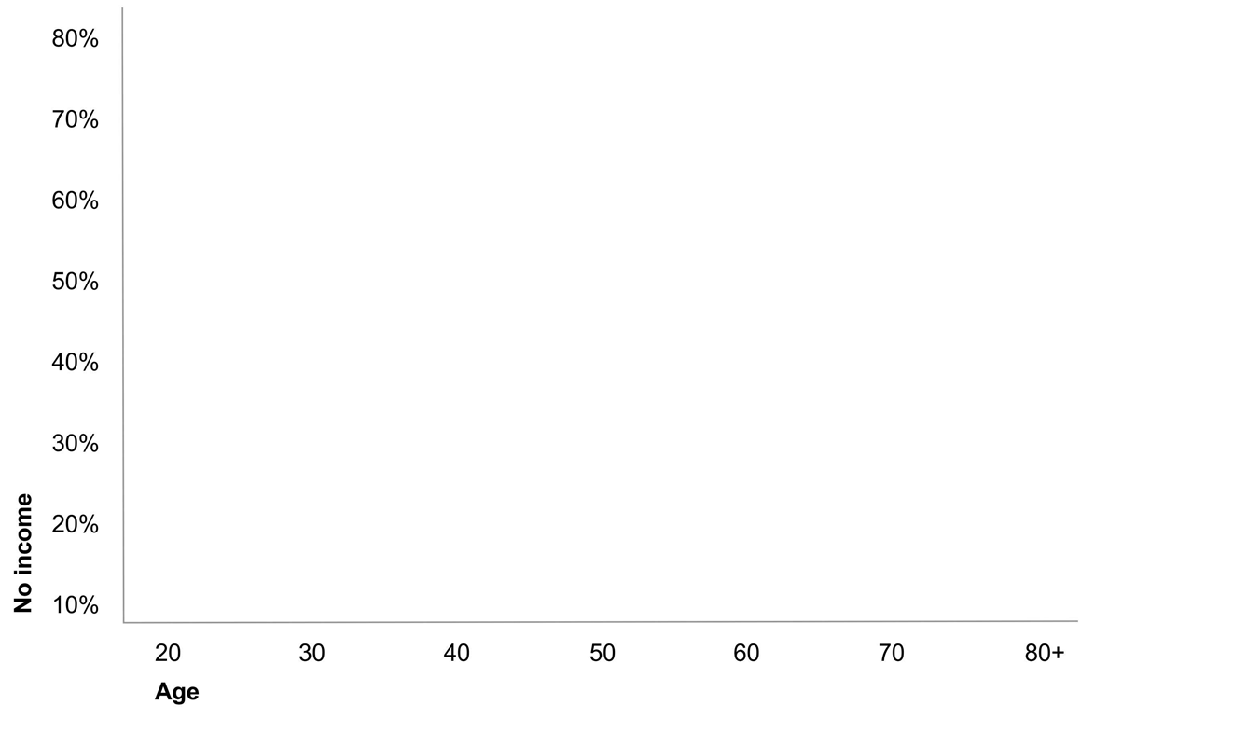
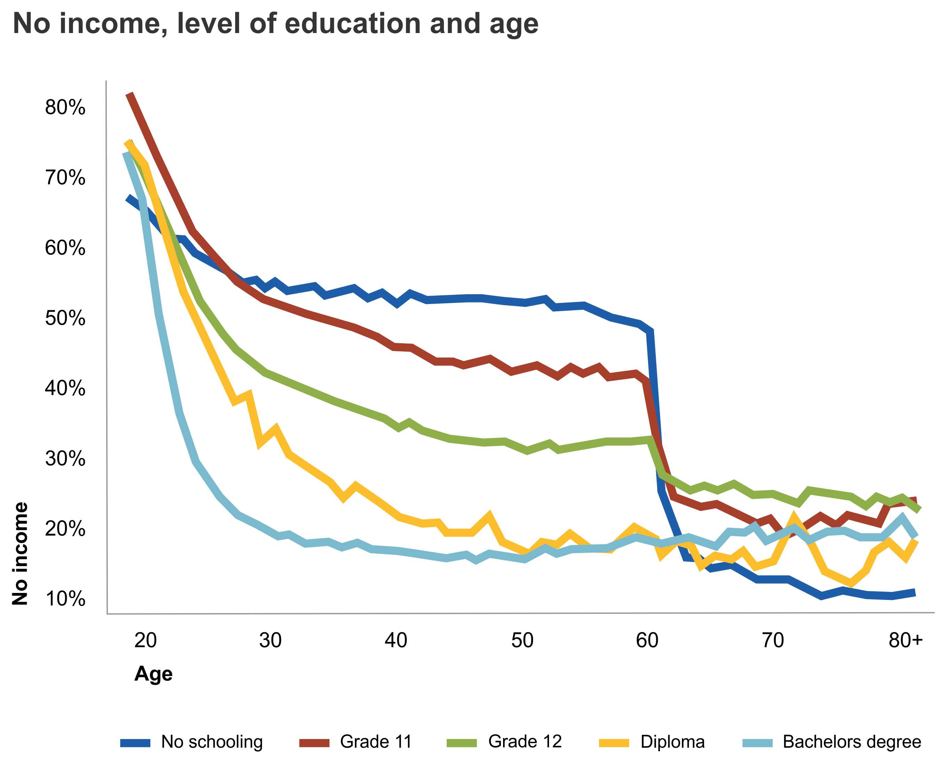
No Income by Level of Education and age
Source: Census 2011

Slide 15
Poverty headcounts by sex
Female
Male
Females remain more disadvantaged than males consistently recording a higher headcount, gap and severity measures at each point in time; however, the difference between the sexes is narrowing.

Slide 16
SAQA’s contribution to national priorities

Slide 17
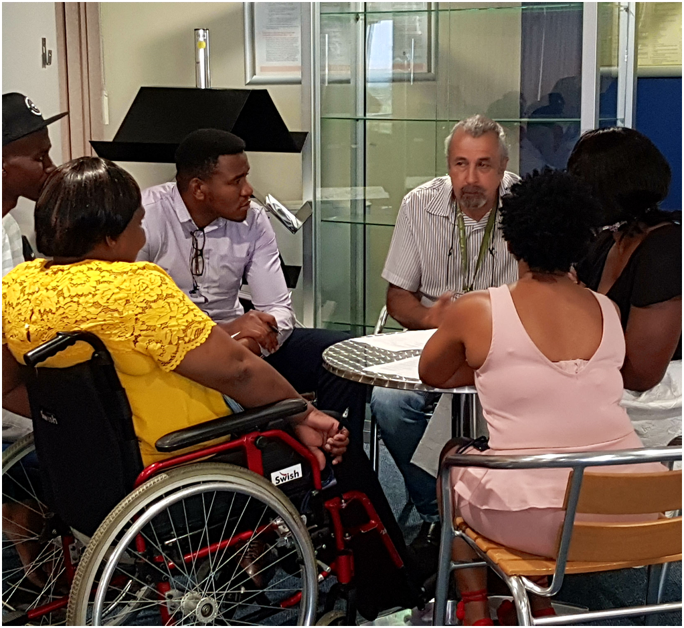
Value for money
Major achievements over last 3 years:
Published 14 NQF Policies
Grew NLRD (18.4 mil learners)
Registered 961 qualifications, recognised 34 professional bodies & registered 129 designations
Verified 234 307 national & evaluated 74 026 foreign qualifications
Launched SADCQVN
Produced NQF Articulation Baseline Study
Produced 2014 NQF Impact Study
Developed Common language
Piloted electronic SAQA Certificate of Evaluation (eSCOE)
Expenditure over last 3 years:
R 318 960 000

Slide 18
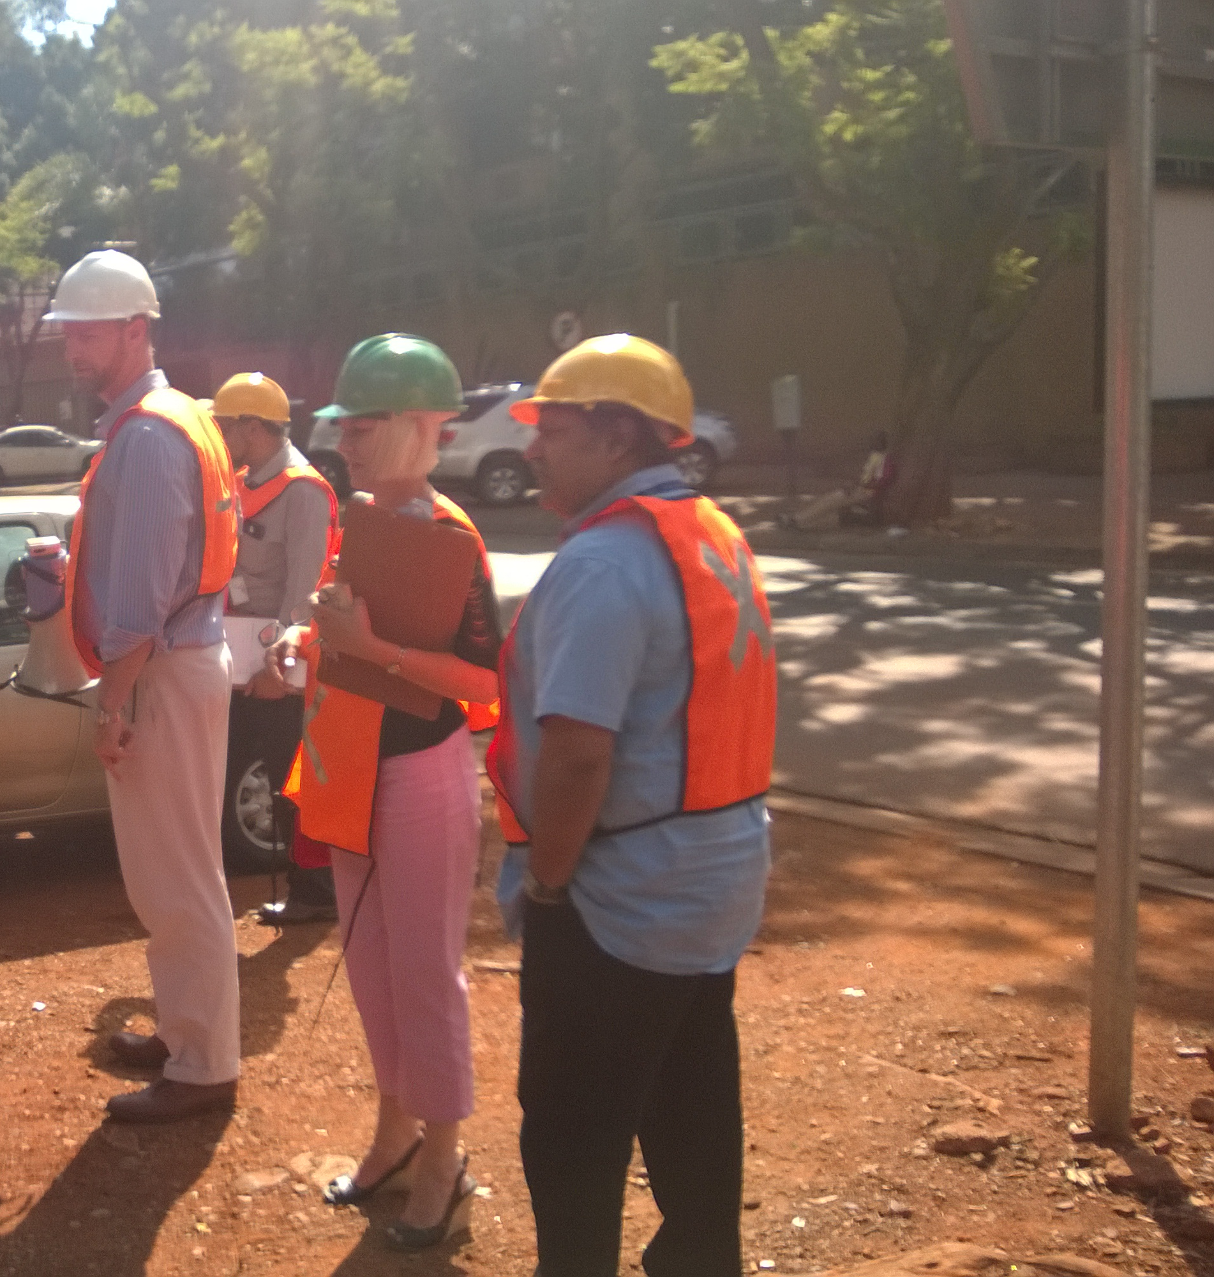
RPL
RPL data - 2006-2015
No. of learners who achieved 1/more qualifications via RPL | 23 260
No. of learners who achieved 1/more part-qualifications via RPL | 45 806
No. of records of achievement of qualifications via RPL | 25 631
No. of records of achievement of part-qualifications via RPL | 1 067 802
No. of qualifications achieved through RPL | 178

Slide 19
Name of certificate holder
Linked to paper-based
Holder’s qualification details
Closest comparable qualification, NQF Level and credits
Real-time confirmation
Click to confirm

Slide 20
Transformation within SAQA

Slide 21
Transformation within SAQA

Slide 22
Transformation within SAQA

Slide 23
NQF Act Evaluation Findings

Slide 24
Relevance and appropriateness
NQF Act relevant and appropriate
Weakness:
Does not specify contribution to E&T system; and
No measurable objectives
As a result thereof:
NQF bodies held accountable for broad E&T goals over which they have no influence; and
Institution roles overlooked

Slide 25
coherence
There is coherence amongst NQF Policies
Less alignment between broader PSET and NQF policy frameworks due to insufficient engagement between branches at DHET and NQF bodies

Slide 26
efficiency
Challenges in efficiency due to funding.
Funding for SAQA and CHE decreased in real terms.
Umalusi and QCTO also have insufficient funding to deliver on their mandates.

Slide 27
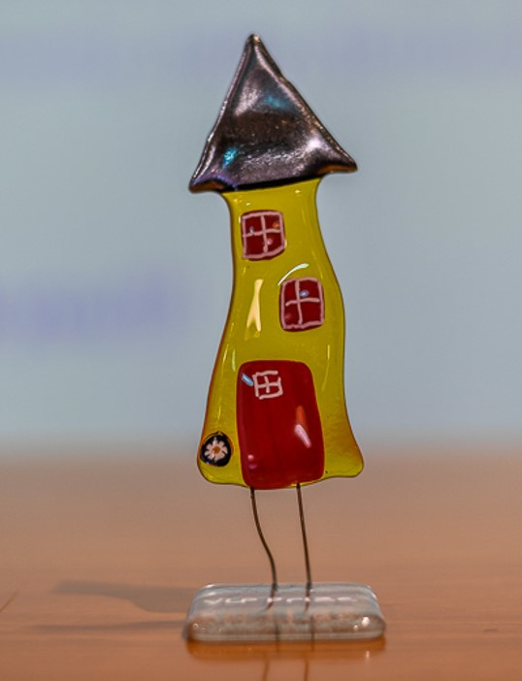
effectiveness
RPL viewed as key mechanism to address past unfair discrimination
OQSF ahead of the GFETQSF and HEQSF in implementing RPL
OQSF implements RPL for access and credits
HEQSF – limited access

Slide 28
Strategic Plan 2015-2020

Slide 29
Mandate
Derived from the NQF Act
Vision
Mission
Values
A world class NQF for South Africa
Oversee the further development and implementation of a National Qualifications Framework (NQF) and advance its objectives, which contributes to the full development of each lifelong learner and to the social and economic development of the nation at large
Social and Economic Transformation
Integration
High Energy and Corporate Vibrancy
Quality Service
Integrity
Quality Qualifications

Slide 30
Strategic Imperatives
LEADERSHIP: Provide decisive and coherent leadership, co-ordination and effective monitoring and evaluation towards an articulated NQF
RELATIONSHIP BUILDING: Use and promote constructive relationship building for the effective implementation of NQF objectives
PUBLIC POSITIONING: Continue to make the NQF visible and understood through its positive impact and structured advocacy and communication in South Africa’s context
NQF POLICIES: Oversee and facilitate the implementation of NQF policies in a coherent, simple and integrated manner across education, training, development and work
STAFF: Empower staff to achieve organisational excellence and value their contributions

Slide 31
Annual Performance Plan 2018/19

Slide 32
Focus areas
Recognition of Prior Learning
Articulation
Simplification
Advocacy
Genuine Qualifications

Slide 33
High Level Deliverables

Slide 34
Implementing the National Qualifications Framework
Monitor NQF implementation
Implement Ministerial Guidelines
Register qualifications and part-qualifications
Recognise professional bodies & register their designations
Monitor professional body compliance with Policy
De-register qualifications with no learner uptake
Implement NQF Amendment Bill/Act
Further simplify the NQF
Develop & implement Improvement Plan: NQF Act Implementation Evaluation

Slide 35
Ensuring Genuine Qualifications
Verify national qualifications
Evaluate foreign qualifications
Report on misrepresented qualifications
Establish relationship with DOJ (fraudulent qualifications)

Slide 36
Research & Articulation
Action Plan
Develop new Articulation Action Plan
Policy
Implement Articulation Policy
Research
Conclude research with DUT
Publish 2017 NQF Impact Study
Publish 5th Trends Report
Conceptualise 2021 NQF Impact Study
Produce SAQA Bulletin

Slide 37
Advocacy & corporate reputation
Continue to implement the NQF Advisory Service
Obtain a clean audit
Revamp the SAQA website
Increase our influence through social media platforms and traditional media stories
Continue to comply with all relevant legislation
Continue to grow international footprint

Slide 38
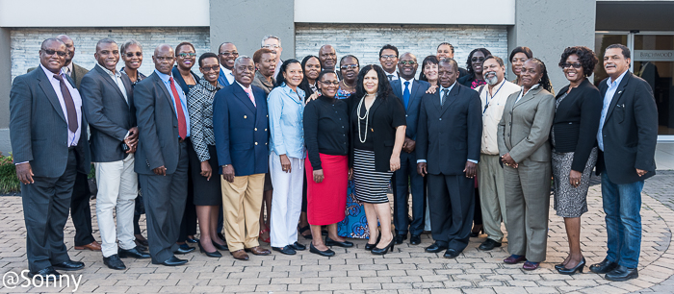
SADCQVN Established

Slide 39
Information and Technology
Embed the knowledge management system into SAQA business processes
Maintain an ICT Enterprise Architecture that supports our work
Maintain and further develop the NLRD

Slide 40
Staff Development
Update and implement staff Succession Plan
Implement Learning and Development initiatives in line with priorities

Slide 41
Prioritised Risks

Slide 42
Major risks for 2018/19
Insufficient budget to support mandate
SAQA is named as a respondent in cases brought before the courts
Inability to reach revenue targets
Expectations of stakeholders not met due to limited resources
Reputational damage due to litigation
Different understandings of legislation

Slide 43
Financial Situation

Slide 44
Six-Year Revenue Projection (%)

Slide 45
Government Grant in Relation to Expenditure

Slide 46
Expenditure per Programme
Administration | R 68 802 000 (51%)
Foreign Qualifications Evaluation and Advisory Services | R 29 712 000 (22%)
National Learners’ Records Database | R 7 155 643 (5%)
Verifications Project | R 10 991 831 (8%)
Registration and Recognition | R 10 031 000 (7%)
Research | R 6 102 000 (5%)
International Liaison | R 2 575 000 (2%)
2018/19

Slide 47
Financial Challenges
Budget cut by further R 2 million
Outstanding government debtors
Repairs & maintenance of building
Maintaining monthly positive cash flow

Slide 48
Follow-up from last meeting with PFC – 25 October 2017
Letter of motivation regarding R10 million on baseline funding was sent to PFC – still awaiting response
Replied to concerns raised in the minutes of the PFC – received acknowledgement but no indication whether changes were made.
Articulation – baseline study undertaken. This will be shared with the committee by the end of April 2018.
Verification unit to be strengthened to improve turn around times. – Turn around times has been excellent over the last financial year

Slide 49
In Summary

Slide 50
Strategic Plan 2015-2020 & Annual Performance Plan 2018/19
Presentation to the Portfolio Committee on Education and Training
Joe Samuels
19 April 2018

