Slide 1
MDDA ANNUAL PERFORMANCE PLAN – 2018/19
Presentation to the Portfolio Committee on Communications
19 April 2018

Slide 2
Contents
External issues raised by PCC
PCC meeting with MDDA Staff
AGSA Findings
MDDA mandate
MDDA Strategic Five Year Priorities
Development of 2018/2019 APP
Revised MDDA Strategy Map
Impact Study Findings
Human Resources
APP: Core Programmes
APP: Programme 1 - Governance and Administration
Revenue Analysis
Expenditure Analysis

Slide 3
External issues raised by PCC
MDDA Act review
Initiated process at Board Strat Session (Jan 2018)
Lobby for media diversity & public engagement
Community Media Indaba planned for Q1 of 2018/19
Sustainability Strategy
Regulation and Fair Competition
Engaged with SALGA on supporting community media in 2017/18
Reviewing funding model, call for applications and M&E framework in 2018/19
Engaged with Sentech on transmission costs, negotiation with DoC on late fees
Training in governance/business enterprise development –SEDA MOU in 2018/19
Engaged with Competition Commission in 2017/18 on unfair competition and managing Empowerment Fund – MoU in progress
Content Diversity Strategy
MoU with SAASTA on Science and Technology reporting training in progress
Intensifying support to projects for people living with disabilities through project applications
Research with GenderLinks on Women in Media commissioned in Q3 2017/2018
Partnership with Soul City on training on reporting on gender violence on progress
Intensified media engagement in Q4 of 2017/18
Increase MDDA funding base
Engaged mainstream print media in 2017/18
Review of the MDDA Act to address funding allocations in 2018/2019
Develop aggressive funding strategy in 2018/2019
ICASA Moratorium – to propose joint research on regulation of community broadcast
Meetings to explore revival of Social engagement strategy being set up
Lobby for print contribution regulation/ include in MDDA Act review
3

Slide 4
PCC Meeting with MDDA Staff
Issue raised | Status
Staff morale and improved channels between Board, Executive Management and staff | Focus on organizational renewal though initiatives such as increased internal communication, enhanced staff benefits and enabling staff to achieve healthy work/life balance by fully capacitating Agency and encouraging staff to take leave Structured internal communications plan introduced with staff meetings, supported by staff weekly newsletters Other initiatives being introduced to uplift staff morale, such as rewards recognition programme and continued staff team building sessions
Vacancies and Executive Committee members in acting positions Under-capacitated Community media | CEO: interviews conducted on 15&19 March 2018. CFO: shortlist to be conducted Director: Strategy: shortlist conducted Director: Projects: shortlist to be conducted Managers: Finance; Internal Audit and Research: re-advertised. Closing date 29 March 2018 Risk Specialist: shortlist to be conducted Legal Officer appointed. Start date 04 April 2018 Digital Media Coordinator appointed. Start date 16 April 2018

Slide 5
PCC Meeting with MDDA Staff
Item | Status
Revision of policies to be aligned with those of DoC | Benchmarking conducted on job grading and medical aid benefits During staff meeting of January 2018 staff members made additions to proposed amendments to staff benefits - to be presented to Board
Monitoring and evaluation capacity | During 2017 academic year, study assistance afforded to employees to improve skills and knowledge. Study assistance offered in academic year – 2018.
Cost to Company policy (TCTC) | TCTC model is considered best practice by SARS TCTC model is progressive model, however it is impacted by grading of posts, employer contribution to Medical Aid and Provident Fund
Lack of resource in Information Technology department | Extra post to be made available for IT
Decentralisation of MDDA | Establishing provincial operations important in MDDA’s long term goal, given availability of funds. In absence of provincial offices, current organogram developed to ensure adequate capacity for MDDA’s project staff to cover all 9 provinces.
Compliance with corporate governance and risk management | MDDA is filling vacant positions of Internal Audit Manager and Risk Management Specialist. Board appointed 3 independent Audit Committee members

Slide 6
AGSA Findings
Audit Findings | Progress detail
PERFORMANCE INFORMATION Technical indicator description vulnerable to misinterpretation Measurement basis for targets not reliable Cumulative total for Projects funded not in agreement | Complete MDDA KPI's for 2017/18 APP reviewed in terms of SMART principle and comply with National Treasury guidelines. POE's verified and adjustments made in Annual Report
SUPPLY CHAIN MANAGEMENT Awards above R 30 000 without complying with Preferential Procurement Framework Three quotations not obtained | Complete MDDA in full conformance with National Treasury, communication of National Treasury updates on SCM From 1 April 2017, SCM sourced 3 quotations for all services.
FINANCIAL MANAGEMENT Assets not recorded separately in asset register, register not complete Accounting policy not consistent with prior year Incomplete disclosure of leasing arrangements and provisions Amortisation expense incorrectly calculated | Complete Each asset given asset code and all assets added to FAR Issues resolved in finalisation of 2016/17 AFS.
HUMAN RESOURCES HR policy not followed upon termination of employment Poor HR document and record management Key positions vacant for longer than six months | Complete In 2017/18 FY all Exit interviews and termination procedures conducted Document and record management fully instituted Ongoing - HR & CA Manager and Officer appointed.
INFORMATION TECHNOLOGY AND GOVERNANCE Inadequate Service Level Agreement management IT Risk Register Application user and administrator activities not monitored Inadequate Disaster Recovery Plan | In progress New tender for printer leasing facilities placed, expired contracts terminated Updated IT Risk register IT Manager monitoring user access information, reported to Managers Draft aligning DRP combined with BC pending approval from ICT committee
ADMINISTRATIVE Invoices not recorded in correct accounting period | Complete Expense and trade payables adjusted in final 2016/2017 AFS
RISK MANAGEMENT AND DISCLOSURES Internal control deficiency of risk management & assessment Adequacy of investigations for IRFW expenditure | In progress Draft risk management strategy and risk assessment plan approved by ARC Theft and Losses Committee policy awaiting Board approval

Slide 7
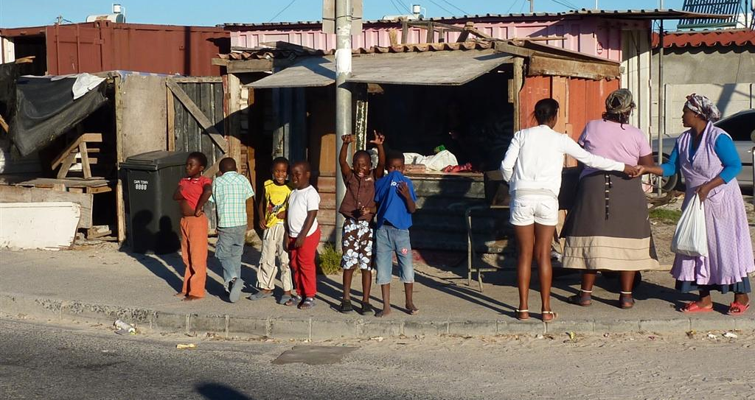
MDDA Mandate
Encourage ownership of, and access to, media by HDGs as well as by historically diminished indigenous language and cultural groups
Encourage the development of human resources and training, and capacity building, within the media industry, especially amongst HDGs
Encourage the channeling of resources to the community media sectors. Raise public awareness with regard to media development & diversity issues
Support initiatives which promote literacy and a culture of reading. Encourage research regarding media development & diversity

Slide 8
MDDA Strategic Five Year Priorities
Lead MDDA Act Review Processes: reconfiguration of the MDDA Act to support changes in the sector.
Organisational Renewal: review the current MDDA organisation structure, capacity, policy frameworks and funds to promote enhanced organisational delivery.
Build Knowledge-based Organisation: promote implementation of cutting-edge research responsive to sectoral dynamics.
Expand Funding and Capacity for Community Media Development: review sustainability model to ensure media diversity and transformation.
Position MDDA as a Leader in the Community Media Sector: contribute to increased Public and Media Sector Awareness in order to influence national policy.

Slide 9
Board Strategic Planning
(New Board members appointed late 2017)
Updated Situational Analysis (findings from Impact Study)
Socio-political and economic environment
Development of APP for 2018/2019
Review of KPIs in terms of SMART principle
National Development Plan (NDP) and macro environment
Concerns raised by Portfolio Committee on Communications
.
Department of Communications strategic objectives
Community media sector & broader media environment

Slide 10
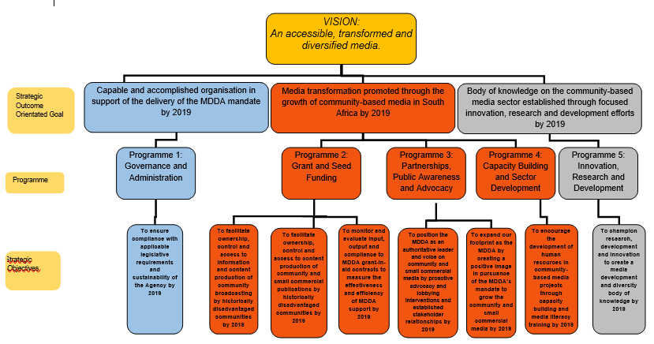
Revised MDDA Strategy Map
Strategic Objectives in Programme 1 – Governance and Administration – reduced from four to one objective to position programme at strategic and not operational level

Slide 11
Impact Study findings
MDDA has made significant impact on transforming media landscape through number of community and small commercial media projects funded – but limitations, internal and external, hinder ability to deliver on its mandate
Training and capacity building of sector identified as core need but receives fraction of amount
MDDA regulations determining percentages of different funding allocations must be reviewed
Sustainability of media projects remains major issue
Pre-assessment, M&E systems require revision
Funding model and grant dispersal activities must be reviewed
Technological changes wreaking havoc in industry
MDDA should adopt ‘Digital First’ strategy
MDDA needs to research / engage with community sector around impact of technological change
Instability of leadership and capacity issues detract from ability to deliver on mandate
Governance instability must be eliminated as senior manager posts are vacant and MDDA Board members change frequently
MDDA Act should be reviewed to re-look at powers, roles and responsibilities of Board vis a vis MDDA management
Resolve impasse on advertising for projects through collaboration with Government and commercial sector
Budget is restrictive - just under half amount required to service all proposals
MDDA needs to adopt different approaches to fundraising
Greater collaboration required between Government and stakeholders

Slide 12
Human Resources - Organogram
Chief Executive Officer
Executive Secretary
Internal Audit Manager
Risk Specialist
Communications Manager
Company Secretary
Assistant
Knowledge Management Co-ordinator
Legal and Compliance Officer
HR Corporate Manager
Strategy, Monitoring & Evaluation Directo
Project Director
Chief Financial Officer
Internal Audit Officer
Communications Officer
Travel & Events Co-ordinator
IT Manager
Human Resources Officer
Reception
Cleaner
Research & Capacity Building Manager
Monitoring & Evaluation Manager
Research & Capacity Building Co-ordinator X2
Monitoring & Evaluation Co-ordinator X2
Manager Broadcasting
Project Administrator
Manager Print
Broadcasting Development Co-ordinator X2
Digital Media Co-ordinator
Project Co-ordinator X2
Finance Manager
Disbursement Officer
Supply Chain Officer X2
Finance Administrator
MDDA Board of Directors
Number of Posts | 39
Number of Filled Posts | 27
Number of Vacant Posts | 12
Vacancy Rate | 30%

Slide 13
APP: Core Programmes
Programme 2: Grant and seed funding
Sub-Programme 2.1: Community Broadcast Media
Strategic Objective | Performance Indicator | Estimated performance | Medium-term targets
 |  | 2017/18 | 2018/19 | 2019/20 | 2020/21
To facilitate ownership, control and access to information and content production of community broadcasting by historically disadvantaged communities by 2019 | Number of community radio stations approved by the Board for funding | 22 | 24 | 28 | 34
 | Number of community television stations approved by the Board for financial support | 3 | 3 | 3 | 3
Sub-Programme 2.2: Print and Digital Media
Strategic Objective | Performance Indicator | Estimated performance | Medium-term targets
 |  | 2017/18 | 2018/19 | 2019/20 | 2020/21
To facilitate ownership, control and access to content production of community and small commercial publications by historically disadvantaged communities by 2019 | Number of Small Commercial Media projects approved by the Board for funding | 8 | 8 | 8 | 8
 | Number of Community print projects approved by the Board for funding | 4 | 4 | 4 | 4

Slide 14
APP: Core Programmes
Programme 2: Grant and seed funding
Sub-Programme 2.3: Monitoring & Evaluation
Strategic Objective | Performance Indicator | Estimated performance | Medium-term targets
 |  | 2017/18 | 2018/19 | 2019/20 | 2020/21
To monitor and evaluate input, output and compliance to MDDA grant-in-aid contracts to measure the effectiveness and efficiency of MDDA support by 2019 | Number of monitoring reports produced on input, output and compliance to MDDA grant-in-aid contracts | 80 | 85 | 90 | 95
 | Number of evaluation reports produced on impact of MDDA funded projects on communities | 35 | 10 | 15 | 20

Slide 15
APP: Core Programmes
Programme 3: Partnerships, public awareness and advocacy
Sub-Programme 3.1: Strategic Programmes
Strategic Objective | Performance Indicator | Estimated performance | Medium-term targets
 |  | 2017/18 | 2018/19 | 2019/20 | 2020/21
To position the MDDA as an authoritative leader and voice on community and small commercial media by proactive advocacy and lobbying interventions and established stakeholder relationships by 2019 | Number of reviews of Community Media digital migration strategy approved by Board in last quarter of each year | - | 1 | 1 | 1
 | Number of reviews of Stakeholder engagement policy and plan in last quarter of each year | 1 | 1 | 1 | 1
Sub-Programme 3.2: MDDA Brand Building
Strategic Objective | Performance Indicator | Estimated performance | Medium-term targets
 |  | 2017/18 | 2018/19 | 2019/20 | 2020/21
To expand our footprint as the MDDA by creating a positive image in pursuance of the MDDA’s mandate to grow the community and small commercial media by 2019 | Number of reviews of Communications strategy and plan approved by Board by end of last quarter of financial year | 1 | 1 | 1 | 1

Slide 16
APP: Core Programmes
Programme 4: Capacity building and sector development
Strategic Objective | Performance Indicator | Estimated performance | Medium-term targets
 |  | 2017/18 | 2018/19 | 2019/20 | 2020/21
To encourage the development of human resources in community-based media projects through capacity building and media literacy training by 2019 | Number of training interventions aimed at capacitating the community media in key sustainability skills | 6 | 6 | 6 | 6
 | Number of media literacy workshops conducted | 0 | 1 | 1 | 1
Programme 5: Innovation, Research and Development
Strategic Objective | Performance Indicator | Estimated performance | Medium-term targets
 |  | 2017/18 | 2018/19 | 2019/20 | 2020/21
To champion research, development and innovation to create a media development and diversity body of knowledge by 2019 | Number of Research projects funded on key trends/developments impacting on the community media sector | - | 1 | 1 | 1
 | Number of Research projects commissioned on key trends/developments impacting on the community media sector | 2 | 2 | 2 | 2

Slide 17
APP: Programme 1 - Governance and Administration
Strategic objective | Programme Performance Indicator | Estimated Performance | Medium-term targets
 |  | 2017/18 | 2018/19 | 2019/20 | 2020/21
To ensure compliance with applicable legislative requirements and sustainability of the Agency by 2019 | Number of Human Resource Plans approved by end of first quarter of the financial year | 17 | 1 | 1 | 1
 | Number of annual strategic risk assessments conducted | 1 | 1 | 1 | 1
 | Number of reviewed Internal Audit 3 year and annual operational plans | - | 1 | 1 | 1
 | Number of procurement plans submitted to National Treasury before 1 April of next financial year | 1 | 1 | 1 | 1
 | Number of compliance frameworks reviewed and approved by Board within 1st quarter of financial year | - | 1 | 1 | 1
 | Number of reviewed IT strategies and plans, approved by the Board within 1st quarter of financial year | 1 | 1 | 1 | 1

Slide 18
Revenue Analysis
 | 2017/18 | 2018/19 | 2019/20 | 2020/21
DoC - government grants | 30,005 | 30,669 | 32,015 | 33,776
% Average growth per year | 26.0% | 2.1% | 4.4% | 5.5%
EXTERNAL FUNDING
Broadcast media | 32,183 | 31,412 | 32,329 | 33,291
Print media | 0 | 0 | 0 | 0
 | 32,183 | 31,412 | 32,329 | 33,291
% Average growth per year | -26.4% | -2.4% | 2.92% | 2.98%
TOTAL EXTERNAL FUNDING | 62,188 | 62,081 | 64,344 | 67,067

Slide 19
Expenditure Analysis
 | 2017/18 | 2018/19 | 2019/20 | 2020/21
Total grant expenditure | 32,786 | 32,618 | 32,608 | 32,842
Compensation of employees | 16,866 | 20,587 | 21,680 | 21,571
Goods and Services | 13,631 | 12,397 | 14,877 | 17,769
Depreciation | 1,060 | 1,300 | 288 | 303
Total administration cost | 31,557 | 34,284 | 36,845 | 39,643
% Average growth per year – Grant expenditure | 14.9% | -0.5% | -0.03% | 0.72%
% Average growth per year – Admin | -0.2% | 8.64% | 7.5% | 7.6%
Over MTEF, spending focus on promoting media development and diversity through financial and nonfinancial support to community broadcasting and community and small commercial print projects.
Grant funding will be allocated to ensuring sustainability, through strengthening of existing small commercial, community print and community broadcast projects.
Seed funding for new small commercial, community print and community broadcast projects will be allocated from transfers from DoC and external funders.
Spending on these activities expected to amount to R125 million over MTEF.

Slide 20
Thank You

